Slide 1
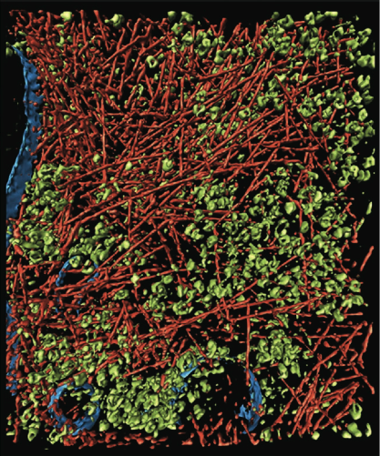
V1 - Introduction
A cell is a crowded environment
=> many different proteins,
metabolites, compartments, …
On a microscopic level
=> direct two-body interactions
At the macroscopic level
=> complex behavior
Can we understand the behavior from the interactions?
=> Connectivity
Medalia et al, Science 298 (2002) 1209

Slide 2
The view of traditional molecular biology
Molecular Biology: "One protein — one function"
mutation => phenotype
Linear one-way dependencies: regulation at the DNA level, proteins follow
DNA => RNA => protein => phenotype
Structural Biology: "Protein structure determines its function"
biochemical conditions => phenotype
No feedback, just re-action:
genetic information
molecular structure
biochemical function
=>
=>
=>
phenotype

Slide 3
The Network View of Biology
Molecular Systems Biology: "It's both + molecular interactions"
genetic information
molecular structure
biochemical function
=>
=>
=>
phenotype
molecular interactions
➔ highly connected network of various interactions, dependencies
=> study networks

Slide 4
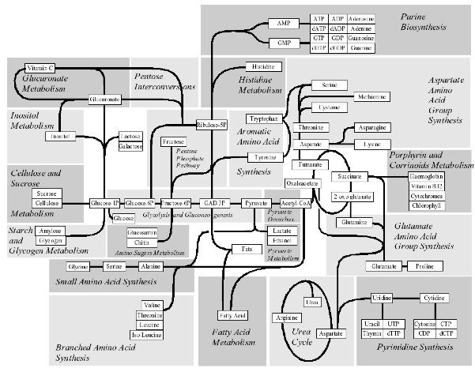
Major Metabolic Pathways
static connectivity
dynamic response to external conditions
different states during the cell cycle
<=>
<=>

Slide 5
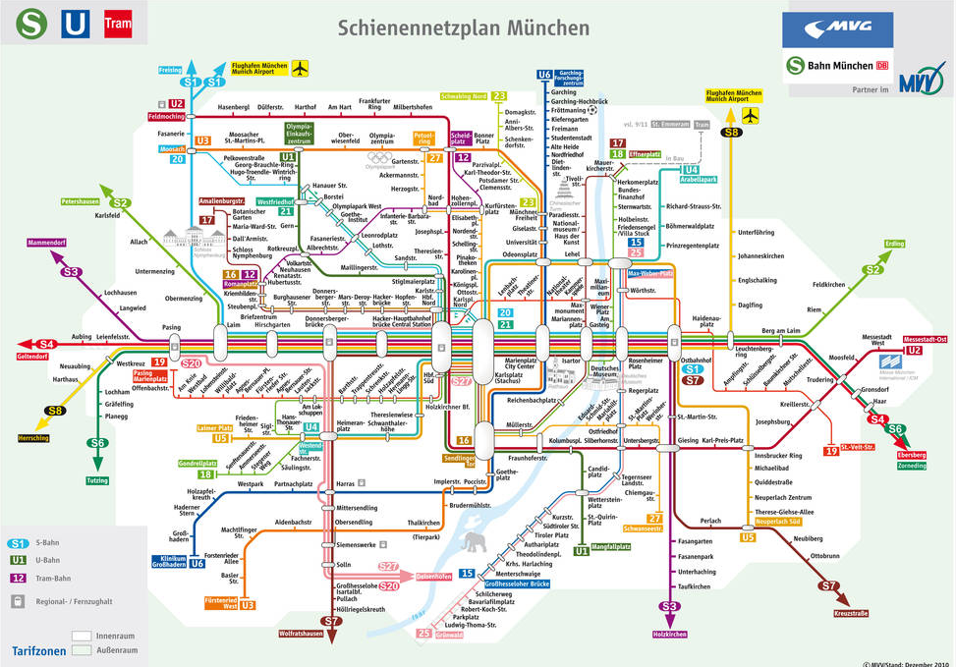
http://www.mvv-muenchen.de/de/netz-bahnhoefe/netzplaene/index.html

Slide 6
Lecture – Overview
Protein complexes: spatial structure
=> experiments, spatial fitting, docking
Protein association:
=> interface properties, spatial simulations
Protein-Protein-Interaction Networks: pairwise connectivity
=> data from experiments, quality check
PPI: static network structure
=> network measures, clusters, modules, …
Systems Biology
Gene regulation: cause and response
=> Boolean networks
Metabolic networks: steady state of large networks
=> FBA, extreme pathways
Metabolic networks / signaling networks: dynamics
=> ODEs, modules, stochastic effects

Slide 7
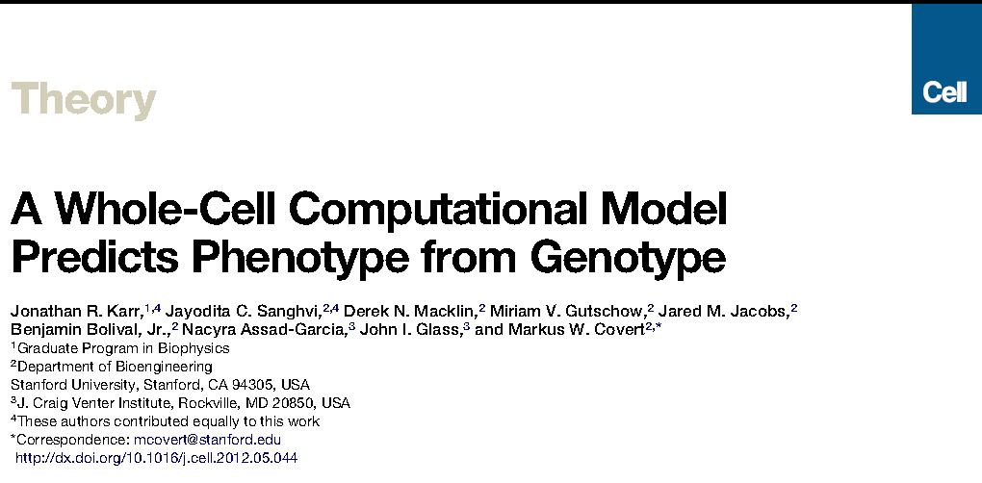
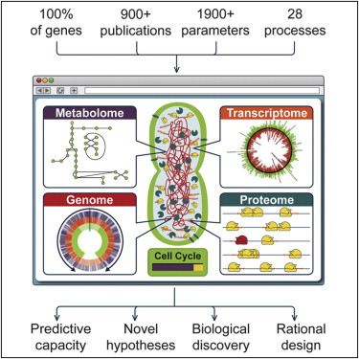
Appetizer: A whole-cell model for the life cycle of the human pathogen Mycoplasma genitalium
Cell 150, 389-401 (2012)

Slide 8
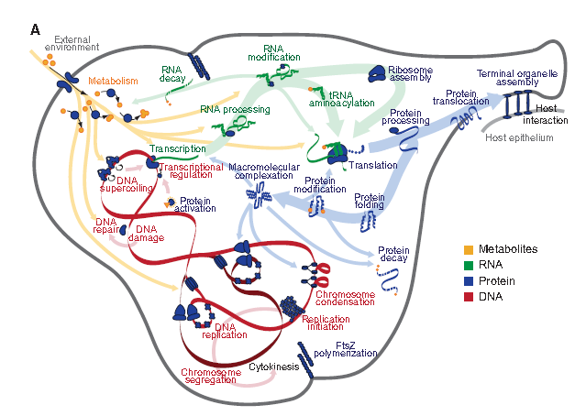
Divide and conquer approach (Caesar): split whole-cell model into 28 independent submodels
28 submodels are built / parametrized / iterated independently

Slide 9
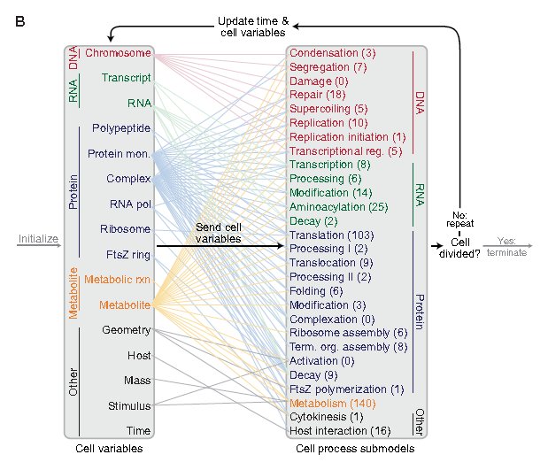
Cell variables
System state is described by 16 cell variables
Colored lines: cell variables affected by individual submodels
Mathematical tools:
Differential equations
Stochastic simulations
Flux balance analysis

Slide 10
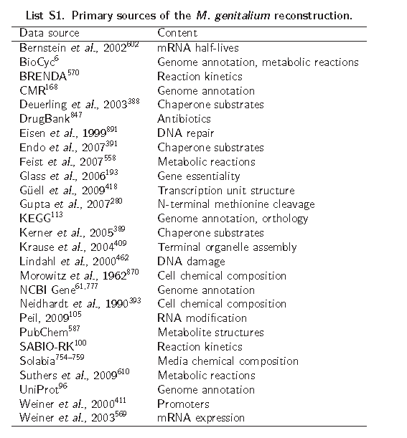

Slide 11
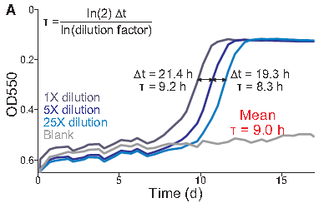
Growth of virtual cell culture
Growth of three cultures (dilutions indicated by shade of blue) and a blank control measured by OD550 of the pH indicator phenol red. The doubling time, t, was calculated using the equation at the top left from the additional time required by more dilute cultures to reach the same OD550 (black lines).
The model calculations were consistent with the observed doubling time!

Slide 12
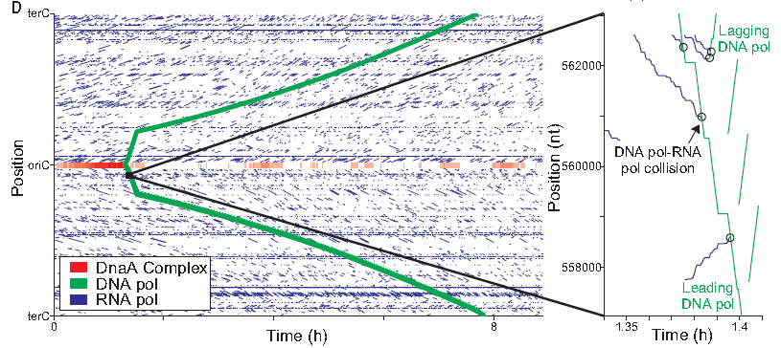
DNA-binding and dissociation dynamics
DNA-binding and dissociation dynamics of the oriC DnaA complex (red) and of RNA (blue) and DNA (green) polymerases for one in silico cell. The oriC DnaA complex recruits DNA polymerase to the oriC to initiate replication, which in turn dissolves the oriC DnaA complex. RNA polymerase traces (blue line segments) indicate individual transcription events. The height, length, and slope of each trace represent the transcript length, transcription duration, and transcript elongation rate, respectively.
Inset : several predicted collisions between DNA and RNA polymerases that lead to the displacement of RNA polymerases and incomplete transcripts.

Slide 13
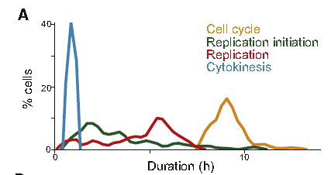
Predictions for cell-cycle regulation
Distributions of the duration of three cell-cycle phases, as well as that of the total cell-cycle length, across 128 simulations.
There was relatively more cell-to-cell variation in the durations of the replication initiation (64.3%) and replication (38.5%) stages than in cytokinesis (4.4%) or the overall cell cycle (9.4%).
This data raised two questions:
what is the source of duration variability in the initiation and replication phases; and
(2) why is the overall cell-cycle duration less varied than either of these phases?

Slide 14
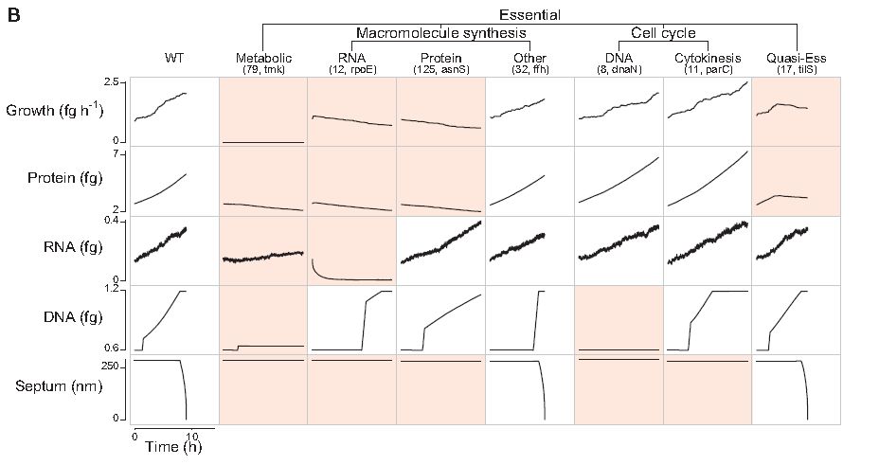
Single-gene knockouts : essential vs. non-essential genes
Single-gene disruption strains grouped into phenotypic classes (columns) according to their capacity to grow, synthesize protein, RNA, and DNA, and divide (indicated by septum length).
Each column depicts the temporal dynamics of one representative in silico cell of each essential disruption strain class.
Dynamics significantly different from wild-type are highlighted in red.
The identity of the representative cell and the number of disruption strains in each category are indicated in parenthesis.

Slide 15
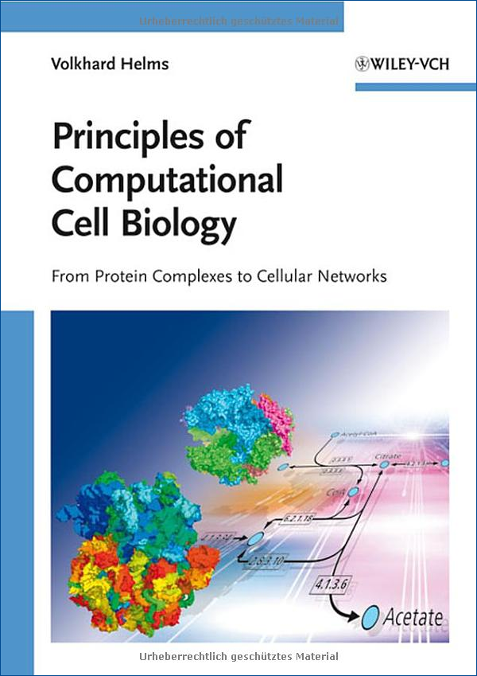
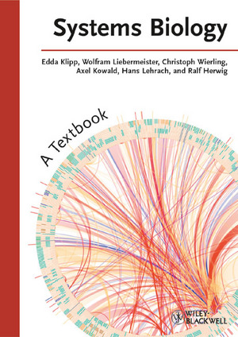
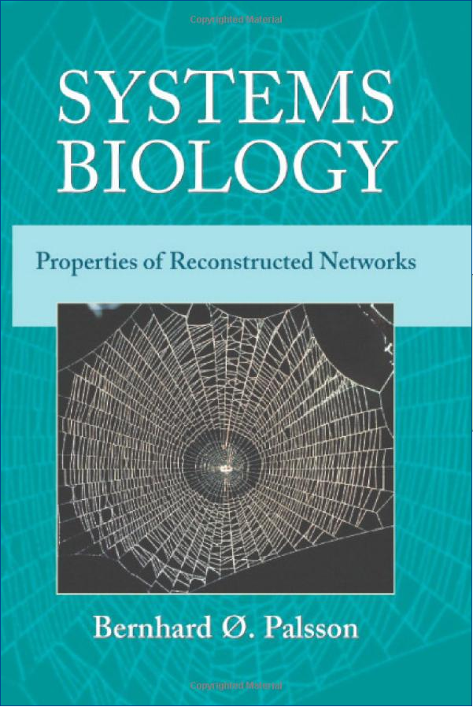
Literature
Lecture slides — available before the lecture
Suggested reading
=> check our web page
http://gepard.bioinformatik.uni-saarland.de/teaching/…
Textbooks
=> check computer science library

Slide 16
How to pass this course
Schein = you need to qualify for the the final exam and pass it
Final exam:
written test of 180 min length about selected parts of the lecture
(will be defined 2 weeks before exam) and about the assignments
requirements for participation:
• 50% of the points from the assignments
• one assignment task presented @ blackboard
Final exam will take place at the end of the semester
In case you are sick (final exam) you should bring
a medical certificate to get a re-exam.
Re-exam: will take place in first week of the summer term 2016

Slide 17
Assignments
Tutors: Thorsten Will, Maryam Nazarieh
Duy Nguyen, Ha Vu Tranh
Tutorial: ?? Mon, 12:00–14:00, E2 1, room 007
10 assignments with 100 points each
Assignments are part of the course material (not everything is covered in lecture)
=> one solution for two students (or one)
=> hand-written or one printable PDF/PS file per email
=> content: data analysis + interpretation — think!
=> no 100% solutions required!!!
=> attach the source code of the programs for checking (no suppl. data)
=> present one task at the blackboard
Hand in at the following Fri electronically until 13:00 or
printed at the start of the lecture.

Slide 18
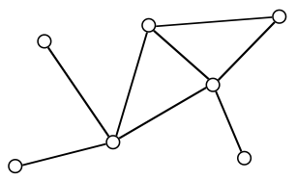
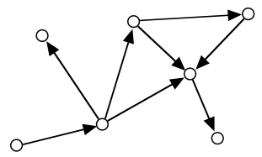
Some Graph Basics
Network <=> Graph
Formal definition:
A graph G is an ordered pair (V, E) of a set V of vertices and a set E of edges.
G = (V, E)
undirected graph
directed graph
If E = V⁽²⁾ => fully connected graph

Slide 19
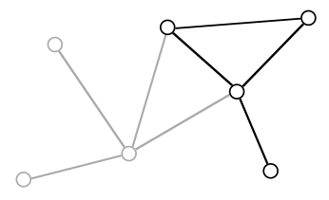
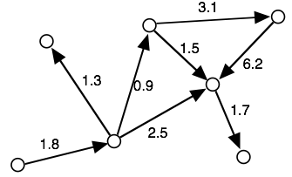
Graph Basics II
Subgraph:
Weighted graph:
G' = (V', E') is a subset of G = (V, E)
Weights assigned to the edges
Practical question: how to define useful subgraphs?
Note: no weights for vertices

Slide 20
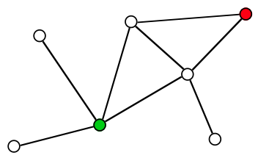
Walk the Graph
Path = sequence of connected vertices
start vertex => internal vertices => end vertex
Two paths are independent (internally vertex-disjoint),
if they have no internal vertices in common.
Vertices u and v are connected, if there exists a path from u to v.
otherwise: disconnected
Trail = path, in which all edges are distinct
Length of a path = number of vertices || sum of the edge weights
How many paths connect the green to the red vertex?
How long are the shortest paths?
Find the four trails from the green to the red vertex.
How many of them are independent?

Slide 21
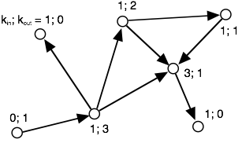
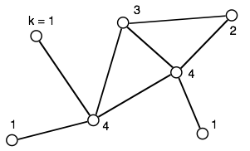
Local Connectivity: Degree/Degree Distribution
Degree k of a vertex = number of edges at this vertex
Directed graph => distinguish kin and kout
Degree distribution P(k) = fraction of nodes with k connections
k | 0 | 1 | 2 | 3
P(kin) | 1/7 | 5/7 | 0 | 1/7
P(kout) | 2/7 | 3/7 | 1/7 | 1/7
k | 0 | 1 | 2 | 3 | 4
P(k) | 0 | 3/7 | 1/7 | 1/7 | 2/7

Slide 22
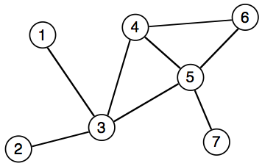
Graph Representation e.g. by adjacency matrix
Adjacency matrix is a N x N matrix
with entries Muv
Muv = weight when edge between u and v exists,
0 otherwise
→ symmetric for undirected graphs
 | 1 | 2 | 3 | 4 | 5 | 6 | 7
1 | – | 0 | 1 | 0 | 0 | 0 | 0
2 | 0 | – | 1 | 0 | 0 | 0 | 0
3 | 1 | 1 | – | 1 | 1 | 0 | 0
4 | 0 | 0 | 1 | – | 1 | 1 | 0
5 | 0 | 0 | 1 | 1 | – | 1 | 1
6 | 0 | 0 | 0 | 1 | 1 | – | 0
7 | 0 | 0 | 0 | 0 | 1 | 0 | –
+ fast O(1) lookup of edges
– large memory requirements
– adding or removing nodes is expensive
Note: very convenient in programming languages that support sparse multi-dimensional arrays
=> Perl

Slide 23
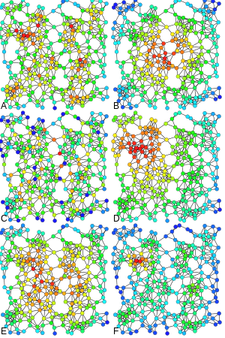
Measures and Metrics
“ Which are the most important or central vertices in a network? “
Examples of
Degree
centrality,
C) Betweenness centrality,
E) Katz centrality,
B) Closeness centrality,
D) Eigenvector centrality,
F) Alpha centrality of the same graph.
www.wikipedia.org
book by Mark Newman / Oxford Univ Press
Chapter 7: measures and metrics
Chapter 11: matrix algorithms and graph partitioning

Slide 24
Degree centrality
Perhaps the simplest centrality measure in a network is the
degree centrality that is simply equal to the degree of each vertex.
E.g. in a social network, individuals that have many connections
to others might have
more influence,
more access to information,
or more prestige than those individuals who have fewer connections.
A natural extension of the simple degree centrality is eigenvector centrality.

Slide 25
Towards Eigenvector Centrality
Let us start by defining the centrality of vertex x_{i} as the sum of the centralities
of all its neighbors:
$${x_{i}}^{′}=\sum_{j}{A_{ij}x_{j}}$$
where A_{ij} is an element of the adjacency matrix.
(This equation system must be solved recursively until convergence.)
We can also write this expression in matrix notation as
x’ = A x where x is the vector with elements x_{i} .
Repeating this process to make better estimates gives after t steps
the following vector of centralities:
x(t) = A^{t} x(0)

Slide 26
Eigenvector Centrality
Now let us write x(0) as a linear combination of the eigenvectors v_{i} of the
(quadratic) adjacency matrix¹
$\text{x}\left(0\right)= \sum_{i}{c_{i}{\text{v}}_{i}}$ with suitable constants c_{i}
Then $\text{x}\left(t\right)=A^{t}\sum_{i}{c_{i}{\text{v}}_{i}}$ = $\sum_{i}{c_{i}{ {k_{i}}^{t} \text{v}}_{i}}={k_{1}}^{t}\sum_{i}{c_{i}{\left[\frac{k_{i}}{k_{1}}\right]}^{t}{\text{v}}_{i}}$
where the k_{i} are the eigenvalues of A and k₁ is the largest of them.
(remember A x = λ x from linear algebra for each eigenvector x)
Since k_{i} / k₁ < 1 for all i ≠ j , all terms in the sum decay exponentially as t
becomes large.
In the limit t → ∞, we get x(t) = c₁ k₁^{t} v₁
¹ Remember from linear algebra that a quadratic matrix with full rank can be diagonalized.

Slide 27
Eigenvector Centrality
This limiting vector of the eigenvector centralities is simply proportional
to the leading eigenvector of the adjacency matrix.
Equivalently, we could say that the centrality x satisfies
A x = k₁ x
This is the eigenvector centrality first proposed by Bonacich (1987).
The centrality x_{i} of vertex i is proportional to the sum of the centralities of
its neighbors:
$x_{i}={k_{1}}^{−1}\sum_{j}{A_{ij}x_{j}}$
This has the nice property that the centrality can be large either because a vertex
has many neighbors or because it has important neighbors with high centralities
(or both).

Slide 28
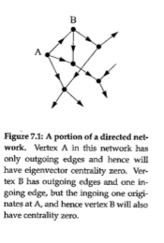
Problems of the Eigenvector Centrality
The eigenvector centrality works best for undirected networks.
For directed networks, certain complications can arise.
In the figure on the right,
vertex A will have eigenvector
centrality zero.
Hence, vertex B will also have
centrality zero.

Slide 29
Katz Centrality
One solution to the issues of the Eigenvector Centrality is the following:
We simply give each vertex a small amount of centrality “for free”,
regardless of its position in the network or the centrality of its neighbors.
→ we define $x_{i}=α\sum_{j}{A_{ij}x_{j}+β}$ where α and β are positive constants.
In matrix terms, this can be written as x = αAx + β 1
where 1 is the vector (1,1,1,…) ^{T} . By rearranging for x we find
I x - α A x = β 1 (where we used I x = x)
(I - α A) x = β 1
(I - α A )⁻¹ (I - α A) x = (I - α A )⁻¹ β 1
x = β (I - α A )⁻¹ 1
When setting β =1, we get the Katz centrality (1953) x = (I - α A )⁻¹ 1

Slide 30
Computing the Katz Centrality
The Katz centrality differs from the ordinary eigenvector centrality by having
a free parameter α, which governs the balance between the eigenvector term and the constant term.
However, inverting a matrix on a computer has a complexity of O(n³) for a graph with n vertices.
This becomes prohibitively expensive for networks with more than 1000 nodes or so.
It is more efficient to make an initial guess of x and then repeat
x' = αAx + β 1
many times. This will converge to a value close to the correct centrality.
A good test for convergence is to make two different initial guesses and run this until the resulting centrality vectors agree within some small threshold.

Slide 31
Towards PageRank
The Katz centrality also has one feature that can be undesirable.
If a vertex with high Katz centrality has edges pointing to many other vertices,
then all those vertices also get high centrality.
E.g. if a Wikipedia page points to my webpage,
my webpage will get a centrality comparable to Wikipedia!
But Wikipedia of course also points to many other websites,
so that its contribution to my webpage “should” be relatively small
because my page is only one of millions of others.
-> we will define a variation of the Katz centrality in which the
centrality I derive from my network neighbors is proportional
to their centrality divided by their out-degree.

Slide 32
PageRank
This centrality is defined by
$x_{i}=α\sum_{j}{A_{ij}\frac{x_{j}}{{k_{j}}^{out}}+β}$
At first, this seems problematic if the network contains vertices with zero outdegree.
However, this can easily be fixed by setting k_{j}^{out} = 1 for all such vertices.
In matrix terms, this equation becomes
x = α A D⁻¹ x + β 1
where 1 is the vector (1,1,1,…)^{T} and D the diagonal matrix with D_{ij} = max(k_{j}^{out} , 1)

Slide 33
PageRank
By rearranging we find that
x = β (I - α A D⁻¹ )⁻¹ 1
Because β plays the same unimportant role as before, we will set β = 1.
Then we get x = (I - α A D⁻¹ )⁻¹ 1 = D (D - α A )⁻¹ 1
This centrality measure is commonly known as PageRank,
using the term used by Google.
PageRank is one of the ingredients used by Google
to determine the ranking of the answers to your queries.
α is a free parameter and should be chosen less than 1. (Google uses 0.85).

Slide 34
Hubs and Authorities
So far we have considered measures that assign high centrality to a vertex
if those vertices that point to it have high centrality too.
However, in some networks it is appropriate also to accord
a vertex high centrality if it points to others with high centrality.
E.g. a review article pointing at many important papers in one research field may be a useful source of information.
Authorities are nodes that contain useful information on a topic of interest.
Hubs are nodes that tell us where the best authorities can be found.
An authority may also be a hub, and vice versa.

Slide 35
Hubs and Authorities
Kleinberg developed this into a centrality algorithm called
Hyperlink-induced topic search (HITS).
The HITS algorithm gives each vertex i in a network
an authority centrality x_{i} and a hub centrality y_{i} .
A vertex with high authority centrality is pointed to by many hubs,
i.e. by many other vertices with high hub centrality.
A vertex with high hub centrality points to many vertices
with high authority centrality.
Thus, an important scientific paper (in the authority sense) would be
one that is cited in many important reviews (in the hub sense).
An important review is one that cites many important papers.

Slide 36
Authority and Hub Centralities
Kleinberg defined the authority centrality of a vertex to be proportional to the sum of the hub centralities of the vertices that point to it
$x_{i}=α\sum_{j}{A_{ij}y_{j}}$ where α is a constant.
Similarly the hub centrality of a vertex is proportional to the sum of the authority centralities of the vertices it points to:
$y_{i}=β\sum_{j}{A_{ji}x_{j}}$ with another constant β
Note that the indices of the matrix element A_{ji} are swapped around in this second equation.
These equations can be written as x = α A y and y = β A^{t} x
Or, combining the two, A A^{t} x = λ x , A^{t} A y = λ y

Slide 37
Closeness centrality
An entirely different measure of centrality is provided
by the closeness centrality.
Suppose d_{ij} is the length of a geodesic path (i.e. the shortest path)
from a vertex i to another vertex j.
Here, length means the number of edges along the path.
Then, the mean geodesic distance from i, averaged over
all vertices j in the network is
$l_{i}=\frac{1}{n}\sum_{j}{d_{ij}}$
The mean distance l_{i} is not a centrality measure in the same sense
as the other centrality measures.
It gives low values for more central vertices and
high values for less central ones.

Slide 38
Closeness centrality
The inverse of l_{i} is called the closeness centrality C_{i}
$C_{i}=\frac{1}{l_{i}}=\frac{n}{\sum_{j}{d_{ij}}}$
It has become popular in recent years to rank film actors
according to their closeness centrality in the network
of who has appeared in films with who else.
Using data from www.imdb.com the largest component of the network includes more than 98 % of about half a million actors.

Slide 39
Closeness centrality
The highest closeness centrality of any actor is
0.4143 for Christopher Lee.
The second highest centrality has
Donald Pleasence (0.4138).
The lowest value has the Iranian actress Leia Zanganeh (0.1154).
→ the closeness centrality values are crammed in a very small interval [0,0.4143]
Other centrality measures including degree centrality and eigenvector centrality typically don‘t suffer from this problem. They have a wider dynamic range.
Pictures from wikipedia

Slide 40
Summary
What you learned today:
=> networks are everywhere
how to get the "Schein" for BI3
How to determine the most central nodes in a network
Next lecture:
=> basic network types and definitions:
random, scale-free, degree distribution, Poisson distribution, ageing, …
=> clusters, percolation
=> algorithm on a graph: Dijkstra's shortest path algorithm
=> looking at graphs: graph layout

