Slide 1
V11 –
8. Function Annotation and Protein Synthesis
Gene Ontology: annotate function to gene and gene products, e.g. to differentially expressed genes
Similarity of GO Terms
Translation of Proteins
Tue, Nov. 26, 2019

Slide 2
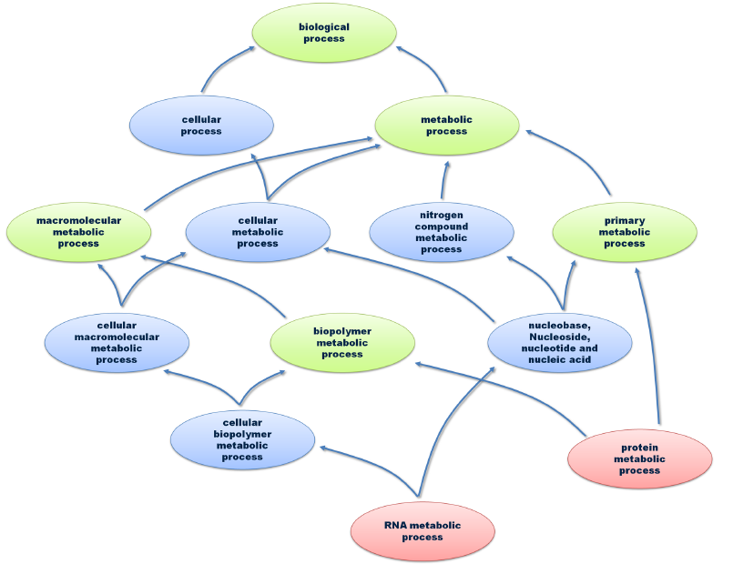
The Gene Ontology (GO)
Ontologies are structured vocabularies.
The Gene Ontology consists of
3 non-redundant areas:
- Biological process (BP)
- molecular function (MF)
- cellular component (localisation).
Shown here is a part of the BP
vocabulary.
At the top: most general term (root)
Red: tree leafs (very specific GO terms)
Green: common ancestor
Blue: other nodes.
Arcs: relations between parent and child nodes
PhD Dissertation
Andreas Schlicker (UdS, 2010)

Slide 3
Simple tree vs. cyclic graphs
Boxes represent nodes; arrows represent edges.
a | An example of a simple tree, in which each child has only one parent and the edges are directed.
That is, there is a source (parent) and a destination (child) for each edge.
b | A directed acyclic graph (DAG), in which each child can have one or more parents.
The red-colored node has multiple parents. The additional edge is colored grey.
Rhee et al. (2008) Nature Rev. Genet. 9: 509

Slide 4
Gene Ontology is a directed acyclic graph
An example of the node
vesicle fusion
in the BP ontology with
multiple parentage.
(Arrows point into the wrong direction.)
Dashed edges : there are other nodes not shown between the nodes and the root node.
Root : node with no incoming edges, and at least one leaf.
Leaf node : a terminal node with no children (vesicle fusion).
Similar to a simple tree, a DAG has directed edges and does not have cycles.
Depth of a node : length of the longest path from the root to that node.
Height of a node: length of the longest path from that node to a leaf.
Rhee et al. (2008) Nature Rev. Genet. 9: 509

Slide 5
relationships in GO
is_a​
is a part_of​
Gene X regulates relationship
negatively_regulates ​
positively_regulates
{
Gaudet​, Škunca​, Hu​, Dessimoz
Primer on the Gene Ontology,
https://arxiv.org/abs/1602.01876

Slide 6
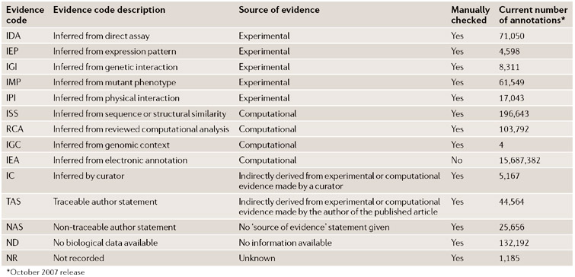
Where do the Gene Ontology annotations come from?
Rhee et al. Nature Reviews Genetics 9, 509-515 (2008)

Slide 7
IEA: Inferred from Electronic Annotation
The evidence code IEA is used for all inferences made without human supervision, regardless of the method used.
The IEA evidence code is by far the most abundantly used evidence code.
Guiding idea behind computational function annotation:
genes with similar sequences or structures are likely to be evolutionarily related.
Thus, assuming that they largely kept their ancestral function, they might still have similar functional roles today.
Gaudet​, Škunca​, Hu​, Dessimoz
Primer on the Gene Ontology,
https://arxiv.org/abs/1602.01876.
Published in : Methods in Molecular Biology
Vol1446 (2017) – open access!

Slide 8
Significance of GO annotations
Very general GO terms such as “cellular metabolic process“ are annotated to many genes in the genome.
Very specific terms belong to a few genes only.
→ One needs to compare how significant the occurrence of a GO term is in a given set of genes compared to a randomly selected set of genes of the same size.
This is often done with the hypergeometric test.
PhD Dissertation Andreas Schlicker (UdS, 2010)

Slide 9
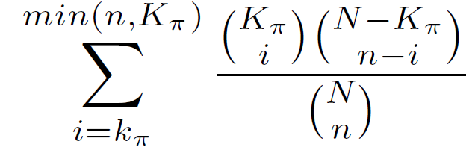
Hypergeometric test
p-value =
The hypergeometric test is a statistical test.
It can be used to check e.g. whether a biological annotation π is statistically significant enriched in a given test set of genes compared to the full genome.
▪ N : number of genes in the genome
▪ n : number of genes in the test set
▪ K_{π} : number of genes in the genome with annotation π.
▪ k_{π} : number of genes in test set with annotation π.
The hypergeometric test provides the likelihood that k_{π} or more genes that were randomly selected from the genome also have annotation π.
http://great.stanford.edu/

Slide 10
Hypergeometric test
Select i ≥ k_{π} genes with annotation π from the genome.
There are K_{π} such genes.
The other n – i genes in the test set do NOT have annotation π. There are N – K_{π} such genes in the genome.
p-value =
number of possibilities for selecting n elements from a set of N elements.
This correction is applied if the sequence of drawing the elements is not important.
The sum runs from k_{π} elements to the maximal possible number of elements.
This is either the number of genes with annotation π in the genome (K_{π}) or the number of genes in the test set (n).
http://great.stanford.edu/
http://www.schule-bw.de/

Slide 11
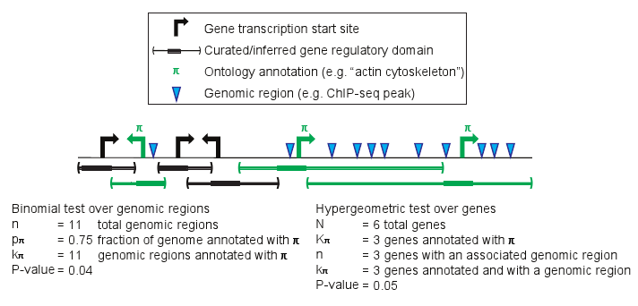
Example
p-value =
Is annotation π significantly enriched in the test set of 3 genes?
Yes! p = 0.05 is (just) significant.
http://great.stanford.edu/

Slide 12
Comparing GO terms
The hierarchical structure of the GO allows to compare proteins annotated to different terms in the ontology, as long as the terms have relationships to each other.
Terms located close together in the ontology graph (i.e., with a few intermediate terms between them) tend to be semantically more similar than those further apart.
One could simply count the number of edges between 2 nodes as a measure of their similarity.
However, this is problematic because not all regions of the GO have the same term resolution.
Gaudet​, Škunca​, Hu​, Dessimoz
Primer on the Gene Ontology,
https://arxiv.org/abs/1602.01876

Slide 13



Information content of GO terms
The likelihood of a node t can be defined in 2 ways:
How many genes have annotation t Number of GO terms in subtree below t
relative to the root node? relative to number of GO terms in tree
.
The likelihood takes values between 0 and 1 and
increases monotonic from the leaf nodes to the root.
Define information content of a node from its likelihood:
A rare node has high information content.
PhD Dissertation Andreas Schlicker (UdS, 2010)

Slide 14
Common ancestors of GO terms
Common ancestors of
two nodes t₁ and t₂ :
all nodes that are located
on a path from t₁ to root AND
on a path from t₂ to root.
The most informative common ancestor (MICA) of terms t₁ und t₂ is their common ancestor with highest information content.
Typically, this is the closest common ancestor.
PhD Dissertation
Andreas Schlicker (UdS, 2010)

Slide 15

Measure functional similarity of GO terms
Lin et al. defined the similarity of two GO terms t₁ und t₂
based on the information content of the most informative common ancestor (MICA)
If MICAs are close to the two GO terms, they receive a high similarity score.
Schlicker et al. defined the following variant:
where the term similarity is weighted with the counter-probability of the MICA.
By this, shallow annotations (low “depth” in the tree, slide #4) receive less relevance than MICAs further away from the root.
PhD Dissertation Andreas Schlicker (UdS, 2010)

Slide 16

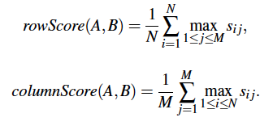


Measure functional similarity of two genes
Two genes or two sets of genes A und B typically have more than 1 GO annotation each. → Consider similarity of all terms i and j:
and select the maxima in all rows and columns:
Compute funsim-Score from scores for BP tree and MF tree:
PhD Dissertation Andreas Schlicker (UdS, 2010)

Slide 17
GO is inherently incomplete
The Gene Ontology is a representation of the current state of knowledge; thus, it is very dynamic.
The ontology itself is constantly being improved to more accurately represent biology across all organisms.
The ontology is augmented as new discoveries are made.
The creation of new annotations occurs at a rapid pace, aiming to keep up with published work.
Despite these efforts, the information contained in the GO database is necessarily incomplete.
Thus, absence of evidence of function does not imply absence of function.
This is referred to as the Open World Assumption
Gaudet, Dessimoz,
Gene Ontology: Pitfalls, Biases, Remedies
https://arxiv.org/abs/1602.01876

Slide 18
Summary
The GO is the gold-standard for computational annotation of gene function.
It is continuously updated and refined.
Hypergeometric test is most often used to compute enrichment of GO terms in gene sets
Semantic similarity concepts allow measuring the functional similarity of genes. Selecting an optimal definition for semantic similarity of 2 GO terms and for the mixing rule depends on what works best in practice.
Functional gene annotation based on GO is affected by a number of biases.

Slide 19
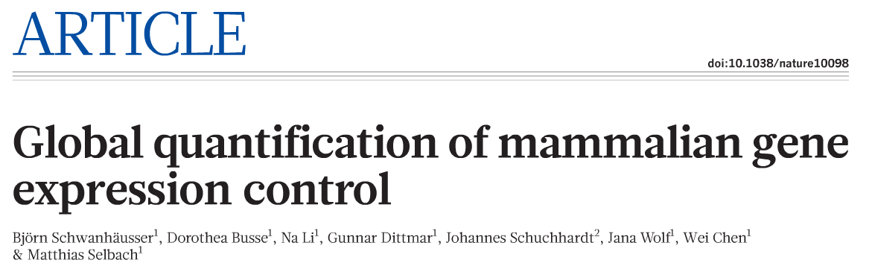
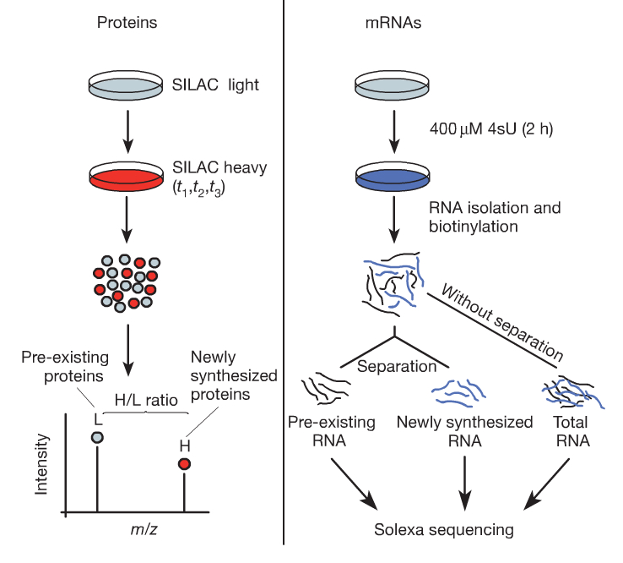
Rates of mRNA transcription and protein translation
SILAC: „stable isotope labelling by amino acids in cell culture“ means that cells are cultivated in a medium containing heavy stable-isotope versions of essential amino acids.
When non-labelled (i.e. light) cells are transferred to heavy SILAC growth medium, newly synthesized proteins incorporate the heavy label while pre-existing proteins remain in the light form.
Quantification of protein turnover and levels. Mouse fibroblasts were pulse-labelled with heavy amino acids (SILAC). Protein turnover is quantified by mass spectrometry.
Schwanhäuser et al. Nature 473, 337 (2011)

Slide 20
Rates of mRNA transcription and protein translation
Quantification of mRNA turnover and levels. Mouse fibroblasts were pulse-labelled with the nucleoside 4-thiouridine (4sU). mRNA turnover is quantified by next-generation sequencing.
The 4sU-labeled RNA fraction is thiol-specifically biotinylated generating a disulfide bond between biotin and the newly transcribed RNA.
'Total cellular RNA' can then be quantitatively separated into labeled ('newly transcribed') and unlabeled ('pre-existing') RNA with high purity using streptavidin-coated magnetic beads.
Finally, labeled RNA is recovered from the beads by simply adding a reducing agent (e.g. dithiothreitol) cleaving the disulfide bond and releasing the newly transcribed RNA from the beads.
Rädle, J Vis Exp. 2013; (78): 50195.
Schwanhäuser et al. Nature 473, 337 (2011)

Slide 21
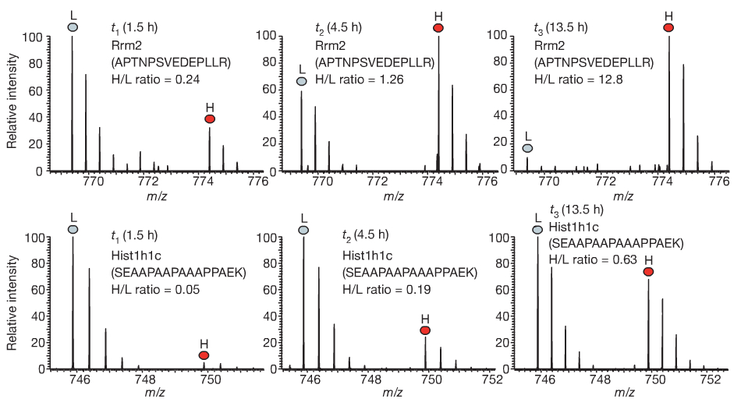
Rates of mRNA transcription and protein translation
84,676 peptide sequences were identified by MS and assigned to 6,445 unique proteins.
5,279 of these proteins were quantified by at least 3 heavy to light (H/L) peptide ratios belonging to these proteins.
Top: high-turnover protein
Mass spectra of peptides for two proteins (x-axis: mass over charge ratio).
Over time, the heavy to light (H/L) ratios increase.
You should understand these spectra!
Schwanhäuser et al. Nature 473, 337 (2011)
Bottom: low-turnover protein, slow synthesis, long half-life

Slide 22

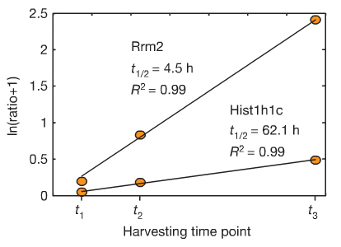


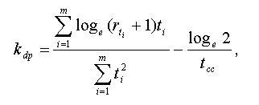





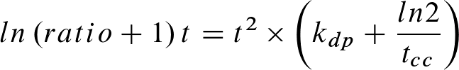
Consider ratio r of protein with heavy amino acids (P_{H}) and light amino acids (P_{L}):
Protein half-lifes and decay rates
Assume that proteins labelled with light amino acids decay exponentially with degradation rate constant k_{dp} :
Express (P_{H}) as difference between total number of a specific protein P_{total} and P_{L}:
Assume that P_{total} doubles during duration of one cell cycle (which lasts t∞ ):
Consider m intermediate time points:
From k_{dp} we get the desired half-life:
because this gives
take ln on both sides
The same is done to compute mRNA half-lives (not shown).
Schwanhäuser et al. Nature 473, 337 (2011)

Slide 23
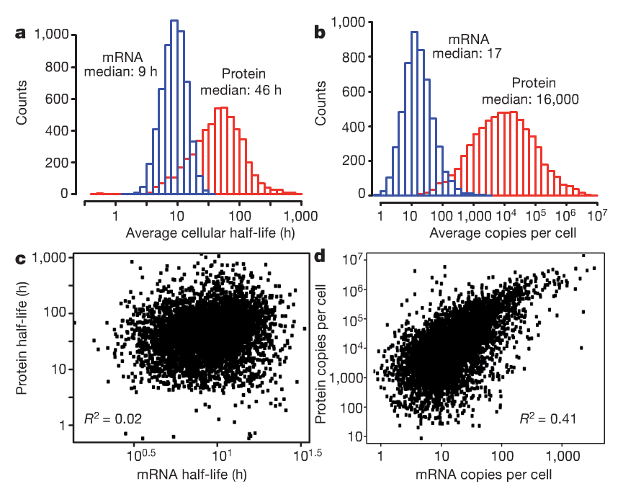
mRNA and protein levels and half-lives
a, b, Histograms of mRNA (blue) and protein (red) half-lives (a) and levels (b).
Proteins were on average 5 times more stable (46h vs. 9h) and 900 times more abundant than mRNAs.
(right) mRNA and protein levels showed reasonable correlation (R² = 0.41)
(left) However, there was practically no correlation of protein and mRNA half-lives.
Schwanhäuser et al. Nature 473, 337 (2011)

Slide 24
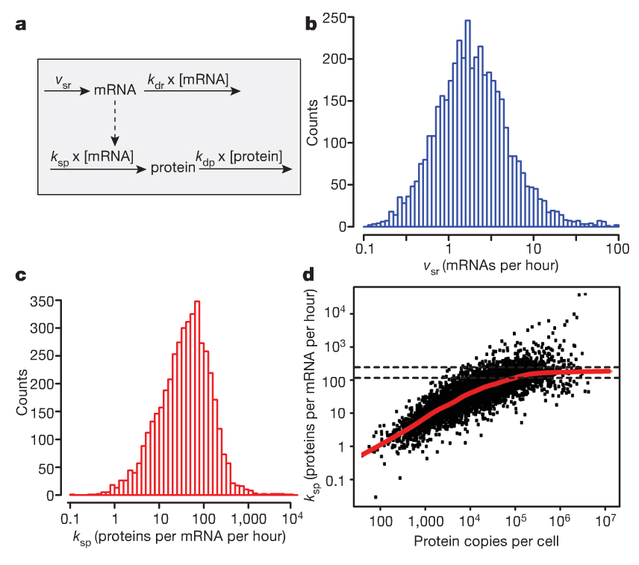
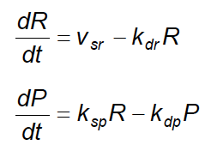
Mathematical model of transcription and translation
A widely used minimal description of the dynamics of transcription and translation includes the synthesis and degradation of mRNA and protein, respectively
The mRNA (R) is synthesized with a constant rate v_{sr} and
degraded proportional to their numbers with rate constant k_{dr}.
The protein level (P) depends on the number of mRNAs,
which are translated with rate constant k_{sp}.
Protein degradation is characterized by the rate constant k_{dp}.
The synthesis rates of mRNA and protein are calculated
from their measured half lives and levels.
Schwanhäuser et al. Nature 473, 337 (2011)

Slide 25
Computed transcription and translation rates
Top
Average cellular transcription rates predicted by the model span two orders of magnitude.
The median is about 2 mRNA molecules per hour (very slow!).
An extreme example is the protein Mdm2 of which more than 500
mRNAs per hour are transcribed.
Bottom
The median translation rate constant
is about 40 proteins per mRNA
per hour
Calculated translation rate constants are not uniform
Schwanhäuser et al. Nature 473, 337 (2011)

Slide 26
Maximal translation constant
Abundant proteins are translated about 100 times more efficiently than those of low abundance
Translation rate constants of abundant proteins saturate between approximately 120 and 240 proteins per mRNA per hour.
The maximal translation rate constant in mammals is not known.
The estimated maximal translation rate constant in sea urchin embryos is 140 copies per mRNA per hour, which is surprisingly close to the prediction of this model.
Schwanhäuser et al. Nature 473, 337 (2011)

Slide 27
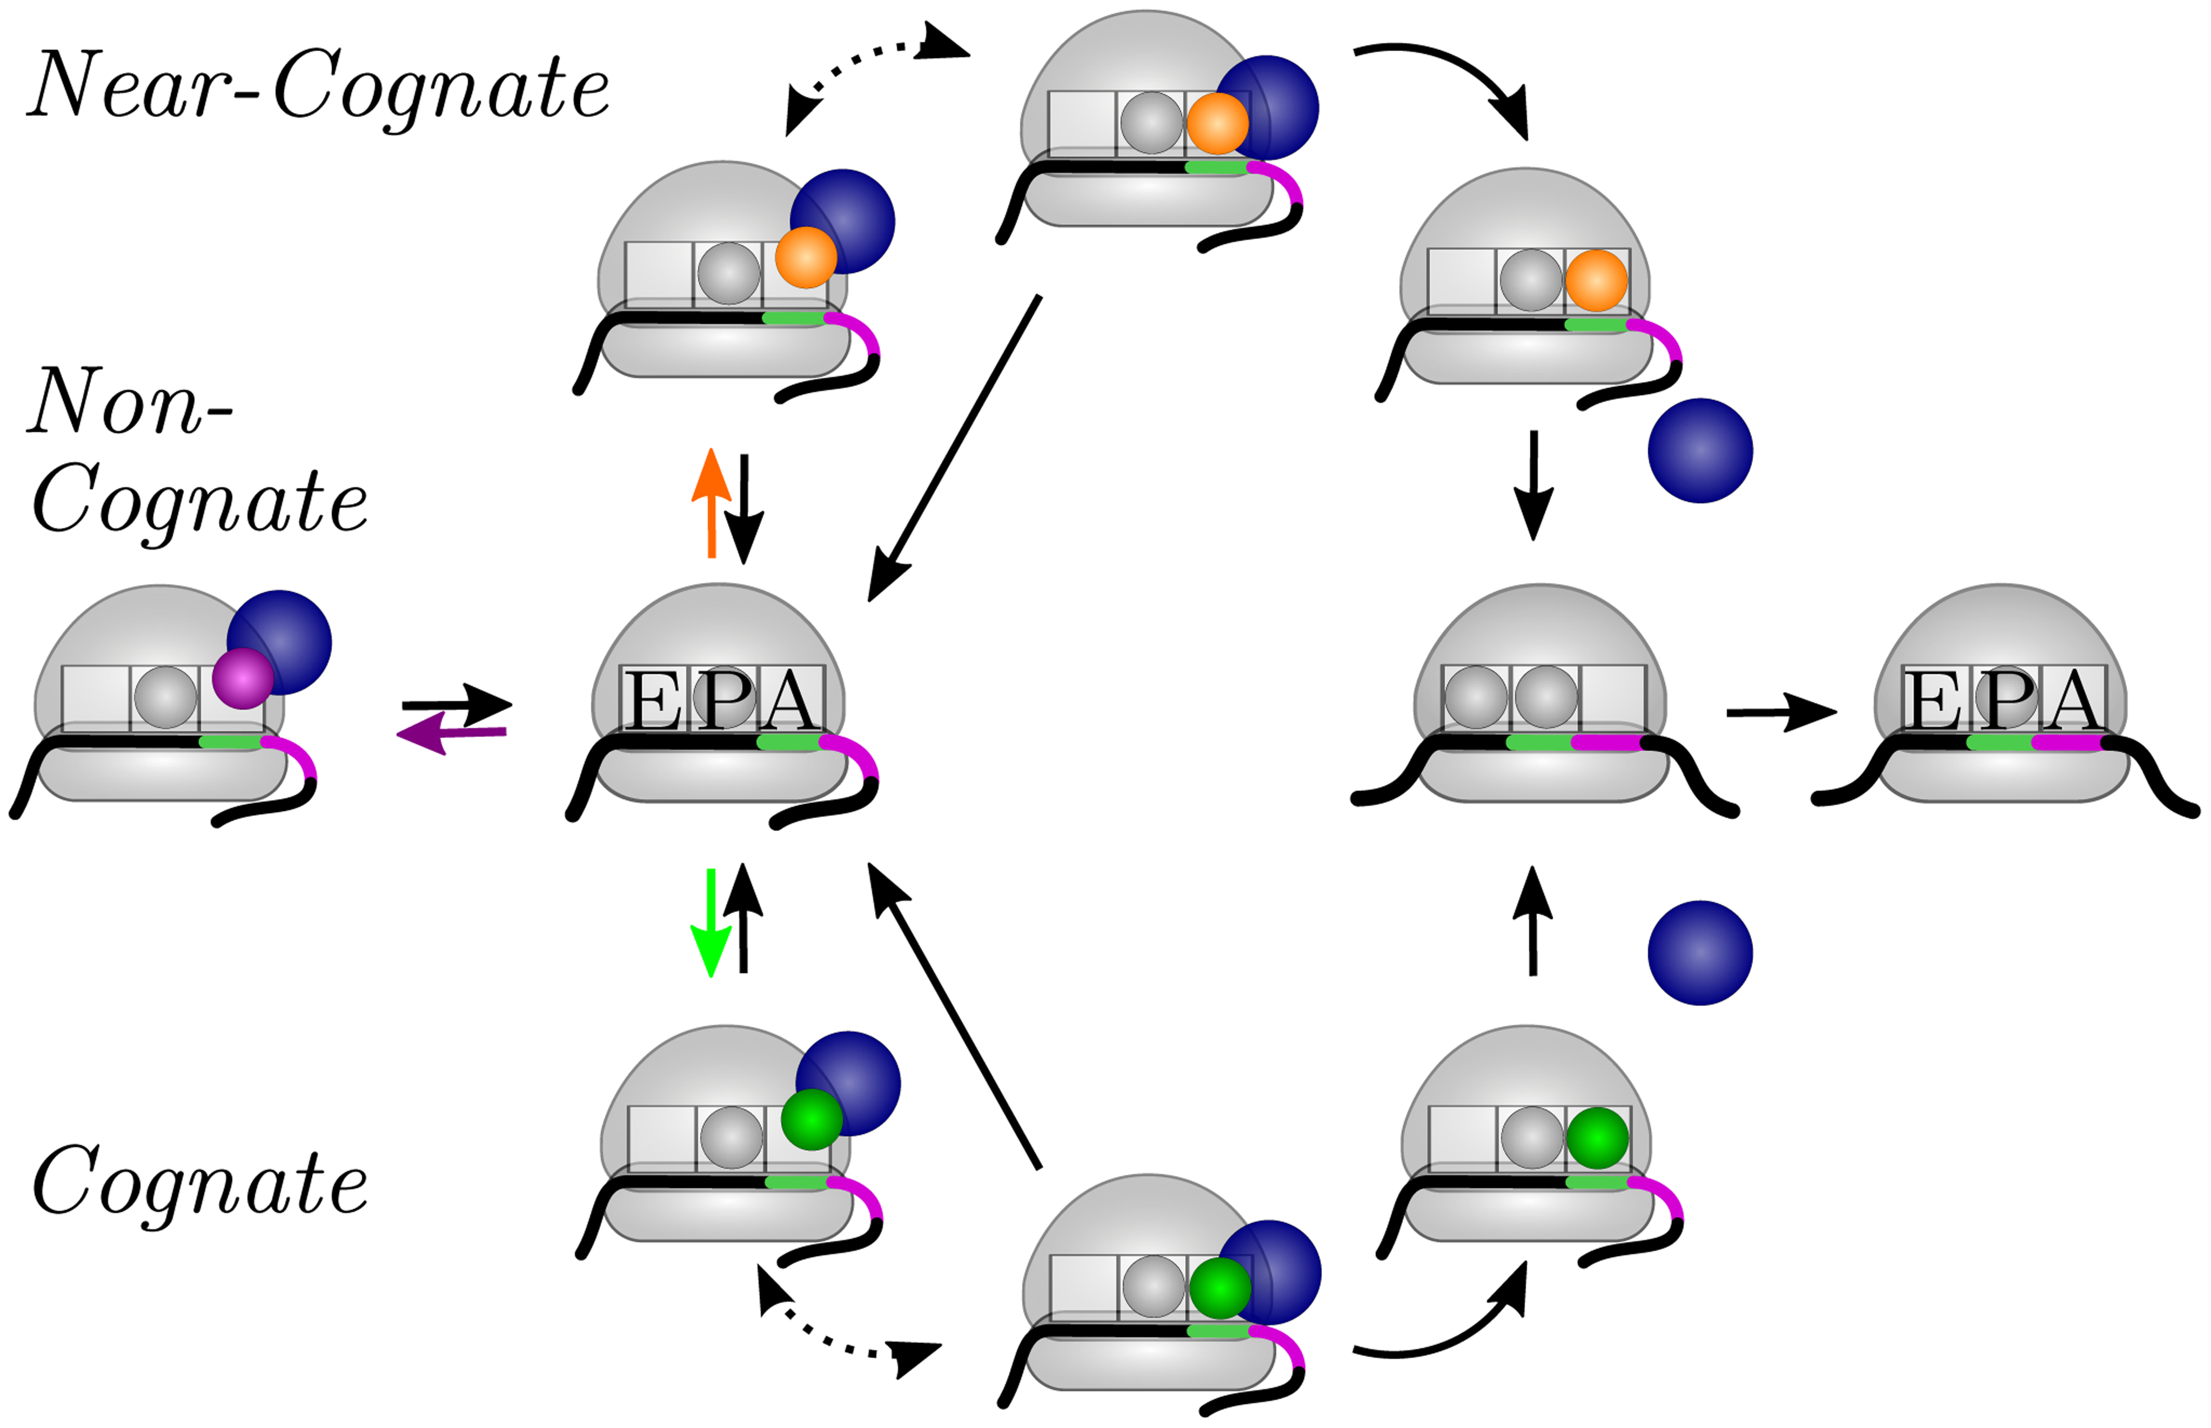
Ribosomal mRNA translation
Elongation cycle of a ribosome (gray dome) translating an mRNA.
Aminoacyl-tRNA (small gray, green, purple, or orange sphere) is delivered to the ribosome in a ternary complex with the elongation factor EF-Tu (larger blue sphere) and GTP (not shown).
In addition to the initial binding site, the ribosome has 3 tRNA binding sites, the A, P, and E sites.
The elongation cycle of translation starts when the A site of the ribosome has arrived at a new codon (green) of the mRNA. The ribosome then binds a ternary complex with a tRNA that may be cognate (sequence matches), near-cognate, or non-cognate to this codon.
As a consequence, the elongation cycle exhibits 3 different branches corresponding to 3 different reaction pathways:
(left) A non-cognate ternary complex is again released from the initial binding site of the ribosome;
(top) A near-cognate ternary complex is usually rejected but is very rarely used to elongate the peptide chain; and
(bottom) A cognate ternary complex may also be rejected but is typically used for elongation of the peptide chain.
Rudorf et al. (2014)
PLoS Comput Biol 10: e1003909.

Slide 28
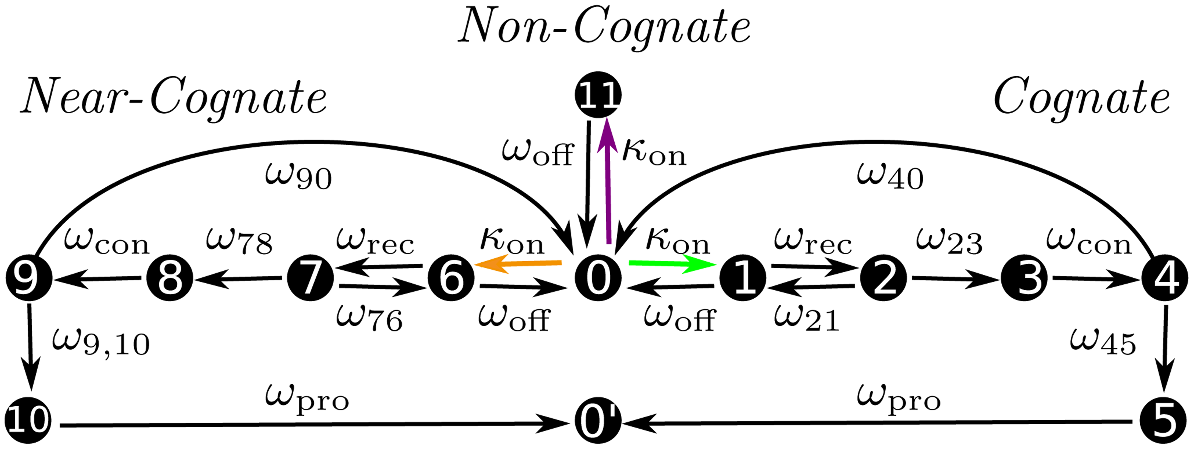
mRNA translation modelled as Markov process
(Left) All transition rates of this Markov model could be measured for E.coli in vitro. ω_{rec} : recognition rate, ω_{con} : conformational rate
What are the in vivo rates?
From the model, one can deduce codon-specific translation rates:
(A) In-vitro values for high-fidelity buffer at 37°C.
To derive in vivo rates from this, one adjusts the diffusion constant and uses exp. measured tRNA concentrations. This gave
(B) in-vivo values for E. coli at growth conditions of 0.7 dbl/h.
Rudorf et al. (2014) PLoS Comput Biol 10: e1003909.

Slide 29
Optimization of elongation rates
Sequences with alternative, synonymous codons are proposed from the original sequence and selected to maximize the protein expression score.
COSEM current: translation rate per mRNA transcript
mRNA secondary structure: mRNA folding energy in the first 30 codons of the 5′-end,
GC3 content: fraction of guanine and cytosine in the third nucleotide positions of all codons
Trösemeier et al. Sci. Rep. 9, 7511 (2019)

Slide 30
Derive codon-specific elongation rates
Protein expression of synthetic ovalbumin (main constituent of egg white) in S. Typhimurium
(after artificial gene transfer).
Measured protein abundance (Western blot) relative to wildtype compared to protein expression score relative to wildtype for ova variants.
Geneart (GeneOptimizer) from ThermoFisher is another tool to optimize codon usage.
This tool did not lead to increased Ova levels.
COSEM gave 3-4 fold increase.
Trösemeier et al. Sci. Rep. 9, 7511 (2019)

Slide 31
Codon-specific elongation rates in human
UAA, UAG and UGA are stop codons.
The elongation rates for other codons are of similar magnitude (between 1 and 30 per second) as in E.coli.
Trösemeier et al. Sci. Rep. 9, 7511 (2019)

Slide 32
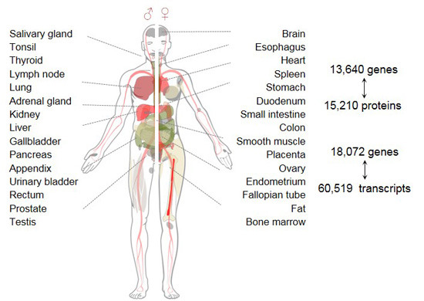
Transcriptome / Proteome
FINDINGS:
hundreds of proteins, particularly in testis, could not be detected
even for highly expressed mRNAs, few proteins show tissue specific expression,
there exist strong differences between mRNA and protein quantities within and across tissues
Protein expression is often more stable across tissues than that of transcripts.
Wang et al. Mol. Syst. Biol. 15, e8503 (2019)

Slide 33
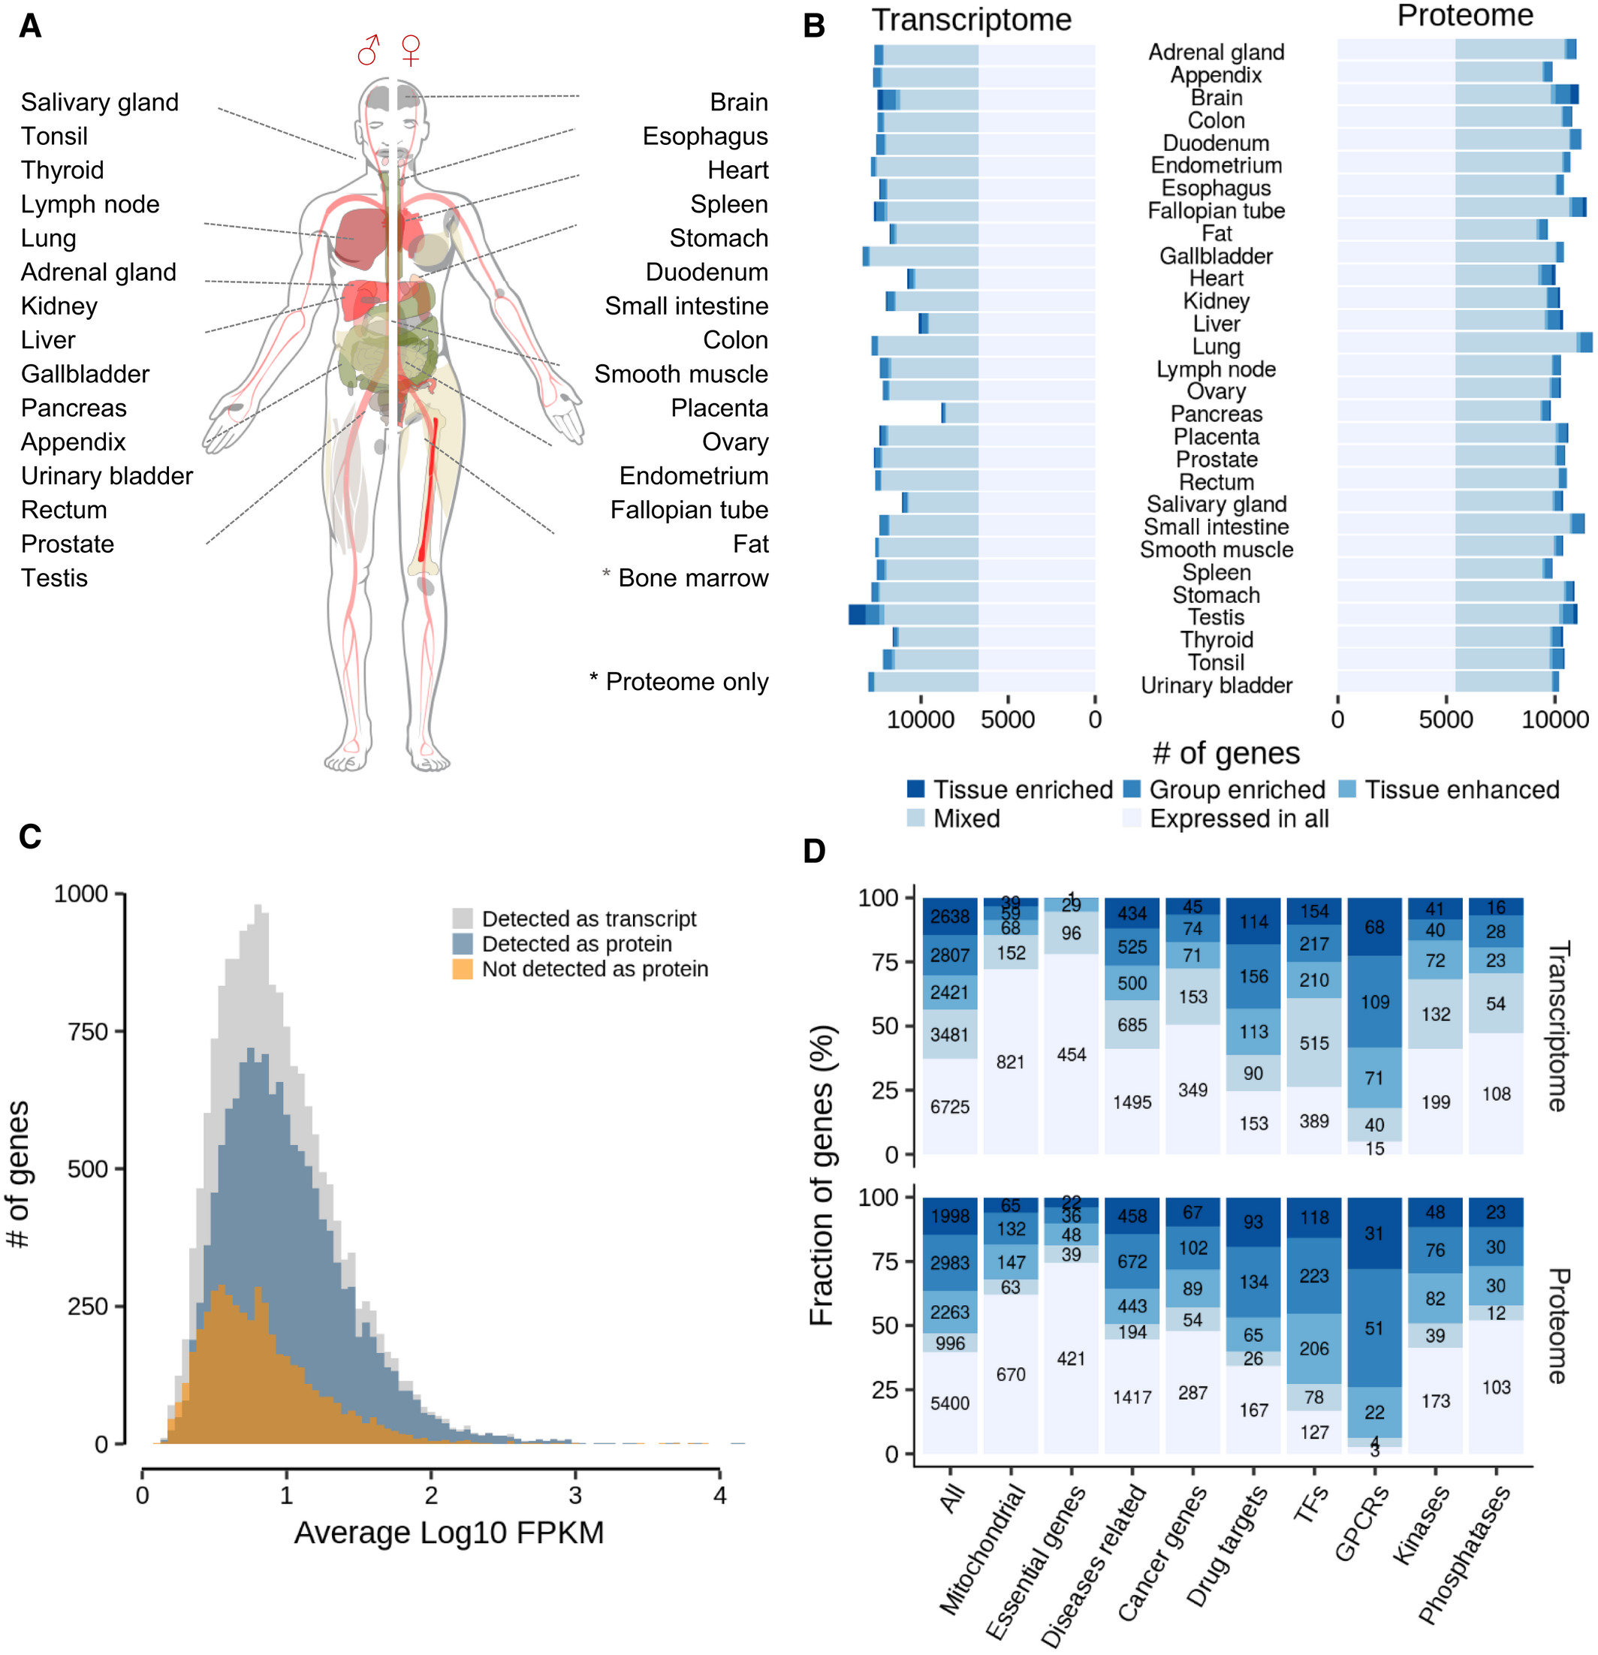
Transcriptome / Proteome
A large fraction of all represented genes was expressed in all tissues: 37% (6,725) at the transcript level and 39% (5,400) at the protein level.
However, 43% of all transcripts and 53% of all proteins showed elevated expression in one or more tissues.
Wang et al. Mol. Syst. Biol. 15, e8503 (2019)

Slide 34
Transcriptome / Proteome
Grey:
Abundance distribution of all transcripts detected in all tissues
Blue: fraction of detected proteins
Orange: fraction of transcripts for which no protein was detected.
Ca. 1/3 of these transcripts were found in testis.
Interpretation: the mRNA of not detected proteins shows - on average - smaller levels of mRNA expression.
However, even some highly expressed mRNAs were missing as proteins.
Wang et al. Mol. Syst. Biol. 15, e8503 (2019)

Slide 35
Transcriptome / Proteome
The tissue distribution of expression of disease-associated
genes followed that of all genes,
However, the expression of drug targets in general and GPCRs in particular was much more tissue restricted.
This suggests that proteins may make for better drug targets if they are not ubiquitously expressed.
Wang et al. Mol. Syst. Biol. 15, e8503 (2019)

Slide 36
Summary
Transcription and translation are tightly regulated processes in cells because the cells need
(a) to make sure that the right mRNAs and proteins are being synthesized which are needed for the particular cell state or cell fate, and
(b) to make sure that no unnecessary molecules are synthesized which would be costly in terms of resources.
How transcription and translation processes are regulated is still subject of intense research.
Recently, the SILAC method and the ribosome profiling method (where processing ribosomes are stalled by application of small-molecule inhibitors, and the mRNA sequences the ribosomes bind to get sequenced) have enabled researchers to pinpoint the precise kinetics of expressing individual genes and of translating individual mRNAs.

