Slide 1
V12 – Gene Regulatory Networks,
Boolean Networks
Thu, Nov 28, 2019

Slide 2
Gene Expression
Sequence of processes: from DNA to functional proteins
degraded mRNA
nucleus
cytosol
microRNAs
transcription
transport
degradation
transcribed RNA
DNA
mRNA
mRNA
translation
TFs
In eukaryotes:
RNA processing:
capping, splicing
protein
post-translational modifications
→ regulation at every step!!!
active protein
degraded protein

Slide 3
What is a GRN?
Gene regulatory networks (GRN) are model representations
of how genes regulate the expression levels of each other.
In transcriptional regulation, proteins called transcription factors (TFs) regulate the transcription of their target genes to produce
messenger RNA (mRNA).
In post-transcriptional regulation, microRNAs (miRNAs)
cause degradation and repression of target mRNAs.
These interactions are represented in a GRN by adding
edges linking TF or miRNA genes to their target mRNAs.
Narang et al. (2015). PLoS Comput Biol 11(9): e1004504

Slide 4

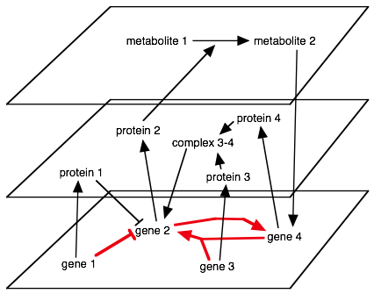
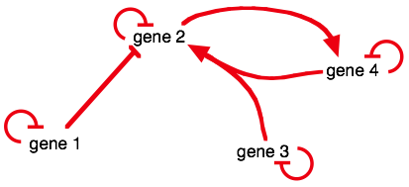
Layers upon Layers
Biological regulation
via proteins and metabolites
<=>
Projected regulatory network
activation
<=>
repression
self-
repression
Note that genes do not interact directly
Gene regulation networks have "cause and action"
→ directed networks
A gene can enhance or suppress the expression of another gene
→ two types of arrows

Slide 5

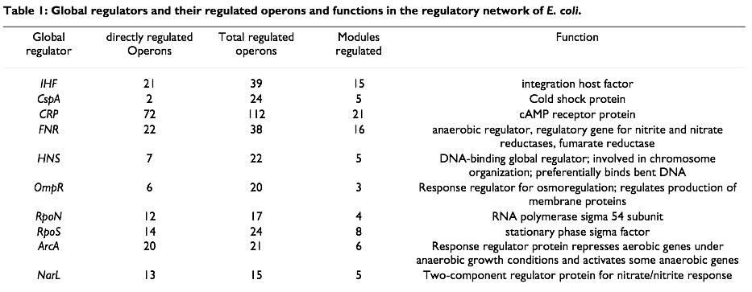
Global Regulators in E. coli
Ma et al., BMC Bioinformatics 5 (2004) 199

Slide 6
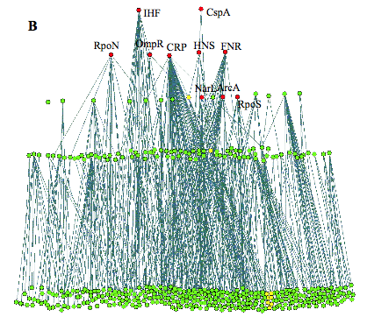
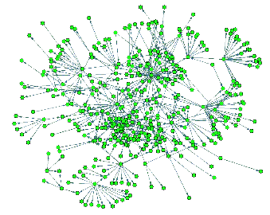
Simple organisms have hierarchical GRNs
Largest weakly connected component (WCC)
(ignore directions of regulation): 325 operons
(3/4 of the complete network)
Lowest level: operons that code for TFs with only auto-regulation, or no TFs
Next layer: delete nodes of lower layer, identify TFs that do not regulate other operons in this layer (only lower layers)
Continue …
Network from standard layout algorithm
Network with all regulatory edges pointing downwards
→
→ a few global regulators (•) control all the details
Ma et al., BMC Bioinformatics 5 (2004) 199

Slide 7
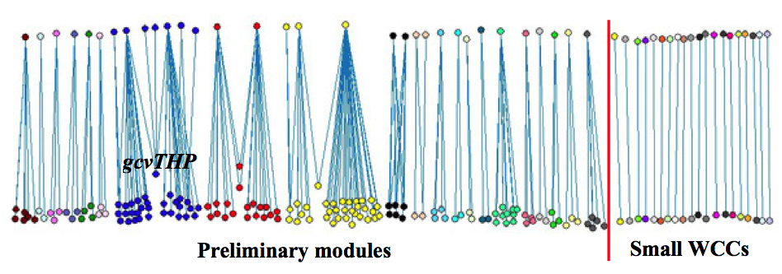
E.coli GRN modules
Remove top 3 layers and determine WCCs
→ just a few modules
Ma et al., BMC Bioinformatics 5 (2004) 199

Slide 8
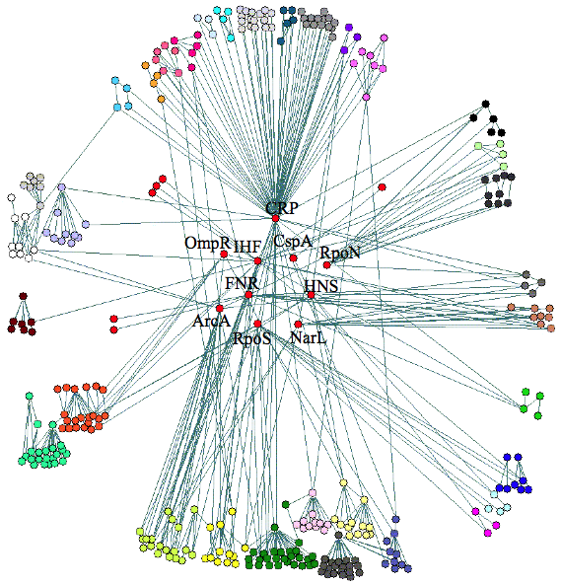
Putting it back together
The 10 global regulators are at the core of the network,
some hierarchies exist between the modules
Ma et al., BMC Bioinformatics 5 (2004) 199

Slide 9

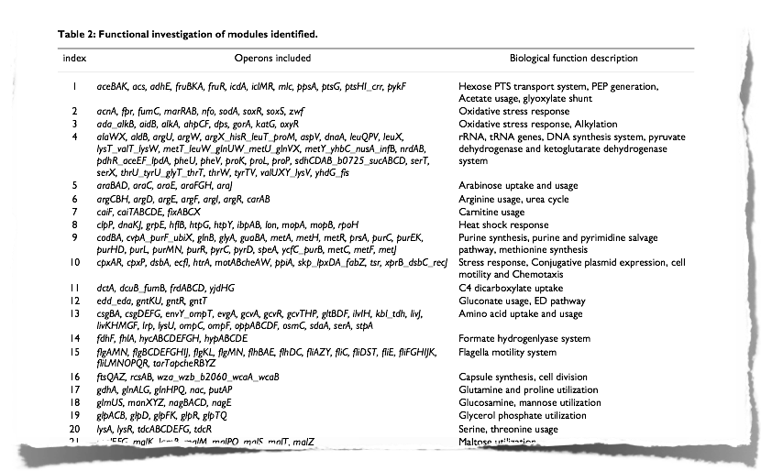
Modules have specific functions
Ma et al., BMC Bioinformatics 5 (2004) 199

Slide 10
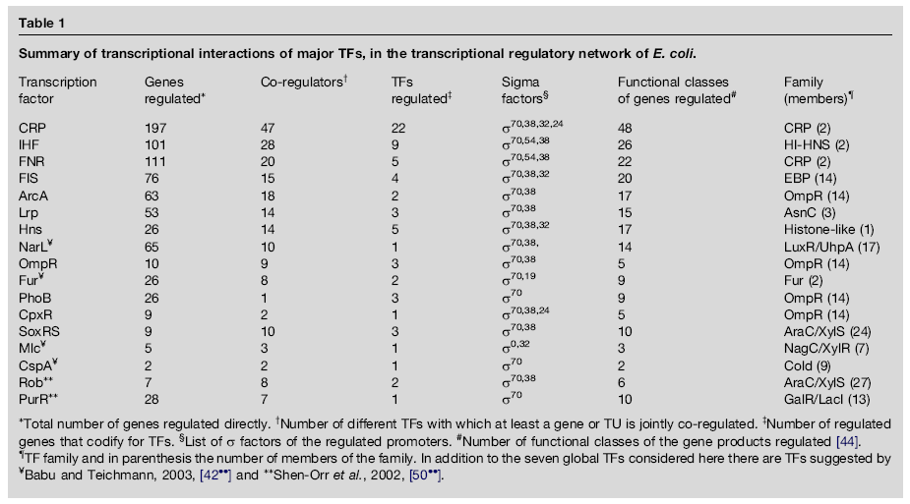
Frequency of co-regulation
Martinez-Antonio, Collado-Vides,
Curr Opin Microbiol 6, 482 (2003)
Half of all target genes are regulated by multiple TFs.
In most cases, a „gobal“ regulator (with > 10 interactions)
works together with a more specific local regulator.

Slide 11
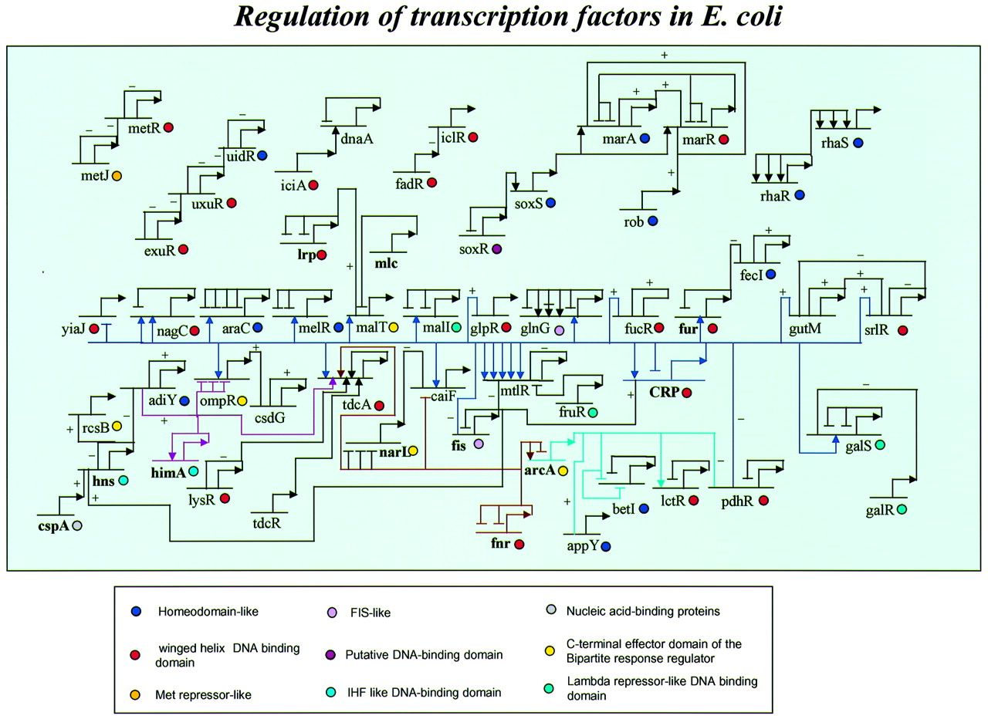
TF regulatory network in E.coli
When more than one TF regulates a gene, the order of their binding sites is as given in the figure.
Arrowheads and horizontal bars indicate positive / negative regulation when the position of the binding site is known.
In cases where only the nature of regulation is known, without binding site information, + and – are used to indicate positive and negative regulation.
The names of global regulators are in bold.
Babu, Teichmann, Nucl. Acid Res. 31, 1234 (2003)

Slide 12
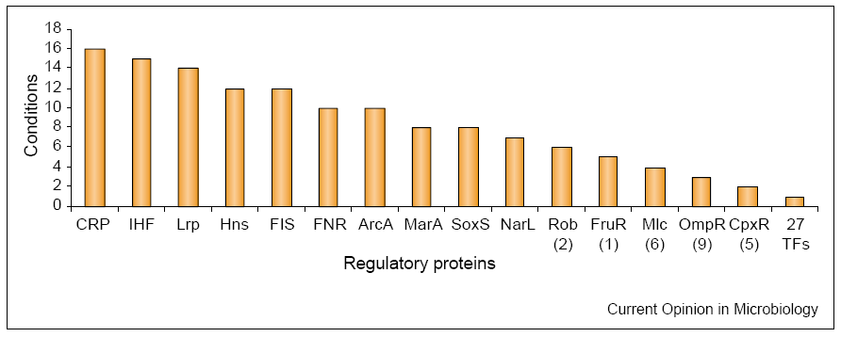
Response to changes in environmental conditions
TFs also sense changes in environmental conditions or other changes that encode internal signals.
Global environment growth conditions in which TFs are regulating.
# in brackets indicates how many additional TFs participate in the same number of conditions.
Martinez-Antonio, Collado-Vides, Curr Opin Microbiol 6, 482 (2003)

Slide 13
Story: Quorum sensing of Vibrio fischeri
V. fischeri has a microbial symbiotic relationship with the squid Euprymna scolopes.
The bacterium exists in small amounts in the ocean (10² cells/ml) and in large amount in the light organs of the squid (10¹⁰ cells/ml).
At low concentrations, V. fischeri does not produce luminescence.
At high cell density these bacteria emit a blue-green light.
The light organ of the squid provides to the bacteria all the nutrients
that they need to survive.
The squid benefits from the bacteria's quorum sensing and bioluminescence abilities.
https://www.bio.cmu.edu/courses/03441/TermPapers/99TermPapers/Quorum/vibrio_fischeri.html

Slide 14
Quorum sensing of Vibrio fischeri
The cell density-dependent control of gene expression is activated by a transcriptional activator protein that is coupled to a signal molecule (autoinducer).
The autoinducer is released by the bacteria into its surrounding environment and taken up from there.
During the day, the squid keeps the bacteria at lower concentrations by expelling some of them into the ocean during regular intervals.
At night however, the bacteria are allowed to accumulate to about
10¹⁰ cells/ml so that they will emit blue-green light.
https://www.bio.cmu.edu/courses/03441/TermPapers/99TermPapers/Quorum/vibrio_fischeri.html

Slide 15
Vibrio fischeri helps with Camouflage
This is perfect for the squid because it is a night feeder.
In the moonlight, the swimming squid would normally cast a shadow beneath itself making it a perfect target for squid-eating organisms.
However, the bacterial glow will counter the shadowing effect the moon makes and mask the squid from its predators.
In the morning, the squid expels some bacteria into the ocean to a concentration where they will not generate light anymore so as to conserve energy.
https://www.bio.cmu.edu/courses/03441/TermPapers/99TermPapers/Quorum/vibrio_fischeri.html

Slide 16
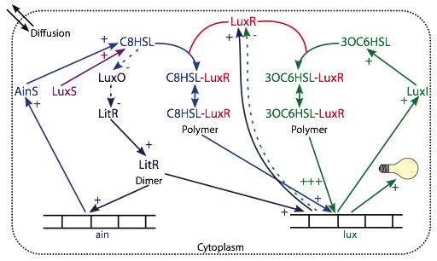
Quorum sensing of Vibrio fischeri

Slide 17
Boolean Networks
Dependencies between variables can be formulated as conditional transitions
• "If LuxI is present, then AI will be produced…"
• "If there is AI and there's no LuxR:AI bound to the genome, then LuxR will be expressed and complexes can form…"
• "If LuxR:AI is bound to the genome, then LuxI is expressed…"
Simplified mathematical description of the dependencies:
Densities of the species
<=> discrete states: on/off, 1/0
Network of dependencies
<=> condition tables
Progress in time
<=> discrete propagation steps

Slide 18
Boolean Networks II
State of the system:
described by vector of discrete values
Si = {0, 1, 1, 0, 0, 1, …}
Si = {x1(i), x2(i), x3(i), …}
fixed number of species with finite number of states each
→ finite number of system states
→ periodic trajectories
→ periodic sequence of states = attractor
→ all states leading to an attractor = basin of attraction
Propagation:
Si+1 = {x1(i+1), x2(i+1), x3(i+1), …}
x1(i+1) = f1(x1(i), x2(i), x3(i), …)
with fi given by condition tables

Slide 19
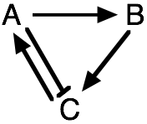
A Small Example
State vector S = {A, B, C} → 8 possible states
Conditional evolution:
A is on if C is on A activates B C is on if (B is on && A is off)
Ai+1 | Ci
0 | 0
1 | 1
Bi+1 | Ai
0 | 0
1 | 1
Ci+1 | Ai | Bi
0 | 0 | 0
1 | 0 | 1
0 | 1 | 0
0 | 1 | 1
Start from {A, B, C} = {1, 0, 0}
# | Si | A | B | C
0 | S0 | 1 | 0 | 0
1 | S1 | 0 | 1 | 0
2 | S2 | 0 | 0 | 1
3 | S3 = S0 | 1 | 0 | 0
assume here that inhibition through A
is stronger than activation via B
periodic orbit of length 3

Slide 20
Test the Other Starting Conditions
Test the other states
Ai+1 | Ci
0 | 0
1 | 1
Bi+1 | Ai
0 | 0
1 | 1
Ci+1 | Ai | Bi
0 | 0 | 0
1 | 0 | 1
0 | 1 | 0
0 | 1 | 1
# | A | B | C
0 | 1 | 1 | 1
1 | 1 | 1 | 0
2 | 0 | 1 | 0
3 | 0 | 0 | 1
4 | 1 | 0 | 0
5 | 0 | 1 | 0
# | A | B | C
0 | 1 | 0 | 1
1 | 1 | 1 | 0
# | A | B | C
0 | 0 | 1 | 1
1 | 1 | 0 | 1
Same attractor as before:
100 → 010 → 001 → 100
is also reached from:
110, 111, 101, 011
# | A | B | C
0 | 0 | 0 | 0
1 | 0 | 0 | 0
→ Either all off or stable oscillations

Slide 21
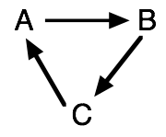
A Knock-out Mutant
Ai+1 | Ci
0 | 0
1 | 1
Bi+1 | Ai
0 | 0
1 | 1
Ci+1 | Bi
0 | 0
1 | 1
Attractors:
# | A | B | C
0 | 1 | 0 | 0
1 | 0 | 1 | 0
2 | 0 | 0 | 1
3 | 1 | 0 | 0
# | A | B | C
0 | 1 | 1 | 0
1 | 0 | 1 | 1
2 | 1 | 0 | 1
3 | 1 | 1 | 0
# | A | B | C
0 | 1 | 1 | 1
1 | 1 | 1 | 1
# | A | B | C
0 | 0 | 0 | 0
1 | 0 | 0 | 0
no feedback
→ no stabilization, network just "rotates"

Slide 22
Boolean Network of QS
Minimum set of species:
LuxR, AI, LuxR:AI, LuxR:AI:genome, LuxI
Here: Light signal (LuxAB) α LuxI
Condition tables:
describe the state of a species in the next step given the current states of all relevant species.
LuxI | LuxR:AI:Genome
0 | 0
1 | 1
LuxR:AI:Genome | LuxR:AI
0 | 0
1 | 1
How does LuxI depend on LuxR:AI:Genome?
How does LuxR:AI:Genome depend on LuxR:AI?

Slide 23
Condition Tables for QS II
LuxR | LuxR | AI | LuxR:AI:Genome
1 | 0 | 0 | 0
1 | 1 | 0 | 0
1 | 0 | 1 | 0
1 | 1 | 1 | 0
0 | 0 | 0 | 1
1 | 1 | 0 | 1
0 | 0 | 1 | 1
0 | 1 | 1 | 1
When LuxR:AI:Genome is empty,
LuxR is produced in next step
Comment: LuxR present, no AI available
LuxR present, binds AI in next step,
no LuxR is produced because
LuxR:AI:Genome inhibits LuxR production
LuxR:AI | LuxR | AI | LuxR:AI:Genome
0 | 0 | 0 | 0
0 | 1 | 0 | 0
0 | 0 | 1 | 0
1 | 1 | 1 | 0
0 | 0 | 0 | 1
0 | 1 | 0 | 1
0 | 0 | 1 | 1
1 | 1 | 1 | 1
LuxR:AI | LuxR | AI | LuxR:AI:Genome
0 | x | x | x
1 | 1 | 1 | x
→
Note: no dissociation
(LuxR:AI:Genome → LuxR:AI + Genome)
only degradation of AI in this model
LuxR:AI:Genome → LuxR + Genome

Slide 24
Condition tables for QS III
AI | LuxR | AI | LuxI
0 | 0 | 0 | 0
0 | 1 | 0 | 0
1 | 0 | 1 | 0
0 | 1 | 1 | 0
1 | 0 | 0 | 1
1 | 1 | 0 | 1
1 | 0 | 1 | 1
1 | 1 | 1 | 1
AI | LuxR | AI | LuxI
1 | x | x | 1
0 | x | 0 | 0
1 | 0 | 1 | 0
0 | 1 | 1 | 0
→

Slide 25
Scanning for Attractors
States of V. fischeri QS system are mapped onto integers
{LuxR (LR), LuxR:AI (RA), AI, LuxR:AI:Genome (RAG), LuxI (LI)}
= {1, 2, 4, 8, 16} - current state can be interpreted as binary number!
For each attractor:
• periodic orbit and its length (period)
• basin of attraction and its relative size (32 states in total)
→ how likely will the system end up in each of the attractors?
Attractor 1:
orbit: 1
→ period 1
states: 0, 1
→ size 2, 2/32 = 6.25 %
start from state 0:
# LR RA AI RAG LI - state
0 . . . . . - 0
1 X . . . . - 1
2 X . . . . - 1
<= attractor
States: named by reading occupancies as binary numbers in reversed order.

Slide 26
Scanning for Attractors II
Attractor 2:
orbit: 3, 9, 17, 5
→ period 4
states: 2, 3, 5, 8, 9, 16, 17
→ size 7, 21.9 %
start from state 8:
# LR RA AI RAG LI - state
0 . . . X . - 8
1 . . . . X - 16
2 X . X . . - 5
3 X X . . . - 3
4 X . . X . - 9
5 X . . . X - 17
6 X . X . . - 5
Attractor:
17 returns to 5
averaged occupancies in this periodic orbit:
LR
RA
AI
RAG
LI
4/4 = 1
1/4 = 0.25
1/4 = 0.25
1/4 = 0.25
1/4 = 0.25

Slide 27
Attractors III
Attractor 3:
period 4, basin of 16 states → 50 %
# LR RA AI RAG LI
. X X . .
. X X X .
. . X X X
. . X . X
Attractor 4:
period 4, basin of 4 states → 12.5 %
# LR RA AI RAG LI
X X X . .
X X . X .
X . . X X
X . X . X
Attractor 5:
period 2, basin of 3 states → 9.4 %
# LR RA AI RAG LI
X . X X .
. X . X

Slide 28
Classifying the Attractors
→ Interpret the system's behavior from the properties of the attractors
Attractor | period | basin size | <LuxR> | <LuxR:AI> | <AI> | <LuxR:AI:Gen> | <LuxI>
1 | 1 | 6.25 % (2) | 1 | 0 | 0 | 0 | 0
2 | 4 | 21.9% (7) | 1 | 0.25 | 0.25 | 0.25 | 0.25
3 | 4 | 50 % (16) | 0 | 0.5 | 1 | 0.5 | 0.5
4 | 4 | 12.5 % (4) | 1 | 0.5 | 0.5 | 0.5 | 0.5
5 | 2 | 9.4% (3) | 0.5 | 0.5 | 0.5 | 0.5 | 0.5
There exist three regimes:
dark: LuxI = 0
intermediate: LuxI = 0.25
bright: LuxI = 0.5
little free LuxR (0.24) + much AI (0.85)
free LuxR, no AI
free LuxR + little AI

Slide 29
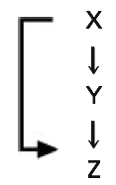
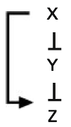
The Feed-Forward-Loop
Signal propagation
Left column: external signal
External signal determines state of X
→ response Z for short and long signals X
X | Y | Z
0 | 0 | 0
1 | 0 | 0
0 | 1 | 0
0 | 0 | 0
1 | 0 | 0
1 | 1 | 0
1 | 1 | 1
0 | 1 | 1
0 | 0 | 0
0 | 0 | 0
Short
Signal
Long
signal
condition tables:
Y | X
0 | 0
1 | 1
Z | X | Y
0 | 0 | 0
0 | 0 | 1
0 | 1 | 0
1 | 1 | 1
Response to signal X(t)
X | Y | Z
0 | 1 | 0
1 | 1 | 0
0 | 0 | 0
0 | 1 | 0
1 | 1 | 0
1 | 0 | 0
1 | 0 | 1
0 | 0 | 1
0 | 1 | 1
0 | 1 | 0
Y | X
1 | 0
0 | 1
Z | X | Y
0 | 0 | 0
0 | 0 | 1
1 | 1 | 0
0 | 1 | 1

Slide 30
Can Boolean Networks be predictive?
Generally:
→ quality of the results depends on the quality of the model
→ quality of the model depends on the quality of the assumptions
Assumptions for the Boolean network description:
(• subset of the species considered
→ reduced system state space)
• only discrete density levels
→ dynamic balances lost,
reduced to oscillations
• conditional yes–no causality
→ no continuous processes
• discretized propagation steps
→ timing of concurrent paths?
"You get what you pay for"

Slide 31
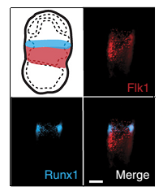
Understand Blood development (hemato-poeisis) with the help of Boolean Networks
Blood development represents one of the earliest stages of organogenesis. The production of primitive erythrocytes is required to support the growing embryo.
Blood has long served as a model to study organ development owing to the accessibility of blood cells and the availability of markers for specific cell populations.
Blood development is initiated at gastrulation from multipotent Flk1⁺ mesodermal cells
(Flk1⁺ is a marker gene for this developmental stage.)
These cells initially have the potential to form either
blood, endothelium and smooth muscle cells.
Flk1 and Runx1 staining in E7.5 mesoderm and blood band, respectively
Moignard et al.,
Nature Biotech.
33, 269 (2015)
31

Slide 32
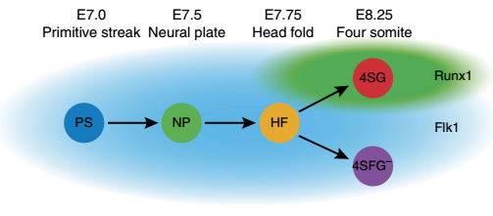
Early stages of hematopoesis
The first wave of primitive hematopoiesis originates from Flk1⁺ mesoderm,
with all hematopoietic potential in the mouse contained within
the Flk1⁺ population from E7.0 onwards.
In this study, cells were flow sorted into single Flk1⁺ cells at E7.0 (primitive streak, PS), E7.5 (neural plate, NP) and E7.75 (head fold, HF) stages.
E8.25 cells were subdivided into putative blood and endothelial populations by isolating GFP⁺ cells (four somite, 4SG) and Flk1⁺GFP⁻ cells (4SFG−), respectively
Moignard et al., Nature Biotech. 33, 269 (2015)
32

Slide 33
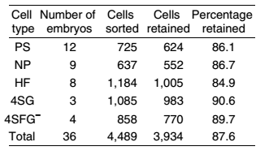
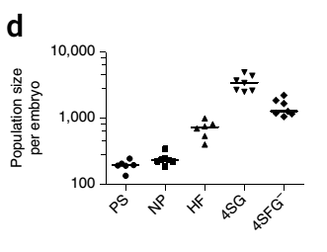
Studied cells
Cells were sorted from multiple embryos at each time point, with 3,934 cells going on to subsequent analysis.
Total cell numbers and numbers of cells of different stages present in each embryo were estimated from fluorescence-activated cell sorting (FACS) data.
Number of cells grows as embryonic development progresses.
Moignard et al.,
Nature Biotech.
33, 269 (2015)
33

Slide 34
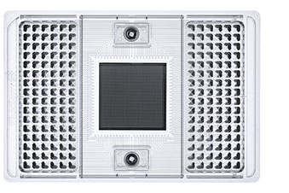
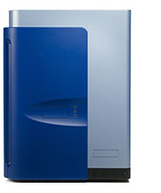
Assay gene expression in single cells
Gene expression in single cells assayed with PCR for:
- 33 transcription factors known to be involved in endothelial and hematopoietic development
9 marker genes (needed for FACS-sorting)
4 house-keeping genes (needed for quality checks and normalization)
Discard cells that did not express all
4 house-keeping genes, or for which their expression was more than 3 standard deviations from the mean.
www.fluidigm.com
Moignard et al.,
Nature Biotech.
33, 269 (2015)
34

Slide 35
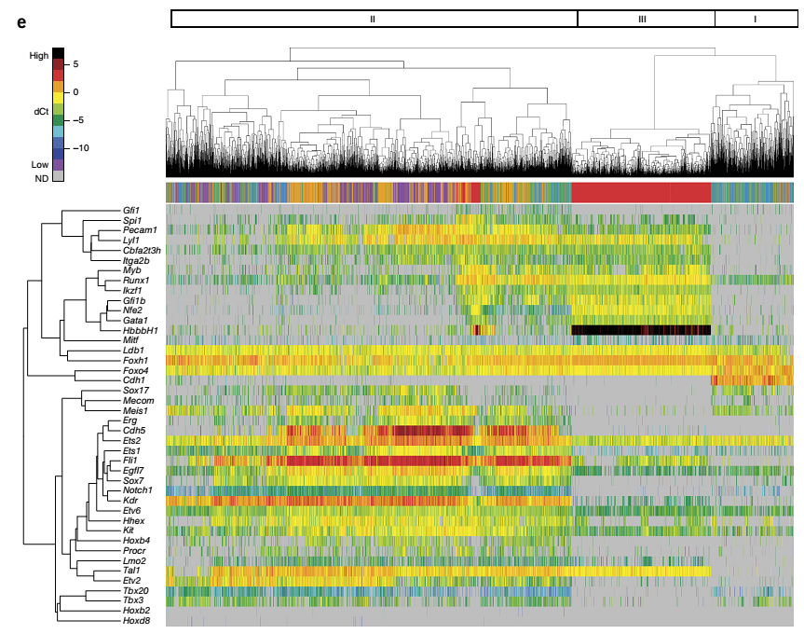
Hierarchical clustering of gene expression data
3 main clusters:
Cluster I (right side) contains mostly PS and NP cells (green/blue)
Cluster III contains exclusively 4SG cells (red)
Cluster II (left side) is mixed (NF, 4SFG⁻ , …)
Cell differentiation
progresses
asynchronously
Color code
Moignard et al.,
Nature Biotech.
33, 269 (2015)
← Single cells →
35

Slide 36
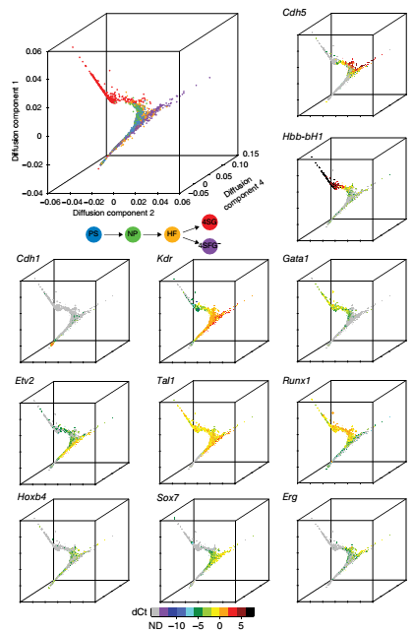


Dimensionality reduction: diffusion maps
Similarity of expression in cells i and j :
P(i,j) is normalized so that
The cells are organized in 2D or 3D such that the Euclidean distance between the cells corresponds to the diffusion metric P(i,j) .
The quantity P(i,j) can then be interpreted as the transition probability of a diffusion process between cells.
Axes: eigenvectors of matrix P with largest eigenvalues.
Moignard et al.,
Nature Biotech.
33, 269 (2015)
36

Slide 37
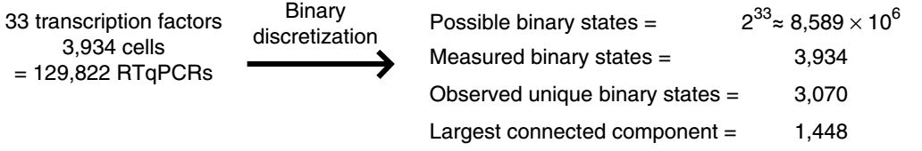
Who regulates hematopoiesis?
Design Boolean Network
Determine suitable expression thresholds for each gene to categorize its expression levels into binary on / off states.
Note that less than 0.1% of the possible states have been observed.
Moignard et al.,
Nature Biotech.
33, 269 (2015)
37

Slide 38
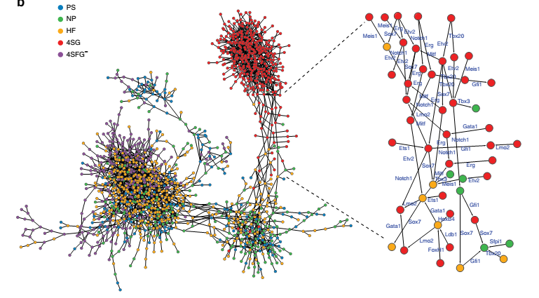
State graph of largest connected comp.
Moignard et al.,
Nature Biotech.
33, 269 (2015)
State graph (largest connected component) of 1448 states reaching all 5 stages.
Add edges to connect all those pairs of states that differ in the on/off levels of a single gene (and are identical otherwise), see right side with labeled edges.
Idea behind this: these transitions can be best interpreted.
38

Slide 39
Automatic derivation of rules for Boolean Network
We are given:
a set of variables V, corresponding to genes,
- an undirected graph G = (N,E)
where each node n ∈ N is labeled with a state s:V→{0,1}, and
each edge {s₁,s₂} ∈ E is labeled with the single variable
that changes between state s₁ and s₂.
We are also given a designated set I ⊆ N of initial vertices
and a designated set F ⊆ N of final vertices,
along with a threshold t_{i} for each variable v_{i} ∈ V.
Moignard et al.,
Nature Biotech.
33, 269 (2015)
39

Slide 40
Optimality criteria for rules
The rule synthesis method searches for an orientation of G, along with an update function u_{i}:{0,1}^{n}→{0,1} for each variable v_{i}∈V, such that the following conditions hold:
1. For each edge (s₁,s₂) labeled with variable v_{i} in the orientated graph,
the update function for v_{i} takes state s₁ to state s₂: u_{i}(s₁) = s₂(i).
2. The number of states is maximized in which no transitions induced by the update functions are missing.
3. Every final vertex f ∈ F is reachable from some initial vertex i ∈ I by a
directed path in the orientated graph.
Moignard et al.,
Nature Biotech.
33, 269 (2015)
40

Slide 41
Allowed complexity of the rules
The update function u_{i} is restricted to have the form:
f ₁ ∧ ¬f₂
where f_{j} is a Boolean formula that has
and-nodes of in-degree two,
or-nodes of arbitrary in-degree, and
where f₁ has a maximum depth of N_{i} and f₂ has a maximum depth of M_{i}.
N_{i} and M_{i} are given as parameters to the method.
The search for edge orientations and associated Boolean update rules is
encoded as a Boolean satisfiability (SAT) problem.
Moignard et al.,
Nature Biotech.
33, 269 (2015)
41

Slide 42
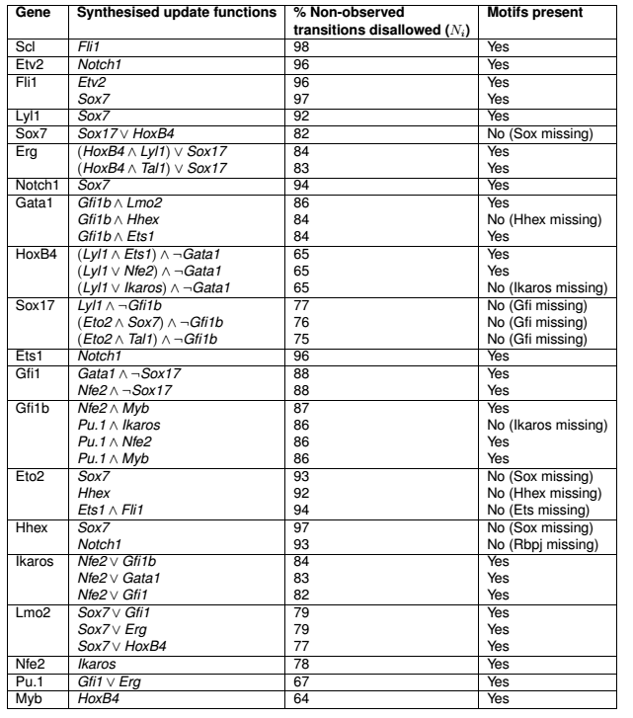
Generated rules for Boolean Network
Additional validity check of the postulated rules:
check whether regulated genes contain TF-binding motifs in their promoters
(right column).
This is the case for 70% of the rules.
Moignard et al.,
Nature Biotech.
33, 269 (2015)
42

Slide 43
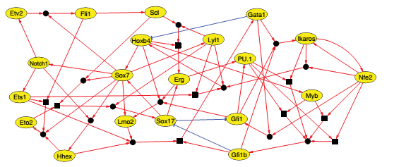
Core network controlling hematopoiesis
Derived core network of 20 TFs.
Red edges: activation
Blue edges: repression
Moignard et al.,
Nature Biotech.
33, 269 (2015)
43

Slide 44
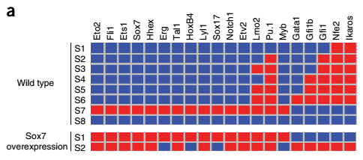
Predict effects of perturbations as validation
Simulate overexpression and knockout experiments for each TF.
Assess ability of the network to reach wildtype or new stable states.
Red : gene expressed;
blue : gene not expressed.
S2-S6: blood-like
S7: endothelial-like
S8 : no activity
Network stable states for wt and Sox7 overexpression.
Enforced expression of Sox7 (that is normally downregulated) stabilized the endothelial module and an inability to reach any of the blood-like states.
Sox7 is predicted to regulate more targets than any other TF,
suggesting that perturbing its expression could have
important downstream consequences.
Moignard et al.,
Nature Biotech.
33, 269 (2015)
44

Slide 45
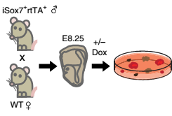
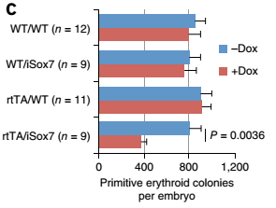
Control experiments
Moignard et al.,
Nature Biotech.
33, 269 (2015)
(b) Colony assays with or without doxycycline from genotyped E8.25 embryos from iSox7⁺rtTA⁺ mice crossed with wild types.
(c) Quantification of primitive erythroid colonies after 4 days.
Embryos carrying both transgenes (rtTA/iSox7) showed a 50% reduction of primitive erythroid colony formation following doxycycline-induced Sox7 expression compared to controls.
This suggests, in agreement with modeling data and gene expression patterns, that downregulation of Sox7 is important for
the specification of primitive erythroid cells.
In iSox7-mouse, overexpression of Sox7 is stimulated by inducing the Sox7-promoter by addition of the chemical doxycycline (+Dox).
45

Slide 46
Conclusions
Cells destined to become blood and endothelium arise at all stages of the analyzed time course rather than in a synchronized fashion at one precise time point. This is consistent with the gradual nature of gastrulation.
Using an automated Boolean Network synthesis toolkit, a core network of 20 highly connected TFs was identified which could reach 8 stable states
representing blood and endothelium.
The model predictions could be validated by demonstrating e.g. that Sox7 blocks primitive erythroid development.
→ Boolean Networks can be predictive and may guide experiments.
Moignard et al.,
Nature Biotech.
33, 269 (2015)
46

