Slide 1
V22
Dynamic Modelling: Rate Equations + Stochastic Propagation

Slide 2


Mass Action Kinetics
Most simple dynamic system: inorganic chemistry
Consider reaction
A + B <=> AB
<=>
Interesting quantities:
(changes of) densities of A, B, and AB
number of particles
unit volume
density =
1 mol = 1 Mol / Liter = 6.022 x 10²³ x (0.1 m)^{–3} = 0.6 nm^{–3}
This means that proteins cannot reach 1 mol concentrations. Why?
Association: probability that A finds and reacts with B
=> changes proportional to densities of A and of B
How to put this into formulas?
Dissociation: probability for AB to break up
=> changes proportional to density of AB
Notes:
[A] = \frac{N_A}{V}, \quad \frac{d}{dt}[A](t)

Slide 3



Mass Action II
Again:
A + B <=> AB
Objective:
mathematical description for the changes of [A], [B], and [AB]
Consider [A]:
Gain due to dissociation AB => A + B
Loss due to association A + B => AB
AB falls apart
=> GA depends only on [AB]
A has to find B
=> LA depends on [A] and [B]
phenomenological proportionality constant
Notes:
\frac{d}{dt}[A] = G_A - L_A
L_A = k_f \,[A]\,[B]
G_A = k_r \, [AB]
\frac{d}{dt}[A] \,=\, k_r \, [AB] \;-\; k_f \,[A]\,[B]

Slide 4


Mass Action !!!
A + B <=> AB
For [A]:
we just found:
For [B]:
for symmetry reasons
For [AB]:
exchange gain and loss
with [A](t0), [B](t0), and [AB](t0) => complete description of the system
time course = initial conditions + dynamics
Notes:
\frac{d}{dt}[A] = G_A - L_A
L_A = k_f \,[A]\,[B]
G_A = k_r \, [AB]
\frac{d}{dt}[A] \,=\, k_r \, [AB] \;-\; k_f \,[A]\,[B]
\frac{d}{dt}[B] = \frac{d}{dt}[A]
\frac{d}{dt}[AB] = -\frac{d}{dt}[A] = k_f \,[A]\,[B]\;-\; k_r \, [AB]

Slide 5




A Second Example
Slightly more complex:
A + 2B <=> AB2
Association:
• one A and two B have to come together
• forming one complex AB2 requires two units of B
Dissociation:
one AB2 decays into one A and two B
Put everything together
Notes:
L_A \;=\; k_f\;[A]\,[B]\,[B] \;=\; k_f \;[A]\,[B]^2
L_B \;=\; 2k_f \;[A]\,[B]^2
G_A \;=\; k_r\, [AB_2]
G_B \;=\; 2k_r\, [AB_2]

Slide 6
Some Rules of Thumb
A + 2B <=> AB2
"A is produced when AB2 falls apart or
is consumed when AB2 is built from one A and two B"
Sign matters: Gains with "+", losses with "–"
Logical conditions: "…from A and B"
“and” corresponds to "×" “or” corresponds to "+"
Stoichiometries:
one factor for each educt (=> [B]²)
prefactors survive
Mass conservation:
terms with "–" have to show up with "+", too
Notes:
\frac{d}{dt}[A] = k_r\,[AB_2]\;-\; k_f\,[A]\,[B]^2
\frac{d}{dt}[B] = 2\frac{d}{dt}[A]
\frac{d}{dt}[AB_2] = -\frac{d}{dt}[A]

Slide 7




A Worked Example
Lotka-Volterra population model
R1:
A + X => 2X
prey X lives on A
R2:
X + Y => 2Y
predator Y lives on prey X
R3:
Y => B
predator Y dies
stoichiometric matrix S
Rates for the reactions
Changes of the metabolites
 | R1 | R2 | R3
A | –1
X | 1 | –1
Y |  | 1 | –1
B |  |  | 1
=> change of X:
Notes:
\frac{dR_1}{dt} = k_1\;A\;X
\frac{dR_2}{dt} = k_2\;X\;Y
\frac{dR_3}{dt} = k_3\;Y
\frac{dX}{dt} = 1 \times \frac{dR_1}{dt} \;+(-1) \times \frac{dR_2}{dt} \; + 0 \times \frac{dR_3}{dt}

Slide 8
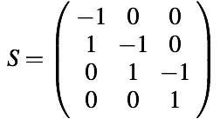
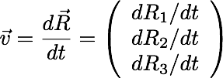
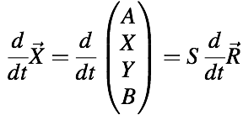





Setting up the Equations
With
and
we get:
or
amounts processed per reaction
speeds of the reactions
Plug in to get:
Notes:
\frac{d\vec{R}}{dt} = \left( \begin{array}{c} dR_1/dt\\ dR_2/dt \\ dR_3/dt \end{array} \right)
S = \left( \begin{array}{ccc} \;-1\;&0&0\\ 1&\;-1\;&0\\ 0&1&\;-1\;\\ 0&0&1 \end{array} \right)
\frac{d}{dt}\vec{X} = \frac{d}{dt}\left( \begin{array}{c} A \\X \\ Y \\ B \end{array} \right) = S\;\frac{d}{dt}\vec{R}
\frac{dX_i}{dt} = \sum_j\;S_{ij}\;\frac{dR_j}{dt}
\frac{dA}{dt} = -\frac{dR_1}{dt} = -k_1\;A\;X
\frac{dX}{dt} = +\frac{dR_1}{dt} - \frac{dR_2}{dt} = -k_1\;A\;X\; + \; k_2\;X\;Y
\frac{dY}{dt} = +\frac{dR_2}{dt} - \frac{dR_3}{dt} = -k_2\;X\;Y\; - \; k_3\;Y
\frac{dB}{dt} = +\frac{dR_3}{dt} = k_3\;Y

Slide 9





How Does It Look Like?
Lotka–Volterra: assume A = const, B ignored
=> cyclic population changes
X
Y
X, Y
k1 = k2 = k3 = 0.3
time
Steady State: when the populations do not change anymore
Steady state = fluxes balanced
=>
With k1 = k2 = k3 = 0.3 and A = 1
=> X = Y = 1
Notes:
\frac{dX}{dt} = -k_1\;A\;X\; + \; k_2\;X\;Y
\frac{dY}{dt} = -k_2\;X\;Y\; - \; k_3\;Y
\frac{dX}{dt} = \frac{dY}{dt} = 0
Y = \frac{k_1}{k_2}\;A
X = \frac{k_3}{k_2}

Slide 10


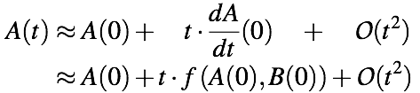
From rates to differences
Reaction:
Rate equation:
derivative of A(t) = some function
Taylor expansion for
displacement t around t₀ = 0:
Truncate this expansion after second term (linear approximation):
Notes:
A + B \Longrightarrow AB
\frac{dA}{dt} = -k\cdot A\cdot B = f\left( A(t), B(t)\right)
A(t) = A(0) + t\cdot \frac{dA}{dt}(0) + \frac{t^2}{2}\cdot \frac{d^2A}{dt^2}(0) + \dots =
\sum_{k=0} \frac{t^k}{k!}\cdot \frac{d^kA}{dt^k}(0)
A(t) &\;\approx\;& A(0) + \quad t\cdot \frac{dA}{dt}(0) \quad + \quad \mathcal{O}(t^2) \\
&\;\approx\;& A(0) + t\cdot f\left( A(0), B(0)\right) + \mathcal{O}(t^2)

Slide 11


From rates to differences II
Linear approximation to (true) A(t):
initial condition
increment
error
For :
Use linear approximation for small time step Δt:
This is the so-called
"forward Euler" algorithm
Notes:
AB(t) &\;\approx\;& AB(0) \; +\; t\cdot f\left( A(0), B(0)\right) \\
&\;\approx\;& AB(0) \; -\; t\cdot k\; A(0) \; B(0) \quad +\; \mathcal{O}(t^2)
t \to 0
t\cdot \frac{dA}{dt}(0) \;\;\gg\;\; \frac{t^2}{2}\cdot \frac{d^2A}{dt^2}(0) \;\;\gg\;\; \dots
A(t+\Delta t) \; =\; A(t) \; + \; \Delta t\cdot \frac{dA}{dt}(t)

Slide 12

“Forward Euler” algorithm
General form:
relative error:
1st order algorithm
relative error decreases with 1st power of step size Δt
Black: ideal dynamic trajectory, red: dynamics integrated by forward Euler algorithm
Right side: integration time steps are half of left side -> smaller error
Notes:
\vec{X}_i(t+\Delta t) \; =\; \vec{X}_i(t) \; + \; \Delta t\cdot \vec{f}(\vec{X}_j(t)) \; + \; \mathcal{O}(\Delta t^2)
\epsilon \;= \; \frac{\Delta t^2/2\cdot X''}{\Delta t\;X'} \;\propto\; \Delta t

Slide 13
Example: chained reactions
Reaction:
Time evolution:
Relative error vs. Δt
at t = 10:
Δt = 1
A
A, B
C
B
relative error
concentrations
C
Δt = 10
A
B
C
time step Δt
runtime α (Δt)^{–1}
time
Notes:
A \;\Longrightarrow\; B \;\Longrightarrow\; C
k_{AB} = 0.1,\quad k_{BC}=0.07
\Delta t^{1.1}

Slide 14
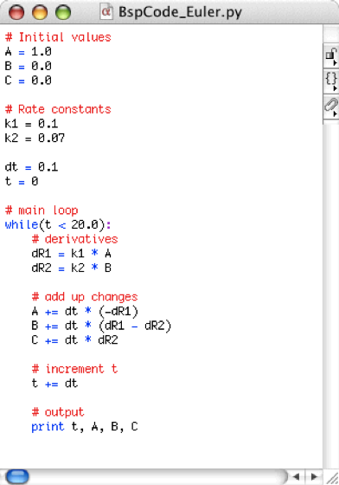

Example Code: Forward Euler
A => B => C
Iterate:
Important:
first calculate all derivatives,
then update densities!
Notes:
A(t+\Delta t) \; =\; A(t) \; + \; \Delta t\cdot \frac{dA}{dt}(t)

Slide 15


What is the “correct” time step?
Δt = 1
A
Approximation works for:
C
B
concentrations
Δt = 10
A
B
=>
C
Here:
time
=>
Note 1:
read “«” as “a few percent”
Notes:
|\Delta A| \; =\; \left| \Delta t\;\frac{dA}{dt}\right| = \left| -k_{AB}\cdot A\cdot \Delta t\right| \; \ll \; A
\Delta t \; \ll \; \frac{1}{\max(k)}
\Delta t \;\ll\; 0.1^{-1} = 10
A + B \Longrightarrow AB \Delta t \;\ll\; (\max(kA, kB))^{-1}

Slide 16
From Test Tubes to Cells
Rate equations <=> description via densities
indistinguishable particles
volume element
density =
=> density is a continuum measure,
independent of the volume element
"half of the volume => half of the particles"
When density gets very low
=> each particle matters
Examples:
~10 Lac repressors per cell, chemotaxis,
transcription from a single gene, …

Slide 17
Density Fluctuations
N = 10
N = 100
N = 1000
N = 10000

Slide 18





Spread: Poisson Distribution
Stochastic probability that k events occur follows the Poisson distribution
(here: event = "a particle is present"):
k = 0, 1, 2, …
λ > 0 is a parameter
Average:
Variance:
Relative spread (error):
Avg. number of particles per unit volume
100
1000
1 Mol
relative uncertainty
10%
3%
1e-12
=> Fluctuations are negligible for "chemical" test tube situations
Notes:
p_k = \frac{\lambda^k}{k!}\,\mbox{e}^{-\lambda}
\langle k \rangle = \sum \; k\; p_k = \lambda
\sigma^2 = \sum \; p_k\; (k - \langle k \rangle)^2 = \lambda
\sigma = \sqrt{\lambda}
\langle k \rangle \pm \sigma \quad = \quad \lambda \pm \sqrt{\lambda}
\frac{\Delta k}{k} \;=\; \frac{\sigma}{\langle k \rangle} \;=\; \frac{1}{\sqrt{\lambda}}

Slide 19
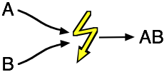

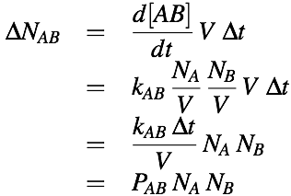
Reactions in the Particle View
Consider association:
A + B => AB
Continuous rate equation:
Number of new AB in volume V during Δt:
Density “picture” Particle “picture”
reaction rate kAB => reaction probability PAB
Notes:
\frac{d[AB]}{dt} \;=\; k\,[A]\,[B]
\Delta N_{AB} &\quad = \quad& \frac{d[AB]}{dt} \;V \;\Delta t\\
&=& k_{AB} \; \frac{N_A}{V}\; \frac{N_B}{V}\; V\; \Delta t \\
&=& \frac{k_{AB}\; \Delta t}{V}\; N_A\; N_B\\
&=& P_{AB} \; N_A\; N_B

Slide 20





Units!
Consider:
A + B => AB
Change in the number of AB:
Association probability:
Units:
Continuous case
<=>
Stochastic case
<=>
Notes:
\Delta N_{AB} \;=\; P_{AB} \; N_A\; N_B
P_{AB} \;=\;\frac{k_{AB}\; \Delta t}{V}
\frac{dAB}{dt} \;=\; k_{AB}\;A\;B
\left[ \frac{dAB}{dt} \right] = \frac{\mbox{Mol}}{l\,s}
[A]\;=\;[B] \;=\;\frac{\mbox{Mol}}{l}
[k_{AB}]\;=\; \frac{l}{\mbox{Mol}\;s}
[N_{AB}]\;=\; [N_A]\;=\; [N_B]\;=\; 1
[P_{AB}]\;=\;1

Slide 21
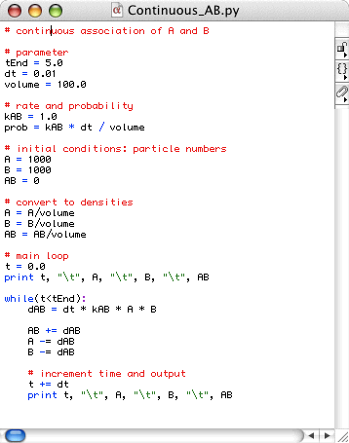
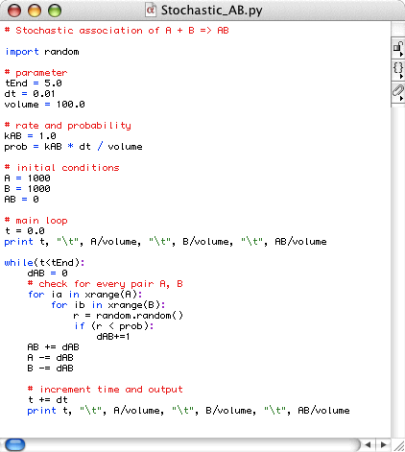
Direct Implementation
A + B => AB
Note: both versions are didactic implementations

Slide 22



Example: Chained Reactions
A => B => C
Rates:
Time course from continuous rate equations (benchmark):
NA, NB, NC [NA0]
k1 = k2 = 0.3 (units?)
Notes:
\frac{dA}{dt} = -k_1\,A
\frac{dB}{dt} = k_1\,A - k_2\,B
\frac{dC}{dt} = k_2\,B

Slide 23
Stochastic Implementation
A => B => C
A0 = 1000 particles initially
t = 7
A
A
C
B
C
A, B, C / A0
B
frequency
k1 = k2 = 0.3
Values at t = 7 (1000 runs)
=> Stochastic version exhibits fluctuations

Slide 24
Less Particles => Larger Fluctuations
A0 = 100 shown are 4 different runs
A, B, C / A0
A, B, C / A0
A, B, C / A0
A, B, C / A0

Slide 25
Even Less Particles
A0 = 30
A, B, C / A0
A, B, C / A0
A, B, C / A0
A, B, C / A0

Slide 26


Spread vs. Particle Number
Poisson:
relative fluctuations
A
B
A0 = 1000
Repeat calculation 1000 times
and record values at t = 7.
A
A0 = 100
Fit distributions with Gaussian
(Normal distribution)
B
C
frequencies
A
B
A0 = 30
C
<A> = 0.13, wA = 0.45
<B> = 0.26, wB = 0.55
<C> = 0.61, wC = 0.45
Notes:
\propto 1/\sqrt{N}
g(x) = \exp \left[ -\frac{(x-<x>)^2}{w/\sqrt{A_0}} \right]

Slide 27
Stochastic Propagation
Naive implementation:
Features of this implementation
For every timestep:
  events = 0
  For every possible pair of A, B:
    get random number r ∈ [0, 1)
    if r ≤ PAB:
      events++
  AB += events
  A, B –= events
+ very simple
+ direct implementation of the
underlying process
– costly runtime O(N²)
– first order approximation
– one trajectory at a time
=> how to do better???
Determine complete
probability distribution
=> Master equation
More efficient propagation
=> Gillespie algorithm

Slide 28
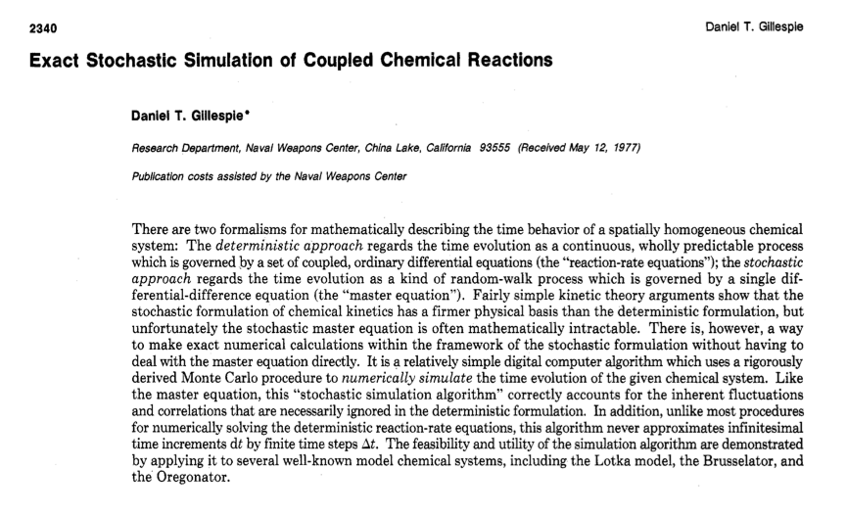
A Fast Algorithm
D. Gillespie, J. Phys. Chem. 81 (1977) 2340–2361

Slide 29
Gillespie – Step 0
Consider decay reaction:
A => Ø (this model describes e.g. the radioactive decay)
Probability for one reaction in (t, t+Δt) with A(t) molecules = A(t) k Δt
Naive Algorithm:
A = A0
For every timestep:
  get random number r ε [0, 1)
  if r ≤ A*k*dt:
    A = A-1
It works, but:
A*k*dt << 1 for reasons of (good) accuracy
=> many many steps where nothings happens
=> Use adaptive stepsize method?

Slide 30
Gillespie – Step 1
Idea: Figure out when the next reaction will take place!
(In between the discrete events nothing happens anyway … :-)
Suppose there are A(t) molecules in the system at time t
f(A(t), s) = probability that with A(t) molecules the next reaction takes place in
interval (t+s, t+s+ds) with ds => 0
g(A(t), s) = probability that with A(t) molecules no reaction occurs in (t, t+s)
Then:
No reaction during (t, t+s):
probability for reaction in (t+s, t+s+ds)
Notes:
f(A(t), s)\,ds \;=\; g(A(t), s)\; A(t+s)\,k\,ds
f(A(t), s)\,ds \;=\; g(A(t), s)\; \underbrace{A(t)\,k\,ds}

Slide 31

Probability for (No Reaction)
Now we need g(A(t), s)
Extend g(A(t), s) a bit:
Replace again A(t+s) by A(t) and rearrange:
With g(A, 0) = 1 ("no reaction during no time")
=> Distribution of waiting times between discrete reaction events:
Life time = average waiting time:
Notes:
g(A(t), s+ds) \;=\; g(A(t), s) \;[1 - A(t+s)\,k\,ds]
\lim_{ds\to 0}\, \frac{g(A(t), s+ds) - g(A(t), s)}{ds} \;=\; \frac{g(A(t), s)}{ds} \;=\; -A(t)\,k\,g(A(t), s)
g(A(t), s) \;= \; \exp[-A(t)\,k\,s]
s_0 \;=\; \frac{1}{k\,A(t)}

Slide 32

Exponentially Distributed Random Numbers
Exponential probability distribution:
r ε [0,1]
Solve
for s:
life time
Simple Gillespie algorithm for the decay reaction A => Ø :
A = A0
While(A > 0):
  get random number r ε [0, 1)
  t = t + s(r)
  A = A - 1
Notes:
r \;= \; \exp[-A(t)\,k\,s]
s \;=\; \frac{1}{k\,A(t)}\,\ln\left[\frac{1}{r}\right] \;=\; \frac{1}{\alpha_0}\,\ln\left[\frac{1}{r}\right]

Slide 33
Gillespie vs. Naive Algorithm
Naive:
Gillespie:
"What is the probability that an event will occur during the next Δt?"
"How long will it take until the next event?"
=> small fixed timesteps
=> variable timesteps
=> 1st order approximation
=> exact
• Gillespie
• naive
- analytic
• Gillespie
• naive
- analytic
NA
NA
t
t

Slide 34


Gillespie – Complete
For an arbitrary number of reactions (events):
(i) determine probabilities for the individual reactions: αi i = 1, …, N
total probability α0 = Σ αi
(ii) get time s until next event in any of the reactions:
(iii) Choose the next reaction j from:
(iv) update time and particle numbers
Notes:
s \;=\; \frac{1}{\alpha_0}\,\ln\left[\frac{1}{r_1}\right]
\sum_{i=1}^{j-1} \alpha_i \;\leq\; \alpha_0\,r_2\; < \sum_{i=1}^j \alpha_i

Slide 35

An Example with Two Species
Reactions:
k1
k2
k3
k4
A + A => Ø
A + B => Ø
Ø => A
Ø => B
Continuous rate equations:
Stationary state:
with
k1 = 10^{–3} s^{–1}
k2 = 10^{–2} s^{–1}
k3 = 1.2 s^{–1}
k4 = 1 s^{–1}
=> Ass = 10,
Bss = 10
Notes:
\frac{dA}{dt} \;= \; k_3 \;-\; 2\,A^2\,k_1 \; - \; A\,B\,k_2
\frac{dB}{dt} \;= \; k_4 \; - \; A\,B\,k_2
A_{ss} \;=\; \sqrt{\frac{\;k_3 - k_4\;}{2 k_1}}
B_{ss} \;=\; \frac{k_4}{k_2 \,A}

Slide 36
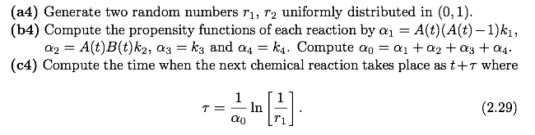
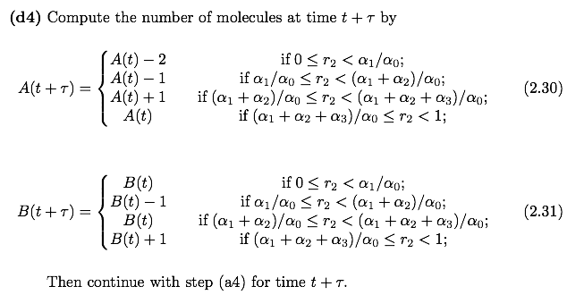
Gillespie Algorithm
Erban, Chapman, Maini, arXiv:0704.1908v2 [q-bio.SC]

Slide 37
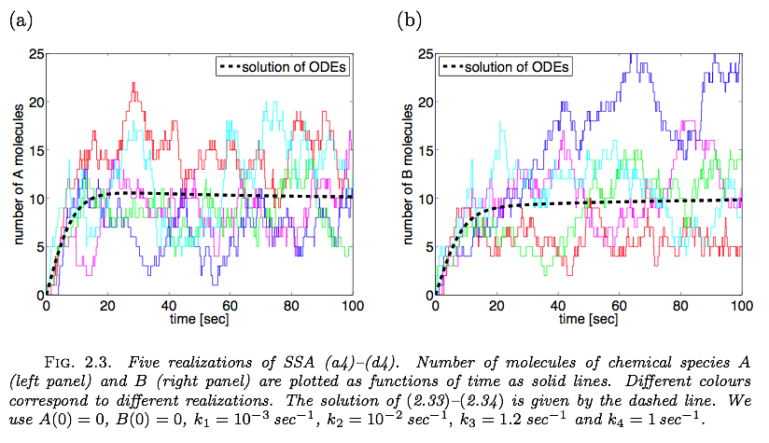
Stochastic Simulation
k1
k2
k3
k4
A + A => Ø
A + B => Ø
Ø => A
Ø => B
Erban, Chapman, Maini, arXiv:0704.1908v2 [q-bio.SC]

Slide 38
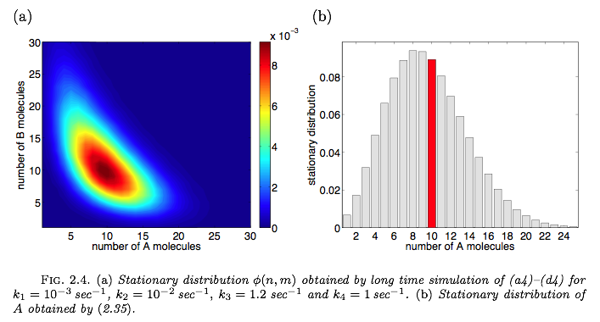
Distribution of Stationary States
k1
k2
k3
k4
A + A => Ø
A + B => Ø
Ø => A
Ø => B
k1 = 10^{–3} s^{–1}
k2 = 10^{–2} s^{–1}
k3 = 1.2 s^{–1}
k4 = 1 s^{–1}
Continuous model:
Ass = 10, Bss = 10
From long–time Gillespie runs:
<A> = 9.6, <B> = 12.2
<=>
Erban, Chapman, Maini, arXiv:0704.1908v2

Slide 39
Stochastic vs. Continuous
For many simple systems:
stochastic solution looks like noisy deterministic solution
Yet in some cases, stochastic description gives qualitatively different results
• swapping between two stationary states
• noise-induced oscillations
• Lotka-Volterra with small populations
• sensitivity in signalling

Slide 40



Two Stationary States
Reactions:
F. Schlögl, Z. Physik 253 (1972) 147–162
Rate equation:
With:
k1 = 0.18 min^{–1}
k2 = 2.5 x 10^{–4} min^{–1}
k3 = 2200 min^{–1}
k4 = 37.5 min^{–1}
Stationary states:
As1 = 100, As2 = 400 (stable)
Au = 220 (unstable)
=> Depending on initial conditions (A(0) <> 220),
the deterministic system goes into As1 or As2 (and stays there).
Notes:
\frac{dA}{dt} \;=\; k_1\,A^2 \;-\; k_2\,A^3 \;+\; k_3 \;-\; k_4\,A

Slide 41
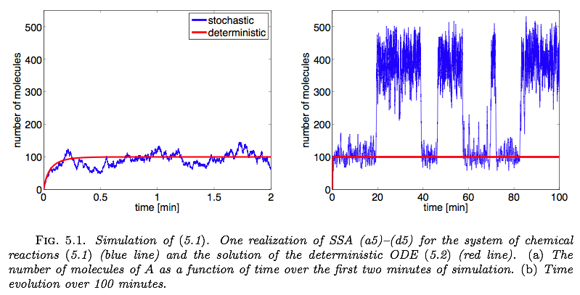
Two States – Stochastic
Erban, Chapman, Maini, arXiv:0704.1908v2
=> Fluctuations can drive the system from one stable state into another

Slide 42
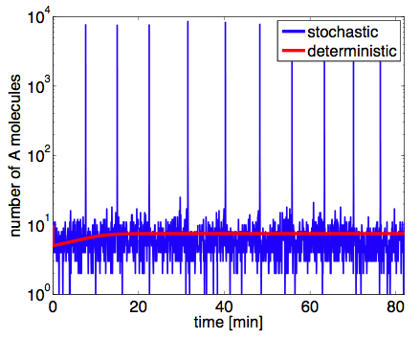
Self-Induced Stochastic Resonance
System
k1
k2
k4
2A + B => 3A
Ø <=> A
Ø => B
k3
Compare the time evolution from initial state (A, B) = (10, 10)
in deterministic and stochastic simulations.
=> deterministic simulation converges to and stays at fixed point (A, B) = (10, 1.1e4)
=> periodic oscillations in the stochastic model

Slide 43
Stochastic dynamics of PP complex assembly
Stochastic simulations,
4096 compartments on 2D lattice,
association rates set to 100,
dissociation rates set to 1
CUDA implementation of Gillespie algorithm

Slide 44
Gillespie-type simulation of PP complex assembly

Slide 45
Summary
• Mass action kinetics
=> solving (integrating) differential equations for time-dependent behavior
=> Forward-Euler: extrapolation, time steps
• Stochastic Description
=> why stochastic?
=> Gillespie algorithm
=> different dynamic behavior

