Slide 1
V26 Regular vs. alternative splicing
Regular splicing
mechanistic steps
recognition of splice sites
Alternative splicing
different mechanisms
how frequent is alternative splicing?
Effect of alternative splicing on protein – protein interactions
Interplay of alternative splicing and epigenetic modifications

Slide 2
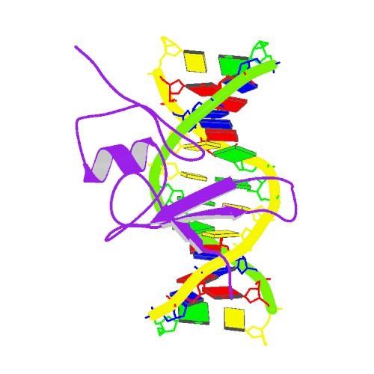
Our contact with splicing:
MBD2 recognizes methylated cytosines
Ohki et al. (2001) Cell 105: 487-497

Slide 3
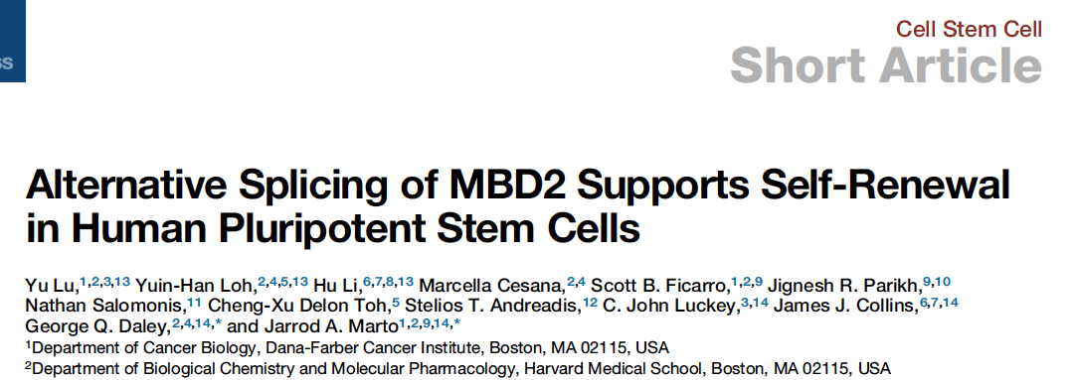
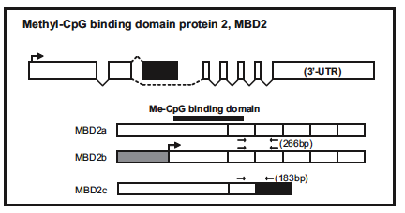
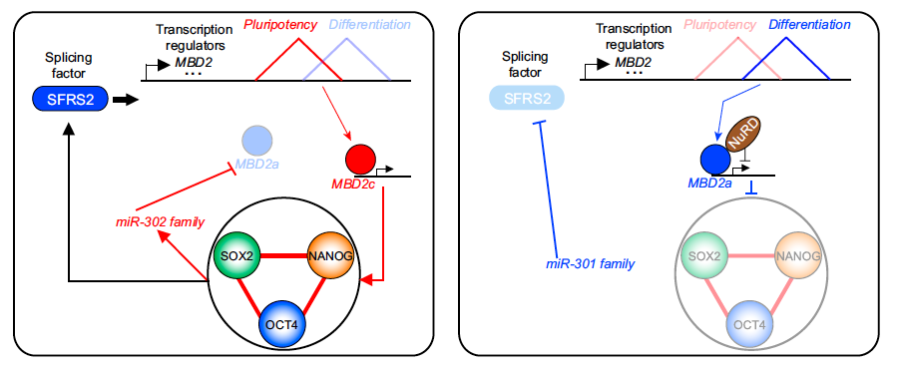
MBD2 is alternatively spliced and then plays a role for maintenance of pluripotency

Slide 4
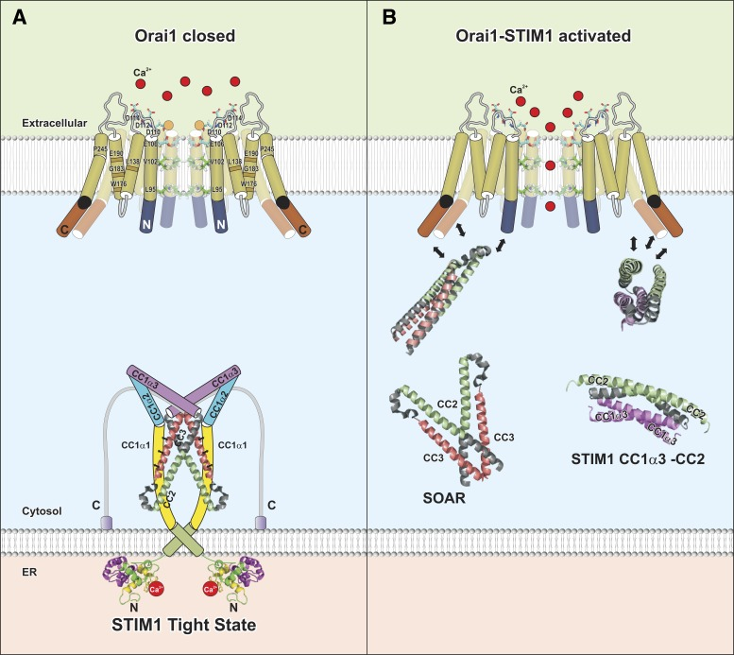
STIM: Orai channels
STIM proteins regulate store-operated calcium entry (SOCE) by sensing Ca²⁺ concentration in the ER and forming oligomers to trigger Ca²⁺ entry through plasma membrane-localized Orai1 channels.
Derler et al. Am J Physiol Cell Physiol.
(2016) 310: C643–C662.

Slide 5
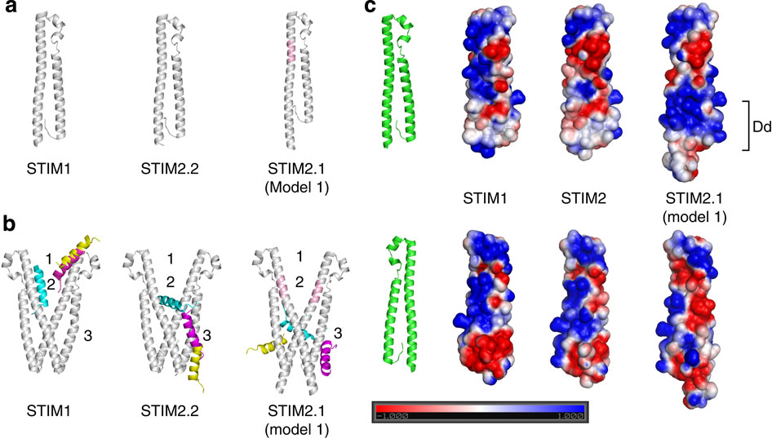
Alternative splicing may affect
PP interactions: STIM2 splice variant
Niemeyer and co-workers characterized a STIM2 splice variant which retains an additional 8-amino acid exon in the region encoding the channel-activating domain.
STIM2.1 knockdown increases SOCE in naive CD4⁺ T cells, whereas knockdown of STIM2.2 decreases SOCE.
Overexpression of STIM2.1, but not STIM2.2, decreases SOCE.
STIM2.1 interaction with Orai1 is impaired and prevents Orai1 activation.
Miederer, ..., Lee, ..., Helms, Barbara Niemeyer, Nature Commun 6, 6899 (2015)

Slide 6
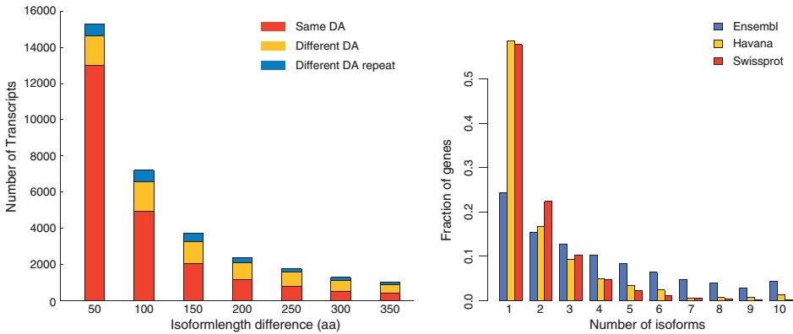
Effect of AS on protein domain architecture
(left) fraction of proteins where the domain architecture (DA) is altered as a result of splicing (based on Swissprot transcripts)
(right) number of isoforms for 3 databases; Ensembl, Vega/ Havana and Swissprot.
Light & Elofsson Curr Opin Struct Biol
(2013) 23: 451-458

Slide 7
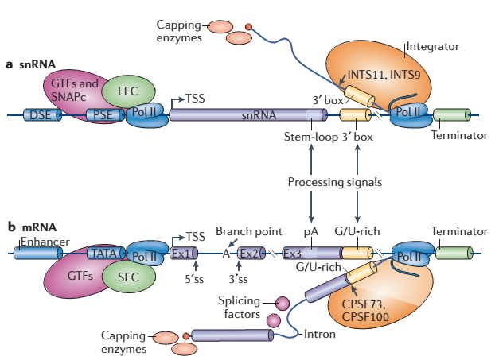
Transcription + processing of snRNAs and mRNAs
small nuclear RNA (snRNA) genes are part of the spliceosome.
Shown are cis-acting elements and trans-acting factors involved in the expression of snRNA genes.
DSE: distal sequence element, and
PSE: proximal sequence element
TSS, transcription start site.
snRNA promoters recruit the little elongation complex (LEC).
Initiation of snRNA transcription requires general transcription factors (GTFs), as well as the snRNA-activating protein complex (SNAPc).
Matera & Wang, Nature Rev Mol Cell Biol
15, 108–121 (2014)

Slide 8
Transcription + processing of snRNAs and mRNAs
Shown in (b) are cis-acting elements and trans-acting factors involved in the expression of protein-coding mRNA genes.
DSE and PSE of snRNAs are roughly equivalent to the enhancer and TATA box elements, respectively, of mRNA genes.
Ex, exon
pA, polyA signal
ss, splice site.
While snRNA promoters recruit the LEC, mRNA promoters recruit the super elongation complex (SEC).
Integrator subunit 11 (INTS11) and INTS9 have sequence similarities to the mRNA 3ʹ-processing factors cleavage and polyadenylation specificity factor 73 kDa subunit (CPSF73) and CPSF100, respectively.
Matera & Wang, Nature Rev Mol Cell Biol
15, 108–121 (2014)

Slide 9
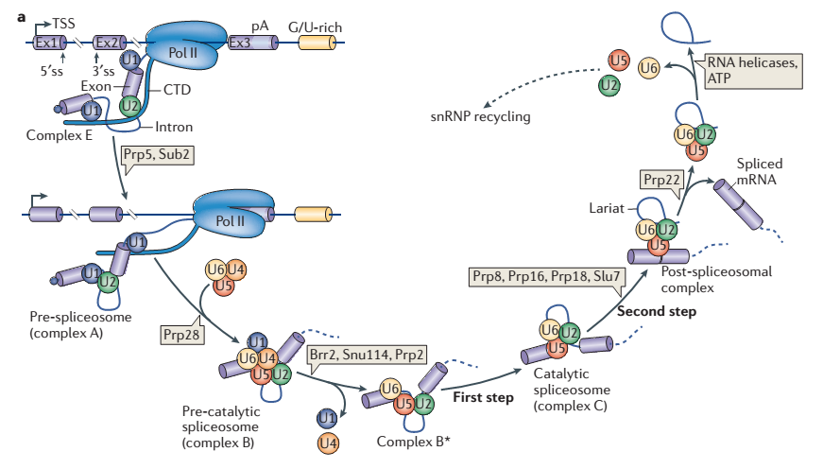
Assembly of the splicesome + splicing steps of pre-mRNA
DNA
Spliceosome assembly takes place at sites of transcription.
The U1 and U2 small nuclear ribonucleoproteins (snRNPs) assemble onto the pre-mRNA in a co-transcriptional manner through recognition of the 5ʹ splice site (5ʹss) and 3ʹss.
Recognition is mediated by the carboxy-terminal domain (CTD) of polymerase II.
The U1 and U2 snRNPs of different exons then interact with each other to form the pre-spliceosome (complex A).
This process is dependent on DExD/H helicases pre-mRNA-processing 5 (Prp5) and Sub2.
mRNA
Matera & Wang,
Nature Rev Mol Cell Biol
15, 108–121 (2014)

Slide 10
Assembly of the splicesome + splicing steps
In a subsequent reaction catalysed by Prp28, the preassembled tri-snRNP U4–U6•U5 is recruited to form complex B.
The resulting complex B undergoes a series of rearrangements to form a catalytically active complex B (complex B*), which requires multiple RNA helicases (Brr2, Snu114, Prp2) and results in the release of U4 and U1 snRNPs.
Complex B* then carries out the first catalytic step of splicing,
generating complex C, which contains free exon 1 (Ex1) and the intron–exon 2 “lariat intermediate”.
Matera & Wang,
Nature Rev Mol Cell Biol
15, 108–121 (2014)

Slide 11
Assembly of the splicesome + splicing steps
Matera & Wang,
Nature Rev Mol Cell Biol
15, 108–121 (2014)
Complex C undergoes additional rearrangements and then carries out the second catalytic step, resulting in a post-spliceosomal complex that contains the lariat intron and spliced exons.
Finally, the U2, U5 and U6 snRNPs are released from the mRNP particle and recycled for additional rounds of splicing. Release of the spliced product from the spliceosome is catalysed by the DExD/H helicase Prp22.

Slide 12
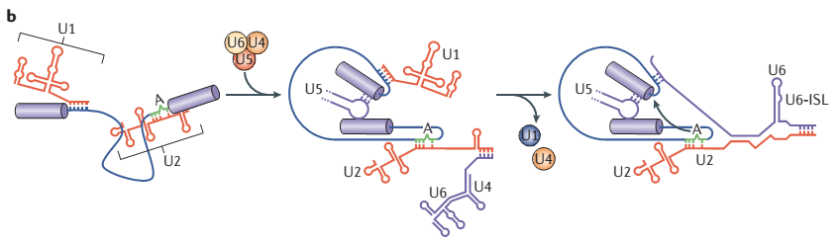
RNA interactions during splicing
Matera & Wang,
Nature Rev Mol Cell Biol
15, 108–121 (2014)
During splicing, RNA–RNA interactions are rearranged in a stepwise manner to create the catalytic centre of the spliceosome.
- Initially, U1 and U2 small nuclear RNA (snRNA) pair with the 5ʹss and the branch point sequence within complex A (the branch point adenosine is indicated by the letter A).
- Subsequently, complex A associates with the U4–U6•U5 tri-snRNP, leading to new base pairs between U2 and U6 snRNA and between U5 snRNA and exonic sequences near the 5ʹss.
- The U4 snRNA is disassociated from U6 to expose the 5ʹ end of U6, which then base pairs with the 5ʹss to displace U1 snRNA.
- In the end, an extensive network of base-pairing interactions is formed between U6 and U2, juxtaposing the 5ʹss and branch-point adenosine for the first catalytic step of splicing. The central region of U6 snRNA forms an intramolecular stem-loop (the U6-ISL), which is essential for splicing catalysis.

Slide 13
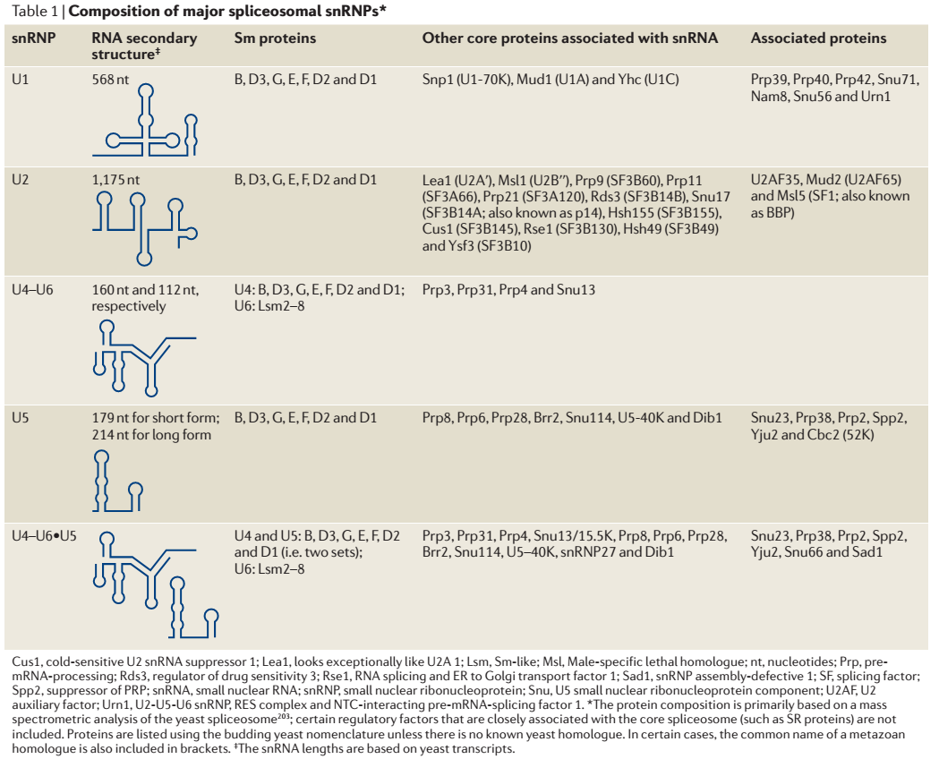
Composition of spliceosomal snRNPs
Matera & Wang,
Nature Rev Mol Cell Biol
15, 108–121 (2014)

Slide 14
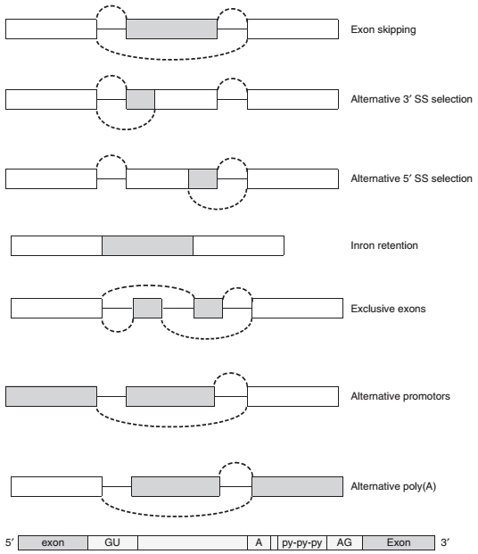
most important sequence patterns related to a splicing
The splicing starts with an AG site and is preceded with a non-AG (pyrimidine rich) region preceded by the branch point that includes an Adenosine residue.
The 5’ end of the intron contains
an almost invariant GU sequence.
Light & Elofsson Curr Opin Struct Biol
(2013) 23: 451-458

Slide 15
Mechanisms of alternative splicing
Gray boxes: exons
White boxes: introns
The (gray) protein coding regions are excluded/included in different transcripts.
Light & Elofsson Curr Opin Struct Biol
(2013) 23: 451-458

Slide 16
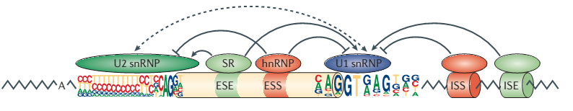
Regulation of alternative splicing
Splice site choice is regulated through cis-acting splicing regulatory elements (SREs) and trans-acting splicing factors.
Shown sequence motifs are the consensus motifs of splice sites.
The height of each letter represents the nucleotide frequency in each position.
The dashed arrow represents the formation of the exon definition complex.
Matera & Wang,
Nature Rev Mol Cell Biol
15, 108–121 (2014)

Slide 17
Regulation of alternative splicing
On the basis of their relative locations and activities, splicing regulatory elements are classified as
exonic splicing enhancers (ESEs),
intronic splicing enhancers (ISEs),
exonic splicing silencers (ESSs) or
intronic splicing silencers (ISSs).
Sequence motifs cannot exert their effects directly → these SREs specifically recruit splicing factors to promote or inhibit recognition of nearby splice sites:
- SR proteins recognize ESEs to promote splicing,
- heterogeneous nuclear ribonucleoproteins (hnRNPs) typically recognize ESSs to inhibit splicing.
Matera & Wang,
Nature Rev Mol Cell Biol
15, 108–121 (2014)

Slide 18
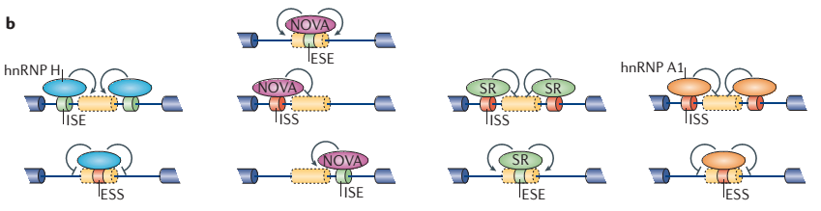
Activity of splicing factors and SREs
The activity of splicing factors and cis-acting SREs is context-dependent.
Oligo-G tracts are recognized by hnRNP H.
(Top) When the oligo-G tracts are located inside an intron, they function as intronic splicing enhancers (ISE) to promote splicing.
(Bottom) When they are located within exons, they function as exonic splicing silencers (ESSs).
Matera & Wang,
Nature Rev Mol Cell Biol
15, 108–121 (2014)

Slide 19
Activity of splicing factors and SREs
YCAY motifs are recognized by neuro-oncological ventral antigen (NOVA).
Y stands for pyrimidine (C/T).
(Top) When YCAY motifs are located inside an exon, they act as ESEs,
(Middle) When they are located in the upstream intron of an alternative exon, they act as ISSs,
(Bottom) When they are located inside an intron, they act as ISEs.
Matera & Wang,
Nature Rev Mol Cell Biol
15, 108–121 (2014)

Slide 20
Activity of splicing factors and SREs
Binding sites for SR proteins and hnRNP A1 also have distinct activities when located at different regions on the pre-mRNA.
Matera & Wang,
Nature Rev Mol Cell Biol
15, 108–121 (2014)

Slide 21
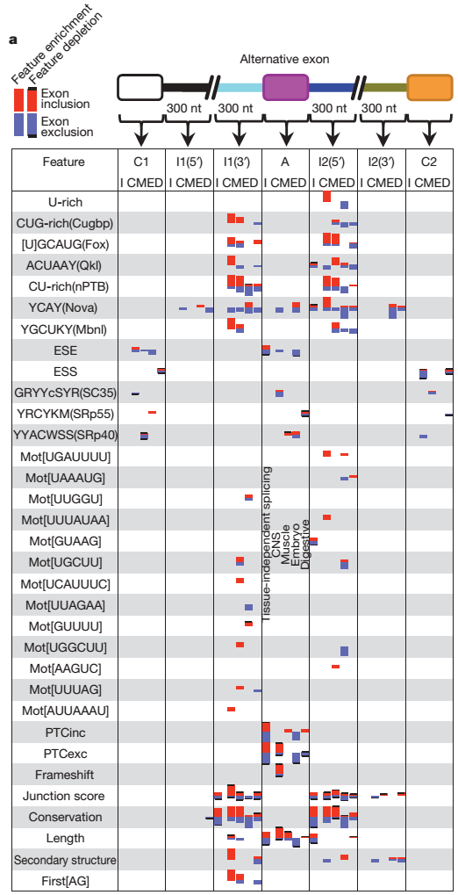
Sequence motifs of the splicing code
Define 3 regions C1/I1(5‘)/I1(3‘) before an „alternative exon“ (A) and
3 regions I2(5‘)/I2(3‘)/C2 behind the alternative exon.
Barash et al. Nature
465, 53- (2010)

Slide 22
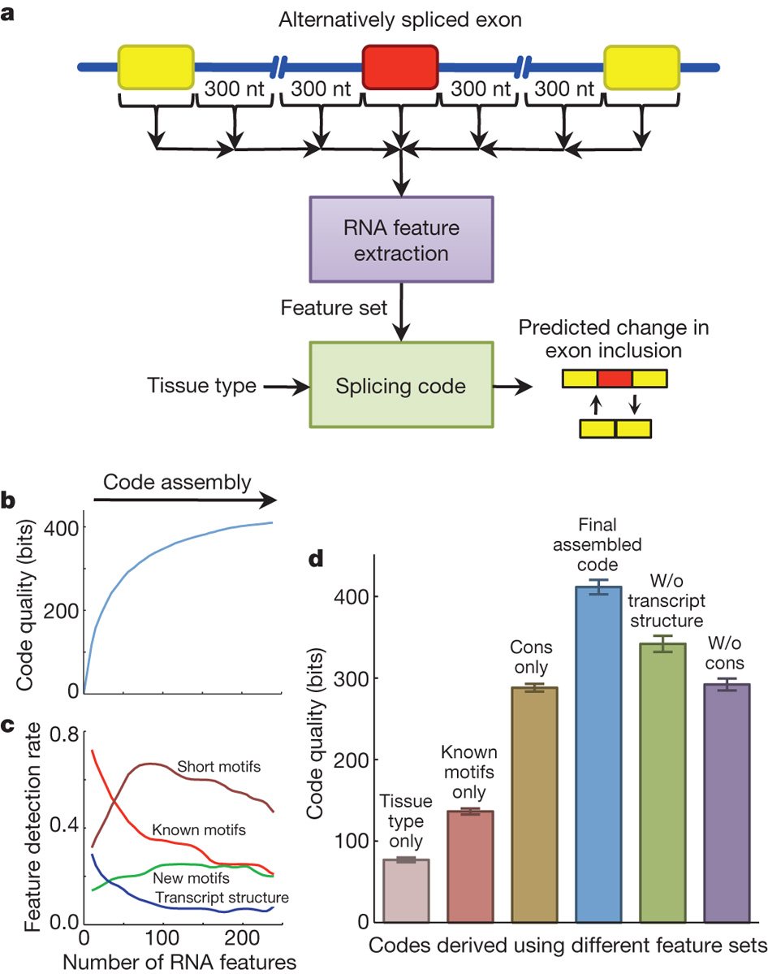
Approach to extract RNA features
Barash et al. Nature
465, 53- (2010)

Slide 23
The splicing code
Barash et al. Nature
465, 53- (2010)
Bars without black line denote feature enrichment,
bars with black line feature depletion.
Bar size conveys enrichment P-value;
P < 0.005 in all cases.
Column “Feature” lists sequence motifs.
E.g. the CUG-rich motif of the second row recruits the binding protein Cugbp.
Each table cell contains 5 bars. They show the region-specific activity of each feature for increased exon inclusion (red bar) or exclusion (blue bar) in 5 different mouse tissues:
CNS (C),
muscle (M),
embryo (E) and
digestive (D) tissues, plus a
tissue-independent mixture (I).

Slide 24
The splicing code
Barash et al. Nature
465, 53 (2010)

Slide 25
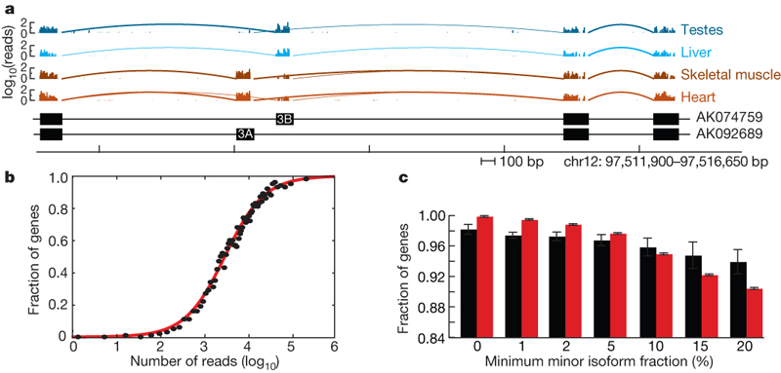
Tissue-specific alternative splicing
What are microRNAs?
How can one identify microRNAs?
What is the function of microRNAs?
Shown are mRNA-Seq reads mapping to a portion of the SLC25A3 gene locus.
SLC25a3 is a mitochondrial phosphate carrier.
The number of mapped reads starting at each nucleotide position is displayed (log₁₀) for the tissues listed at the right.
Bottom: exon/intron structures of representative transcripts containing
mutually exclusive exons 3A and 3B
(GenBank accession numbers AK074759 and AK092689).
Wang et al. Nature (2008) 456: 470-6

Slide 26
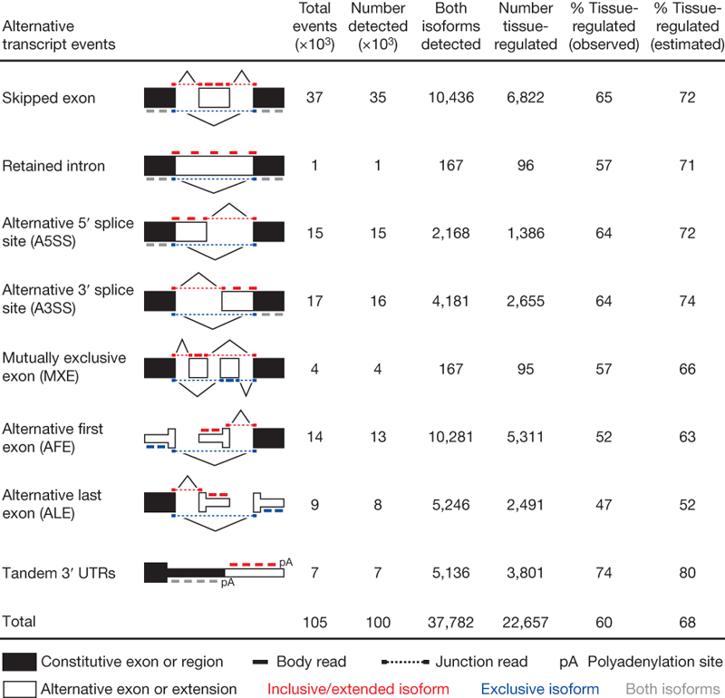
tissue-specific regulation of alternative mRNA isoforms
Blue, red, grey: mapped reads supporting expression of upper isoform, lower isoform or both isoforms.
The four columns to the right show the numbers of events of each type:
(1) supported by cDNA and/or EST data; (2) 1 isoform supported by mRNA-Seq reads;
(3) both isoforms supported by reads;
(4) events detected as tissue-regulated (difference significant under Fisher's exact test).
What are microRNAs?
How can one identify microRNAs?
What is the function of microRNAs?
Wang et al. Nature (2008) 456: 470-6

Slide 27
Review from V3: Not considered yet: alternative splicing
exon 1
exon 2
exon 3
exon 4
DNA
5’
3’
3’
5’
transcription
primary
RNA transcript
3’
5’
alternative splicing
(~95% of human multi-exon genes)
mRNAs
translation
translation
translation
protein isoforms
AS affects ability of
proteins to interact with
other proteins
Notes:
this is especially relevant because higher eukaryotes not only express genes and translate them to proteins, they are able to construct variants of the same protein.
- and a change in the building blocks there can imply a change in interaction partners!
- we thought about a way to account for that.

Slide 28
Differential PPI wiring analysis
112 matched normal tissues (TCGA)
112 breast cancer tissues (TCGA)
P1
P2
P3
P2
P3
comparison 1:
d1
P4
P5
P4
P5
P1
P2
P3
P2
P3
comparison 2:
d2
P4
P5
P4
P5
P1
P2
P3
P1
P2
comparison 3:
d3
P4
P5
P4
∑di
one-tailed binomial test
+ BH/FDR (<0.05)
P1
-2
P2
-1
P3
P1
-2
P2
-1
-1
-1
P4
P5
Check whether rewiring of a particular PP interaction occurs in a significantly large number of patients compared to what is expected by chance rewiring events.
Notes:
for every single comparison we noted any interaction that is only found in one of the groups.
- positively if the interaction is only contained in the network of the T sample, and neg if only in the SC sample.
- we summed up those observations to obtain a network where each edge is annotated with the #changes found in corresponding interactions and filtered spurious observations by applying simple statistics.

Slide 29
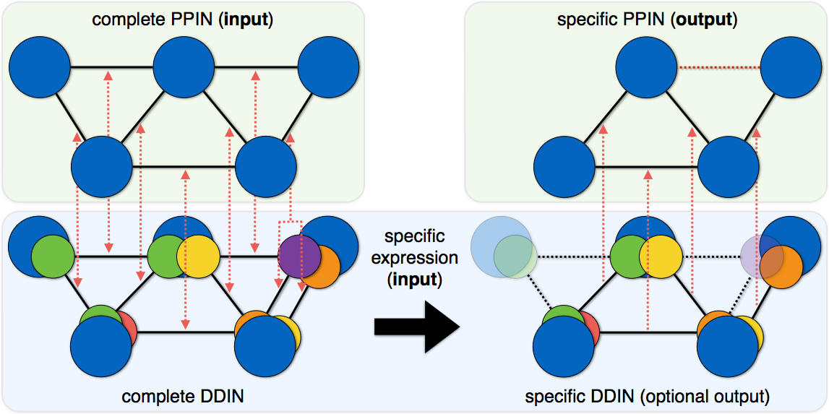
PPIXpress method
Interaction is lost
reference: principal protein isoforms
built using most abundant protein isoforms
I. mapping
II. instantiation
Notes:
after this initial mapping, the expression data comes into play. for all proteins, the most abundant transcript is determined and becomes the representative in a sample specific DDIN.
- then, the mapping can be used in reverse and tell us which protein interactions are actually supported in the sample.

Slide 30
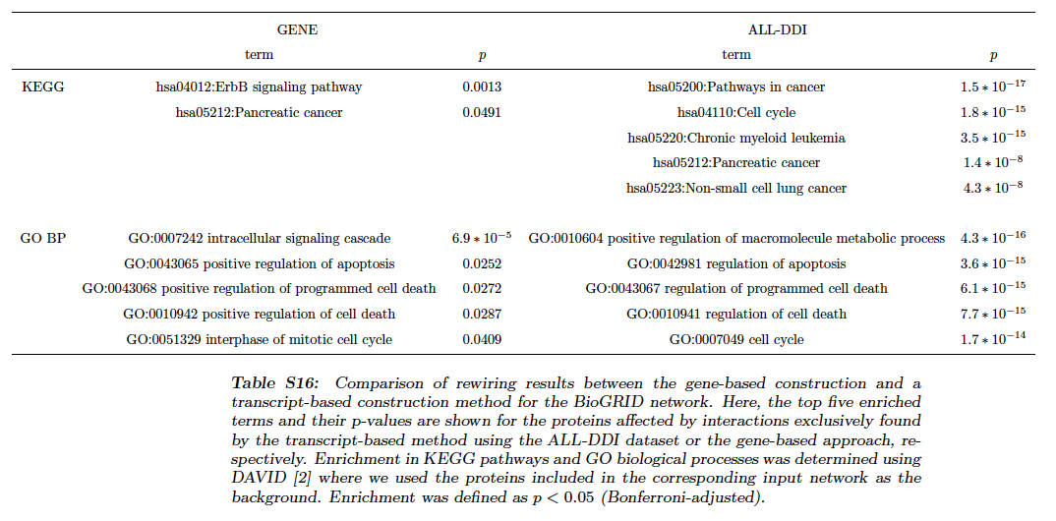
Enriched KEGG and GO-BP terms in gene-level \ transcript-level set
The enriched terms that are exclusively found by the transcript-level method (right) are closely linked to carcinogenetic processes.
Hardly any significant terms are exclusively found at the gene level (left).
Will, Helms, Bioinformatics, 47, 219 (2015)
doi: 10.1093/bioinformatics/btv620

Slide 31
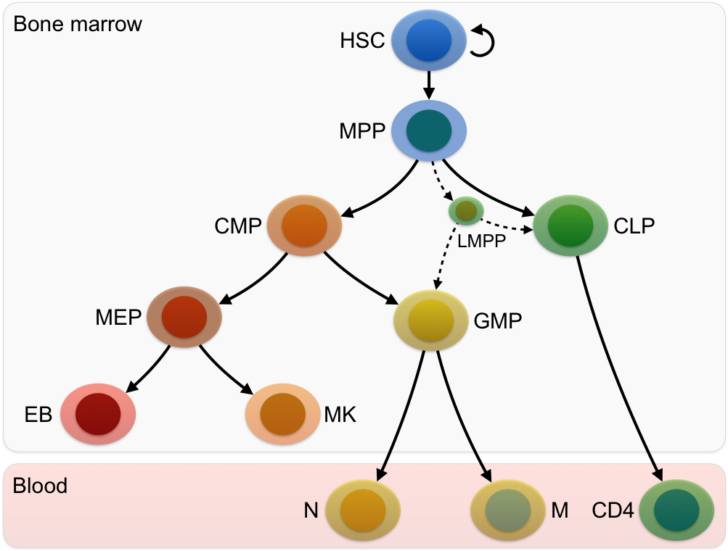
Hematopoiesis (development of blood cells)
Hematopoietic stem cells
(in bone marrow)
progenitor cells
terminally differentiated cells

Slide 32
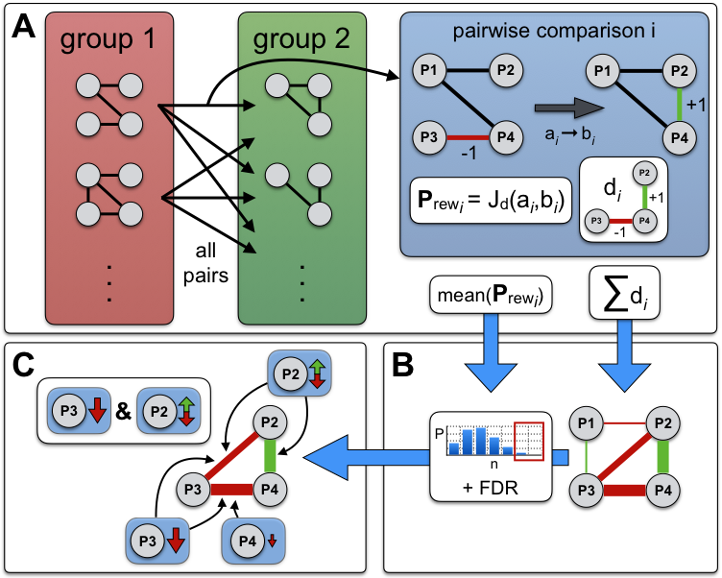
PPICompare workflow

Slide 33
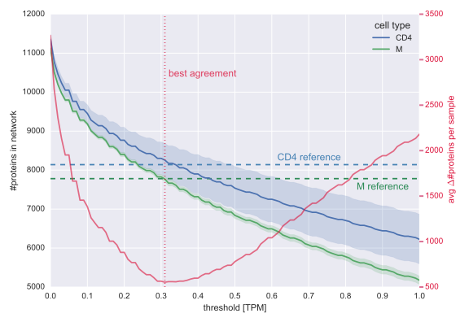
Calibrating RNAseq on/off threshold against proteome data (MS)

Slide 34
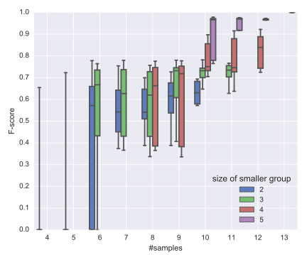
How many RNAseq samples are needed?
X-axis:
Total number of samples in both groups
Blue -> violet:
Imbalance reduces
Subsampling shows that reasonable results are obtained for ≥ 3 samples

Slide 35
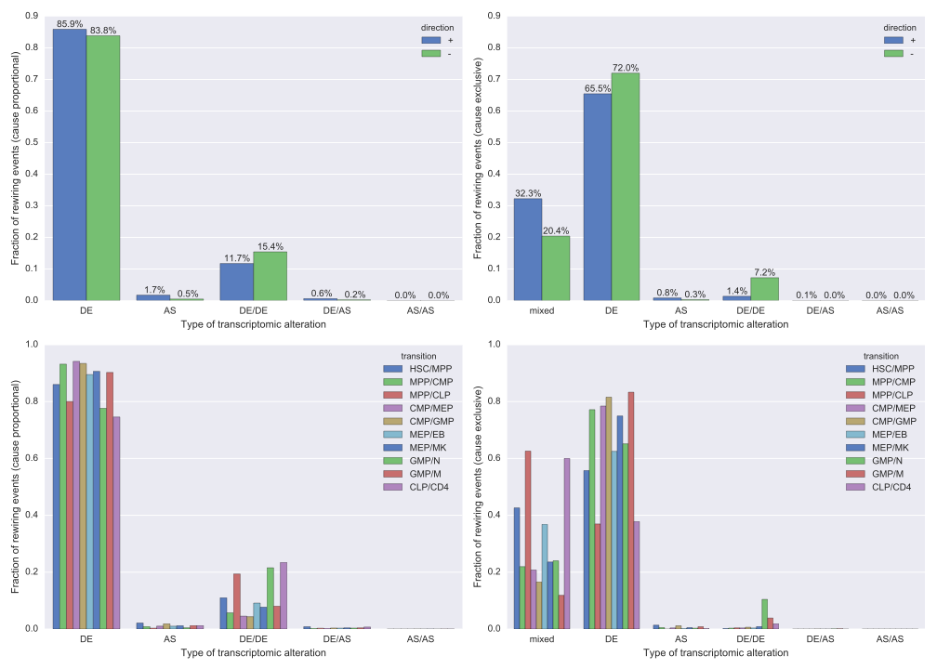
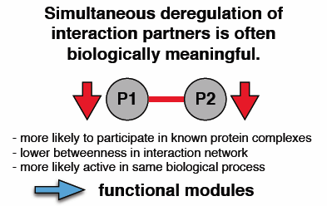
Rewiring is due to …
DE: differential expression
DE/DE: both proteins DE
AS: alternative splicing
DE/AS: one protein affected by DE, the other by AS
DE of a single protein is most frequent event for PPI rewiring
Different types of
alterations can cause
same rewiring event

Slide 36
contribution of AS seems minor (< 1%)
BUT 548 rewiring events in hematopoiesis are due to AS.
Rewiring events exclusively regulated by AS were enriched in GO terms related to:
post-elongation processing of mRNA
cell cycle (G2-M checkpoint and control of pre-replication complex)
transport of mRNA from the nucleus to the cytoplasm, Hippo signaling, as well as Interleukin receptor SHC signaling

Slide 37
reduced set
Identify reduced set of transcriptomic changes that
– explains all rewiring events (i.e. is very likely given the data) and
– is of small cardinality: weighted set-cover problem
→ (left) roteins in reduced set are hub proteins in the differential network,
not in full reference network (right)
They tend to be connectors of different functional modules.

Slide 38
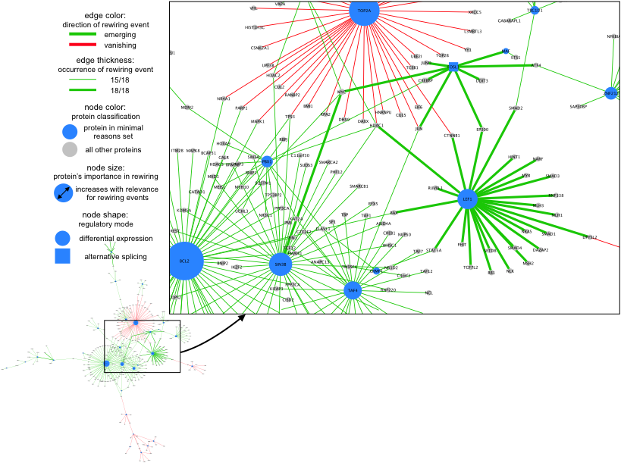
Rewiring HSC MPP

Slide 39
involvement of epigenetics in alternative splicing?
V14 – V16 showed that chromatin state plays an essential role
in regulating gene expression.
Although epigenetic signatures are mainly found to be enriched in promoters,
it has become increasingly clear that they are also present in exon regions, indicating a potential link of epigenetic regulation to splicing.

Slide 40
Procedure to recognize AS events
Junction site annotation and alternative splicing recognition process.
Data sources:
Annotated AS types from Ensembl
DNA methylation data from Salk institute
Chip-seq data from ENCODE and elsewhere
Zhou et al. BMC Genomics (2012) 13:123

Slide 41
Procedure to recognize AS events
CNE: constitutively spliced exon (no AS)
The recognition code of AS events and the number of each type of splicing event
Zhou et al. BMC Genomics (2012) 13:123

Slide 42
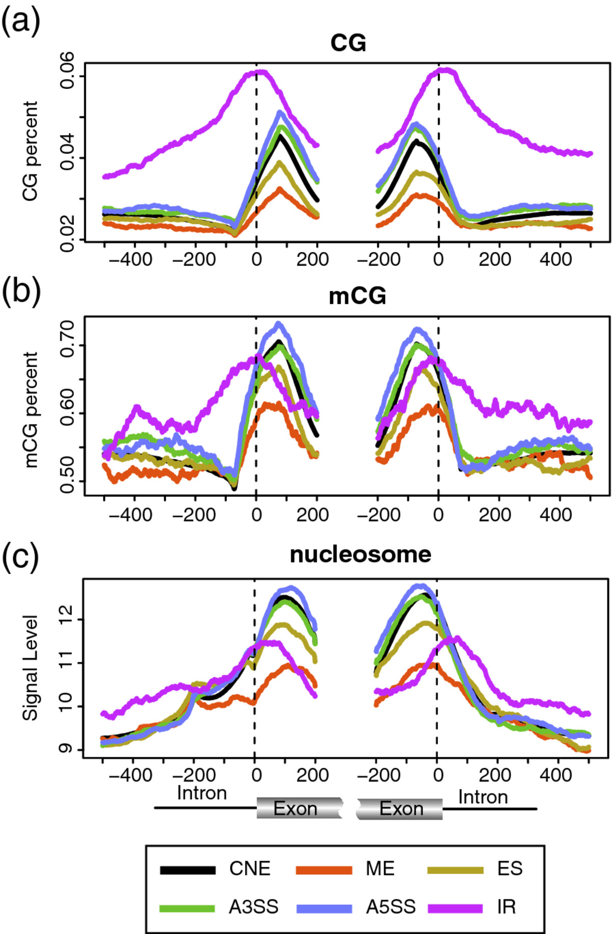
Coupling AS ↔ epigenetic modifications
The association of DNA methylation and nucleosome occupancy with AS.
(a) Distribution of genomic CpG levels around the splice sites of different types of AS events. 6% is the expexted frequency of dinucleotides. However CpG levels are lower on average (V21).
(b) Distribution of DNA methylation level (mCG) around the splice sites of different types of AS events.
Both a and b use a sliding window of 147 bp
CNE: constitutively spliced exon (no AS)
ES: exon skipping
ME : mutually exclusive exon
A5SS : alternative 5' splice site selection
A3SS : alternative 3' splice site selection
IR : intron retention.
Zhou et al. BMC Genomics (2012) 13:123

Slide 43
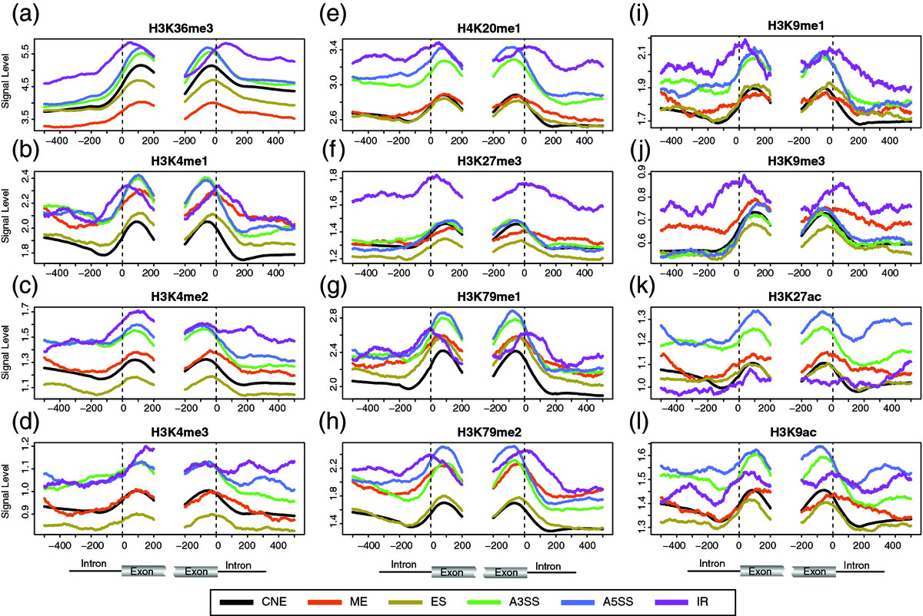
Association of histone modification with AS
H3K36me3 (a) is the only histone PTM that is significantly associated with all types of AS events in all regions.
However the association patterns are different: H3K36me3 levels are significantly lower in ME and ES and significantly higher in A3SS, A5SS and IR.
The levels of H3K4 methylation, including H3K4me1, H3K4me2, and H3K4me3 (b - d), are almost all significantly higher in A3SS and A5SS.
Zhou et al. BMC Genomics (2012) 13:123

Slide 44
Association of histone modification with AS
For the other histone methylations,
(e) the level of H4K20me1 is significantly higher in A3SS, A5SS and IR;
(f) the level of H3K27me3 is significantly higher in the exonic region of ES;
(g) the level of H3K79me1 is significantly higher in A3SS and A5SS, and slightly higher in the intronic region of ES;
(h) the level of H3K79me2 (h) is significantly higher in ME, A3SS and A5SS, and most region of IR;
(i) the level of H3K9me1 is significantly higher in A3SS, A5SS and most regions of IR.
(j) However, H3K9me3 is not significantly associated with any type of ASE.
Zhou et al. BMC Genomics (2012) 13:123

Slide 45
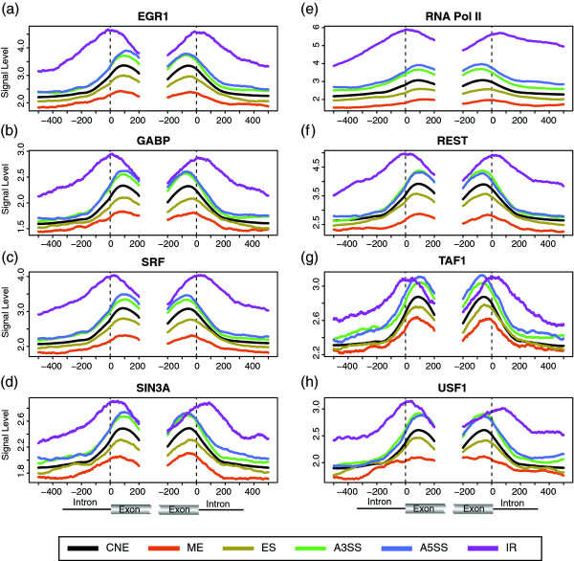
Association of protein features with AS
ChIP-seq data for 9 TFs, CTCF and RNA Pol II
The binding levels of EGR1, GABP, SIN3A, SRF and RNA Pol II (a - e) are all signifycantly higher in A3SS, A5SS and IR, and significantly lower in ME and ES,
Their levels all steadily increase from ME, ES, CNE, A3SS, A5SS to IR.
This is similar to the results for H3K36me3.
Zhou et al. BMC Genomics (2012) 13:123

Slide 46
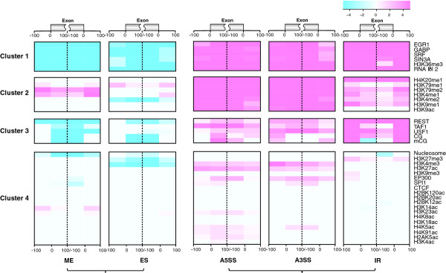
Clustering of associations
ChIP-seq data for
TF binding.
Zhou et al. BMC Genomics (2012) 13:123

Slide 47
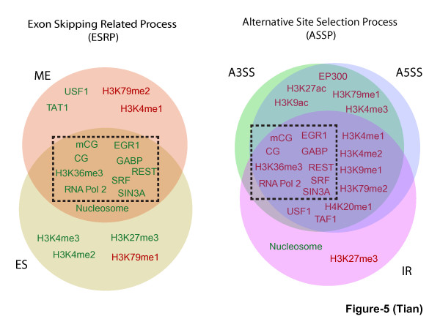
epigenetic modifications that are associated with AS
Mutually exclusive exon
Exon skipping
The Epigenetic features are strongly associated with different types of AS.
The features showing higher level and lower level in AS events than in CNE are colored in red and green, respectively. The features inside the dashed black box are those common in both ESRP and ASSP; note their association patterns are very different in between ESRP and ASSP.
Zhou et al. BMC Genomics (2012) 13:123

Slide 48
Coupling AS ↔ epigenetic modifications
Epigenetic features are strongly associated with AS.
This suggests that epigenetic regulation may be involved in AS.
Clustering yielded 4 tight clusters of epigenetic features that are associated with AS.
The AS events may be grouped into 2 classes on the basis of their association patterns with epigenetic features.
- the exon skipping related process (ESRP) (including ME and ES) and
- the alternative splice site selection process (ASSP) (including A3SS, A5SS and IR)
→ these 2 processes may involve different mechanisms of epigenetic regulation.
Zhou et al. BMC Genomics (2012) 13:123

Slide 49
Content of final exam
Lecture | Slides relevant for exam
1 | 15-21
2 | 1-11, 30-42
3 | 1-40
4 | None
5 | 1-20,24-32,37-39,42
6 | None
7 | 1-21
8 | None (V1-V8 as announced in V8)
9 | 19-20,30-37
10 | 10-34, 42-54
11 | 9-16
12 | 17-30
13 | 3-33
14 | 11-30
Lecture | Slides relevant for exam
15 | None
16 | None
17 | All slides (only proofs presented in lecture)
18 | All slides (only proofs presented in lecture)
19 | 22-40
20 | 6-10, 24-37
21 | 2-6, 15-22, 26, 29-45 (main ideas)
22 | 1-34
23 | 1-8
24 | 1-13
25 | None
26 | None
Relevant are also the assignments !
(theoretical parts, not the programming parts)

