Slide 1
V 6 – Network analysis
Dijkstra algorithm: compute shortest pathways
Graph layout
Network robustness
are biological networks really scale-free?
Tue, Nov 5, 2019

Slide 2
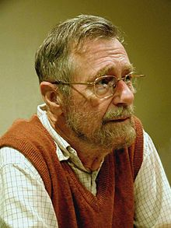
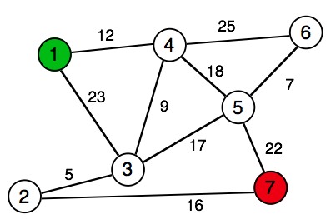
The Shortest Path Problem
Problem:
Find the shortest path from a given vertex
to the other vertices of the graph (Dijkstra 1959).
We need (input):
• weighted graph G(V, E)
• start (source) vertex s in G
We get (output):
• shortest distances d[v] between s and v
• shortest paths from s to v
Edsger Dijkstra
(1930-2002):
Idea:
Always proceed with the closest node
→ greedy algorithm
Real world application:
→ GPS navigation devices

Slide 3
Dijkstra Algorithm 0
Initialization:
for all nodes v in G:
d[v] = oo
pred[v] = nil
d[s] = 0
distance and path to all other nodes is still unknown
distance from source to source = 0
d[v] = length of path from s to v
pred[v] = predecessor node on the shortest path
In the example: s = 1
node | 1 | 2 | 3 | 4 | 5 | 6 | 7
d | 0 | oo | oo | oo | oo | oo | oo
pred | – | – | – | – | – | – | –

Slide 4
Dijkstra I
Iteration:
Q = V
while Q is not empty:
u = node with minimal d
if d[u] = oo:
break
delete u from Q
for each neighbor v of u:
d_temp = d[u] + d(u,v)
if d_temp < d[v]:
d[v] = d_temp
pred[v] = u
return pred[]C
Save {V} into working copy Q
choose node closest to s
exit if all remaining nodes are inaccessible
calculate distance to u's neighbors
if new path is shorter
=> update

Slide 5
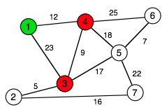
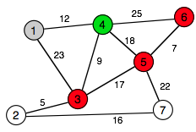
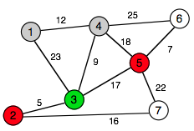
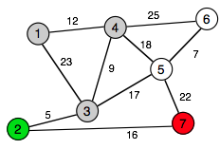
Dijkstra-Example
1)
Q = (1, 2, 3, 4, 5, 6, 7)
node | 1 | 2 | 3 | 4 | 5 | 6 | 7
d | 0 | oo | 23 | 12 | oo | oo | oo
pred | – | – | 1 | 1 | – | – | –
Q = V
while Q is not empty:
u = node with minimal d
if d[u] = oo:
break
delete u from Q
for each neighbor v of u:
d_temp = d[u] + d(u,v)
if d_temp < d[v]:
d[v] = d_temp
pred[v] = u
return pred[]C
2)
Q = (2, 3, 4, 5, 6, 7)
node | 1 | 2 | 3 | 4 | 5 | 6 | 7
d | 0 | oo | 21 | 12 | 30 | 37 | oo
pred | – | – | 4 | 1 | 4 | 4 | –
Q = (2, 3, 5, 6, 7)
3)
node | 1 | 2 | 3 | 4 | 5 | 6 | 7
d | 0 | 26 | 21 | 12 | 30 | 37 | oo
pred | – | 3 | 4 | 1 | 4 | 4 | –
Q = (2, 5, 6, 7)
4)
node | 1 | 2 | 3 | 4 | 5 | 6 | 7
d | 0 | 26 | 21 | 12 | 30 | 37 | 42
pred | – | 3 | 4 | 1 | 4 | 4 | 2

Slide 6
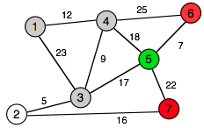
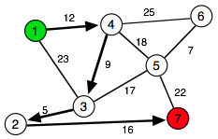
Example contd.
4)
Q = (2, 5, 6, 7)
node | 1 | 2 | 3 | 4 | 5 | 6 | 7
d | 0 | 26 | 21 | 12 | 30 | 37 | 42
pred | – | 3 | 4 | 1 | 4 | 4 | 2
5)
Q = (5, 6, 7)
node | 1 | 2 | 3 | 4 | 5 | 6 | 7
d | 0 | 26 | 21 | 12 | 30 | 37 | 42
pred | – | 3 | 4 | 1 | 4 | 4 | 2
Q = (6, 7)
Q = (7)
Final result:
node | 1 | 2 | 3 | 4 | 5 | 6 | 7
d | 0 | 26 | 21 | 12 | 30 | 37 | 42
pred | – | 3 | 4 | 1 | 4 | 4 | 2
d(1, 7) = 42
path = (1, 4, 3, 2, 7)
d(1, 6) = 37
path = (1, 4, 6) or (1,4,5,6)

Slide 7
Beyond Dijkstra
Dijkstra works for directed and undirected graphs with
non-negative weights.
Straight-forward implementation: O(N²)
Graphs with positive and negative weights
→ Bellman-Ford-algorithm
If there is a heuristic to estimate weights:
→ improve efficiency of Dijkstra
→ A*-algorithm

Slide 8
Graph Layout
Task: visualize various interaction data:
e.g. protein interaction data (undirected):
nodes – proteins
edges – interactions
metabolic pathways (directed)
nodes – substances
edges – reactions
regulatory networks (directed):
nodes – transcription factors/miRNAs + regulated proteins/miRNAs
edges – regulatory interactions
co-localization (undirected)
nodes – proteins
edges – co-localization information
homology (undirected/directed)
nodes – proteins
edges – sequence similarity (BLAST score)

Slide 9
Graph Layout Algorithms
Graphs encapsulate relationship between objects
→ drawing gives visual impression of these relations
Good Graph Layout: aesthetic
• minimal edge crossing
• highlight symmetry (when present in the data)
• even spacing between the nodes
Many approaches in literature (and in software tools),
most useful ones are usually NP-complete (exponential runtime)
Most popular for straight-edge-drawing:
→ force-directed: spring model or spring-electrical model
→ embedding algorithms like H3 or LGL (not covered)

Slide 10
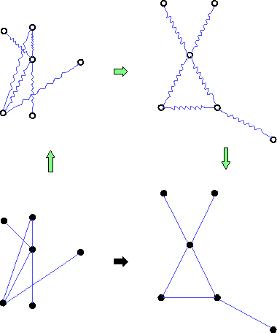
Force-Directed Layout
Peter Eades (1984): graph layout heuristic
"Spring Embedder'' algorithm.
• edges → springs
vertices → rings that connect the springs
• Layout by dynamic relaxation
→ lowest-energy conformation
→ "Force Directed'' algorithm
http://www.hpc.unm.edu/~sunls/research/treelayout/node1.html

Slide 11

Energy and Force
Energy: describes the altitude of the landscape
Energy increases when you go up the hill
You need more force for a steeper ascent
Force: describes the change of the altitude, points downwards.

Slide 12
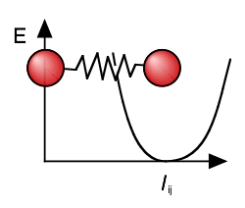

Spring Embedder Layout
Springs regulate the mutual distance between the nodes
• too close → repulsive force
• too far → attractive force
Spring embedder algorithm:
• add springs for all edges
• add loose springs to all non-adjacent vertex pairs
Total energy of the system:
xi, xj = position vectors for nodes i and j
lij = rest length of the spring between i and j
R = spring constant (stiffness)
Problem: lij have to be determined a priori, e.g., from network distance

Slide 13
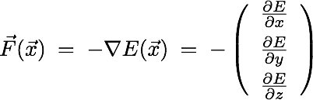
Spring Model Layout
Task: find configuration of minimal energy
In 2D/3D: force = negative gradient of the energy
→ Iteratively move nodes "downhill" along the gradient of the energy
→ displace nodes proportional to the force acting on them
Problems:
• local minima
• a priori knowledge of all spring lengths
→ works best for regular grids

Slide 14


The Spring-Electrical-Model
More general model than spring embedder model: use two types of forces
1) attractive harmonic force between connected nodes (springs)
one uses usually the same
spring constant k for all edges
2) repulsive Coulomb-like force between all nodes
"all nodes have like charges" → repulsion
either Qij = Q or, e.g., Qij = ki kj
Repulsion pushes all nodes apart, springs pull connected nodes together
→ workhorse method for small to medium sized graphs
→ Do-it-yourself in Assignment 4 (?) <=

Slide 15
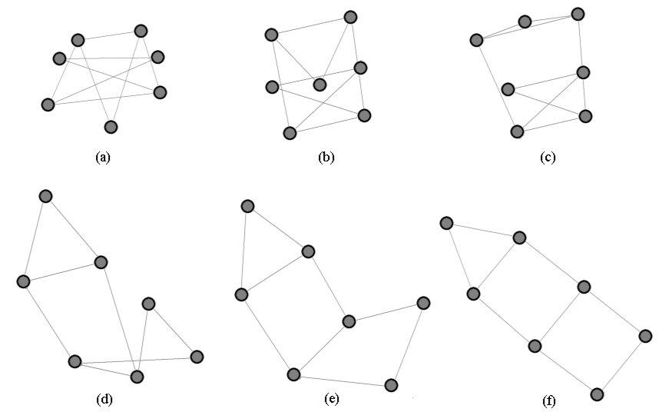
Spring-Electrical Example
http://www.it.usyd.edu.au/~aquigley/3dfade/

Slide 16
Force-Directed Layout: Summary
Analogy to a physical system
=> force directed layout methods tend to meet various aesthetic standards:
• efficient space filling,
• uniform edge length (with equal weights and repulsions)
• symmetry
• smooth animation of the layout process (visual continuity)
Force directed graph layout → the "work horse" of layout algorithms.
Not so nice: the initial random placement of nodes and even very small changes of layout parameters will lead to different representations.
(no unique solution)
Side-effect: vertices at the periphery tend to be closer to each other than those in the center…

Slide 17
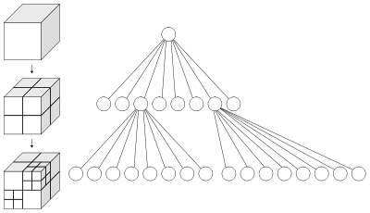
Runtime Scaling
Force directed layout:
Several possible arrangements!!!
(local minima)
loop until convergence:
calculate forces:
L springs
N(N-1)/2 charge pairs
move vertices
output positions
O(N²)!!!
→ force directed layout suitable for small to medium graphs (≤ O(1000) nodes?)
Speed up layout by:
• multi-level techniques to overcome local minima
• clustering (octree) methods for distant
groups of nodes → O(N log N)

Slide 18
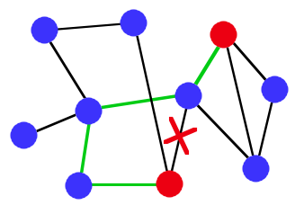
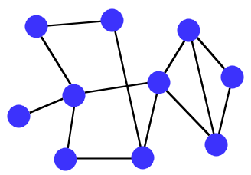
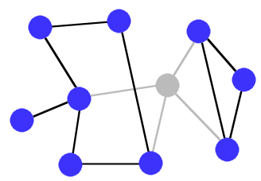
Network Robustness
Network = set of connections
Failure events:
• loss of edges
• loss of nodes (together with their edges)
→ loss of connectivity
• paths become longer (detours required)
• connected components break apart
→ network characteristics change
→ Robustness = how much does the network (not) change when edges/nodes are removed

Slide 19

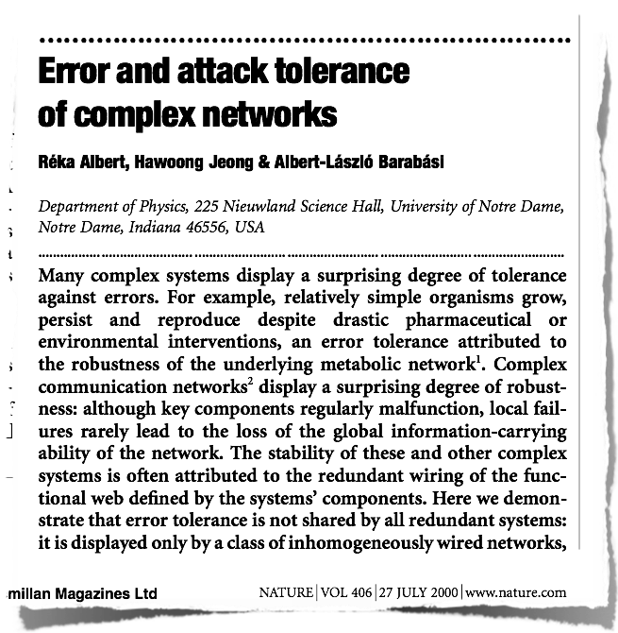

Slide 20
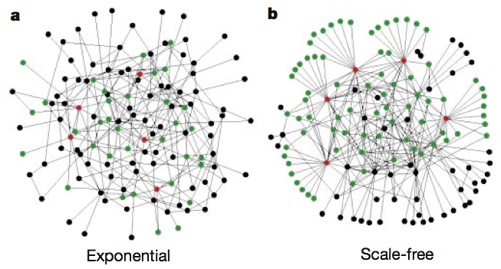
Random vs. Scale-Free
130 nodes, 215 edges
The top 5 nodes with the highest k connect to…
… 27% of the network
… 60% of the network
Albert, Jeong, Barabási,
Nature 406 (2000) 378

Slide 21
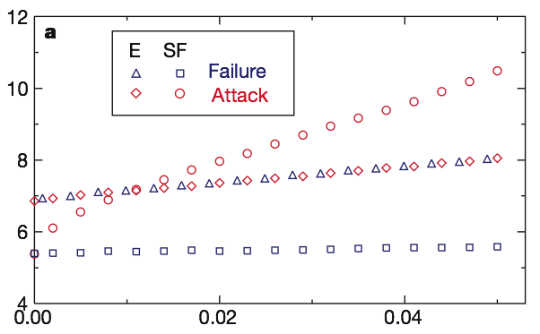
Failure vs. Attack
Failure: remove randomly
selected nodes
Attack: remove nodes with
highest degrees
SF: scale-free network -> attack
E: exponential (random) network
-> failure / attack
SF: failure
network diameter
fraction of nodes removed
N = 10000, L = 20000, but effect is size-independent;
Interpretation:
SF network diameter increases strongly when network is attacked
but not when nodes fail randomly
Albert, Jeong, Barabási, Nature 406 (2000) 378

Slide 22
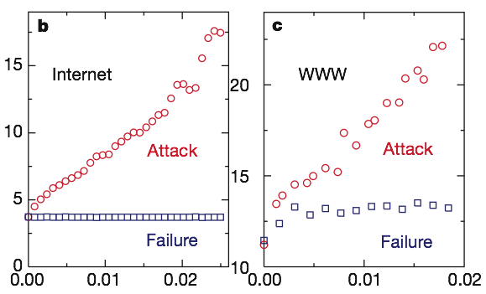
Two real-world networks
Scale-free:
• very stable against random failure ("packet re-rooting")
• very vulnerable against dedicated attacks ("9/11")
network diameter
fraction of nodes removed
http://moat.nlanr.net/Routing/rawdata/ :
6209 nodes and 12200 links (2000)
WWW-sample containing 325729 nodes and 1498353 links
Albert, Jeong, Barabási,
Nature 406 (2000) 378

Slide 23
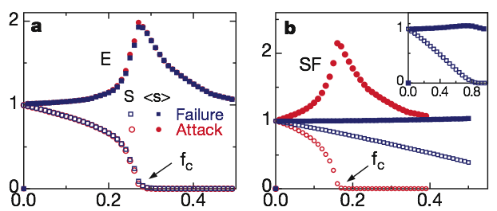
Network Fragmentation
<s>: average size of the isolated clusters (except the largest one)
S: relative size of the largest cluster S; this is defined as the fraction of nodes contained in the largest cluster (that is, S = 1 for f = 0)
cluster sizes S and <s>
fraction of nodes removed
Random network:
• no difference between attack and failure (homogeneity)
• fragmentation threshold at fc ≳ 0.28 (S ≈ 0)
Scale-free network:
• delayed fragmentation and isolated nodes for failure
• critical breakdown under attack at fc ≈ 0.18
Albert, Jeong, Barabási,
Nature 406 (2000) 378

Slide 24
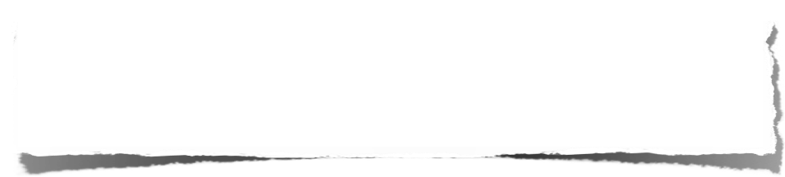
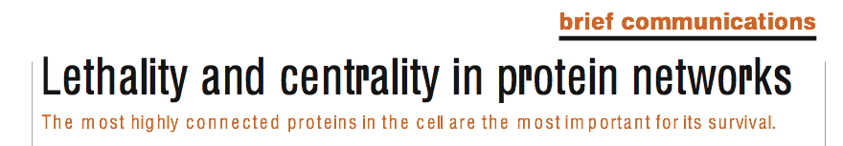
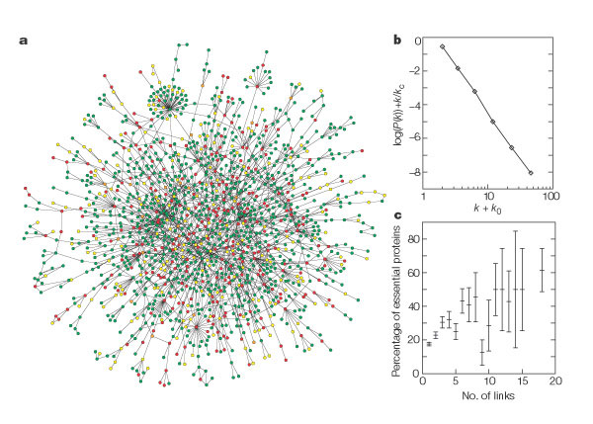
Jeong, Mason, Barabási, Oltvai, Nature 411 (2001) 41
→ "PPI networks
apparently are
scale-free…"
"Are" they scale-free
or
"Do they look like" scale-free???
largest cluster of the yeast proteome (at 2001)

Slide 25

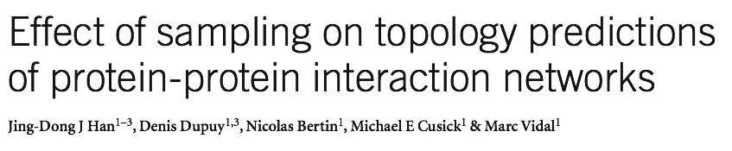
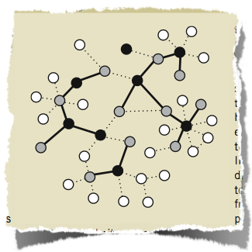
Nature Biotech 23 (2005) 839
Generate networks of various types,
sample sparsely from them
→ determine degree distribution
• Random (ER / Erdös-Renyi) → P(k) = Poisson
• Exponential (EX) → P(k) ~ exp[-k]
• scale-free / power-law (PL) → P(k) ~ k^{–γ}
• P(k) = truncated normal distribution (TN)

Slide 26
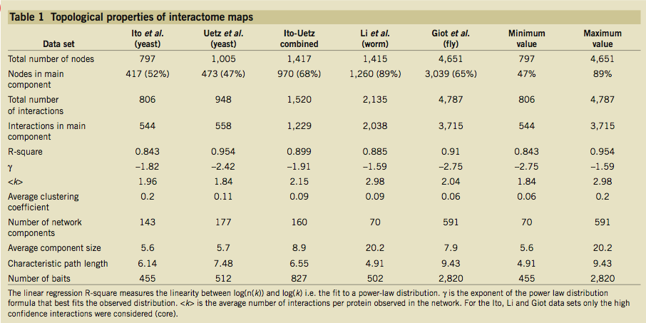
Partial Sampling
Estimated for yeast: 6000 proteins, 30000 interactions
Y2H experiments detected only 3…9% of the complete interactome!
Han et al, Nature Biotech 23 (2005) 839

Slide 27




R square
Given: a data set with n values y₁,...,y_{n} and
a set of fitted / predicted / modelled values f₁,...,f_{n} e.g. from linear regression.
We call their difference residuals e_{i} = y_{i} − f_{i}
and the mean value
The total sum of squares (proportional to the variance of the data) is:
The sum of squares of residuals is:
The coefficient of determination, R² or r² is often defined as:
www.wikipedia.org

Slide 28
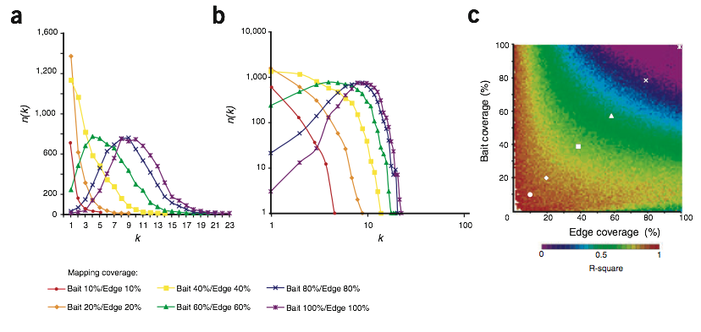
Sparsely Sampled random (ER) Network
(c) Shows linearity (R square) between detected P(k) and ideal power law; good agreement (red; R ≈1 for low edge coverage)
resulting P(k) for different coverages
(b) Shows log-scale
R square
→ for sparse sampling (10-20%), even an ER network
"looks" scale-free (when only P(k) is considered)
Han et al, Nature Biotech 23 (2005) 839

Slide 29
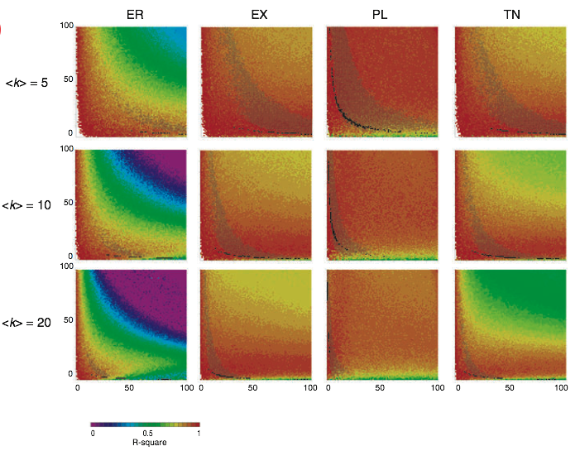
Anything Goes – different topologies
All network topologies look scale-free (red) when undersampled
Han et al, Nature Biotech 23 (2005) 839

Slide 30
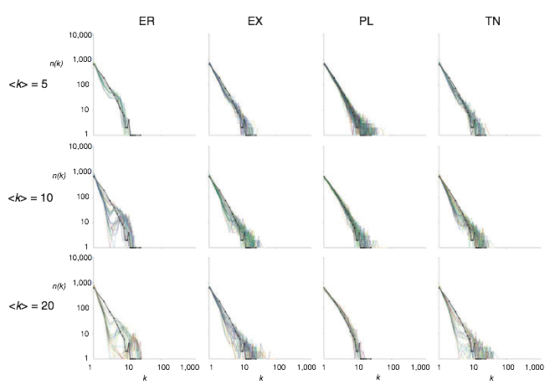
Compare to Uetz et al. data
Uetz et al. data
(solid line) is
compared to
sampled
networks of
similar size.
Sampling density affects observed degree distribution
→ true underlying network cannot be identified from available data
Han et al, Nature Biotech 23 (2005) 839

Slide 31
Link prediction based on PPI network
Kovács, ... Vidal & Barabási
Nature Commun. 10, 1240 (2019)
In social networks, a large number of common friends implies a higher chance to become friends (red link between nodes X and Y), known as the Triadic Closure Principle (TCP).
TCP predicts (P) links based on node similarity (S), quantifying the number of shared neighbors between each node pair (A²).
(b) A basic mathematical formulation of TCP would imply that protein pairs of high Jaccard similarity are more likely to interact

Slide 32
TCP does not apply to PPI networks
Kovács, ... Vidal & Barabási
Nature Commun. 10, 1240 (2019)
J = |N_{X} ∩ N_{Y}| / |N_{X} ∪ N_{Y}|, where N_{X} and N_{Y} are the interaction partners of X and Y.
However, Kovács and co-workers did not observe the expected trend in Protein-Protein Interaction (PPI) datasets, as illustrated here for a binary human PPI network (HI-II-14): high Jaccard similarity indicates a lower chance for the proteins to interact.
The data are binned logarithmically based on the Jaccard similarity values.

Slide 33
PPIs involve binding interfaces
PPIs often require complementary interfaces (see V8).
Hence, two proteins, X and Y, with similar interfaces share many of their neighbors.
Yet, a shared interface does not typically guarantee that X and Y directly interact with each other.
Instead, an additional interaction partner of X (protein D) might be also shared with protein Y (blue link).
Such a link can be predicted by using paths of length 3 (L3). L3 identifies similar nodes to the known partners (P = AS), going one step beyond the similarity-based argument of TCP.
Kovács, ... Vidal & Barabási
Nature Commun. 10, 1240 (2019)

Slide 34
Structural illustration of L3 principle
We will illustrate this link prediction principle with existing 3D structural data on two human proteins from PDB, CDC42 and RHOA that interact with some of their partners through the same shared interface.
CDC42 and RHOA are not known to interact with each other. But we expect them to share some additional interaction partners, interacting with the same shared interface.
From a network perspective, the structurally inferred (blue) interaction between ITSN1 and RHOA connects nodes that are linked by a larger number of paths of length l = 3.
Kovács, ... Vidal & Barabási
Nature Commun. 10, 1240 (2019)

Slide 35
L3 applies to PPI networks
e Even without using any structural information, two proteins, such as Y and D are expected to interact if they are linked by multiple ℓ = 3 paths in the network (L3).
f A strong positive trend in HI-II-14 is observed between the probability of two proteins interacting and the number of ℓ=3 paths between them, supporting the validity of the L3 principle
Kovács, ... Vidal & Barabási
Nature Commun. 10, 1240 (2019)

Slide 36
Apply degree normalization
High-degree nodes (hubs) induce multiple, unspecific shortcuts in the network, resulting in biased predictions that can only be avoided by proper degree normalization.
Such degree normalization is particularly important for L3, as it needs to choose candidates from nodes at l = 3 steps, an exponentially larger pool than the l = 2 distance pool utilized by TCP.
To eliminate potential degree biases caused by intermediate hubs, we assign a degree-normalized L3 score to each node pair, X and Y
where k_{U} is the degree of node U and a_{XU} = 1 if proteins X and U
interact, and zero otherwise.
Kovács, ... Vidal & Barabási
Nature Commun. 10, 1240 (2019)

Slide 37
Cross-validation
We randomly select 50% of the PPIs and use it as the input network to predict the rest of the PPIs.
L3 outperforms Common Neighbors (CN) on PPI networks. Monte Carlo cross-validation of CN (a TCP implementation).
Precision: fraction of interacting proteins vs. all predicted pairs.
Recall : fraction of predicted PPIs compared to the number of test PPIs.
Kovács, ... Vidal & Barabási
Nature Commun. 10, 1240 (2019)

Slide 38
High-throughput validation
Top 500 predicted interactions were tested by Y2H method (positives and negative combinations).
-> High validation rate
-> L3 method outperforms all other link prediction methods (such as PrePPI) at least 2-fold.
Kovács, ... Vidal & Barabási
Nature Commun. 10, 1240 (2019)

Slide 39
L3 predicted interaction
For 2 proteins involved in retinitis pigmentosa, FAM161A and PRPF31, we show all known interacting partners (gray), together with those predicted by the L3 algorithm and confirmed by pairwise tests (blue).
The top L3 predicted interaction is connecting FAM161A to GOLGA2, two proteins without any shared interaction partners. The node size and color illustrates the degree of the proteins in HI-tested.
Kovács, ... Vidal & Barabási
Nature Commun. 10, 1240 (2019)

Slide 40
Link to evolution
A key evolutionary mechanism responsible for the emergence of novel proteins is gene duplication (see V7).
If protein V duplicates, the duplicated node (V') will (at least initially) retain the links of the original protein.
This may partly explain the success of L3.
Kovács, ... Vidal & Barabási
Nature Commun. 10, 1240 (2019)

Slide 41
Summary
What you learned today:
• Graph layout: spring-electric layout algorithm
produces aesthetic graphs
• Network robustness
scale-free networks are failure-tolerant, but fragile to attacks
<=> the few hubs are important
=> immunize hubs!
• L3 principle suitable for link prediction
Next lecture:
- graph bisection (-> communities)
- graph modularity
- network growth
- functional annotation in the network

Slide 42
Additional slides (not used)

Slide 43
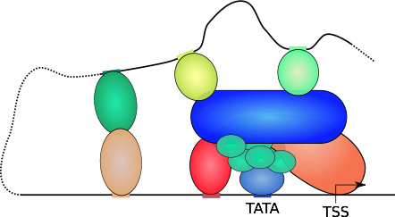
Transcriptional activation
looping factors
Mediator
DNA-looping enables interactions for the distal promotor regions,
Mediator cofactor-complex serves as a huge linker

Slide 44
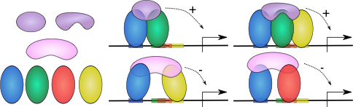
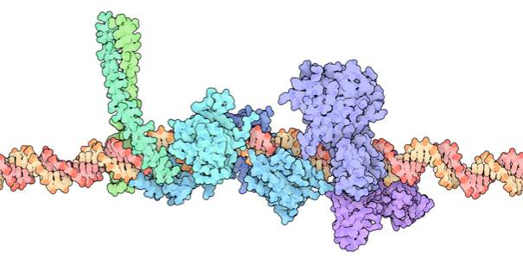
cis-regulatory modules
coactivators
corepressor
TFs
TFs are not dedicated activators or respressors!
It‘s the assembly that is crucial.
IFN-enhanceosome from RCSB Protein Data Bank, 2010

Slide 45
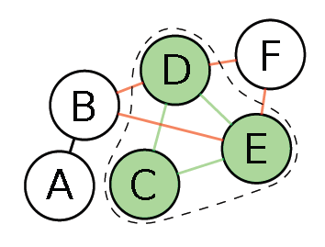
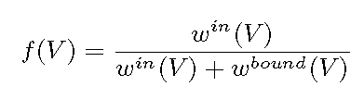
Protein complexes involving multiple transcription factors
Borrow idea from ClusterOne method:
Identify candidates of TF complexes
in protein-protein interaction graph
by optimizing the cohesiveness

Slide 46
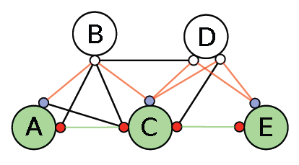
underlying domain-domain representation of PPIs
Assumption: every domain supports only one interaction.
Green proteins A, C, E form actual complex.
Their red domains are connected by the two green edges.
B and D are incident proteins. They could form new interactions (red edges) with unused domains (blue) of A, C, E

Slide 47
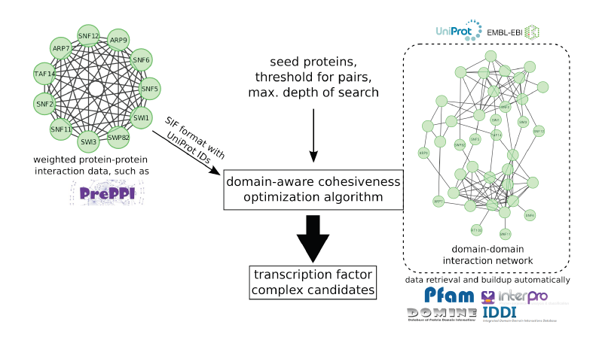
data source used: Yeast Promoter Atlas, PPI and DDI
Will, T. and Helms, V. (2014) Bioinformatics, 30, i415-i421

Slide 48
Daco identifies far more TF complexes than other methods

Slide 49
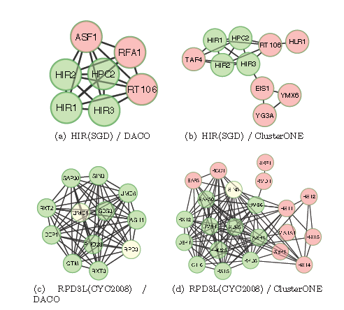
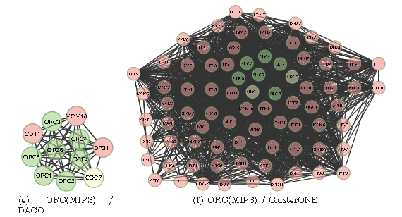
Examples of TF complexes – comparison with ClusterONE
Green nodes: proteins in the reference that were matched by the prediction
red nodes: proteins that are in the predicted complex, but not part of the reference.

Slide 50
Performance evaluation

Slide 51
Co-expressed target genes of MET4/MET32
TF complex during yeast cell cycle

Slide 52
Functional role of TF complexes

