Slide 1
V7 – Biological PPI Networks - graph bisection (-> communities) - graph modularity - network growth - functional annotation in the network
Thu, Nov 7, 2019

Slide 2
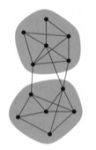
Graph bisection
The simplest graph partitioning problem is the division of a
network into just 2 parts. This is called graph bisection.
If we can divide a network into 2 parts, we can also divide
it further by dividing one or both of these parts …
graph bisection problem: divide the vertices of a
network into 2 non-overlapping groups of given sizes
such that the number of edges running between
vertices in different groups is minimized.
The number of edges between groups is called the cut size.
In principle, one could simply look through all possible divisions
of the network into 2 parts and choose the one with smallest cut size.

Slide 3
Algorithms for graph partitioning
But this exhaustive search is prohibitively expensive!
Given a network of n vertices. There are $\frac{n!}{n_{1}!n_{2}! }$ different ways of dividing it
into 2 groups of n₁ and n₂ vertices.
The amount of time to look through all these divisions will go up roughly
exponentially with the size of the system.
Only values of up to n = 30 are feasible with today‘s computers.
In computer science, one often encounters the following situation:
either an algorithm can be clever and run quickly, but will fail to provide the optimal answer in some (or perhaps in many) cases, or it will always find the optimal answer, but takes an impractical length of time to do so.

Slide 4
The Kernighan-Lin algorithm
This algorithm proposed by Brian Kernighan and Shen Lin in 1970 is one of the simplest and best known heuristic algorithms for the graph bisection problem.
(Kernighan is also one of the developers of the C language).
(a) The algorithm starts with any division of the vertices of a network into two groups (shaded) and then searches for pairs of vertices, such as the pair highlighted here, whose interchange would reduce the cut size between the groups.
(b) The same network after interchange of the 2 vertices.

Slide 5
The Kernighan-Lin algorithm
Divide the vertices of a given network into 2 groups (e.g. randomly).
For each pair (i,j) of vertices, where i belongs to the first group and j to the second group, calculate how much the cut size between the groups would change if i and j were interchanged between the groups.
Find the pair that reduces the cut size by the largest amount and swap the vertices.
If no pair reduces it, find the pair that increases it by the smallest amount.
Repeat this process, but with the important restriction that each vertex in the network can only be moved once.
Stop when there is no pair of vertices left that can be swapped.

Slide 6
The Kernighan-Lin algorithm (II)
Go back through every state that the network passed through during the swapping procedure and choose among them the state in which the cut size takes its smallest value.
Perform the steps (2) – (4) repeatedly, starting each iteration with the best division of the network found in the last round (in step (3)).
Stop when no improvement on the cut size occurs.
Note that if the initial assignment of vertices to groups is done randomly,
the Kernighan-Lin algorithm may give (slightly) different answers
when it is run twice on the same network.

Slide 7
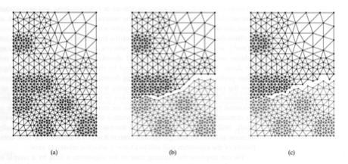
The Kernighan-Lin algorithm (II)
(a) A mesh network of 547 vertices of the kind commonly used in finite element analysis.
(b) The best division found by the Kernighan-Lin algorithm when the task is to split the network into 2 groups of almost equal size.
This division involves cutting 40 edges in this mesh network and gives parts of 273 and 274 vertices.
(c) The best division found by spectral partitioning (alternative method).

Slide 8
Runtime of the Kernighan-Lin algorithm
The number of swaps performed during one round of the algorithm is equal to the smaller of the sizes of the two groups ∈ [0, n / 2].
→ in the worst case, there are O(n) swaps.
For each swap, we have to examine all pairs of vertices in different groups to determine how the cut size would be affected if the pair was swapped.
At most (if both groups have the same size),
there are n / 2 × n / 2 = n² / 4 such pairs, which is O(n²).

Slide 9
Runtime of the Kernighan-Lin algorithm (ii)
When a vertex i moves from one group to the other group, any edges connecting it to vertices in its current group become edges between groups after the swap.
Let us suppose that there are k_{i}^{same} such edges.
Similarly, any edges that i has to vertices in the other group, (say k_{i}^{other} ones)
become within-group edges after the swap.
There is one exception. If i is being swapped with vertex j and they are connected by an edge, then the edge is still between the groups after the swap
→ the change in the cut size due to the movement of i is – (k_{i}^{other} - k_{i}^{same} – A_{ij})
A similar expression applies for vertex j.
→ the total change in cut size due to the swap is
– (k_{i}^{other} - k_{i}^{same} +k_{j}^{other} - k_{j}^{same} – 2A_{ij})

Slide 10
Runtime of the Kernighan-Lin algorithm (iii)
For a network stored in adjacency list form, the evaluation of this expression involves running through all the neighbors of i and j in turn, and hence
takes time on the order of the average degree in the network,
or O (m/n) with m edges in the network.
→ the total running time is O ( n × n² × m/n ) = O(mn²).
For a sparse network with m ∝ n, this is O(n³).
For a dense network (with $m→\frac{n\left(n−1\right)}{2}$) , this is O(n⁴).
This time still needs to be multiplied by the number of rounds the algorithm is run before the cut size stops decreasing.
For networks up to a few 1000 of vertices, this number may be between 5 and 10.

Slide 11
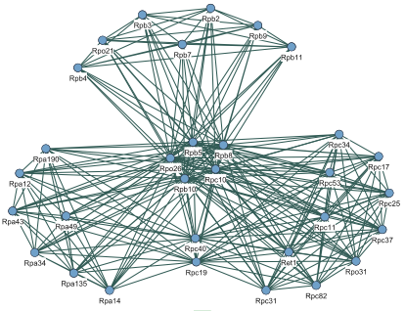
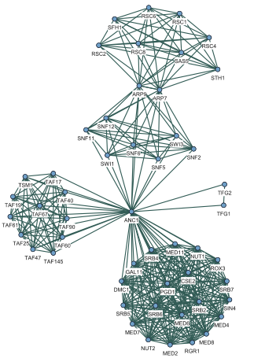
Reducing Network Complexity?
Is there a representation that highlights
the structure of these networks???
• Modular Decomposition (Gagneur, …, Casari, 2004)
• Network Compression (Royer, …, Schröder, 2008)

Slide 12
Genome Biology 5 (2004) R57

Slide 13
Shared Components
Shared components = proteins or groups of proteins occurring in different complexes are fairly common. A shared component may be a small part of many complexes, acting as a unit that is constantly reused for its function.
Also, it may be the main part of the complex e.g. in a family of variant complexes that differ from each other by distinct proteins that provide functional specificity.
Aim: identify and properly represent the modularity of protein-protein interaction networks by identifying the shared components and the way they are arranged to generate complexes.
Gagneur et al. Genome Biology 5, R57 (2004)
Georg Casari, Cellzome (Heidelberg)

Slide 14
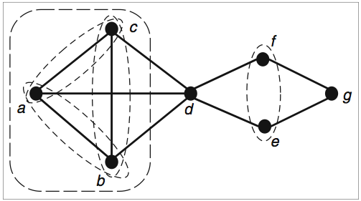
Modular Decomposition of a Graph
Module := set of nodes that have the
same neighbors outside of the module
trivial modules:
{a}, {b}, …, {g}
{a, b, …, g}
non-trivial modules:
{a, b}, {a, c}, {b, c}
{a, b, c}
{e, f}
Quotient: representative node for a module
Iterated quotients → labeled tree representing the original network
→ "modular decomposition"
Gagneur et al, Genome Biology 5 (2004) R57

Slide 15
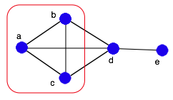
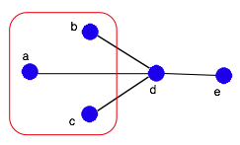
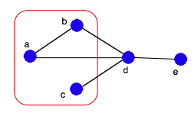
Quotients
Series: all included nodes are direct neighbors (= clique)
→
Parallel: all included nodes are non-neighbors
→
Prime: "anything else" (best labeled with the actual structure)
→

Slide 16
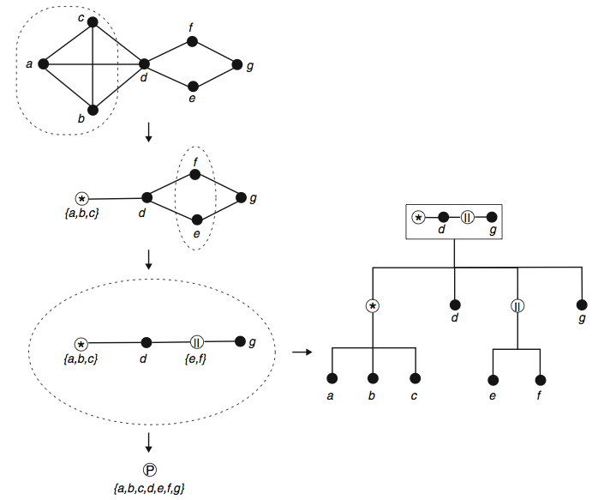
A Simple Recursive Example
parallel
series
prime
Gagneur et al, Genome Biology 5 (2004) R57

Slide 17
Using data from protein complex purifications e.g. by TAP
Different types of data:
• Y2H: detects direct physical interactions between proteins
• PCP by tandem affinity purification with mass-spectrometric identification of the protein components identifies multi-protein complexes
→ Molecular decomposition will have a different meaning due to different semantics of such graphs.
Here, we focus analysis on PCP content from TAP-MS data.
PCP experiment: select bait protein where TAP-label is attached → Co-purify protein with those proteins that co-occur in at least one complex with the bait protein.
Gagneur et al. Genome Biology 5, R57 (2004)

Slide 18
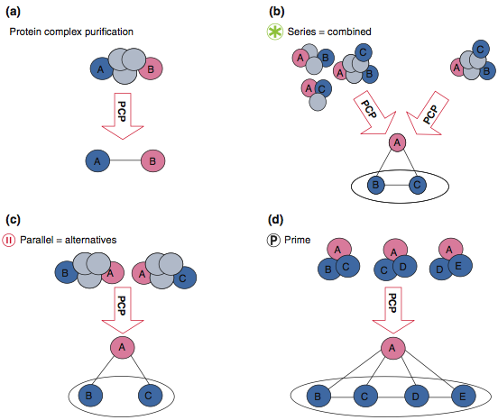
Data from Protein Complex Purification
Graphs and module labels from systematic PCP experiments:
(a) Two neighbors in the network are proteins occurring in a same complex.
(b) Several potential sets of complexes can be the origin of the same observed network. Restricting interpretation to the simplest model (top right), the series module reads as a logical AND between its members.
(c) A module labeled ´parallel´ corresponds to proteins or modules working as strict alternatives with respect to their common neighbors.
(d) The ´prime´ case is a structure where none of the two previous cases occurs.
Gagneur et al. Genome Biology 5, R57 (2004)

Slide 19
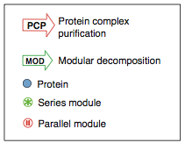
Real World Examples
Two examples of modular decompositions of protein-protein interaction networks.
In each case from top to bottom: schemata of the complexes, the corresponding protein-protein interaction network as determined from PCP experiments, and its modular decomposition (MOD).
(a) Protein phosphatase 2A.
Parallel modules group proteins that do not interact but are functionally equivalent.
Here these are the catalytic proteins Pph21 and Pph22 (module 2) and the regulatory proteins Cdc55 and Rts1 (module 3), connected by the Tpd3 „backbone“.
Notes: • Graph does not show functional alternatives!!!
• other decompositions also possible
Gagneur et al. Genome Biology 5, R57 (2004)

Slide 20
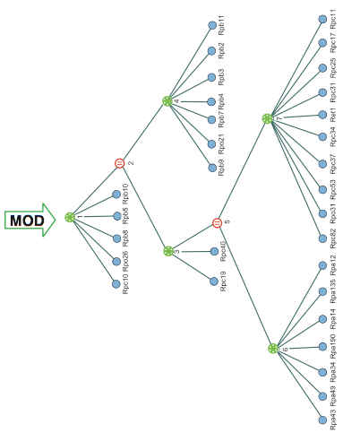
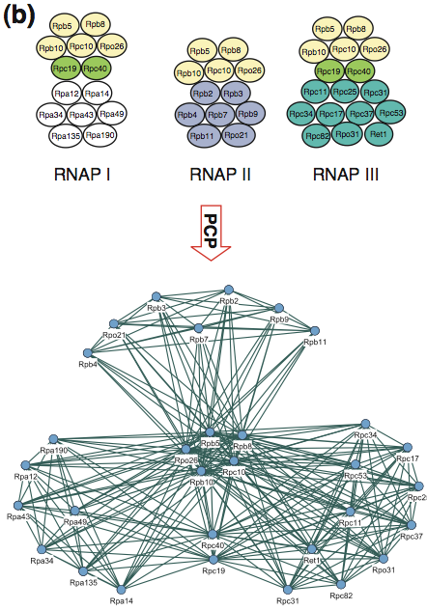
RNA polymerases I, II and III
Again: modular decomposition is much easier to understand than the connectivity graph
Gagneur et al. Genome Biology 5, R57 (2004)

Slide 21
Summary
Modular decomposition of graphs is a well-defined concept.
• One can proof thoroughly for which graphs a modular decomposition exists.
• Efficient O(m + n) algorithms exist to compute the decomposition.
However, experiments have shown that biological complexes are not strictly disjoint. They often share components
→ separate complexes do not always fulfill the strict requirements of modular graph decomposition.
Also, there exists a „danger“ of false-positive or false-negative interactions.
→ other methods, e.g., for detecting communities (Girven & Newman) or densely connected clusters are more suitable for identification of complexes because they are more sensitive.

Slide 22
Network Growth Mechanisms
Given: an observed PPI network → how did it grow (evolve)?
PNAS 102 (2005) 3192
Look at network motifs (local connectivity):
compare motif distributions from various network prototypes to fly network
Idea: each growth mechanism leads to a typical motif distribution,
even if global measures are comparable

Slide 23
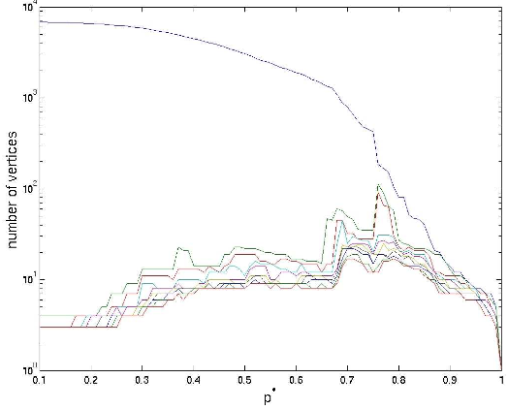
The Fly Network
Y2H PPI network for D. melanogaster from Giot et al. [Science 302 (2003) 1727]
Giot et al. assigned a confidence score [0, 1] to every observed interaction.
→ use only data with
p > 0.65 (0.5) because …
→ remove self-interactions
and isolated nodes
percolation events for p > 0.65
High confidence network
with 3359 (4625) nodes
and 2795 (4683) edges.
Use prototype networks
of same size for training.
Size of largest components. At p = 0.65, there is one large component with 1433 nodes and the other 703 components contain at most 15 nodes.
Middendorf et al, PNAS 102 (2005) 3192

Slide 24
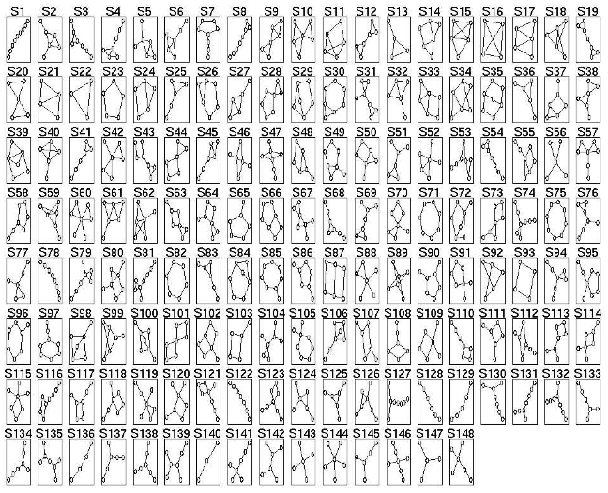
Network subgraphs -> motifs
All non-isomorphic subgraphs that can be generated with a walk of length 8
Middendorf et al, PNAS 102 (2005) 3192

Slide 25
Growth Mechanisms
Generate 1000 networks, each, of the following 7 types
(same size as fly network, undefined parameters were scanned)
DMC Duplication-mutation, preserving complementarity
DMR Duplication with random mutations
RDS Random static networks
RDG Random growing network
LPA Linear preferential attachment network (Albert-Barabasi)
AGV Aging vertices network
SMW Small world network

Slide 26
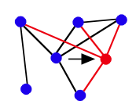
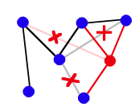
Growth Type 1: DMC
"Duplication – mutation with preserved complementarity"
Evolutionary idea: gene duplication, followed by a partial loss of
function of one of the copies, making the other copy essential
Algorithm:
Start from two connected nodes
• duplicate existing node with all interactions
• for all neighbors: delete with probability qdel
either link from original node or from copy
Repeat these steps many (e.g. N – 2) times

Slide 27
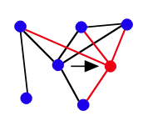
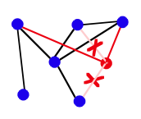
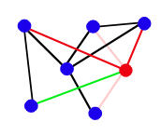
Growth Type 2: DMR
"Duplication with random mutations"
Gene duplication, but no correlation between original and copy
(original unaffected by copy)
Algorithm:
Start growth from five-vertex cycle,
repeat N - 5 times:
• duplicate existing node with all interactions
• for all neighbors: delete with probability qdel
link from copy
• add new links to non-neighbors with
probability qnew/n

Slide 28
Growth Types 3–5: RDS, RDG, and LPA
RDS = static random network
Start from N nodes, add L links randomly
RDG = growing random network
Start from small random network, add nodes,
then edges between all existing nodes
LPA = linear preferential attachment
Add new nodes similar to Barabási-Albert algorithm,
but with preference according to (ki + α), α = 0…5
(BA for α = 0)

Slide 29
Growth Types 6-7: AGV and SMW
AGV = aging vertices network
Like growing random network,
but preference decreases with age of the node
→ citation network: more recent publications are cited more likely
SMW = small world networks, see Watts, Strogatz, Nature 363, 202 (1998)
Randomly rewire regular ring lattice

Slide 30
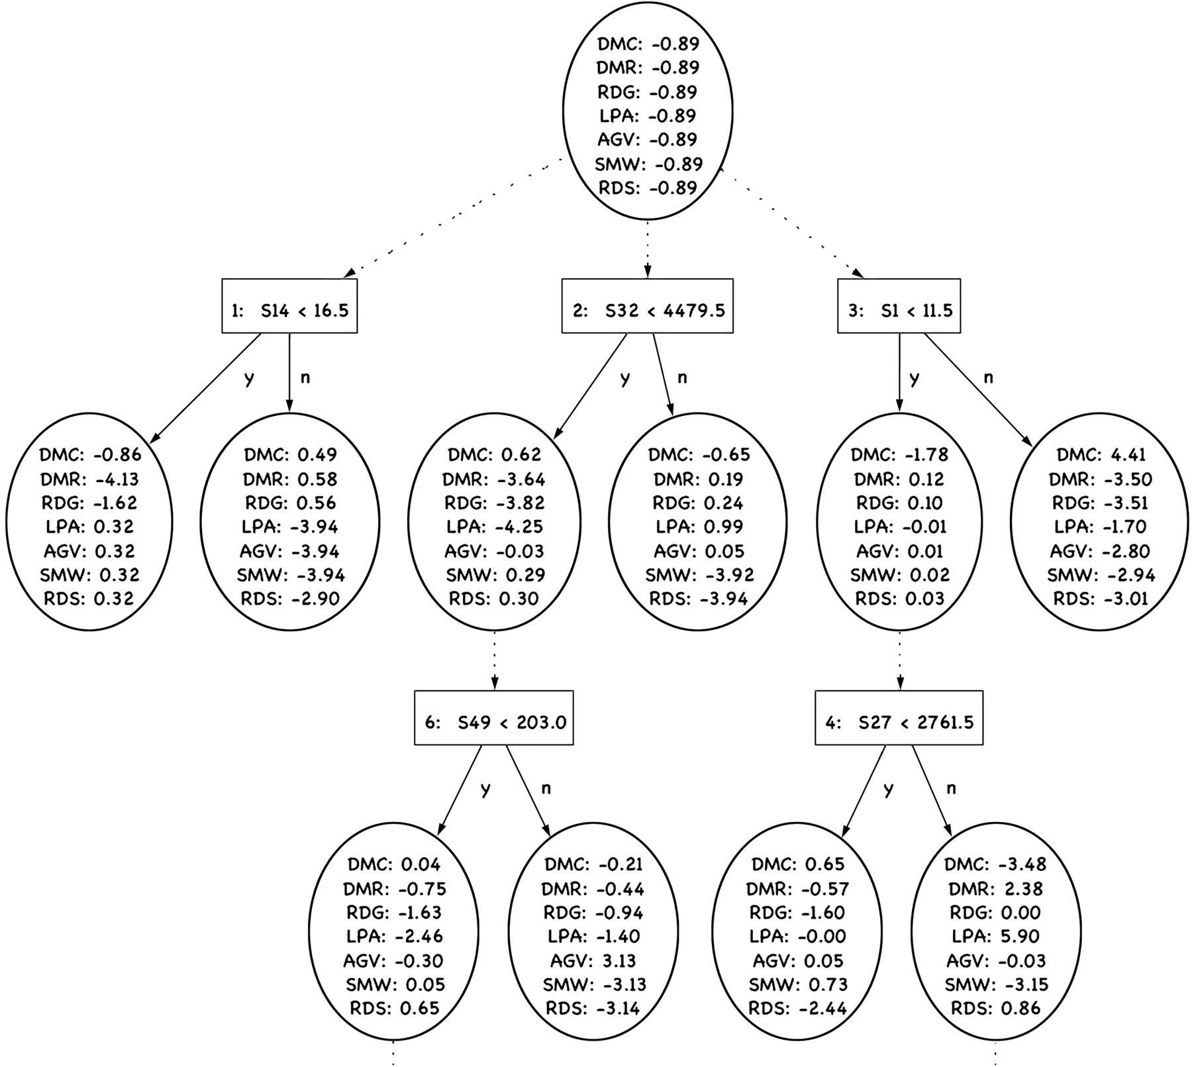
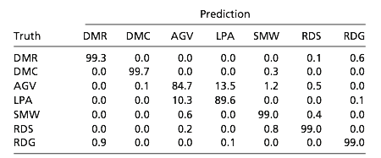
Alternating Decision Tree Classifier
Trained with the motif counts from 1000 networks of each of the 7 types
→ prototypes are well separated and can be reliably classified
Prediction accuracy for networks similar to fly network with p = 0.5:
Part of a trained ADT
Decision nodes count occurrence of subgraphs
Middendorf et al, PNAS 102 (2005) 3192

Slide 31
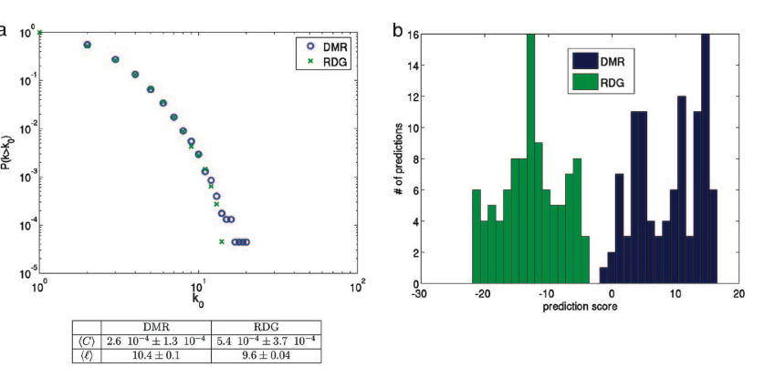
Are the generated networks different?
Clustering coefficient
Average shortest path length
Example: DMR vs. RDG: Similar global parameters <C> and <l> (left),
but different counts of the network motifs (right)
-> networks can (only) be perfectly separated by motif-based classifier
Middendorf et al, PNAS 102 (2005) 3192

Slide 32
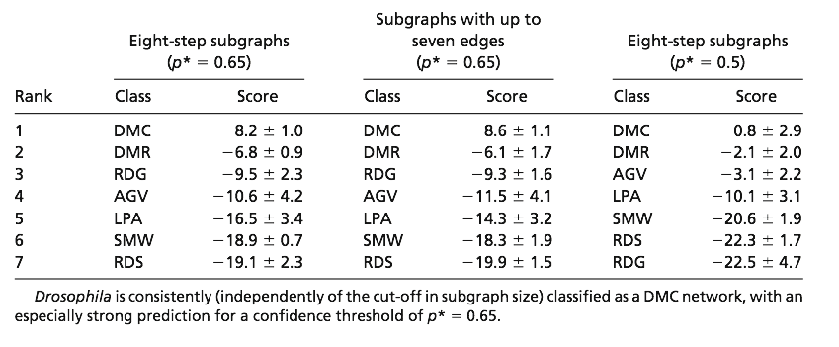
How Did the Fly Evolve?
→ Best overlap with DMC (Duplication-mutation, preserved complementarity)
→ Scale-free (LPA) or random networks (RDS/RDG) are very unlikely
Middendorf et al, PNAS 102 (2005) 3192

Slide 33
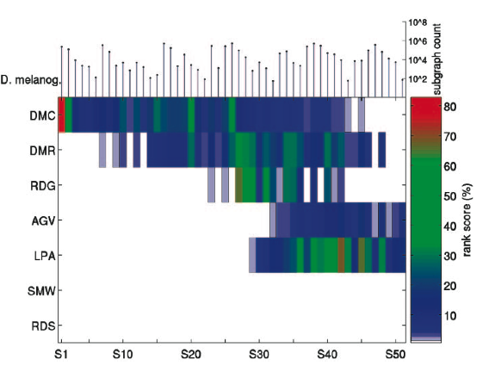
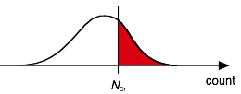
Motif Count Frequencies
-> DMC and DMR networks contain most subgraphs in similar amount as fly network (top).
rank score: fraction of test networks with a higher count than Drosophila
(50% = same count as fly on avg.)
Middendorf et al, PNAS 102 (2005) 3192

Slide 34
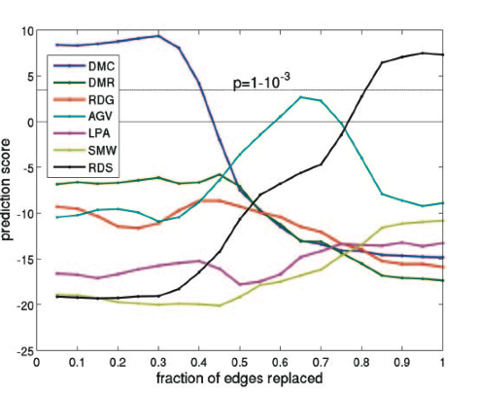
Experimental Errors?
Randomly replace edges in fly network and classify again:
→ Classification unchanged for ≤ 30% incorrect edges,
at higher values RDS takes over (as to be expected)

Slide 35
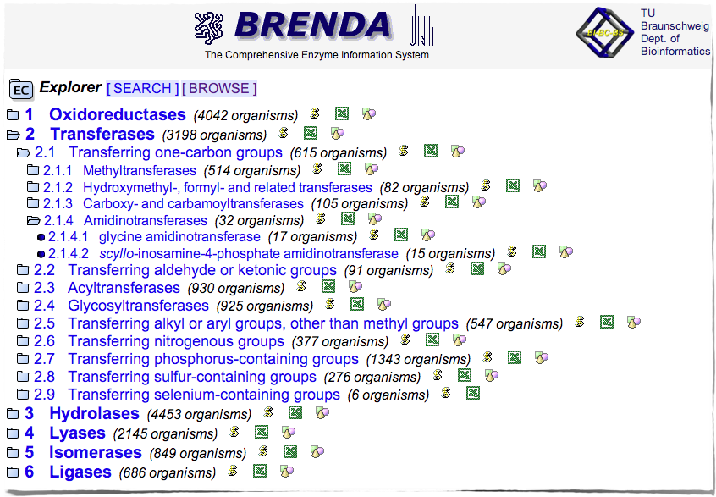
What Does a Protein Do?
Enzyme Classification scheme
(from http://www.brenda-enzymes.org/)

Slide 36
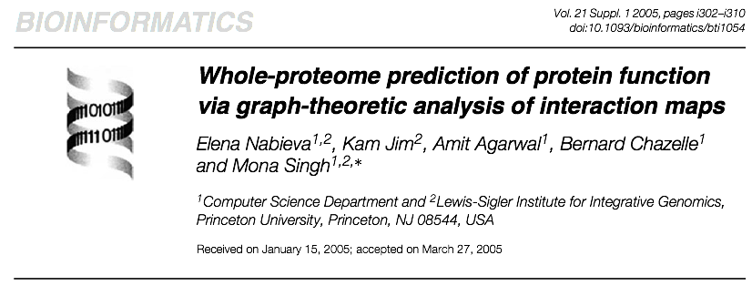
What about Un-Classified Proteins?
Many unclassified proteins:
→ estimate: ~1/3 of the yeast proteome not annotated functionally
→ BioGRID: 4495 proteins in the largest cluster of the yeast physical interaction map.
only 2946 have a MIPS functional annotation

Slide 37
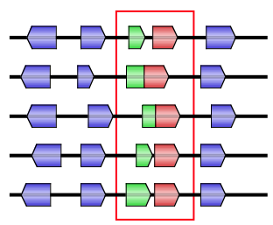
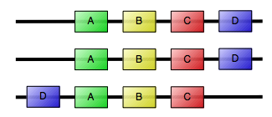
Partition the Graph
Large PPI networks can be built from (see V3, V4, V5):
• HT experiments (Y2H, TAP, synthetic lethality, coexpression, coregulation, …)
• predictions (gene profiling, gene neighborhood, phylogenetic profiles, …)
→ proteins that are functionally linked
sp 1
genome 1
sp 2
sp 3
genome 2
sp 4
genome 3
sp 5
Identify unknown functions from clustering of these networks by, e.g.:
• shared interactions (similar neighborhood)
• membership in a community
• similarity of shortest path vectors to all other proteins (= similar path into
the rest of the network)

Slide 38
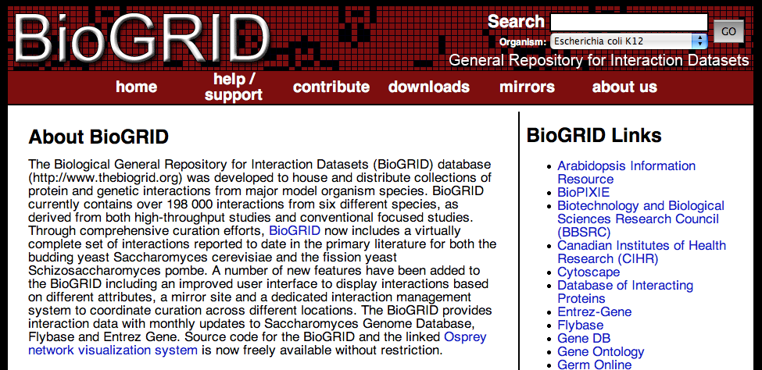
Protein Interactions
Nabieva et al used the S. cerevisiae dataset from GRID of 2005 (now BioGRID)
→ 4495 proteins and 12 531 physical interactions in the largest cluster
http://www.thebiogrid.org/about.php

Slide 39
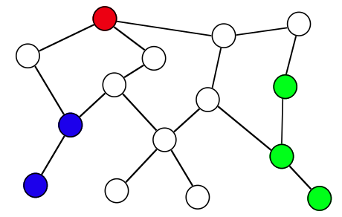
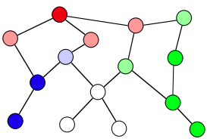
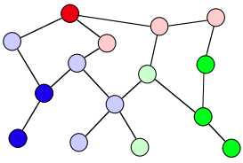
Function Annotation
Task: predict function (= functional annotation) for an unlabeled protein
from the available annotations of other proteins in the network
Similar task:
How to assign colors to the white nodes?
Use information on:
• distance to colored nodes
• local connectivity
• reliability of the links
• …
<=>

Slide 40
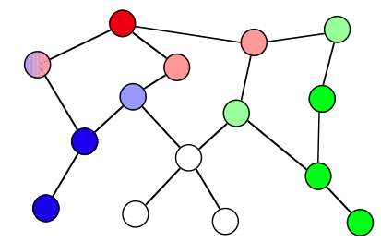
Algorithm I: Majority
This concept was presented in
Schwikowski, Uetz, and Fields, " A network of protein–protein interactions in yeast" Nat. Biotechnol. 18 (2000) 1257
Consider all direct neighbors and sum up how often a certain annotation occurs
→ score for an annotation = count among the direct neighbors
→ take the 3 most frequent functions
Majority makes only limited use of the local connectivity
→ cannot assign function to
next-neighbors
For weighted graphs:
→ use weighted sum

Slide 41
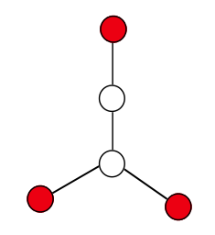
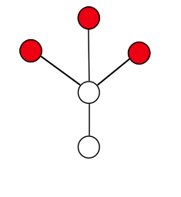
Extended Majority: Neighborhood
This concept was presented in
Hishigaki, Nakai, Ono, Tanigami, and Takagi, "Assessment of prediction accuracy of protein function from protein–protein interaction data",
Yeast 18 (2001) 523
Look for overrepresented functions within a given radius of 1, 2, or 3 links
→ use as function score the value of a χ²–test
Neighborhood algorithm does not consider local network topology
Both examples (left) are treated identically with r = 2
although the right situation feels more certain (2 direct neighbors of ? are labeled)
?
?

Slide 42
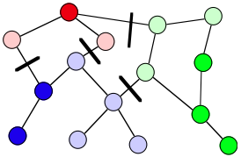
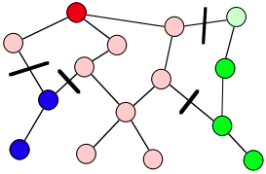
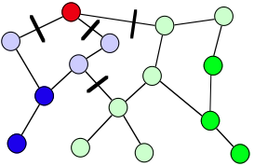
Minimize Changes: GenMultiCut
This concept was presented in
Karaoz, Murali, Letovsky, Zheng, Ding, Cantor, and Kasif, "Whole-genome annotation by using evidence integration in functional-linkage networks"
PNAS 101 (2004) 2888
"Annotate proteins so as to minimize the number of times that different functions are associated to neighboring (i.e. interacting) proteins"
→ generalization of the multiway k-cut problem for weighted edges,
can be stated as an integer linear program (ILP)
Multiple possible solutions → scores from frequency of annotations

Slide 43
Nabieva et al: FunctionalFlow
Extend the idea of "guilty by association"
→ each annotated protein is considered as a source of "function"-flow
→ propagate/simulate for a few time steps
→ choose the annotation a with the highest accumulated flow
Each node u has a reservoir Rt(u), each edge a capacity constraint (weight) wu,v
Initially:
and
Then: downhill flow from node u to neighbor node v:
Idea: Node v has already „more function“ than node u → no flow uphill
Score from accumulated in-flow:
Nabieva et al, Bioinformatics 21 (2005) i302

Slide 44
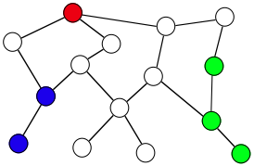
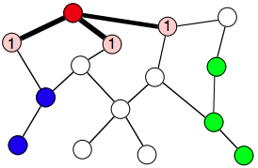
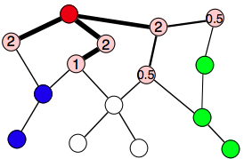
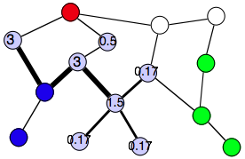
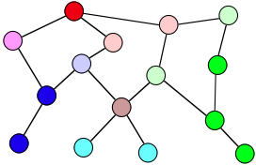
An Example
accumulated flow
thickness = current flow
…..
…..
…..

Slide 45
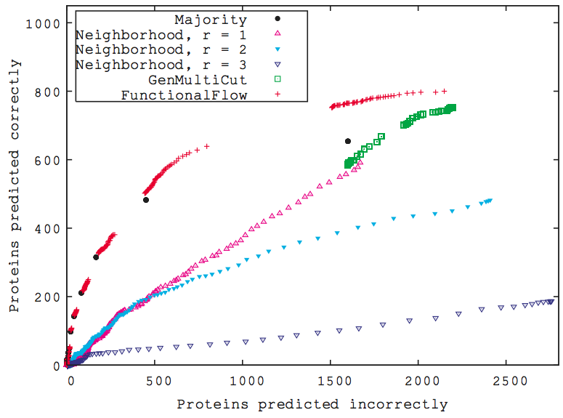
Comparison
For FunctionalFlow:
six propagation steps were simulated; this is comparable to the diameter of the yeast network ≈ 12
Majority results are initially very good, but method has limited coverage.
Results with neighborhood get more imprecise for larger radii r
unweighted yeast map
Change score threshold for accepting annotations → ratio TP/FP
→ FunctionalFlow performs best in the high-confidence region
→ but generates still many false predictions!!!
Nabieva et al, Bioinformatics 21 (2005) i302

Slide 46
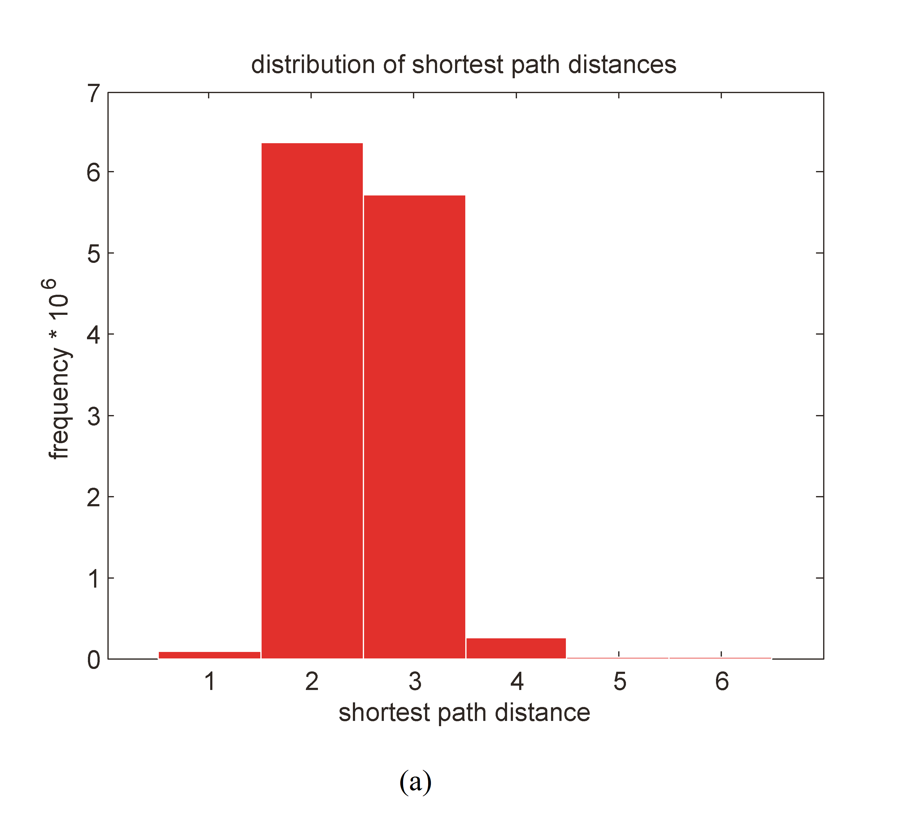
Relying on the ordinary shortest-path distance metric in PPI networks is problematic because PPI networks are “small world” networks.
Most nodes are “close” to all other nodes.
→ any method that infers similarity based on proximity will find that a large fraction of the network is proximate to any typical node.
Largest connected component of S. cerevisiae PPI network (BioGRID) has 4990 nodes and 74,310 edges (physical interactions).
Right figure shows the histogram of shortest-path lengths in this network. Over 95% of all pairs of nodes are either 2 hops or 3 hops apart

Slide 47
What nodes mediate short contacts?
The 2-hop neighborhood of a typical node
probably includes around half of all nodes in the graph.
One of the reasons that paths are typically short in biological networks
like the PPI network is due to the presence of hubs.
But hub proteins often represent proteins with
different functional roles than their neighbors.
Hub proteins likely also have multiple, distinct functions.
not all short paths provide equally strong evidence
of similar function in PPI networks.

Slide 48
DSD Distance Metric
If there is no ambiguity about k, we can drop k.
He(v_{i}) is a „random walk distance vector“ of node v_{i} from all other nodes.
where
Two nodes u and v have small DSD if they have similar distance from all other nodes.
Explanation:

Slide 49
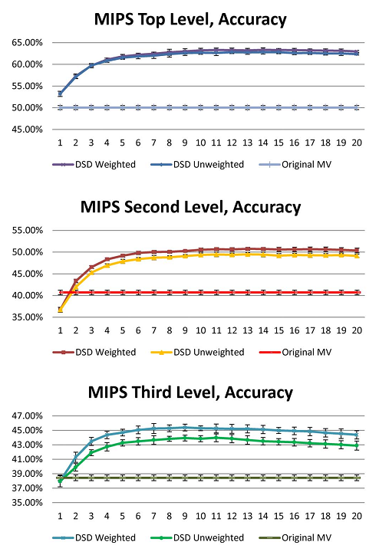
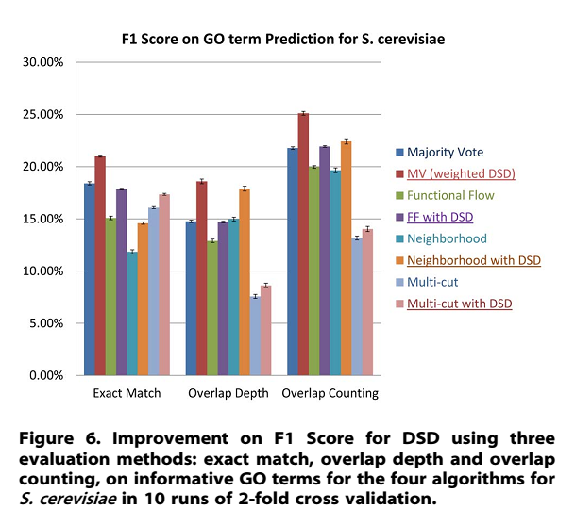
DSD clearly improves functional predictions
MV: majority voting

Slide 50
Summary
What you learned today:
- Graph bisection
=> Kernighan Lin algorithm
- Modules in networks
=> modular decomposition
- Postulated modes of network evolution
=> DMC yields networks that mimicking real networks most closely
- Predicting unknown protein functions
from a protein’s connectivity in PPI network
V8: wrap up protein interaction networks
Then next block of the lecture: gene-regulatory networks

