Slide 1
V15: Analysis of DNA methylation data
Epigenetics refers to alternate phenotypic states that are
not based on differences in genotype,
and are potentially reversible,
but are generally stably maintained during cell division.
Examples: imprinting, twins, cancer vs. normal cells, differentiation, ...
Narrow interpretation of this concept : stable differential states of gene expression.
Laird, Hum Mol Gen 14, R65 (2005)

Slide 2
11.1 What is epigenetics?
A much more expanded view of epigenetics has recently emerged
in which multiple mechanisms interact to collectively establish
- alternate states of chromatin structure (open – packed/condensed),
- histone modifications,
composition of associated proteins (e.g. histones),
transcriptional activity,
activity of microRNAs, and
- in mammals, cytosine-5 DNA methylation at CpG dinucleotides.
Laird, Hum Mol Gen 14, R65 (2005)

Slide 3
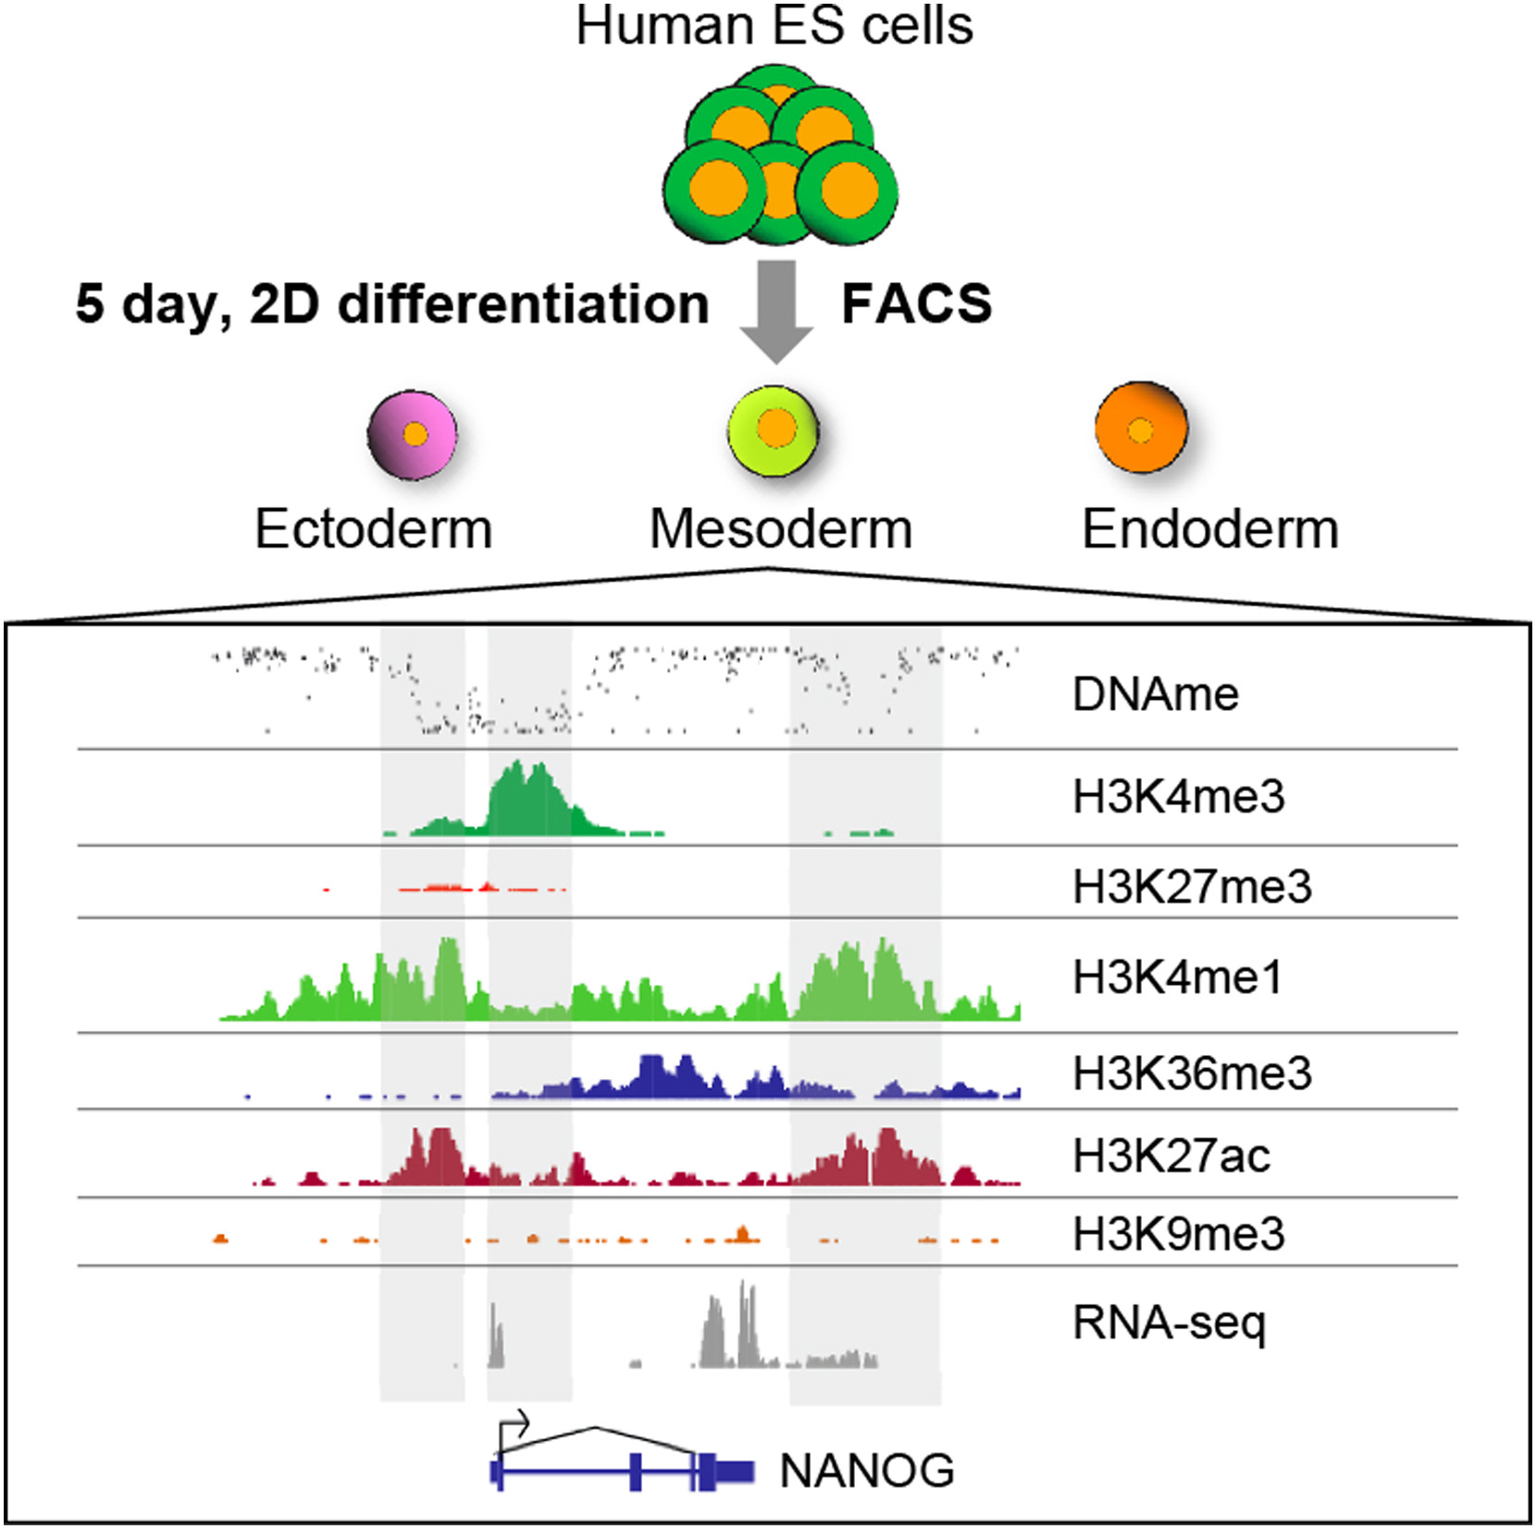
11.1 Epigenetic marks
Epigenetic marks around the NANOG gene after 2 days of directed differentiation of human embryonic stem cells into mesoderm tissue.
Top row : DNA methylation level.
Next six rows : presence/absence of specified histone marks.
Bottom row : level of gene transcription measured by RNA sequencing.
Shown at the bottom is the exon structure of the gene NANOG that is crucial for development.
Gifford CA et al. (2013) Cell 153, 1149-1163

Slide 4
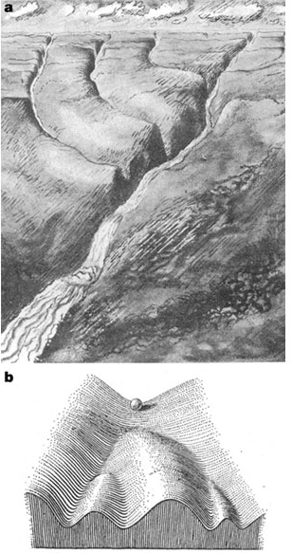

Waddington epigenetic landscape for embryology
Waddington worked in embryology
a) is a painting by John Piper that was used as the frontispiece for Waddington's book Organisers and Genes.
It represents an epigenetic landscape.
Developmental pathways that could be taken by each cell of the embryo are metaphorically represented by the path taken by water as it flows down the valleys.
b) Later depiction of the epigenetic landscape. The ball represents a cell, and the bifurcating system of valleys represents bundles of trajectories in state space.
Conrad Hal Waddington
(1905 – 1975)
pictures.royalsociety.org
Slack, Nature Rev Genet 3, 889-895 (2002)

Slide 5
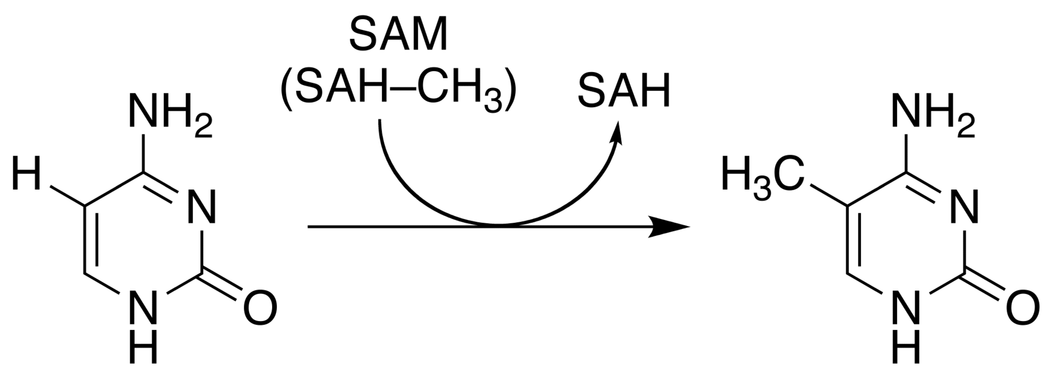
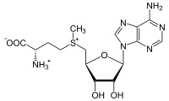
Cytosine methylation
Observation: 3-6 % of all cytosines are methylated in human DNA.
This methylation occurs (almost) exclusively when cytosine is followed by a guanine base -> CpG dinucleotide.
5-methyl-cytosine
SAM: S-adenosyl-methionine
SAH: S-adenosyl-homocysteine
Cytosine
As most CpGs serve as targets of DNA methyltransferases,
about 70 - 80% of them are usually methylated.
BUT mammalian genomes contain much fewer (only 20-25 %)
of the CpG dinucleotide than is expected by the G+C content
(we expect 1/16 ≈ 6% for any random dinucleotide).
This is typically explained in the following way:
…. (see following page)
Esteller, Nat. Rev. Gen. 8, 286 (2007)
www.wikipedia.org

Slide 6
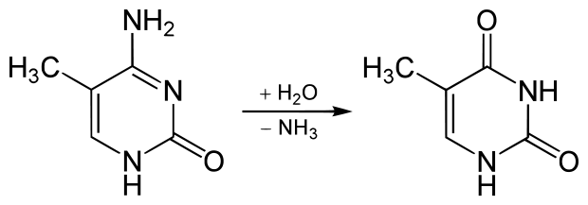
Cytosine methylation
5-Methylcytosine can easily deaminate to thymine.
If this mutation is not repaired, the affected CpG is permanently converted to TpG
(or CpA if the transition occurs on the reverse DNA strand).
Hence, methylCpGs represent mutational hot spots in the genome.
If such mutations occur in the germ line, they become heritable.
A constant loss of CpGs over thousands of generations
can explain the low frequency of this
special dinucleotide in the genomes of human and mouse.
5-methyl-cytosine
thymine
Esteller, Nat. Rev. Gen. 8, 286 (2007)
www.wikipedia.org

Slide 7
chromatin organization affects gene expression
Schematic of the reversible changes in chromatin organization that influence
gene expression:
genes are expressed (switched on) when the chromatin is open (active), and they are inactivated (switched off) when the chromatin is condensed (silent).
White circles = unmethylated cytosines;
red circles = methylated cytosines.
Rodenhiser, Mann, CMAJ 174, 341 (2006)

Slide 8


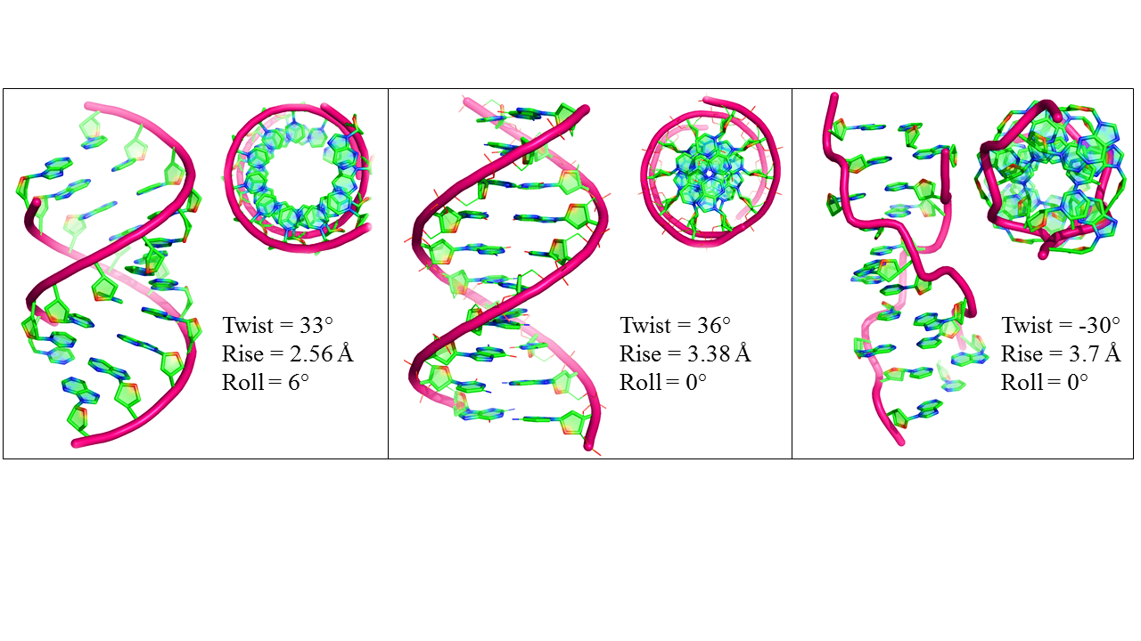
DNA fiber forms
A-DNA B-DNA Z-DNA
Requires more methylation,
higher concentration of physiological salts
Methylation of adenine vs. cytosine has very different effects
Dry Environment
Most prominent in cellular conditions
Equilibrium shift with specific conditions

Slide 9
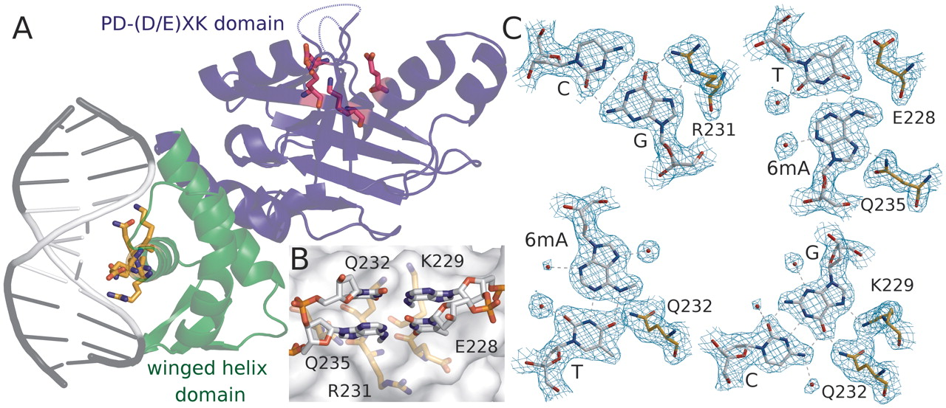
Protein-DNAMe interaction (R.DpnI from E.coli)
Left: structural transitions of DNA affect accessibility of the base pairs
Right: recognition of 6-methylated adenine (common form of DNA methylation in bacteria)
Siwek et al. Nucl. Acids Res. (2012) 40 (15): 7563-7572.

Slide 10
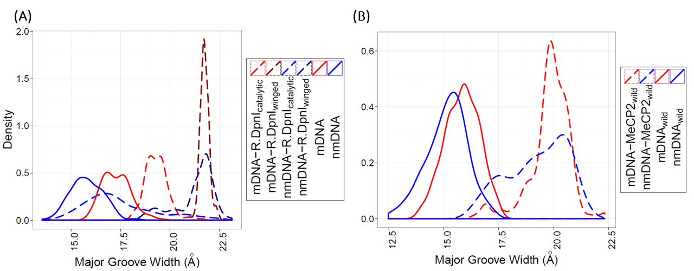
Protein-DNAMe interaction
Binding of E.coli restriction enzyme R.DpnI to adenine- methylated or unmethylated target sequence
-> methylation has clear effects on width of major groove
Binding of MeCP2 to cytosine- methylated or unmethylated target BDNF sequence from human
-> methylation has smaller effects on width of major groove
PhD thesis Siba Shanak (2015)

Slide 11
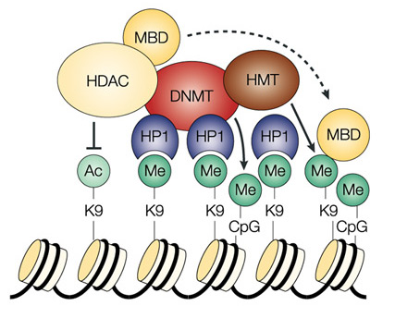
Enzymes that control
DNA methylation and histone modfications
These dynamic chromatin states are controlled by reversible
epigenetic patterns of DNA methylation and histone modifications.
Enzymes involved in this process include
- DNA methyltransferases (DNMTs),
- histone deacetylases (HDACs),
- histone acetylases,
- histone methyltransferases and the
methyl-binding domain protein MECP2.
For example, repetitive genomic sequences
(e.g. human endogenous retroviral sequences
= HERVs) are heavily methylated,
which means transcriptionally silenced.
Rodenhiser, Mann, CMAJ 174, 341 (2006)
Feinberg AP & Tycko P (2004) Nature Reviews: 143-153

Slide 12
DNA methylation
Typically, unmethylated clusters of CpG pairs are located in
tissue-specific genes and in essential housekeeping genes.
(House-keeping genes are involved in routine maintenance roles and are expressed in most tissues.)
These clusters, or CpG islands, are targets for proteins
that bind to unmethylated CpGs and initiate gene transcription.
In contrast, methylated CpGs are generally associated with silent DNA,
can block methylation-sensitive proteins and can be easily mutated.
The loss of normal DNA methylation patterns is the
best understood epigenetic cause of disease.
In animal experiments, the removal of genes that encode DNMTs is lethal;
in humans, overexpression of these enzymes has been linked
to a variety of cancers.
Rodenhiser, Mann, CMAJ 174, 341 (2006)

Slide 13
CpG islands
CpG islands are characterized by a high density of CpG dinucleotides that can be targeted by DNA methylation.
CpG islands are regulatory elements and are often located in the promoter region of genes.
Criteria to define CpG islands:
Gardiner-Garden and Frommer: ≥ 200 bp length,
G + C ≥ 50%
CpG_{obs}/CpG_{exp} ≥ 0.6
Takai and Jones: ≥ 500 bp length
G + C ≥ 55%
CpG_{obs}/CpG_{exp} ≥ 0.65.
Hutter, Helms, Paulsen, Genomics 88, 323 (2006)

Slide 14
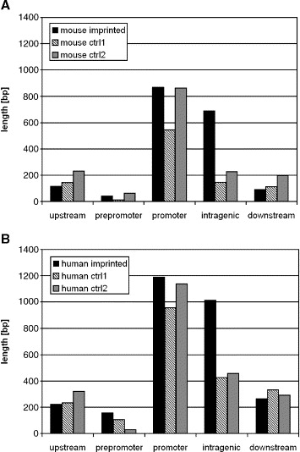
CpG islands
Average total length of CpG islands per gene in repeat-masked sequences at five different locations in (A) Mouse, (B) human.
Imprinted genes are monoallelically expressed, the other allele is silenced by DNA methylation.
About 100 imprinted genes are experimentally confirmed.
Ctrl1, ctrl2: groups of randomly selected (most likely biallelic) control genes
Takai and Jones parameters
-> CpG islands frequent in promoters and in the gene body of imprinted genes.
Hutter, Helms, Paulsen, Genomics 88, 323 (2006)

Slide 15
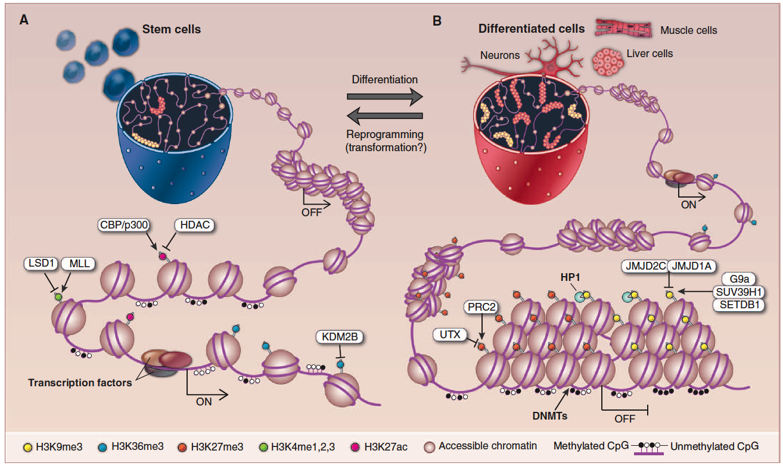
Differentiation linked to alterations of chromatin structure
(B) Upon differentiation, inactive genomic regions may be sequestered by repressive chromatin enriched for characteristic histone modifications.
(A) In pluripotent cells, chromatin is hyperdynamic and globally accessible.
ML Suva et al. Science 2013;
339:1567-1570

Slide 16
Altered DNA methylation upon cancerogenesis
Esteller, Nat. Rev. Gen. 8, 286 (2007)

Slide 17
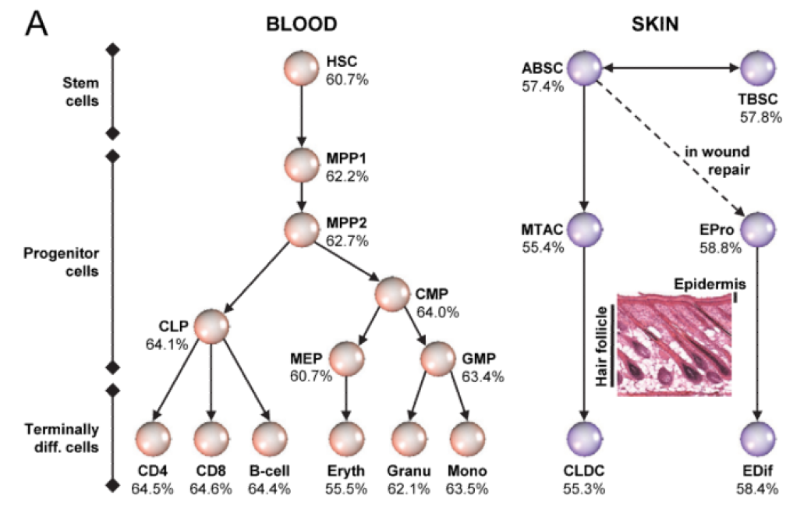
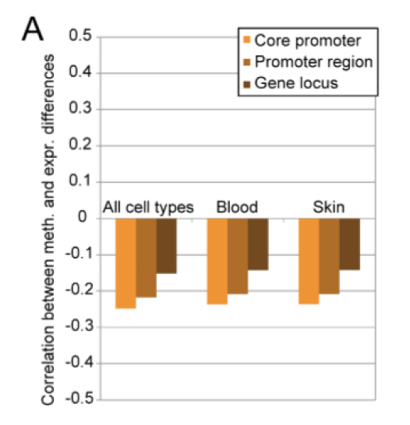
DNA methylation is typically only weakly correlated with gene expression!
Left: different states of hematopoiesis (blood cell differentiation).
HSC: hematopoietic stem cell
MPP1/2: multipotent progenitor cell
Right: skin cell differentiation
Bock et al. , Mol. Cell.
47, 633 (2012)

Slide 18
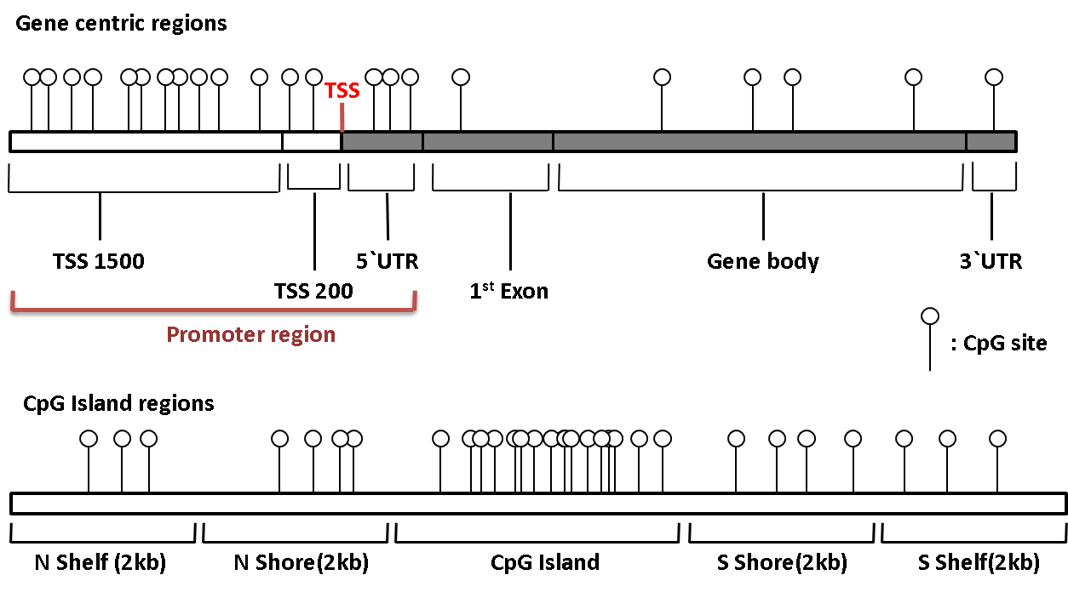
Promoter methylation vs. gene-body methylation
The relationship between methylation and gene expression is complex.
High levels of gene expression are often associated with
low promoter methylation but elevated gene body methylation.
The causality relationships between expression levels and DNA methylation have not yet been determined.
Wagner et al.
Genome Biology (2014) 15:R37
http://methhc.mbc.nctu.edu.tw

Slide 19
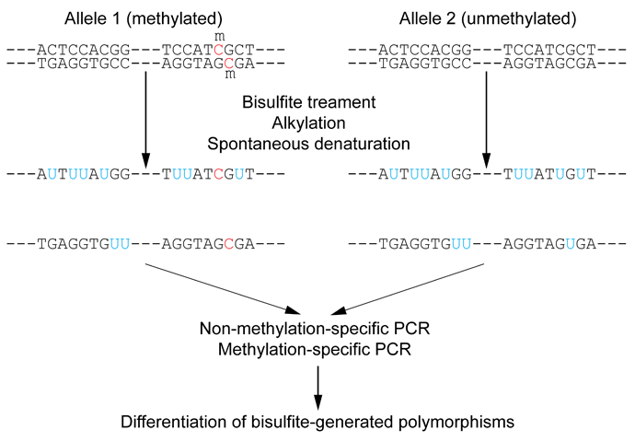
Detect DNA methylation by bisulfite conversion
Or NGS sequencing
www.wikipedia.org

Slide 20
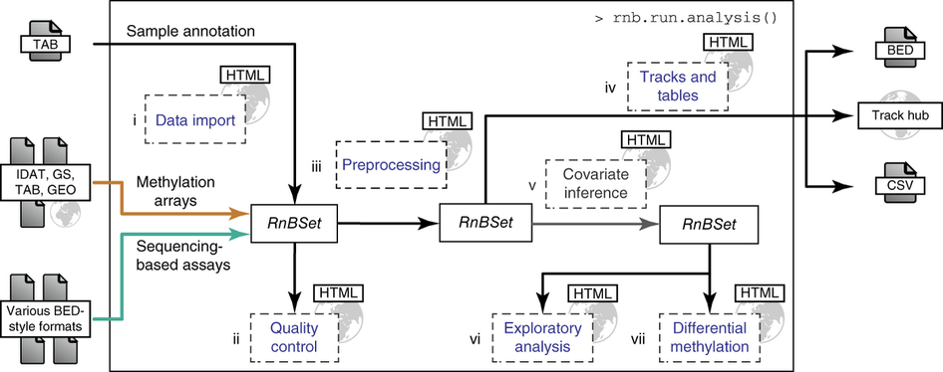
Processing of DNA methylation data with RnBeads
Left stages: processing of raw data (sequencing reads e.g. from bisulfite conversion)
Assenov et al. Nature Methods 11, 1138–1140 (2014)

Slide 21
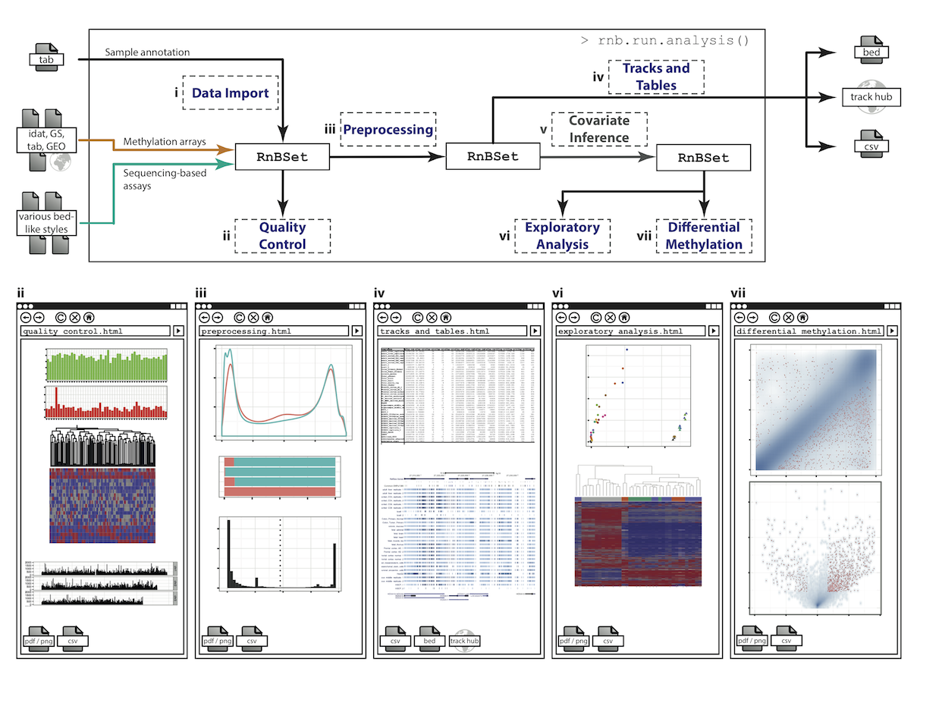
DNA methylation analysis with RnBeads
Top: read coverage
of CpGs
Distribution of
beta-values
Bottom: „Volcano“ plot
x-axis – difference
of methylation site
between 2 probes,
y-axis – statistical
significance of the
difference;
Require enough
variation and enough
significance
Assenov et al. Nature Methods 11, 1138–1140 (2014)

Slide 22
Beta-values measure fractional DNA methylation levels
After analysis of raw sequencing data + filtering of problematic regions etc
the degree of methylation is typically expressed as
fractional beta value: %mCG(i) / ( %mCG(i) + %CG(i) )
A beta value for CpG position i takes on values between
0 (position i not methylated) and 1 (position i fully methylated)

Slide 23
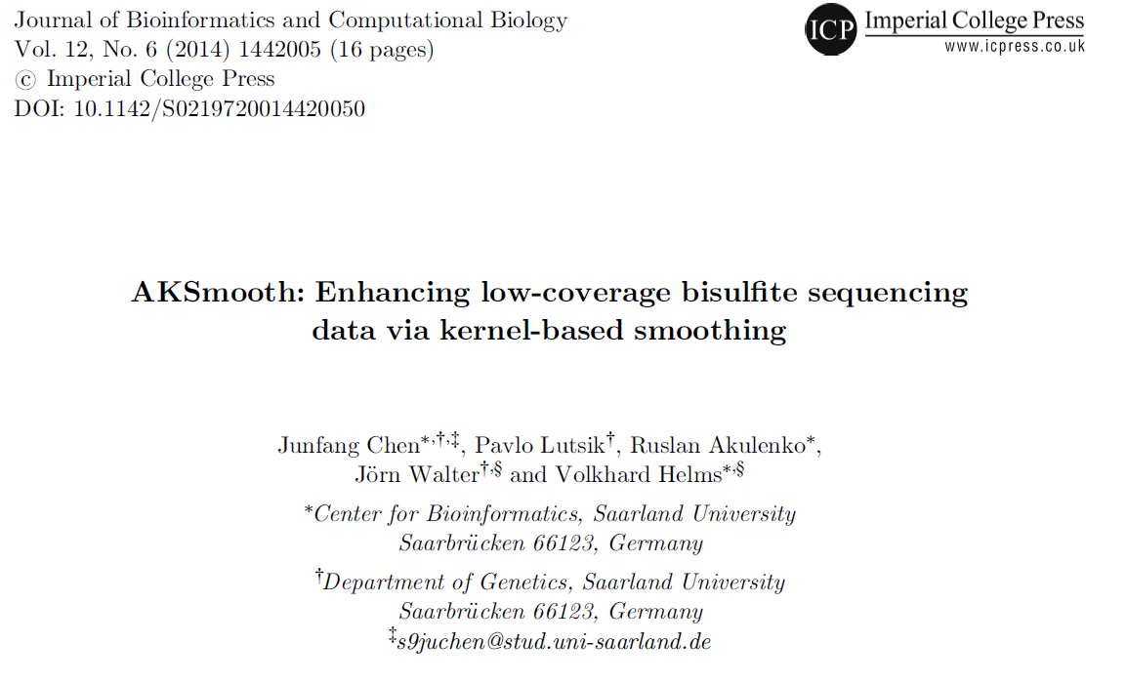
Methylation levels of neighboring sites are correlated
Observation: methylation levels of neighboring CpG positions within 1000 bp are often correlated;
distance between neighboring CpGs is ca. 100 bp (1% frequency)
Idea: exploit this effect to „smoothen“ experimental data,
e.g. when this is obtained at low coverage
Master thesis of Junfang Chen (February 2014):

Slide 24
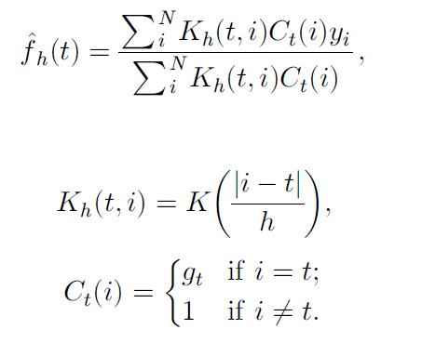
Correlated methylation of neighboring CpGs
t : target CpG site
h : „band-width“: size of window
(# of neighboring CpGs around t)
y_{i} : methylation level of i-th CpG site within window of given size
C_{t}(i): weighting factor to consider read coverage of neighboring CpG sites relative to that of target site
K_{h}(t, i): Kernel function that considers the distance between positions t and i.
-> more distant positions get smaller weight.

Slide 25
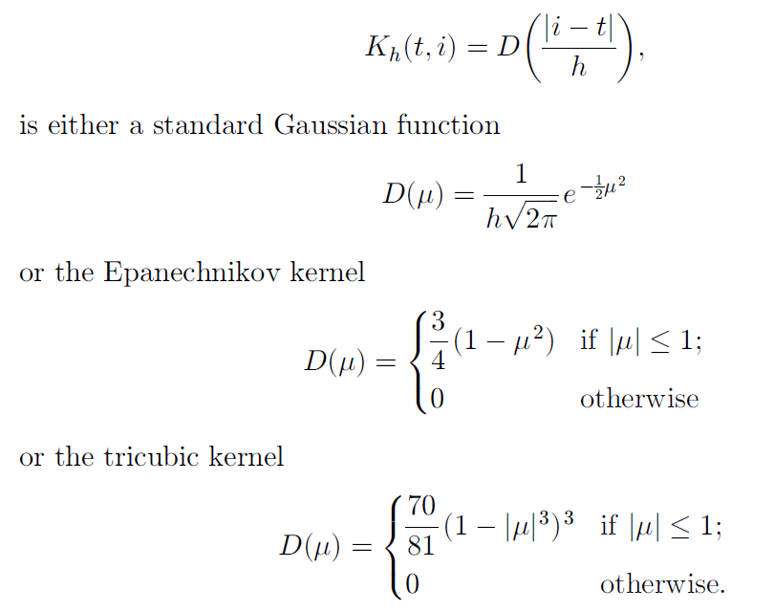
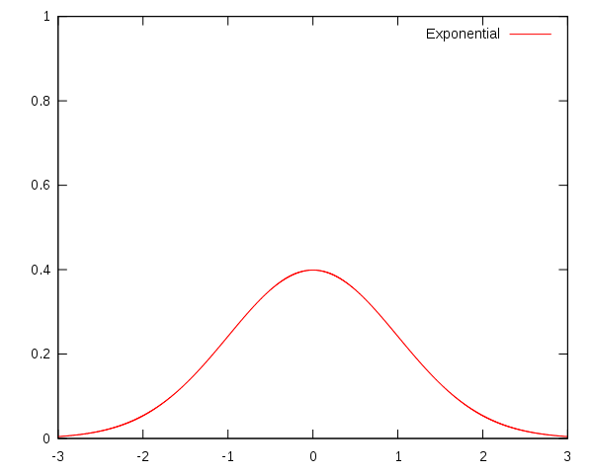
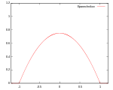
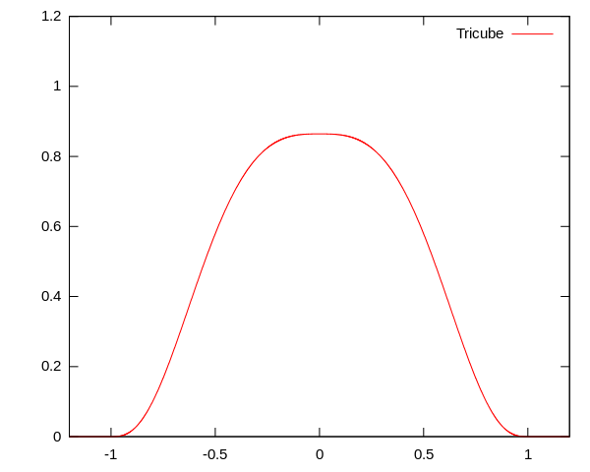
Choice of kernel function
The kernel K
www.wikipedia.org

Slide 26
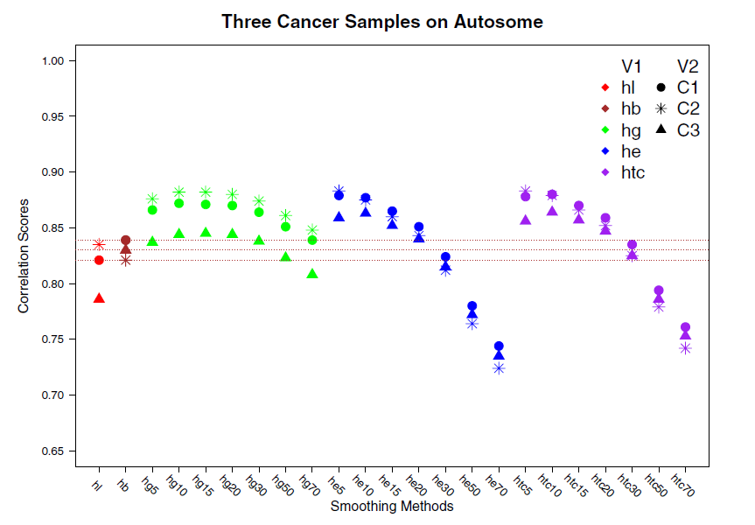
Correlation of low-coverage and high-coverage data
C1, C2, C3 are three different samples.
Best results for window considering nearby 10-20 CpGs.
Gaussian kernel („hg“) more robust with distance (exponential weighting).
Tricubic and Epanechikov kernels show stronge decrease for large windows.
Gaussian
kernel
Epanechikov
kernel
Tricubic
kernel
Every method was tested for including neighboring
5, 10, 15, … 70 CpGs.
Red symbols „hl“ : low-coverage data (unsmoothened)
Brown symbols „hb“: low-coverage data processed with (another) Bsmooth-program

Slide 27
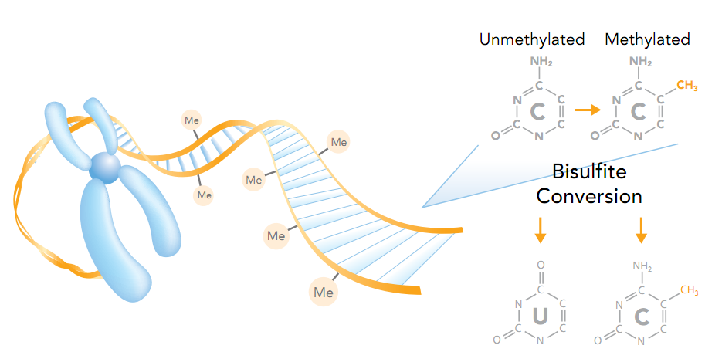
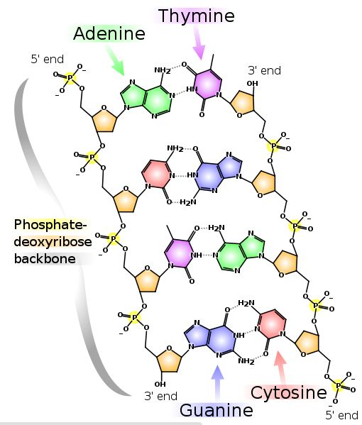
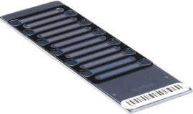
DNA methylation in breast cancer
Infinium HumanMethylation27, RevB BeadChip Kits

Slide 28
DNA methylation in cancer
Normal cell
CpG Islands
Cancer cell

Slide 29
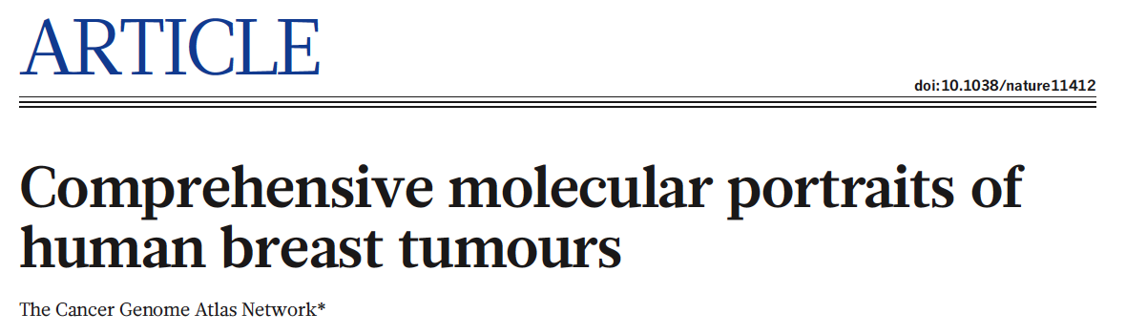
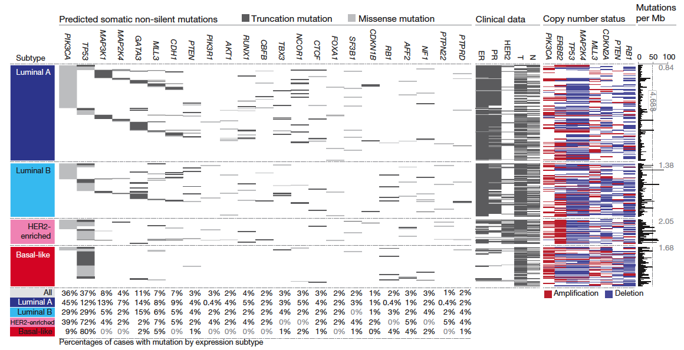
The Cancer Genome Atlas

Slide 30
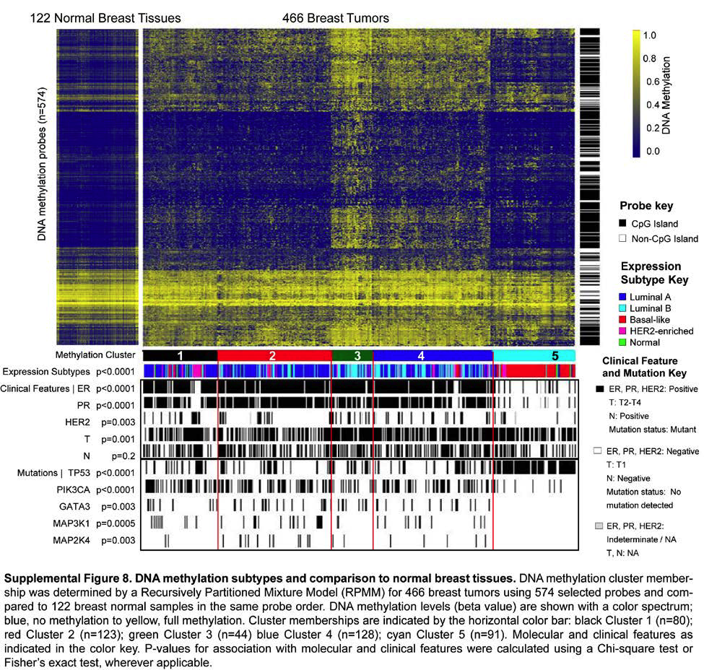
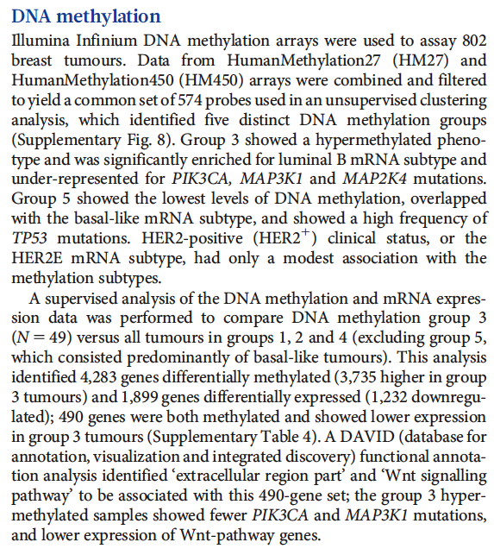
The Cancer Genome Atlas

Slide 31
11.2 Differential methylation analysis
After quantification of methylation levels, one typically detects differentially methylated regions (DMRs) that show consistent differences between sample groups (e.g. cases versus controls).
Length of DMRs ranges from a single cytosine base to an entire gene locus.
In some cases a single methylated CpG may be involved in regulating gene expression and may thus affect disease risk.
The vast majority of known DMRs have a size between a few hundred and a few thousand bases. This range matches that of gene-regulatory regions.
It is assumed that DMRs can regulate transcriptional repression of an associated gene in a cell-type-specific manner.

Slide 32
11.2 Differential methylation analysis
Given sufficient data for 2 groups of samples, DMRs can be detected by
t-tests or Wilcoxon rank-sum tests (see differential expression analysis).
Importantly, when differences in DNA methylation are detected by a statistical test at a large number of genomic loci, the results need to be corrected for multiple hypothesis testing so that a false-discovery rate is inferred for each DMR.
As there exists a large number of CpGs in the genome, often only the most pronounced single-CpG differences are kept as significant after such an adjustment.

Slide 33
11.2 Differential methylation analysis
One can apply 2 complementary strategies to enhance the statistical power while detecting weak differences in DNA methylation.
one can apply the statistical tests to longer genomic regions rather than to individual CpG sites. (Reason: there are much fewer of them. Not so much statistical power is lost due to multiple testing correction.)
If neighbouring CpGs show similar differences of DNA methylation levels, this reduced „resolution“ leads to more significant results.
(2) small standard deviations frequently arise by chance and may yield spurious results.
When the standard deviation of a given CpG or genomic region is estimated by taking the average of observed and expected values, more robust p-values can be obtained for DNA methylation comparisons with many measurements and few samples per sample group.

Slide 34
Idea: identify co-methylation of genes in TCGA samples
Co-methylation of genes 1 and 3 across samples

Slide 35
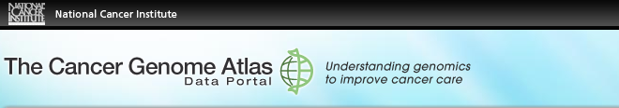
Tumor data
Data Type (Base-Specific) | Level 1 (Raw Data) | Level 2 (Normalized/ Processed) | Level 3 (Segmented/ Interpreted) | Level 4 (Summary Finding/ROI)
DNA Methylation | Raw signals per probe | Normalized signals per probe or probe set and allele calls | Methylated sites/genes per sample | Statistically significant methylated sites/genes across samples
183 tumor samples deposited in Sept 2011 (tumor group 1);
134 tumor samples deposited in Oct 2011 (tumor group 2) and
27 matched normal samples from Oct 2011.

Slide 36

Difficulties: batch effect
Sept. 2011
Oct. 2011
Filter 1: delete genes affected by batch effect

Slide 37
Difficulties: outliers
Filter 2: require zero outliers

Slide 38
Difficulties: low variance
Filter 3: delete genes with low variance

Slide 39
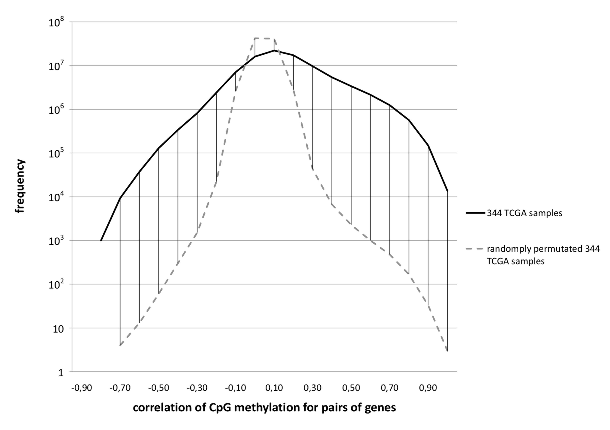
Comparison against randomized data
We found a significantly
larger number of
co-methylated gene
pairs (r > 0.75) than
expected by chance.

Slide 40
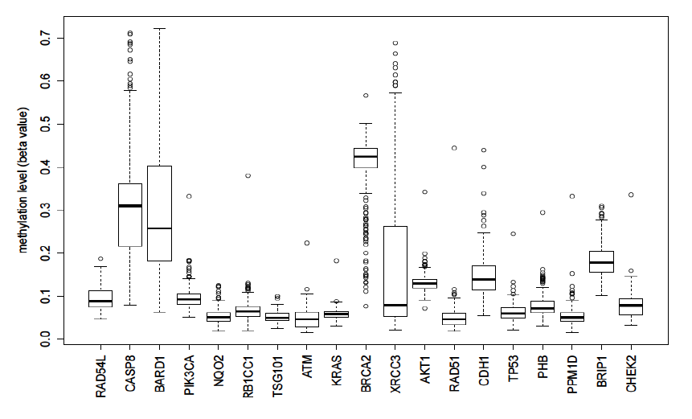
Known breast cancer genes in OMIM: mostly unmethylated
These 19 genes are associated with breast cancer in the Online version of the Mendelian Inheritance in Man (OMIM) database.
They are not involved in co-methylation because most of them show little changes of their (low) methylation levels

Slide 41
top 10 co-methylated gene pairs
First gene | Second gene | Pearson correlation | Related genes?
SPRR1B | SPRR1A | 0,872 | Yes
FCN2 | FCN1 | 0,870 | Yes
CD244 | CD48 | 0,866 | Yes
SPRR1B | SPRR4 | 0,862 | Yes
TAS2R13 | PRB4 | 0,859 | No
F7 | TFF1 | 0,856 | No
SH3TC2 | SPARCL1 | 0,853 | No
ABCE1 | SC4MOL | 0,849 | No
REG1B | REG1P | 0,846 | Yes
SPRR3 | SPRR4 | 0,843 | Yes
Some genes have related names -> co-methylation may be expected

Slide 42
Are all co-methylated genes neighbors?
Less than half of all co-methylated gene pairs lie on the same chromosome
Functional similarity of
gene pair
bp: biological process (GO)
mf: molecular function (MF)
1 10² 10⁴ 10⁶ 10⁸
Distance between genes (bps)

Slide 43
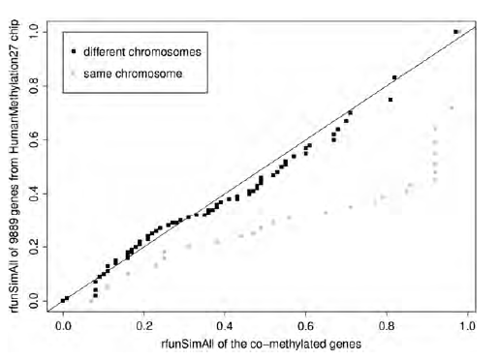
Functional similarity of co-methylated genes
Co-methylated gene pairs on the same chromosome have higher functional
similarity (determined by FunSimMat) than between random pairs of genes
Not the case for co-methylated gene pairs on different chromosomes

Slide 44
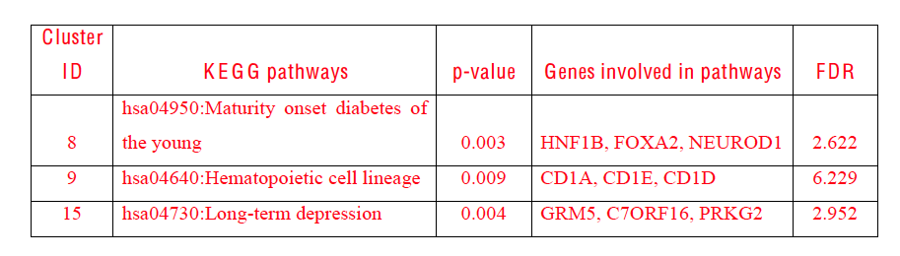
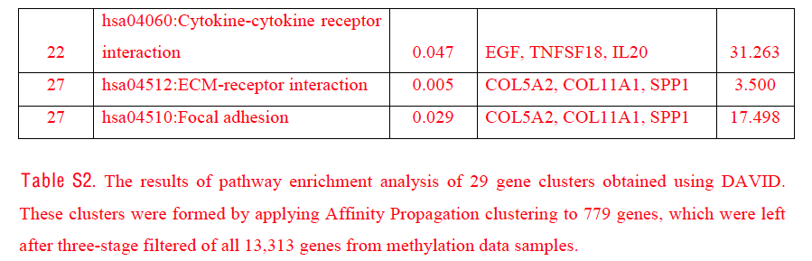
Enriched pathways in co-methylated gene clusters

Slide 45
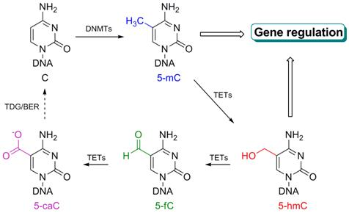
Further modifications of cytosine bases
Further modifications were discovered in the last few years. They are present in cells in much smaller fractions than 5-mC.
Tet enzymes catalyze the conversions. The biological roles of these modifications mostly unclear.
http://he-group.uchicago.edu

Slide 46
Summary
DNA methylation and histone marks are epigenetic modifications of genomic DNA and nucleosomes that appear to have regulatory roles in a broad range of biological processes and diseases.
Detection of DMRs allows to distinguish and classify different developmental stages of cell differentiation or to distinguish tumor tissue from normal tissue.
DNA methylation levels are generally higher in condensed chromatin regions and in differentiated cells than in open chromatin regions and in stem cells.
Our understanding of the relationship between epigenetic modifications and their effects on gene expression levels is still limited.
DNA methylation levels of promoter regions only show weak anticorrelation of around 0.15 with the expression levels of the respective genes.

