Slide 1

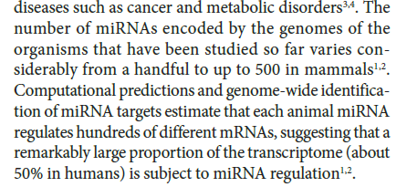
V16: involvement of microRNAs in GRNs
What are microRNAs?
How can one identify microRNAs?
What is the function of microRNAs?
Elisa Izaurralde,
MPI Tübingen
Huntzinger, Izaurralde, Nat. Rev. Genet. 12, 99 (2011)
Laird, Hum Mol Gen 14, R65 (2005)

Slide 2
RNA world
short name full name function oligomerization
mRNA, rRNA, tRNA, you know them well ... Single-stranded
snRNA small nuclear RNA splicing and other functions
snoRNA small nucleolar RNA nucleotide modification of RNAs
Long ncRNA Long noncoding RNA various
miRNA microRNA gene regulation single-stranded
siRNA small interfering RNA gene regulation double-stranded
2

Slide 3
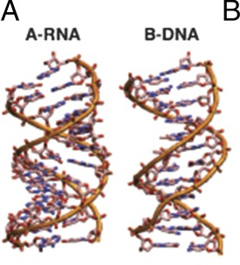
RNA double-strand structure
RNA, like DNA, can form double helices held together by the pairing of complementary bases, and such helices are ubiquitous in functional RNAs.
In contrast to DNA, RNA forms an A-form helix with a radius of ∼1.2 nm and a length increase per base pair of ∼2.8 Å, ∼20% wider and shorter than B-form dsDNA
PNAS (2014) 111, 15408–15413.
3

Slide 4
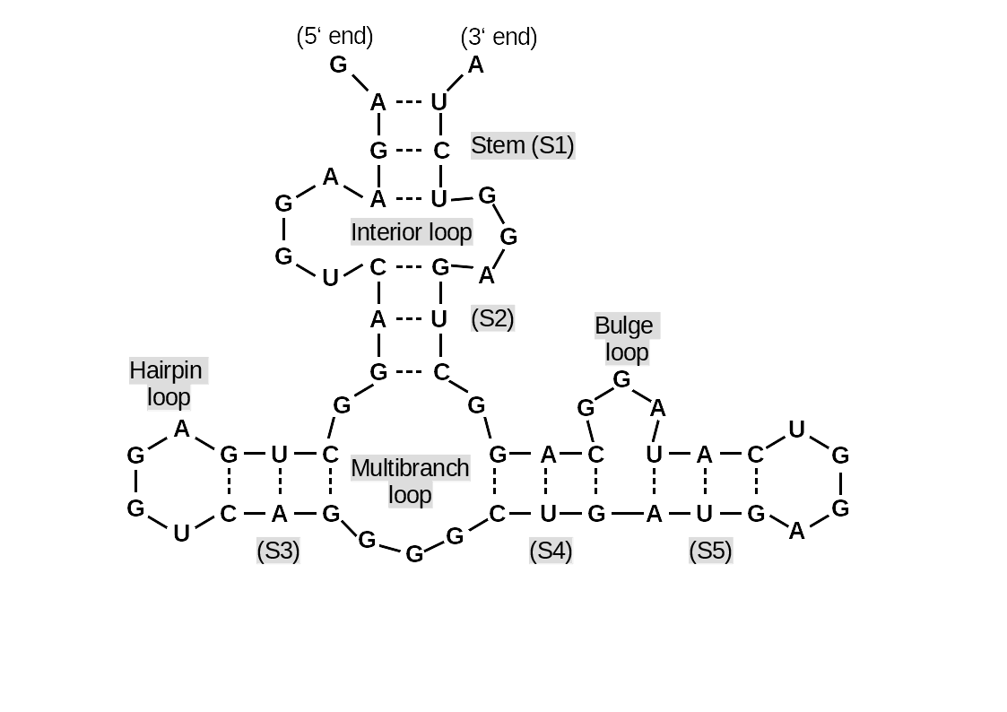
RNA secondary structure
Basic structural motifs of RNA secondary structure.
This RNA consists of five stems (labeled S1-S5) connected by loops (labeled according to loop type).
4

Slide 5
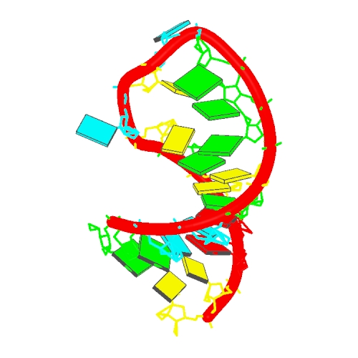
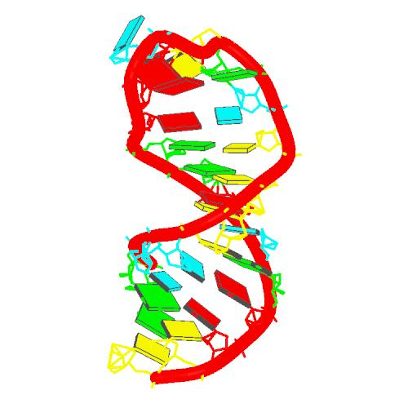
Structure of single-stranded RNA
Also single stranded RNA molecules frequently adopt a specific tertiary structure.
The scaffold for this structure is provided by secondary structural elements
which are non-covalent hydrogen bonds within the molecule.
This leads to several recognizable structural "domain“ types of
secondary structure such as hairpin loops, bulges and internal loops.
RNA hairpin 2RLU Stem loop 1NZ1
www.rcsb.org
5

Slide 6
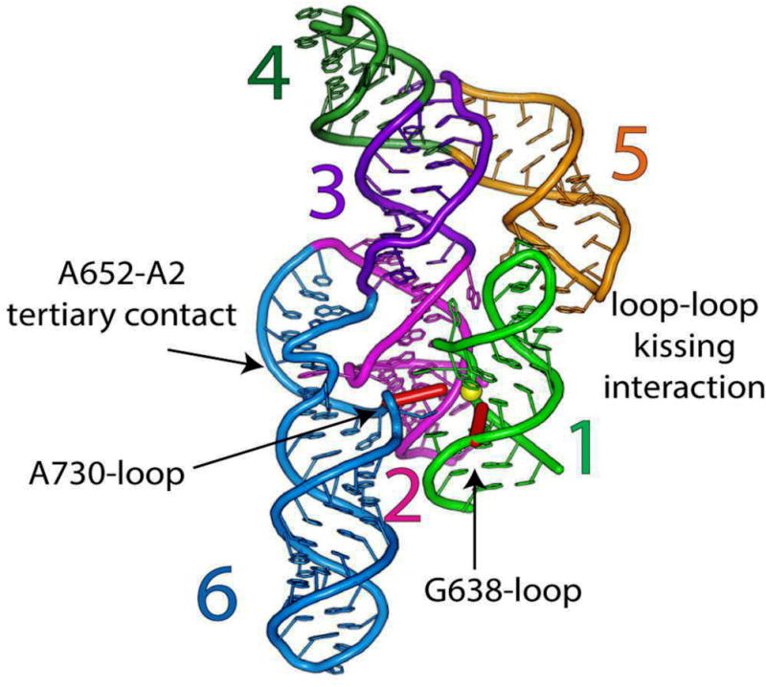
RNA tertiary structure
3D of the VS ribozyme. This ribozyme
(ribonucleic acid & enzyme) from the mitochondria of Neurospora performs self-cleavage during replication.
Shown is the catalytic domain (helices 2–6) of one protomer and the substrate-helix (helix 1) that belongs to another protomer. The three-way helical junctions 2-3-6 and 3-4-5 organize the overall fold of the catalytic domain.
Yellow spheres : scissile phosphate.
Red sticks : catalytic nucleobases. Junction 1-2-7 and accompanying helices 1 and 7 have been omitted for clarity.
Suslov et al. Nature Chemical Biology 11, 840–846 (2015).
6

Slide 7
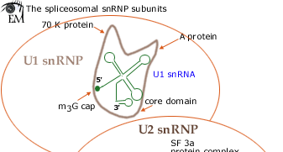
snRNAs
Small nuclear RNA (snRNA) are found within the nucleus of eukaryotic cells.
They are transcribed by RNA polymerase II or RNA polymerase III and are involved in a variety of important processes such as
RNA splicing,
regulation of transcription factors or RNA polymerase II, and
maintaining the telomeres.
snRNAs are always associated with specific proteins.
The snRNA:protein complexes are referred to as
small nuclear ribonucleoproteins (snRNP) or sometimes as snurps.
5 small nuclear RNAs (snRNAs) and approximately
50 different proteins make up the splicing machinery.
The five snRNAs are essential splicing factors.
Each snRNA is associated with several different
proteins to make up five snRNP complexes, called U1, U2, U4, U5 and U6.
7
www.wikipedia.org

Slide 8
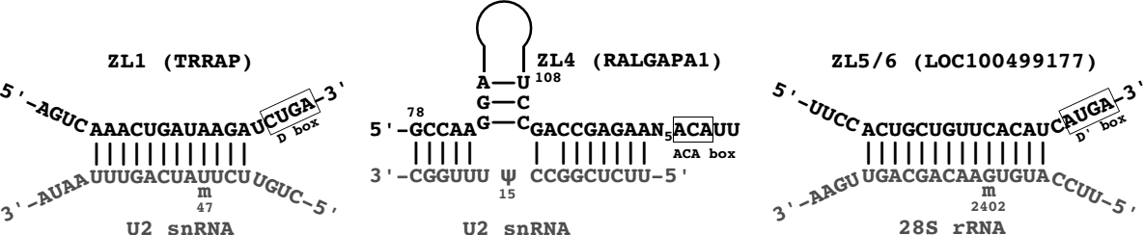
snoRNAs
A large subgroup of snRNAs are known as small nucleolar RNAs (snoRNAs).
These are small RNA molecules that play an essential role in RNA biogenesis and guide chemical modifications of rRNAs, tRNAs and snRNAs.
They are located in the nucleolus and the cajal bodies of eukaryotic cells.
Predicted structure of hybrids between novel snoRNAs and target RNAs. Top: predicted snoRNA
Bottom: target small nuclear RNA (snRNA)
Kishore et al. Genome Biology 2013 14:R45
www.wikipedia.org
8

Slide 9
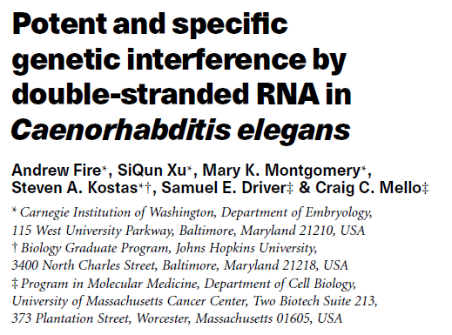
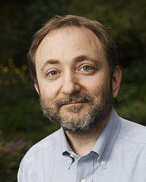

RNA interference
RNA interference may involve siRNAs or miRNAs.
Nobel prize in Physiology or Medicine 2006
for their discovery of RNAi in C. elegans in 1998. Andrew Fire Craig Mello
www.wikipedia.org
9

Slide 10
siRNAs
Small interfering RNA (siRNA), sometimes known as
short interfering RNA or silencing RNA, is a class of
double-stranded RNA molecules,
that are 20-25 nucleotides in length (often precisely 21 nt) and
play a variety of roles in biology.
Most notably, siRNA is involved in the RNA interference (RNAi) pathway,
where it interferes with the expression of a specific gene.
In addition to their role in the RNAi pathway,
siRNAs also act in RNAi-related pathways,
e.g., as an antiviral mechanism or in
shaping the chromatin structure of a genome.
www.wikipedia.org
10

Slide 11
miRNAs
In contrast to double-stranded siRNA,
microRNAs (miRNA) are single-stranded RNA molecules
of 21-23 nucleotides in length.
miRNAs have a crucial role in regulating gene expression.
Remember: miRNAs are encoded by DNA but not
translated into protein (non-coding RNA).
www.wikipedia.org
11

Slide 12
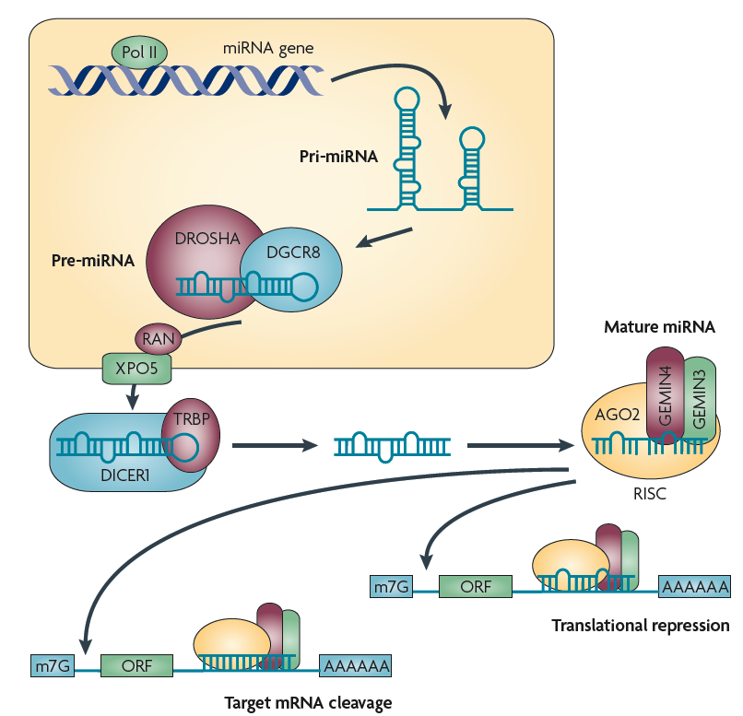
Overview of the miRNA network
RNA polymerase II (Pol II) produces a 500–3,000 nucleotide transcript, called the primary microRNA
(pri-miRNA).
pri-miRNA is then cropped to form a
pre-miRNA hairpin of ~60–100 nucleotides in length by a multi-protein complex that includes the protein DROSHA.
AA, poly A tail;
m7G, 7-methylguanosine cap;
ORF, open reading frame.
Ryan et al. Nature Rev. Cancer (2010) 10, 389

Slide 13
Overview of the miRNA network
This double-stranded pre-miRNA hairpin structure is exported from the nucleus by RAN GTPase and exportin 5 (XPO5).
Finally, the pre-miRNA is cleaved by the protein DICER1 to produce two miRNA strands:
- a mature miRNA sequence, approximately 20 nt in length,
- and its short-lived complementary sequence, which is denoted miR.
Ryan et al. Nature Rev. Cancer (2010) 10, 389

Slide 14
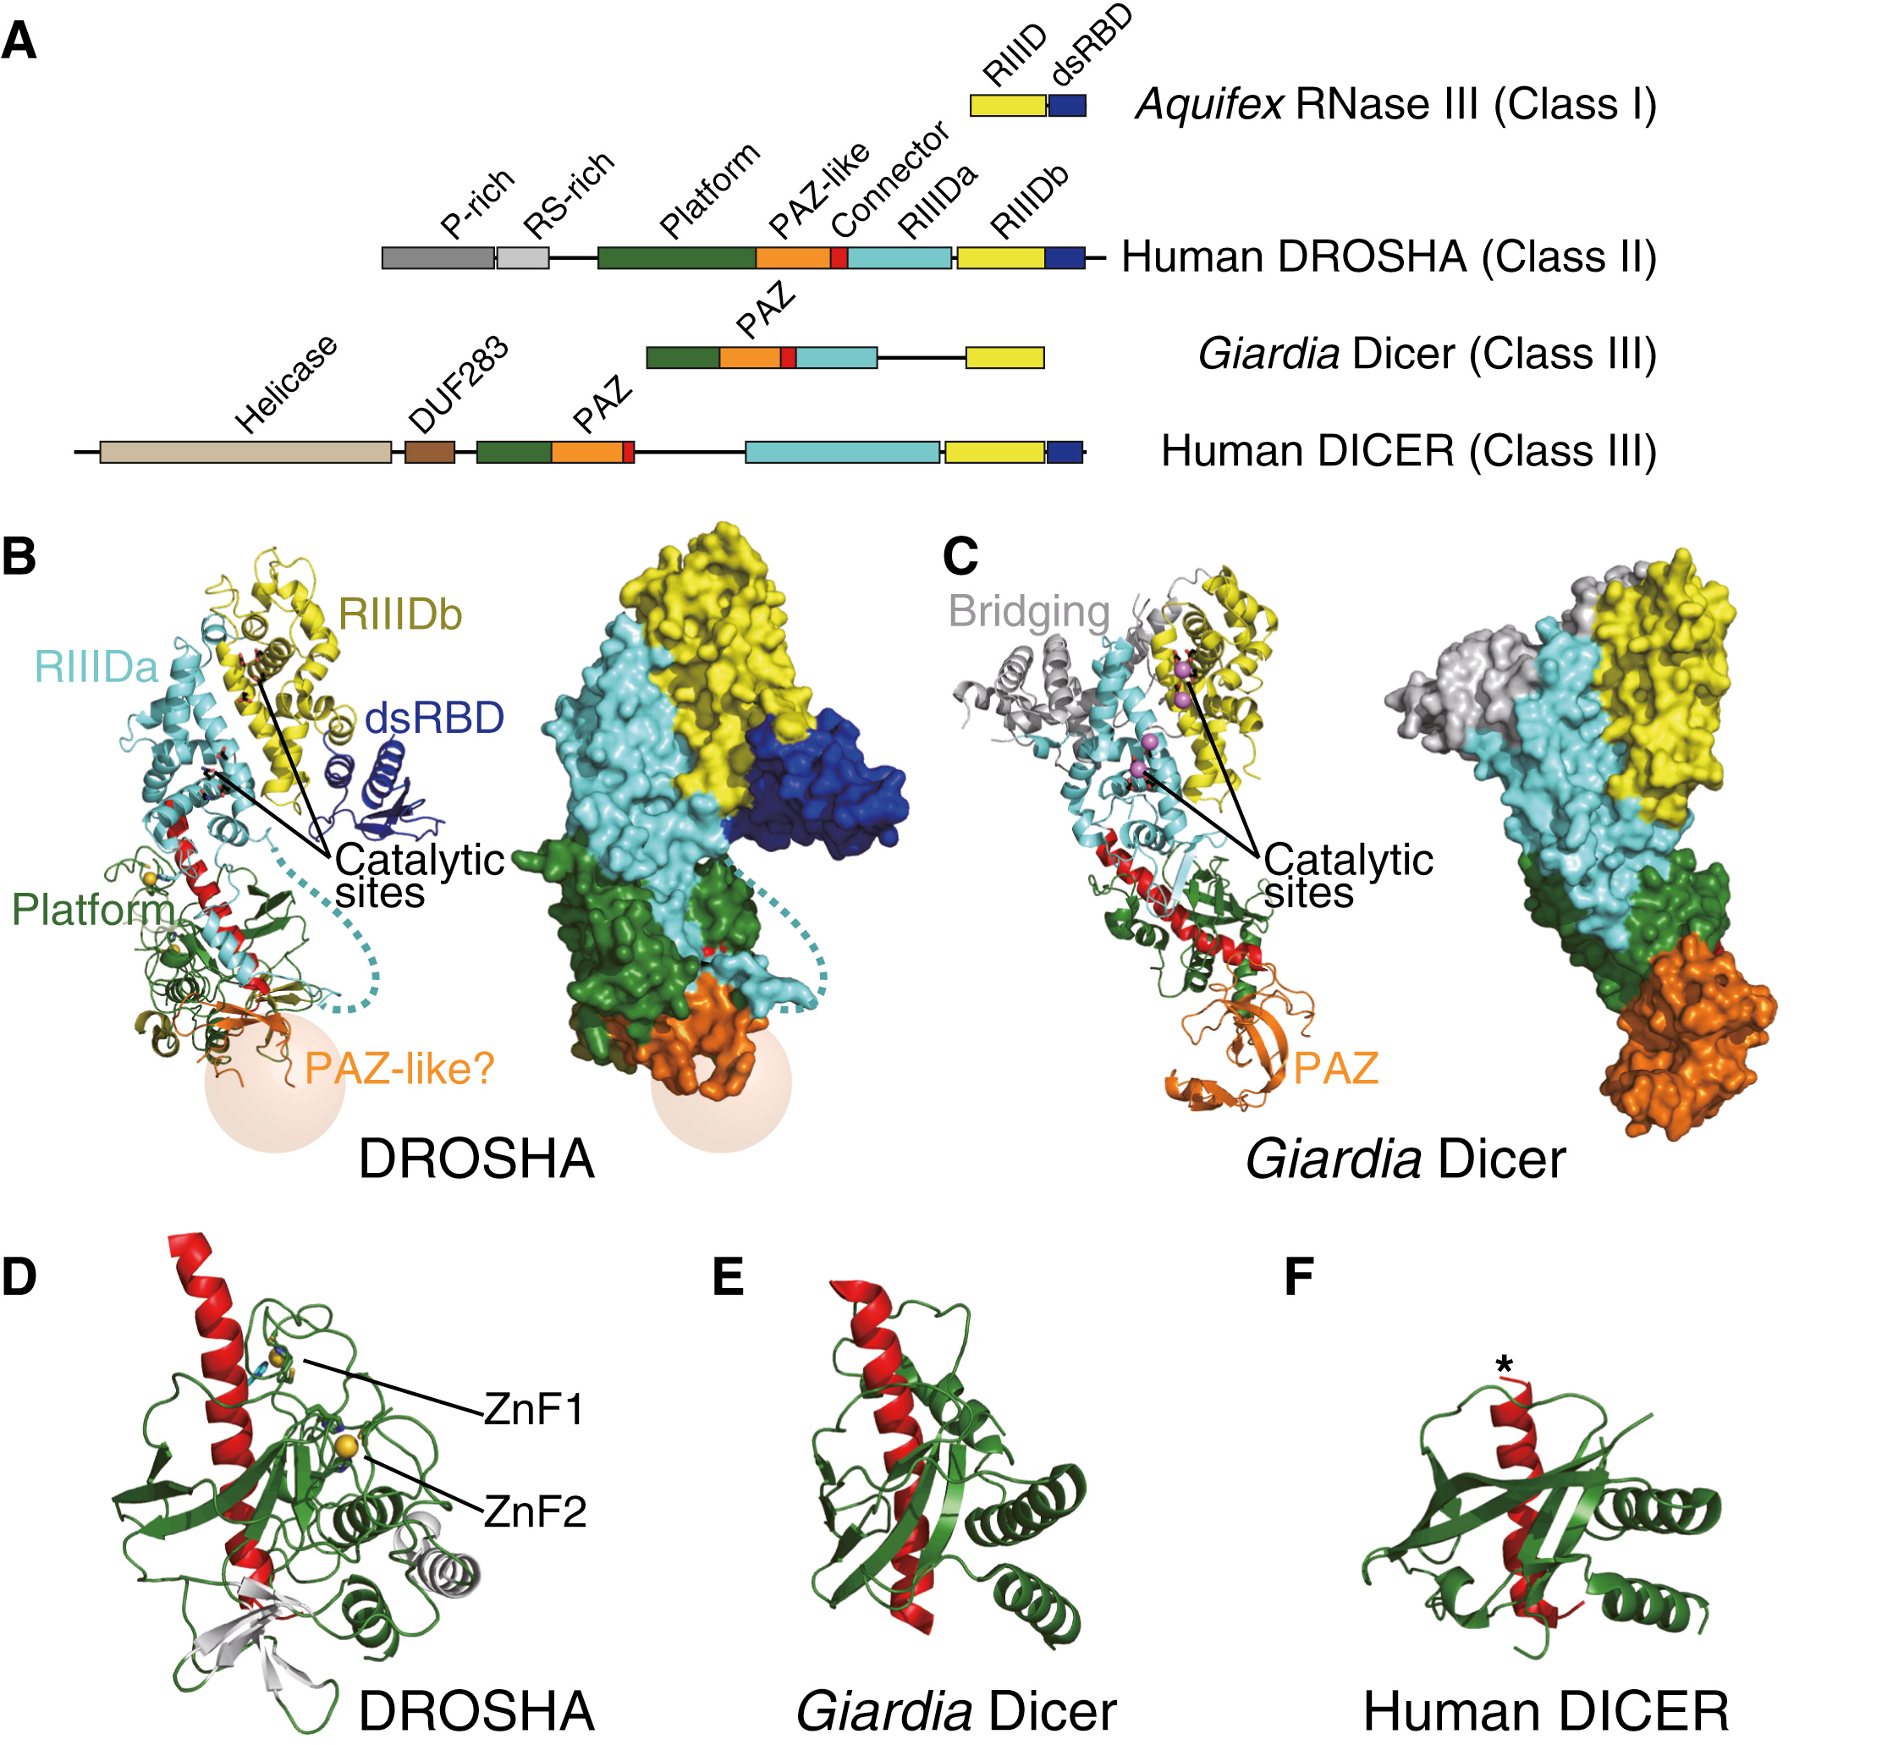
DROSHA X-ray structure
The overall structure of DROSHA is surprisingly similar to that of Dicer despite no sequence homology apart from the C-terminal part.
This suggests that DROSHA may have evolved from a Dicer homolog.
AA, poly A tail;
m7G, 7-methylguanosine cap;
ORF, open reading frame.
Kwon et al. Cell. (2016) 164:81-90.

Slide 15
Overview of the miRNA network
The thermodynamic stability of the miRNA duplex termini and the identity of the nucleotides in the 3′ overhang determines which of the single strand miRNA is incorporated into the RNA-inducing silencing complex (RISC).
The RISC complex is then targeted by the miRNA to the target 3′ untranslated region of a mRNA sequence to facilitate repression and cleavage.
The main function of miRNAs is to down-regulate
gene expression of their target mRNAs.
Ryan et al. Nature Rev. Cancer (2010) 10, 389

Slide 16
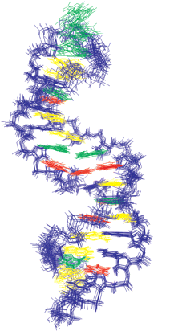
miRNAs
Mature miRNA molecules are partially complementary to
one or more mRNA molecules.
Fig. shows the solution NMR-structure of
let-7 miRNA:lin-41 mRNA complex from C. elegans
Cevec et al. Nucl. Acids Res. (2008) 36: 2330.
miRNAs typically have incomplete base pairing to a target and inhibit the translation of many different mRNAs with similar sequences.
In contrast, siRNAs typically base-pair perfectly and
induce mRNA cleavage only in a single, specific target.
www.wikipedia.org
16

Slide 17
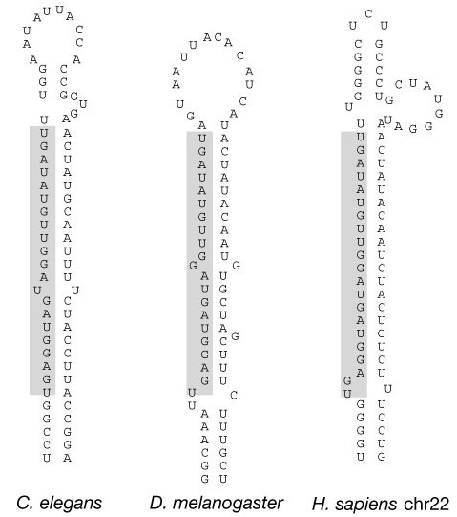
discovery of let7
The first two known microRNAs, lin-4
and let-7, were originally discovered in the nematode C. elegans.
There, they control the timing of stem-cell division and differentiation.
let-7 was subsequently found as the
first known human miRNA.
let-7 and its family members are highly conserved across species in sequence and function.
Misregulation of let-7 leads to a less differentiated cellular state and the development of cell-based diseases
such as cancer.
Pasquinelli et al. Nature (2000) 408, 86
www.wikipedia.org
17

Slide 18
Action of let7
Let-7 directly down-regulates the expression of the oncogene RAS in human cells.
All the three RAS genes in human, K-, N-, and H-,
have the predicted let-7 binding sequences in their 3'UTRs.
In lung cancer patient samples, expression of RAS and let-7 is anticorrelated.
Cancerous cells have low let-7 and high RAS,
normal cells have high let-7 and low RAS.
Another oncogene, high mobility group A2 (HMGA2),
has also been identified as a target of let-7.
Let-7 directly inhibits HMGA2 by binding to its 3'UTR.
Removal of the let-7 binding site by 3'UTR deletion causes
overexpression of HMGA2 and formation of tumor.
MYC is also considered as a oncogenic target of let-7.
www.wikipedia.org
18

Slide 19
miRNA discovery
miRNA discovery approaches, both biological and bioinformatics,
have now yielded many thousands of miRNAs.
This process continues with new miRNA appearing daily in various databases.
miRNA sequences and annotations are compiled in the
online repository miRBase (http://www.mirbase.org/).
Each entry in the database represents a predicted hairpin portion
of a miRNA transcript with information on the location and
sequence of the mature miRNA sequence
Liu et al. Brief Bioinf. (2012) doi: 10.1093/bib/bbs075
19

Slide 20
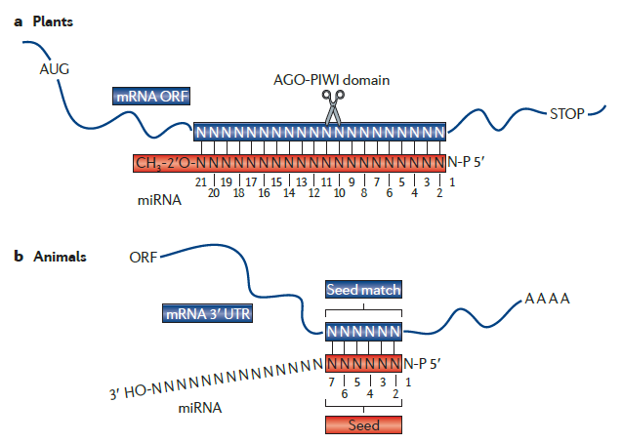
miRNAs recognize targets by Watson-Crick base pairing
(a) Plant miRNAs recognize fully or nearly complementary binding sites.
(b) Animal miRNAs recognize partially complementary binding sites which are generally located in 3’ UTRs of mRNA.
Complementarity to the 5’ end of the miRNA – the “seed” sequence containing nucleotides 2-7 – is a major determinant in target recognition and is sufficient to trigger silencing.
4⁶ = (2²)⁶ = 2¹² = 4096 k-mers of length 6
On average, the 3'-UTR in humans is ca. 800 nt long (www.wikipedia.org)
20.000 genes x 800 nt / 4096 6-mers = 4000 binding sites for 1 miRNA 6-mer
Huntzinger, Izaurralde, Nat. Rev. Genet.
12, 99 (2011)
20

Slide 21
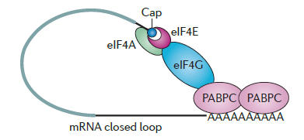
Mechanism of miRNA-mediated gene silencing
mRNAs are competent for translation if they possess a 5’cap structure
and a 3’-poly(A) tail
miRNAs could, in principle, either work by translational repression or by target degradation.
This has not been fully answered yet.
Current view: degradation of target mRNA by miRNA dominates.
Huntzinger, Izaurralde, Nat. Rev. Genet. 12, 99 (2011)
21

Slide 22
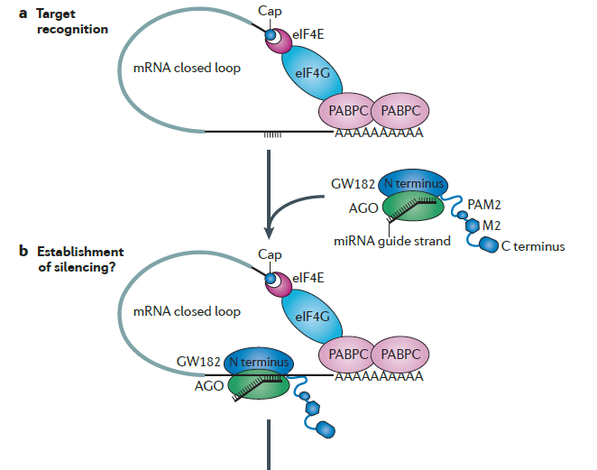
Mechanism of miRNA-mediated gene silencing
(a) The mRNA target is presented in a closed-loop conformation.
eIF: eukaryotic translation initiation factor
PABPC: poly(A)-binding protein
(b) Animal miRNAs bound to the argonaute protein AGO and to a GW182 protein recognize their mRNA targets by base-pairing to partially complementary binding sites.
Huntzinger, Izaurralde, Nat. Rev. Genet. 12, 99 (2011)
22

Slide 23
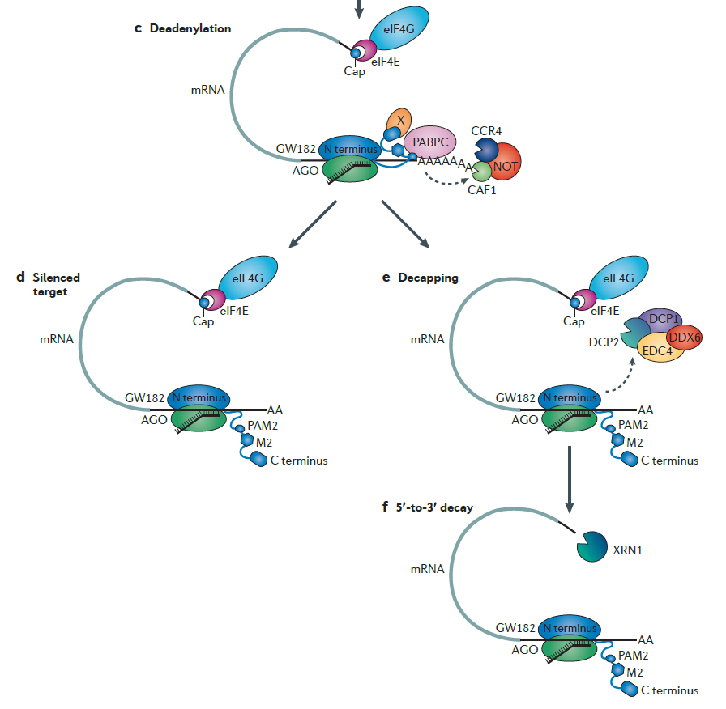
Mechanism of miRNA-mediated gene silencing
(c) The AGO-GW182 complex targets the mRNA to deadenylation by the
deadenylation protein complex CCR4-CAF1-NOT.
(e) The mRNA is decapped by the protein DCP2 and then degraded by XRN1 in step (f).
Alternatively (d), the deadenylated mRNA remains silenced.
Huntzinger, Izaurralde, Nat. Rev. Genet. 12, 99 (2011)
23

Slide 24
Bioinformatics prediction of miRNAs
With bioinformatics methods, putative miRNAs are first predicted
in genome sequences based on the structural features of miRNA.
These algorithms essentially identify hairpin structures
in non-coding and non-repetitive regions of the genome
that are characteristic of miRNA precursor sequences.
The candidate miRNAs are then filtered by their
evolutionary conservation in different species.
Known miRNA precursors play important roles in searching algorithms
because structures of known miRNA are used to train the learning processes
to discriminate between true predictions and false positives.
Many algorithms exist such as miRScan, miRSeeker, miRank, miRDeep, miRDeep2 and miRanalyzer.
24
Liu et al. Brief Bioinf. (2012) doi: 10.1093/bib/bbs075

Slide 25
Recognition of miRNA targets
There seem to be two classes of binding patterns.
One class of miRNA target sites has perfect Watson–Crick complementarity
to the 5’-end of the miRNAs, referred to as ‘seed region’,
which includes positions 2–7 of miRNAs.
When bound in this way, miRNAs suppress their targets without requiring significant further base pairings at the 3’-end of the miRNAs.
The second class of target sites has imperfect complementary base pairing at the 5’-end of the miRNAs, but it is compensated via additional base pairings in the 3’-end of the miRNAs.
The multiple-to-multiple relations between miRNAs and mRNAs
lead to complex miRNA regulatory mechanisms.
25
Liu et al. Brief Bioinf. (2012) doi: 10.1093/bib/bbs075

Slide 26
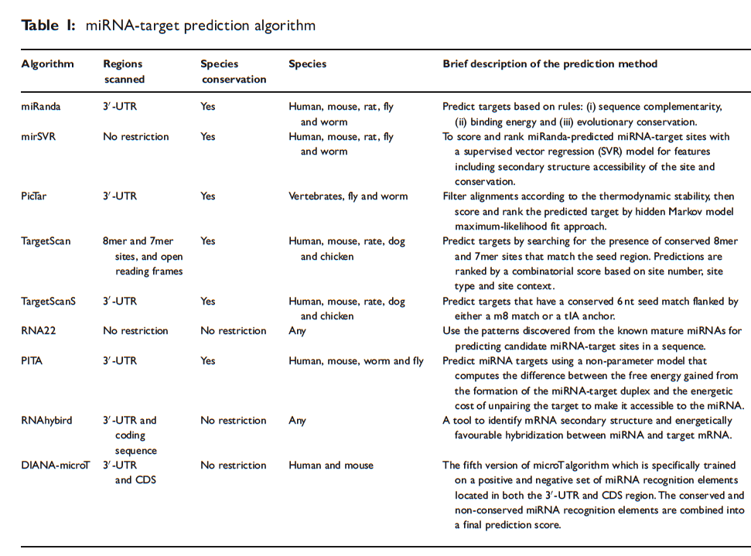
miRNA-target prediction algorithms
Liu et al. Brief Bioinf. (2012) doi: 10.1093/bib/bbs075

Slide 27
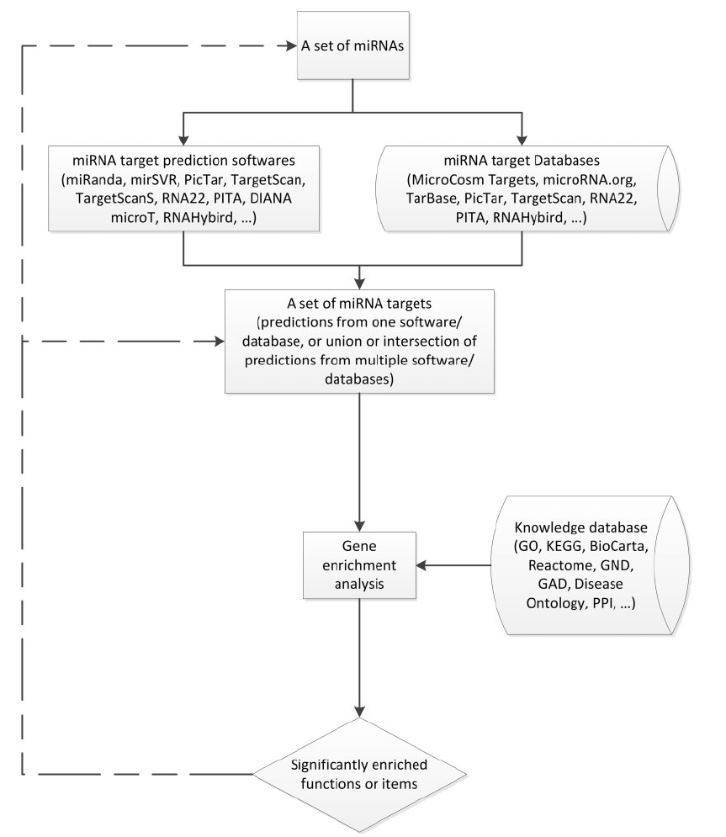
Predicting miRNA function based on target genes
The most straight-forward approach for miRNA functional annotation is through functional
enrichment analysis using the miRNA-target genes.
This approach assumes that miRNAs have similar functions as their target genes.
Liu et al. Brief Bioinf. (2012) doi: 10.1093/bib/bbs075

Slide 28
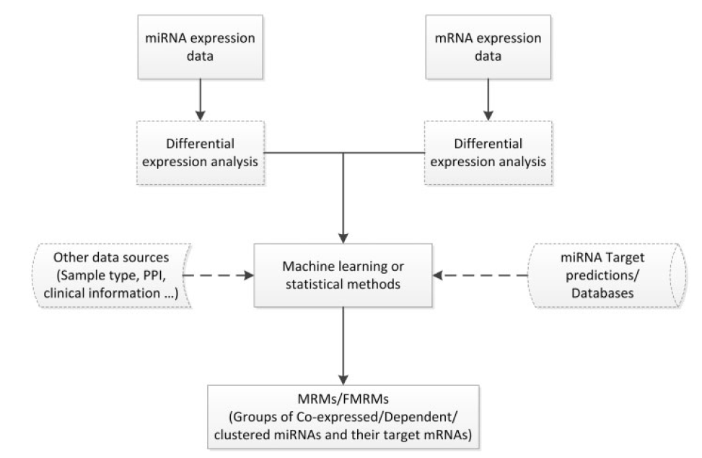
Predicting miRNA function based on correlated expression
miRNA functional annotation heavily relies on the miRNA-target prediction.
In the last few years, many studies have been conducted to infer the miRNA regulatory mechanisms by incorporating
target prediction with other genomics data, such as
the expression profiles of miRNAs and mRNAs.
Liu et al. Brief Bioinf. (2012) doi: 10.1093/bib/bbs075

Slide 29

Discovering MRMs
A MRM (group of co-expressed miRNAs and mRNAs) may be defined as a special bipartite graph, named biclique, where
two sets of nodes are connected by edges.
Every node of the first set representing miRNA
is connected to every node of the second set
representing mRNAs.
The weights of edges correspond to the miRNA–mRNA binding strength are
inferred from target prediction algorithms
Most of the integrative methods for MRM discovery are based on the assumption that miRNAs negatively regulate their target mRNAs so that the expression of a specific miRNA and its targets should be anti-correlated.
Liu et al. Brief Bioinf. (2012) doi: 10.1093/bib/bbs075

Slide 30
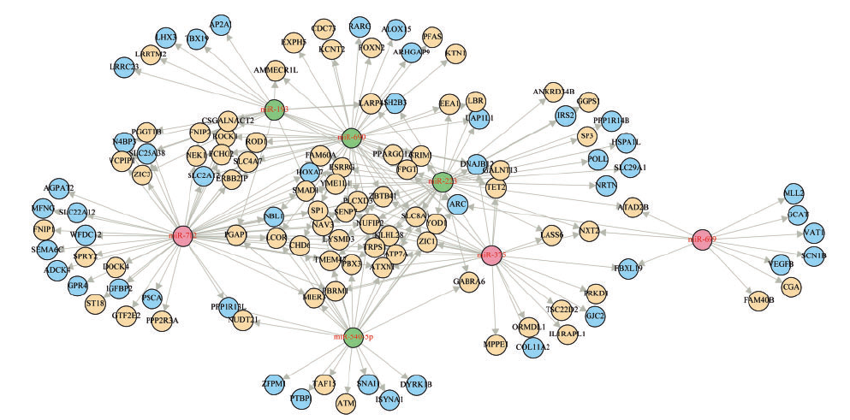
miRNA-mRNA network
A MRM identified from analysis of schizophrenia patients. It shows that miRNAs may up/down regulate their target mRNAs, either directly or indirectly.
Up-regulated miRNAs are coloured in red and down-regulated miRNAs are coloured in green.
Up-regulated mRNAs are coloured in yellow, while down-regulated mRNAs are coloured in blue.
Liu et al. Brief Bioinf. (2012) doi: 10.1093/bib/bbs075

Slide 31
SNPs in miRNA may lead to diseases
miRNAs can have dual oncogenic and tumour suppressive roles in cancer
depending on the cell type and pattern of gene expression.
Approximately 50% of all annotated human miRNA genes are located
in fragile sites or areas of the genome that are associated with cancer.
→ Mutations in miRNAs or their binding sites may lead to diseases.
E.g. Abelson et al. found that a mutation in the miR-189 binding site
of the gene SLITRK1 was associated with Tourette’s syndrome.
SNPs in miRNA genes are thought to affect function in one of three ways:
(1) by affecting the transcription of the primary miRNA transcript;
(2) by affecting the processing of pri-miRNA or pre-miRNA processing; and
(3) through effects on miRNA–mRNA interactions
Volinia et al. PNAS (2013) 110, 7413

Slide 32
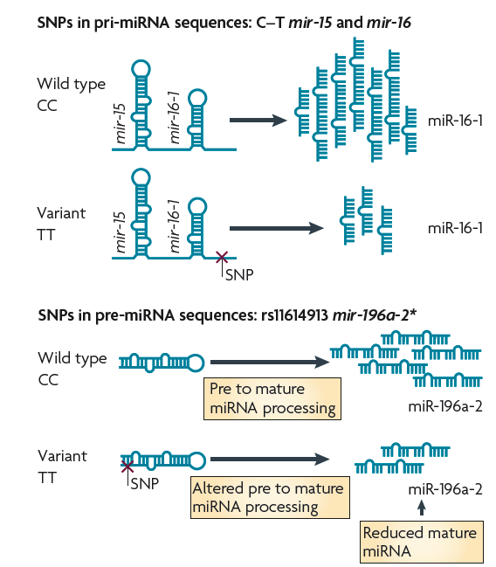
SNPs in pri-miRNA and pre-miRNA sequences
SNPs can occur in the pri-miRNA and pre-miRNA strands.
Then they are likely to affect miRNA processing and, thus, levels of mature miRNA.
Such SNPs can lead to either an increase or decrease in processing.
Ryan et al. Nature Rev. Cancer (2010) 10, 389

Slide 33
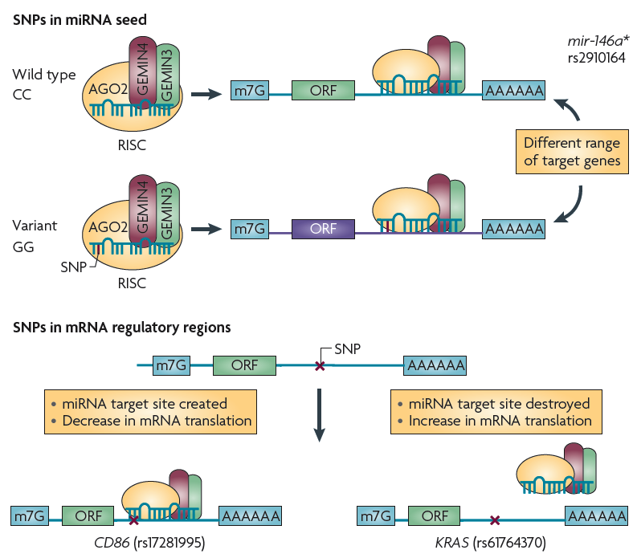
SNPs in miRNA seed and regulatory regions
SNPs in mature microRNAs (miRNAs) within the seed sequence can strengthen or reduce binding between the miRNA and its mRNA target.
Moreover, such SNPs can create or destroy target binding sites, as is the case for mir‑146a*.
Ryan et al. Nature Rev. Cancer (2010) 10, 389

Slide 34
SNPs in miRNA seed and regulatory regions
SNPs located within the 3′ untranslated region of miRNA binding sites function analogously to seed region SNPs and modulate the miRNA–mRNA interaction.
They can create or destroy miRNA binding sites
and affect subsequent mRNA translation.
Ryan et al. Nature Rev. Cancer (2010) 10, 389

Slide 35
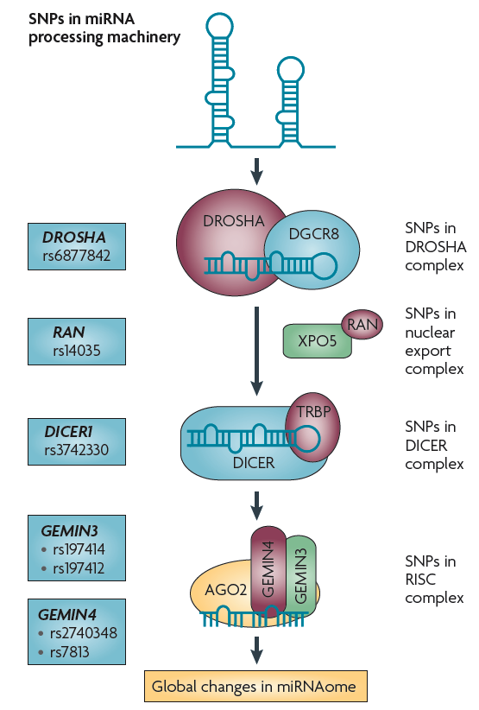
SnPs in miRNA processing machinery
SNPs can also occur within the processing machinery.
These SNPs are likely to affect the microRNAome (miRNAome) as a whole, possibly leading to the overall suppression of miRNA output.
In addition, SNPs in cofactors of miRNA processing, such as p53, may indirectly affect miRNA maturation.
Ryan et al. Nature Rev. Cancer (2010) 10, 389

Slide 36
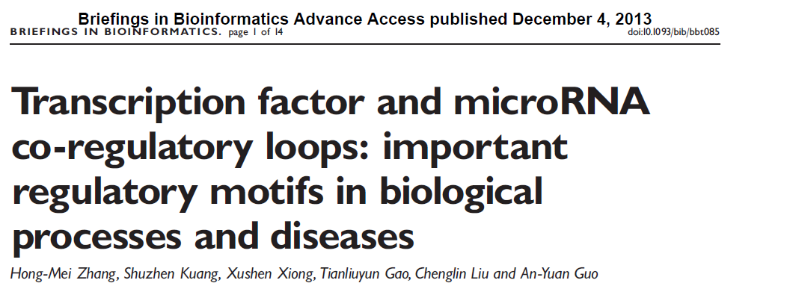
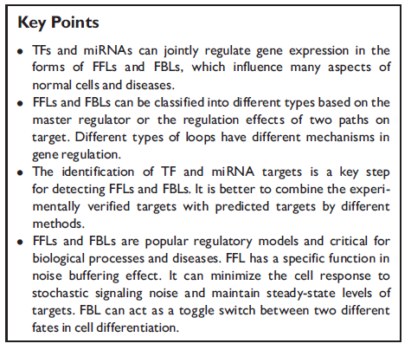
FFL: feed-forward loop
FBL: feedback loop
Volinia et al. PNAS (2013) 110, 7413

Slide 37
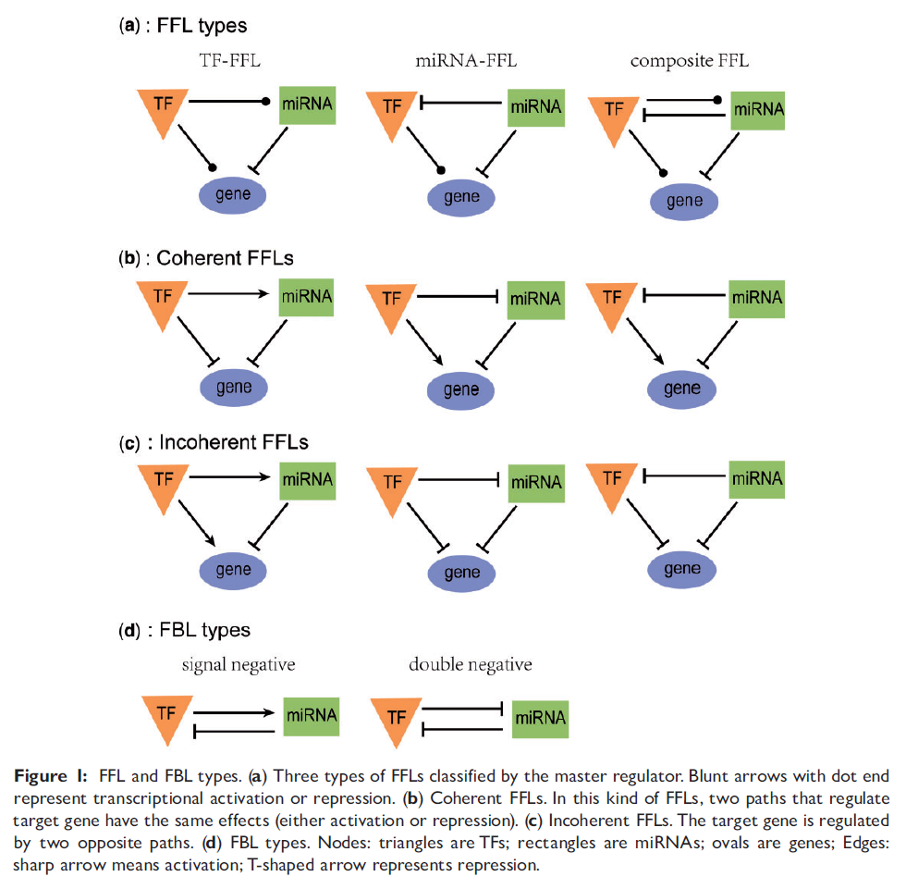

Slide 38
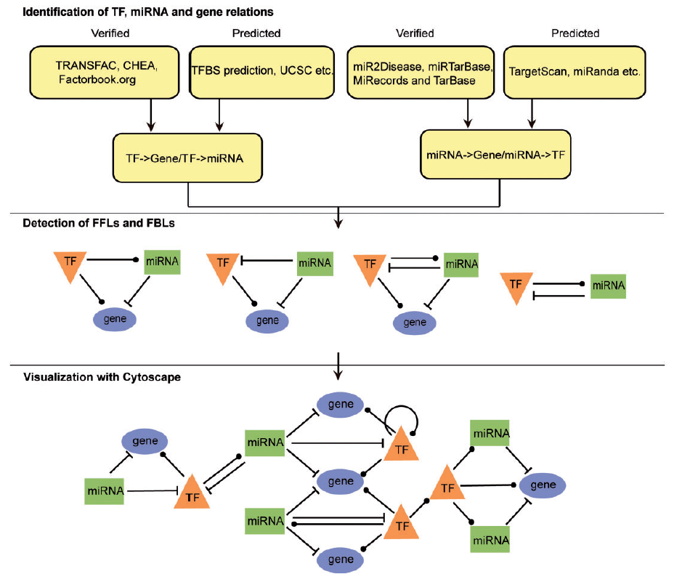

Slide 39
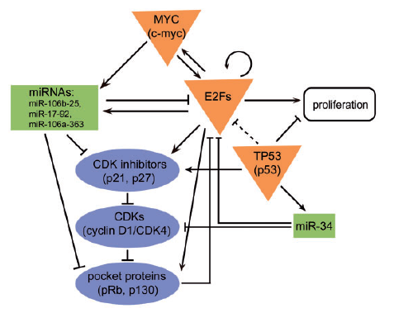
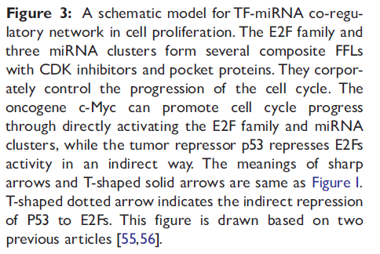

Slide 40
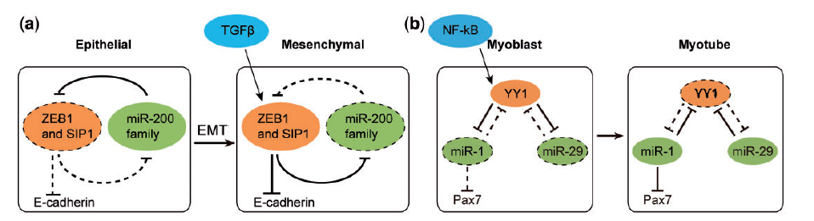
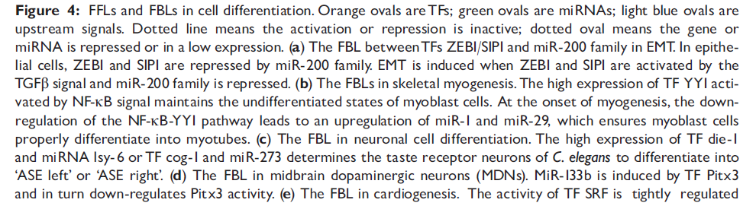

Slide 41
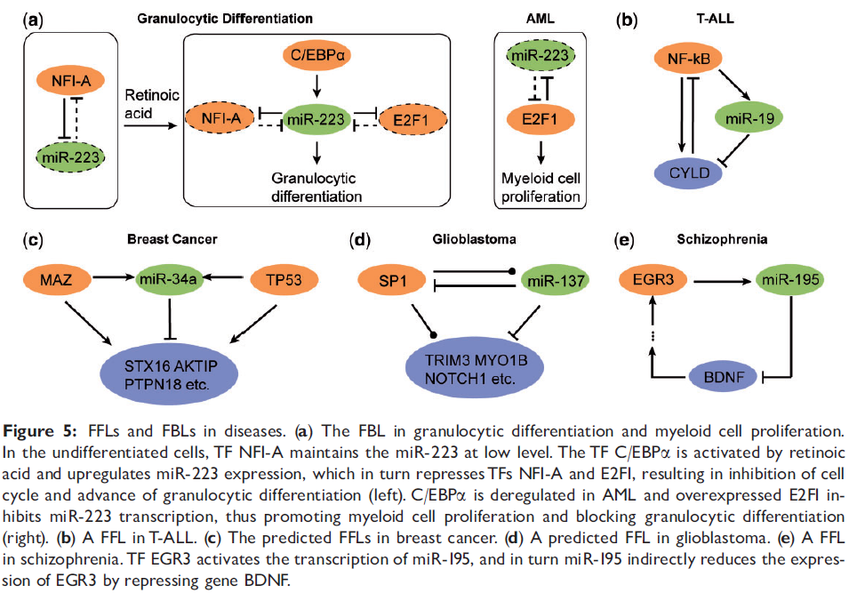

Slide 42
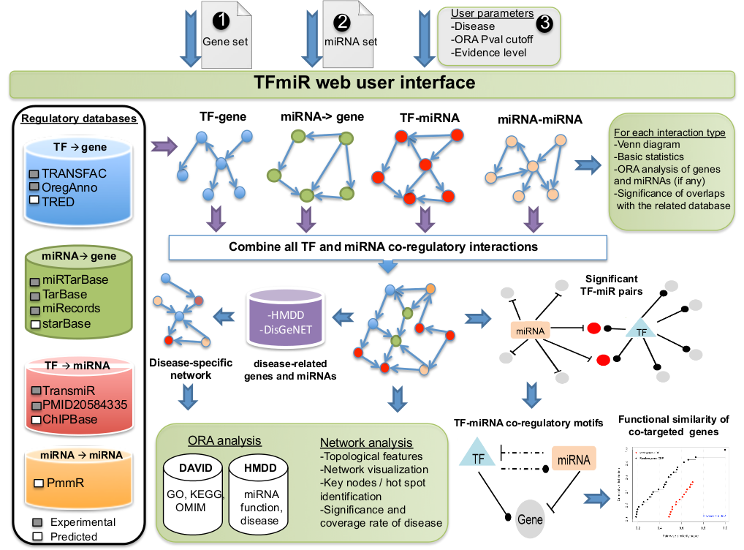
TFmiR
Hamed et al. Nucl Ac Res
43: W283-W288 (2015)

Slide 43
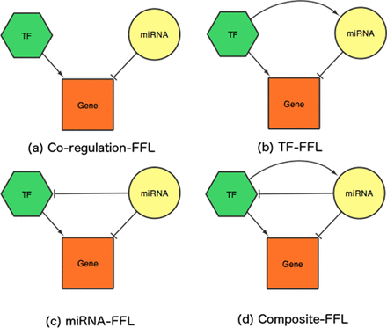
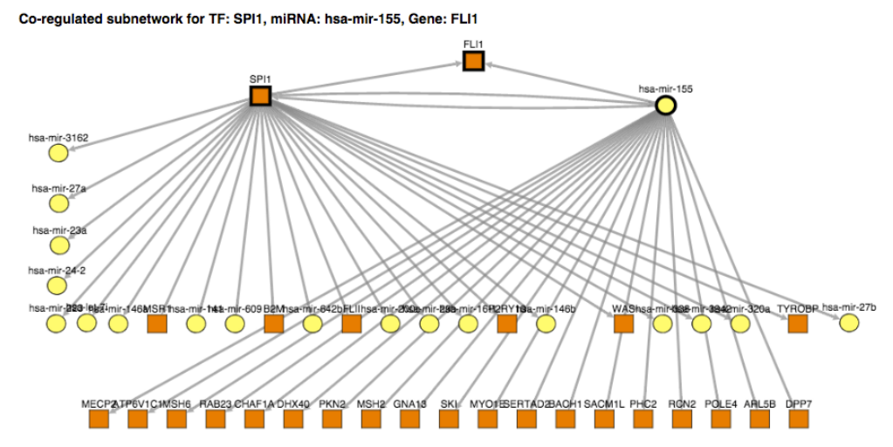
TFmiR
Hamed et al. Nucl Ac Res
43: W283-W288 (2015)

Slide 44

Significance of FFL motifs
Compare how often FFL motifs appear in the real network to the number of times they appear in randomized ensembles preserving the same node degrees.
Use degree preserving randomization algorithm.
For 2 × L steps, two edges e1 = (v1, v2) and e2 = (v3, v4) are randomly chosen from the network and rewired such that the start and end nodes are swapped, i.e. e3 = (v1, v4) and e4 = (v3, v2) if {e3, e4} ∈ V.
Construct 100 random networks. Compare motif frequencies to the real network. The P-value is calculated as
where N_{h} is the number of random times that a certain motif type is acquired more than or equal to its number in the real network, and N_{r} is 100.

Slide 45
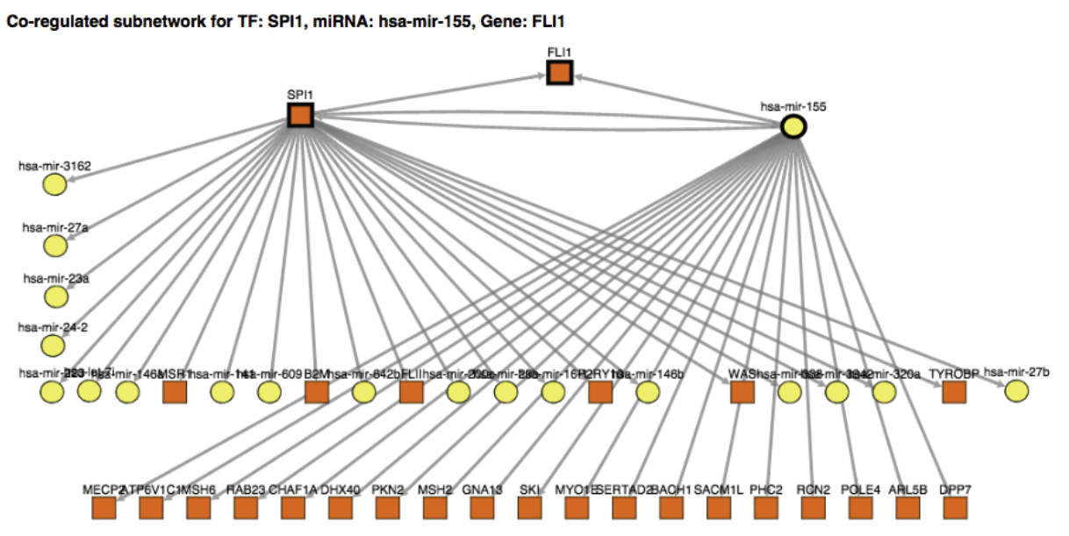
Enriched motifs
Below: interesting motif involving the TF SPI1, the miRNA hsa-mir-155 and the target gene FLI1.
Recent studies reported that the oncogene SPI1 is involved in tumor progression and metastasis. The postulated co-regulation of the oncogene FLI1 by both SPI1 and the oncomiR hsa-mir-155 is novel.
We identified 53 significantly enriched FFL motifs in breast cancer GRN:
-3 compositeFFLs,
- 2 TF-FFLs,
- 6 miRNA-FFLs
- 42 coreg-FFLs).

Slide 46
Summary
The discovery of microRNAs has led to an additional layer of complexity in understanding cellular networks.
Prediction of miRNA-mRNA networks is challenging due to the often non-perfect base matching of miRNAs to their targets.
Individual SNPs may alter network properties, and may be associated with cancerogenesis.
miRNAs can be exploited as sensitive biomarkers.
miRNAs are becoming important elements of GRNs
-> new hierarchical layer, novel types of network motifs …
Bioinformaticians do not run out of work ☺
Volinia et al. PNAS (2013) 110, 7413

Slide 47
Content of final exam (July 27, 2018)
Lecture | Slides relevant for exam
1 | 17-21
2 | 1-16, 35-58
3 | All
4 | 20
5 | 1-20,28-37,47
6 | 8-33
7 | 1-10,18-42
8 | 1-10,14-28
9 | 18-22,30-37
10 | 10-23,25-49
11 | 4-5,9-16,19-25
12 | 20-23, 31-32
Lecture | Slides relevant for exam
13 | 3-9, 34-40
14 | 9-27
15 | 5-7, 12-13, 22-23
16 | 20, 24-25, 27-28, 43-44
17
18
19
20
21
22
23
24
25
as in V8
Relevant are also the assignments !
(theoretical parts, not the programming parts)

