Slide 1
Bioinformatics 3
V 5 – Weak Indicators and Communities
Fri, April 27, 2018

Slide 2
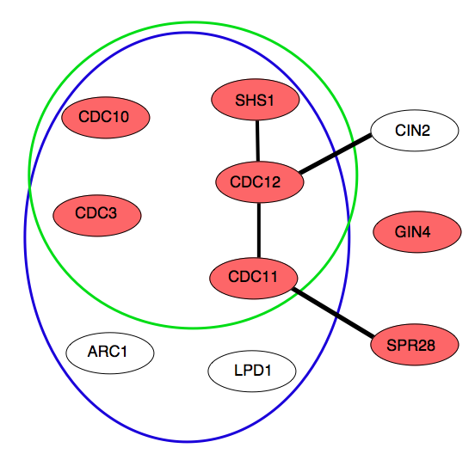
Noisy Data — Clear Statements?
For yeast: ~ 6000 proteins → ~18 million potential interactions
rough estimates: ≤ 100000 interactions occur
→ 1 true positive for 200 potential candidates = 0.5%
→ decisive experiment must have accuracy << 0.5% false positives
Different experiments detect different interactions
For yeast: 80000 interactions known,
only 2400 found in > 1 experiment
TAP
Y2H:
→ many false positives
(up to 50% errors)
Y2H
Co-expression: → gives indications at best
Combine weak indicators = ???
annotated: septin complex
HMS-PCI
see: von Mering (2002)

Slide 3

Conditional Probabilities
Joint probability for "A and B":
P(A ⋂ B)
P(A)
Solve for conditional probability for "A when B is true"
→ Bayes' Theorem:
P(B)
P(A) =
prior probability (marginal prob.) for "A" → no prior knowledge about A
P(B) =
prior probability for "B" → normalizing constant
P(B | A) =
conditional probability for "B given A"
P(A | B) =
posterior probability for "A given B"
→ Use information about B to improve knowledge about A

Slide 4

What are the Odds?
Express Bayes theorem
P(A ⋂ B)
P(A)
P(B)
in terms of odds:
• Also consider case "A does not apply":
• odds for A when we know about B
(we will interpret B as information or features):
posterior odds for A
likelihood ratio
prior odds for A
Λ(A | B) → by how much does our knowledge about A improve?

Slide 5

2 types of Bayesian Networks
(1) Naive Bayesian network
→ independent odds
(2) Fully connected Bayesian network
→ table of joint odds
 | B | !B
C | 0.3 | 0.16
!C | 0.4 | 0.14

Slide 6

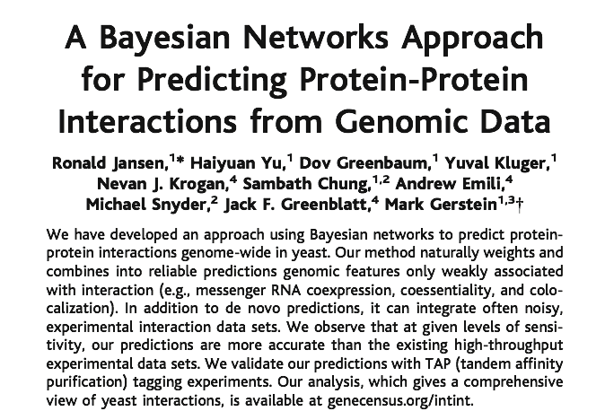
Bayesian Analysis of Complexes
Science 302 (2003) 449

Slide 7
Improving the Odds
Is a given protein pair AB a complex (from all that we know)?
likelihood ratio:
improvement of the odds when we know about features f1, f2, …
prior odds for a random pair AB to be a complex
Idea: determine from known complexes and use for prediction of new complexes
estimate (somehow)
Features used by Jansen et al (2003):
• 4 experimental data sets of complexes
• mRNA co-expression profiles
• biological functions annotated to the proteins (GO, MIPS)
• essentiality for the cell

Slide 8

Gold Standard Sets
To determine
→ use two data sets with known features f1, f2, … for training
Requirements for training data:
i) independent of the data serving as evidence
ii) large enough for good statistics
iii) free of systematic bias
Gold Standard Positive Set (GP):
8250 complexes from the hand-curated MIPS catalog of protein complexes
(MIPS stands for Munich Information Center for Protein Sequences)
Gold Standard Negative Set (GN):
2708746 (non-)complexes formed by proteins from different cellular compartments (assuming that such protein pairs likely do not interact)

Slide 9
Prior Odds
Jansen et al:
• estimated ≥ 30000 existing complexes in yeast
• 18 Mio. possible complexes
→ P(Complex) ≈ 1/600
→ Oprior = 1/600
→ The odds are 600 : 1 against picking a real complex at random
→ expect 50% good hits (TP ≥ FP) when Λ ≈ 600 and higher
Note: Oprior is mostly an educated guess

Slide 10

Essentiality
Test whether both proteins are essential (E) for the cell or not (N)
→ for protein complexes, EE or NN should occur more often
pos/neg: # of gold standard positives/
negatives with essentiality information
Essentiality | pos | neg | P(Ess|pos) | P(Ess|neg) | L(Ess)
EE | 1114 | 81924 | 5,18E-01 | 1,43E-01 | 3,6
NE | 624 | 285487 | 2,90E-01 | 4,98E-01 | 0,6
NN | 412 | 206313 | 1,92E-01 | 3,60E-01 | 0,5
sum | 2150 | 573724 | 1,00 | 1,00
possible values of the feature
overlap of gold standard sets with feature values
In the „pos“ case, the essentiality was only known for 2150 out of 8250 complexes of the gold-standard.
probabilities for each feature value
likelihood ratios
1114
2150
0.19
0.36
= 0,518
= 0,5
-> Essentiality is a weak feature!

Slide 11
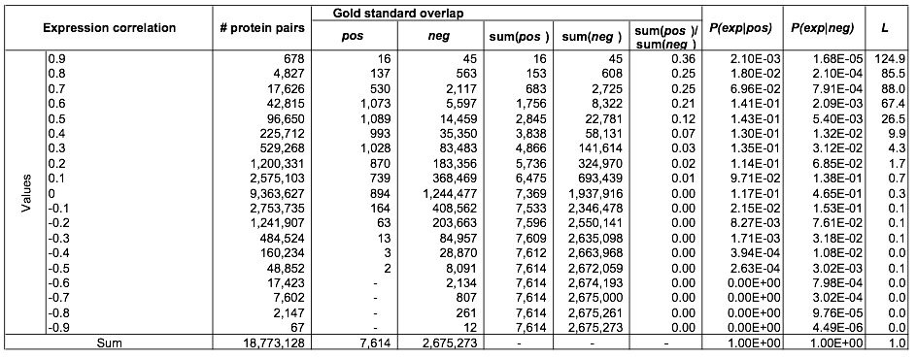
mRNA Co-Expression
Publicly available expression data from
• the Rosetta compendium
• the yeast cell cycle
)
Correlation between the data sets
→ use principal component
-> Co-expression is a much better feature
than essentiality!
Jansen et al, Science 302 (2003) 449

Slide 12
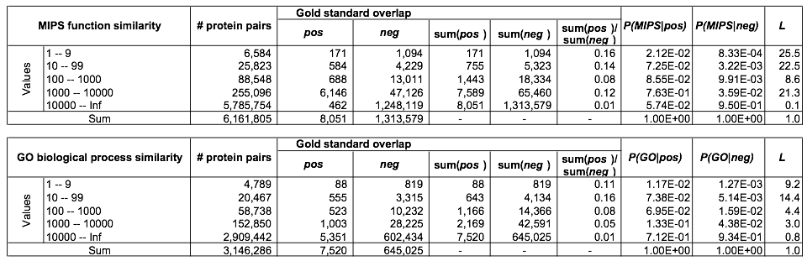
Biological Function
Use MIPS function catalog and Gene Ontology function annotations
• determine functional class shared by the two proteins; small values (1-9)
Indicate highest MIPS function or GO BP similarity
• count how many of the 18 Mio potential pairs share this classification
-> Co-Functionality is a semi-weak feature!
Jansen et al, Science 302 (2003) 449

Slide 13
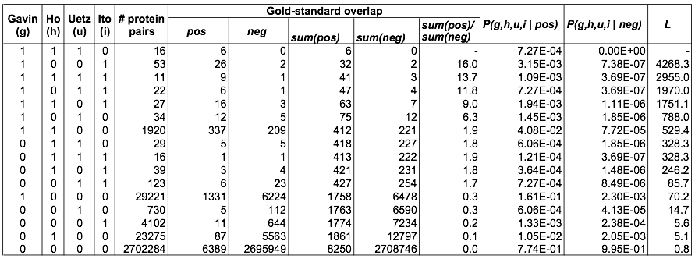
Experimental Data Sets
In vivo pull-down:
Gavin et al, Nature 415 (2002) 141
Ho et al, Nature 415 (2002) 180
31304 pairs
25333 pairs
HT-Y2H:
Uetz et al, Nature 403 (2000) 623
Ito et al, PNAS 98 (2001) 4569
981 pairs
4393 pairs
4 experiments on overlapping PP pairs
→ 2⁴ = 16 categories — table represents fully connected Bayes network
Jansen et al, Science 302 (2003) 449

Slide 14
Statistical Uncertainties
1) L(1111) < L(1001)
statistical uncertainty:
Overlap with all experiments is smaller → larger uncertainty
2) L(1110) = NaN?
Use conservative lower bound → assume 1 overlap with GN
→ L(1110) ≥ 1970
Jansen et al, Science 302 (2003) 449

Slide 15
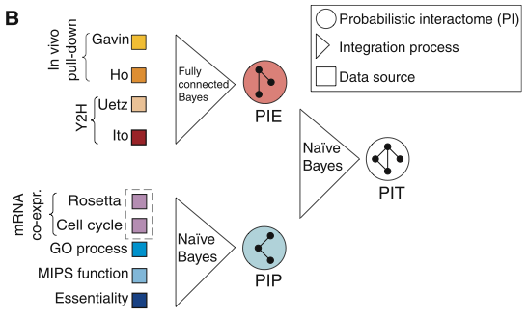
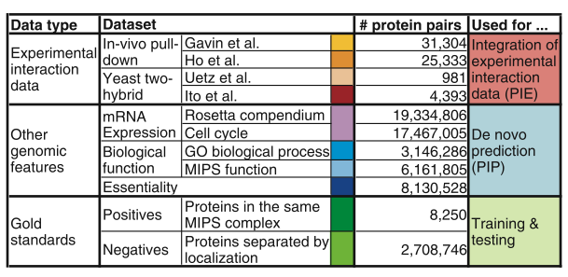
Overview
Jansen et al, Science 302 (2003) 449

Slide 16
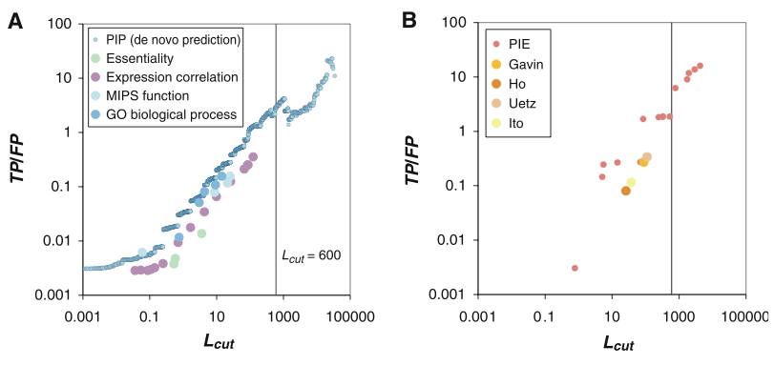
Performance of complex prediction
Predictions
Experimental data
None of the individual evidences alone was enough to get
a likelihood ratio > 600,
neither predicted nor experimental evidences
Jansen et al, Science 302 (2003) 449

Slide 17
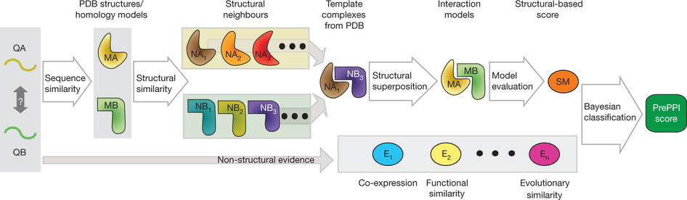
Follow-up work: PrePPI (2012)
Given a pair of query proteins that potentially interact (QA, QB), try to find representative structures for the individual subunits (MA, MB) in the PDB, where available, or from homology model databases.
For each subunit, find both close and remote structural neighbors.
A ‘template’ for the interaction exists whenever a PDB structure contains a pair of inter-acting chains (e.g. NA₁–NB₃) that are structural neighbors of MA and MB, respectively.
A model is constructed by superposing the individual subunits, MA and MB, on their corresponding structural neighbors, NA₁ and NB₃.
Zhang et al, Nature (2012) 490, 556–560

Slide 18
Follow-up work: PrePPI (2012)
We assign 5 empirical-structure-based scores to each interaction model and then calculate a likelihood for each model to represent a true interaction by combining these scores using a Bayesian network trained on a high-confidence data set of positive interactors and a reference set of non-interactors.
We finally combine the structure-derived score (SM) with non-structural evidence associated with the query proteins (for example, co-expression, functional similarity) using a naive Bayesian classifier.
Zhang et al, Nature (2012) 490, 556–560

Slide 19
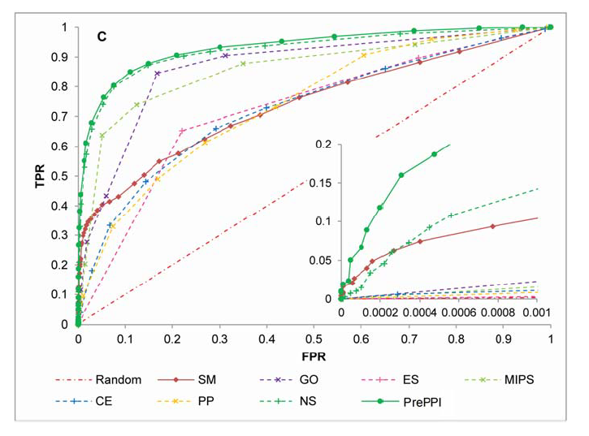
Results of PrePPI
Receiver-operator characteristics (ROC) for predicted yeast complexes.
Examined features:
- structural modeling (SM),
- GO similarity,
- protein essentiality (ES) relationship,
- MIPS similarity,
- co‐expression (CE),
- phylogenetic profile (PP) similarity.
Also listed are 2 combinations:
- NS for the integration of all non‐structure clues, i.e. GO, ES, MIPS, CE, and PP, and
- PrePPI for all structural and non‐structure clues).
This gave 30.000 high-confidence PP interactions for yeast and 300.000 for human.
Jansen et al, Science 302 (2003) 449

Slide 20
Summary: Bayesian Analysis
Combination of weak features yields powerful predictions
• boosts odds via Bayes' theorem
• Gold standard sets for training the likelihood ratios
Bayes vs. other machine learning techniques:
(voting, unions, SVM, neuronal networks, decision trees, …)
→ arbitrary types of data can be combined
→ weight data according to their reliability
→ include conditional relations between evidences
→ easily accommodates missing data (e.g., zero overlap with GN)
→ transparent procedure
→ predictions easy to interpret

Slide 21
Insert: Relation of PPI networks to diseases
In principle, a protein mutant can
destabilize proteins (left) or
perturb interactions (right)
3 possible outcomes: all interactions kept,
some or no interactions remain.
Disease alleles enriched in „edgetic“ cases.
Can one study this systematically
on a genome-level?
Sahni et al., Marc Vidal (2015)
Cell 161, 647–660

Slide 22
Y2H: screen native PPIs
Aim 1: Systematic characterization of PPI perturbations associated with disease mutation.
Experimental dataset: 2,449 mutant proteins and their 1,072 corresponding WT proteins.
Approach: run Y2H screen how mutant and WT proteins interact with proteins encoded by the 7,200 ORFs in the human ORFeome v1.1.
Intersect this with the human interactome map HI-II-14 (enhance confidence).
-> interaction profiles for 460 mutant proteins and their 220 WT counterparts. Out of 1,316 PPIs (ca. 6 per protein), 521 interactions were perturbed.
Only two mutations conferred PPI gains, suggesting that gain of interactions may be a rare event in human disease.
Sahni et al., Marc Vidal (2015)
Cell 161, 647–660

Slide 23
Findings
Ca. 60% of disease-associated missense mutations perturb PPIs.
- Of these, half result in complete loss of interactions,
generally caused by protein misfolding and impaired expression.
- The other half lead to edgetic perturbations.
Importantly, different mutations in the same gene frequently result in different interaction perturbation profiles.
Sahni et al., Marc Vidal (2015)
Cell 161, 647–660

Slide 24
How do mutations affect protein folding?
Aim 2: How do disease mutations impact protein folding and disposition?
Measure how well hmORF-encoded proteins and their WT counterparts interact with cellular quality control factors (QCFs) using a quantitative high-throughput LUMIER assay.
They selected the following QCFs based on their broad specificity:
the cytoplasmic chaperones HSP90 and HSC70,
(2) their co-chaperones BAG2 and CHIP/STUB1,
(3) the regulatory subunit PSMD2 of the proteasome and
(4) the ER chaperones GRP78/BIP and GRP94.
Idea: Increased interaction between a QCF and mutant or WT protein, as measured by the LUMIER assay, indicates a mutation-induced perturbation in conformational stability that is often associated with compromised or complete loss of function.
Sahni et al., Marc Vidal (2015)
Cell 161, 647–660

Slide 25
Experimental pipeline
Select mutations associated with a wide range of disorders, including
cancer susceptibility and
heart, respiratory, and neurological diseases.
Out of 16,400 such mutations affecting over 1,200 genes for which we have a wild-type (WT) open-reading frame (ORF) clone in our human
‘‘ORFeome’’ collection, the authors selected 1 to 4 mutations per gene.
Sahni et al., Marc Vidal (2015)
Cell 161, 647–660

Slide 26
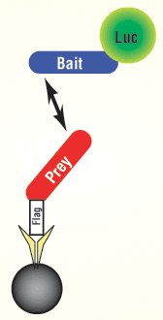
Lumier assay
LUMIER stands for “luminescence-based mammalian interactome mapping”.
In a LUMIER assay, a luciferase-tagged 'bait' protein is screened against a series of Flag-tagged 'prey' proteins.
An antibody against Flag is used to affinity-purify the prey, and the prey-associated luminescence reveals the extent of bait interaction
The antibodies (yellow) are immobilized on sepharose beads (black sphere).
An array scanner can be used to quantify the relative extent of interaction for large numbers of assays.
Barrios-Rodiles, M. et al. High-throughput mapping of a dynamic signaling network in mammalian cells. Science 307, 1621−1625 (2005).

Slide 27
Interaction with QCFs
The interaction profiles of most mutant proteins correlated with their WT counterparts. However, compared to a background control set, a significant enrichment was found for mutant alleles having increased interaction with QCFs (A–H) but little or no enrichment for decreased interaction (A).
(I) The interaction profiles of mutant proteins with the five cytoplasmic QCFs were highly correlated, distinct from those with the 2 ER factors.
-> coordination and specificity of cellular quality control pathways.
28% of the tested alleles exhibited increased binding to at least 1 of the 7 QCFs tested.
Sahni et al., Marc Vidal (2015)
Cell 161, 647–660

Slide 28
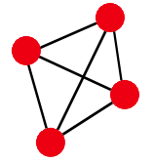
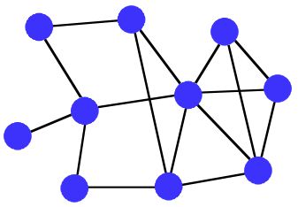
Connected Regions
Observation: there are more interactions inside a complex
than to the outside
→ how can one identify highly connected regions in a network?
1) Fully connected region: Clique
clique := G' = (V', E' = V'⁽²⁾)
Problems with cliques:
• finding cliques is NP-hard
(but can be done in O(N²) for sparsely
connected biological networks)
• biological protein complexes are not
always fully connected

Slide 29
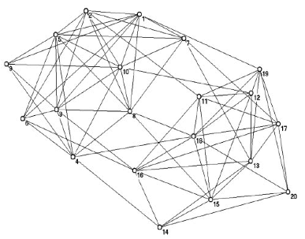
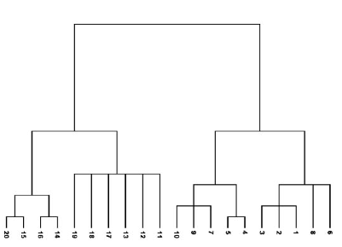
Communities
Community :=
subset of vertices, for which the internal connectivity is
denser than to the outside
Aim: map network onto tree that reflects the community structure
???
<=>
Radicchi et al, PNAS 101 (2004) 2658:

Slide 30
Define communities by agglomerative clustering
1) Assign a weight Wij to each pair of vertices i, j that measures
how "closely related" these two vertices are.
2) Iteratively add edges between pairs of nodes with decreasing Wij
Measures for Wij:
1) Number of vertex-independent paths between vertices i and j
(vertex-independent paths between i and j: no shared vertex except i and j)
Menger (1927): the number of vertex-independent paths equals the
number of vertices that have to be removed to cut all paths between i and j
→ measure for network robustness
2) Number of edge-independent paths between i and j
3) Total number of paths L between i and j
but L = 0 or ∞ → weight paths with their length α^{L} with α < 1
Problem: vertices with a single link are separated from the communities

Slide 31
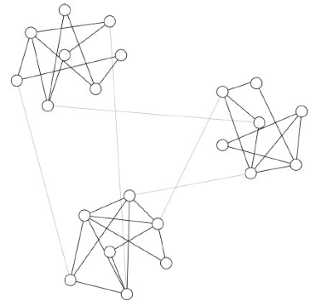

Vertex Betweenness
Freeman (1927): count on how many shortest paths a vertex is visited
For a graph G = (V, E) with |V| = n
Betweenness for vertex ν:
σ_{st} (v) : shortest path including v.
There are n - 1 other vertices besides v.
They have shortest paths to n - 2 vertices.
-> Computing shortest paths takes O(n²) operations
Alternative: edge betweenness
→ to how many shortest paths does
this edge belong

Slide 32
Girvan-Newman Algorithm
Girvan, Newman, PNAS 99 (2002) 7821:
For a graph G = (V, E) with |V| = n, |E| = m
1) Calculate betweenness for all m edges
2) Remove edge with highest betweenness
3) Recalculate betweenness for all affected nodes
4) Repeat from 2) until no more edge is left (at most m iterations)
5) Build up tree from V by reinserting vertices in reverse order
Works well, but slow: O(mn²) ≈ O(n³) for scale-free networks (|E| = 2 |V|)
Reason for complexity: compute shortest paths (n²) for m edges
→ recalculating a global property is expensive for larger networks

Slide 33
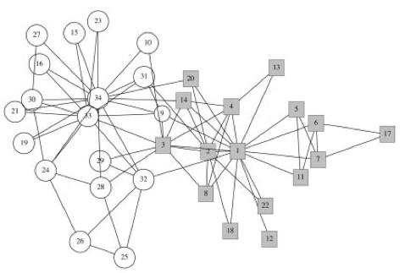
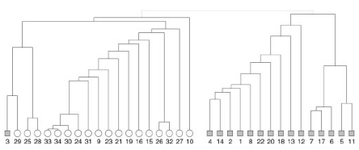
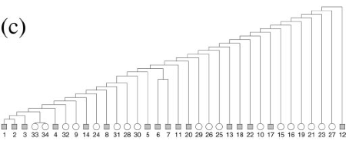
Zachary's Karate Club
• observed friendship relations of 34 members over two years
• correlate fractions at break-up with calculated communities
with edge betweenness:
with number of edge-independent paths:
administrator's fraction
instructor's fraction
Girvan, Newman, PNAS 99 (2002) 7821

Slide 34
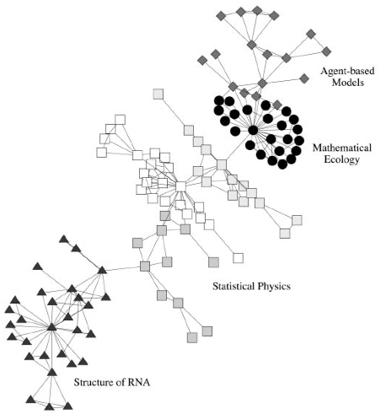
Collaboration Network
Vertices: scientists at the Santa Fe Institute.
Edge: two authors have co-authored a joint paper.
Show is the largest component of the Santa Fe Institute collaboration network.
The primary divisions detected by the GN algorithm are indicated by different vertex shapes.
Girvan, Newman, PNAS 99 (2002) 7821

Slide 35
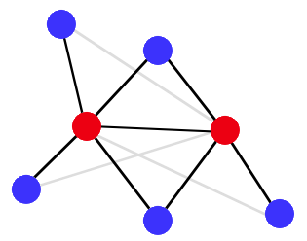

Determining Communities Faster
Radicchi et al, PNAS 101 (2004) 2658:
Determine edge weights via edge-clustering coefficient
→ local measure
→ much faster, esp. for large networks
Modified edge-clustering coefficient:
→ fraction of potential triangles
with edge between i and j
k = 5
k = 4
Here, z_{i,j}⁽³⁾ is the number of triangles,
k_{i} and k_{j} are the degrees of nodes i and j.
Note: "+ 1" to remove degeneracy for zi,j⁽³⁾ = 0
C⁽³⁾ = (2+1) / 3 = 1
Algorithm works exactly like GN-algorithm except that at each iteration, the edge is removed with smallest

Slide 36

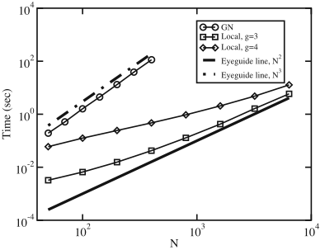
Performance
Instead of triangles: cycles of higher order g
→ continuous transition to a global measure
Radicchi et al-algorithm: O(N²) for large networks
Radicchi et al, PNAS 101 (2004) 2658:

Slide 37
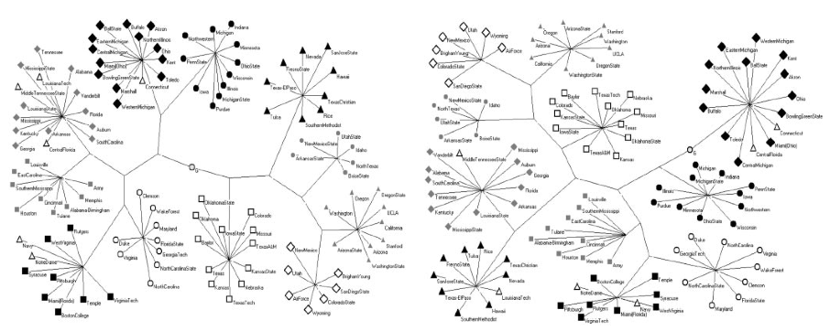
Comparison of algorithms
Data set: football teams from US colleges; different symbols = different conferences, teams played ca. 7 intraconference games and 4 inter-conference games in 2000 season.
Girven-Newman algorithm
Radicchi with g = 4
→ very similar communities

Slide 38
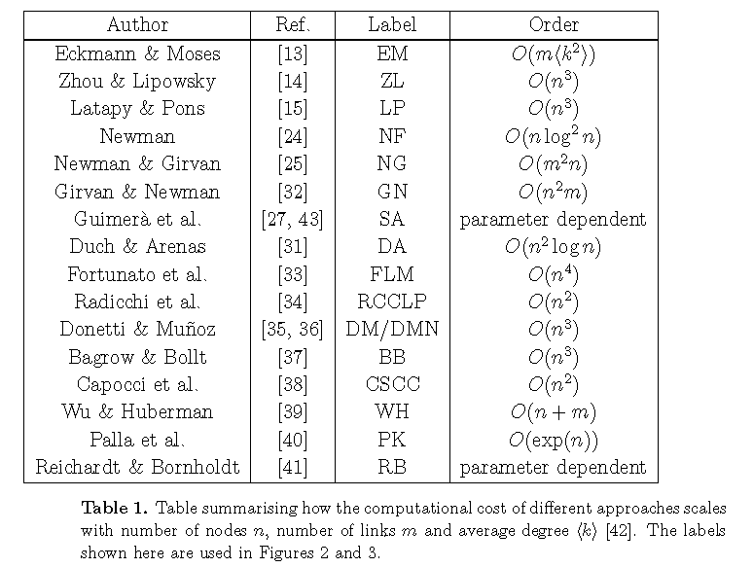
Comparison of modularity maximization methods
A large number of approaches have been developed to maximize modularity for divisions into any number of communities of any sizes.
Danon, Duch, Diaz-Guilera, Arenas, J. Stat. Mech. P09008 (2005)

Slide 39
Comparison of modularity maximization methods
Test the sensitivity of these methods:
How well can each method detect communities in ad hoc networks with a well known, fixed community structure.
Such networks are typically generated with n = 128 nodes
that are split into 4 communities containing 32 nodes each.
Pairs of nodes belonging to the same community are linked
with probability p_{in} whereas
pairs belonging to different communities are joined with probability p_{out}.
Danon, Duch, Diaz-Guilera, Arenas, J. Stat. Mech. P09008 (2005)

Slide 40
Comparison of modularity maximization methods
The value of p_{out} is taken so that the average number of links that a node has to members of any other community, z_{out}, can be controlled.
While p_{out} (and therefore z_{out}) is varied freely, the value of p_{in} is chosen to keep the total average node degree, k constant, and is set to 16.
Danon, Duch, Diaz-Guilera, Arenas, J. Stat. Mech. P09008 (2005)

Slide 41
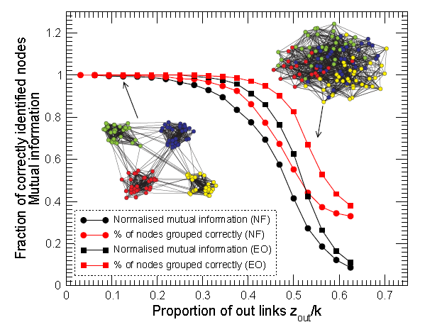
Comparison of modularity maximization methods
As z_{out} increases, the communities become more and more diffuse and harder to identify, (see figure).
Since the “real” community structure is well known in this case,
it is possible to measure the number of nodes correctly classified by the method of community identification.
Danon, Duch, Diaz-Guilera, Arenas, J. Stat. Mech. P09008 (2005)

Slide 42
Insert: Quantify detection of communities
How can one quantify the quality of a division?
A good division is one where there are fewer than expected edges between groups.

Slide 43
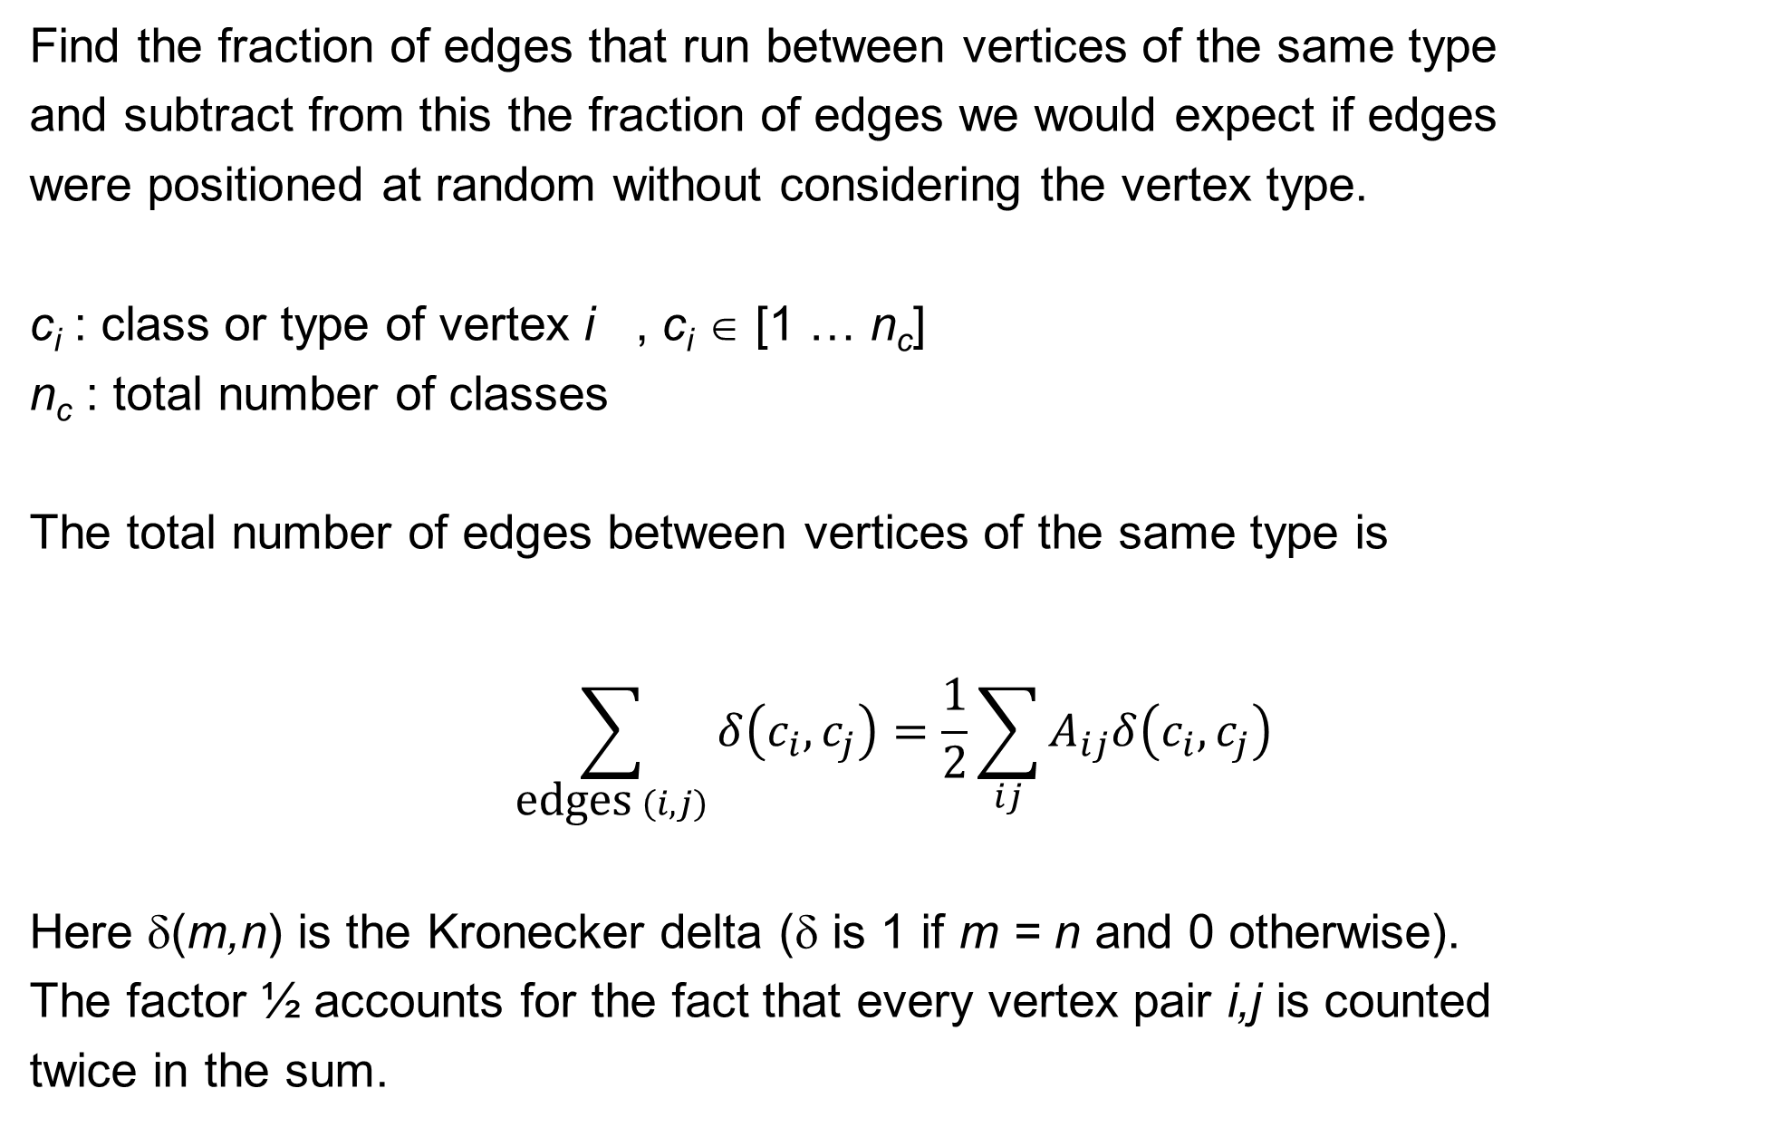
Quantify assortative mixing
Find the fraction of edges that run between vertices of the same type
and subtract from this the fraction of edges we would expect if edges
were positioned at random without considering the vertex type.
c_{i} : class or type of vertex i , c_{i} ∈ [1 … n_{c}]
n_{c} : total number of classes
The total number of edges between vertices of the same type is
$$\sum_{\text{e}\text{dges} \left(i,j\right)}{δ\left(c_{i},c_{j}\right)=\frac{1}{2}\sum_{ij}{A_{ij}δ\left(c_{i},c_{j}\right)}}$$
Here δ(m,n) is the Kronecker delta (δ is 1 if m = n and 0 otherwise).
The factor ½ accounts for the fact that every vertex pair i,j is counted
twice in the sum.

Slide 44
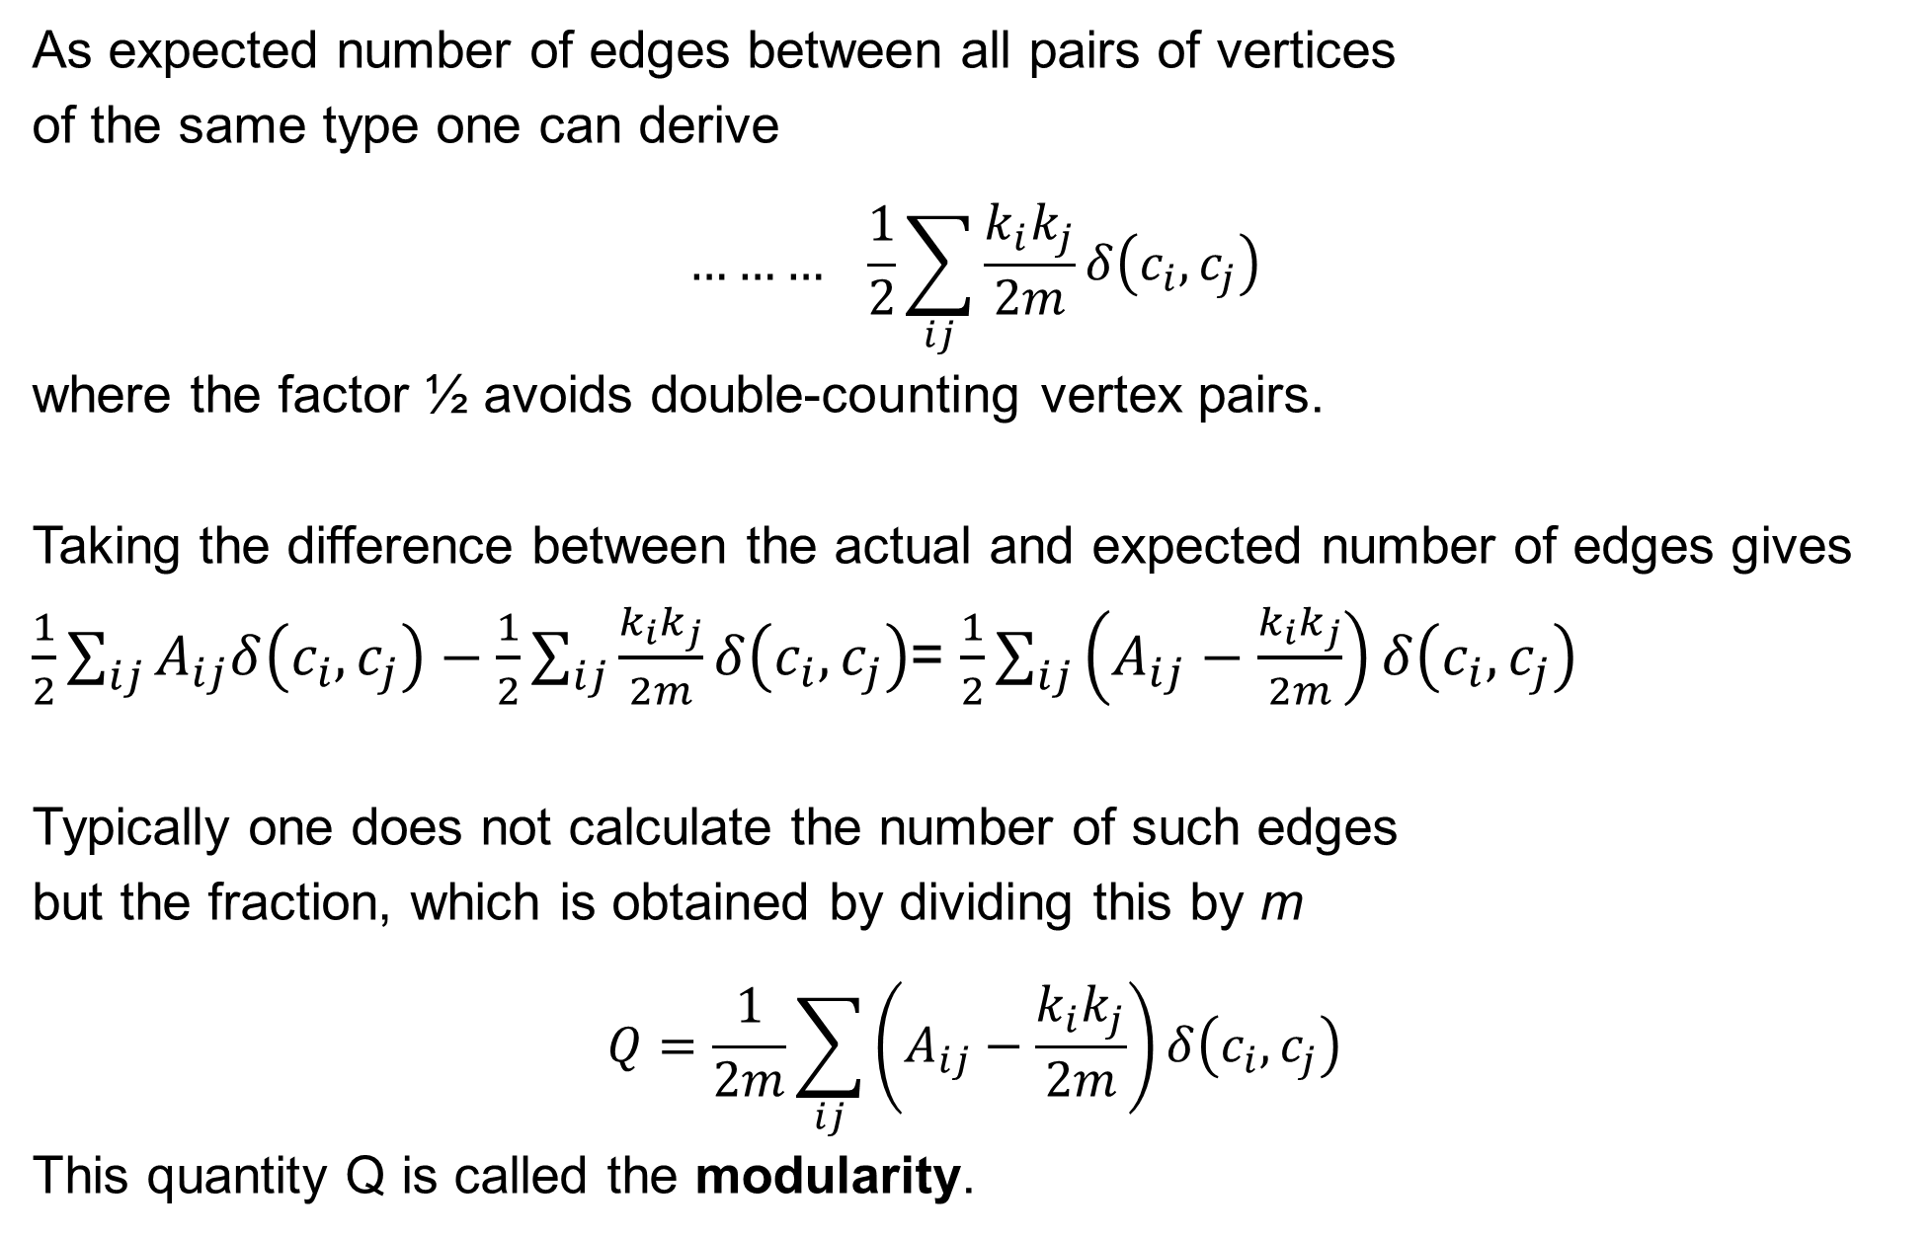
Quantify assortative mixing
As expected number of edges between all pairs of vertices
of the same type one can derive
$$……… \frac{1}{2}\sum_{ij}{\frac{k_{i}k_{j}}{2m}δ\left(c_{i},c_{j}\right)}$$
where the factor ½ avoids double-counting vertex pairs.
Taking the difference between the actual and expected number of edges gives
$\frac{1}{2}\sum_{ij}{A_{ij}δ\left(c_{i},c_{j}\right)}−\frac{1}{2}\sum_{ij}{\frac{k_{i}k_{j}}{2m}δ\left(c_{i},c_{j}\right)}$= $\frac{1}{2}\sum_{ij}{\left(A_{ij}−\frac{k_{i}k_{j}}{2m}\right)δ\left(c_{i},c_{j}\right)}$
Typically one does not calculate the number of such edges
but the fraction, which is obtained by dividing this by m
$$Q=\frac{1}{2m}\sum_{ij}{\left(A_{ij}−\frac{k_{i}k_{j}}{2m}\right)δ\left(c_{i},c_{j}\right)}$$
This quantity Q is called the modularity.

Slide 45
Comparison of modularity maximization methods
One of the most successful approaches is simulated annealing (SA).
At the start: define an initial partition of the nodes into communities.
At each step, a node is chosen at random and moved to a different community, also chosen at random.
If the change improves the modularity (ΔQ > 0), it is always accepted, otherwise it is accepted with a probability exp(ΔQ/kT).
The simulation will start at high temperature T and is then slowly cooled down.
Several improvements have been tested.
Firstly, the algorithm is stopped periodically, or quenched,
and ΔQ is calculated for moving each node to every community that is not its own.
Finally, the move corresponding to the largest value of ΔQ is accepted.

Slide 46
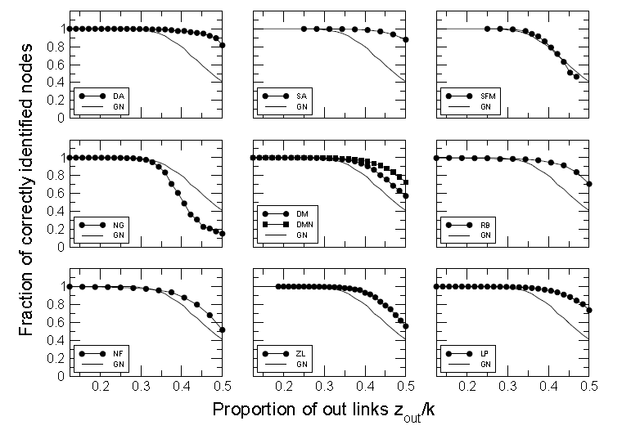
Comparison of modularity maximization methods
GN:
Girven-Newman
algorithm (used as standard here).
SA: simulated annealing.
Most modern
algorithms work better than GN.
Danon, Duch, Diaz-Guilera, Arenas, J. Stat. Mech. P09008 (2005)

Slide 47

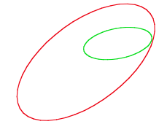
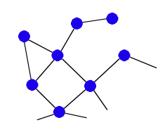
Strong Communities
"Community := subgraph with more interactions inside than to the outside"
A subgraph V is a community in a…
…strong sense when:
…weak sense when:
→ Check every node individually
→ allow for borderline nodes
Radicchi et al, PNAS 101 (2004) 2658
• Σ kin = 2, Σ kout = 1
{kin, kout} = {1,1}, {1,0}
→ community in a weak sense
• Σ kin = 10, Σ kout = 2
{kin, kout} = {2,1}, {2, 0}, {3, 1}, {2,0}, {1,0}
→ community in a strong and weak sense

Slide 48
Summary
What you learned today:
• how to combine a set of noisy evidences into a powerful prediction tool
→ Bayes analysis
• how to find communities in a network efficiently
→ betweenness, edge-cluster-coefficient
Next lecture: Fri, May 4, 2018
• Modular decomposition
• Robustness

