Slide 1
Bioinformatics 3
V 2 – Clusters, Dijkstra, and Graph Layout
Mon, Oct 31, 2016

Slide 2

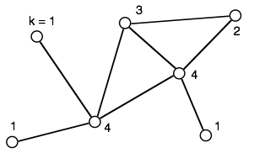

Graph Basics
A graph G is an ordered pair (V, E) of a set V of vertices and a set E of edges.
Degree distribution P(k)
Random network:
also called the "Erdös-Renyi model“:
start with set of given nodes
then add links randomly
P(k) = "Poisson“ (will show this on the
next slides)
Scale-free network:
grow network stepwise
Add links according to preferential attachment “rule” between new nodes and existing nodes
P(k) = power law (dt. Potenzgesetz)
k | 0 | 1 | 2 | 3 | 4
P(k) | 0 | 3/7 | 1/7 | 1/7 | 2/7

Slide 3
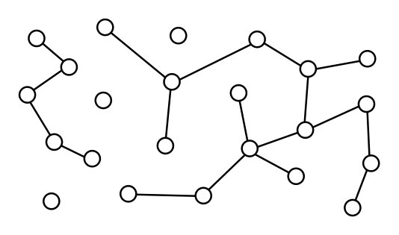
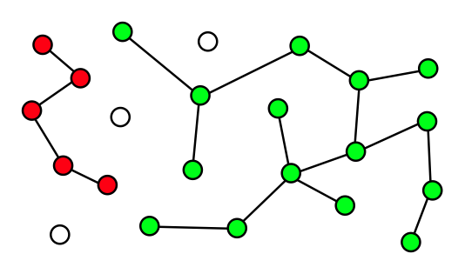
Connected Components
Connected graph <=> there is a path between all pairs of nodes
In large (random) networks: complete {V} is often not connected
→ identify connected subsets {Vi} with {V} = U {Vi}
→ connected components (CC)
#CC = 5
Nmax = 15
Nmin = 1

Slide 4


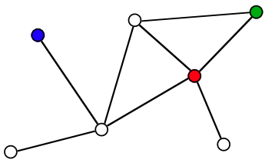
Connectivity of the Neighborhood
How many of the neighboring vertices are themselves neighbors?
=> this is measured by the clustering coefficient C(k)
Number of possible undirected edges between k nodes:
nk is the actual number of edges between the neighbor nodes.
Fraction of actual edges ≅ clustering coefficient
green: k = 2, nk = 1 → C = 1
red: k = 4, nk = 2 → C = 1/3
blue: k = 1, nk = ? → C is not defined
Note: clustering coeff. is sometimes also defined via fraction of possible triangles

Slide 5
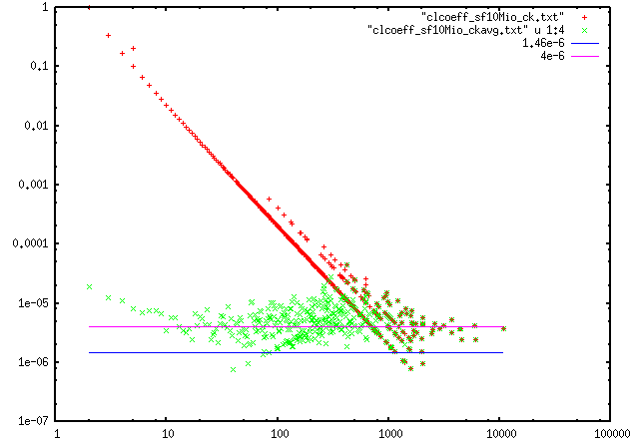


Clustering Coefficient of a Graph
Data: Ci for each node i → N values
Statistics:
average at fixed k
→
Ci, C(k), <C>
average over all nodes
→
k
Note: it is also possible to average the C(k)
This yields a different value for <C> !!!
because no weighting is done for different occupancy of k’s.

Slide 6



Basic Types: (1) Random Network
Generally: N vertices connected by L edges
More specific: distribute the edges randomly between the vertices
Maximal number of links between N vertices:
=> probability p for an edge between two randomly selected nodes:
=> average degree λ
path lengths in a random network grow with ln(N) => “small world”

Slide 7



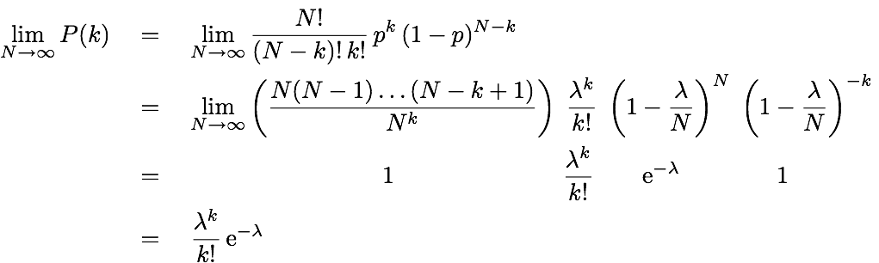
Random Network: P(k)
Network with N vertices, L edges
=> probability for a random link:
Probability that random node has links to k other particular nodes:
Probability that random node has links to any k other nodes:
Limit of large graph: N → oo, p = λ / N

Slide 8
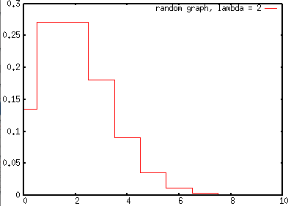
Random Network: P(k)
Many independently placed edges => Poisson statistics
k | P(k | λ = 2)
0 | 0.14
1 | 0.27
2 | 0.27
3 | 0.18
4 | 0.090
5 | 0.036
6 | 0.012
7 | 0.0034
8 | 0.00086
9 | 0.00019
10 | 3.82e-05
=> Small probability for k >> λ

Slide 9

Basic Types: (2) Scale-Free
Growing network a la Barabasi and Albert (1999):
• start from a small "nucleus“ of m₀ connected nodes
• add new node with n links
• connect new links to existing nodes with probability p_{i} proportional to
degree k_{i} of each existing node (preferential attachment;
in BA-model β = 1
=> "the rich get richer"
Properties:
• this leads to a power-law degree distribution:
with γ = 3 for the BA model
• self-similar structure with highly connected hubs (no intrinsic length scale)
=> average path length grows with ln (N) / ln(ln(N))
=> this grows much slower than for random graphs
=> “very small world”

Slide 10
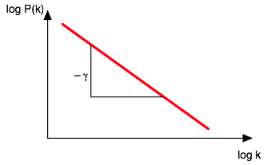

The Power-Law Signature
Power law
Take log on both sides:
Plot log(P) vs. log(k) => straight line
Note: for fitting γ against experimental data it is often better to use the integrated P(k)
=> integral smoothes the data

Slide 11
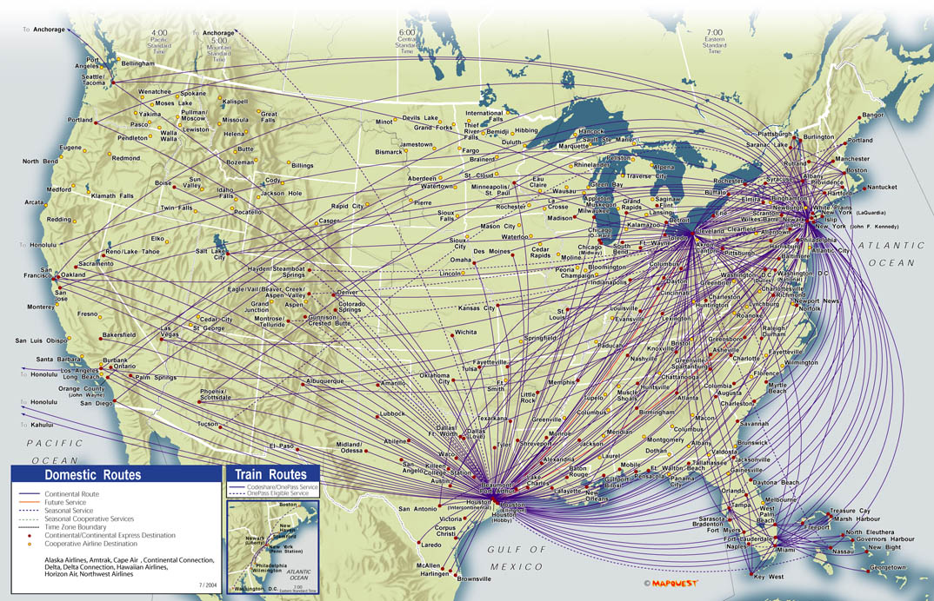
Scale-Free: Examples
The World-Wide-Web:
=> growth via links to portal sites
Flight connections between airports
=> large international hubs, small local airports
Protein interaction networks
=> some central,
ubiquitous proteins
http://a.parsons.edu/~limam240/blogimages/16_full.jpg

Slide 12
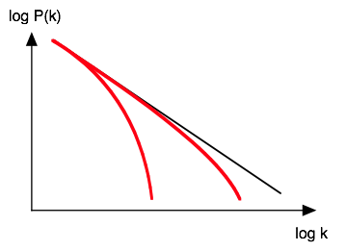
Saturation: Ageing + Costs
Example: network of movie actors (with how many other actors did
an actor appear in a joint movie?)
Each actor makes new acquaintances for ~40 years before retirement
=> limits maximum number of links
Example: building up a physical computer network
It gets more and more expensive for a network hub to grow further
=> number of links saturates
cost

Slide 13
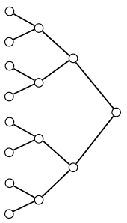
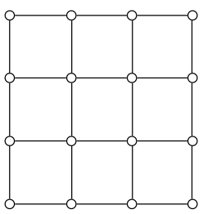
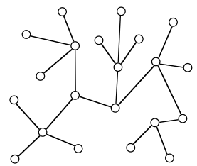
Hierarchical, Regular, Clustered…
Tree-like network with similar degrees
=> like an organigram
=> hierarchic network
All nodes have the same degree and the same local neighborhood
=> regular network
P(k) for these example networks? (finite size!)
Note: most real-world networks are somewhere in between the basic types

Slide 14


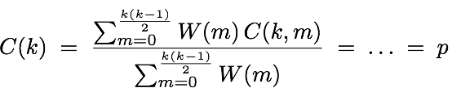
C(k) for a Random Network
Clustering coefficient when m edges exist between k neighbors
Probability to have exactly m edges between the k neighbors
In this way, we pick the m start nodes for the m edges from the k nodes.
Average C(k) for degree k:
→ C(k) is independent of k
<=> same local connectivity throughout the network

Slide 15
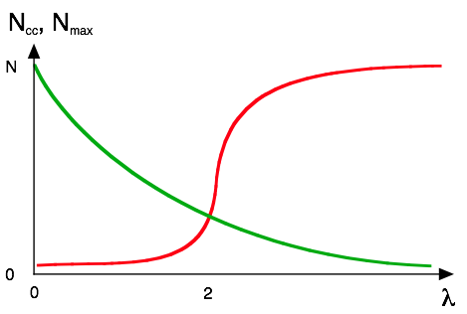
The Percolation Threshold
Connected component = all vertices that are connected by a path
Very few edges
only CCs
of size 2
Percolation transition at λ = 2
Many edges
→ graph is one CC
Identify:
Ncc = number of connected
components (clusters)
(green)
Nmax = size of the largest
cluster (red)
For λ > 2:
“giant component”
exists
average degree λ

Slide 16
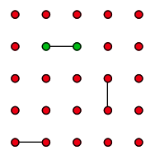
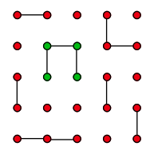
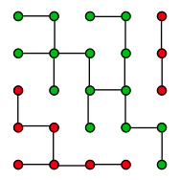
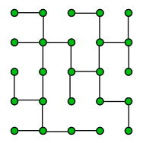
Percolation Transition
Example: regular square lattice, N = 25 nodes, Lmax = 40 links between
next neighbors
L = 3
λ = 0.24
Ncc = 22
Nmax = 2
L = 11
λ = 0.88
Ncc = 14
Nmax = 4
L = 22
λ = 1.76
Ncc = 3
Nmax = 15
L = 24
λ = 1.92
Ncc = 1
Nmax = 25
"percolation"
percolation = "spanning structure" emerges (long range connectivity)
for an infinite square lattice: percolation transition at λ = 2
here: finite size effect <=> fewer possible links at the boundaries

Slide 17
Clusters in scale free graphs
Scale-free network <=> no intrinsic scale
→ same properties at any k-level
→ same local connectivity
→ C(k) = const.
"Real" biological data
→ missing links
→ multiple clusters
Ci, C(k), <C>
Is the metabolic network of a cell fully connected?
k

Slide 18
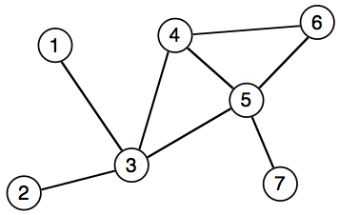
Algorithms on Graphs
How to represent a graph in the computer?
1. Adjacency list
=> list of neighbors for each node
1:
2:
3:
4:
5:
6:
7:
(3)
(3)
(1, 2, 4, 5)
(3, 5, 6)
(3, 4, 6, 7)
(4, 5)
(5)
+ minimal memory requirement
+ vertices can easily be added or removed
– requires O(λ) time to determine
whether a certain edge exists
Note: for weighted graphs store pairs of (neighbor label, edge weight)

Slide 19
Graph Representation II
2. Adjacency matrix
→ N x N matrix with entries Muv
Muv = weight when edge between u and v exists,
0 otherwise
→ symmetric for undirected graphs
+ fast O(1) lookup of edges
– large memory requirements
– adding or removing nodes is expensive
 | 1 | 2 | 3 | 4 | 5 | 6 | 7
1 | – | 0 | 1 | 0 | 0 | 0 | 0
2 | 0 | – | 1 | 0 | 0 | 0 | 0
3 | 1 | 1 | – | 1 | 1 | 0 | 0
4 | 0 | 0 | 1 | – | 1 | 1 | 0
5 | 0 | 0 | 1 | 1 | – | 1 | 1
6 | 0 | 0 | 0 | 1 | 1 | – | 0
7 | 0 | 0 | 0 | 0 | 1 | 0 | –
Note: very convenient in programming languages that support sparse multi-dimensional arrays
=> Perl

Slide 20
Graph Representation III
3. Incidence matrix
→ N x M matrix with entries Mnm
Mnm = weight when edge m ends at node n
0 otherwise
e5
e1
e6
e3
e4
e7
e2
→ for a plain graph there are
two entries per column
→ directed graph:
indicate direction via sign (in/out)
 | e1 | e2 | e3 | e4 | e5 | e6 | e7
1 | 1
2 |  | 1
3 | 1 | 1 | 1 | 1
4 |  |  | 1 |  | 1
5 |  |  |  | 1 |  | 1 | 1
6 |  |  |  |  | 1 | 1
7 |  |  |  |  |  |  | 1
The incidence matrix is a special form of the stoichiometric matrix of reaction networks.

Slide 21
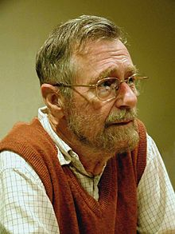
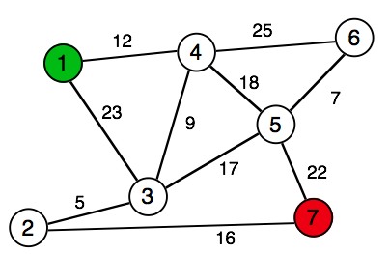
The Shortest Path Problem
Problem:
Find the shortest path from a given vertex
to the other vertices of the graph (Dijkstra 1959).
We need (input):
• weighted graph G(V, E)
• start (source) vertex s in G
We get (output):
• shortest distances d[v] between s and v
• shortest paths from s to v
Edsger Dijkstra
(1930-2002):
Idea:
Always proceed with the closest node
→ greedy algorithm
Real world application:
→ GPS navigation devices

Slide 22
Dijkstra Algorithm 0
Initialization:
for all nodes v in G:
d[v] = oo
pred[v] = nil
d[s] = 0
distance and path to all other nodes is still unknown
distance from source to source = 0
d[v] = length of path from s to v
pred[v] = predecessor node on the shortest path
In the example: s = 1
node | 1 | 2 | 3 | 4 | 5 | 6 | 7
d | 0 | oo | oo | oo | oo | oo | oo
pred | – | – | – | – | – | – | –

Slide 23
Dijkstra I
Iteration:
Q = V
while Q is not empty:
u = node with minimal d
if d[u] = oo:
break
delete u from Q
for each neighbor v of u:
d_temp = d[u] + d(u,v)
if d_temp < d[v]:
d[v] = d_temp
pred[v] = u
return pred[]C
Save {V} into working copy Q
choose node closest to s
exit if all remaining nodes are inaccessible
calculate distance to u's neighbors
if new path is shorter
=> update

Slide 24
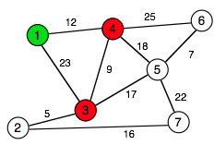
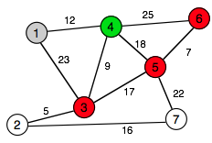
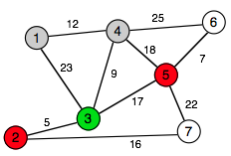
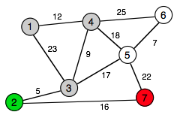
Dijkstra-Example
1)
Q = (1, 2, 3, 4, 5, 6, 7)
node | 1 | 2 | 3 | 4 | 5 | 6 | 7
d | 0 | oo | 23 | 12 | oo | oo | oo
pred | – | – | 1 | 1 | – | – | –
Q = V
while Q is not empty:
u = node with minimal d
if d[u] = oo:
break
delete u from Q
for each neighbor v of u:
d_temp = d[u] + d(u,v)
if d_temp < d[v]:
d[v] = d_temp
pred[v] = u
return pred[]C
2)
Q = (2, 3, 4, 5, 6, 7)
node | 1 | 2 | 3 | 4 | 5 | 6 | 7
d | 0 | oo | 21 | 12 | 30 | 37 | oo
pred | – | – | 4 | 1 | 4 | 4 | –
Q = (2, 3, 5, 6, 7)
3)
node | 1 | 2 | 3 | 4 | 5 | 6 | 7
d | 0 | 26 | 21 | 12 | 30 | 37 | oo
pred | – | 3 | 4 | 1 | 4 | 4 | –
Q = (2, 5, 6, 7)
4)
node | 1 | 2 | 3 | 4 | 5 | 6 | 7
d | 0 | 26 | 21 | 12 | 30 | 37 | 42
pred | – | 3 | 4 | 1 | 4 | 4 | 2

Slide 25
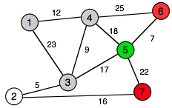
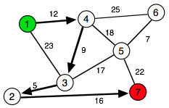
Example contd.
4)
Q = (2, 5, 6, 7)
node | 1 | 2 | 3 | 4 | 5 | 6 | 7
d | 0 | 26 | 21 | 12 | 30 | 37 | 42
pred | – | 3 | 4 | 1 | 4 | 4 | 2
5)
Q = (5, 6, 7)
node | 1 | 2 | 3 | 4 | 5 | 6 | 7
d | 0 | 26 | 21 | 12 | 30 | 37 | 42
pred | – | 3 | 4 | 1 | 4 | 4 | 2
Q = (6, 7)
Q = (7)
Final result:
node | 1 | 2 | 3 | 4 | 5 | 6 | 7
d | 0 | 26 | 21 | 12 | 30 | 37 | 42
pred | – | 3 | 4 | 1 | 4 | 4 | 2
d(1, 7) = 42
path = (1, 4, 3, 2, 7)
d(1, 6) = 37
path = (1, 4, 6) or (1,4,5,6)

Slide 26
Beyond Dijkstra
Dijkstra works for directed and undirected graphs with
non-negative weights.
Straight-forward implementation: O(N²)
Graphs with positive and negative weights
→ Bellman-Ford-algorithm
If there is a heuristic to estimate weights:
→ improve efficiency of Dijkstra
→ A*-algorithm

Slide 27
Graph Layout
Task: visualize various interaction data:
e.g. protein interaction data (undirected):
nodes – proteins
edges – interactions
metabolic pathways (directed)
nodes – substances
edges – reactions
regulatory networks (directed):
nodes – transcription factors + regulated proteins
edges – regulatory interaction
co-localization (undirected)
nodes – proteins
edges – co-localization information
homology (undirected/directed)
nodes – proteins
edges – sequence similarity (BLAST score)

Slide 28
Graph Layout Algorithms
Graphs encapsulate relationship between objects
→ drawing gives visual impression of these relations
Good Graph Layout: aesthetic
• minimal edge crossing
• highlight symmetry (when present in the data)
• even spacing between the nodes
Many approaches in literature (and in software tools),
most useful ones usually NP-complete (exponential runtime)
Most popular for straight-edge-drawing:
→ force-directed: spring model or spring-electrical model
→ embedding algorithms like H3 or LGL

Slide 29
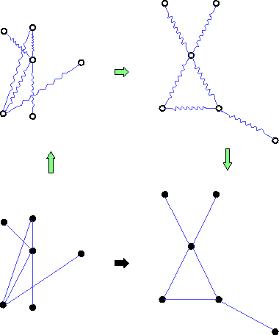
Force-Directed Layout
Peter Eades (1984): graph layout heuristic
"Spring Embedder'' algorithm.
• edges → springs
vertices → rings that connect the springs
• Layout by dynamic relaxation
→ lowest-energy conformation
→ "Force Directed'' algorithm
http://www.hpc.unm.edu/~sunls/research/treelayout/node1.html

Slide 30

Energy and Force
Energy: describes the altitude of the landscape
Energy increases when you go up the hill
You need more force for a steeper ascent
Force: describes the change of the altitude, points downwards.

Slide 31
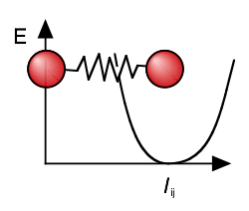

Spring Embedder Layout
Springs regulate the mutual distance between the nodes
• too close → repulsive force
• too far → attractive force
Spring embedder algorithm:
• add springs for all edges
• add loose springs to all non-adjacent vertex pairs
Total energy of the system:
xi, xj = position vectors for nodes i and j
lij = rest length of the spring between i and j
R = spring constant (stiffness)
Problem: lij have to be determined a priori, e.g., from network distance

Slide 32
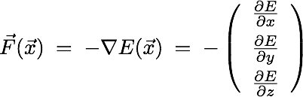
Spring Model Layout
Task: find configuration of minimal energy
In 2D/3D: force = negative gradient of the energy
→ Iteratively move nodes "downhill" along the gradient of the energy
→ displace nodes proportional to the force acting on them
Problems:
• local minima
• a priori knowledge of all spring lengths
→ works best for regular grids

Slide 33


The Spring-Electrical-Model
More general model than spring embedder model: use two types of forces
1) attractive harmonic force between connected nodes (springs)
one uses usually the same
spring constant k for all edges
2) repulsive Coulomb-like force between all nodes
"all nodes have like charges" → repulsion
either Qij = Q or, e.g., Qij = ki kj
Repulsion pushes all nodes apart, springs pull connected nodes together
→ workhorse method for small to medium sized graphs
→ Do-it-yourself in Assignment 2 <=

Slide 34
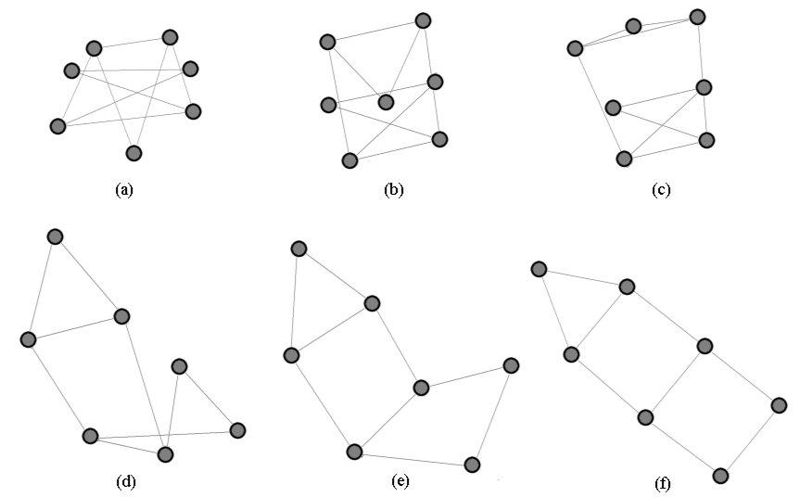
Spring-Electrical Example
http://www.it.usyd.edu.au/~aquigley/3dfade/

Slide 35
Force-Directed Layout: Summary
Analogy to a physical system
=> force directed layout methods tend to meet various aesthetic standards:
• efficient space filling,
• uniform edge length (with equal weights and repulsions)
• symmetry
• smooth animation of the layout process (visual continuity)
Force directed graph layout → the "work horse" of layout algorithms.
Not so nice: the initial random placement of nodes and even very small changes of layout parameters will lead to different representations.
(no unique solution)
Side-effect: vertices at the periphery tend to be closer to each other than those in the center…

Slide 36
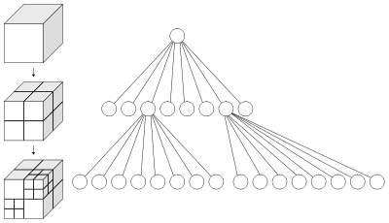
Runtime Scaling
Force directed layout:
Several possible arrangements!!!
(local minima)
loop until convergence:
calculate forces:
L springs
N(N-1)/2 charge pairs
move vertices
output positions
O(N²)!!!
→ force directed layout suitable for small to medium graphs (≤ O(1000) nodes?)
Speed up layout by:
• multi-level techniques to overcome local minima
• clustering (octree) methods for distant
groups of nodes → O(N log N)

Slide 37

H3 Algorithm
Two problems of force directed layout:
• runtime scaling
• 2D space for drawing the graph
Tamara Munzner (1996-1998): H3 algorithm
→ interactively visualize large data sets of ∼100.000 nodes.
• focusses on quasi-hierarchical graphs
→ use a spanning tree as the backbone of a layout algorithm
• graph layout in exponential space (projected on 2D for interactive viewing)
Spanning tree: connected acyclic subgraph that contains all the vertices of the original graph, but does not have to include all the links
→ find a minimum-weight spanning tree through a graph with weighted edges,
where domain-specific information is used to compute the weights

Slide 38
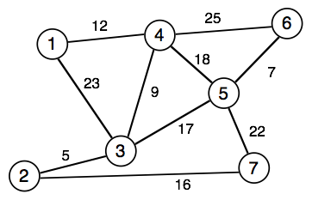
Spanning Tree
Some algorithms work only/better on trees
Idea:
remove links until graph has tree structure, keep all nodes connected
→ spanning tree
Minimal spanning tree = spanning tree with the least total weight of the edges
Greedy Kruskal-Algorithm:
→ iteratively choose unused edge
with smallest weight,
if it does not lead to a circle!
greedy <=> base choice on current state,
(locally optimal choice)

Slide 39
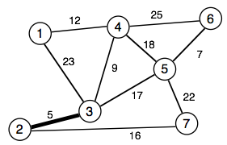
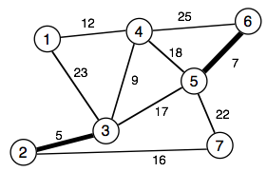
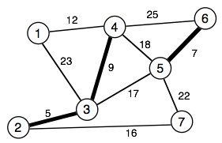
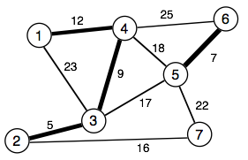
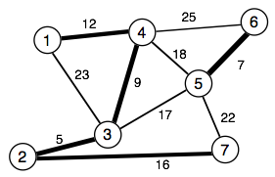
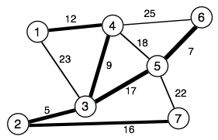
Kruskal - Example
Proof that there is no spanning tree with a lower weight?
Minimum spanning tree
weight = 66

Slide 40
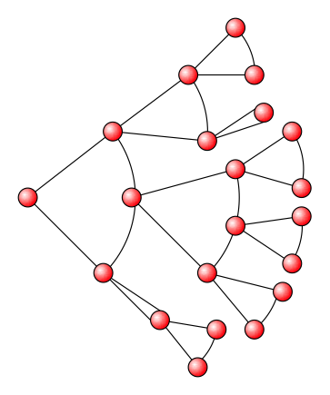
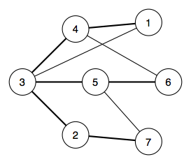
Cone Layout
Place the nodes according to their hierarchy
starting from the root node
→ direction indicates lineage
For arbitrary graphs
→ how to get weights?
→ which node is the root?

Slide 41
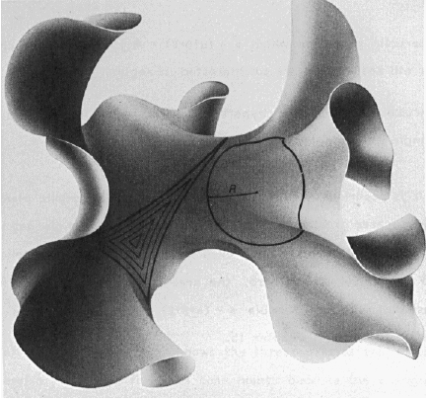
Exponential Room
In Euklidian space: circumference of a circle grows linear:
U = 2πr
In hyperbolic space:
U = 2π sinh r
→ exponentially growing space
on the circle
For (cone) graph layout
→ there is enough room
for yet another level
Also: mappings of the
complete hyperbolic space
→ finite volume of Euklidian space
PhD thesis Tamara Munzner, chapter 3

Slide 42
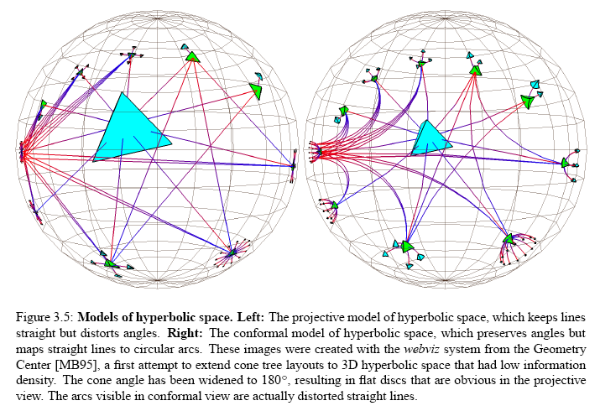
Models of hyperbolic space
PhD thesis Tamara Munzner, chapter 3

Slide 43

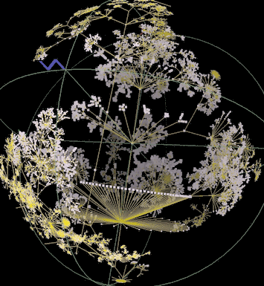
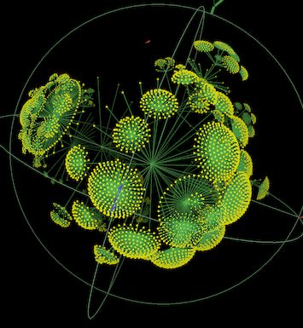
GIFs don't work here…
http://www.caida.org/tools/visualization/walrus/gallery1/
H3: + layout based on MST → fast
+ layout in hyperbolic space → enough room
– how to get the MST for biological graphs????

Slide 44
Summary
What you learned today:
→ Local connectivity: clustering
→ random graphs vs. scale-free graphs
→ shortest path: Dijkstra algorithm
→ graph layout: force-directed and embedding schemes
→ spanning tree: Kruskal algorithm
Next lecture:
→ biological data to build networks from

