Slide 1
V 3 – Data for Building
Protein Interaction Networks
- Detect PPIs by experimental methods
- Detect (predict) PPIs by computational methods
- Derive condition-specific PPIs by data integration
Fri, Nov 4, 2016

Slide 2
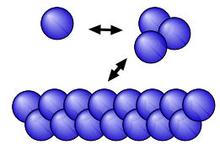
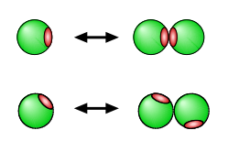
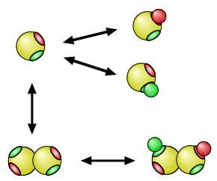
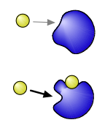
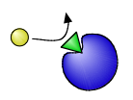
Different Roles of Protein Complexes
Complex formation may lead to
modification of the active site
Assembly of structures
protein machinery is built from parts via dimerization and oligomerization
Complex formation may lead to
increased diversity
Cooperation and allostery

Slide 3
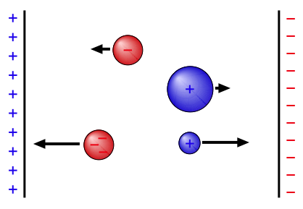
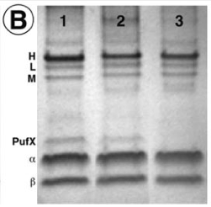
Identification of proteins / components of a complex (1): gel electrophoresis
Electrophoresis: directed diffusion of charged particles in an electric field
faster diffusion
higher charge, smaller
lower charge, larger
slower diffusion
Put proteins in a spot on a gel-like matrix,
apply electric field
→ separation according to size (mass) and charge
→ identify constituents of a complex
Nasty details: protein charge vs. pH, cloud of counter ions,
protein shape, denaturation, …

Slide 4
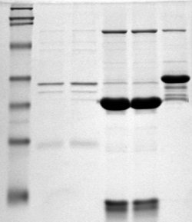

SDS-PAGE
For better control: denature proteins with detergent
Often used: sodium dodecyl sulfate (SDS)
→ denatures and coats the proteins with a negative charge
→ charge proportional to mass
→ traveled distance per time
→ SDS-polyacrylamide gel electrophoresis
After the run: staining to make proteins visible
For "quantitative" analysis: compare to marker
(set of proteins with known masses)
Image from Wikipedia, marker on the left lane

Slide 5
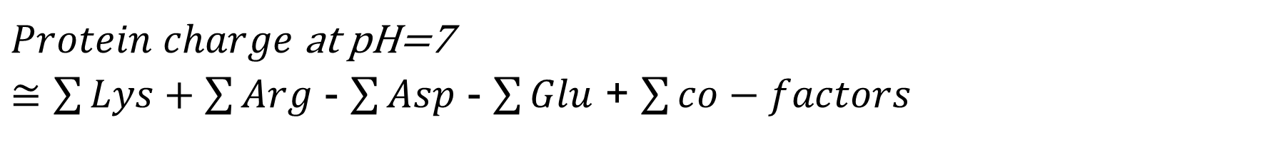

Protein Charge?
Main source for charge differences: pH-dependent protonation states
<=> Equilibrium between
• density (pH) dependent H⁺-binding and
• density independent H⁺-dissociation
Probability to have a proton:
P
pKa = pH value for 50% protonation
Asp 3.7–4.0 … His 6.7–7.1 … Lys 9.3-9.5
pH
Each H⁺ has a +1e charge
→ Isoelectric point: pH at which the protein is uncharged
→ protonation state cancels permanent charges

Slide 6
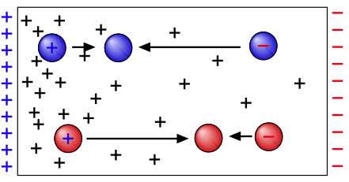
2D Gel Electrophoresis
Two steps:
i) separation by isoelectric point via pH-gradient
ii) separation by mass with SDS-PAGE
low pH
high pH
Step 1:
protonated
=> pos. charge
unprotonated
=> neg. charge
Step 2:
SDS-Page
→ Most proteins differ in mass and isoelectric point (pI)

Slide 7
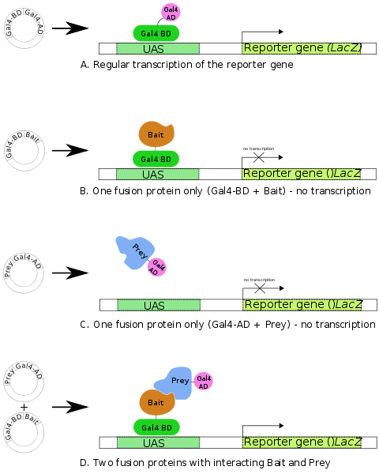
Detect interactions: Yeast Two-Hybrid method
Discover binary protein-protein interactions (bait/prey) via physical interaction
Transcription factor consisting of
binding domain (BD) +
activator domain (AD)
induces expression of reporter gene
(LacZ or GFP)
Disrupt BD-AD protein;
fuse bait to BD, prey to AD
→ expression only when
bait:prey-complex formed
Reporter gene may be fused
to green fluorescent protein.
www.wikipedia.org

Slide 8
Pros and Cons of Y2H
Advantages:
• in vivo test for interactions
• cheap + robust → large scale (genome-wide) tests possible
Problems:
• investigates the interaction between
(i) overexpressed
(ii) fusion proteins in the
(iii) yeast
(iv) nucleus
→ many false positives
(up to 50% errors)
• spurious interactions via third protein

Slide 9
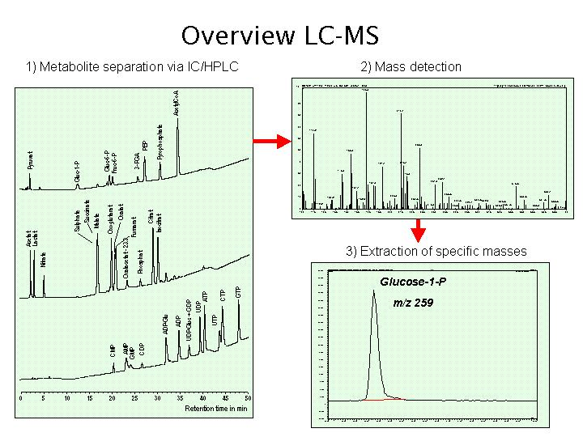
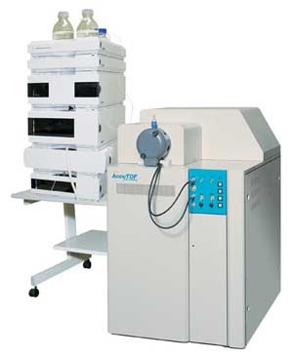
Identify fragments of proteins / components of a complex (2): Mass Spectrometry
HPLC: high pressure liquid chromatography (first purification step)
Then identify constituents of a (fragmented) complex by MS via their
mass/charge patterns m / z
http://gene-exp.ipk-gatersleben.de/body_methods.html

Slide 10
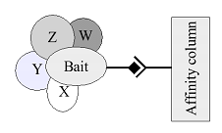
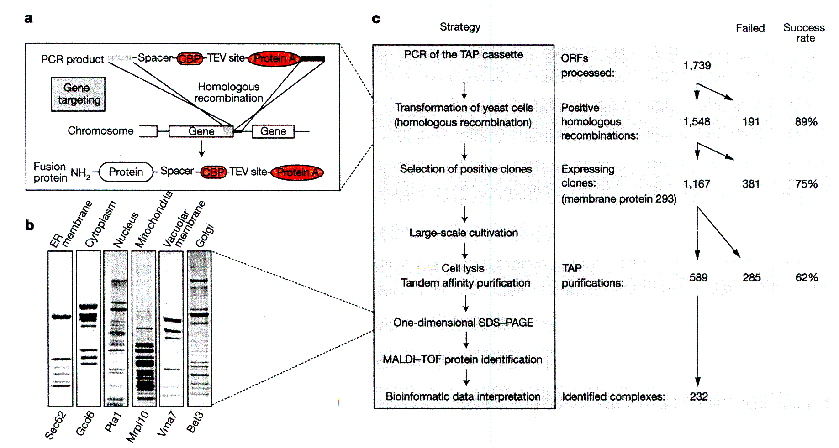
Detect interactions:
Tandem affinity purification (also „pull-down“)
Yeast 2-Hybrid-method can only identify binary complexes.
In affinity purification, a protein of interest (bait) is tagged with a molecular label (dark route in the middle of the figure) to allow easy purification.
The tagged protein is then co-purified together with its interacting partners (W–Z).
This strategy can be applied on a genome scale (as Y2H).
Identify proteins
by mass spectro-
metry (MALDI-
TOF).
Gavin et al. Nature 415, 141 (2002)

Slide 11
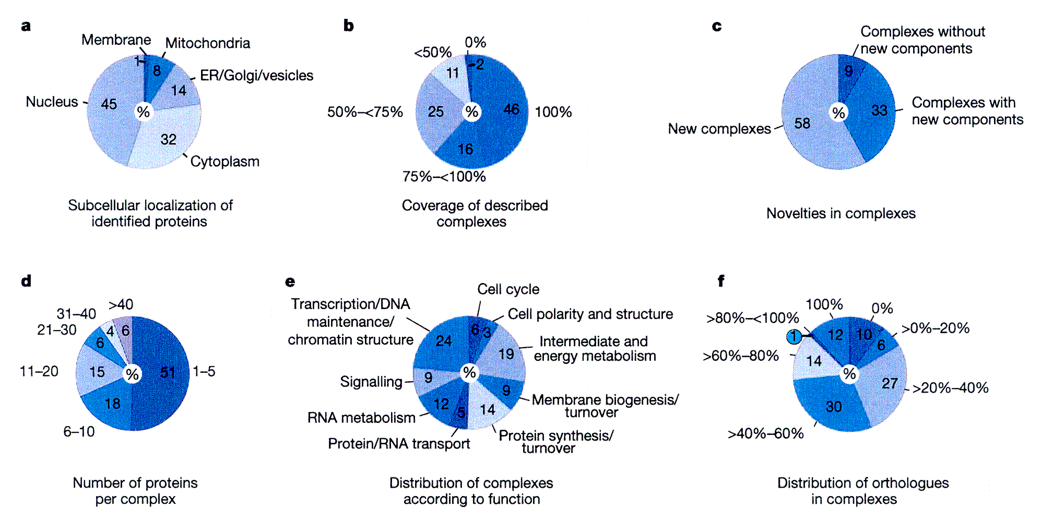
TAP analysis of yeast PP complexes
Identify proteins by
scanning yeast protein
database for protein
composed of fragments
of suitable mass.
(a) lists the identified
proteins according to
their localization
-> no apparent bias for
one compartment, but
very few membrane
proteins (should be
ca. 25%)
(d) lists the number of
proteins per complex
-> half of all PP complexes
have 1-5 members, the
other half is larger
(e) Complexes are involved
in practically all cellular
processes
Gavin et al. Nature 415, 141 (2002)

Slide 12
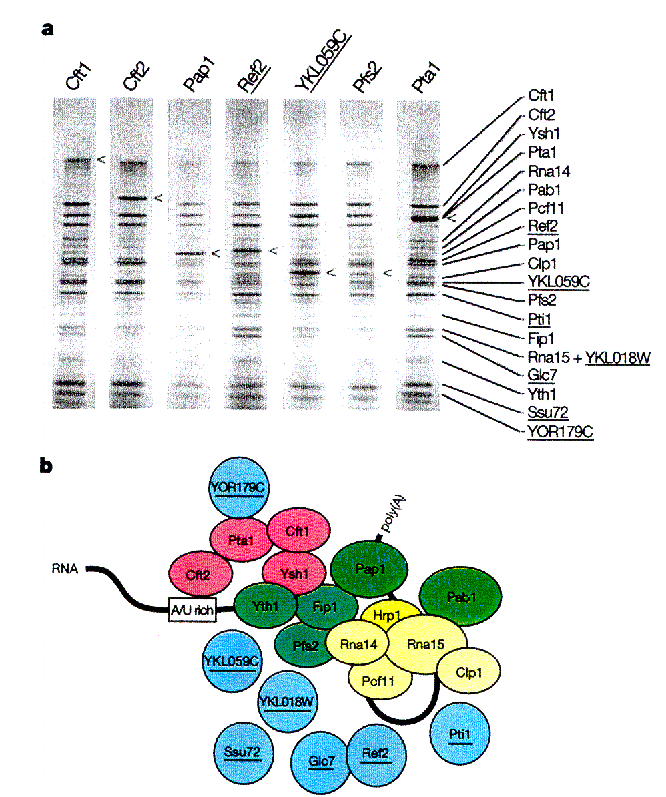
Validation of TAP methodology
Check of the method:
can the same complex be obtained for different choices of the attachment point
(tag protein is attached to different
components of complex shown in (b))?
Yes, more or less (see gel in (a)).
< signs mark tag proteins in the gel lane
Gavin et al. Nature 415, 141 (2002)

Slide 13
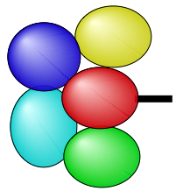
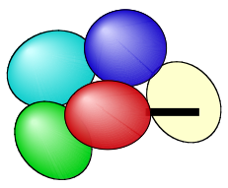
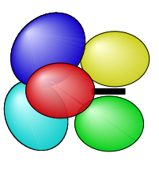
Pros and Cons of TAP-MS
Advantages:
• quantitative determination of complex
partners in vivo without prior knowledge
• simple method, high yield, high throughput
Difficulties:
• tag may prevent binding of the interaction partners
• tag may change (relative) expression levels
• tag may be buried between
interaction partners
→ no binding to beads

Slide 14
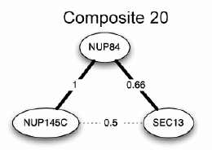
Protein interactions in nuclear pore complex
Figure (right) shows 20 NPCs (blue) in a slice of a nucleus.
Aim: identify individual PPIs in Nuclear Pore Complex.
Below : mutual arrangement of Nup84-complex-associated proteins
as visualized by their localization volumes in the final NPC structure.
Nup84 protein shown in light brown.
14

Slide 15
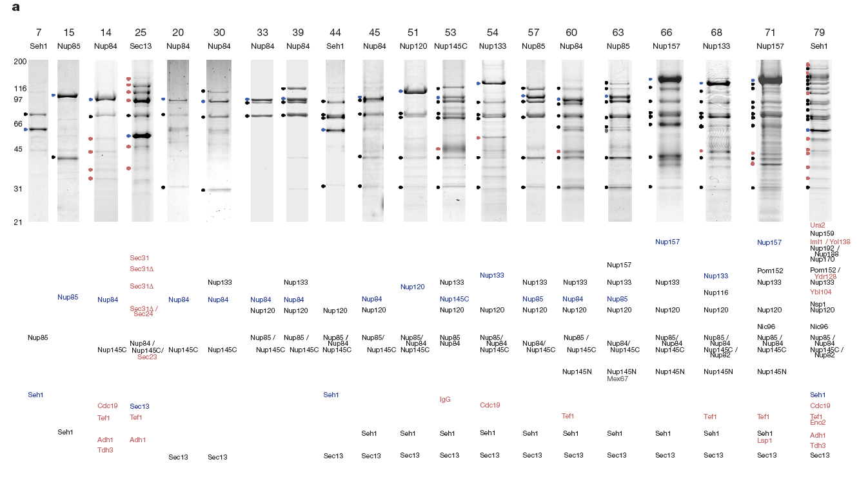
SDS + MS:Composites involving Nup84
above lanes: name of ProteinA-tagged protein and identification number for composite
Molecular mass standards (kDa)
identity of co-purifying proteins
Blue: PrA-tagged proteins,
Black: co-purifying nucleoporins,
Grey: NPC-associated proteins,
Red: and other proteins (e.g. contaminants)
Affinity-purified PrA-tagged proteins and interacting proteins were resolved by SDS–PAGE and visualized with Coomassie blue. The bands marked by filled circles at the left of the gel lanes were identified by mass spectrometry (cut out band from the gel and use as input for MS).

Slide 16
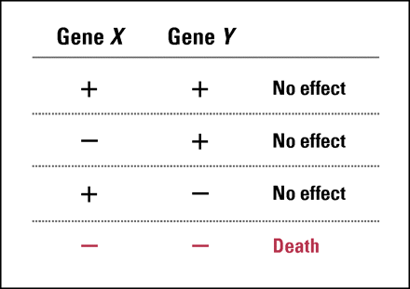
Indirect Evidence on PPIs: Synthetic Lethality
Apply two mutations that are viable on their own,
but lethal when combined.
In cancer therapy, this effect implies that inhibiting one of these genes in a context where the other is defective should be selectively lethal to the tumor cells but not toxic to the normal cells, potentially leading to a large therapeutic window.
http://jco.ascopubs.org/
Synthetic lethality may point either to:
• physical interaction of proteins (they are building blocks of a complex)
• both proteins belong to the same pathway
• both proteins have the same function (redundancy)

Slide 17
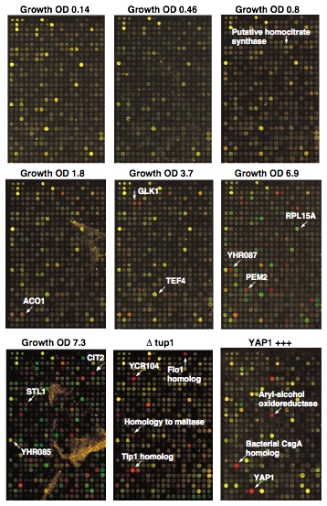
Indirect Evidence on PPIs: Gene Coexpression
All constituents of a complex should be present at the same point in the cell cycle
→ test for correlated expression
Co-expression is not a direct indication for formation of complexes
(there are too many co-regulated genes),
but it is a useful "filter"-criterion.
Standard tools: DNA micro arrays / RNA-seq
DeRisi, Iyer, Brown, Science 278 (1997) 680:
Diauxic shift from fermentation (growth on sugar) to respiration (growth on ethanol) in
S. cerevisiae
→ Identify groups of genes with
similar expression profiles

Slide 18
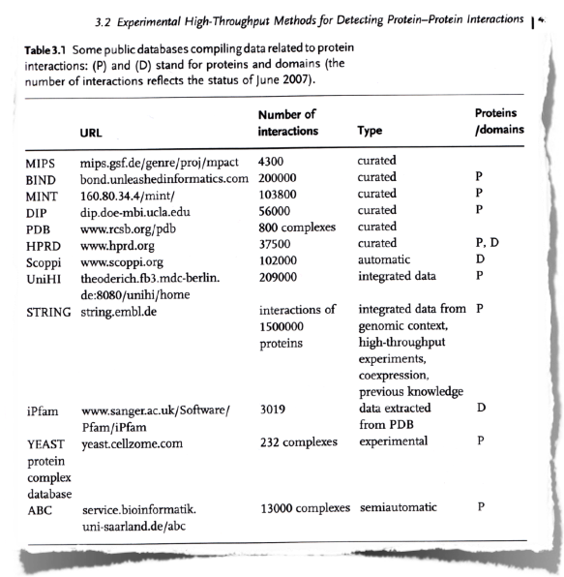
Interaction Databases
Bioinformatics: make experimental data available in databases

Slide 19
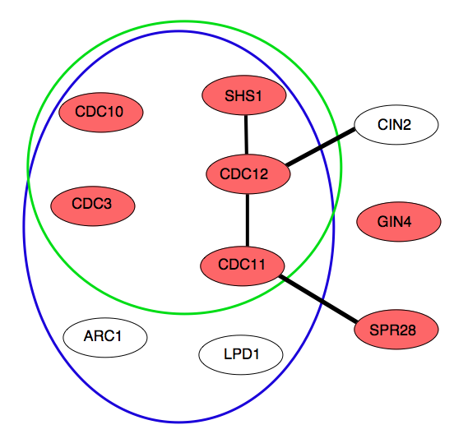
Initially low overlap of results
For yeast: ~ 6000 proteins => ~18 million potential interactions
rough estimates: ≤ 100000 interactions occur
→ 1 true positive for 200 potential candidates = 0.5%
→ decisive experiment must have accuracy << 0.5% false positives
TAP
Different experiments detect different interactions
For yeast: 80000 interactions known in 2002
only 2400 were found by ≥ 2 experiments
Y2H
Problems with experiments:
i) incomplete coverage
ii) (many) false positives
iii) selective to type of interaction
and/or compartment
annotated
septin complex
HMS-PCI
von Mering (2002)
Y2H: yeast two hybrid screen
TAP: tandem affinity purification
HMS-PCI: protein complex identication by MS

Slide 20
Criteria for reliability of detected PPIs
Guiding principles to judge experimental results on PPIs (incomplete list!):
1) check mRNA abundance of detected PPIs:
most experimental techniques are biased towards high-abundance proteins.
If this is the case, results for low-abundance proteins are not reliable.
2) Check localization to cellular compartments:
• most methods have their "preferred compartment"
• if interacting proteins belong to the same compartment
=> results are more reliable
3) co-functionality
it is realistic to assume that members of a protein complex should have closely related biological functions -> check whether interaction proteins have overlapping annotations with terms from Genome Ontology (GO)

Slide 21
In-Silico Prediction Methods
Sequence-based:
• gene clustering
• gene neighborhood
• Rosetta stone
• phylogenetic profiling
• coevolution
Structure-based:
• interface propensities
• protein-protein docking
• spatial simulations (e.g. MD)
"Work on the parts list"
→ fast
→ unspecific
→ high-throughput methods
for pre-sorting
"Work on the parts"
→ specific, detailed
→ expensive
→ accurate
Will be covered today Not subject of this lecture

Slide 22
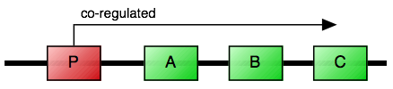
Gene Clustering
Idea: functionally related proteins or parts of a complex
are expressed simultaneously
Search for genes with a common promoter
→ when activated, all are transcribed together as one operon
Example:
bioluminescence in V. fischeri is
regulated via quorum sensing
three proteins: I, AB, CDE
are responsible for this.
They are organized as 1 operon
named luxICDABE.

Slide 23
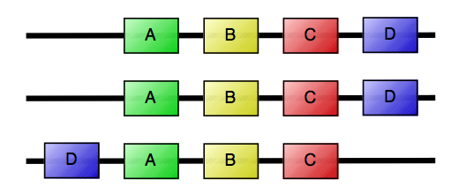
Gene Neighborhood
Hypothesis again: functionally related genes are expressed together
"functionally related” means same {complex | pathway | function | …}
genome 1
genome 2
genome 3
→ Search for similar arrangement of related genes in different organisms
(<=> Gene clustering: done in one species, need to know promoters)

Slide 24
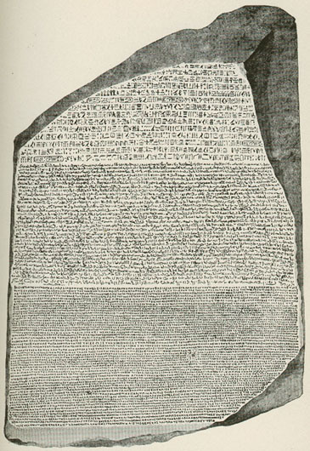
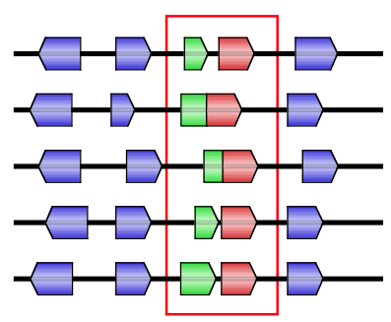
Rosetta Stone Method
Idea: find homologous genes (”words”) in genomes of different organisms ("texts”)
- check if fused gene pair exists in one organism
→ May indicate that these 2 proteins form a complex
sp 1
sp 2
Fused gene
sp 3
Fused gene
sp 4
Multi-lingual stele from 196 BC,
found by the French in 1799
The same decree is inscribed on the stone 3 times, in hieroglyphic, demotic, and greek.
→ key to deciphering meaning of hieroglyphs
sp 5
Enright, Ouzounis (2001):
40000 predicted pair-wise interactions
from search across 23 species

Slide 25
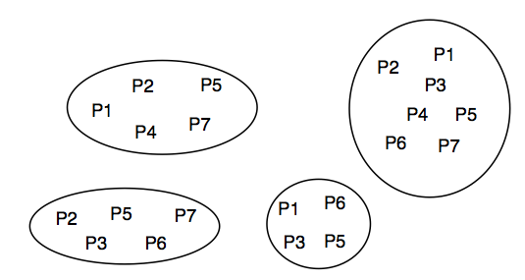
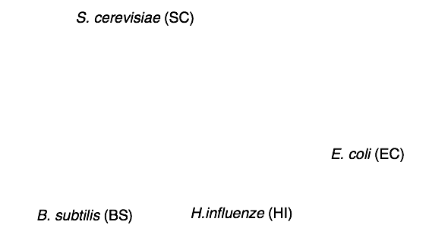
Phylogenetic Profiling
Idea: either all or none of the proteins of a complex should
be present in an organism
→ compare presence of protein homologs across species
(e.g., via sequence alignment)

Slide 26
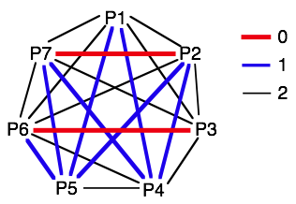
Distances in Phylogenetic Profiling
Decode presence/absence
 | EC | SC | BS | HI
P1 | 1 | 1 | 0 | 1
P2 | 1 | 1 | 1 | 0
P3 | 1 | 0 | 1 | 1
P4 | 1 | 1 | 0 | 0
P5 | 1 | 1 | 1 | 1
P6 | 1 | 0 | 1 | 1
P7 | 1 | 1 | 1 | 0
Hamming distance between species: number of different protein occurrences
 | P1 | P2 | P3 | P4 | P5 | P6 | P7
P1 | 0 | 2 | 2 | 1 | 1 | 2 | 2
P2 |  | 0 | 2 | 1 | 1 | 2 | 0
P3 |  |  | 0 | 3 | 1 | 0 | 2
P4 |  |  |  | 0 | 2 | 3 | 1
P5 |  |  |  |  | 0 | 1 | 1
P6 |  |  |  |  |  | 0 | 2
P7 |  |  |  |  |  |  | 0
Two pairs with similar occurrence: P2-P7 and P3-P6
These are candidates to interact with eachother.

Slide 27
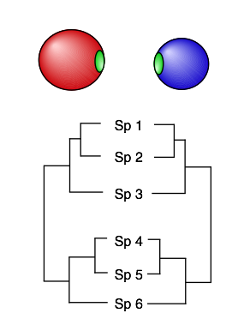
Co-evolution
Binding interfaces of complexes are often
better conserved in evolution than the
rest of the protein surfaces.
Idea of Pazos & Valencia (1997):
if a mutation occurs at one interface
that changes the character of this
residue (e.g. polar –> hydrophobic),
a corresponding mutation could occur
at the other interface at one of the residues
that is in contact with the first residue.
Detecting such correlated mutations
could help in identifying binding
candidates.

Slide 28
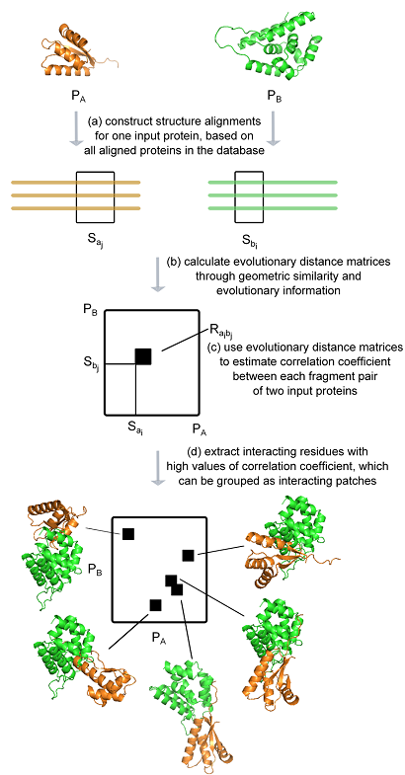
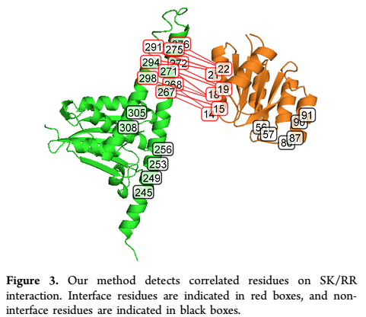
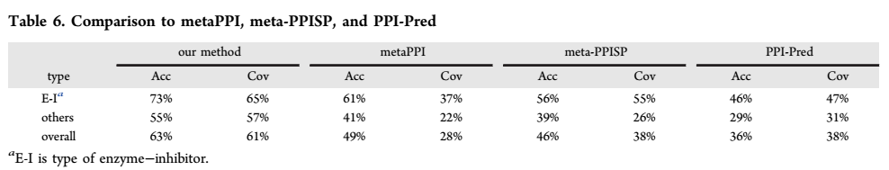
Correlated mutations
Guo et al. J. Chem. Inf. Model. 2015, 55, 2042−2049

Slide 29
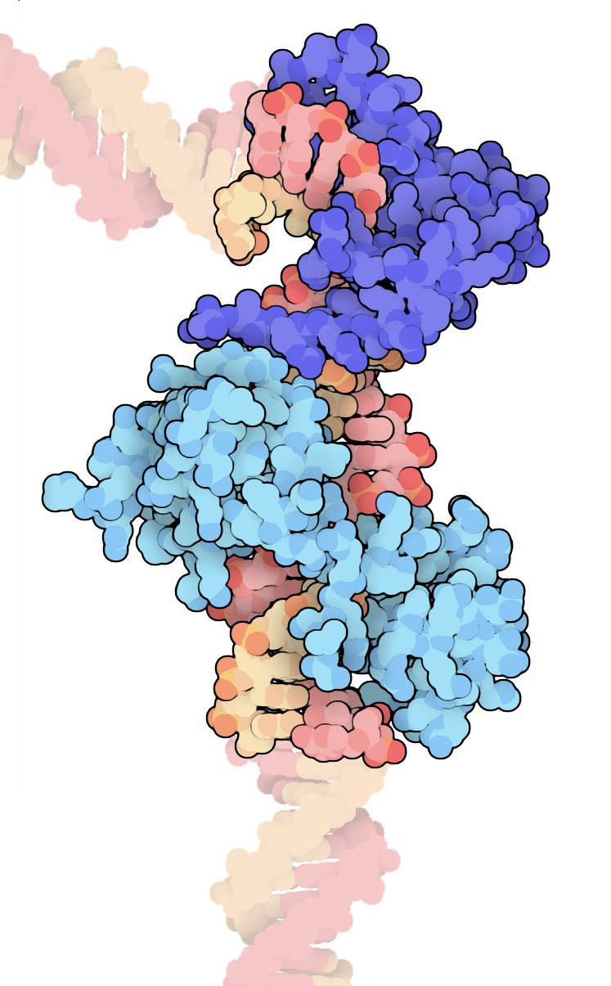
Toward condition-specific protein interaction networks
Full interaction PP network, e.g. of
human
= collection of pairwise interactions compiled from different experiments
broad range of applications
Oct1/Sox2 from RCSB Protein Data Bank, 2013
Notes:
protein interaction networks are a std data source in comp. biology.
- basically, they consist of pairwise interactions from independent experiments that are put together to a static network.

Slide 30
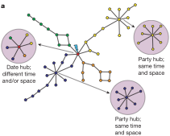
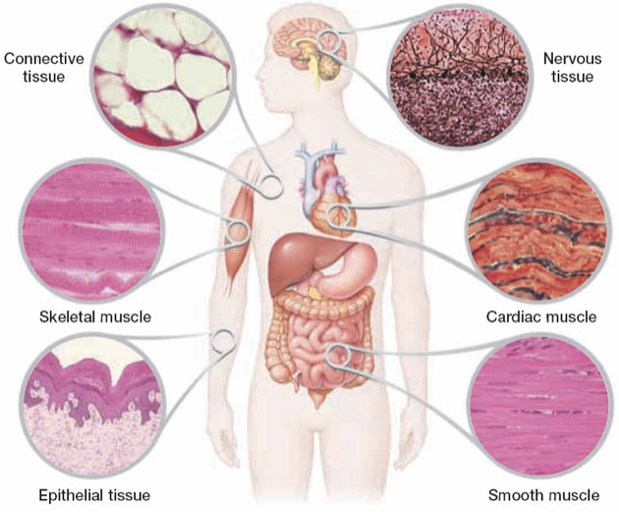
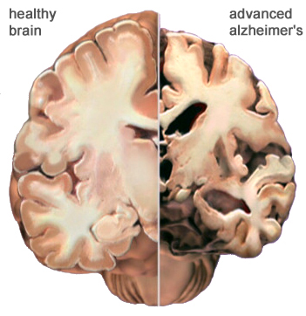
But protein interactions can be …
dynamic in time and space
condition-specific protein composition
from Han et al., Nature, 2004
same color = similar expression profiles
interaction data itself
generally static
Human tissues from www.pharmaworld.pk
Alzheimer from www.alz.org
Notes:
in reality, those networks are highly dynamic. often proteins are not expressed at all in a certain sample of choice, for example a certain cell type or disease phenotype.
- interaction data itself does not reflect that. so one needs to incorporate expression data to account for that.

Slide 31
Simple condition-specific PPI networks
P1
P2
P3
database(s)
…
P4
P5
complete protein interaction network
idea:
prune to subset of
expressed genes
e.g.:
Bossi and Lehner, Mol. Syst. Bio., 2009
Lopes et al., Bioinformatics, 2011
Barshir et al., PLoS CB, 2014
P1
P2
P3
P2
P4
P4
P5
Notes:
the common way to do that is to prune the networks to the set of expressed genes. this means an interaction can only be there if its interacting partners are expressed.
- while the correctness of this method is undeniable, we think with one could do better with nowaday’s data.

Slide 32
Differential PPI wiring analysis
112 matched normal tissues (TCGA)
112 breast cancer tissues (TCGA)
P1
P2
P3
P2
P3
comparison 1:
d1
P4
P5
P4
P5
P1
P2
P3
P2
P3
comparison 2:
d2
P4
P5
P4
P5
P1
P2
P3
P1
P2
comparison 3:
d3
P4
P5
P4
∑di
one-tailed binomial test
+ BH/FDR (<0.05)
P1
-2
P2
-1
P3
P1
-2
P2
-1
-1
-1
P4
P5
Check whether rewiring of a particular PP interaction occurs in a significantly large number of patients compared to what is expected by chance rewiring events.
Will, Helms, Bioinformatics, 47, 219 (2015)
doi: 10.1093/bioinformatics/btv620
Notes:
for every single comparison we noted any interaction that is only found in one of the groups.
- positively if the interaction is only contained in the network of the T sample, and neg if only in the SC sample.
- we summed up those observations to obtain a network where each edge is annotated with the #changes found in corresponding interactions and filtered spurious observations by applying simple statistics.

Slide 33
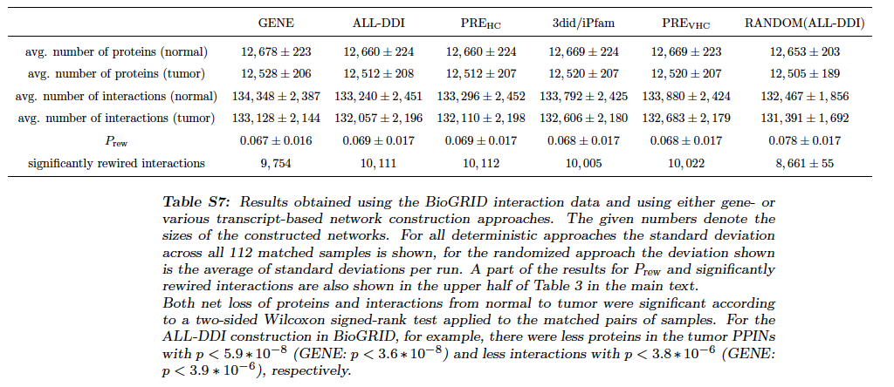
Coverage of PPIs with domain information
Standard deviations reflect differences betwen patients.
About 10.000 out of 133.000 protein-protein interactions are significantly rewired between
normal and cancer samples.
Will, Helms, Bioinformatics, 47, 219 (2015)
doi: 10.1093/bioinformatics/btv620

Slide 34
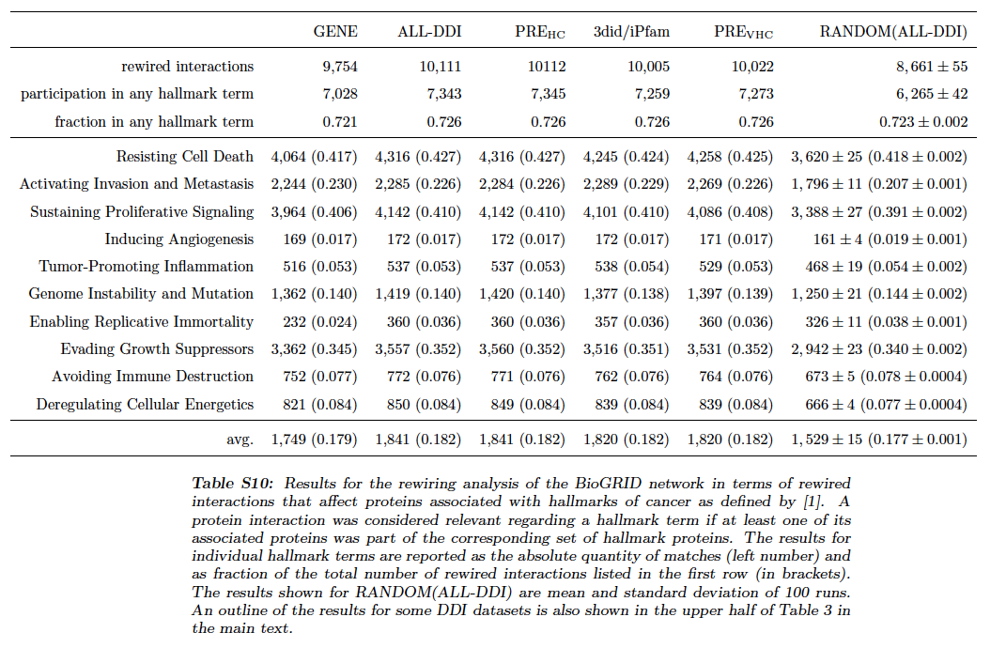
Rewired PPIs are associated with hallmarks
A large fraction (72%) of the
rewired interactions affects genes
that are associated
with „hallmark of cancer“ terms.
Will, Helms, Bioinformatics, 47, 219 (2015)
doi: 10.1093/bioinformatics/btv620

Slide 35
Not considered yet: alternative splicing
exon 1
exon 2
exon 3
exon 4
DNA
5’
3’
3’
5’
transcription
primary
RNA transcript
3’
5’
alternative splicing
(~95% of human multi-exon genes)
mRNAs
translation
translation
translation
protein isoforms
AS affects ability of
proteins to interact with
other proteins
Notes:
this is especially relevant because higher eukaryotes not only express genes and translate them to proteins, they are able to construct variants of the same protein.
- and a change in the building blocks there can imply a change in interaction partners!
- we thought about a way to account for that.

Slide 36
PPIXpress uses domain information
see http://sourceforge.net/projects/ppixpress
I. Determine “building blocks“ for all proteins
transcript abundance from RNA-seq data
protein domain composition from
sequence (Pfam annotation)
Will, Helms, Bioinformatics, 47, 219 (2015)
doi: 10.1093/bioinformatics/btv620
II. Connect them on the domain-level
Use info from
high-confidence
domain-domain
interactions
protein-protein
interaction network
domain-domain
interaction network
Notes:
we developed PPIXpress that uses expression data at the transcript-level and is able to reveal alterations in the PIN not only caused by a change in gene exp but also by alternative splicing.
- we achieve this by introducing domain interaction data; which means individual transcripts are decomposed into their conserved functional building blocks, the then resulting protein domains.
- together with knowledge about physical interactions of different protein domain types one can construct a finer grained network that shows the interaction between individual domains of interacting proteins.

Slide 37
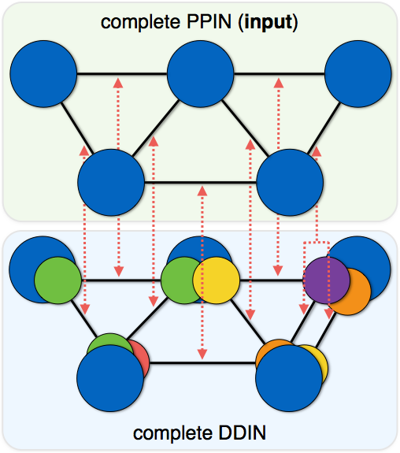
PPIXpress method
mapping:
protein-protein interaction
establish
one-to-at-least-one
relationship
domain-domain interaction
reference: principal protein isoforms = longest coding transcript
Notes:
PPIXpress uses this network of increased detail to relate protein interactions to domain interactions. the assumption here is that each protein interaction needs to be supported by at least one domain interaction on the molecular level.
- at this stage, the longest isoform of each protein is considered as the reference.

Slide 38
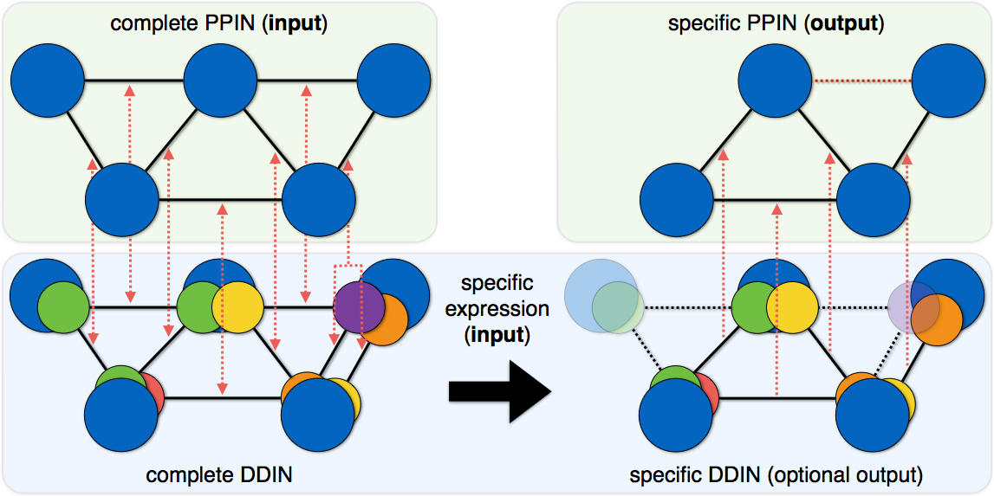
PPIXpress method
Interaction is lost
reference: principal protein isoforms
built using most abundant protein isoforms
I. mapping
II. instantiation
Notes:
after this initial mapping, the expression data comes into play. for all proteins, the most abundant transcript is determined and becomes the representative in a sample specific DDIN.
- then, the mapping can be used in reverse and tell us which protein interactions are actually supported in the sample.

Slide 39
Differential PPI wiring analysis at domain level
112 matched normal tissues (TCGA)
112 breast cancer tissues (TCGA)
P1
P2
P3
P2
P3
comparison 1:
d1
P4
P5
P4
P5
P1
P2
P3
P2
P3
comparison 2:
d2
P4
P5
P4
P5
P1
P2
P3
P1
P2
comparison 3:
d3
P4
P5
P4
∑di
one-tailed binomial test
+ BH/FDR (<0.05)
P1
-2
P2
-1
P3
P1
-2
P2
-1
-1
-1
P4
P5
Notes:
for every single comparison we noted any interaction that is only found in one of the groups.
- positively if the interaction is only contained in the network of the T sample, and neg if only in the SC sample.
- we summed up those observations to obtain a network where each edge is annotated with the #changes found in corresponding interactions and filtered spurious observations by applying simple statistics.

Slide 40
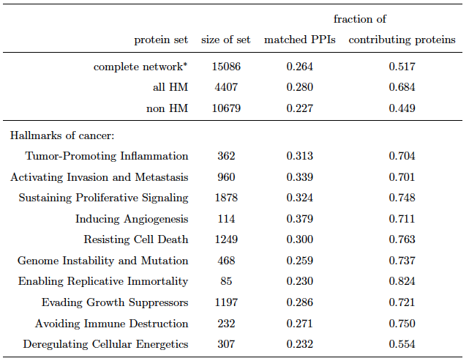
Coverage of PPIs with domain information
Domain information is currently available for 51.7% of
the proteins of the PP interaction network.
This means that domain information supports about
one quarter (26.7%) of all PPIs.
All other PPIs were connected by us via artificially added domains (1 protein = 1 domain).
Will, Helms, Bioinformatics, 47, 219 (2015)
doi: 10.1093/bioinformatics/btv620

Slide 41
Coverage of PPIs with domain information
At domain-level, slightly more (10.111 vs. 9.754) PPIs out of 133.000 PPIs are
significantly rewired between normal and cancer samples.
Will, Helms, Bioinformatics, 47, 219 (2015)
doi: 10.1093/bioinformatics/btv620

Slide 42
Rewired PPIs are associated with hallmarks
The construction at transcript-level also found a larger fraction (72.6 vs 72.1%) of differential interactions that can be associated with hallmark terms than the gene-level based approach.
Will, Helms, Bioinformatics, 47, 219 (2015)
doi: 10.1093/bioinformatics/btv620

Slide 43
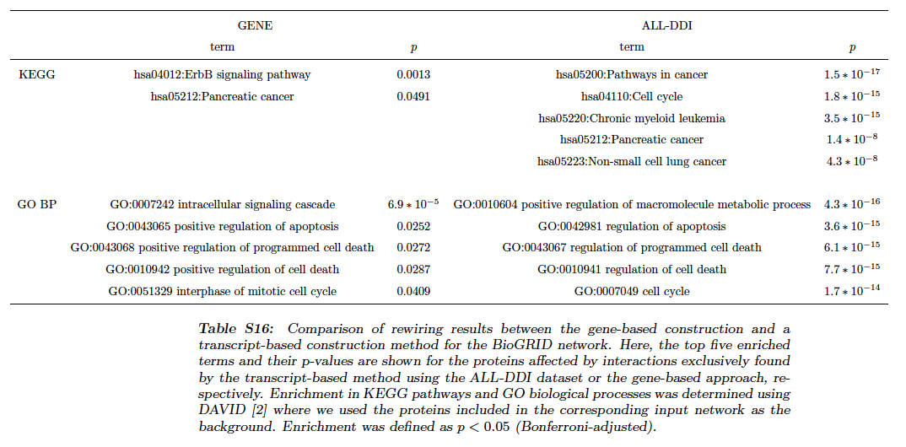
Enriched KEGG and GO-BP terms in gene-level \ transcript-level set
The enriched terms that are exclusively found by the transcript-level method (right) are closely linked to carcinogenetic processes.
Hardly any significant terms are exclusively found at the gene level (left).
Will, Helms, Bioinformatics, 47, 219 (2015)
doi: 10.1093/bioinformatics/btv620

Slide 44
Conclusion (PPIXpress)
About 10.000 out of 130.000 PP interactions are rewired in cancer tissue compared to matched normal tissue due to altered gene expression.
The method PPIXpress exploits domain interaction data to adapt protein interaction networks to specific cellular conditions at transcript-level detail.
For the example of protein interactions in breast cancer this increase in granularity positively affected the performance of the network construction compared to a method that only makes use of gene expression data.
Will, Helms, Bioinformatics, 47, 219 (2015)
doi: 10.1093/bioinformatics/btv620

Slide 45
Summary
What you learned today: how to get some data on PP interactions
gene clustering
SDS-PAGE
TAP
DB
MS
gene neighborhood
micro array
Y2H
Rosetta stone
synthetic lethality
phylogenic profiling
coevolution
type of interaction? — reliability? — sensitivity? — coverage? — …
Next lecture: Mon, Nov.7, 2016
• combining weak indicators: Bayesian analysis
• identifying communities in networks

