Slide 1
V12: Cell cycle – summary
(1) Content of minitest #3:
Lecture V9 (slides 1-5),
V10 (slides 1-13)
V11 (slides 19-22, 24-25)
Specified content from Papers 7 to 9:
methods, results and discussion section related to the indicated figures.

Slide 2
V9: Cellular differentiation - development
In developmental biology, cellular differentiation is the process
where a cell changes its cell fate from one cell type to another.
Most commonly the cell changes to a more specialized type.
Differentiation occurs numerous times during the development of a multicellular organism as it changes from a simple zygote to a complex system of tissues and cell types.
Differentiation continues in adulthood as adult stem cells divide and create fully differentiated daughter cells during tissue repair and during normal cell turnover.
Differentiation dramatically changes a cell's size, shape, membrane potential, metabolic activity, and responsiveness to signals.
These changes are largely due to highly controlled modifications in gene expression that are often controlled by epigenetic effects.
www.wikipedia.org

Slide 3
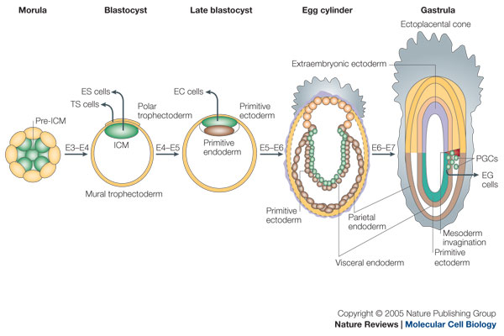
Embryonic development of mouse
gastrulation
ICM: Inner cell mas
TS: trophoblast cells (develop into large part of placenta)
- After gastrulation, they are called trophectoderm
PGCs: primordial germ cells (progenitors of germ cells)
E3: embryonic day 3
Boiani & Schöler, Nat Rev Mol Cell Biol 6, 872 (2005)

Slide 4
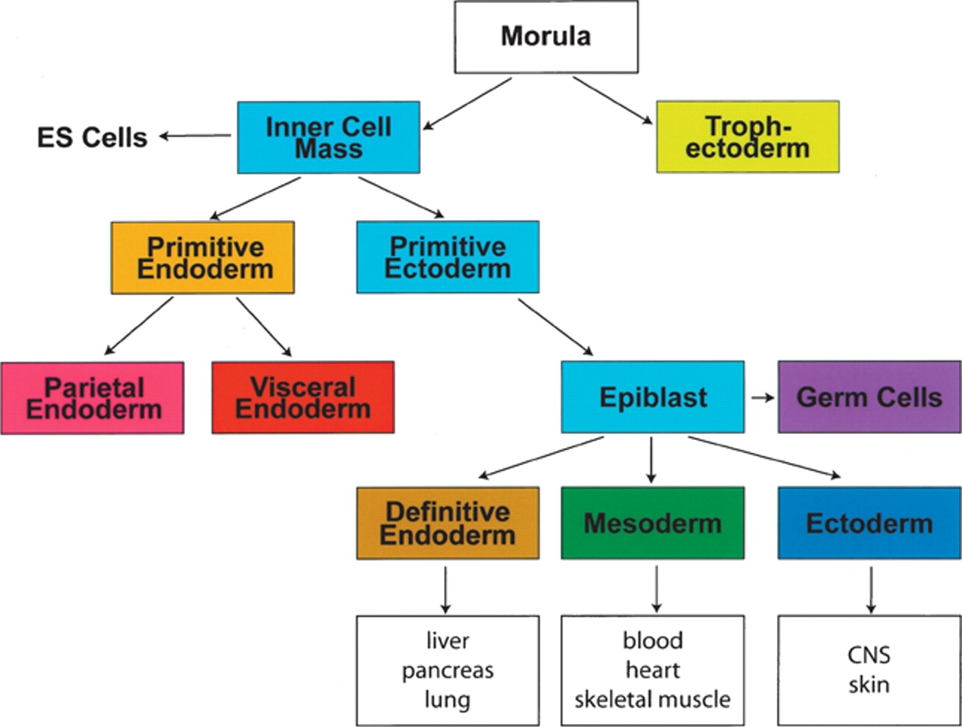
Cell populations in early mouse development
Scheme of early mouse development depicting the relationship of early cell populations to the primary germ layers
Keller, Genes & Dev. (2005) 19: 1129-1155

Slide 5
Types of body cells
3 basic categories of cells make up the mammalian body:
germ cells (oocytes and sperm cells)
somatic cells, and
stem cells.
Each of the approximately 100 trillion (10¹⁴) cells in an adult human has its own copy or copies of the genome except certain cell types, such as red blood cells, that lack nuclei in their fully differentiated state.
Most cells are diploid; they have two copies of each chromosome.
Cells differentiate to specialize for different functions.
Somatic cells make up most of the human body, such as skin and muscle cells.
www.wikipedia.org

Slide 6
Development controlled by transcriptional programs
Embryonic development is a complex process that remains to be understood despite knowledge of the complete genome sequences of many species and rapid advances in genomic technologies.
A fundamental question is how the unique gene expression pattern in each cell type is established and maintained during embryogenesis.
It is well accepted that the gene expression program encoded in the genome is executed by transcription factors that bind to cis-regulatory sequences and
modulate gene expression in response to environmental cues.
Xie et al., Cell 153, 1134-1148 (2013)

Slide 7
V10: Cellular differentiation - Epigenetics
E4.5 epiblast cells: represent ground-state pluripotency
Implantation: stage of pregnancy at which the blastocyst adheres to the wall of the uterus.
After implantation (E5.5): epiblast cells undergo a strong wave of epigenetic reprogramming. They are now „primed“.
Atlasi & Stunnenberg, Nature Rev Genet 18, 643–658 (2017)

Slide 8
Epigenetic mechanisms
Epigenetics refers to alternate phenotypic states that are
not based on differences in genotype, and are potentially reversible,
but are generally stably maintained during cell division.
Examples: imprinting, twins, cancer vs. normal cells, differentiation, ...
Multiple mechanisms interact to collectively establish
- alternate states of chromatin structure (open – packed/condensed),
- histone modifications,
composition of associated proteins (e.g. histones),
transcriptional activity,
activity of microRNAs, and
- in mammals, cytosine-5 DNA methylation at CpG dinucleotides.
Laird, Hum Mol Gen 14, R65 (2005)

Slide 9
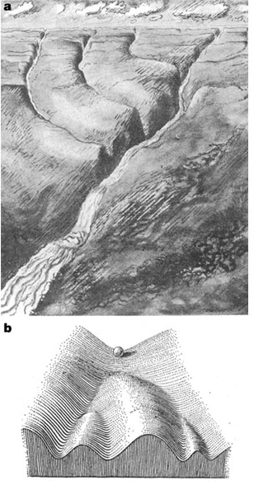

Waddington’s epigenetic landscape for embryology
Waddington worked in embryology
a) is a painting by John Piper that was used as the frontispiece for Waddington's book Organisers and Genes.
It represents an epigenetic landscape.
Developmental pathways that could be taken by each cell of the embryo are metaphorically represented by the path taken by water as it flows down the valleys.
b) Later depiction of the epigenetic landscape. The ball represents a cell, and the bifurcating system of valleys represents bundles of trajectories in state space.
Conrad Hal Waddington
(1905 – 1975)
pictures.royalsociety.org
Slack, Nature Rev Genet 3, 889-895 (2002)

Slide 10
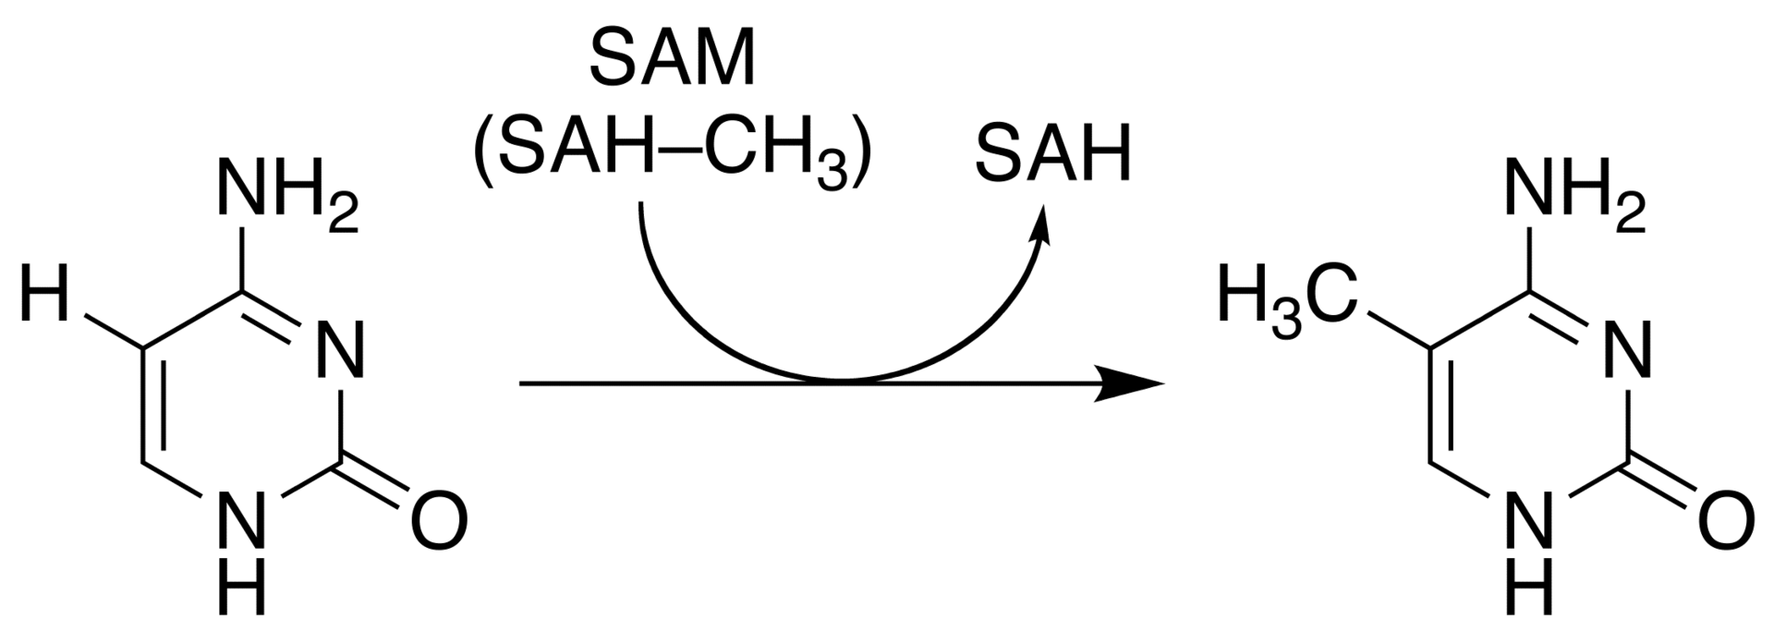
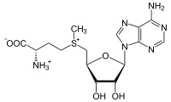
Cytosine methylation
Observation: 3-6 % of all cytosines are methylated in human DNA.
This methylation occurs (almost) exclusively when cytosine is followed by a guanine base -> CpG dinucleotide.
5-methyl-cytosine
SAM: S-adenosyl-methionine
SAH: S-adenosyl-homocysteine
Cytosine
Mammalian genomes contain much fewer (only 20-25 %)
of the CpG dinucleotide than is expected by the G+C content
(we expect 1/16 ≈ 6% for any random dinucleotide).
This is typically explained in the following way:
As most CpGs serve as targets of DNA methyltransferases,
they are usually methylated …. (see following page)
Esteller, Nat. Rev. Gen. 8, 286 (2007)
www.wikipedia.org

Slide 11
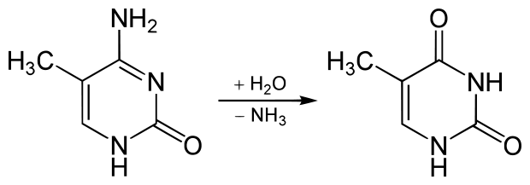
Cytosine methylation
But 5-Methylcytosine can easily deaminate to thymine.
If this mutation is not repaired, the affected CpG is permanently converted to TpG
(or CpA if the transition occurs on the reverse DNA strand).
Hence, methylCpGs represent mutational hot spots in the genome.
If such mutations occur in the germ line, they become heritable.
A constant loss of CpGs over thousands of generations
can explain the low frequency of this
special dinucleotide in the genomes of human and mouse.
5-methyl-cytosine
thymine
Esteller, Nat. Rev. Gen. 8, 286 (2007)
www.wikipedia.org

Slide 12
chromatin organization affects gene expression
Schematic of the reversible changes in chromatin organization that influence
gene expression:
genes are expressed (switched on) when the chromatin is open (active), and they are inactivated (switched off) when the chromatin is condensed (silent).
White circles = unmethylated cytosines;
red circles = methylated cytosines.
Rodenhiser, Mann, CMAJ 174, 341 (2006)

Slide 13
Altered DNA methylation upon cancerogenesis
Genomic
Imprinting:
Mono-allelic
expression; one
allele (either from
the mother or the
father) is silenced.
Typically, this is
implemented by
methylating the
silenced allele.
The human genome
contains ca. 8% of
retroviral sequences.
Typically, these are
also silenced by
DNA methylation.
Esteller, Nat. Rev. Gen. 8, 286 (2007)

Slide 14
DNA methylation
Typically, unmethylated clusters of CpG pairs are located in
tissue-specific genes and in essential housekeeping genes.
(House-keeping genes are involved in routine maintenance roles and are expressed in most tissues.)
These clusters, or CpG islands, are targets for proteins
that bind to unmethylated CpGs and initiate gene transcription.
In contrast, methylated CpGs are generally associated with silent DNA,
can block methylation-sensitive proteins and can be easily mutated.
The loss of normal DNA methylation patterns is the
best understood epigenetic cause of disease.
In animal experiments, the removal of genes that encode DNMTs is lethal;
in humans, overexpression of these enzymes has been linked
to a variety of cancers.
Rodenhiser, Mann, CMAJ 174, 341 (2006)

Slide 15
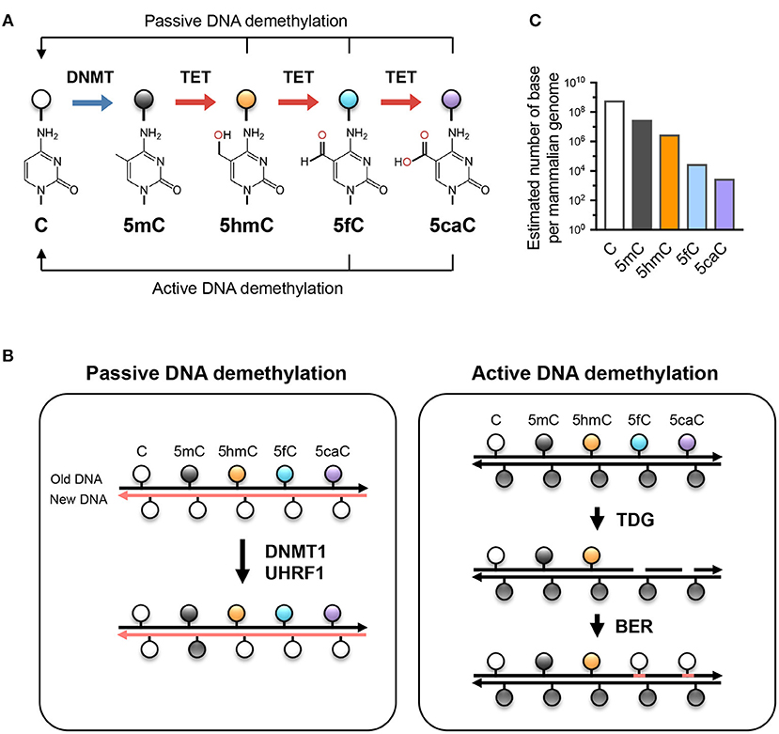
Higher forms of methylation – Tet enzymes
Unmodified cytosine (C) is methylated by DNA methyltransferases (DNMTs) at the 5 position to become 5-methylcytosine (5mC).
TET proteins oxidize 5mC into 5-hydroxymethylcytosine (5hmC), a stable epigenetic mark, and subsequently to 5-formylcytosine (5fC) and 5-carboxylcytosine (5caC).
TET can demethylate DNA via replication-dependent (passive) or replication-independent (active) mechanisms.
Lio & Rao, Front. Immunol. (2019)

Slide 16
Higher forms of methylation – abundance
The approximate abundance of unmodified and modified cytosines in the haploid human/mouse genome.
About 5% of cytosine is methylated (5mC); in most cells, the vast majority of 5mC is present at CG dinucleotides although it is low at CpG islands.
5hmC amounts to about 1-10% of 5mC (estimated at 10% here as in embryonic stem cells),
while the levels of 5fC and 5caC are each about an order of magnitude lower than the previous oxidative modification.
Lio & Rao, Front. Immunol. (2019)

Slide 17
Passive DNA methylation
The DNMT1/UHRF1 complex recognizes 5mC at the hemi-methylated CpG motif during DNA replication and methylates the unmodified cytosine on the newly synthesized DNA strand.
However, the oxidized methylcytosines 5hmC, 5fC, and 5caC are not recognized by DNMT1/UHRF1, resulting in unmodified cytosine on the new DNA strand.
Further DNA replication in the presence of continuing TET activity will result in progressive dilution of 5mC in the daughter cells.
Lio & Rao, Front. Immunol. (2019)

Slide 18
Active DNA methylation
While 5hmC is stable and persists in the genome, 5fC and 5caC can be recognized and excised by thymine DNA glycosylase (TDG),
and the resulting abasic sites are repaired as unmodified C by base excision repair (BER).
Lio & Rao, Front. Immunol. (2019)

Slide 19
V11 miRNAs
microRNAs (miRNA) are single-stranded RNA molecules
of 21-23 nucleotides in length.
miRNAs have a crucial role in regulating gene expression.
Remember: miRNAs are encoded by DNA but not
translated into protein (non-coding RNA).
www.wikipedia.org
19

Slide 20
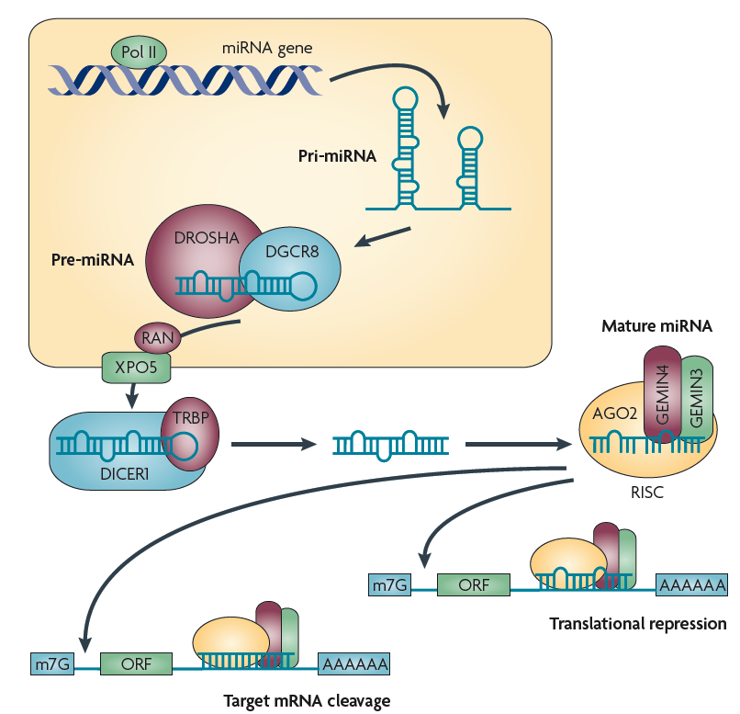
Overview of the miRNA network
RNA polymerase II (Pol II) produces a 500–3,000 nucleotide transcript, called the primary microRNA
(pri-miRNA).
pri-miRNA is then cropped to form a
pre-miRNA hairpin of ~60–100 nucleotides in length by a multi-protein complex that includes the protein DROSHA.
AA, poly A tail;
m7G, 7-methylguanosine cap;
ORF, open reading frame.
Ryan et al. Nature Rev. Cancer (2010) 10, 389

Slide 21
Overview of the miRNA network
This double-stranded pre-miRNA hairpin structure is exported from the nucleus by RAN GTPase and exportin 5 (XPO5).
Finally, the pre-miRNA is cleaved by the protein DICER1 to produce two miRNA strands:
- a mature miRNA sequence, approximately 20 nt in length,
- and its short-lived complementary sequence, which is denoted miR.
Ryan et al. Nature Rev. Cancer (2010) 10, 389

Slide 22
Overview of the miRNA network
The thermodynamic stability of the miRNA duplex termini and the identity of the nucleotides in the 3′ overhang determines which of the single strand miRNA is incorporated into the RNA-inducing silencing complex (RISC).
The RISC complex is then targeted by the miRNA to the target 3′ untranslated region of a mRNA sequence to facilitate repression and cleavage.
The main function of miRNAs is to down-regulate
gene expression of their target mRNAs.
Ryan et al. Nature Rev. Cancer (2010) 10, 389

Slide 23
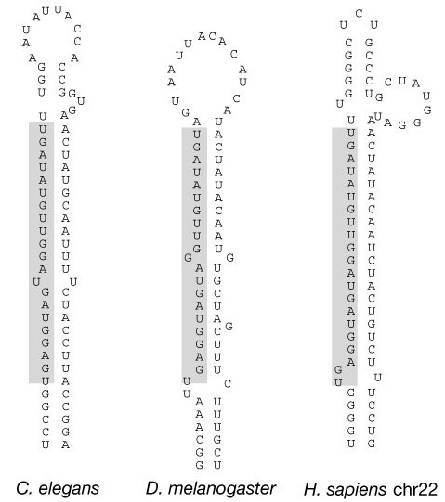
discovery of let7
The first two known microRNAs, lin-4
and let-7, were originally discovered in the nematode C. elegans.
There, they control the timing of stem-cell division and differentiation.
let-7 was subsequently found as the
first known human miRNA.
let-7 and its family members are highly conserved across species in sequence and function.
Misregulation of let-7 leads to a less differentiated cellular state and the development of cell-based diseases
such as cancer.
Pasquinelli et al. Nature (2000) 408, 86
www.wikipedia.org
23

Slide 24
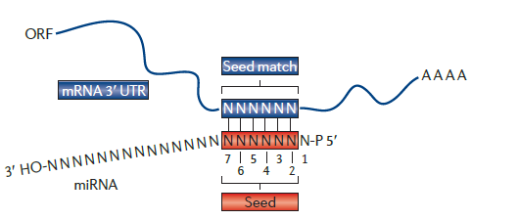
miRNAs recognize targets by Watson-Crick base pairing
Animal miRNAs recognize partially complementary binding sites which are generally located in 3’ UTRs of mRNA.
Complementarity to the 5’ end of the miRNA – the “seed” sequence containing nucleotides 2-7 – is a major determinant in target recognition and is sufficient to trigger silencing.
Huntzinger, Izaurralde, Nat. Rev. Genet.
12, 99 (2011)
24

Slide 25
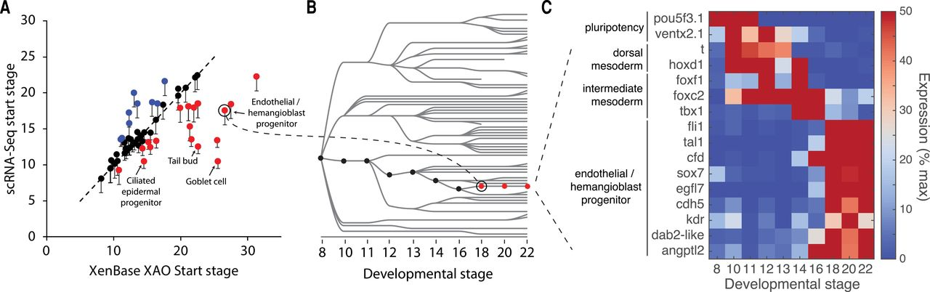
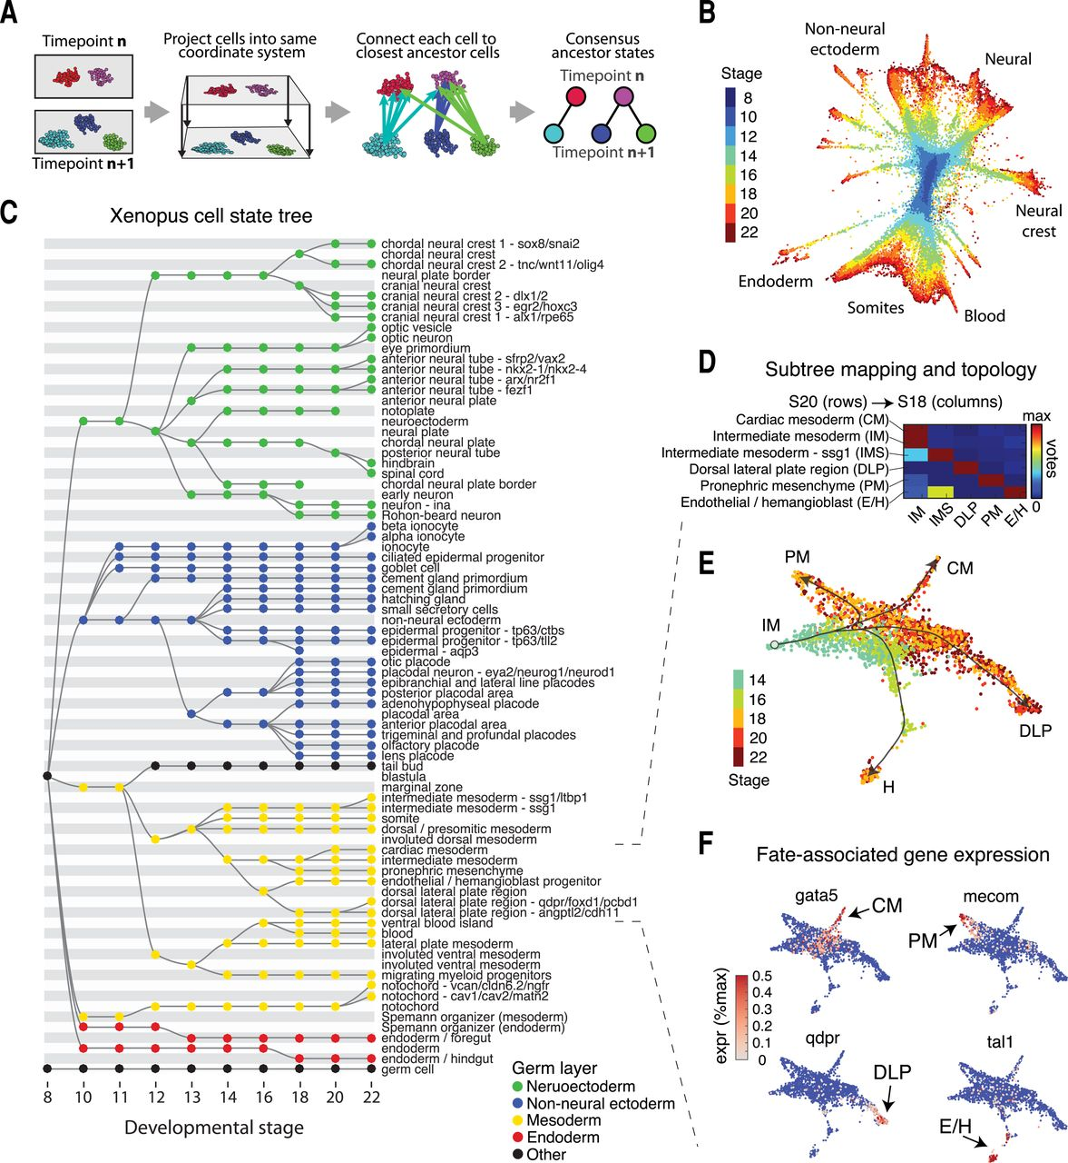
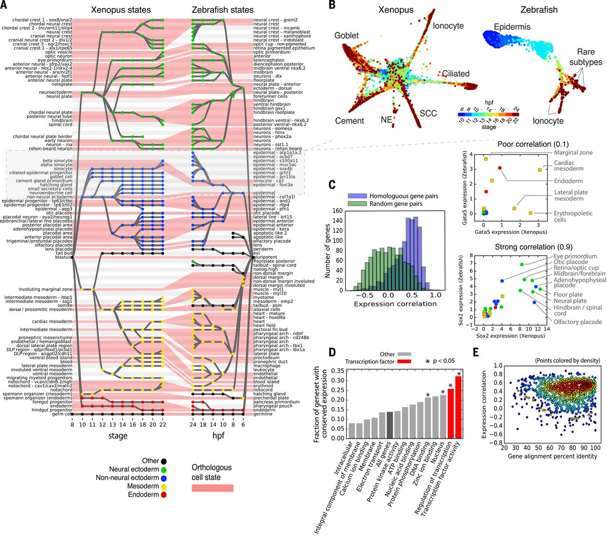
Content from paper 7 that is relevant for mini test #3
ONLY: methods and
results related
to Figs 2, 3, 4

Slide 26
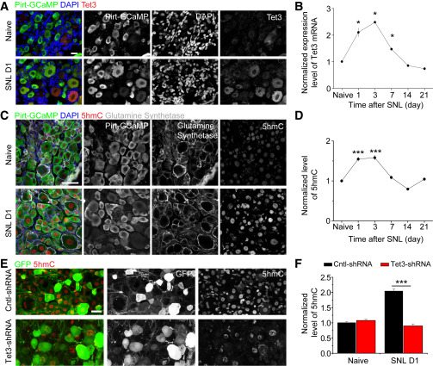
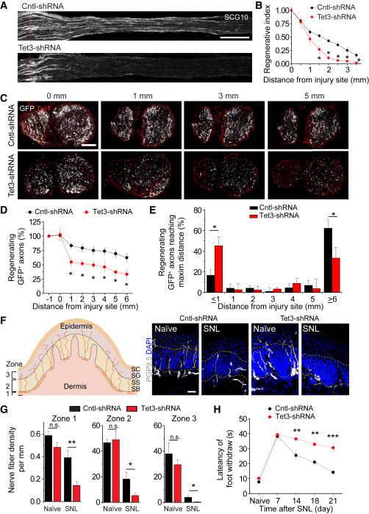
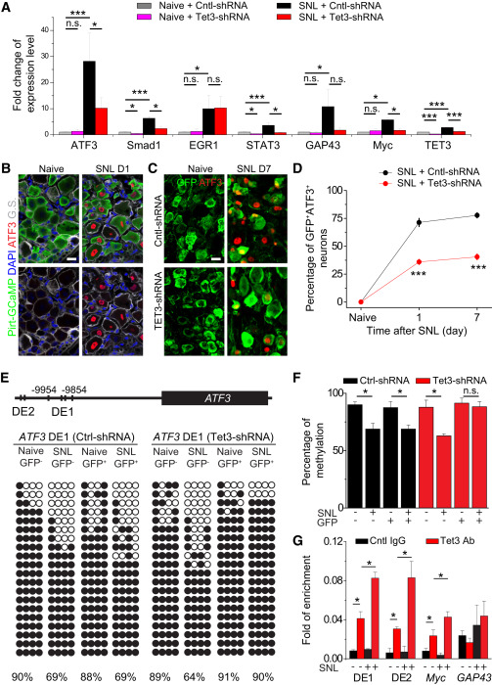
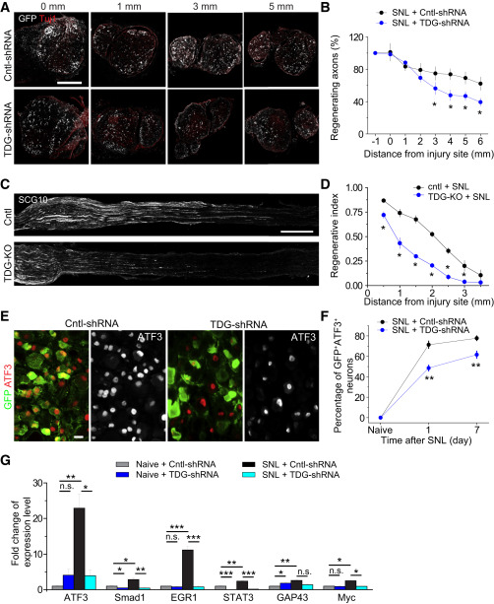
Content from paper 8 that is relevant for mini test #3
ONLY: methods and
results related
to Figs 1, 2, 3, 4

Slide 27
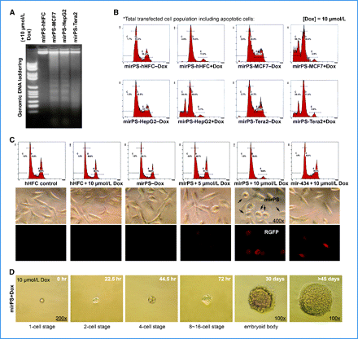
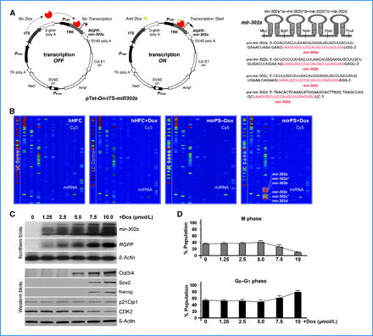
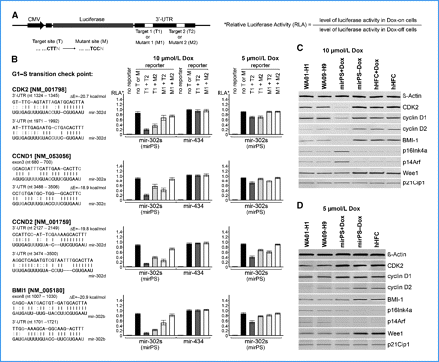
Content from paper 9 that is relevant for mini test #3
ONLY: methods and
results related
to Figs 1, 2, 4

