Slide 1
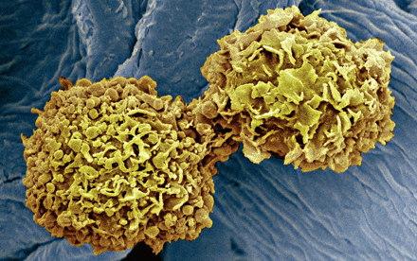
V7: CDK inhibitors
Cancer is characterized by aberrant cell cycle activity.
This occurs either as result of mutations in upstream signaling pathways or by genetic lesions within genes encoding cell cycle proteins.
Aberrant activation of CDKs, which is frequently seen in human cancers, provided a rationale for designing synthetic inhibitors of CDKs as anticancer drugs.
http://www.nature.com/articles/nrd4504 (2015)
https://www.ncbi.nlm.nih.gov/pmc/articles/PMC5345933/
http://science.sciencemag.org/content/345/6199/865.full
Mol Cancer Ther 15 2273-2281 (2016)
A dividing cancer cell.

Slide 2
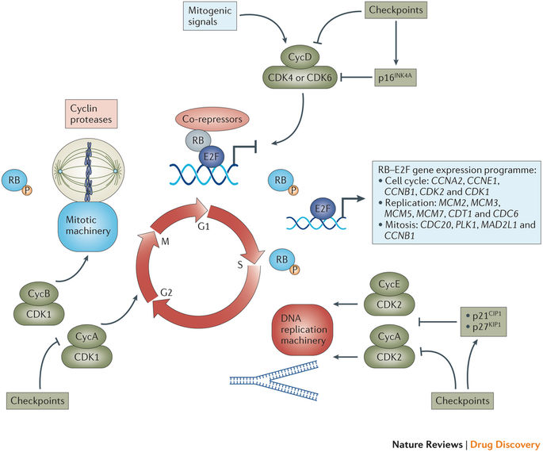
Review: Progression of the human cell cycle driven by CDKs
Mitogenic signals stimulate CDK4 and CDK6 and promote entry into the cell cycle.
In contrast, antiproliferative checkpoints inhibit CDK4 and CDK6 activity or induce the expression of the CDK4 and CDK6 inhibitor p16^{INK4A}
(compare lecture V5, p.12).
http://www.nature.com/articles/nrd4504

Slide 3
Progression of the cell cycle driven by CDKs
Active CDK4 and CDK6 complexes initiate the phosphorylation (P) of key substrates, including the tumor suppressor retinoblastoma protein (RB).
Thereby, they unleash a gene expression program that is coordinated by the E2F family of transcription factors.
MAD2L1, MAD2 mitotic arrest deficient-like 1; MCM, minichromosome maintenance complex component
http://www.nature.com/articles/nrd4504

Slide 4
Retinoblastoma protein
Rb was discovered as the first tumor suppressor gene by the team of Robert Weinberg/MIT in 1987.
They wrote in the abstract of that paper:
“Retinoblastoma is a childhood tumor that can arise because of mutant alleles acquired as somatic or germinal mutations.
The mutant allele can be carried in the germ line.
The mutations creating these alleles act by inactivating copies of a recessive oncogene located within band q14 of chromosome 13 and termed the RB1 locus. “
Robert Weinberg
http://wi.mit.edu/people/faculty/weinberg
Proc Natl Acad Sci U S A. 1987 Dec;84(24):9059-63.

Slide 5
Phosphorylation of retinoblastoma protein
Domain organization and location of Cdk phosphorylation sites on Rb.
The structured domains, which are colored, include the N-terminal domain (RbN) and the pocket domain.
In contrast, several regions are intrinsically disordered including two large loops in RbN (RbNL) and the pocket (RbPL), an interdomain linker (RbIDL), and parts of the C-terminal domain (RbC).
Trends Biochem Sci. 2013 Jan; 38(1): 12–19.
Deciphering the Rb phosphorylation code
Seth M. Rubin

Slide 6
Phosphorylation of retinoblastoma protein
Model of unphosphorylated Rb from crystal structures of individual domains and complexes with E2F and an LxCxE peptide.
Unstructured loops and linkers connecting the structured domains are represented as broken lines.
Approximate locations of phosphorylation sites are indicated.
The Rb domains are colored as in (a); E2F is in pink, and the LxCxE peptide is in yellow.
The C-terminal helix of RbN, which becomes disordered upon T356 phosphorylation is colored brown.
Trends Biochem Sci. 2013 Jan; 38(1): 12–19.

Slide 7
Phosphorylation of retinoblastoma protein
Model of phosphorylated Rb from crystal structures. Only phosphates that are known to promote intramolecular interactions (T373, S608/S612, and T821/T826) are shown.
T821/T826 induces binding of RbC to the pocket domain at the LxCxE site.
The N-terminal helix of the pocket domain that is nucleated by T373 phosphorylation is shown in green.
Trends Biochem Sci. 2013 Jan; 38(1): 12–19.
Deciphering the Rb phosphorylation code
Seth M. Rubin

Slide 8
Cdk phosphorylation events in Rb
Sites | Domain | Structural Effect | Biochemical Output
S249/T252 | RbN | Unknown | Inhibits protein interactions with RbN
T356 | RbIDL | C-terminal helix of RbN becomes disordered | Unknown
T373 | RbIDL | Nucleates N-terminal pocket helix to induce RbN-pocket association | Inhibits E2F^{TD} and LxCxE binding to pocket domain
S608/S612 | RbL | RbL binds pocket | Inhibits E2F^{TD} binding
S780 | Pocket | Unknown | Unknown
S788/S795 | RbC | Unknown | Inhibits RbC-E2F1^{MB}-UP^{MB} binding
S807/S811 | RbC | Unknown | Might prime phosphorylation at other sites
T821/T826 | RbC | Induces RbC binding to the pocket domain | Inhibits RbC-E2F1^{MB}-DP^{MB} binding and inhibits LxCxE binding to pocket domain.
Trends Biochem Sci. 2013 Jan; 38(1): 12–19.

Slide 9
Progression of the cell cycle driven by CDKs
CDK4 and CDK6 initiate transcription and stability of E-type and A-type cyclins (CycE and CycA, respectively) and the subsequent activation of CDK2 that contributes to the further phosphorylation of RB and the initiation of DNA replication.
http://www.nature.com/articles/nrd4504

Slide 10
Progression of the cell cycle driven by CDKs
(1) Further checkpoints can directly inhibit CDK2 activity or induce the CDK-interacting protein/kinase inhibitory protein (CIP/KIP) class of inhibitors (p21^{CIP1} and p27^{KIP1}) that bind to and inhibit CDK2–cyclin complexes.
(2) With the completion of DNA replication, CDK1–Cyc A and CDK1–Cyc B complexes form
to phosphorylate targets in G2 phase.
http://www.nature.com/articles/nrd4504

Slide 11
Progression of the cell cycle driven by CDKs
In the absence of DNA damage and following appropriate preparation for chromosomal segregation, the cellular default is to activate CDK1–CycB complexes and progress into mitosis.
However, there are potent checkpoints that limit CDK1 activity and halt mitotic progression.
http://www.nature.com/articles/nrd4504

Slide 12
Progression of the cell cycle driven by CDKs
Subsequent degradation of CycB is required for anaphase progression and the production of two daughter cells in G1 phase of the cell cycle.
During this transition from M phase back into G1 phase, RB is dephosphorylated, and the cycle is once more responsive to mitogenic and antiproliferative signalling.
http://www.nature.com/articles/nrd4504

Slide 13
Control over G1-S transition - details
Control over the G1–S transition is coordinated by distinct regulatory modules that are dysregulated in cancer.
Initially, mitogenic signals impinge on cyclin-dependent kinase 4 (CDK4) or CDK6 activity through multiple mechanisms, including the induction of cyclin D1 (CycD1) gene (CCND1) expression, protein stability and assembly of the CDK–CycD complex.
These steps can be individually antagonized. Else, the induction of CDK4 and CDK6 inhibitors (that is, the inhibitor of CDK4 (INK4) family of proteins) can function to prevent complex assembly and to inhibit assembled complexes.
http://www.nature.com/articles/nrd4504

Slide 14
Control over G1-S transition
The net activation state of CDK4 and CDK6 initiates the phosphorylation of the tumor suppressor retinoblastoma protein (RB) that contributes to activation and release of the E2F family of transcription factors.
E2F proteins control the expression of a multitude of positive-acting factors that are critical for progression through the S phase and the G2–M transition.
Multiple mechanisms lead to RB inactivation in cancer, such as mutations, aberrant phosphorylation or protein sequestration
http://www.nature.com/articles/nrd4504

Slide 15
Control over G1-S transition
E2Fs and additional signals drive the expression and activation of CDK2–CycE and CDK2–CycA complexes, which contribute to DNA replication and further phosphorylation of RB.
Deregulation of this activity is found in cancer through amplification of E-type cyclins or loss of CDK inhibitors.
CIP, CDK-interacting protein; KIP, kinase inhibitory protein
http://www.nature.com/articles/nrd4504

Slide 16
Recap: biological functions of CDK-cyclin complexes
CDK–Cyc complexes shown in green promote cell cycle progression,
http://www.nature.com/articles/nrd4504

Slide 17
Biological functions of CDK-cyclin complexes
http://www.nature.com/articles/nrd4504

Slide 18
Deregulation of CDK regulatory genes in cancer.
Frequencies of genetic amplification of CDK4 and CDK6 across multiple disease sites.
The frequencies of mutation (green), amplification (red) and homozygous deletion (dark blue) were determined using genetic data from >2,000 cancer cases.
Different types of cancer exhibit distinct predominant mechanisms of genetic alterations in cell cycle control.
http://www.nature.com/articles/nrd4504

Slide 19
Deregulation of CDK regulatory genes in cancer.
cyclin D1 („activator is amplified“)
retinoblastoma 1 („tumor suppressor is mutated or deleted“)
http://www.nature.com/articles/nrd4504

Slide 20
Deregulation of CDK regulatory genes in cancer.
cyclin-dependent kinase inhibitor 2A („inhibitors are shut down by deletion“)
cyclins E1 and E2 („activators are amplified“)
http://www.nature.com/articles/nrd4504

Slide 21
First generation of CDK inhibitors
Over the past 20 years, several small molecule inhibitors of CDKs have been developed as potential cancer therapeutics and tested in numerous trials and in several tumor types.
The first-generation CDK inhibitors developed were relatively nonspecific and may therefore be referred to as ‘pan- CDK’ inhibitors.
Of these inhibitors, flavopiridol is the most extensively investigated CDK inhibitor so far, with >60 clinical trials carried out between 1998 and 2014.
Although flavopiridol can induce cell cycle arrest in G1 and G2 phases, in certain contexts it also induces a cytotoxic response.
Flavopiridol did not meet the initial high expectations. Low levels of clinical activity were seen in Phase II studies in several solid tumor types
Despite extensive investment, no Phase III studies have emerged and drug development of flavopiridol was discontinued in 2012.
http://www.nature.com/articles/nrd4504

Slide 22
Second generation inhibitors of multiple CDKs
Other CDK inhibitors were developed with the aim of increasing selectivity for CDK1 and CDK2 and/or increasing overall potency.
Again, numerous CDK inhibitors seemed to be particularly promising in preclinical studies, but only a few progressed past Phase I clinical trials.
http://www.nature.com/articles/nrd4504

Slide 23
Reasons for failure of broad-specificity CDK inhibitors
The general failure of non-selective CDK inhibitors in the clinic can be partly explained by at least 3 key underlying principles.
(1) There was a lack of clear understanding of the mechanism of action. For many of the CDK inhibitors with low specificity, there remains a lack of clarity with regard to which CDKs are actually being inhibited in vivo and therefore the corresponding mechanism that could underlie the therapeutic effect.
(2) There was a lack of appropriate patient selection. The vast majority of studies conducted with CDK inhibitors with low specificity were in unstratified patient cohorts. This is because there are essentially no biomarkers that may select for sensitive subpopulations for this class of inhibitors.
(3) There is a lack of a therapeutic window. Many of these CDK inhibitors target several proteins that are critical to the proliferation (e.g. CDK1) and survival (e.g. CDK9) of normal cells. This limits the ability to achieve therapeutic levels of these drugs because of their intrinsic inability to discriminate between cancerous and healthy tissues.
http://www.nature.com/articles/nrd4504

Slide 24
The Palbociclib story
In 2017, palbociclib was approved by the Food and Drug Administration (FDA) as a first-in-class cyclin-dependent kinase (CDK) 4/6 inhibitor,
Palbociblib has traveled a long and tortuous road. It is the product of a project started in 1995 by researchers at Parke-Davis, a now-vanished drug company.
Palbociclib blocks key enzymes driving the cell cycle.
Mounting scientific evidence suggested its potential in breast cancer.
Yet Pfizer, where the compound was ultimately synthesized by the Parke-Davis team after Pfizer acquired their company, later shelved the then-unique drug for much of a decade.
In the end, it took several dedicated outside researchers to demonstrate the worth of this drug.
Garber K. The cancer drug that almost wasn’t. Science. 2014;345:865–7.

Slide 25
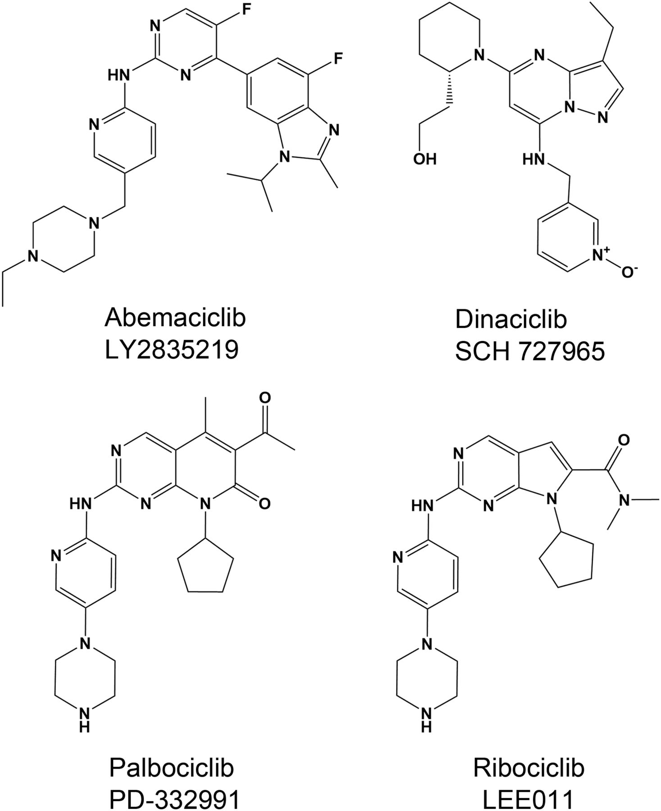
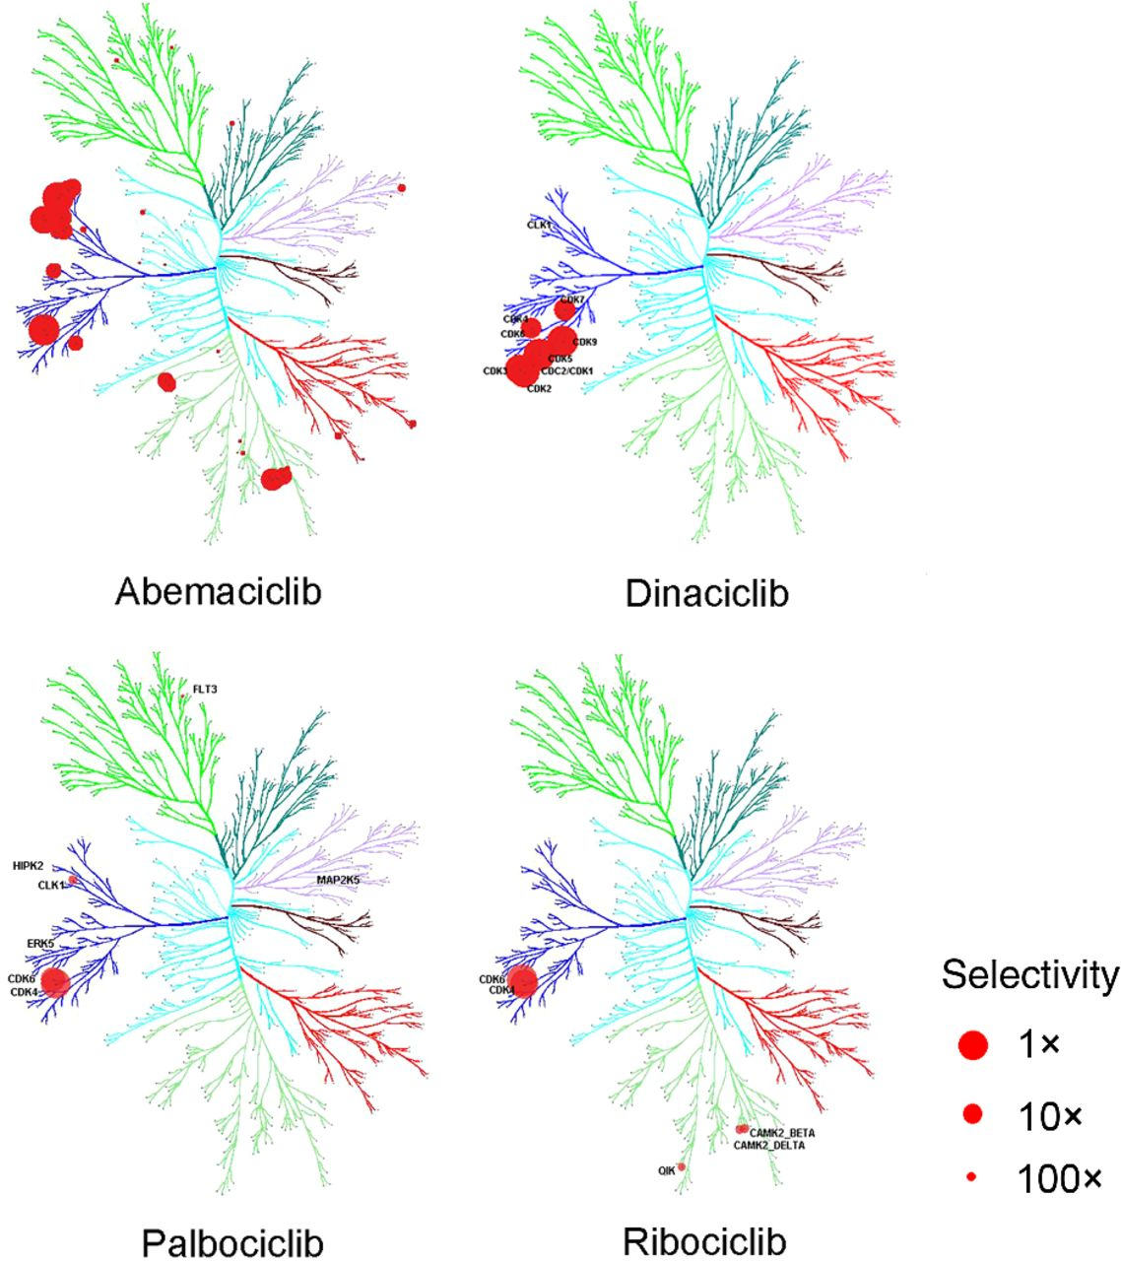
Kinome selectivity of selective CDK4/6 inhibitors
CDK4/CDK6
The size of the circles represents the affinity of the drug for a particular protein relative to on-target potency; the bigger the circle, the higher the affinity. The on-target activity is either CDK4 (abemaciclib, palbociclib, ribociclib) or CDK2 (dinaciclib).
(2016) Mol Cancer Ther 15 2273-2281

Slide 26
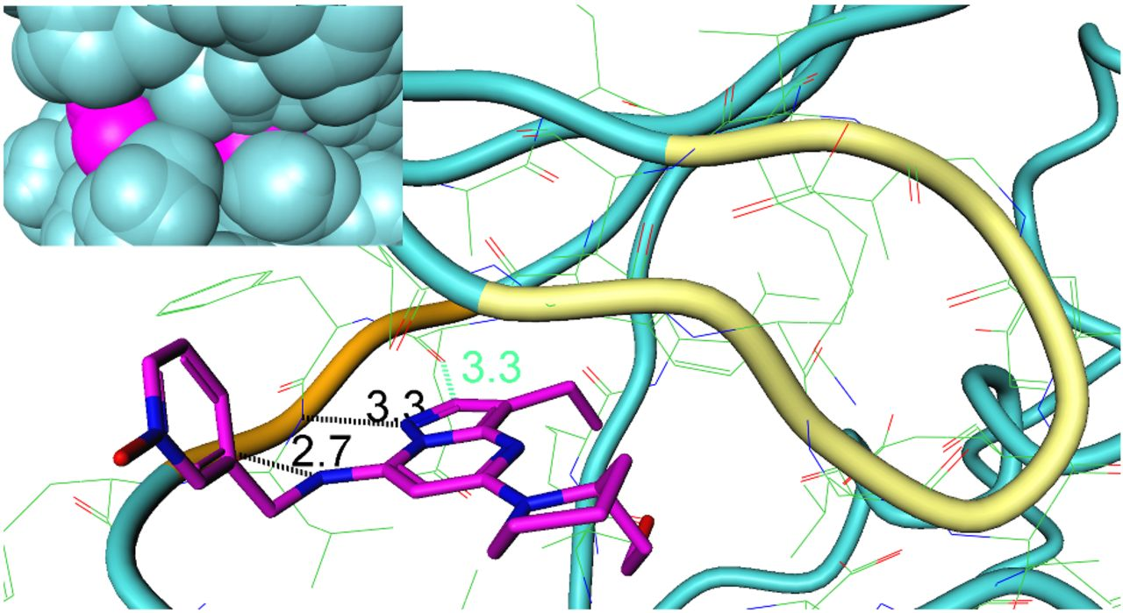
Binding mode for dinaciclib
Only 3 H-bonds with the protein on one side of the small molecule.
Binding is mostly driven through hydrophobic interactions.
Crystal structure of pCDK2/cyclin E with dinaciclib (PDB 5L2W).
The G-loop of pCDK2 is colored in yellow and the hinge region in orange.
Inserted figure represents the surfaces for pCDK2 in blue and dinaciclib in purple.
(2016) Mol Cancer Ther 15 2273-2281

Slide 27
Binding modes for third-generation drugs
H-bonds with the protein on both side of the ligands
-> higher specificity
E.g. His100 is specific to CDK4/6
CDK6 co-crystal structures for: palbociclib (A), ribociclib (B), and abemaciclib (C).
(PDB 5L2S, abemaciclib; 5L2I, palbociclib; 5L2T, ribociclib).
Hydrogen bonds are rendered as dotted lines.
Key active site residues are labeled.
(2016) Mol Cancer Ther 15 2273-2281

Slide 28
Next week: MONALEESA-3 study
Paper #6:
DJ Slamon et al.
“Phase III randomized study of ribociclib and fulvestrant in hormone receptor-positive, human epidermal growth factor receptor 2-negative advanced breast cancer: MONALEESA-3." J Clin Oncol 36.24: 2465-2472 (2018)
Then, we will review the cell cycle topic covered in the lecture.
Week 9: mini test 2# about lectures V5 (second half), V6, V7, V8 and papers 4-6

