Slide 1
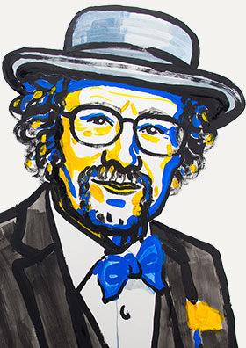
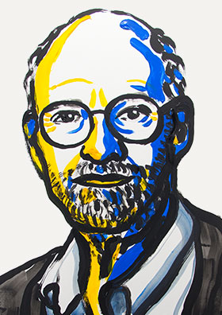
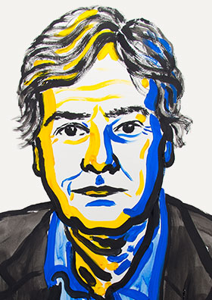
V2: Noble prize in physiology or medicine 2017
Jeffrey C. Hall Michael Roshbash Michael W. Young
*1945 *1944 *1949
„for their discoveries of molecular mechanisms controlling the circadian rhythm”
https://www.nobelprize.org/nobel_prizes

Slide 2
Noble prize in physiology or medicine 2017
During the 1970's, Seymour Benzer and his student Ronald Konopka asked whether it would be possible to identify genes that control the circadian rhythm in fruit flies. They demonstrated that mutations in an unknown gene disrupted the circadian clock of flies. They named this gene period. But how could this gene influence the circadian rhythm?
In 1984, Jeffrey Hall and Michael Rosbash, working in close collaboration at Brandeis University in Boston, and Michael Young at the Rockefeller University in New York, succeeded in isolating the period gene.
Jeffrey Hall and Michael Rosbash then went on to discover that PER, the protein encoded by period, accumulated during the night and was degraded during the day. Thus, PER protein levels oscillate over a 24-hour cycle, in synchrony with the circadian rhythm.
https://www.nobelprize.org/nobel_prizes

Slide 3
Noble prize in physiology or medicine 2017
The next key goal was to understand how such circadian oscillations could be generated and sustained. Jeffrey Hall and Michael Rosbash hypothesized that the PER protein blocked the activity of the period gene. They reasoned that by an inhibitory feedback loop, PER protein could prevent its own synthesis and thereby regulate its own level in a continuous, cyclic rhythm.
The model was tantalizing, but a few pieces of the puzzle were missing. To block the activity of the period gene, PER protein, which is produced in the cytoplasm, would have to reach the cell nucleus, where the genetic material is located. Jeffrey Hall and Michael Rosbash had shown that PER protein builds up in the nucleus during night, but how did it get there?
In 1994 Michael Young discovered a second clock gene, timeless, encoding the TIM protein that was required for a normal circadian rhythm. In elegant work, he showed that when TIM bound to PER, the two proteins were able to enter the cell nucleus where they blocked period gene activity to close the inhibitory feedback loop.
https://www.nobelprize.org/nobel_prizes

Slide 4
Noble prize story of Michael Roshbash
“I worked almost exclusively on nucleic acids and gene expression from the age of 19 as an undergraduate until the age of 38 as an associate professor.
Mentors featured prominently in my choice of paths. My friendship with influential Brandeis colleagues then persuaded me that genetics was an important tool for studying gene expression, and I switched my experimental organism to yeast for this reason.
Several years later, friendship also played a prominent role in my beginning work on circadian rhythms.”
Cold Spring Harb Perspect Biol doi:10.1101/cshperspect.a032516 (2017)

Slide 5
Noble prize story of Michael Roshbash
„I graduated from Caltech in 1965 with a BS in Chemistry. There I worked on nucleic acids in the laboratories of Norman Davidson and then Robert Sinsheimer. ….
Then I attended graduate school at Massachusetts Institute of Technology (MIT). Although my PhD from there was officially in biophysics, I worked in the laboratory of Sheldon Penman; he was an ex-physicist turned cell physiologist with an intense interest in the messenger RNA (mRNA) of higher cells.
I then did a 3-year postdoc at the University of Edinburgh in the laboratory of John Bishop, who was a young faculty member in the Department of Epigenetics.
I arrived at Brandeis in the fall of 1974 as a newly minted assistant professor.
I was 30 years old, and 9 years had passed since I graduated from Caltech.
This was a standard trajectory in those days, when graduate work and postdocs were much shorter than they are today.”
Cold Spring Harb Perspect Biol doi:10.1101/cshperspect.a032516 (2017)

Slide 6
Noble prize story of Michael Roshbash
“In this context (“the good old days”), it is notable that many prominent new professor instructors (PIs) had no publications during their postdocs, or their papers were published considerably after they took their first faculty jobs and often without the names of their postdoc mentors.
..
I was denied tenure in the Rosenstiel Center, where my laboratory was located in the 1970s and early 1980s. … my laboratory was forced to move to the only available Biology Department space, which was adjacent to Jeff ’s laboratory.
… this proximity, including a shared conference room where we had joint laboratory meetings for many years, catalyzed our collaborative efforts.
… I had a serious health crisis in the summer of 1982. … this crisis lowered the energy barrier to making serious changes to my life. They included deciding to work on the cloning of period as soon as someone appeared who was interested.“
Cold Spring Harb Perspect Biol doi:10.1101/cshperspect.a032516 (2017)

Slide 7
Noble prize story of Michael Roshbash
“I gave the period cloning project to the second-year graduate student Pranitha Reddy, and this is how my collaborative work with Jeff Hall on circadian rhythms began in the early fall of 1982.
We were locked in an intense battle for primacy with the Young laboratory at Rockefeller for the first few years, and the cloning and rescue of period was performed independently in both places.
Mike and his colleagues deserve high marks for their accomplishments. Although unpleasant, the competition contributed to a fast-paced focus, which probably contributed to some of our successes.”
Cold Spring Harb Perspect Biol doi:10.1101/cshperspect.a032516 (2017)

Slide 8
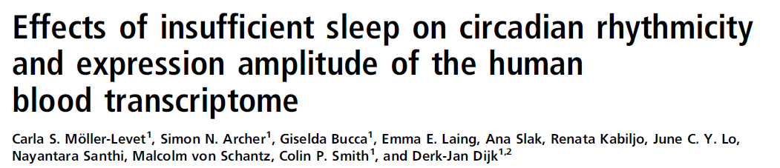
Effect of sleep duration on humans?
30% of civilian adults in the US sleep less than 6 hours per day …
However, short sleep duration (< 6 hours/day) has been associated with negative health outcomes!
Short sleep increases: overall mortality, obesity, diabetes, cardiovascular diseases …
→ What happens on the molecular level?
PNAS (2013) 110, E1132-E1141

Slide 9
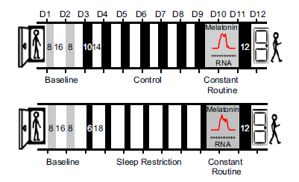
Cross-over design study
26 participants were first put (top) into sleep-restricted conditions with 6 hours of sleep opportunity per night
and then into conditions of sufficient sleep with 10 hours of sleep opportunity.
-> effects of genetic pre-disposition are mimimized by using „matched samples“
PNAS 110, E1132 (2013)

Slide 10
Effects of sleep deprivation on melatonin (SCN marker)
Melatonin peaked significantly later after sleep restriction:
04:15 hours ± 19 min → 05:01 hours ± 19 min
Duration of melatonin secretion was insignificantly shortened:
9:53 ± 12 min → 9:35 ± 11 min
PNAS 110, E1132 (2013)

Slide 11
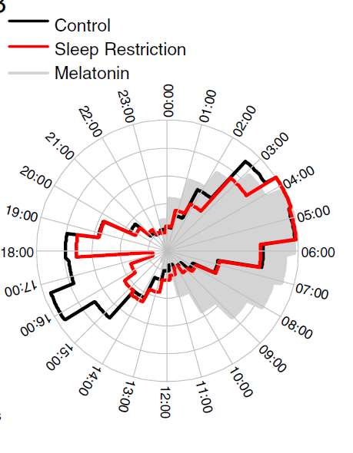
Shift in melatonin-aligned peak times
Clear reduction (> 50%) of the # of genes that peak during day time!
Genes with night peaks (control)
are enriched in GO terms for:
- gene expression,
- RNA metabolic processes,
- cellular metabolic processes
Genes with day peaks (control) are enriched in:
- response to hormone and stress,
- inflammatory,
- immune and defense response,
- interleukin and cytokine activity.
Phase histogram of melatonin-aligned peak times of prevalent circadian
genes following and sleep restriction.

Slide 12
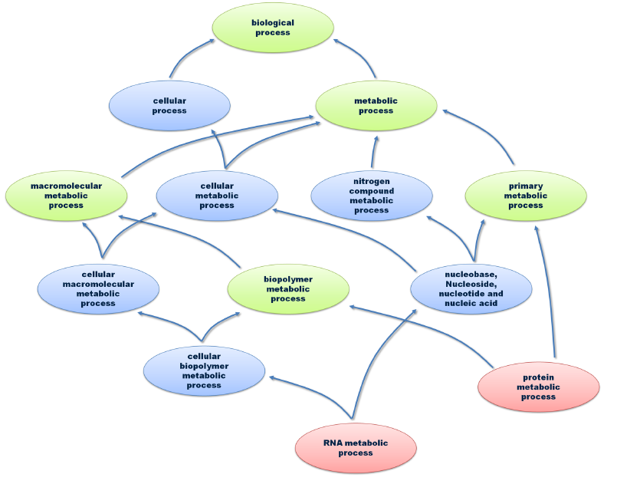
Gene Ontology (GO)
Ontologies are structured vocabularies.
The Gene Ontology has 3 tracks:
- biological process (BP)
- molecular function (MF)
cellular component (lokalisation).
Shown here is a part of the BP tree.
At the top: most general expression (root).
Red: leafs of the tree (very specific GO terms)
Green: common ancestors of 2 red nodes.
Blue: other nodes.
Lines: „Y is contained in X“- relationships
Dissertation Andreas Schlicker (UdS, 2010)

Slide 13
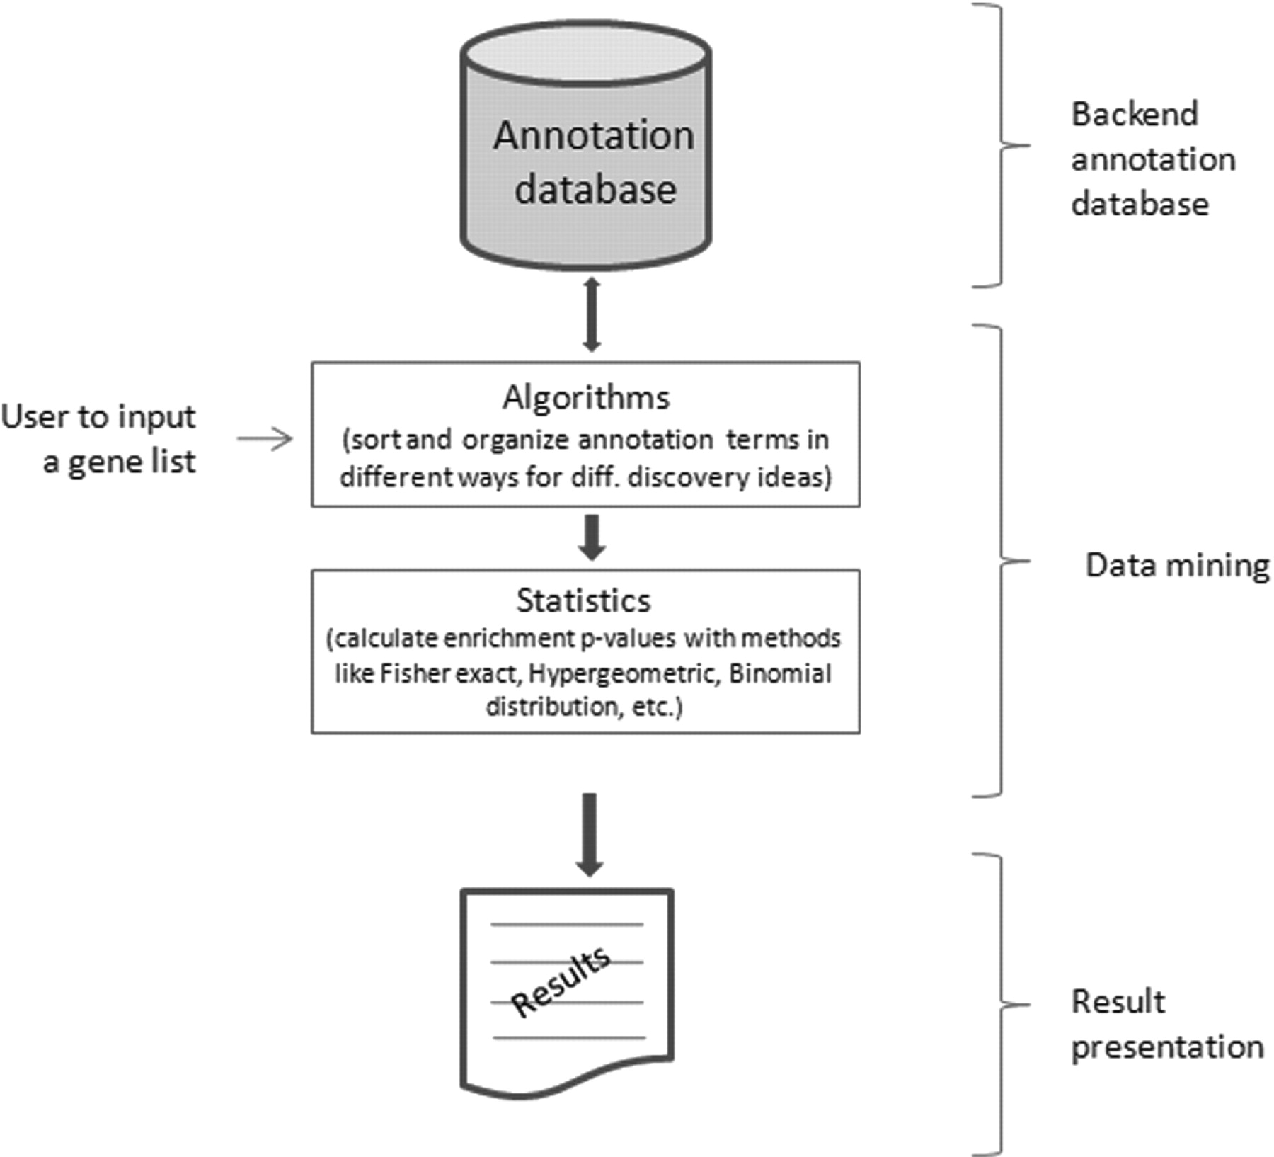
Over-representation analysis
4 services used for over-representation analysis
of GO terms in gene sets:
2 with Agilent Probe IDs
(1) DAVID (NIH)
(2) MetaCoreTM (Thomson-Reuters)
Features
Pathway analysis of ‘omics’ data for drug discovery
Knowledge mining of the database for hypothesis generation
Target and biomarker assessment and validation
Disease pathway modeling and investigation of causal mechanisms
Patient stratification, comprehensive comparison, and
functional fingerprinting
2 with HUGO gene symbols
(3) Toppcluster uses the hypergeometric test, Bonferroni/FDR
(4) Webgestalt uses hypergeometric test or the Fisher's exact test
Huang, Sherman, Lempicki,
Nucl. Acids Res. (2009) 37: 1-13

Slide 14
Over-representation analysis (WebGestalt)
Suppose that we have n genes in a “gene set of interest” (A)
and m genes in the reference gene set (B).
Suppose further that there are k genes in A and j genes in B
that are in a given functional category (C)
(e.g. a GO category, a KEGG pathway, a BioCarta pathway etc.).
Based on the reference gene set, the expected value of k would be
k_{exp} = (n/m) × j
If k exceeds the above expected value,
category C is said to be enriched,
with a ratio of enrichment (r) given by r = k/k_{exp}.
Zhang, Kirov, Snoddy (2013)
Nucl Ac Res 33: W741-W748

Slide 15
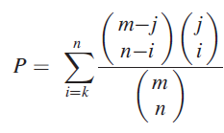
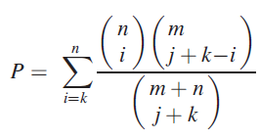
Over-representation analysis (WebGestalt)
If B represents the population from which the genes in A are drawn,
WebGestalt uses the hypergeometric test to evaluate the significance
of enrichment for category C in gene set A,
If A and B are two independent gene sets,
WebGestalt uses Fisher's exact test instead,
Interpretation: draw i = k genes for A that
belong to category C from the j genes from B
that belong to C.
The other n – i genes in A do not belong to C.
They are drawn from the m – j genes in B that
do not belong to C.
Normalization is done by the total number of
possibilities to draw n genes from m genes.
Zhang, Kirov, Snoddy (2013)
Nucl Ac Res 33: W741-W748

Slide 16
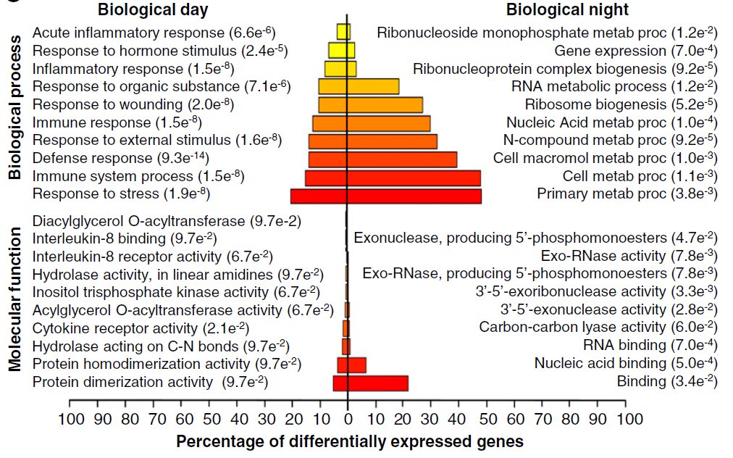
Gene functions of „normal“ circadian genes (Fig. 4!)
Top 10 enriched GO BPs within the circadian gene list of the control condition using
the human genome as a background.
Immune, defense, stress and inflammatory responses, cytokine receptor activity, IL-1 receptor activity, NF-κB signaling more prominent during day time.
(Also found for rodents, taking into account that they are night-active).

Slide 17
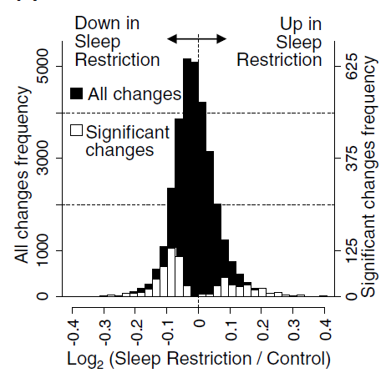
Global overview: changes open sleep deprivation
Frequency distribution of expression fold-changes after sleep restriction relative to control.
Filled area: Histogram of changes in all transcripts
(31,685 probes that target 22,862 genes)
Open area: changes in transcripts identified as having a statistically significant (multiplicity corrected p-value < 0.05) main effect of sleep condition
(744 transcripts that target 711 genes).
444 genes are down-regulated upon sleep restriction (including the circadian rhythm related genes RORA, IL6, PER2, PER3, TIMELESS, CAMK2D)
267 genes are up-regulated (including several circadian-rhythm related genes)

Slide 18
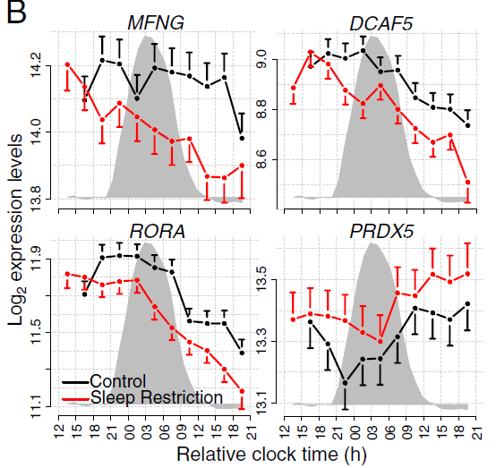
Examples of genes with significant effect of Sleep Condition
Most affected genes: P < 1 × 10⁻⁶
MFNG: O-fucosylpeptide 3-beta-N-acetylglucosaminyltransferase
DCAF5: is a protein-coding gene …
RORA: retinoic acid receptor-related orphan receptor alpha is a nuclear hormone receptor – associated with circadian rhythms
PRDX5: peroxiredoxin 5
Greyed areas: melatonin profile averaged for the two conditions.
Individual data were aligned relative to the individual melatonin rhythm
and sorted into discrete circadian phase bins.

Slide 19
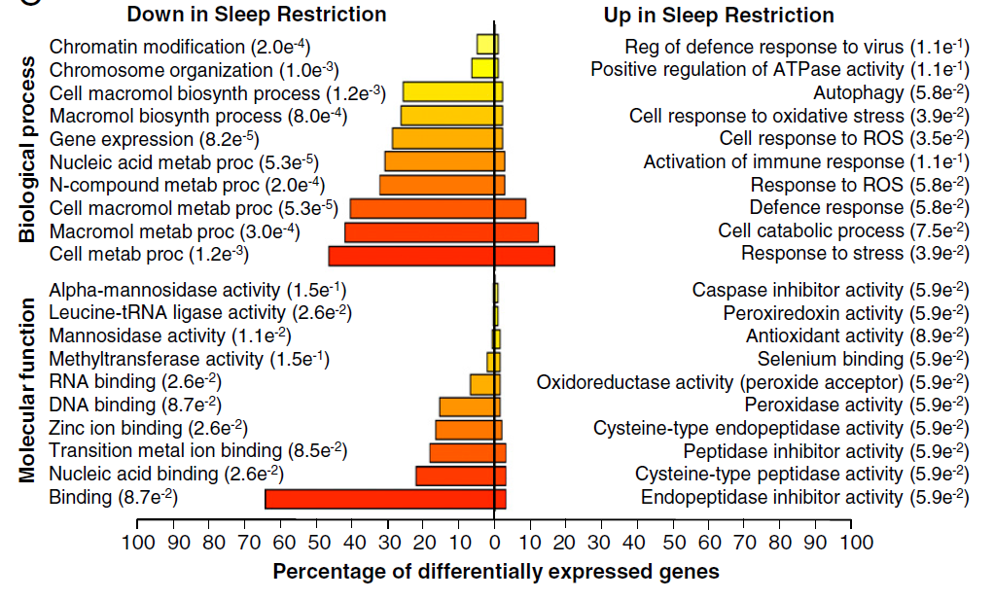
What sort of genes are differentially expressed?
The top 10 enriched GO biolo-gical processes and within the statistically significant differentially expressed gene list as identified by WebGestalt when using the human genome as background.
P-values corrected by Benjamini-Hochberg method.
Down-regulation: chromatin modification and organization, metabolism
Up-regulation: cellular response to oxidative stress and reactive oxygen

Slide 20
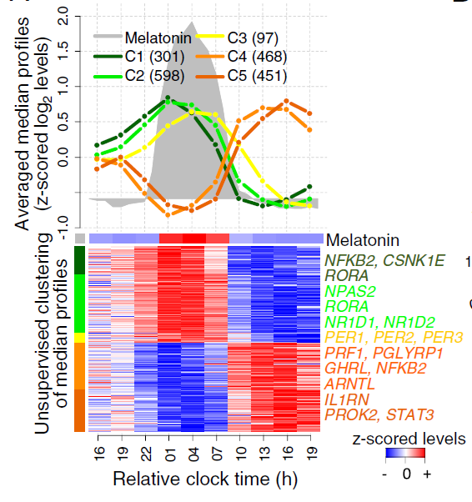
Cluster phases of circadian genes
Genes with a prevalent circadian variation during the constant routine/total sleep deprivation after the control condition (2,103 probes that target 1,855 genes, FDR <5%).
Heatmap rows correspond to the median of the melatonin-aligned probe values across all participants in the control condition.
In parenthesis: number of genes per cluster (C1–C5).
Genes related to circadian rhythmicity and sleep (according to GO) are indicated in the heatmap (colors indicate cluster location).
Many day-peaking genes are no longer circadian upon sleep-deprivation ->
sleep restriction leads to a change in the control of functions and processes such as immune function, response to inflammation and stress.

Slide 21
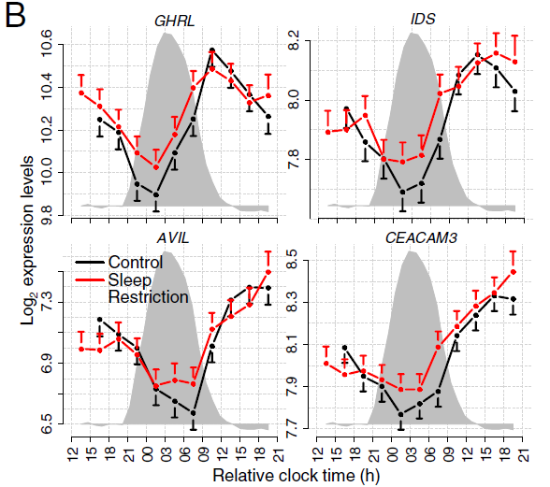
Genes with significant difference in circadian amplitude
Examples of genes with a significant difference in circadian amplitude:
GHRL,
IDS
AVIL, and
CEACAM3

Slide 22
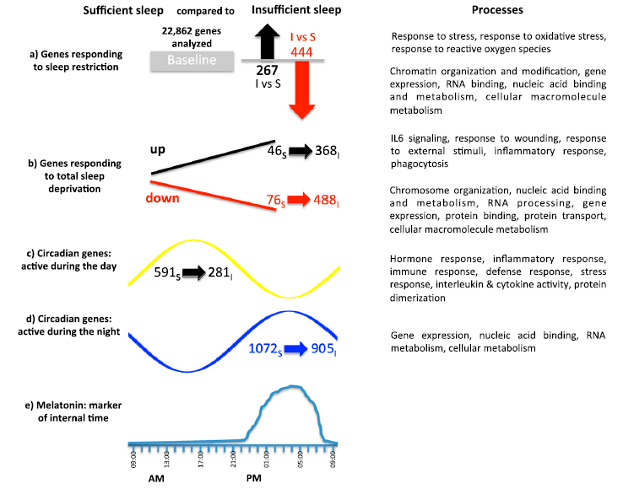
Summary of results

Slide 23
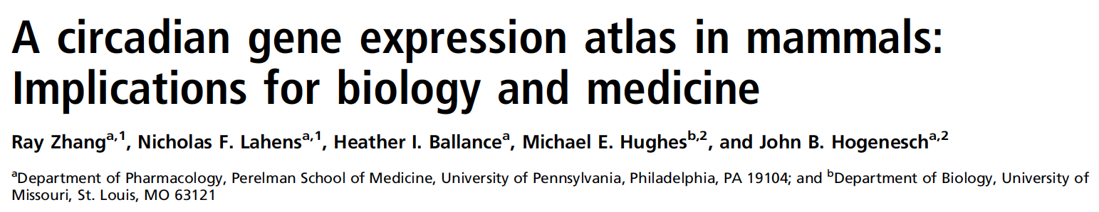
Next paper for you …
Proc Natl Acad Sci USA (2014) 111:16219-24
Introduction: 3 paragraphs
What are circadian rhythms? Biological/medical relevance
Previous work, only single organs analyzed – here: profiling of 12 organs.
What has been achieved in this study?
Methods section:
(1) Animal Preparation and Organ Collection
(2) Microarray Data
(3) RNA-seq Data
(4) Oscillation Detection

Slide 24
Oscillation detection: JTK_CYCLE
JTK_CYCLE applies the Jonckheere-Terpstra-Kendall (JTK) algorithm to alternative hypothesized group orderings corresponding to a range of user-defined period lengths and phases.
JTK is a special case of Kendall’s more general method of rank correlation.
The JTK_CYCLE algorithm finds the optimal combination of period and phase that minimizes the exact p-value of Kendall’s tau correlation between an experimental time series and each tested cyclical ordering.
Group orderings are derived from cosine curves.
Each minimal p-value is Bonferroni-adjusted for multiple testing.
J Biol Rhythms. 2010;25:372-80.

Slide 25
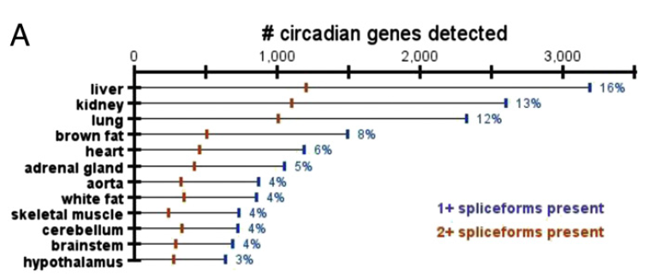
Results: start with overview of the data …
How many circadian genes are detected in various organs?

Slide 26
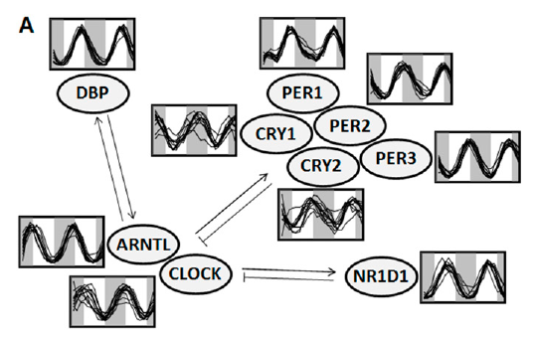
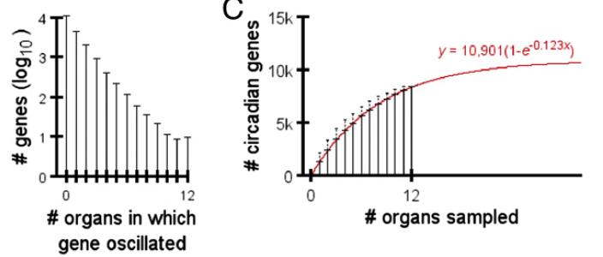
Globally oscillating genes
Only 10 genes oscillated in all organs:
Arntl, Dbp, Nr1d1, Nr1d2, Per1, Per2, and Per3 (core clock factors – as expected), and Usp2, Tsc22d3, and Tspan4.
Usp2 - Ubiquitin carboxyl-terminal hydrolase 2
Tsc22d3 - TSC22 domain family protein 3
Tspan4 - The protein encoded by this gene is a member of the transmembrane 4 superfamily, also known as the tetraspanin family.

Slide 27
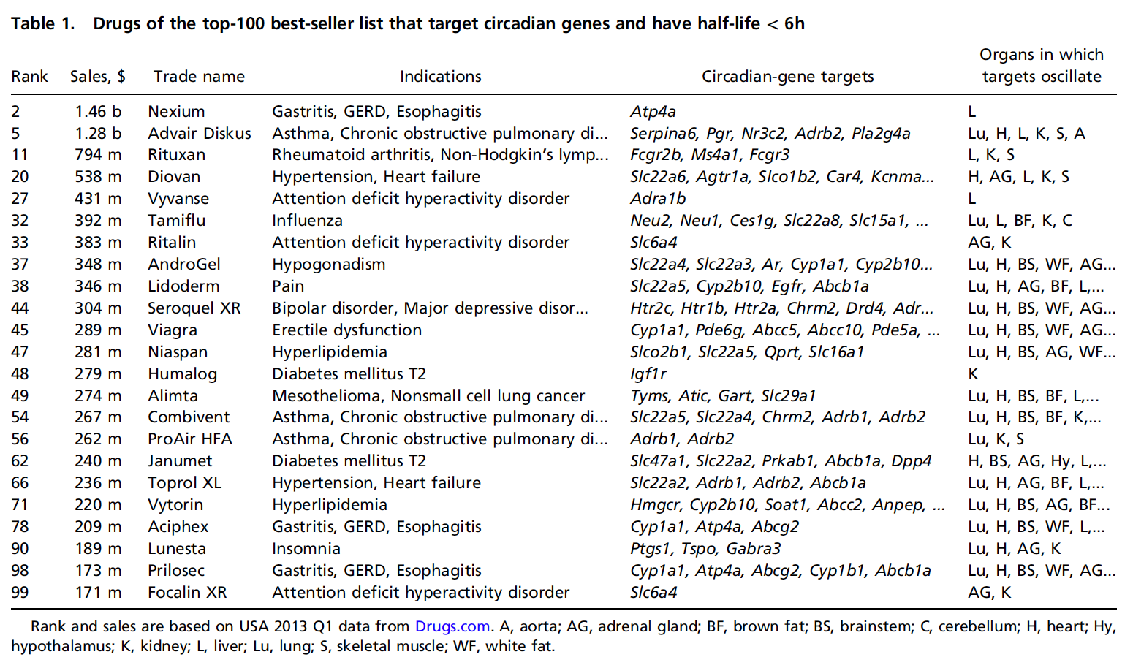
Relevance: mouse -> humans, drugs

