Slide 1
V3: Circadian rhythms – program for today
Case study: circadian effects on drug response
Circadian rhythms are closely connected to metabolism
Circadian clock genes generate epigenetic effects
Circadian clock genes activate leukemia stem cells (paper for V4)

Slide 2
Case study: Circadian effects on drug response
Daily fluctuations in drug absorption, metabolism, and elimination can alter the
effectiveness and toxicity of many pharmaceutical compounds.
The xenobiotic metabolizing system constitutes a series of biochemical reactions that enable the transport, solubilization, chemical conversion, and
eventual elimination of a wide variety of environmental toxins and drug compounds.
Many of the enzymes and transporters involved in xenobiotic metabolism have been found to undergo circadian oscillations of expression at the mRNA and/or protein level.

Slide 3
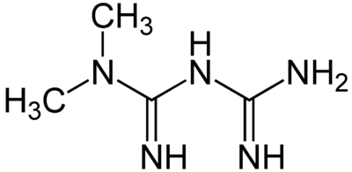
Metformin – mechanism and uptake
Metformin (i.e., Glucophage) is currently the most widely prescribed drug for type 2 diabetes worldwide.
It is also the treatment of choice for polycystic ovary
syndrome (PCOS) and is being investigated as a
treatment for certain types of cancer and even to delay aging.
It is believed to exert its clinical effects by inhibiting mitochondrial complex I. The resulting reduced flux through the electron transport chain lowers cellular ATP production which activates AMP-activated protein kinase (AMPK).
Metformin is most commonly prescribed as an immediate-release formula, which reaches a peak concentration in plasma within 1 to 3 h and is usually
taken twice each day.
An extended-release formulation that peaks in circulation 4 to 8 h after delivery is recommended for single daily dosing.

Slide 4
Metformin response
(A) Typical daily variation of glucose level.
Metformin response is greatest at ZT15 and ZT19.
(A,B) Blood glucose levels measured in male mice before (basal) and 30 min after intraperitoneal injection of 250 mg of metformin per kilogram of bodyweight at the indicated zeitgeber times (ZT, hours after lights-on).

Slide 5
Metformin – mechanism and uptake
Overall, metformin treatment resulted in a significant reduction in blood glucose 30 min after injection compared with saline-treated mice.
There was also a striking effect of time of day on blood glucose levels.
We observed the greatest reduction in blood glucose in response to metformin
treatment at ZT15 and ZT19, corresponding to the middle of the active phase for mice and likely similar to late morning in humans.
In addition, we observed unexpected severe toxicity of metformin at night with the relatively high dose used in this study. In preliminary experiments, we observed > 60% mortality within 12 h after treatment with 250 mg/kg metformin at ZT19.
We could reverse this outcome by providing supplemental glucose and heating pads to maintain glycemic and thermal homeostasis within 30 to 60 min of metformin delivery.

Slide 6
Metformin – mechanism and uptake
Many events could influence blood glucose reduction in response to metformin:
drug transport,
the effectiveness of complex I inhibition, and
the expression or localization of components of molecular pathways involved in the physiological response.
Metformin entry into hepatocytes is largely driven by the organic cation transporter 1 (OCT1) expressed from the gene Slc22a1.
CLOCK, BMAL1, CRY1, CRY2, and PER2 all bind to the promoter region of Slc22a1 in mouse liver, suggesting that the hepatic circadian clock could
directly regulate its expression.
Multidrug and toxin extrusion-1 (MATE-1) protein, expressed from the solute carrier Slc47a1, enables the export of metformin from hepatocytes.
CRY1 and CRY2 bind to the promoter region of Slc47a1 in mouse liver, suggesting that it could also be under clock control.

Slide 7
Expression of solute carriers
Slc47a1 tends to be more highly expressed at night, while we observed no significant effect of zeitgeber time on the expression of Slc22a1.
Although we did not measure differential expression
of the mRNAs encoding metformin import transporter Slc22a1, it remains possible that transporter protein level or membrane localization is modulated by ZT and thus influences drug distribution.

Slide 8
Metformin level in liver
Metformin concentration in mouse liver, as detected by mass spectrometry.
Tissues were snap frozen in liquid nitrogen at the indicated times after intraperitoneal injection with metformin at ZT7 (open circles) or ZT19 (closed circles).
→ Metformin peaked in the liver 20 min after administration

Slide 9
Activation of AMPK
To begin to investigate possible mechanisms downstream of drug transport underlying the observed differences in metformin effects on blood glucose at different times of day, we measured the kinetics of the signal transduction response to metformin at ZT7 and ZT19.
These 2 time points exhibit similar basal blood glucose levels but markedly different
reductions in blood glucose in response to metformin.
Consistent with the observed enhanced reduction of blood glucose during the night, the activating phosphorylation of AMPK on threonine 172 (T172) occurred more quickly after metformin treatment at ZT19 compared with treatment at ZT7.

Slide 10
Summary
Here, it was demonstrated that acute reduction in blood glucose in response to metformin depends on the time of day of treatment in mice.
The kinetics of metformin-induced activation of AMPK are dramatically different in the middle of the day (ZT7) compared with the middle of the night
(ZT19, active phase for mice).
Thus, the timing of metformin treatment could affect its clinical efficacy

Slide 11
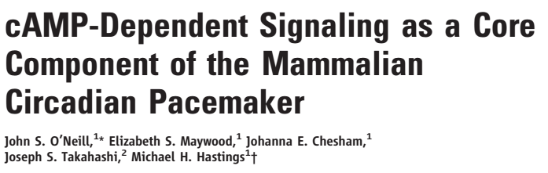
Circadian rhythms are coupled to metabolism
O‘Neill et al.
Science, 320, 949 (2008)
Review:
The suprachiasmatic nuclei (SCN) of the
hypothalamus are the principal circadian pacemaker in mammals,
They drive the sleepwake cycle and coordinate peripheral clocks in other tissues.
Current understanding:
The molecular clockwork within the SCN is being modeled as a combination of transcriptional and posttranslational negative feedback loops.
Protein products of Period and Cryptochrome genes periodically suppress their own expression.

Slide 12
Control of circadian rhythms?
Open question: It is unclear how long-term, high-amplitude oscillations with a daily period are maintained.
In particular, transcriptional feedback loops are typically less precise than the oscillation of the circadian clock and oscillate at a higher frequency than one cycle per day.
Possible explanations:
- Phosphorylation (e.g. casein kinase) causes delay (see V1),
- secondary loops give stabilization.
O‘Neill et al.
Science, 320, 949 (2008)

Slide 13
Evidence for coupling of circadian clocks with metabolism
Recombinant cyanobacterial proteins can sustain circadian cycles of autophosphorylation in vitro, in the absence of transcription,
(2) The intracellular signaling molecules cyclic adenosine diphosphate–ribose (cADPR) and Ca²⁺ are essential regulators of circadian oscillation in Arabidopsis and Drosophila.
This indicates that transcriptional mechanisms may not be the sole, or principal, mediator of circadian pacemaking.
O‘Neill et al.
Science, 320, 949 (2008)

Slide 14
Example of a gene regulatory network
O’Neill and co-workers showed that the transcriptional feedback loops of the SCN are sustained by cytoplasmic cAMP signaling.
cAMP signaling determines their canonical properties (amplitude, phase, period).
Roles of cAMP?
In molluscs, birds, and the mammalian SCN, cAMP is implicated in entrainment or maintenance of clocks, or both, or mediation of clock output.
It was not considered as part of the core oscillator sofar.
These findings extend the concept of the mammalian pacemaker beyond transcriptional feedback to incorporate its integration with rhythmic cAMP-mediated cytoplasmic signaling.
O‘Neill et al.
Science, 320, 949 (2008)

Slide 15
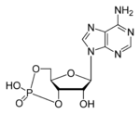
What is cAMP
Cyclic adenosine monophosphate (cAMP) is a second messenger that is important in many biological processes.
cAMP is derived from ATP and used for intracellular signal transduction in many different organisms, conveying the cAMP dependent pathway.
In humans, cyclic AMP works by activating
cAMP-dependent protein kinase (PKA).
Cyclic AMP binds to specific locations on the regulatory units of the protein kinase, and causes dissociation between the regulatory and catalytic subunits
Thus it activates the catalytic units and enables them to phosphorylate substrate proteins.
www.wikipedia.org

Slide 16
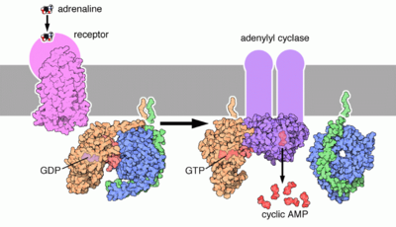
Side functions of cAMP
There are some minor PKA-independent functions of cAMP, e.g. activation of calcium channels.
This provides a minor pathway by which growth hormone is released.
Picture: Epinephrine (adrenaline) binds its receptor, that associates with an heterotrimeric G protein. The G protein associates with adenylyl cyclase that converts ATP to cAMP, spreading the signal.
www.wikipedia.org

Slide 17
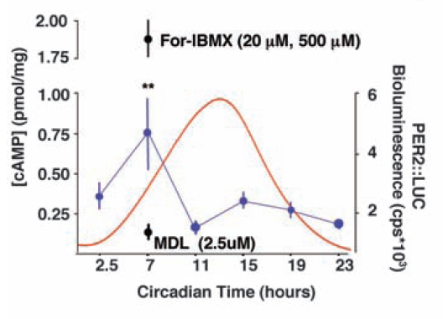
Cyclic cAMP levels in mouse brain
The molecular oscillations of the SCN were tracked as circadian emission of bioluminescence by organo-typical slices from transgenic mouse brain.
Picture: a fusion protein of mPER2 and LUCIFERASE (mPER2::LUC) reported circadian protein synthesis rhythms.
Circadian oscillation of cAMP concentration (blue) and PER2::LUC bioluminescence (red).
Interpretation: Under these conditions, the cAMP content of the SCN was circadian.
O‘Neill et al.
Science, 320, 949 (2008)

Slide 18
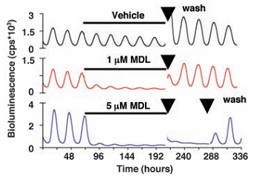
Effect of MDL
Idea: can one show that cAMP is the reason for the oscillations?
Realization: need to suppress cAMP-production in the cell.
Experiment: treat SCN slices with MDL, a potent, irreversible inhibitor of the enzyme adenylyl cyclase
(that synthesizes cAMP) to reduce concentrations of cAMP to basal levels.
Interpretation: MDL rapidly suppressed circadian CRE:luciferase activity, presumably through loss of cAMP-dependent activation of CRE sequences.
This caused a dose-dependent decrease in the amplitude of cycles of circadian transcription and protein synthesis observed with mPer1::luciferase and mPER2::LUC.
O‘Neill et al.
Science, 320, 949 (2008)

Slide 19
MDL also affects the synchronization of the clock
Prolonged exposure to mild levels of MDL (1.0 μM) suppressed and desynchro-nized the transcriptional cycles of SCN cells.
O‘Neill et al.
Science, 320, 949 (2008)

Slide 20
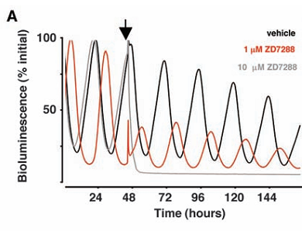
Can one block cAMP action?
Idea: If cAMP sustains the clock, interference with cAMP effectors should compromise pacemaking.
PlanA: treat brain slices with inhibitors of cAMP-dependent protein kinase.
This had no effect, however, on circadian gene expression in the SCN.
PlanB: But cAMP also acts through hyperpolarizing cyclic nucleotide–gated ion (HCN) channels and through the guanine nucleotide–exchange factors Epac1 and Epac2 (Epac: exchange protein directly activated by cAMP).
Time of application of ZD7288
The irreversible HCN channel blocker ZD7288, which would be expected to hyperpolarize the neuronal membrane, dose-dependently damped circadian gene expression in the SCN.
This is consistent with disruption of trans-criptional feedback rhythms.
O‘Neill et al.
Science, 320, 949 (2008)

Slide 21
Can cAMP stimulation be recoved?
Experimentalists typically interrupt a cellular process and then restore it by a side-process.
Idea: Direct activation of the effectors might compensate for inactivation of adenylate cyclase by MDL.
Observation: A hydrolysis-resistant Epac agonist (bottom plot) transiently activated oscillations in transcriptional activity in SCN treated with MDL.
O‘Neill et al.
Science, 320, 949 (2008)

Slide 22
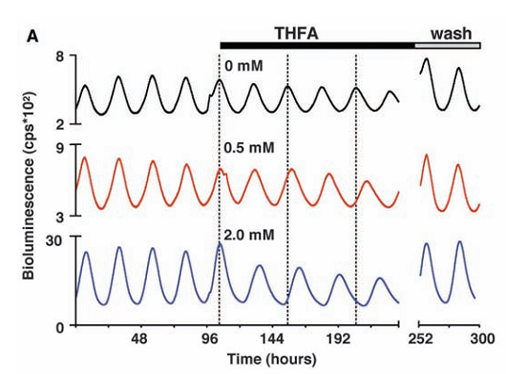
slowing cAMP synthesis
Idea: if cAMP signaling is an integral component of the SCN pacemaker, altering the rate of cAMP synthesis should affect circadian period.
Experiment: 9-(tetrahydro-2-furyl)-adenine (THFA) is a noncompetitive inhibitor of adenylate cyclase that slows the rate of G_{s}-stimulated cAMP synthesis, which attenuates peak concentrations.
Interpretation: THFA dose-dependently increased the period of circadian pacemaking in the SCN, from 24 to 31 hours, with rapid reversal upon washout
O‘Neill et al.
Science, 320, 949 (2008)

Slide 23
Conclusions on cAMP-coupling
Circadian pacemaking in mammals is sustained.
Its canonical properties of amplitude, phase, and period are determined by
a reciprocal interplay in which transcriptional and posttranslational feedback loops drive rhythms of cAMP signaling.
Dynamic changes in cAMP signaling, in turn, regulate transcriptional cycles.
Thus, output from the current cycle constitutes an input into subsequent cycles.
The interdependence between nuclear and cytoplasmic oscillator elements we describe for cAMP also occurs in the case of Ca²⁺ and cADPR.
This highlights an important newly recognized common logic to circadian pacemaking in widely divergent taxa.
O‘Neill et al.
Science, 320, 949 (2008)

Slide 24
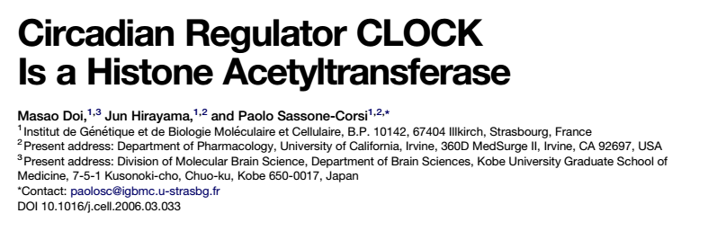
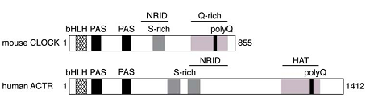
Circadian regulation of epigenetic chromatin
Doi, Hirayama, Sassone-Corsi,
Cell 125, 497 (2006)
Schematic representation of the primary structures of mouse CLOCK and human ACTR with common features; a basic helix-loop-helix (bHLH) motif (bind to DNA), Per-Arnt-Sim (PAS) domains, serine-rich (S-rich) regions, a nuclear receptor interaction domain (NRID), a glutamine-rich (Q-rich) region containing a poly-glutamine (polyQ) stretch.
A horizontal line above hACTR indicates a region known to have HAT activity.

Slide 25
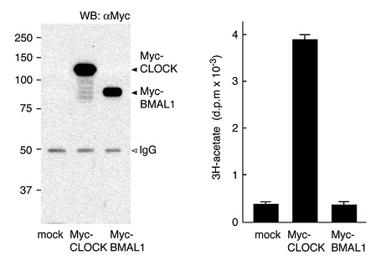
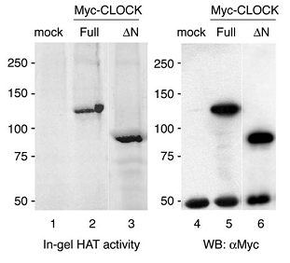
CLOCK is a histone acetyl transferase
(A) Myc-mCLOCK or Myc-mBMAL1 were transiently expressed in JEG3 cells and then immunoprecipitated with antiMyc 9E10 antibody.
After extensive washing, the resulting immunoprecipitates were incubated with [3H] acetyl-CoA and a mixture of histone H3 and H4 amino-terminal tail peptides.
The incorporated [3H] acetate was detected by filter binding assays. As a control, cells transfected with an empty vector (mock) were also subjected to the immunoprecipitation HAT assay. Representative Western blot, illustrating the protein levels of the immunoprecipitated Myc-tagged proteins, is shown on the left.
(B) In-gel HAT activities of Myc-CLOCK. Either a full-length (Full) or an N-terminally truncated (ΔN) mCLOCK protein was expressed in JEG3 cells and immunoprecipitated as described in (A).
The immunoprecipitates were resolved on a 7.5% SDS-PAGE gel containing core histones and processed to detect acetyltransferase activity (left). Identical immunoprecipitated samples were electrophoresed in a parallel SDS-PAGE gel and immunoblotted with antiMyc 9E10 antibody (right).
Doi, Hirayama, Sassone-Corsi,
Cell 125, 497 (2006)

Slide 26
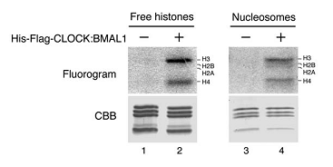
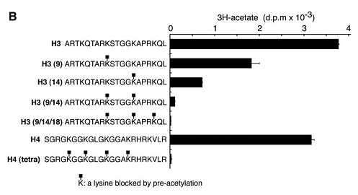
CLOCK is a histone acetyl transferase
TOP: HAT assays using either free core histones or mononucleosomes were performed and the reaction products analyzed on SDSPAGE. The mCLOCK protein acetylated
primarily histones H3 and H4 on both free histone and
mononucleosomes,
BOTTOM: Specificity of CLOCK enzymatic activity was then investigated by using H3 and H4 tails with preacetylated lysines. In this approach, putative HAT substrate sites are occupied, resulting in a block of potential de novo acetylation. Our results determined that histone H3 Lys-14, and in a lesser extent Lys-9, are the
major sites acetylated by mCLOCK.
Doi, Hirayama, Sassone-Corsi,
Cell 125, 497 (2006)

Slide 27
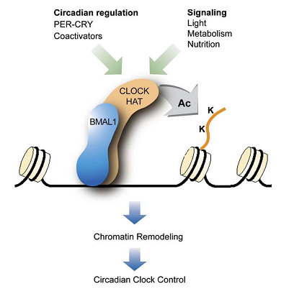
Schematic model
Schematic Model of CLOCK-Mediated Histone
Acetylation and Its Role within the Physiological Pathways of Circadian Rhythmicity
The HAT function of CLOCK activity is enhanced by BMAL1, its natural heterodimerization partner,
with which it binds to E box promoter elements within clock gene promoters (such as per1).
Acetylation by CLOCK, e.g. at H3 Lys-14, is thought to elicit chromatin remodeling by inducing a transcription-permissive state.
Metabolic, nutritional, and environmental circadian cues likely modulate the HAT function of CLOCK.
Doi, Hirayama, Sassone-Corsi,
Cell 125, 497 (2006)

Slide 28
Current understanding: clock – chromatin - metabolites
Circadian transcription is associated with rhythmic changes in epigenetic marks at circadian promoters such as H3K4 trimethylation and H3K9 and H3K14 acetylation.
The histone methyltransferase MLL contributes to the recruitment of CLOCK-BMAL1 to chromatin and thereby to the expression of clock-controlled genes.
Sirtuins are a class of NAD⁺-dependent deacetylases.
Circadian fluctuation of NAD⁺-levels induce rhythmicity in SIRT1 enzymatic activity.
NAD⁺-oscillation is dictated by CLOCK-BMAL1 which control the gene Nampt, encoding the nicotinamide phosphoribosyltransferase enzyme.
Aguila-Arnal et al. show that MLL1 is an acetylated protein and its enzymatic activity is controlled by SIRT1-dependent deacetylation.
Aguila-Arnal et al.
Nature Struct Mol Biol
22, 312 (2015)

Slide 29
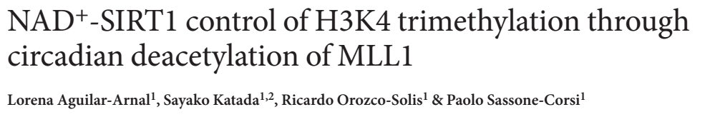
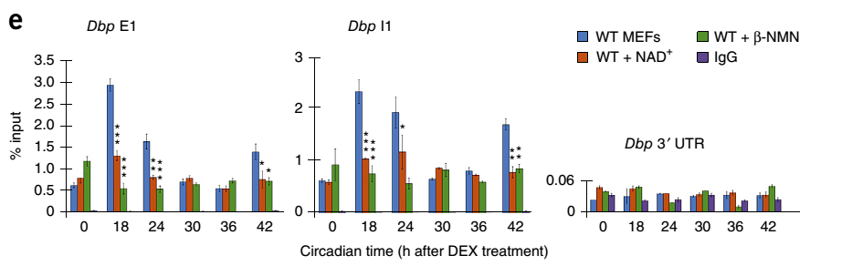
CLOCK is a histone acetyl transferase
Fig. (e) shows H3K4 ChIP-data for the promoter of the circadian gene Dbp.
→ H3K4-methylation levels are modified by changing the NAD+ concentration.
Aguila-Arnal et al.
Nature Struct Mol Biol
22, 312 (2015)

Slide 30
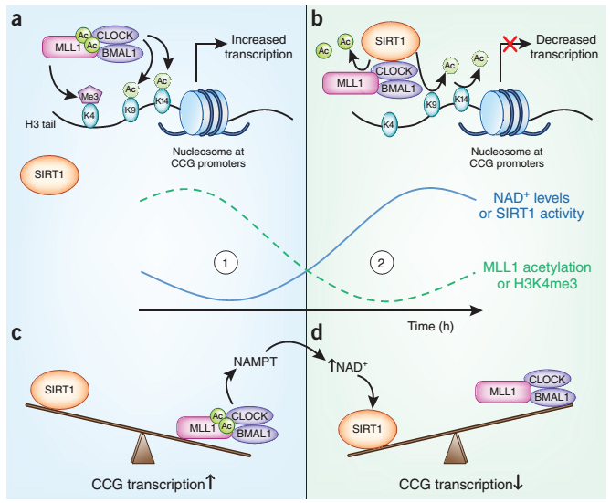
Interpretation: Circadian regulation of epigenetic chromatin
Circadian fluctuations in NAD⁺ levels and SIRT1 activity drive oscillations of the transcriptionally activating H3K4 trimethyl mark at promoters of clock-controlled genes (CCGs).
(a) At circadian times with low NAD⁺ levels (1), SIRT1 deacetylase activity is low, and the histone methyltransferase MLL1 remains acetylated and active, increasing H3K4me3 levels at the promoters of CCGs.
Acetylated MLL1 also favors recruitment of the HAT complex, CLOCK–BMAL1, and acetylation of H3K9 and H3K14 at these promoters. Together, the activating methyl and acetyl histone marks promote transcription of CCGs.
Tasselli & Chua,
Nat Struct Mol Biol 22, 275 (2015)

Slide 31
Interpretation: Circadian regulation of epigenetic chromatin
(b) As NAD⁺ levels increase over time, the deacetylase SIRT1 is activated, and it deacetylates MLL1.
This reduces the methyltransferase activity of MLL1 and thus decreases H3K4me3 occupancy at CCG promoters.
This, together with SIRT1 deace-tylation of H3K9 and H3K14, results in reduced transcription of CCGs.
Tasselli & Chua,
Nat Struct Mol Biol 22, 275 (2015)

Slide 32
Interpretation: Circadian regulation of epigenetic chromatin
(c,d) Schematic illustrating the shifting balance between SIRT1 versus MLL1 activities over circadian time. The circadian oscillations in these activities are linked to each other and to the cellular bioenergetic state via feedback loops involving cyclic production of NAD⁺.
In conditions of low cellular NAD⁺ (c), the balance favors transcription dependent on MLL1 and CLOCK–BMAL1.
Among the CCGs is the Nampt gene, which encodes a key enzyme in NAD⁺biosynthesis. Over time, as NAD⁺ synthesis continues, rising NAD⁺ levels tilt the balance back toward SIRT1 activity and transcriptional repression (d).
Tasselli & Chua,
Nat Struct Mol Biol 22, 275 (2015)

Slide 33
Interpretation: Circadian regulation of epigenetic chromatin
The circadian clock transcriptional system is intricately regulated at the epigenetic level.
The circadian clock transcriptional system was shown to regulate cellular proliferation, making it a potential driver for cancer.
E.g. altered circadian rhythms in shift workers are associated with increased cancer risk.
Core circadian clock TFs act as tumor-suppressors. Deletion of Period2 promotes promotes cancer following exposure to irradiation.
Epigenetic silencing of Bmal1 was described in both B cell lymphoma and acute lymphocytic and myeloid leukemias.
However, even though associations between circadian rhythms and cancer have been established, the mechanisms linking transcriptional control of clock genes and hematopoietic cancers are not well understood.

Slide 34
Next paper for V4
An elegant study by Ebert and co-workers (Puram et al., 2016) demonstrates that the core circadian TFs Bmal1 and Clock are required for leukemia stem cell (LSC) growth and selfrenewal, establishing a novel pro-tumorigenic role for circadian clock genes in acute myeloid leukemia (AML).
Core Circadian Clock Genes Regulate Leukemia Stem Cells in AML
Rishi V. Puram, Monika S. Kowalczyk, Carl G. de Boer, ..., Fatima Al-Shahrour,
Aviv Regev, Benjamin L. Ebert
Cell 165, 303–316 (2016)

