Slide 1

V1 Processing of Biological Data
Leistungspunkte/Credit points: 5 (V2/Ü1)
This course is taught in English language.
The material (from books and original literature) are provided online at the course website:
https://www-cbi.cs.uni-saarland.de/teaching/ss-2020/special-topic-lecture-bioinformatics-processing-of-biological-data/
Topics to be covered:
This course will discuss the handling of different sorts of biological data,
often on the example of recent publications.
Data curation
Processing
Imputation
Data analysis
Machine learning
….
Raw data
Notes:
Welcome to the lecture „Processing of Biological Data“ in summer 2020.
Due to the special conditions during the Corona pandemic, this lecture will be taught by video conferencing.
I recommend that you should first read the content of each slide and then either read the text in this comment block or listen to the recorded Audio.
At the bottom, I visualized the typical flow of a bioinformatics project from raw data over several preprocessing steps listed in the middle box to the data analysis/machine learning block on the right.
Obviously, the last block is expected to reveal the biological or biomedical insight that may be contained in the provided raw data.
Often, answering a biological question relies on selecting 2 suitable groups of samples and comparing them.
So the left and right blocks are obviously most interesting.
However, as I will point out in this lecture, the middle block is equally important in reality as the other two.

Slide 2
Tutorial
We will handout 6 bi-weekly assignments.
Groups of up to two students can hand in a solved assignment.
Send your solutions by e-mail to the responsible tutors
until the time+date indicated on the assignment sheet.
The bi-weekly tutorial on Tuesday 12.45 am – 2.15 pm (time is negotiable) will discuss the assignment solutions.
On demand, the tutors may also give some advice for solving the new assignments.
Notes:
Assignments will be connected to the content of the lecture and will deal with typical tasks of a bioinformatician who is processing biological data.
Some assignments will contain programming tasks, others can be solved either with available software or even by hand.

Slide 3
Schein conditions
The successful participation in the lecture course („Schein“)
will be certified upon fulfilling
Schein condition 1 : ≥ 50% of the points for the assignments
Schein condition 2 : pass final oral exam at end of semester (late July).
  Each student takes an individual exam.
The grade on your „Schein“ will equal that of your final exam.
Those who failed or missed the final exam
can take a oral re-exam at the beginning of WS21.
Note that this is different from our standard regulations (e.g. bioinformatics III) where normally everybody can take the written re-exam.
Notes:
The final exams will be conducted as oral exams of around 20 minute duration.
Depending on how the Corona epidemic develops, oral exams may either be conducted via video conferencing or in person.
As it is very time-consuming to conduct oral exams, we will not offer the chance for a re-exam to those who have passed the first exam.

Slide 4
Planned lecture - overview
  V1: bacterial data (S. aureus): clustering / PCA
  V2: bacterial data/DNA methylation: prediction of missing values (BEclear)
  V3: differential gene expression, detection of outliers
  V4: MS proteomic data, imputation, normalization, protein arrays
  V5: peak detection, breathomics
  V6: shape detection, processing of kidney tumor MRI scans
  V7: genomic sequences, SNPs
  V8: functional GO annotations
  V9: curve fitting, data smoothing (AKSmooth …)
  V10: protein X-ray structures: titration states, hydration sites, multiple side chain and ligand conformations, superposition … protein-protein complexes: crystal contacts, interfaces, …
  V11: analysis of MD simulation trajectories: correlation of snapshots, remove CMS motion
  V12: multi-variate analysis
  V13: integrative analysis of multidimensional data sets
Notes:
In the summer term 2020, due to the Corona epidemic, the lecture will likely contain only 11 instead of 13 lectures.
Depending on how things go and what assignments will be scheduled, we may e.g. skip the normal lectures 10 and 11 on analysis of protein structures and on data from molecular dynamics simulations.

Slide 5
Data preprocessing
Data preprocessing is one of the most critical steps in data mining.
Data preprocessing methods are divided into 4 categories:
Data cleaning
Data integration
Data transformation
Data reduction
Data Mining: Know It All by Ian H. Witten et al. Publisher: Morgan Kaufmann (2008)
Notes:
Although this may not be very obvious to you right now, data preprocessing is a very crucial step of data processing.
If we do not remove problematic data points from the data set at the beginning and if we do not apply proper normalization in the next step, then all downstream processing becomes highly problematic and possibly misleading.
Listed here are 4 categories of data preprocessing methods.
In this lecture, we will discuss examples from all 4 listed categories.

Slide 6
Data preprocessing
◦ Data cleaning: fill in missing values, smooth noisy data, identify or remove outliers, and resolve inconsistencies.
◦ Data integration: using multiple databases, data cubes, or files.
◦ Data transformation: normalization and aggregation.
◦ Data reduction: reducing the volume but producing the same or similar analytical results.
◦ Data discretization: part of data reduction, replacing numerical attributes with nominal ones.
Data Mining: Know It All by Ian H. Witten et al. Publisher: Morgan Kaufmann (2008)
Notes:
Listed here are some typical tasks for all 4 categories of data preprocessing methods.
Note that I took these examples from the text book of Ian Witten listed at the bottom.
In fact, these tasks are typical to any data mining field.
So after you have taken this lecture, you will be ready for data mining☺

Slide 7


Whole Genome Sequence Typing and
Microarray Profiling of Methicillin-Resistant
Staphylococcus aureus isolates
Classification of MSSA / MRSA S. aureus strains in Saarland (PLoS ONE 2012)
DFG Germany-Africa project (J. Clin. Microbiol. 2016; Sci. Reports 2017)
Co-workers
(1) Ruslan Akulenko, Ulla Ruffing, Mathias Herrmann, Lutz von Müller,
(2) StaphNet Consortium led by Mathias Herrmann, funded by DFG
Notes:
Often in this lecture, we will discuss examples from our past and current research projects.
This is how I came into contact with the various tasks of data preprocessing.
You will often read very little about the data preprocessing steps in the methods section of publications.
But be assured, most if not all bioinformatics projects involve significant amount of data preprocessing.
In the example of today‘s first lecture, we will look at genomic data from a project related to bacterial resistance.
Together with Prof. Mathias Herrmann and Prof. Lutz von Müller from the medical department of Saarland University in Homburg, we first started with a pilot study on S. aureus samples that was published in PLoS ONE.
The results from this pilot study then helped us to acquire funding for a large scale multi-center study involving a number of groups from Germany and Africa.

Slide 8
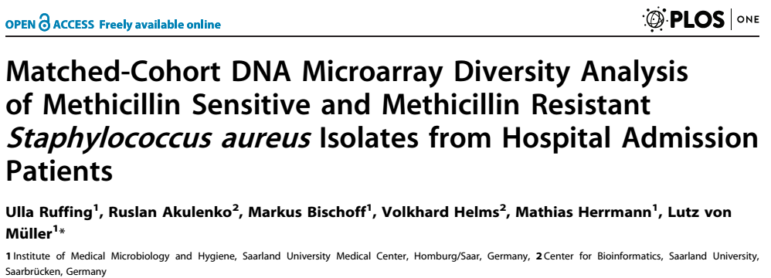
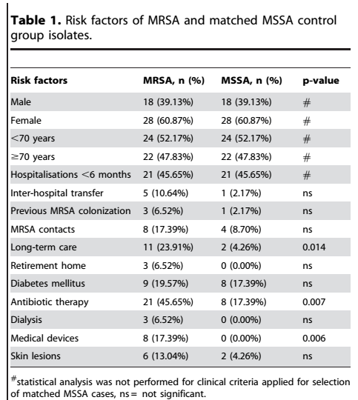

Pilot study: classification of resistant
Staphylococcus aureus strains
Aim: classify MRSA / MSSA
according to gene repertoire
Notes:
At some point in 2011, all patients who were admitted to the university hospital during a period of 1 month
were screened for the presence of methicillin sensitive or methicillin resistant S. aureus strains.
As shown in table 1, we selected 46 MRSA isolates and 46 MSSA colonized patients.
The two groups were matched for gender, age and diverse types of predisposition and exposition.
The aim of the study was to identify the clonal lineage distribution of MSSA and MRSA isolates and to detect differences in the accessory gene equipment of MRSA and MSSA isolates.

Slide 9
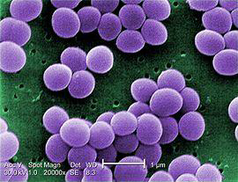
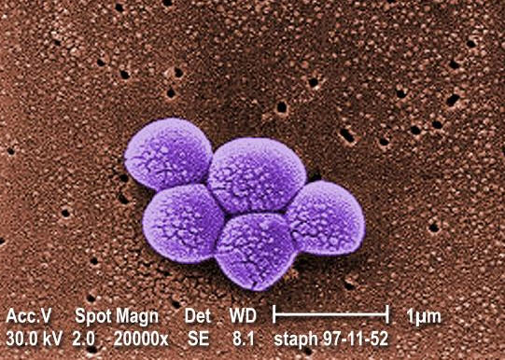
Methycillin sensitive/resistant Staphylococcus aureus
(MSSA/MRSA)
MSSA
MRSA
anaerobic Gram-positive coccal bacterium,
frequently part of the normal skin flora,
60% of population are carriers
any strain of S. aureus with resistance to beta-lactam antibiotics:
penicillins;
cephalosporins;
Need to classify MRSA strains to detect infections, prevent transmission
Notes:
MSSA S.aureus strains are „good strains“. They are sensitive to the antibiotic named methycillin.
More than half of the human population carry MSSA strains in their nose.
MRSA S.aureus strains are „evil strains“ that are multi-resistant to several classes of antibiotics.
It is very important to detect MRSA early on to avoid treating patients with useless therapies and to disrupt transmission chains.

Slide 10
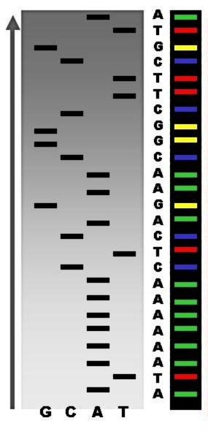

routine: Characterize MRSA by Spa-typing
DNA preparation of polymorphic X-region of staphylococcus protein A from S. aureus (Spa)
amplify by PCR
sequencing assignment using Ridom StaphType software
Spa-types: | Repeats: | Total strains: | Strain records: | Strain countries:
17897 | 762 | 398228 | 165914 | 135
Notes:
In 2012, the typical detection of MRSA relied on so-called Spa-typing.
Spa stands for a protein termed protein A from S. aureus.
It contains a highly variable polymorphic region.
Sequencing of this region was demonstrated to be a rapid and accurate method to discriminate
S. aureus outbreak isolates from those deemed epidemiologically unrelated.
The Spa sequences can be submitted to a Webserver that classifies the submitted strain.

