Slide 1

Example: same bladder cancer microarray data
Clustering of samples after normalization.
The samples perfectly cluster by processing date.
→ clear evidence of batch effect
Processing date is likely a “surrogate” for other variations (laboratory temperature, quality of reagents etc.).
Ten particular genes that are susceptible to batch effects even after RMA normalization.
Hundreds of other genes show similar behavior but, for clarity, are not shown.
Leek et al. Nature Rev. Genet. 11, 733 (2010)
Notes:
This is again the microarray data set that was normalized by RMA.
Although the overall distributions of the samples have been homogenized, there are hundreds of genes left that show clear batch effects.
Note that this plot shows the expression of individual genes.
If one clusters this normalized data (see right plot), the samples cluster according to processing date (green and orange represent two different dates).
This indicates that RMA did not manage to remove the batch effect for these genes.

Slide 2
Example: sequencing data from 1000 Genomes project
Coverage data (number of mapped reads in 10 kb windows)
were standardized across samples:
blue represents three standard deviations below average and orange represents three standard deviations above average.
Each row is a different HapMap sample processed in the same facility with the same platform. The samples are ordered by processing date with horizontal lines dividing the different dates. Shown is a 3.5 Mb region from chromosome 16.
Various batch effects of the read coverage can be observed. The largest one occurs between days 243 and 251 (the large orange horizontal streak).
Leek et al. Nature Rev. Genet. 11, 733 (2010)
Notes:
This is another example for a large-scale batch effect in a famous genomic project.
For some reason, sequencing in the 1000 genome project generated higher read coverage during days 243 and 251.

Slide 3
ComBat
A widely used location-scale method is ComBat.
Here, the expression value of gene i for sample j in batch b is modeled as
where α_{i} is the overall gene expression, and C_{j} is the vector of known covariates representing the sample conditions (such as batch membership).
The error term ε_{bij} is assumed to follow a normal distribution N(0,σ²_{i} ).
Additive and multiplicative batch effects are represented by parameters γ_{bi} and δ_{bi}.
ComBat uses a Bayesian approach to model the different parameters, and then removes the batch effects from the data to obtain the clean data:
Emilie Renard, P.-A. Absil 2017 IEEE International Conference on Bioinformatics and Biomedicine (BIBM), pp. 1511-1518, 2017
See also discussion of Combat in Y.Zhang et al. BMC Bioinformatics 19, 262 (2018)
Notes:
A widely used tool for removing batch effects is ComBat.
It is a location-scale method.
The slide explains the basic principles of ComBat.
However, experience has shown that ComBat also has caveats. The listed Zhang paper discusses some of them.
For example, ComBat removes batch effects impacting both the means and variances of each gene across the batches. However, in some cases, the data might require a less (or more) extreme batch adjustment.
Also, ComBat suffers from sample ’set bias’, meaning that if samples or batches are added to or removed from the set of samples on hand, the batch adjustment must be reapplied, and the adjusted values will be different–even for the samples that remained in the dataset in all scenarios.

Slide 4
Workflow to identify and adjust batch effects
Leek et al. Nature Rev.
Genet. 11, 733 (2010)
Notes:
After a high-throughput study has been performed, the statistical approach for dealing with batch effects consists of two key steps.
Exploratory analyses must be carried out to identify the existence of batch effects and quantify their effect, as well as the effect of other technical artefacts in the data.
Downstream statistical analyses must then be adjusted to account for these unwanted effects.

Slide 5
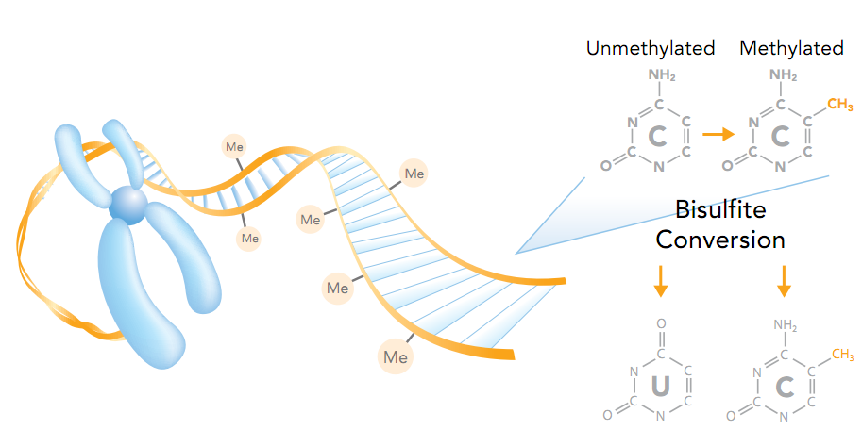
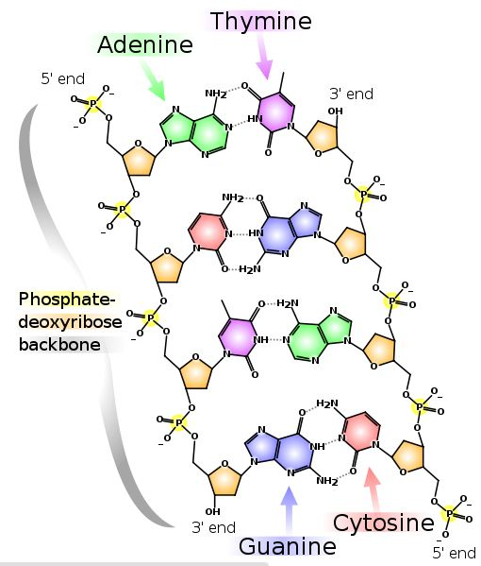

Correcting batch effects in DNA methylation data
Infinium HumanMethylation27, RevB BeadChip Kits
BEclear: Akulenko, Merl, Helms (2016) PLOS ONE, v11, e0159921.
Breast cancer DNA methylation data:
Akulenko and Helms (2013) Human Molecular Genetics, 22, 3016-3022
Notes:
In late 2011, we started working with DNA methylation data from the TCGA breast cancer study.
Soon we detected a severe batch effect that only affected segments on the Illumina chips.
In our 2013 publication, we omitted all affected genes (ca. 25% of the data).
Later, we developed a method termed BEclear (stands for clearing of batch effects) and published that tool in 2016.

Slide 6
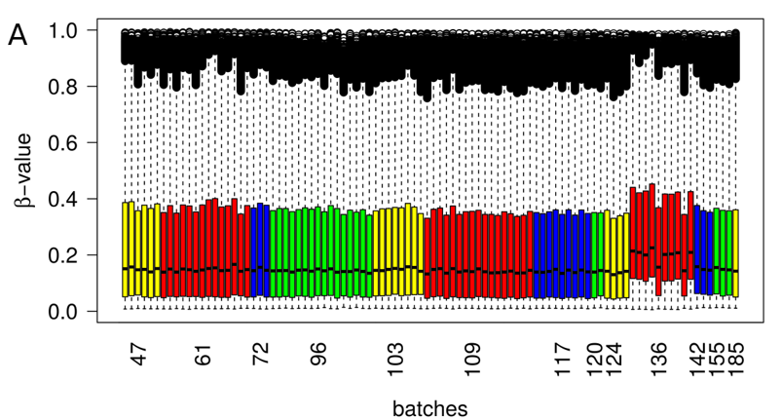
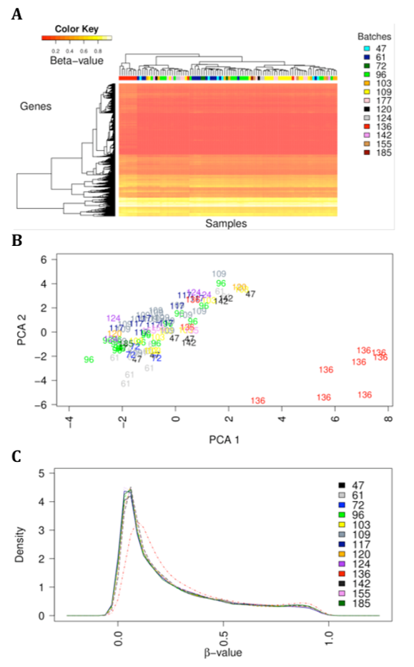
Original DNA methylation data for breast cancer (TCGA)
β: fraction of methylated cytosines in CpG
Clear batch effect in batch 136
Left: box-plot
Right/top: hierarchical clustering
Right/middle: PCA
Right/bottom: density distribution
Notes:
This is an example of exploratory analysis.
The top left panel shows a boxplot of the DNA methylation data in different batches of the TCGA data set.
The top right panel shows hierarchical clustering of the same data.
The middle right panel shows a PCA of the same data.
The bottom right panel shows a density distribution plot.
All plots illustrate clearly that, in batch 136, the distribution of β-values of genes is shifted to larger values than in the other batches.
The per sample plot (top left) shows that the difference in batch 136 is not due to only one sample but exists in all but two samples from this batch.

Slide 7
Beclear: Identify batch effected genes
Compare the distribution of every gene in one batch to its distribution in all other batches using the nonparametric Kolmogorov-Smirnov (KS) test.
P-values are corrected by False Discovery Rate.
(2) To consider only biologically relevant differences in methylation levels, identify the absolute difference between the median of all β-values within a batch for a specific gene and the respective median of the same gene in all other batches.
Beta-values range between 0 and 1. The exp. error was estimated as 5%.
-> Smaller variations are not considered meaningful.
Therefore, only those genes that have a FDR-corrected significance p-value below 0.01 (KS-test) AND a median difference larger than 0.05 are considered as batch effected (BE) genes in a specific batch or sample.
Notes:
We suspected that the batch effect of the analyzed data affected various genes on the chip in different ways.
Therefore, we first had to identify which genes contain data points that differ largely from the remaining data points.

Slide 8
Beclear: score the severeness of batch effect for each batch
(3) Score severeness of batch effect in single batches by a heuristic weighting-scheme :
N : total number of genes in a current batch,
mdif_{cat} : category of median differences ∈ [0,1]
N_{BEgenes_i} : # BE-genes in mdif category i
w_{i} : weight of mdif category i
Weight categories:
if mdif < 0.05, then weight = 0;
if 0.05 ≤ mdif < 0.1 weight = 1;
if mdif ∈ [m × 0.1 ≤ mdif < (m+1) × 0.1] , m ∈ N, m ≤ 9
weight = 2 × m
Scoring scheme considers number of BE-genes in the batch and magnitude of deviation of the medians of BE-genes in one batch compared to all other batches.
Based on the BE-scores of all batches, identify using the Dixon test which batches have BE-scores that deviate significantly from the BE-scores of the other batches.
All BE-gene entries in these affected batches are replaced by LFM predictions (see p.6 in V2).
Notes:
Each batch is assigned a BEscore value that considers the number of BE genes in that batch and the magnitude of their batch effects.
The question was now which values should be replaced, only the individual data points of BE genes in this batch or all of them.
We reasoned that if a sample (or batch) has a BEscore that is significantly larger than the other BEscore values, all values of that sample (or batch) should be replaced by LFM predictions.
Comparison of BEscores is done using the tabulated Dixon test.
This test considers the absolute difference (gap) between the outlier in question and the closest value to it relative to the range of values (max – min).

Slide 9
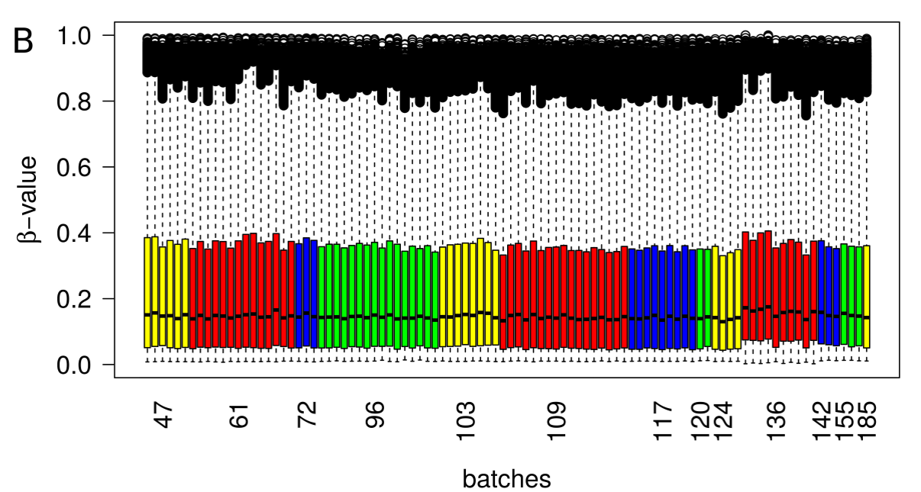
TCGA data for breast cancer – batch affected entries predicted by LFM/BEclear
Batch 136 has still slightly larger values than other batches,
but the deviation is no longer statistically significant.
Notes:
This figure shows the outcome of BEclear for the tumor data.

Slide 10
TCGA data for breast cancer – data corrected by FunNorm
A. Per sample boxplot
B. Density plot.
Functional normalization was able to adjust the batch effect equally well as BEclear
Notes:
This figure shows the normalization result by the tool FunNorm, another tool.

Slide 11
Functional Normalization
Functional normalization uses information from 848 control probes on 450k array.
The method extends the idea of quantile normalization by adjusting for known covariates measuring unwanted variation.
Consider Y₁,…,Y_{n} high-dimensional vectors each associated
with a set of scalar covariates Z_{i,j} with i = 1,…,n indexing samples
and j = 1,…,m indexing covariates.
Ideally these known covariates are associated with unwanted variation and unassociated with biological variation.
Functional normalization attempts to remove their influence.
Notes:
FunNorm builds on the idea of quantile normalization.
It is particularly tailored to the Illumina 450k chip. This chip detects methylation levels for 450.000 CpG sites in the human genome.
It also contains close to 1000 control probes that do not measure CpG methylation of the sample, but are used to test the correctness of the biochemical processing steps carried out.

Slide 12
Functional Normalization
For each high-dimensional observation Y_{i}, we form the empirical quantile function
r ∈ [0,1] for its marginal distribution, and denote it by q_{i}^{emp} .
What is a quantile function:
The k-th percentile of a set of values divides them so that k % of the values lie below and (100−k)% of the values lie above.
• The 25th percentile is known as the lower quartile.
• The 50th percentile is known as the median.
• The 75th percentile is known as the upper quartile.
It is more common in statistics to refer to quantiles.
These are the same as percentiles, but are indexed by sample fractions rather than by sample percentages.
Notes:
The data sets Y to be analyzed are transformed into their quantile functions.
Here, we review what quantiles of a data set are.

Slide 13
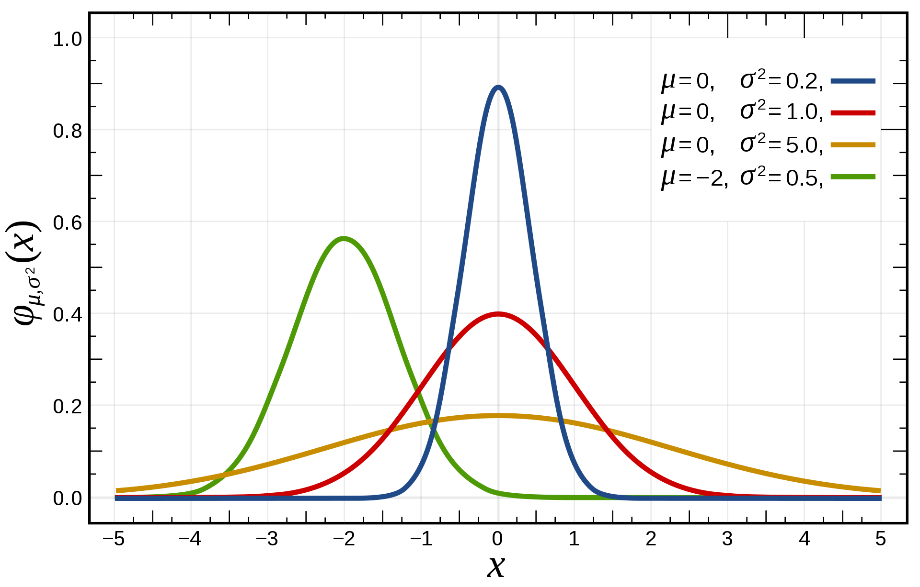
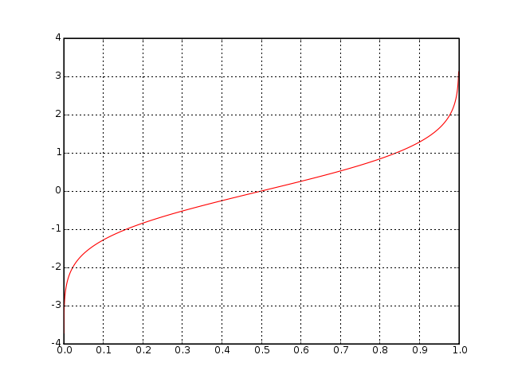
Functional Normalization
The quantile function, associated with a probability distribution F of a random variable, specifies the value of the random variable such that the probability of the variable being less than or equal to that value equals the given probability.
It is also called the percent-point function or inverse cumulative distribution function.
for a probability 0 < p < 1.
normal distribution.
quantile function of the normal distribution.
www.wikipedia.org
Notes:
Let us look at the quantile function of the standard normal distribution (blue curve in the upper plot).
Its quantile function is shown below.
For p=0.5, the variable has a 50% chance to be smaller than 0 in the normal distribution. Thus 0 is plotted on the y-axis for p = 0.5.
For p=0.1, the variable has a 10% chance to be smaller than (about) -1.3 in the normal distribution. Thus -1.3 is plotted on the y-axis for p = 0.1
For p=0.05 (the normal significance threshold), the value is -1.7. It is not -2 as we are used to (two standard deviations) because we are only looking at one tail of the distribution.

Slide 14
Functional Normalization
We assume the following model for the quantile function over the interval r ∈ [0,1]
α : mean of the quantile functions across all samples i,
β_{j} : coefficient functions associated with the covariates j and
ε_{i} : error functions, which are assumed to be independent and centered around 0.
In this model, the term
represents variation in the quantile functions explained by the covariates.
Functional normalization removes unwanted variation by regressing out this term.
Notes:
FunNorm considers the quantile functions of the methylation value in all samples and takes its mean. This is termed alpha.
Then FunNorm assumes that the quantile function of a particlular sample i shows variation due to the covariates and some error term.

Slide 15
Functional Normalization
1, …., m
are estimated using regression from the values observed for the control probes.
Assuming we have obtained estimates for j = 1, . . . ,m, we form the functional normalized quantiles by
We then transform Y_{i} into the functional normalized quantity using the formula
This ensures that the marginal distribution of h has
as its quantile function.
Notes:
The aim is to subtract the variation due to the covariates Z.
The coefficients are estimated based on the values observed for the control probes.
The control probes are explained in the supplementary material of the FunNorm paper:
“For “Bisulﬁte Conversion I” probes, 3 probes (C1,C2,C3) are expected to have high signal in the green channel in case the bisulﬁte conversion reaction was successful,
and similarly 3 additional probes (C4,C5,C6) are expected to have high signal in the red channel. We therefore consider these 6 intensities and take the mean as a single summary value. “
So these probes do not detect methylation levels of CpG sites in the sample, but rather are a quality measure for the performed experiments.

