Slide 1
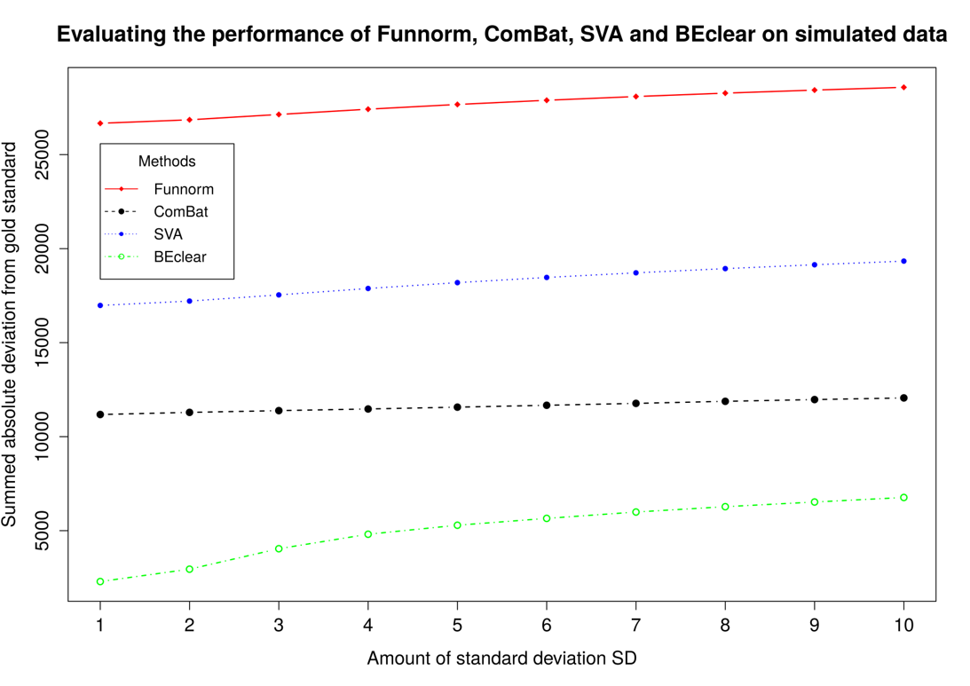
Benchmarking BEclear
Funnorm,
ComBat and SVA scale all values
-> large total
deviation
BEclear corrects only affected entries
Notes:
Here, we generated synthetic data sets with “known” batch effects.
First, we determined the standard deviation of the methylation value of each promoter probe in level 1 adjacent normal samples (samples belonging to batch 136 were excluded due to the existing batch effect).
Then we randomly selected 8000 promoter probes (approximately 10% of all promoter probes present on the chip) and increased the methylation values of 4000 of these promoter probes by a specified multiple of their specific standard deviation plus a noise term. The original probe values before introducing the synthetic batch effect were considered as our gold standard.
Because the methods Funnorm, ComBat and SVA adjust all values, the summed deviation of the corrected values from the original values (y-axis) is quite large.
In contrast, BEclear modifies only the values that are affected by batch effects. Therefore, the summed deviations are much smaller.

Slide 2
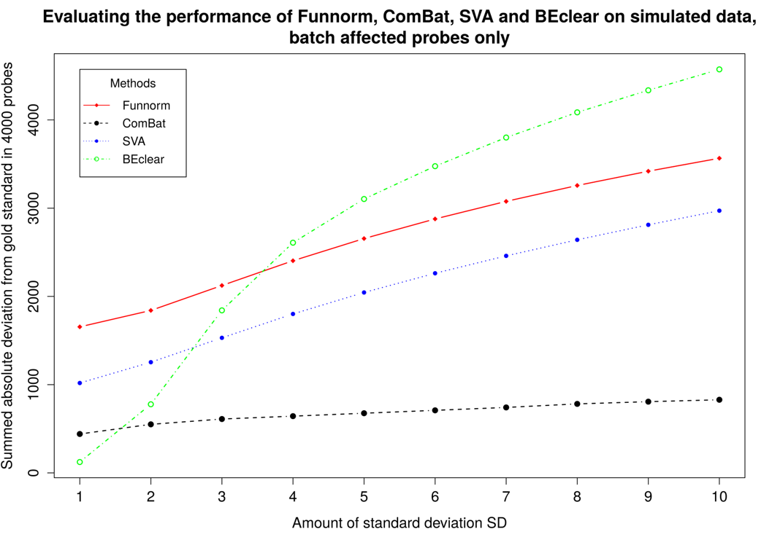
Effect on corrected entries only
Even for affected entries,
BEclear predicts smallest changes for batch effects
up to 2 stand.dev.
which is a typical magnitude of batch effects.
Notes:
Maybe the previous analysis was a bit unfair to the other methods.
Therefore, we now only inspect the deviation of the batch effected data points.
For small batch effects of 2 standard deviations or less (which is a typical magnitude), BEclear still produces the smallest deviations.
Only for larger deviations, BEclear-adjusted values differ more strongly from the original data that with the other methods.

Slide 3
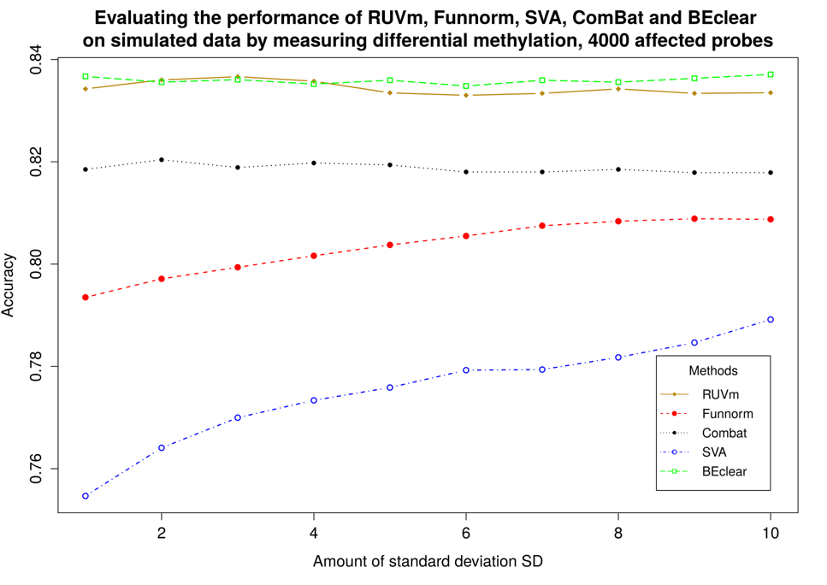
Accuracy of differential methylation analysis
Identify differentially methylated CpG probes (tumor vs. normal) in original data
Then introduce synthetic batch effect (n x st.dev.) + noise term
Identify differentially methylated CpG probes again + compare to reference
Notes:
Then, we considered the identities of differentially methylated genes in breast tumor samples vs. normal samples.
As gold standard reference, we used the list of differentially methylated probes identified in the unaffected data using the limma package.
Then, we designed a synthetic batch effect in a similar fashion as before and applied BEclear, RUVm, FunNorm, ComBat, and SVA to this data.
Then, again we identified differentially methylated genes in this BE-adjusted data with limma and compared the results to the original data.
Shown here is the accuracy defined as (TP + TN) / (TP + TN + FP + FN) for the different BE-adjustment methods.
BEclear yielded a similar accuracy as the RUVm method that is not explained.
Both methods were more accurate compared to all other methods.

Slide 4
Conclusions
Predicting missing values or batch-effected values by Latent Factor Model (BEClear software):
Accuracy of MA hybridization prediction confirmed by WGS (97%),
low LFM error
Superior accuracy of predicting DNA methylation levels by LFM confirmed in benchmark against SVA, Combat, FunNorm tools.
Notes:
Today, we started by discussing various approaches to reconstruct missing data points.
Then, we met the important problem of batch effects in the raw data.
If one does not care about batch effects, the downstream analysis may be heavily corrupted.
Therefore, as a bioinformatician, it is your job to check for possible batch effects.
We discussed different approaches that are implemented in software tools for removing unwanted batch effects.
In our view, there is no „best“ tool.
Certain approaches will offer advantages in certain situations and will give mediocre results in other cases.
Identifying the best suited tool depends on the data to be analyzed.

Slide 5
Review: Foundations of Probability Theory
„Probability“ : degree of confidence that an event of an uncertain nature will occur.
„Events“ : we will assume that there is
an agreed upon space Ω of possible outcomes („events“).
E.g. a normal die (dt. Würfel) has a space Ω = {1,2,3,4,5,6}
Also we assume that there is a set of measurable events S
to which we are willing to assign probabilities.
In the die example, the event {6} is the case where the die shows 6.
The event {1,3,5} represents the case of an odd outcome.
Notes:
Here, I have compiled some basics from probability theory. Some of this will be considered as known to you in the following lectures.
Probably you know most of this already.
Quickly browsing over these slides will fresh up these things.

Slide 6
Foundations of Probability Theory
Probability theory requires that the event space satisfies 3 basic properties:
It contains the empty event ∅ and the trivial event Ω.
It is closed under union → if α, β ∈ S, then so is α ∪ β ∈ S,
It is closed under complementation → if α ∈ S, then so is Ω − α ∈ S
The requirement that the event space is closed under union
and complementation implies that it is also closed under other
Boolean operations, such as intersection and set difference.
Notes:
These are the 3 basic properties that every event space needs to fulfill.

Slide 7
Probability distributions
A probability distribution P over (Ω, S) is a mapping from events in S
to real values. The mapping must satisfy the following conditions:
(1) P(α) ≥ 0 for all α∈ S → Probabilities are not negative
(2) P(Ω) = 1 → The probability of the trivial event which allows all possible outcomes has the maximal possible probability of 1.
(3) If α, β ∈ S and α ∩ β = 0 then P(α ∪ β) = P(α) + P(β)
Notes:
These are the 3 basic conditions that any probability distribution must obey.

Slide 8
Conditional probability
The conditional probability of β given α is defined as
$$P\left(β\left|α\right.\right)=\frac{P\left(α∩β\right)}{P\left(α\right)}$$
The probability that β is true given that we know α is the relative proportion
of outcomes satisfying β among those that satisfy α.
From this we immediately see that
$$P\left(α∩β\right)=P\left(α\right)P\left(β\left|α\right.\right)$$
This equality is know as the chain rule of conditional probabilities.
More generally, if α₁, α₂, … α_{k} are events, we can write
$$P\left(α_{1}∩α_{2}∩…∩α_{k}\right)=P\left(α_{1}\right)P\left(α_{2}\left|α_{1}\right.\right)…P\left(α_{k}\left|α_{1}∩…∩α_{k−1}\right.\right)$$

Slide 9
Bayes rule
Another immediate consequence of the definition of conditional probability is
Bayes‘ rule.
Due to symmetry, we can swap the 2 variables α and β in the definition
$P\left(β\left|α\right.\right)=\frac{P\left(α∩β\right)}{P\left(α\right)}$ and get the equivalent expression $P\left(α\left|β\right.\right)=\frac{P\left(β∩α\right)}{P\left(β\right)}$
If we rearrange, we get Bayes‘ rule $P\left(β\left|α\right.\right)P\left(α\right)=P\left(α\left|β\right.\right)P\left(β\right)$or
$$P\left(α\left|β\right.\right)=\frac{P\left(β\left|α\right.\right)P\left(α\right)}{P\left(β\right)}$$
A more general conditional version of Bayes‘ rule where all probabilities are conditioned on some background event γ also holds:
$$P\left(α\left|β∩γ\right.\right)=\frac{P\left(β\left|α\right.∩γ\right)P\left(α\left|γ\right.\right)}{P\left(β\left|γ\right.\right)}$$

Slide 10
Example 1 for Bayes rule
Consider a student population.
Let Smart denote smart students and GradeA denote students who got grade A.
Assume we believe that P(GradeA|Smart) = 0.6, and that we get to know
that a particular student received grade A.
Suppose that P(Smart) = 0.3 and P(GradeA) = 0.2
Then we have P(Smart|GradeA) = 0.6 × 0.3 / 0.2 = 0.9
In this model, an A grade strongly suggests that the student is smart.
On the other hand, if the test was easier and high grades were more common,
e.g. P(GradeA) = 0.4, then we would get
P(Smart|GradeA) = 0.6 × 0.3 / 0.4 = 0.45 which is much less conclusive.

Slide 11
Example 2 for Bayes rule
Suppose that a tuberculosis skin test is 95% percent accurate.
That is, if the patient is TB-infected, then the test will be positive with probability 0.95
and if the patient is not infected, the test will be negative with probability 0.95.
Now suppose that a person gets a positive test result.
What is the probability that the person is infected?
Naive reasoning suggests that if the test result is wrong 5% of the time, then the probability that the subject is infected is 0.95.
That would mean that 95% of subjects with positive results have TB.

Slide 12
Example 2 for Bayes rule
If we consider the problem by applying Bayes‘ rule, we need to consider the prior probability of TB infection, and the probability of getting a positive test result.
Suppose that 1 in 1000 of the subjects who get tested is infected → P(TB) = 0.001
We see that 0.001 × 0.95 infected subjects get a positive result
and 0.999 × 0.05 uninfected subjects get a positive result.
Thus P(Positive) = 0.001 × 0.95 + 0.999 × 0.05 = 0.0509
Applying Bayes‘ rule, we get P(TB|Positive) = P(TB) × P(Positive|TB) / P(Positive)
= 0.001 × 0.95 / 0.0509 ≅ 0.0187
Thus, although a subject with a positive test is much more probable to be TB-infected than is a random subject, fewer than 2% of these subjects are TB-infected.

Slide 13
Random Variables
A random variable is defined by a function
that associates with each outcome in Ω a value.
For students in a class, this could be a function $f_{grade}$ that maps
each student in the class (in Ω) to his or her grade (1, …, 5).
The event grade = A is a shorthand for the event $\left\{ω∈Ω:f_{grade}\left(ω\right)=A\right\}$.
There exist categorical (or discrete) random values that take on
one of a few values, e.g. intelligence could be „high“ or „low“.
There also exist integer or real random variable that can take on
an infinite number of continuous values, e.g. the height of students.
By Val(X) we denote the set of values that a random variable X can take.

Slide 14
Random Variables
In the following, we will either consider categorical random variables
or random variables that take real values.
We will use capital letters X, Y, Z to denote random variables.
Lowercase values will refer to the values of random variables.
E.g. $P\left(X=x\right)≥0 \text{for} \text{all} x∈Val\left(X\right)$
When we discuss categorical random numbers, we will denote the i-th value as x^{i}.
Bold capital letters are used for sets of random variables: X, Y, Z.

Slide 15
Marginal Distributions
Once we define a random variable X, we can consider the
marginal distribution P(X) over events that can be described using X.
E.g. let us take the two random variables Intelligence and Grade
and their marginal distributions P(Intelligence) and P(Grade)
Let us suppose that
$P\left(\text{Intelligence}\text{=}\text{high}\right)=0.3$
$P\left(\text{Intelligence}\text{=}\text{low}\right)=0.7$
$P\left(\text{Grade}\text{=}\text{A}\right)=0.25$
$P\left(\text{Grade}\text{=}\text{B}\right)=0.37$
$P\left(\text{Grade}\text{=}\text{C}\right)=0.38$
These marginal distributions are probability distributions satisfying the 3 properties.

Slide 16
Joint Distributions
Often we are interested in questions that
involve the values of several random variables.
E.g. we might be interested in the event „Intelligence = high and Grade = A“.
In that case we need to consider the joint distribution $P\left(X_{1},…,X_{n}\right)$
over these two random variables.
The joint distribution of 2 random variables has to be consistent
with the marginal distribution in that $P\left(x\right)=\sum_{y}{P\left(x,y\right).}$
 |  | Intelligence
 |  | low | high
 | A | 0.07 | 0.18 | 0.25
Grade | B | 0.28 | 0.09 | 0.37
 | C | 0.35 | 0.03 | 0.38
 |  | 0.7 | 0.3 | 1

Slide 17
Conditional Probability
The notion of conditional probability extends to
induced distributions over random variables.
$P\left(\text{Intelligence}\left|\text{Grade}\text{=}\text{A}\right.\right)$ denotes the conditional distribution over the events describable by Intelligence given the knowledge that the student‘s grade is A.
Note that the conditional probability $P\left(\text{Intelligence}\text{=}\text{high}\left|\text{Grade}\text{=}\text{A}\right.\right)=\frac{0.18}{0.25}=0.72$
is quite different from the marginal distribution $P\left(\text{Intelligence}\text{=}\text{high}\right)=0.3$.
We will use the notation $P\left(X\left|Y\right.\right)$ to present a set of conditional probability distributions.
Bayes‘ rule in terms of conditional probability distributions reads
$$P\left(X\left|Y\right.\right)=\frac{P\left(X\right)P\left(Y\left|X\right.\right)}{P\left(Y\right)}$$

Slide 18
Probability Density Functions
A function $p:ℝ→ℝ$
is a probability density function (PDF) for X
if it is a nonnegative integrable function so that $\int_{Val\left(X\right)}{p\left(x\right)dx=1}$
The function $P\left(X≤a\right)=\int_{−∞}^{a}{p\left(x\right)dx}$ is the cumulative distribution for X.
By using the density function we can evaluate the probability of other events. E.g.
$$P\left(a≤X≤b\right)=\int_{a}^{b}{p\left(x\right)dx}$$

Slide 19
Uniform distribution
The simplest PDF is the uniform distribution
Definition: A variable X has a uniform distribution over [a,b] denoted X ∼ Unif[a,b]
if it has the PDF
$$p\left(x\right)=\left\{\begin{matrix}\frac{1}{b−a} & b≥x≥a \\ 0 & \text{otherwise}\end{matrix}\right.$$
Thus the probability of any subinterval of [a,b] is proportional
to its size relative to the size of [a,b].
If b – a < 1, the density can be greater than 1.
We only have to satisfy the constraint that the total area under the PDF is 1.

Slide 20
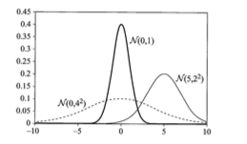
Gaussian distribution
A random variable X has a Gaussian distribution with mean μ and variance σ² ,
denoted X ∼ N(μ;σ²) if it has the PDF
$$p\left(x\right)=\frac{1}{\sqrt{2π}σ}e^{−\frac{{\left(x−μ\right)}^{2}}{2σ^{2}}}$$
A standard Gaussian has mean 0 and variance 1.
Fig. 2.2.

Slide 21
Expectation
Let X be a discrete random variable that takes numerical values.
Then, the expectation of X under the distribution P is
$$E_{P}\left[X\right]=\sum_{x}{x∙P\left(x\right)}$$
If X is a continuous variable,
then we use the density function
$$E_{P}\left[X\right]=\int{x∙p\left(x\right)dx}$$
E.g. if we consider X to be the outcome of rolling a good die with probability 1/6 for each outcome, then E[X] = 1 ⋅ 1/6 + 2 ⋅ 1/6 + … + 6 ⋅ 1/6 = 3.5

Slide 22
Properties of the expectation of a random variable
E[a ⋅ X + b] = a E[X ] + b
Let X and Y be two random variables
E[X + Y] = E[X] + E[Y]
Here, it does not matter whether X and Y are independent or not.
What can be say about the expectation value of a product of two random variables?
In the general case, we can say very little.
Consider 2 variables X and Y that each take on the values +1 and -1 with
probabilities 0.5.
If X and Y are independent, then E[X ⋅ Y] = 0.
If they always take on the same value (they are correlated), then E[X ⋅ Y] = 1.

Slide 23
Properties of the expectation of a random variable
If X and Y are independent then
E[X ⋅ Y]= E[X] ⋅ E[Y]
The conditional expectation of X given y is
$$E_{P}\left[X\left|y\right.\right]=\sum_{x}{x∙P\left(x\left|y\right.\right)}$$

Slide 24
Variance
The expectation of X tells us the mean value of X. However, it does not indicate how far X deviates from this value. A measure of this deviation is the variance of X:
$${Var}_{P}\left[X\right]=E_{P}\left[{\left(X−E_{P}\left[X\right]\right)}^{2}\right]$$
The variance is the expectation of the squared difference between X and its expected value. An alternative formulation of the variance is
$$Var\left[X\right]=E\left[X^{2}\right]−{\left(E\left[X\right]\right)}^{2}$$
If X and Y are independent, then $Var\left[X+Y\right]=Var\left[X\right]+Var\left[Y\right]$
$Var\left[a∙X+b\right]=a^{2}Var\left[X\right]$
For this reason, we are often interested in the square root of the variance, which is called the standard deviation of the random variable. We define
$$σ_{X}=\sqrt{Var\left[X\right]}$$

Slide 25
Variance
Let X be a random variable with Gaussian distribution N(μ;σ²).
Then E[X] = μ and Var[X] = σ².
Thus, the parameters of the Gaussian distribution specify the expectation and the variance of the distribution.
The form of the Gaussian distribution implies that the density of values of X drops exponentially fast in the distance (x - μ) / σ.
Not all distributions show such a rapid decline in the probability of outcomes that are distant from the expectation.
However, even for arbitrary distributions, one can show that there is a decline.
The Chebyshev inequality states $P\left(\left|X−E_{P}\left[X\right]\right|≥t\right)≤\frac{{Var}_{P}\left[X\right]}{t^{2}}$
or in terms of σ $P\left(\left|X−E_{P}\left[X\right]\right|≥kσ_{X}\right)≤\frac{1}{k^{2}}$

Slide 26
Variance
Let X be a random variable with Gaussian distribution N(μ;σ²).
Then E[X] = μ and Var[X] = σ².
Thus, the parameters of the Gaussian distribution specify the expectation and the variance of the distribution.
The form of the Gaussian distribution implies that the density of values of X drops exponentially fast in the distance (x - μ) / σ.
Nice online resources on statistics:
https://www.khanacademy.org/math/statistics-probability
http://tutorials.istudy.psu.edu/basicstatistics/
https://stattrek.com/statistics/problems.aspx

