Slide 1
V4 – differential gene expression analysis - outliers
V2: batch effects
V3: data imputation
What is measured by microarrays?
Microarray normalization
Differential gene expression (DE) analysis based on microarray data
Detection of outliers
RNAseq data
DE analysis based on RNAseq data
Notes:
In lecture 4, we will discuss the detection of differentially expressed genes between samples from two groups.
The 2 groups may correspond to healthy and disease conditions or to two sequential stages in cellular differentiation.
Traditionally, gene expression was measured by DNA microarrays.
Since 2015 or so, this has been replaced more and more by next generation sequencing, namely the RNAseq technology.
But there still exists a lot of useful expression data in public repositories that was measured by microarrays.
So, bioinformaticians will keep analyzing this data in the coming years.

Slide 2
What is measured by microarrays?
Microarrays are a collection of DNA probes that are bound in defined positions to a solid surface, such as a glass slide.
The probes are generally oligonucleotides that are ‘ink-jet printed’ onto slides (Agilent) or synthesised in situ (Affymetrix).
Labelled single-stranded DNA or antisense RNA fragments from a sample are hybridised to the DNA microarray.
The amount of hybridisation detected for a specific probe is proportional to the number of nucleic acid fragments in the sample.
http://www.ebi.ac.uk/training/online/course/
functional-genomics-ii-common-technologies-and-data-analysis-methods/microarrays
Notes:
We will start with some basics about the microarray technology.
Essentially, microarrays detect the hybridization (binding) of single-stranded DNA stretches of the probe to single-stranded DNA probes that were chemically fixed in the wells of the microarray chip.
Each well contains many copies of the same DNA fragment.
The fragments have a typical length of 40-60 nt. If they were much shorter, then multiple DNA stretches could bind to them -> loss of specificity.
If they were much longer, this would increase the costs for production, and carry the danger that the DNA fragment finds a way to hybridize with itself -> loss of accessibility.
So if we want to apply DNA microarrays to measure the abundance of mRNAs in the sample, we first need to reverse-transcribe the mRNAs into cDNA.
Also, we need a detectable readout. For this, we label the cDNA stretches with a fluorescent dye molecule.

Slide 3
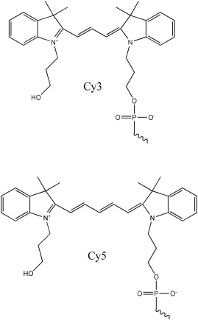
2-color microarrays
In 2-colour microarrays, 2 biological samples are labelled with different fluorescent dyes, usually Cyanine 3 (Cy3) and Cyanine 5 (Cy5).
Equal amounts of labelled cDNA are then simultaneously hybridised to the same microarray chip.
Then, the fluorescence measurements are made separately for each dye and represent the abundance of each gene in the test sample (Cy5) relative to the control sample (Cy3).
http://www.ebi.ac.uk/training/online/course/
functional-genomics-ii-common-technologies-and-data-analysis-methods/microarrays
www.sciencedirect.com
Notes:
If we use 2 different fluorescent dye molecules that emit at different light colors (e.g. green and red light), then we can detect to which sample the majority of cDNA/mRNA belonged to.
Remember: we are not measuring the original mRNA abundance. A cell often only contains 1 – 10 copies of individual mRNA molecules. Detecting this on a chip is practically impossible. This can only be done by mass spectrometry.
Also, we measure the amount of labeled cDNA that was obtained after several chemical processing steps. Each of them has its own efficiency.

Slide 4
MicroArray Quality Control (MAQC) project (2006)
MAQC project: community-wide effort that was initiated and led by FDA scientists involving 137 participants from 51 organizations.
In this project, gene expression levels were measured
- from 2 high-quality, distinct RNA samples (Universal Human Reference RNA (UHRR) from Stratagene and a Human Brain Reference RNA (HBRR) from Ambion)
- in 4 titration pools (Sample A, 100% UHRR; Sample B, 100% HBRR; Sample C, 75% UHRR:25% HBRR; and Sample D, 25% UHRR:75% HBRR.)
- on 7 microarray platforms (Applied Biosystems (ABI); Affymetrix (AFX); Agilent Technologies (AGL for two-color and AG1 for one-color); GE Healthcare (GEH); Illumina (ILM) and Eppendorf (EPP))
- and 3 alternative expression methodologies (TaqMan Gene Expression Assays; StaRT-PCR from Gene Express (GEX) and QuantiGene assays from Panomics (QGN)).
Each microarray platform was deployed at 3 independent test sites and 5 replicates were assayed at each site.
Aim of this study: find out how reproducable MA experiments are.
Nature Biotechnology 24, 1151–1161(2006)
Notes:
Here, we present the findings of a large-scale comparison that tested the reproducability of MA experiments.
This is the link to the paper on the MACS study: https://www.nature.com/articles/nbt1239

Slide 5
MicroArray Quality Control (MAQC) project
The coefficient of variation (CV)
relates standard deviation to mean.
Shown here is CV of the signal (not log transformed) between the intrasite replicates (n ≤ 5) for genes that were detected in at least 3 replicates of the same sample type within a test site.
Most of the one-color microarray platforms and test sites demonstrated similar replicate CV median values of 5–15%.
Nature Biotechnology 24, 1151–1161(2006)
Notes:
ABI – NCI are the 7 different microarray platforms tested. The segments labeled A to D are the 4 titration pools. The right system termed NCI shows higher variability.
The boxplots illustrate the coefficient of variation (y-axis left), the zig-zag lines at the top indicate the number of detected genes (y-axis right).
For each segment, there are 3 data distributions representing 3 different test sites.
The authors concluded in the abstract of their paper that there exists “intraplatform consistency across test sites”.

Slide 6
MicroArray Quality Control (MAQC) project
Concordance of genes identified as differentially expressed for pairs of test sites, labeled as X and Y.
light-colored square: high percent overlap between the gene lists at both test sites.
dark-colored square: low percent overlap
For all but the NCI test sites, the gene list overlap is at least 60% for each test site comparison (both directions) with many site pairings achieving 80% or more between platforms and 90% within platforms.
Nature Biotechnology 24, 1151–1161(2006)
Notes:
The authors concluded in the abstract of their paper that there exists “a high level of interplatform concordance in terms of genes identified as differentially expressed.”
We will explain in a bit how differentially expressed genes are determined by different algorithms.
There is a follow study termed MACS-II: https://www.nature.com/articles/nbt.1665 that compared linear models for tumor outcome based on MA expression data

Slide 7
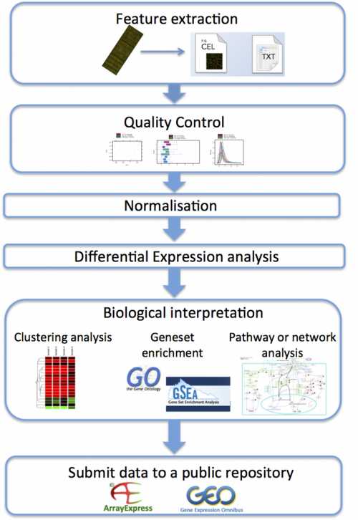
Analysis of microarray data: workflow
Microarrays can be used in many types of experiments including
- genotyping,
- epigenetics,
- translation profiling and
- gene expression profiling.
Gene expression profiling is by far the most common use of microarray technology.
Both one and two colour microarrays can be used for this type of experiment.
http://www.ebi.ac.uk/training/online/course/
functional-genomics-ii-common-technologies-and-data-analysis-methods/microarrays
Notes:
Here, we present an overview of the various steps of microarray data analysis.
The individual steps listed on the flow chart will be explained on subsequent slides.

Slide 8
Extraction of features
Feature extraction is the process of converting the scanned image of the microarray into quantifiable values and annotating it with the gene IDs, sample names and other useful information
Common microarray raw data file types.
Manufacturer | Typical raw data format | How to open / Analysis software examples
Affymetrix | .CEL (binary) | R packages (affy, limma, oligo…)
Agilent | feature extraction file (tab-delimited text file per hybridisation) | Spreadsheet software (Excel, OpenOffice, etc.)
GenePix (scanner) | .gpr (tab-delimited text file per hybridisation) | Spreadsheet software (Excel, OpenOffice, etc.)
Illumina | .idat (binary) | R packages (e.g. illuminaio)
 | txt (tab-delimited text matrix for all samples) | Spreadsheet software (Excel, OpenOffice, etc.)
Nimblegen | NimbleScan, .pair (tab-delimited text matrix for all samples) | Spreadsheet software (Excel, OpenOffice, etc.)
This process is often performed using the software provided by the microarray manufacturer.
http://www.ebi.ac.uk/training/online/course/
functional-genomics-ii-common-technologies-and-data-analysis-methods/microarrays
Notes:
The .CEL files produced from Affymetrix chips and the .idat from Illumina chips are most common.

Slide 9
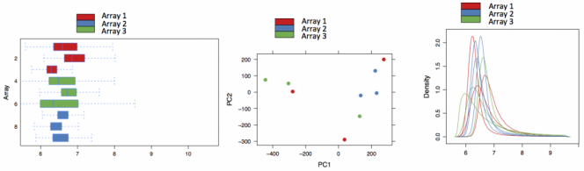
Quality control (QC) is done on the raw data
QC of microarray data begins with the visual inspection of the scanned microarray images to make sure that there are no obvious splotches, scratches or blank areas.
Data analysis software packages produce different sorts of diagnostic plots, e.g. of background signal, average intensity values and percentage of genes above background to help identify problematic arrays, reporters or samples.
expression expression
Box plot PCA Density plot
http://www.ebi.ac.uk/training/online/course/
functional-genomics-ii-common-technologies-and-data-analysis-methods/microarrays
Notes:
Box plot, PCA and density plot are different ways to visualize the distribution of data points in the individual samples, see also lecture #2 slide 21.
In the case shown here, no apparent outlier is visible.

Slide 10
Normalisation
Normalisation is used to control for technical variation between assays, while preserving the biological variation.
There are many ways to normalise the data. The methods used depend on:
- the type of array;
- the design of the experiment;
- assumptions made about the data;
- and the package being used to analyse the data.
For the Expression Atlas at EBI, Affymetrix microarray data is normalised using the 'Robust Multi-Array Average' (RMA) method within the 'oligo' package (which is based on quantile normalization).
Agilent microarray data is normalised using the 'limma' package:
'quantile normalisation' for one-colour microarray data;
'Loess normalisation' for two colour microarray data.
http://www.ebi.ac.uk/training/online/course/
functional-genomics-ii-common-technologies-and-data-analysis-methods/microarrays
Notes:
Normalization is crucial for analysis of microarray data, see also lecture #3 (quantile normalization of proteomics data).
The manufacturers of the microarray chips typically recommend particular normalization strategies that may (or may not?) be best suited for the data produced with their devices.
Usually, it is easiest to follow these instructions. This also avoids most of the trouble with reviewers of your manuscripts.

Slide 11
Differential expression analysis: Fold change
The simplest method to identify DE genes is to evaluate the log ratio between two conditions (or the average of ratios when there are replicates)
and consider all genes that differ by more than an arbitrary cut-off value to be differentially expressed.
E.g. the cut-off value chosen could be chosen as a two-fold difference.
Then, all genes are taken to be differentially expressed if the expression under one condition is over two-fold greater or less than that under the other condition.
This test, sometimes called 'fold' change, is not a statistical test.
→ there is no associated value that can indicate the level of confidence in the designation of genes as differentially expressed or not differentially expressed.
Cui & Churchill, Genome Biol. 2003; 4(4): 210.
Notes:
It is not possible to give a universal threshold above which fold changes should be considered „significant“.
One aspect is statistical significance. This cannot be answered by analyzing fold changes.
Another aspect is biological relevance. For some genes, a small fold change may already be very relevant to the cell. For other genes, only larger fold changes may induce a phenotypic change.

Slide 12
Standard error of the mean
The standard deviation σ gives the „standard“ deviation of all measurements.
Often we are more interested in the standard deviation of the average.
This is denoted by the standard error of the mean (SEM):
Whenever we use a random sample as estimate for a population, there is a good chance that our estimate will contain an error.
SEM provides an estimate for this error.
Typically, we actually need to compute SEM for the difference of the means of two random samples → 2-sample t-test.
Notes:
The standard deviation measures the typical deviation of single data points from the average.
But how about the standard deviation of the average itself?
This is measured by the standard error of the mean.
It is obtained by dividing the standard deviation by the square root of the number of data points.

Slide 13
t-tests
t-value: by how many standard errors does a difference differ from 0?
There are 3 different types of t-tests:
Unpaired t-test
$$t=\frac{average of random sample 1 −average of random sample 2}{SEM of the differences of both averages }$$
Paired t-test
$$t=\frac{average of paired differences−reference value}{SEM of the differences of paired averages }$$
1-sample t-test
$$t=\frac{average of random sample −reference value}{SEM of the random sample}$$
Notes:
The student t-test compares the magnitude of the effect (e.g. what is the different of the averages of 2 sample groups) to the standard error of the mean.

Slide 14
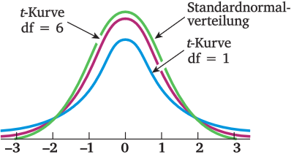
t distribution
The form of the t-distribution is very similar to a standard normal distribution – at least for large random samples.
For small random samples, the t-distribution is flatter than a normal distribution.
Therefore, the t-distribution needs another parameter that adjusts its variance (and thus its shape).
This parameter is called the degrees-of-freedom; abbreviated as df.
https://matheguru.com/stochastik/t-test.html
Notes:
To measure the statistical significance of the obtained t-values (effect over sd), the so-called t-distribution is used.
It is tabulated.

Slide 15
1-sample t-test
A t-test is a parametric statistical hypothesis test that can be used when the population conforms to a normal distribution.
A frequently used t-test is the one-sample location t-test that tests whether the mean of a normally distributed population has a particular value μ₀,
where $\overline{x}$ : sample mean,
σ : standard deviation of the sample,
n : sample size.
The critical value of the t-statistic t₀ is tabulated in t-distribution tables.
The hypothesis (H₀) is that the population mean equals μ₀.
If the p-value is below a threshold, e.g. 0.05, the null hypothesis is rejected.
$t=\frac{\overline{x}−μ_{0}}{σ/{\sqrt{n}}}$ $= \frac{\overline{x}−μ_{0}}{SEM}$
Notes:
The 1-sample t-test compares the mean value of a normally distributed population to a particular value.

