Slide 1

Biases in computational analysis of Hi-C data
Procedures including crosslinking, chromatin fragmentation, biotin-labelling and re‑ligation can all introduce biases that complicate the interpretation of observed contact frequencies.
Efficient and effective removal of multiple systematic biases is critical for the success of any subsequent analysis of C‑data as well as for the proper interpretation of results.
Schmitt et al. Nature Rev Mol Cell Biol (2016) 17, 743
Notes:
Link to this paper: https://www.nature.com/articles/nrm.2016.104
As mentioned, we need to remember that the Hi-C contact matrices are obtained by a complicated multi-step protocol.
All these steps can introduce biases that would lead to misleading interpretations if we do not correct for them.

Slide 2
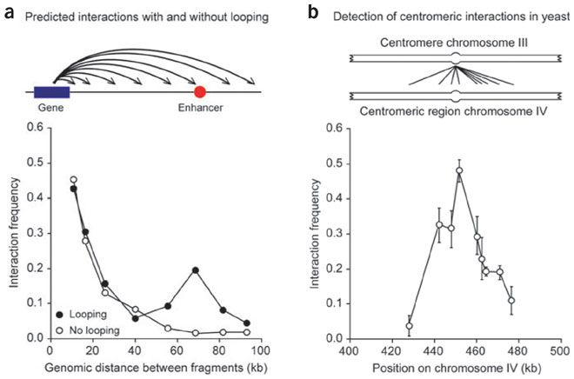

Random collisions affect chromosome capture data
Detection of an interaction between two loci does not necessarily mean that they are engaged in a functional looping interaction.
-> loci along a chromatin fiber will also randomly, and quite frequently, collide as the result of the inherent flexibility of chromatin.
In general, the frequency of random collisions is inversely related to the genomic distance between loci (larger “search space” for larger radius).
Thus, relatively frequent but nonfunctional interactions are expected for loci separated by small distances.
For sites separated by larger genomic distances, this 'background' signal decreases rapidly, but remains detectable for sites separated by as much as 150 kb.
Job Dekker, Nature Methods 3, 17–21 (2006)
Notes:
https://bionumbers.hms.harvard.edu/bionumber.aspx?id=103112:
Job Dekker is first author on a paper from 2002 (https://science.sciencemag.org/content/295/5558/1306) that presented the 3C method. This paper has been cited 3000 times.
Link to this Job Dekker paper: https://www.nature.com/articles/nmeth823
On this slide, we consider how the distance between two regions of the DNA affects the formation of contacts between them.
Job Dekker et al. reported (middle figure) that, on a length scale of many kb, the frequency decays with the inverse of the distance. For this, we consider DNA as a “cooked spaghetti”.
But is this true?
Double-stranded DNA is a polymer. The stiffness of a polymer is typically characterized by its “persistence length” that defines the scale over which a polymer (such as DNA) remains roughly unbent in solution. For DNA, the persistence length has a value of ~50 nm (~150 bp). Thus, on length scales of kb, thermal fluctuations result in spontaneous bending of the DNA and the DNA can be considered as a cooked spaghetti.

Slide 3
Specific contacts affect neighboring loci
A specific contact between two elements located on two different chromosomes—in this example between centromeres—will also bring neighboring fragments into closer proximity.
Then, they may nonspecifically interact.
Failure to determine a local peak in interaction frequencies may result in incorrectly concluding that two elements specifically interact,
whereas in reality it is their neighbors that are engaged in a specific interaction.
In this example, only the interaction between the two centromeres may be specific (-> highest peak) , whereas interactions with neighboring loci are likely the result of random collisions.
Job Dekker, Nature Methods 3, 17–21 (2006)
Notes:
If a specific contact is formed in one location, neighboring regions are also close to the „opposite“ DNA regions.
This may lead to the formation of non-specific contacts between adjacent regions which would not form if the specific contact had not formed.
Dekker suggests that only the highest peak should be considered in the bottom figure and the other peaks should be omitted from the analysis.

Slide 4
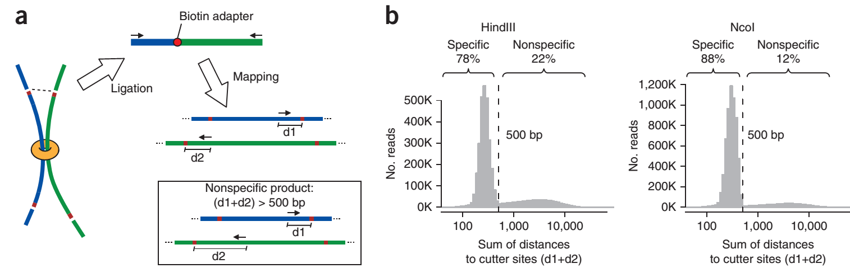
Bias 1: restriction enzyme fragment length
HindIII 78%, NcoI 88% - 2 restriction enzymes
Hi-C ligation products (shown schematically in a) are expected to map near restriction sites because of size selection.
(b) For each Hi-C paired read, the sum of distances is computed from mapped Hi-C sequences to the nearest restriction sites. Shown is the distribution of distances.
Two distinct populations of reads are observed, one distributed as expected for normally ligated and size-selected products and one including reads mapped farther away from restriction sites.
Solution: discard reads with distance > 500 bp
Yaffe, Tanay Nature Genet (2011) 43, 1059
Notes:
Yaffe & Tanay paper: https://www.nature.com/articles/ng.947
Some Hi-C sequence pairs likely represent ligation products between nonspecific cleavage sites rather than restriction fragment ends. This means that the DNA ligase did not merge the blue and green fragments shown in (a) that are connected by a crosslink. Rather, the ligase merged two arbitrary fragments. Such cases are not useful for the analysis of chromatin contacts.
As shown in (b), 22% of the trans read-pairs in the HindIII experiment and 12% in the NcoI experiment were mapped with a generally uniform distribution over the restriction fragments, in contrast to the majority of reads that mapped with the expected distribution within 500 bp (the size selection parameter) of the nearest restriction site.
The cleavage and ligation events that generated these reads are unlikely to have occurred on cutter sites. Yaffe and Tanay therefore suggest to discard them from downstream analysis.

Slide 5
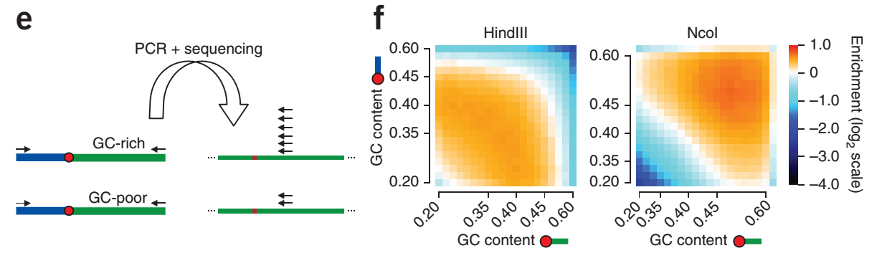
Bias 2 : GC content
(e) Ligation product processing and sequencing may be biased by GC content.
In this schematic example, the GC-rich region produces many more reads.
(f) Plotting the GC content of the 200 bp near the restriction fragment ends for trans-contacts shows intense and contrasting GC biases for the HindIII and NcoI experiments:
NcoI “prefers” GC-rich sequences, HindIII disfavors them.
Yaffe, Tanay Nature Genet (2011) 43, 1059
Notes:
Another known major source of bias in sequencing experiments is the nucleotide composition of the DNA under study.
Also in Hi-C, some key steps are likely to be affected by the GC content near the ligated fragment ends (e). Analysis of the correlation between the GC content of the 200 bp next to the restriction site and the probability of trans contact (f) shows that GC content is a source of incompatibility between the replicates. The GC-content bias maps for the HindIII and NcoI data sets were inversely correlated (element-wise ρ = −0.14), providing a partial explanation for a global low correlation between the derived trans-contact maps.

Slide 6
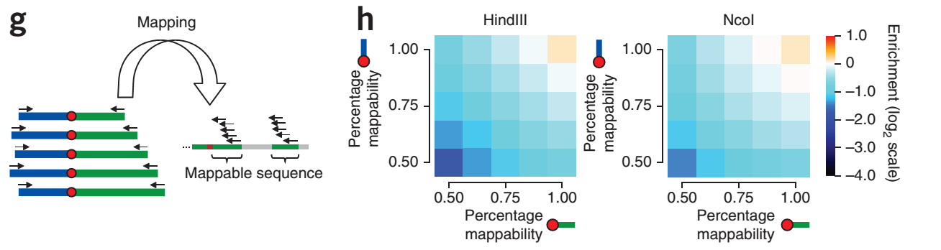
Bias 3 : sequence mappability
(g) Effect of sequence uniqueness. Different fractions of uniquely mappable short tags are observed next to restriction sites.
As shown in h, this has a direct empirical linear effect on Hi-C coverage.
Mappability is predicted and confirmed (h) to have a linear effect on the estimated trans-contact probabilities.
Yaffe & Tanay correct for biases 2 & 3
by a maximum likelihood approach.
Yaffe, Tanay Nature Genet (2011) 43, 1059
Notes:
Another genomic variable affecting trans-contact probabilities in a purely technical fashion is the mappability (or genomic uniqueness) of the fragment ends (g).
To compute the fragment end mappability score, the whole-genome sequence was split into artificial reads (50-bp reads, starting every 10 bp) and then mapped back to the genome using MAQ. For each fragment end the mappability score was then defined to be the portion of artificial reads mapped uniquely to the genome (MAQ quality > 30) within a 500-bp window starting at the fragment end toward the fragment.

Slide 7
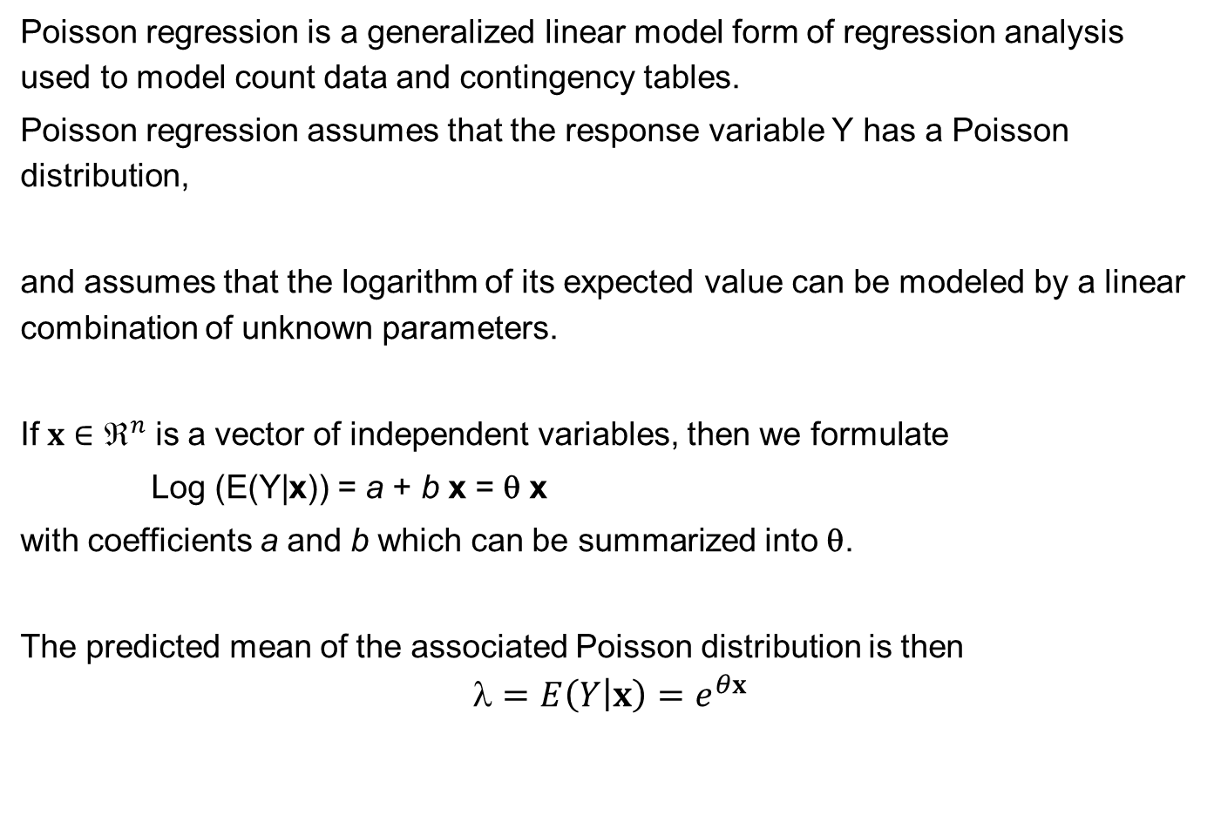
Poisson regression
Poisson regression is a generalized linear model form of regression analysis used to model count data and contingency tables.
Poisson regression assumes that the response variable Y has a Poisson distribution,
and assumes that the logarithm of its expected value can be modeled by a linear combination of unknown parameters.
If $x∈^{n}$ is a vector of independent variables, then we formulate
Log (E(Y|x)) = a + b x = θ x
with coefficients a and b which can be summarized into θ.
The predicted mean of the associated Poisson distribution is then
$$=E\left(Y\left|x\right.\right)=e^{θx}$$
www.wikipedia.org
Notes:
On the next slide, we will introduce the HiCnorm tool for bias correction.
HiCnorm utilites a mathematical technique termed Poisson regression.
On this slide, we provide some brief background on this method.

Slide 8
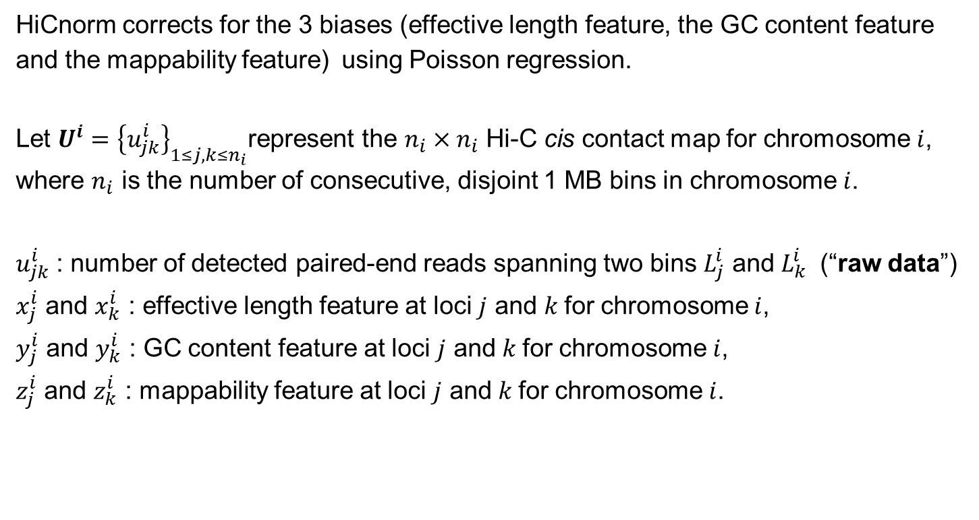
HiCnorm tool
HiCnorm corrects for the 3 biases (effective length feature, the GC content feature and the mappability feature) using Poisson regression.
Let $U^{i}={\left\{u_{jk}^{i}\right\}}_{1≤j,k≤n_{i}}$represent the $n_{i}×n_{i}$ Hi-C cis contact map for chromosome $i$, where $n_{i}$ is the number of consecutive, disjoint 1 MB bins in chromosome $i$.
$u_{jk}^{i}$ : number of detected paired-end reads spanning two bins $L_{j}^{i}$ and $L_{k}^{i}$ (“raw data”)
$x_{j}^{i}$ and $x_{k}^{i}$ : effective length feature at loci $j$ and $k$for chromosome $i$,
$y_{j}^{i}$ and $y_{k}^{i}$ : GC content feature at loci $j$ and $k$for chromosome $i$,
$z_{j}^{i}$ and $z_{k}^{i}$ : mappability feature at loci $j$ and $k$for chromosome $i$.
Hu et al. Bioinformatics 28, 3131-3133 (2012)
www.wikipedia.org
Notes:
Link to HiCnorm paper: https://academic.oup.com/bioinformatics/article/28/23/3131/192582
HiCnorm is an explicit bias correction method.
Here, we will look at the basic steps how biases are estimated and removed.
HiCnorm attempts to correct 3 types of biases. Each one of them is modeled by an independent variable x, y and z.

Slide 9
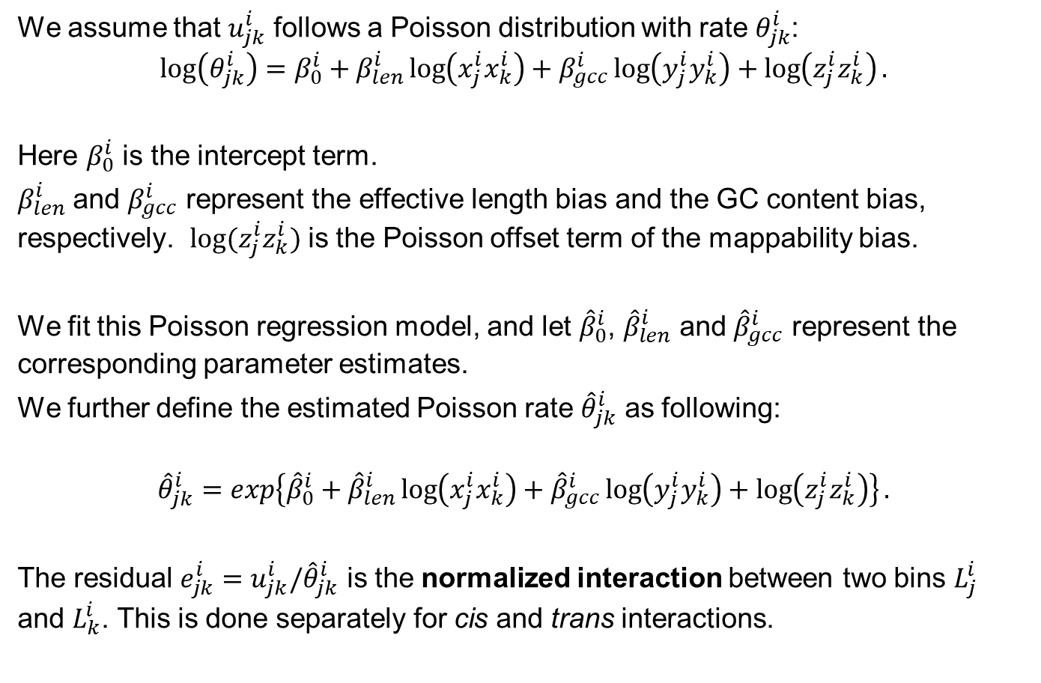
HiCnorm tool
We assume that $u_{jk}^{i}$ follows a Poisson distribution with rate $θ_{jk}^{i}$:
$$\log\left(θ_{jk}^{i}\right)=β_{0}^{i}+β_{len}^{i}\log\left(x_{j}^{i}x_{k}^{i}\right)+β_{gcc}^{i}\log\left(y_{j}^{i}y_{k}^{i}\right)+\log\left(z_{j}^{i}z_{k}^{i}\right).$$
Here $β_{0}^{i}$ is the intercept term.
$β_{len}^{i}$ and $β_{gcc}^{i}$ represent the effective length bias and the GC content bias, respectively. $\log{(z_{j}^{i}z_{k}^{i})}$ is the Poisson offset term of the mappability bias.
We fit this Poisson regression model, and let ${\hat{β}}_{0}^{i}$, ${\hat{β}}_{len}^{i}$ and ${\hat{β}}_{gcc}^{i}$ represent the corresponding parameter estimates.
We further define the estimated Poisson rate ${\hat{θ}}_{jk}^{i}$ as following:
$${\hat{θ}}_{jk}^{i}=\exp\left\{{\hat{β}}_{0}^{i}+{\hat{β}}_{len}^{i}\log\left(x_{j}^{i}x_{k}^{i}\right)+{\hat{β}}_{gcc}^{i}\log\left(y_{j}^{i}y_{k}^{i}\right)+\log\left(z_{j}^{i}z_{k}^{i}\right)\right\}.$$
The residual $e_{jk}^{i}=u_{jk}^{i}/{\hat{θ}}_{jk}^{i}$ is the normalized interaction between two bins $L_{j}^{i}$ and $L_{k}^{i}$. This is done separately for cis and trans interactions.
Hu et al. Bioinformatics 28, 3131-3133 (2012)
www.wikipedia.org
Notes:
Link to HiCnorm paper: https://academic.oup.com/bioinformatics/article/28/23/3131/192582
Shown at the bottom is the normalization of the raw data by the estimated Poisson rate of loci j and k.
Cis interactions take place on the same chromosome.
Trans interactions are contacts between DNA regions that are located on different chromosomes.

Slide 10
Biases in computational analysis of Hi-C data
In general, there exist two types of approaches to account for biases in C‑data.
(1) account for biases in an explicit fashion — by assuming that all sources of systematic biases are known based on biases determined empirically from the observed data.
(2) account for biases in an implicit way — by assuming no known source (or sources) of bias, and assuming that the cumulative effect of the bias is captured in the sequencing coverage of each locus (or ‘bin’).
As Hi‑C is a genome-wide assay, the implicit models assume that each locus should receive equal sequence coverage after biases are removed.
Implicit models all rely on some implementation of matrix-balancing algorithms.
Schmitt et al. Nature Rev Mol Cell Biol (2016) 17, 743
Notes:
Link to this paper: https://www.nature.com/articles/nrm.2016.104
Schmitt et al. recommend that researchers should analyse their data using both the explicit and implicit approaches to ensure the biological relevance of their findings.

