Slide 1
V7 – Genomics data
Program for today:
SNP frequencies in 1000 Genomes data
Repeats in imprinted vs. biallelically expressed genes
Non-canonical translation
It is necessary to filter / clean the gene sets so that
the research question being addressed can be answered in the best way.

Slide 2
Removing sequence redundancy
Let’s assume we want to know whether the amino acid composition of certain protein sequences differs in one genomic region from the other regions.
For example, we want to know whether transmembrane (TM) segments of membrane proteins are more hydrophobic than the rest of the protein sequence
To check this, we could simply analyze all protein sequences from NCBI, predict the TM segments in them and compare the amino acid compositions.
However, this search would likely be biased by
what proteins have been sequenced and which ones not, and
by duplicated sequencing experiments.
→ It is very important to remove sequence redundancy before such analyses!
This can be done by software tools such as CDhit or BlastClust

Slide 3
BlastClust
blastclust -i infile -o outfile -p F -L .9 -b T -S 95
The sequences in "infile" will be clustered and the results will be written to "outfile".
The input sequences are identified as nucleotide (-p F); "-p T", or protein.
To register a pairwise match two sequences will need to be 95% identical (-S 95) over an area covering 90% of the length (-L .9) of each sequence (-b T) .
https://www.ncbi.nlm.nih.gov/Web/Newsltr/Spring04/blastlab.html

Slide 4
Refseq
The Reference Sequence (RefSeq) collection at NCBI provides a comprehensive, integrated, non-redundant, well-annotated set of sequences, including genomic DNA, transcripts, and proteins.
RefSeq transcript and protein records are generated in different ways:
- Computation Eukaryotic Genome Annotation Pipeline
  Prokaryotic Genome Annotation Pipeline
- Manual curation
- Propagation from annotated genomes that are submitted to members of the International Nucleotide Sequence Database Collaboration (INSDC)
First research question:
Are the Single Nucleotide Polymorphism (SNP) frequencies in different genomic regions similar to eachother or not?
https://www.ncbi.nlm.nih.gov/refseq/about/

Slide 5
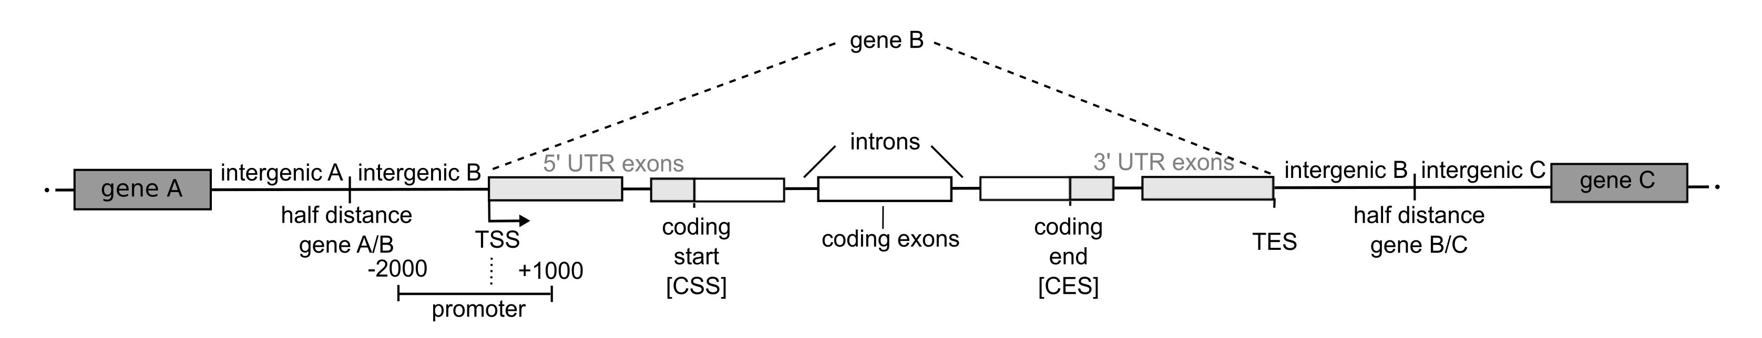
Definition of genomic regions
Every gene is located between two intergenic regions. Our definition for these is:
First intergenic region : interval between the transcription start site (TSS) of the considered gene and the mid-upstream position between this TSS and the transcription end site (TES) of the closest upstream gene.
Second intergenic region : defined analogously according to the TSS of the closest downstream gene.
Intragenic region of a gene : part between its TSS and its TES.
Gene promoter : region from 2000 bp upstream to 1000 bp downstream of the TSS.
Exons : intervals between the exon start positions and exon end positions (taken from UCSC genome browser).
5' UTRs : exonic segments between the TSS and the CSS
3' UTRs : exonic regions between the CES and the TES.
Introns : regions between the exonic gene parts.
Neininger & Helms, submitted

Slide 6
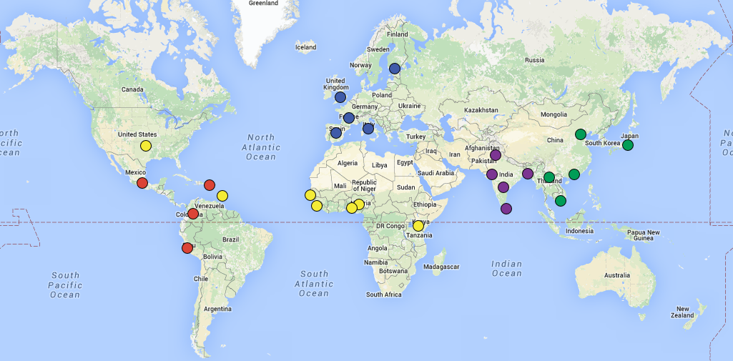
1000 Genomes project
The 1000 Genomes Project ran between 2008 and 2015, creating the largest public catalogue of human variation and genotype data up to date.
The goal of the 1000 Genomes Project was to find most genetic variants with frequencies of at least 1% in the populations studied.
http://www.internationalgenome.org/

Slide 7
Identify SNPs in 1000 Genomes data
We used only the European super-population with 503 individuals and we focused on autosomes (chromosomes 1 – 22). Genes on sex chromosomes X and Y are ignored.
We keep autosomal SNPs with a minor allele frequency larger than zero → SNP exists
allele : variant form of a given gene
major allele : most common variant
minor allele: second-most common variant
We removed:
genes starting with "SNO“ (small nuclear RNAs) or "MIR“ ( microRNAs)
genes with CDS start equal to the CDS end
Neininger & Helms, submitted

Slide 8
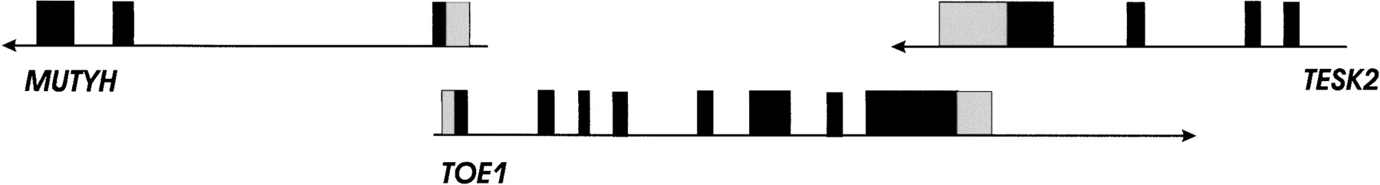
Problem: there exist many overlapping genes
Overlap between three human genes: MUTH, FLJ13949, and TESK2.
Dark boxes : coding sequence.
Light boxes : untranslated regions.
Veeramachaneni et al.
Genome Res. (2004) 14: 280-286

Slide 9
Overlapping genes
One could speculate that overlapping genes would be more conserved between species than non-overlapping genes because a mutation in the overlapping region would cause changes in both genes.
Then, one would expect that evolutionary selection against these mutations is stronger.
However, Veeramachaneni et al. found that this is not the case.
Overlapping human and mouse genes were similarly conserved as non-overlapping genes.
Note that only a small fraction of the analyzed genes preserved exactly the same pattern of gene structure and overlap pattern in human and mouse.
Veeramachaneni et al.
Genome Res. (2004) 14: 280-286

Slide 10
How to deal with overlapping genes
In the case of overlapping genes, it is problematic to define the genomic regions because they have a different meaning for the 2 overlapping genes.
Therefore, we distinguished 2 cases:
Overlaps where one gene is located inside another gene.
Such genes inside other genes were excluded from the SNP analysis.
(2) staggered overlaps (genes overlap partially).
We collected all genes with staggered overlap. From each “bundle", only one gene was selected randomly to avoid overlapping genes.
In total, about 5% of all genes were removed due to overlaps.
Neininger & Helms, submitted

Slide 11
SNP density in genomic regions
Number of SNP variants per kb for different genomic regions.
→ lowest SNP density in coding exons (green)
→ highest SNP density in CpG islands (due to frequent deamination of methylated cytosines into thymines)
Second-highest SNP density in intergenic regions (low evolutionary pressure)
Neininger & Helms, submitted

Slide 12
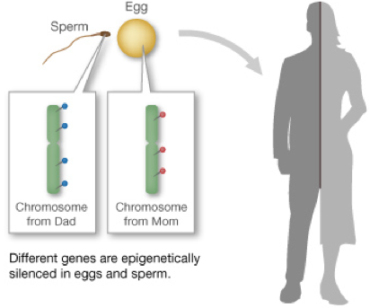
Imprinted genes
Imprinted genes violate the usual rule of inheritance
Bi-allelic genes :
1 gene copy (allele) encoding e.g. hemoglobin from dad
1 gene copy (allele) encoding e.g. hemoglobin from mom
Child: expresses equal amounts of the 2 types of hemoglobin
Mono-allelic (imprinted) genes : one allele silenced by DNA methylation
Notes:
For most genes, we inherit two working copies -- one from mom and one from dad. But with imprinted genes, we inherit only one working copy. Depending on the gene, either the copy from mom or the copy from dad is epigenetically silenced. Silencing usually happens through the addition of methyl groups during egg or sperm formation.
hypothetical imprinted gene responsible for body color
Left : pigment gene is maternally imprinted
Right : pigment gene is paternally imprinted
Reason : Epigenetic Effects

Slide 13
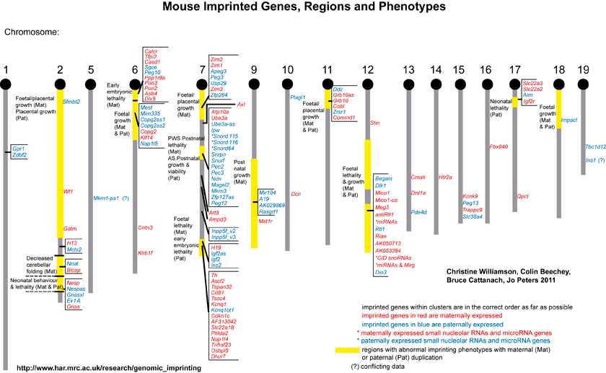
Imprinted genes cluster in the genome

Slide 14


Parental conflict hypothesis = “battle of the sexes”
Paternally expressed genes Maternally expressed genes
embryonic
growth in placenta
embryonic growth in placenta
Notes:
Scientists have come up with a number of hypotheses to explain why imprinting happens in mammals. One of these, the Genetic Conflict hypothesis, supposes that imprinting grew out of a competition between males for maternal resources. In some species, more than one male can father offspring from the same litter.
It turns out that many imprinted genes are involved in growth and metabolism. Paternal imprinting favors the production of larger offspring, and maternal imprinting favors smaller offspring. Often maternally and paternally imprinted genes work in the very same growth pathways. This conflict of interest sets up an epigenetic battle between the parents -- a sort of parental tug-of-war.

Slide 15
Aim of the study
Aim: distinguish general properties of imprinted genes from biallelically expressed (BE) genes.
Example features:
Imprinted genes could be either more or less conserved during evolution than BE genes. Note: imprinting is found in mammals with placenta – also in plants
Imprinted genes may have different functions than BE genes → V8
Imprinted genes may have more or less CpG island promoters than BE genes
….
Hutter, Bieg, Helms & Paulsen,
BMC Genomics (2010) 11, 649

Slide 16
Preparation of data set
If several transcripts are known for one gene, we took the most 5’ annotated transcriptional start site and the most 3’ annotated transcriptional termination site and constructed the longest possible transcript.
Similarly, splice variants and overlapping exons were merged in a way so that the largest possible coding regions were constructed.
The genomic sequence that was assigned to a gene contained the transcribed sequence and intergenic regions upstream and downstream of the transcription
unit.
For determining the intergenic region, the DNA sequence between two genes was cut into two halves, each half was assigned to the nearest gene.
Hutter, Bieg, Helms & Paulsen,
BMC Genomics (2010) 11, 649

Slide 17
Phast regions
As a set of sequences with high conservation in eutherian mammals, we used the UCSC phastCons28wayPlacMammal most conserved sequences (PCSs).
Such highly conserved regions were originally identified from a genome-wide multiple alignment of 29 vertebrate species by the Phast program and afterwards projected onto a reference genome.
The PCSs analyzed here are a subset of these regions showing conservation in 18 eutherian mammals.
We assigned the PCSs to the longest possible RefSeq transcripts based on the human genome March 2006 assembly (hg18).
Hutter, Bieg, Helms & Paulsen,
BMC Genomics (2010) 11, 649

Slide 18
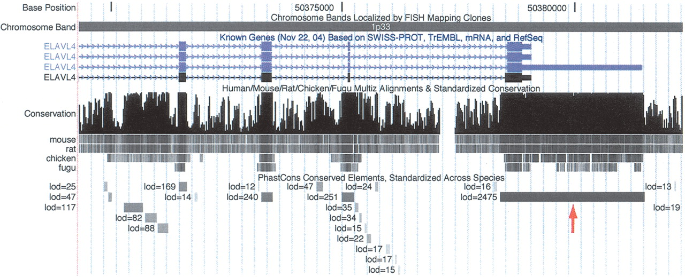
ELAVL4 is a Phast region
Extreme conservation at the 3′ end of the ELAVL4 (HuD) gene, an RNA-binding gene associated with paraneoplastic encephalomyelitis sensory neuropathy and homologous to Drosophila genes with established roles in neurogenesis and sex determination. The 3117-bp conserved element that overlaps the 3′ UTR of this gene (red arrow) is the fifth highest scoring conserved element in the human genome. Several conserved elements in introns are also visible.
Siepel et al. Genome Res. (2005) 15: 1034-1050

Slide 19
Length and conservation of PCS sequences
(A) conservation scores and
(B) lengths of PCSs that overlap with coding exons.
PCSs of paternally expressed ones (blue bars) are similar to PCSs of autosomal genes (black bars).
In contrast, the PCSs of maternally expressed genes (red bars) are shorter (they are shifted to the left) and have lower conservation scores.
→ increased divergence of maternally expressed genes due to reduced selective pressure ??
Hutter, Bieg, Helms & Paulsen,
BMC Genomics (2010) 11, 649

Slide 20
Isoforms
Gene isoforms are mRNAs that are produced from the same locus but are different in their
transcription start sites (TSSs),
protein coding DNA sequences (CDSs) and/or
untranslated regions (UTRs),
All this may potentially alter gene function.
www.wikipedia.org

Slide 21
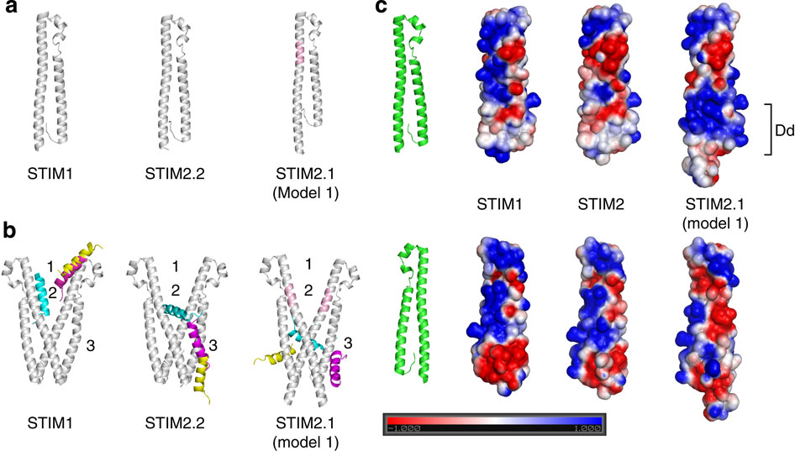
Alternative splicing may affect
PP interactions: STIM2 splice variant
STIM proteins regulate store-operated calcium entry (SOCE) by sensing Ca²⁺ concentration in the ER and forming oligomers to trigger Ca²⁺ entry through plasma membrane-localized Orai1 channels.
Niemeyer and co-workers characterized a STIM2 splice variant which retains an additional 8-AA exon within the region encoding the channel-activating domain.
STIM2.1 knockdown increases SOCE in naive CD4⁺ T cells, whereas knockdown of STIM2.2 decreases SOCE.
Overexpression of STIM2.1, but not STIM2.2, decreases SOCE.
STIM2.1 interaction with Orai1 is impaired and prevents Orai1 activation.
Miederer, ..., Lee, ..., Helms, Barbara Niemeyer
Nature Commun 6, 6899 (2015)

Slide 22
Alternative splicing
Alternative splicing (AS) of mRNA can generate a wide range of mature RNA transcripts.
It is estimated that AS of pre-mRNA occurs in 95% of multi-exon human genes.
There is abundant evidence for the expression of multiple transcripts in cells.
However, it is less clear whether these transcripts are expressed more or less equally across tissues or whether it would be biologically relevant to designate one transcript per gene as dominant and the rest as alternative.
Ezkurdia et al J Proteome Res. (2015) 14: 1880–1887.

Slide 23
Evidence from mRNA expression
Three contrasting large-scale expression studies came to different conclusions.
An EST-based study with 13 different tissues predicted that primary tissues generally had a single dominant transcript per gene.
In contrast, a large-scale study using RNAseq found that > 75% of protein-coding genes had cell-line-specific dominant transcripts.
Those genes with the most splice variants had more dominant transcripts.
A second RNAseq study (Illumina Human BodyMap project) found that ca. 50% of the genes expressed in the 16 tissues studied had the same major transcript in all tissues, whereas another third of the genes had major transcripts that were tissue-dependent.
One curious result in this study was that the major transcript was noncoding in close to 20% of the protein-coding genes.
Ezkurdia et al J Proteome Res. (2015) 14: 1880–1887.

Slide 24
Detect isoforms in proteomic data
Here: re-analysis of 8 HT proteomics MS data sets.
We detected at least two peptides for 12 716 (63.9%) of the protein-coding genes but found alternative protein isoforms for just 246 genes (1.2%).
→ the vast majority of genes had peptide evidence for just one protein isoform.
The isoform with the highest number of peptides was the main proteomics isoform.
In this way, we could identify a unique main proteomics isoform for 5011 genes.
Ezkurdia et al J Proteome Res. (2015) 14: 1880–1887.

Slide 25
Comparison proteomics - RNAseq
CCDS variants are based on genomic evidence and are variants that are mutually agreed on by teams of manual annotators from NCBI, the Sanger Institute, EBI and UC Santa Cruz.
A total of 13 297 genes were annotated with a single CCDS variant. This unique manually curated variant agreed with the main proteomics isoform for 98.6% of the 3331 genes that we compared.
APPRIS annotates principal isoforms on the basis of conservation of structure and function and selected a main isoform for 15 172 of the coding genes.
We were able to compare the APPRIS principal isoforms and the main proteomics isoforms over 4186 genes. The main proteomics isoform agreed with the isoform with the most conserved protein features for 97.8% of these genes.
In contrast, the longest isoform coincided with the main proteomics isoform only for 89.6% of the genes.
Ezkurdia et al J Proteome Res. (2015) 14: 1880–1887.

Slide 26
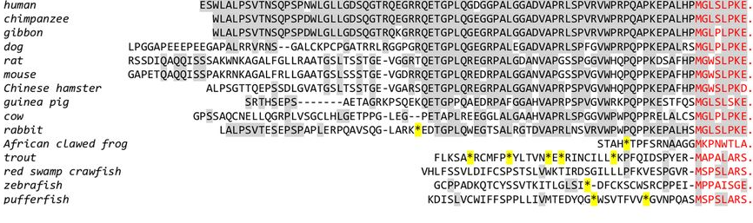
Alternative translation: example TrpV6 channel protein
MUSCLE multiple sequence alignment of the translated 5′-UTR of TRPV6
Identical aa residues (compared with the human sequence) are shaded;
annotated N termini with the first Met⁺¹ are in red;
* : stop codon in frame
− : gap
The mammalian sequences upstream of the first AUG codon are conserved, but the one from rabbit contains an in-frame stop codon. In contrast, sequences from the other organisms contain several stop codons upstream of the annotated AUG and are not conserved. Sequence identity is highest among the 40 amino acids upstream of the first Met residue (position +1). This suggests that translation in mammals may start at a non-AUG
Fecher-Trost et al. J. Biol. Chem. (2013) 288: 16629

Slide 27
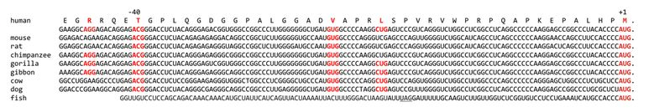
Alternative translation of human TRPV6
Alignment of 5′-UTR TRPV6 sequences including the AUG triplet encoding the first methionine (red, +1) of the human protein.
Red, putative initiation sites;
underlined, STOP-codon in frame.
Experiments in the Flockerzi group (Medical department, Homburg) showed that translation starts at Thr⁻⁴⁰ .
Fecher-Trost et al. J. Biol. Chem. (2013) 288: 16629

Slide 28
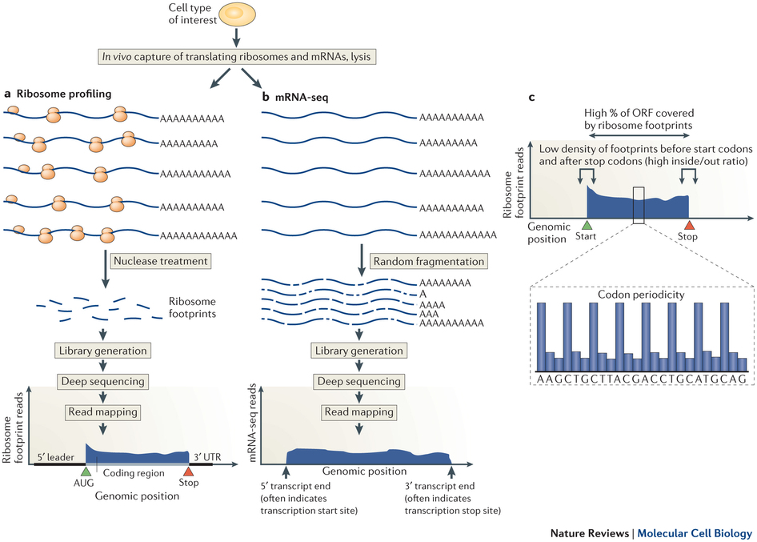
HT discovery of alternative translation: ribosome profiling
Ribosome-bound mRNAs are isolated by size.
Then they are treated with a nonspecific nuclease.
This results in protected mRNA fragments termed 'footprints'.
These ribosome footprints are isolated and converted to a library for deep sequencing.
Brar, Weissman, Nature Rev Mol Cell Biol
16, 651–664 (2015)

Slide 29
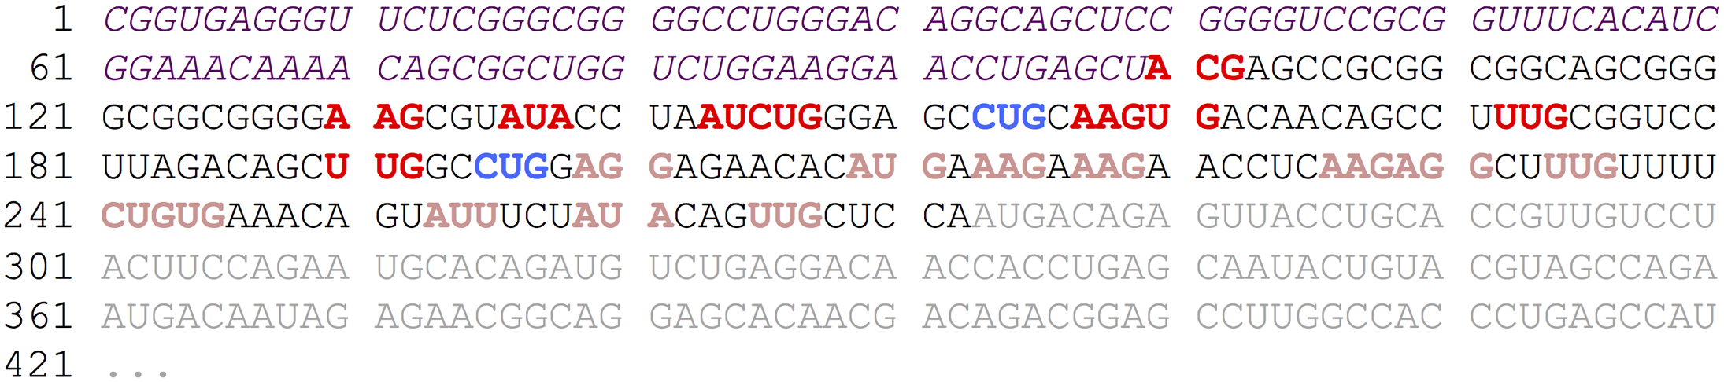
PreTIS: predict alternative translation initiation sites
Example mRNA sequence showing the categorization of true positive (TP) and true negative (TN) start sites.
Suppose that a ribosome profiling experiment detected the following start sites for a given mRNA sequence: CUG at position -78 and CUG at position -120 (blue colored codons). These start sites are then assumed to be TP start sites. In consequence, all near-cognate start sites not listed in the ribosome profiling dataset and upstream of the most downstream reported true start site were assumed to be TN (dark red colored codons).
Light red colored codons : start sites not considered as false starts in the analyses since they are located downstream of the most downstream reported true start site.
Grey colored downstream part : annotated CDS sequence
Italic (purple) upstream part : -99 upstream window needed to calculate some features.
All marked start sites (TP and TN) exhibit a surrounding window of ±99 nucleotides as well as a downstream in–frame stop codon. In total, this mRNA sequence would provide 2 true start sites and 9 false start sites out of 23 putative starts.
Reuter et al Plos Comput Biol (2016) 12: e10005170

Slide 30
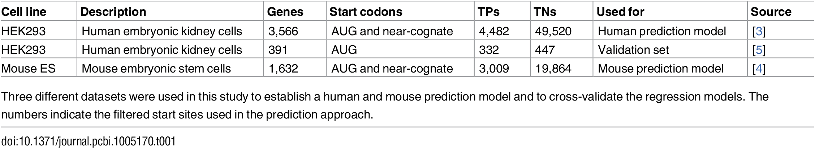
Data sets used for ML classifier
We only included curated mRNA sequences with available mRNA RefSeq identifier (starting with NM_).
Raw data is very unbalanced (number of TPs and TNs very different)
→ need to balance data sets (select random TN data points)
Reuter et al Plos Comput Biol (2016) 12: e10005170

Slide 31
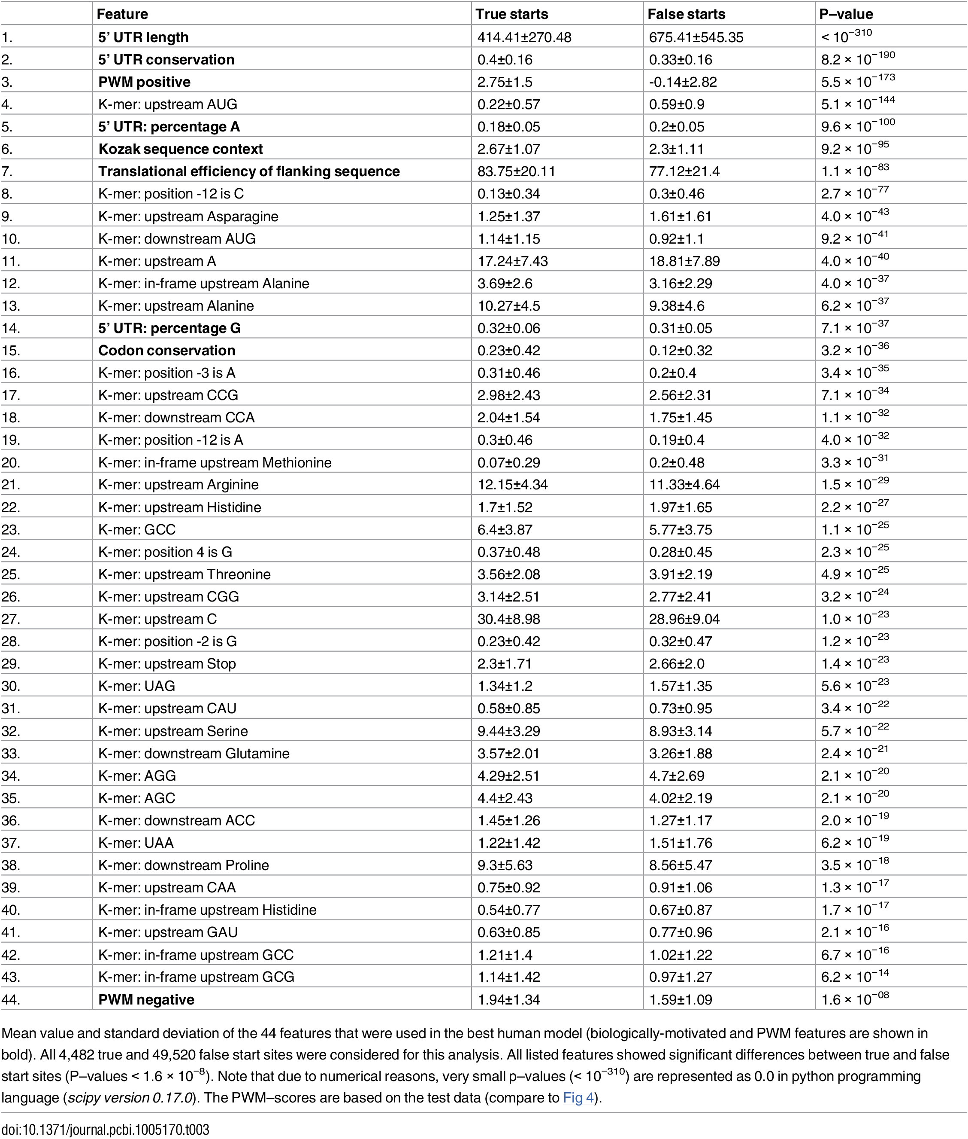

Features used by PreTIS
Mean value and standard deviation of the 44 features that were used in the best human model.
PWM : probability weight matrix
Entries of position–frequency–matrix (PFM) : sum of occurrences of a nucleotide at position i divided by the total number of sequences contained in S.
Reuter et al Plos Comput Biol (2016)
12: e10005170

Slide 32
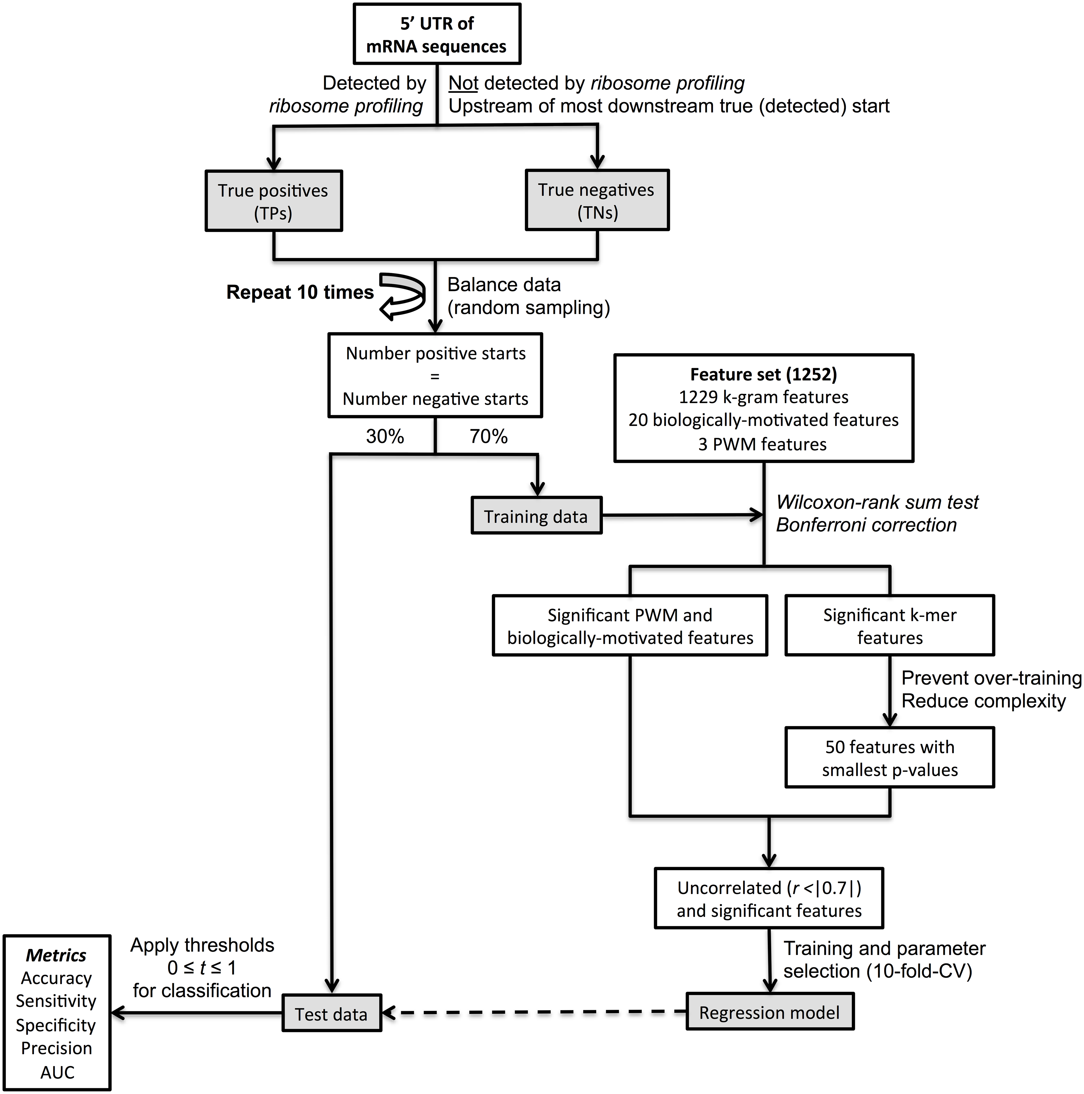
Flow-chart of regression approach
Data balancing was repeated ten times to investigate model robustness.
Significant features were identified by the Wilcoxon-rank sum test.
Reuter et al Plos Comput Biol
(2016) 12: e10005170

Slide 33
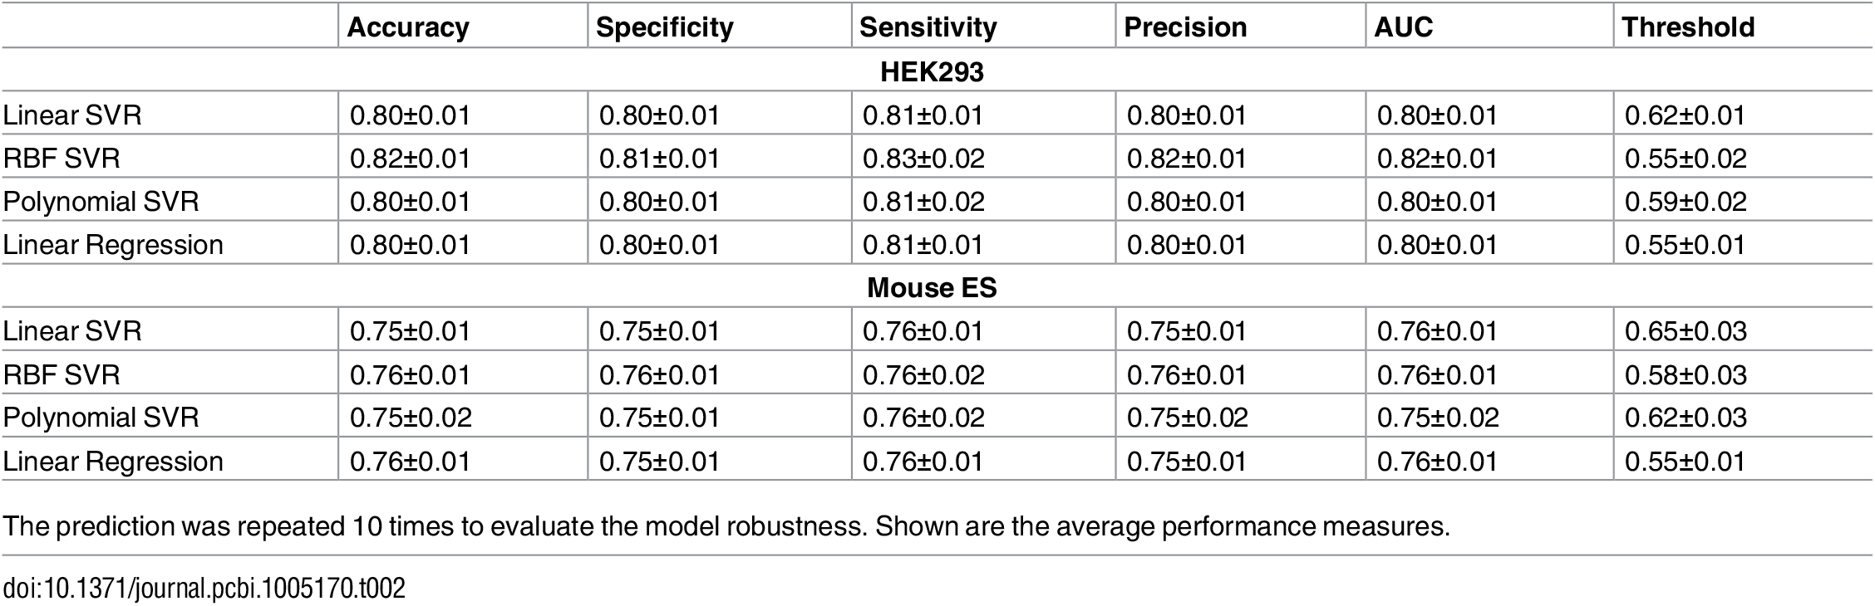
Evaluation
All human models perform very similarly with accuracies of about 80%
while the average performance of the mouse model is lower with average accuracies of about 76%,
Reuter et al Plos Comput Biol (2016) 12: e10005170

Slide 34
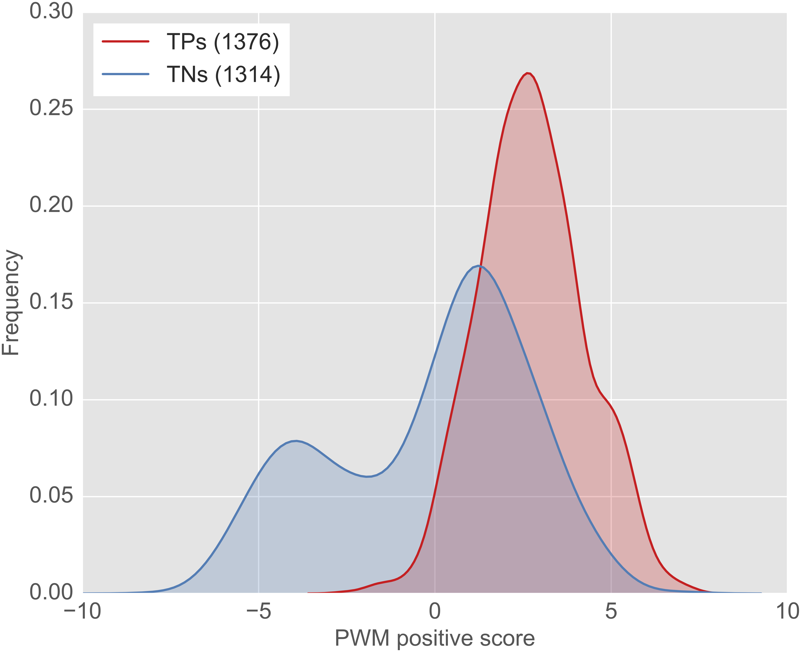
PWM_positive scores
Frequency distribution of PWM_{positive} scores for the test samples of the best performing run 2.
The PWM was established using the true start sites in the training data of run 2. The difference between TPs and TNs was found to be highly significant (p = 5.5 × 10⁻¹⁷³, Wilcoxon–rank sum test).
Reuter et al Plos Comput Biol (2016) 12: e10005170

Slide 35
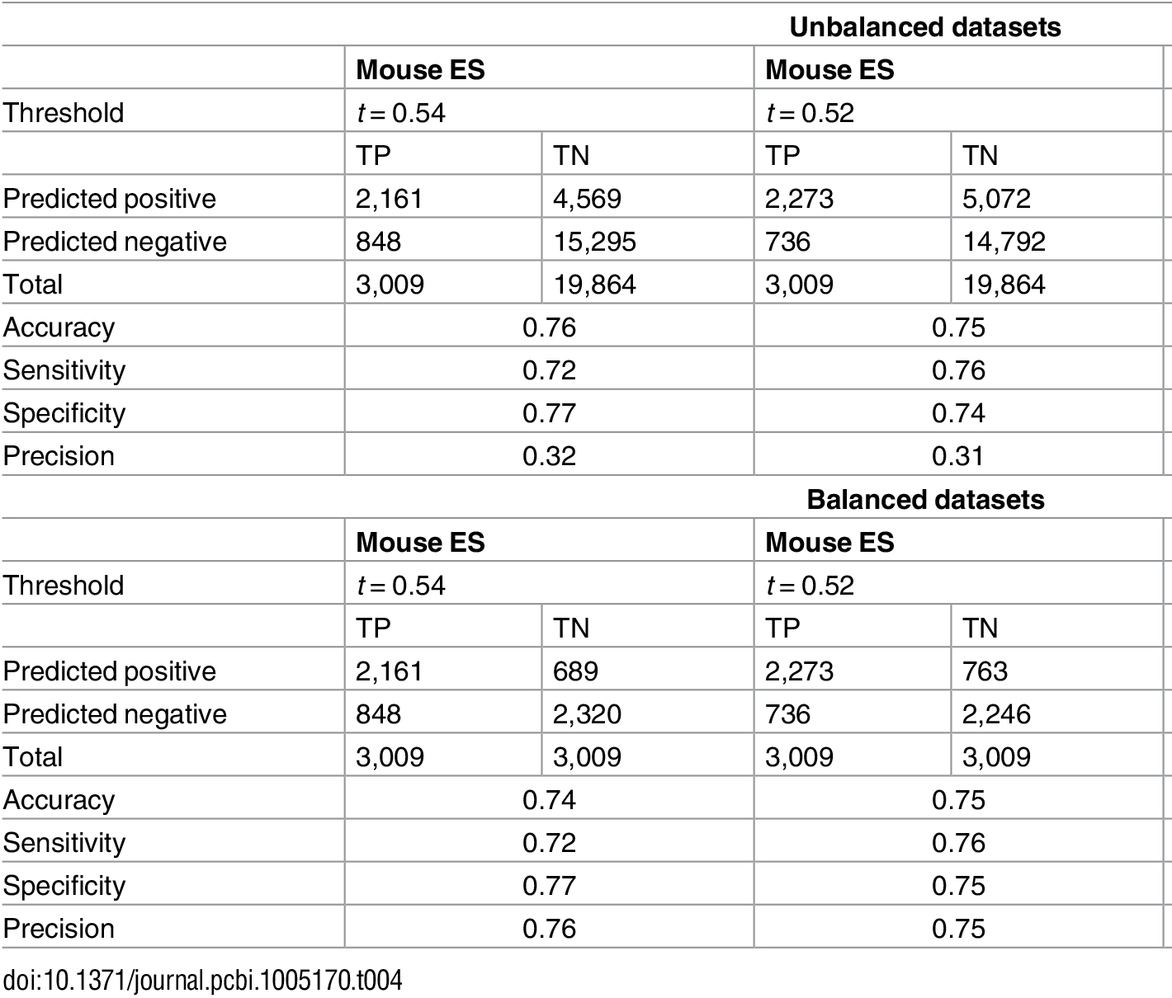
Is model transferable to other species?
Performance of the best human HEK293 model applied to the mouse ES dataset
→ model is reasonably transferable,
suggests universal translation code
Reuter et al Plos Comput Biol (2016) 12: e10005170

Slide 36
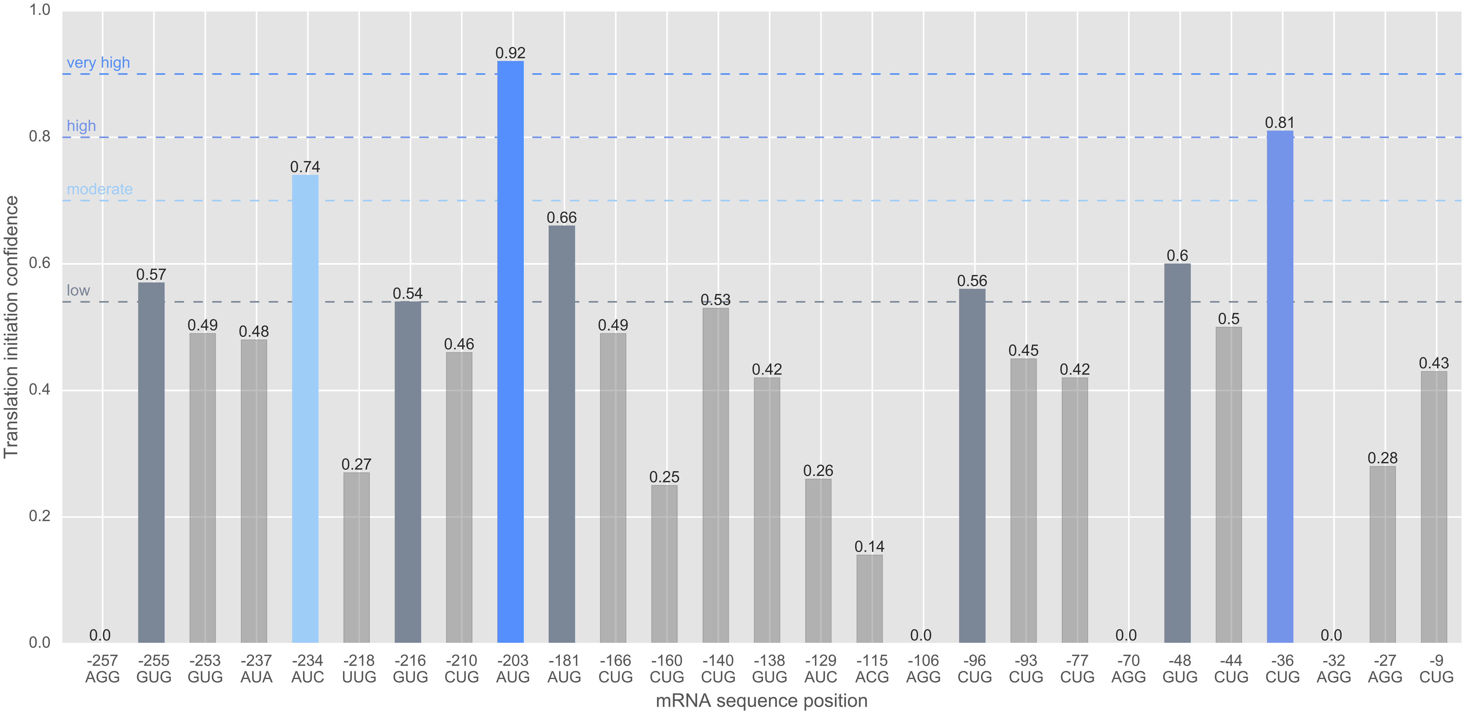
Alternative start codons of human gene GIMAP5
Predicted start sites were subdivided into 4 confidence groups and highlighted by different colors and dashed lines: very high (hot/best candidates with c ≥ 0.9), high (0.8 ≤ c < 0.9), moderate (0.7 ≤ c < 0.8) and low (t = 0.54 ≤ c < 0.7) initiation confidence c.
For this gene, we found one hot candidate with a very high confidence value of 0.92 of being a true start site (AUG at position -203).
Reuter et al Plos Comput Biol (2016) 12: e10005170

Slide 37
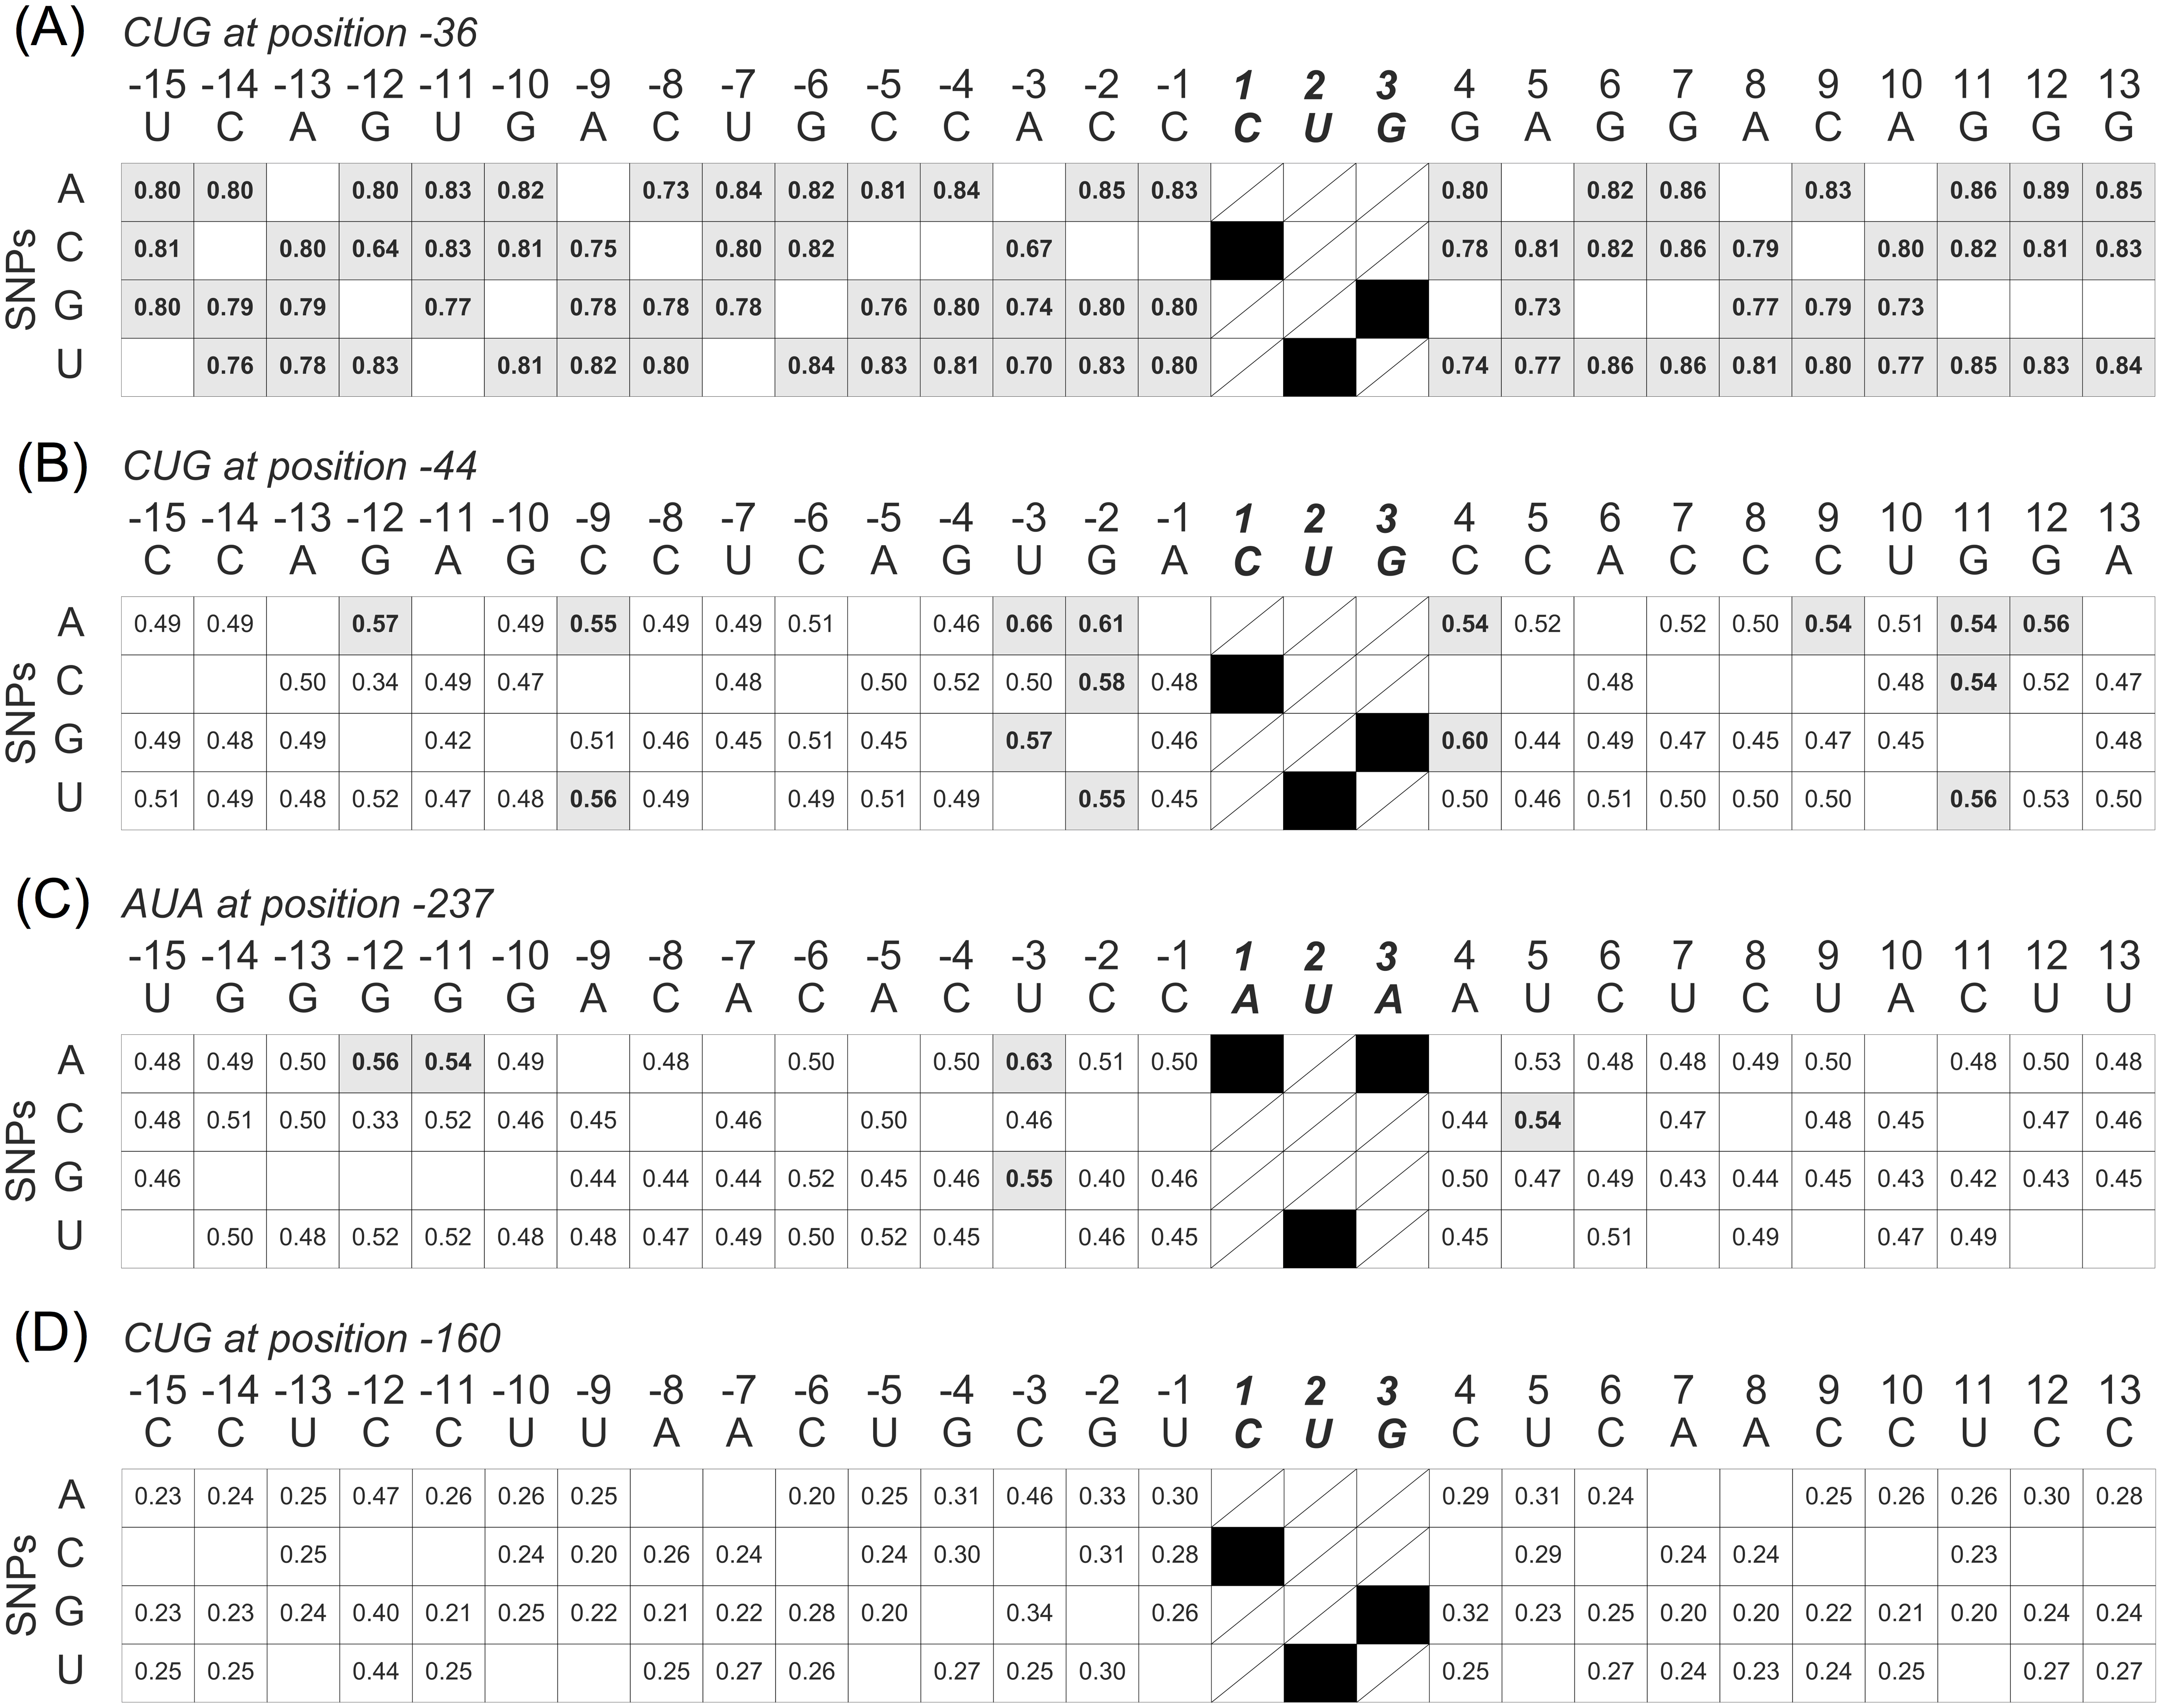
Virtual SNP analysis of gene GIMAP5
Mutation matrix showing the impact of the flanking sequence context of 4 putative start sites of gene GIMAP5 on the predicted initiation confidence.
In each case, only one nucleotide is mutated with respect to the reference sequence (top line). Grey : start was predicted as true translational start (predicted initiation confidence > 0.54). white : start was classified as false start.
Mutations at the start sites itself were not considered. The numbers reflect the predicted initiation confidence values
Reuter et al Plos Comput Biol
(2016) 12: e10005170

Slide 38
Take home messages
You may want to remove sequence redundancy
Check for overlapping genes
Which isoform is relevant?
There are substantial differences between what is expressed at the transcript level and what is expressed at the protein level.
CCDS and APPRIS appear good resources.
Which translated variant is relevant? May want to try PreTIS
Reuter et al Plos Comput Biol (2016) 12: e10005170

