Slide 1
V2 – missing values + batch effect correction
BEclear / applies latent factor model to predict missing values and to remove batch effects
  DNA microarray
  DNA methylation
Functional Normalization
gPCA
Review of Probability Theory Basics

Slide 2
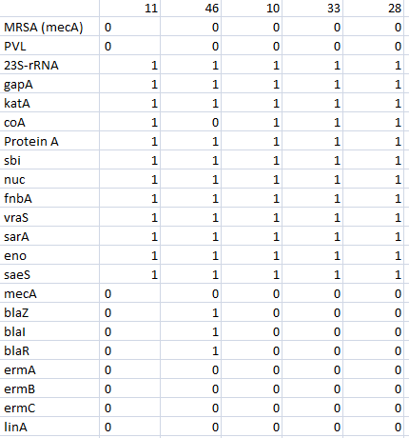
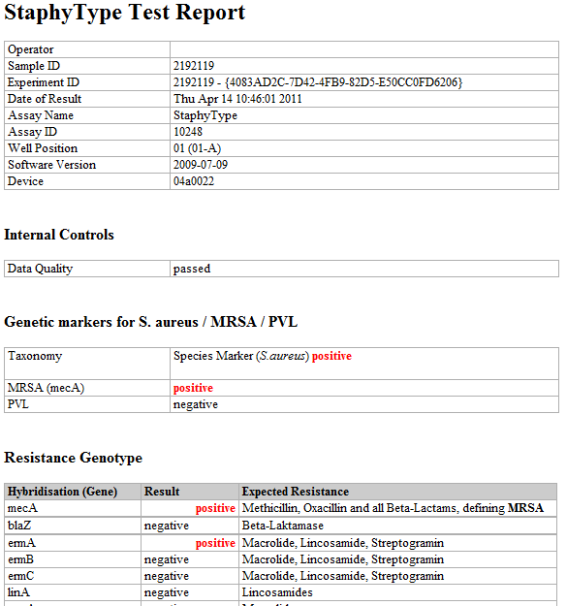
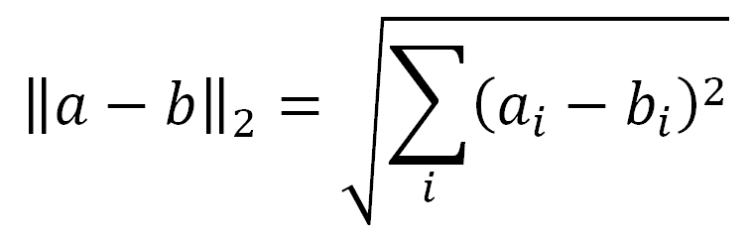
Process S. aureus microarray data – part II
Compute Euclidian distance between samples

Slide 3
Ambiguous values
In the S. aureus genotyping test report, individual markers can be “positive” or “negative” and also “ambiguous”.
Such ambiguous classifications can be caused by:
poor sample quality, or
poor signal quality, or
- by the presence of plasmids in low copy numbers.
www.alere-technologies.com

Slide 4
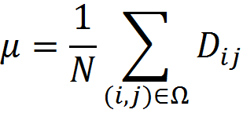
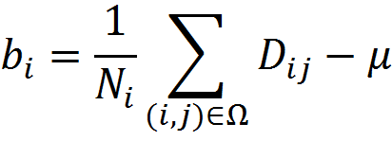
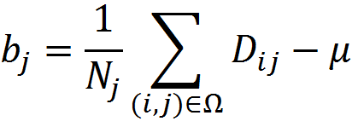


Re-Assign ambiguous values in DNA microarray
Task – predict ambiguous values.
Simple idea: baseline prediction using average values
total average sample average gene average
replace small fraction of known
values by (thresholded) baseline values -> ~85% correct predictions
But better results are obtained with:
Latent Factor Model (LFM)
~95% correct predictions

Slide 5
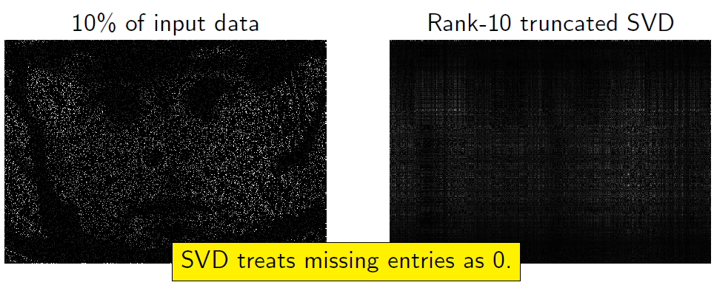
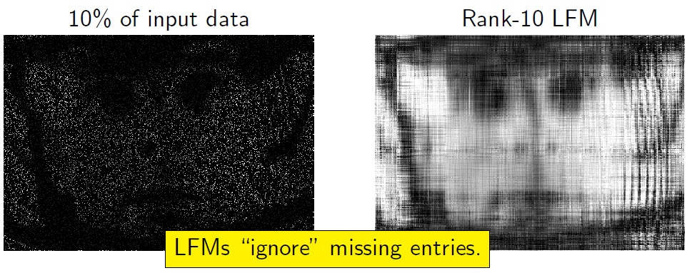
Latent Factor Models in image reconstruction
DMM course by R. Gemulla and P. Miettinen

Slide 6
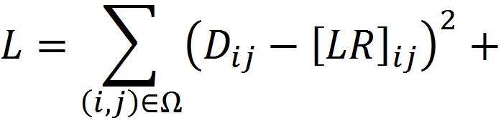
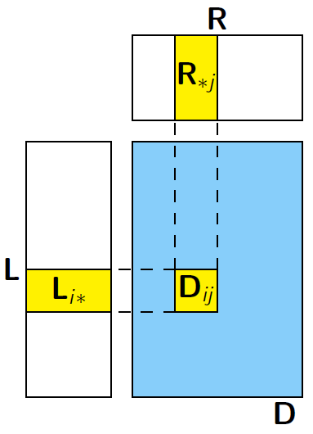

LFM: mathematical background
L (m × r) and R (r × n) are sought matrices of rank r
D (m × n) is a given matrix
Idea: construct L and R from known data; use them to reconstruct the missing data.

Slide 7
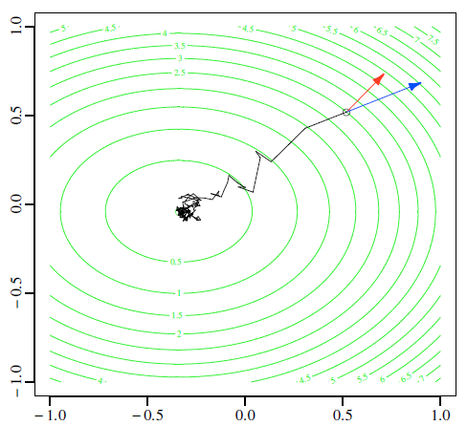
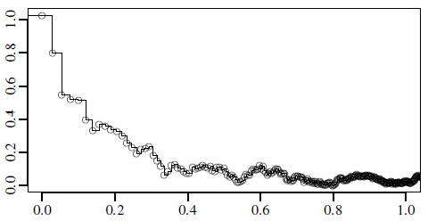
LFM: Stochastic Gradient Descent
Pick a random entry;
Compute approximate gradient;
Update parameters L and R
Repeat N times.
We implemented LFM-completion of missing values in the
Bioconductor package BEclear.
Akulenko, R., Merl, M., Helms, V. (2016) PLoS ONE, 11:e0159921

Slide 8
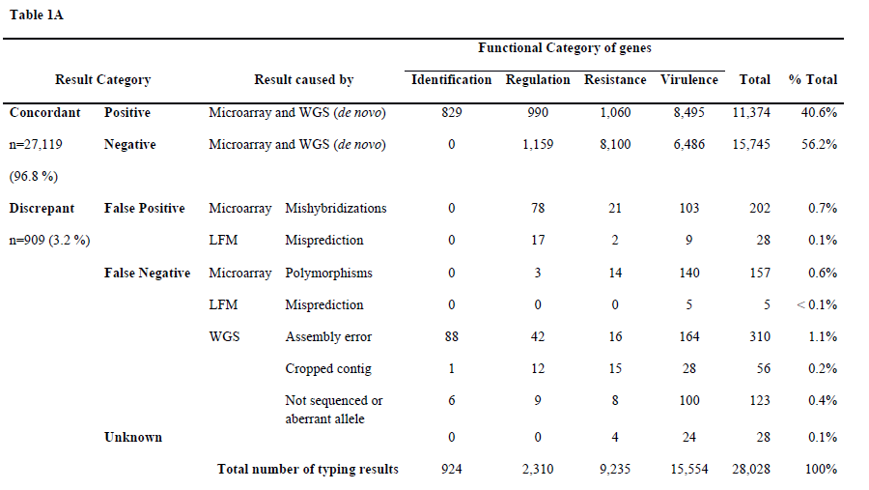
MA assignment to clonal complexes + LFM predictions confirmed by WGS
154 S. aureus isolates (182 target genes) from Germany-vs-Africa study
Very few errors due to LFM mis-predictions.
Strauss et al. J Clin Microbiol (2016)

Slide 9
Batch effects
Batch effects are:
Subgroups of measurements that show qualitatively different behavior across conditions and are unrelated to the biological or scientific variables in a study.
For a microarray experiment, batch effects may occur due to:
Chip type/lot/platform
Different laboratories may have different standard operating procedures
Sample/preservation protocols (procedures of drawing biological samples may vary from center to center and over time within center, relevant to retrospective studies)
Storage/shipment conditions
RNA isolation (different laboratories may use different extraction procedures or kits, and different lots of reagents may perform differently)
cRNA/cDNA synthesis
Amplification/labeling/hybridization protocol (different reagents or lots may be used)
Wash conditions (temperature, ionic strength, fluidics modules/stations; cleaning schedules)
Ambient conditions during sample preparation/handling, such as room temperature and ozone levels
Scanner (types, settings, calibration drift over prolonged studies; scheduled maintenance)
Luo et al. Pharmacogenomics J. (2010) 10: 278–291.

Slide 10
Global methods to correct batch effects
Mean-centering : after the transformation, the mean of each feature across all the samples within each batch is set to zero.
Standardization: Beyond mean-centering, this approach normalizes the standard deviation of all features across samples within each batch to unity.
Ratio-based: All samples are scaled by a reference array.
This can be the average of multiple reference arrays, such as the measurement of universal human reference RNA samples for clinical data and vehicle control samples for toxicogenomics data.
Such global normalization methods do not remove batch effects if these affect specific subsets of genes so that different genes are affected in different ways.
Luo et al. Pharmacogenomics J. (2010) 10: 278–291.

Slide 11
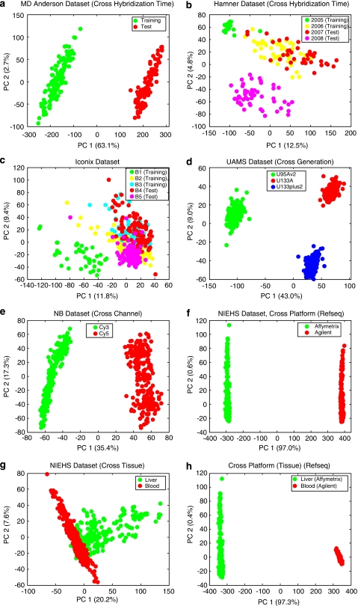
Batch effects in public MA data sets
Score plot of the first two principal components. Batches (groups) are indicated by colors.
MD Anderson breast cancer data set.
Hamner lung carcinogen data set (two batches in training set hybridized in 2005 and 2006, and two batches in test set hybridized in 2007 and 2008)
(d) UAMS multiple myeloma data set (the three batches represent three generations of Affymetrix chips on Homo Sapiens).
Luo et al. Pharmacogenomics J. (2010) 10: 278–291.

Slide 12
Batch effects in public MA data sets
(e) Cologne neuroblastoma data set (the two batches represent the two channels of Agilent arrays).
(f) NIEHS data set (cross-platform: the two groups represent Affymetrix and Agilent microarray platforms.
Luo et al. Pharmacogenomics J. (2010) 10: 278–291.

Slide 13
Example: bladder cancer microarray data
Raw data for normal samples taken from a bladder cancer microarray data set (Affymetrix chip).
Green and orange represent two different processing dates. Box plot of raw gene expression data (log₂ values)
Same data after processing with RMA, a widely used preprocessing algorithm for Affymetrix data.
RMA applies quantile normalization — a technique that forces the distribution of the raw signal intensities from the microarray data to be the same in all samples.
Leek et al. Nature Rev. Genet. 11, 733 (2010)

Slide 14
Quantile normalisation: adjusts multiple distributions
Given: 3 measurements of 4 variables A – D.
Aim: all measurements should get identical distributions of values
Original data
Determine in each column the rank of each value
A | 5 | 4 | 3
B | 2 | 1 | 4
C | 3 | 4 | 6
D | 4 | 2 | 8
→
A | iv | iii | i
B | i | i | ii
C | ii | iii | iii
D | iii | ii | iv
Sort columns by magnitude
Compute mean of each row
A | 2 | 1 | 3
B | 3 | 2 | 4
C | 4 | 4 | 6
D | 5 | 4 | 8
→
A | 2 | Rank i
B | 3 | Rank ii
C | 4.67 | Rank iii
D | 5.67 | Rank iv
A | 5.67 | 4.67 | 2
B | 2 | 2 | 3
C | 3 | 4.67 | 4.67
D | 4.67 | 3 | 5.67
Replace original values by mean values according to the rank of the data field.
Now all columns contain the same values (except of duplicates) so that they can be easily compared.

Slide 15
Example: same bladder cancer microarray data
Clustering of samples after normalization.
The samples perfectly cluster by processing date.
→ clear evidence of batch effect
Processing date is likely a “surrogate” for other variations (laboratory temperature, quality of reagents etc.).
Ten particular genes that are susceptible to batch effects even after RMA normalization.
Hundreds of other genes show similar behavior but, for clarity, are not shown.
Leek et al. Nature Rev. Genet. 11, 733 (2010)

Slide 16
Example: sequencing data from 1000 Genomes project
Coverage data were standardized across samples:
blue represents three standard deviations below average and orange represents three standard deviations above average.
Each row is a different HapMap sample processed in the same facility with the same platform. The samples are ordered by processing date with horizontal lines dividing the different dates. Shown is a 3.5 Mb region from chromosome 16.
Various batch effects can be observed. The largest one occurs between days 243 and 251 (the large orange horizontal streak).
Leek et al. Nature Rev. Genet. 11, 733 (2010)

Slide 17
Workflow to identify batch effects
Leek et al. Nature Rev. Genet. 11, 733 (2010)

Slide 18
Detect batch effects
PCA is commonly used as a visual tool to determine whether batch effects exist after applying a global normalization method.
However, PCA yields linear combinations of the variables that contribute maximum variance and thus will not necessarily detect batch effects if they are not the largest source of variability in the data.
→ Guided PCA: For detecting batch effects, a more informative version of PCA is to perform SVD on Y’X, where Y is an n × b indicator indicator matrix for b batches and n samples.
y_{ik} = 1 if sample is in batch k, y_{ik} = 0 otherwise
Large singular values imply that the batch is important for the corresponding principal component.
Reese et al. Bioinformatics (2013) 29: 2877–2883.

Slide 19
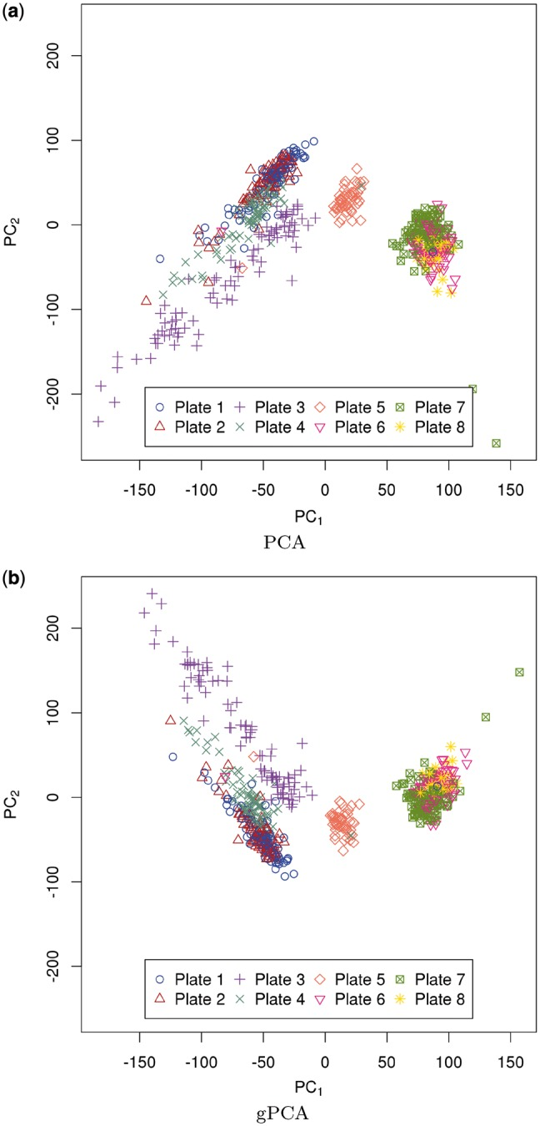
Detect batch effects
GENEMAM data
Unguided PCA of X and
(b) gPCA of Y’X.
The standard use of PCA is to plot PC1 of the data versus PC2.
The GENEMAM data have an obvious batch effect. The PCA plot shows that this batch effect is due to the plate when colored by plate with three batches consisting of plates 1–4, 5 and 6–8 that were run at different times. The gPCA plot of the first two principal components shows greater separation in the batches, especially of plate 3 (+) from plates 1, 2 and 4, than the unguided principal component plot.
Reese et al. Bioinformatics (2013) 29: 2877–2883.

Slide 20
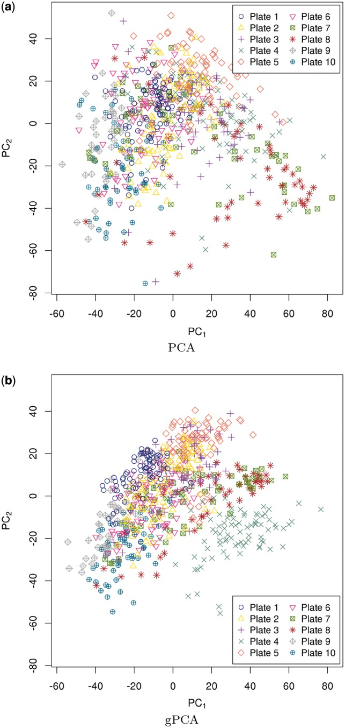
Detect batch effects
GENOA data
Unguided PCA of X and
(b) gPCA of Y’X.
For the GENOA data set, batch is not so easily detected using unguided PCA.
The PCA plot of PC1 and PC2 shows that plates 7 and 8 might be slightly separated from the rest of the plates. A gPCA with batch defined by plate shows that plates 7 and 8, along with plate 4 (X), separate slightly from the other plates.
It is not obvious from the unguided PCA that plate 4 is separate from the rest of the plates. However, gPCA shows a separation between plate 4 and the rest of the plates.
Reese et al. Bioinformatics (2013) 29: 2877–2883.

Slide 21
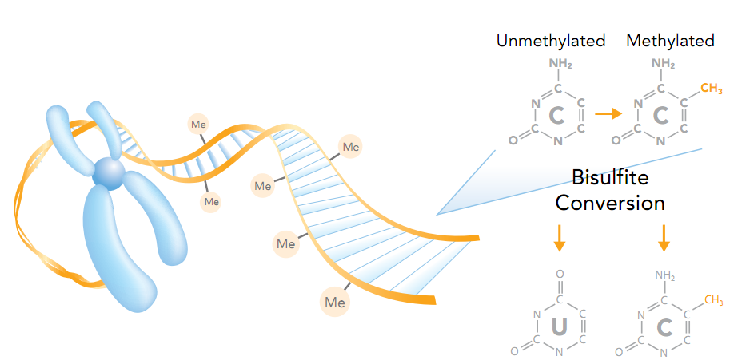
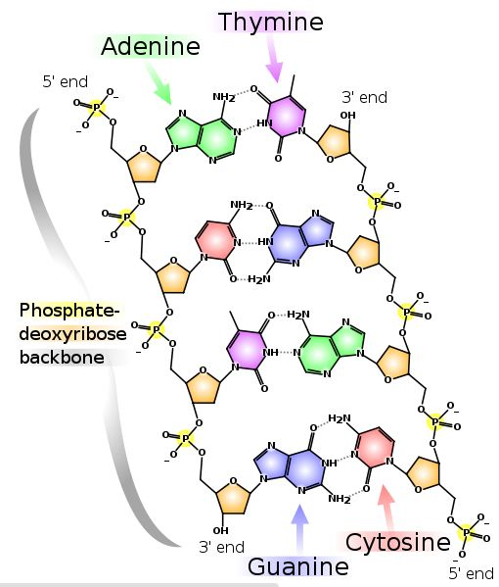

Correcting batch effects in DNA methylation data
Infinium HumanMethylation27, RevB BeadChip Kits

Slide 22
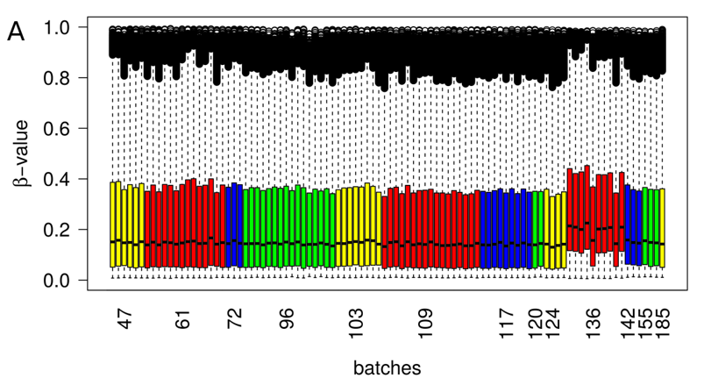
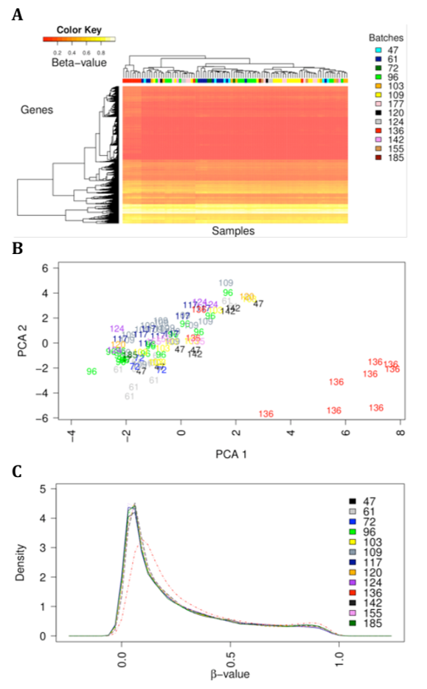
Original DNA methylation data for breast cancer (TCGA)
β: fraction of methylated cytosines in CpG
Clear batch effect in batch 136
Left: box-plot
Right/top: hierarchical clustering
Right/middle: PCA
Right/bottom: density distribution

Slide 23
Batch effect correction with BEclear
Compare the distribution of every gene in one batch to its distribution in all other batches using the nonparametric Kolmogorov-Smirnov (KS) test. P-values are corrected by False Discovery Rate.
(2) To consider only biologically relevant differences in methylation levels, identify the absolute difference between the median of all β-values within a batch for a specific gene and the respective median of the same gene in all other batches.
Those genes that have a FDR-corrected significance p-value below 0.01 (KS-test) AND a median difference larger than 0.05 are considered as batch effected (BE) genes in a specific batch.

Slide 24
Batch effect correction with BEclear
(3) Score severeness of batch effect in single batches by a weighting-scheme :
N : total number of genes in a current batch,
mdif_{cat} : category of median differences,
N_{BEgenes_i} : # BE-genes in mdif category i
w_{i} : weight of mdif category i
Weight categories:
if mdif < 0.05, then weight = 0;
if 0.05 ≤ mdif < 0.1 weight = 1;
if m × 0.1 ≤ mdif < (m + 1) × 0.1, m ∈ N⁺
Scoring scheme considers number of BE-genes in the batch + magnitude of deviation of the medians of BE-genes in one batch compared to all other batches.
Based on the BE-scores of all batches, identify using the Dixon test which batches have BE-scores that deviate significantly from the BE-scores of the other batches.
All BE-gene entries in these affected batches are replaced by LFM predictions.

Slide 25
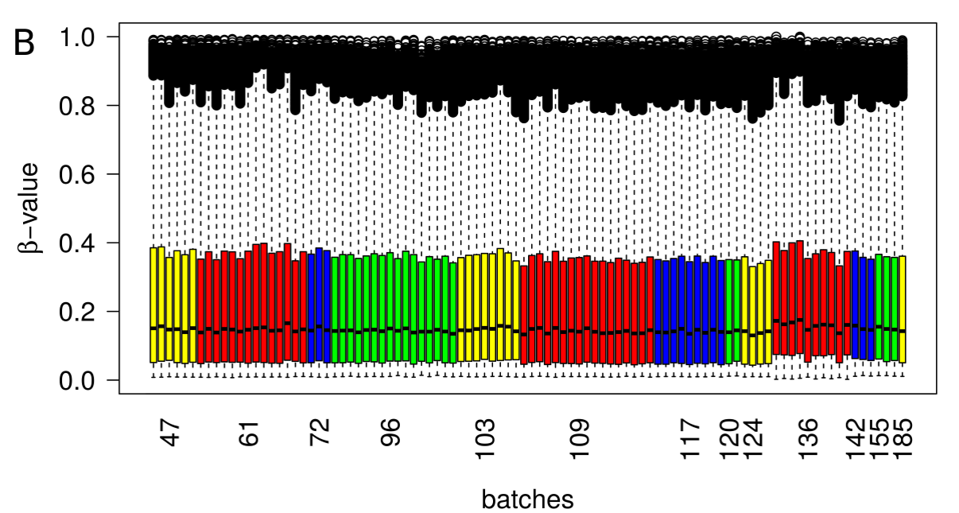
TCGA data for breast cancer – batch affected entries predicted by LFM/BEclear
Batch 136 has still slightly larger values than other batches,
but the deviation is no longer statistically significant.

Slide 26
TCGA data for breast cancer – data corrected by FunNorm
A. Per sample boxplot
B. Density plot.
Functional normalization was able to adjust the batch effect equally well as BEclear

Slide 27
Functional Normalization
Functional normalization uses information from 848 control probes on 450k array.
The method extends the idea of quantile normalization by adjusting for known covariates measuring unwanted variation.
Consider Y₁,…,Y_{n} high-dimensional vectors each associated
with a set of scalar covariates Z_{i,j} with i = 1,…,n indexing samples
and j = 1,…,m indexing covariates.
Ideally these known covariates are associated with unwanted variation and unassociated with biological variation.
Functional normalization attempts to remove their influence.

Slide 28
Functional Normalization
For each high-dimensional observation Y_{i}, we form the empirical quantile function
r ∈ [0,1] for its marginal distribution, and denote it by q_{i}^{emp} .
We assume the following model
α : mean of the quantile functions across all samples,
β_{j} : coefficient functions associated with the covariates and
ε_{i} : error functions, which are assumed to be independent and centered around 0.
In this model, the term
represents variation in the quantile functions explained by the covariates.
Functional normalization removes unwanted variation by regressing out this term.

Slide 29
Functional Normalization
1, …., m
are estimated using regression from the values observed for the control probes.
Assuming we have obtained estimates for j = 1, . . . ,m, we form the functional normalized quantiles by
We then transform Y_{i} into the functional normalized quantity using the formula
This ensures that the marginal distribution of h has
as its quantile function.

Slide 30
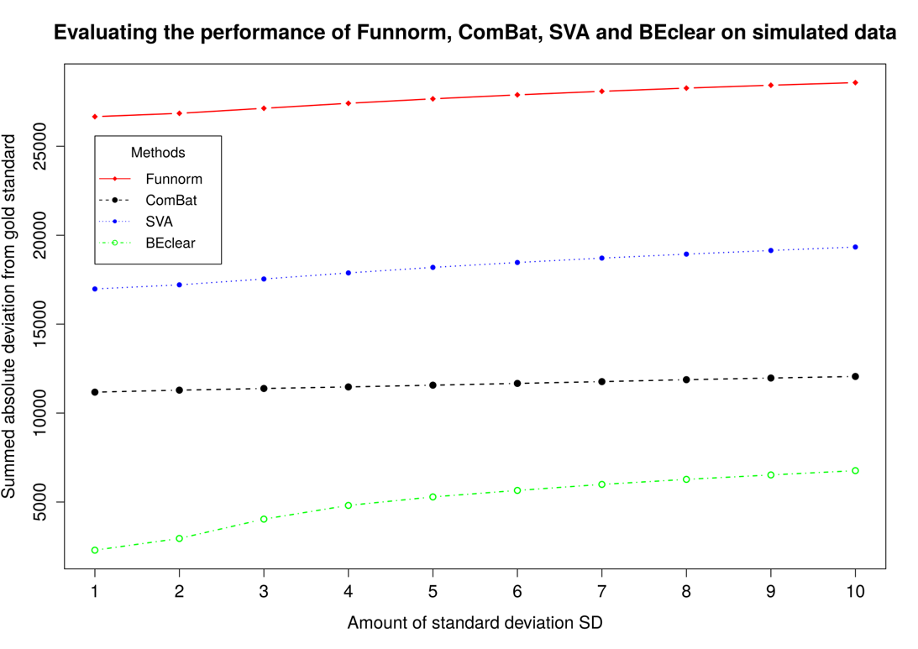
Benchmarking BEclear
Funnorm,
ComBat and SVA scale all values
-> large total
deviation
BEclear corrects only affected entries

Slide 31
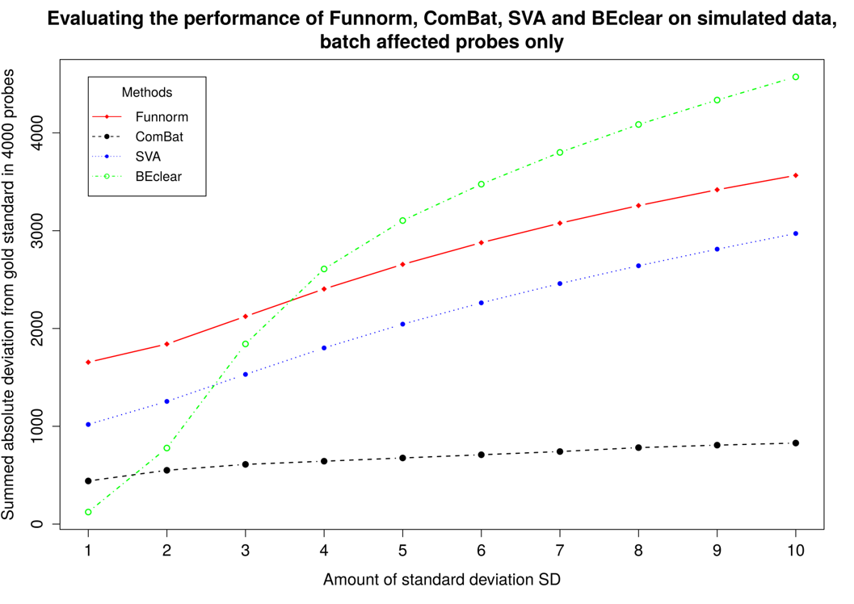
Effect on corrected entries only
Even for affected entries,
BEclear predicts smallest changes for batch effects
up to 2 s.dev.
which is a typical magnitude of batch effects.

Slide 32
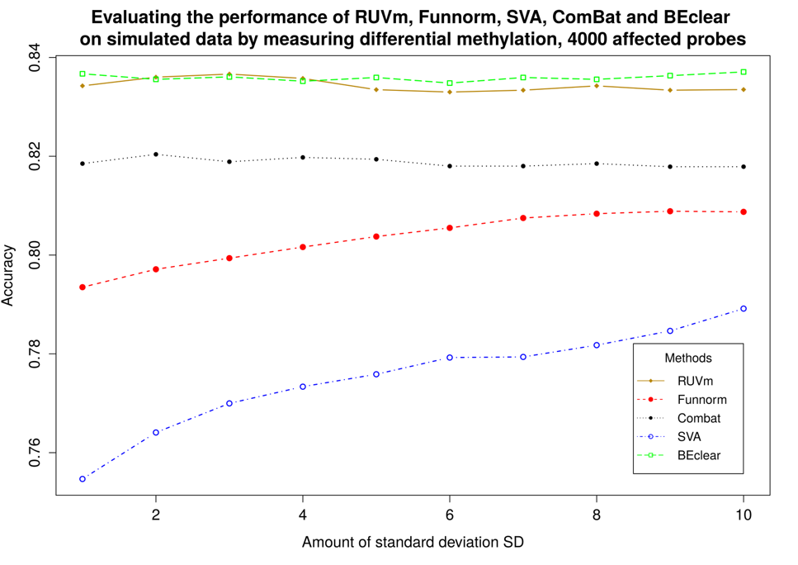
Accuracy of differential methylation analysis
Identify differentially methylated CpG probes (tumor vs. normal) in original data
Then introduce synthetic batch effect (n x st.dev.) + noise term
Identify differentially methylated CpG probes again + compare to reference

Slide 33
Conclusions
Predicting missing values or batch-effected values by Latent Factor Model (BEClear software):
Accuracy of MA hybridization prediction confirmed by WGS (97%),
low LFM error
Superior accuracy of predicting DNA methylation levels by LFM confirmed in benchmark against SVA, Combat, FunNorm softwares

Slide 34
Review: Foundations of Probability Theory
„Probability“ : degree of confidence that an event of an uncertain nature will occur.
„Events“ : we will assume that there is
an agreed upon space Ω of possible outcomes („events“).
E.g. a normal die (dt. Würfel) has a space Ω = {1,2,3,4,5,6}
Also we assume that there is a set of measurable events S
to which we are willing to assign probabilities.
In the die example, the event {6} is the case where the die shows 6.
The event {1,3,5} represents the case of an odd outcome.

Slide 35
Foundations of Probability Theory
Probability theory requires that the event space satisfies 3 basic properties:
It contains the empty event ∅ and the trivial event Ω.
It is closed under union → if α, β ∈ S, then so is α ∪ β ∈ S,
It is closed under complementation → if α ∈ S, then so is Ω − α ∈ S
The requirement that the event space is closed under union
and complementation implies that it is also closed under other
Boolean operations, such as intersection and set difference.

Slide 36
Probability distributions
A probability distribution P over (Ω, S) is a mapping from events in S
to real values. The mapping must satisfy the following conditions:
(1) P(α) ≥ 0 for all α∈ S → Probabilities are not negative
(2) P(Ω) = 1 → The probability of the trivial event which allows all possible outcomes has the maximal possible probability of 1.
(3) If α, β ∈ S and α ∩ β = 0 then P(α ∪ β) = P(α) + P(β)

Slide 37
Interpretation of probabilities
The frequentist‘s interpretation:
The probability of an event is the fraction of times
the event occurs if we repeat the experiment indefinitely.
E.g. throwing of dice, coin flips, card games, …
where frequencies will satisfy the requirements of proper distributions.
For an event such as „It will rain tomorrow afternoon“,
the frequentist approach does not provide a satisfactory interpretation.

Slide 38
Interpretation of probabilities
An alternative interpretation views probabilities as subjective degrees of belief.
E.g. the statement „the probability of rain tomorrow afternoon is 50 percent“
tells us that - in the opinion of the speaker - the chances of rain and no rain
tomorrow afternoon are the same.
When we discuss probabilities in the following we usually do not explicitly state
their interpretation since both interpretations lead to the same mathematical rules.

Slide 39
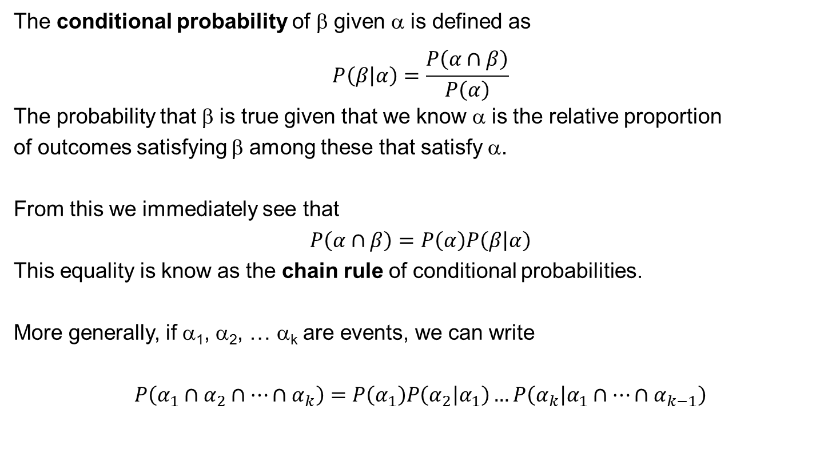
Conditional probability
The conditional probability of β given α is defined as
$$P\left(β\left|α\right.\right)=\frac{P\left(α∩β\right)}{P\left(α\right)}$$
The probability that β is true given that we know α is the relative proportion
of outcomes satisfying β among these that satisfy α.
From this we immediately see that
$$P\left(α∩β\right)=P\left(α\right)P\left(β\left|α\right.\right)$$
This equality is know as the chain rule of conditional probabilities.
More generally, if α₁, α₂, … α_{k} are events, we can write
$$P\left(α_{1}∩α_{2}∩…∩α_{k}\right)=P\left(α_{1}\right)P\left(α_{2}\left|α_{1}\right.\right)…P\left(α_{k}\left|α_{1}∩…∩α_{k−1}\right.\right)$$

Slide 40
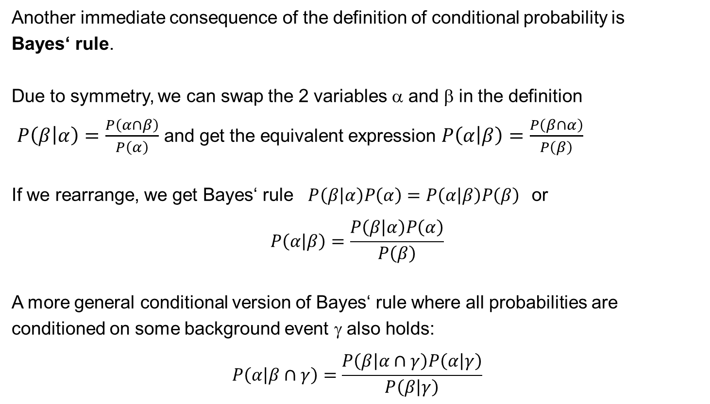
Bayes rule
Another immediate consequence of the definition of conditional probability is
Bayes‘ rule.
Due to symmetry, we can swap the 2 variables α and β in the definition
$P\left(β\left|α\right.\right)=\frac{P\left(α∩β\right)}{P\left(α\right)}$ and get the equivalent expression $P\left(α\left|β\right.\right)=\frac{P\left(β∩α\right)}{P\left(β\right)}$
If we rearrange, we get Bayes‘ rule $P\left(β\left|α\right.\right)P\left(α\right)=P\left(α\left|β\right.\right)P\left(β\right)$or
$$P\left(α\left|β\right.\right)=\frac{P\left(β\left|α\right.\right)P\left(α\right)}{P\left(β\right)}$$
A more general conditional version of Bayes‘ rule where all probabilities are conditioned on some background event γ also holds:
$$P\left(α\left|β∩γ\right.\right)=\frac{P\left(β\left|α\right.∩γ\right)P\left(α\left|γ\right.\right)}{P\left(β\left|γ\right.\right)}$$

Slide 41
Example 1 for Bayes rule
Consider a student population.
Let Smart denote smart students and GradeA denote students who got grade A.
Assume we believe that P(GradeA|Smart) = 0.6, and that we get to know
that a particular student received grade A.
Suppose that P(Smart) = 0.3 and P(GradeA) = 0.2
Then we have P(Smart|GradeA) = 0.6 × 0.3 / 0.2 = 0.9
In this model, an A grade strongly suggests that the student is smart.
On the other hand, if the test was easier and high grades were more common,
e.g. P(GradeA) = 0.4, then we would get
P(Smart|GradeA) = 0.6 × 0.3 / 0.4 = 0.45 which is much less conclusive.

Slide 42
Example 2 for Bayes rule
Suppose that a tuberculosis skin test is 95% percent accurate.
That is, if the patient is TB-infected, then the test will be positive with probability 0.95
and if the patient is not infected, the test will be negative with probability 0.95.
Now suppose that a person gets a positive test result.
What is the probability that the person is infected?
Naive reasoning suggests that if the test result is wrong 5% of the time, then the probability that the subject is infected is 0.95.
That would mean that 95% of subjects with positive results have TB.

Slide 43
Example 2 for Bayes rule
If we consider the problem by applying Bayes‘ rule, we need to consider the prior probability of TB infection, and the probability of getting a positive test result.
Suppose that 1 in 1000 of the subjects who get tested is infected → P(TB) = 0.001
We see that 0.001 × 0.95 infected subjects get a positive result
and 0.999 × 0.05 uninfected subjects get a positive result.
Thus P(Positive) = 0.001 × 0.95 + 0.999 × 0.05 = 0.0509
Applying Bayes‘ rule, we get P(TB|Positive) = P(TB) × P(Positive|TB) / P(Positive)
= 0.001 × 0.95 / 0.0509 ≅ 0.0187
Thus, although a subject with a positive test is much more probable to be TB-infected than is a random subject, fewer than 2% of these subjects are TB-infected.

Slide 44
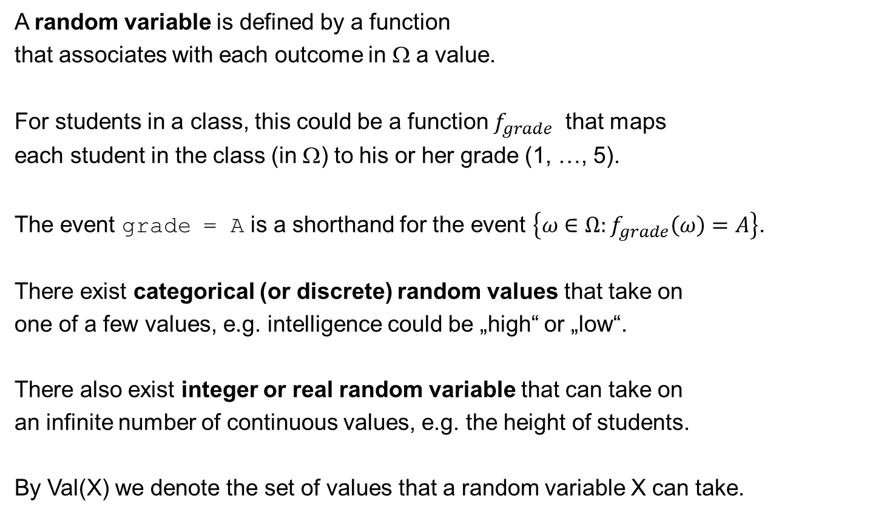
Random Variables
A random variable is defined by a function
that associates with each outcome in Ω a value.
For students in a class, this could be a function $f_{grade}$ that maps
each student in the class (in Ω) to his or her grade (1, …, 5).
The event grade = A is a shorthand for the event $\left\{ω∈Ω:f_{grade}\left(ω\right)=A\right\}$.
There exist categorical (or discrete) random values that take on
one of a few values, e.g. intelligence could be „high“ or „low“.
There also exist integer or real random variable that can take on
an infinite number of continuous values, e.g. the height of students.
By Val(X) we denote the set of values that a random variable X can take.

Slide 45
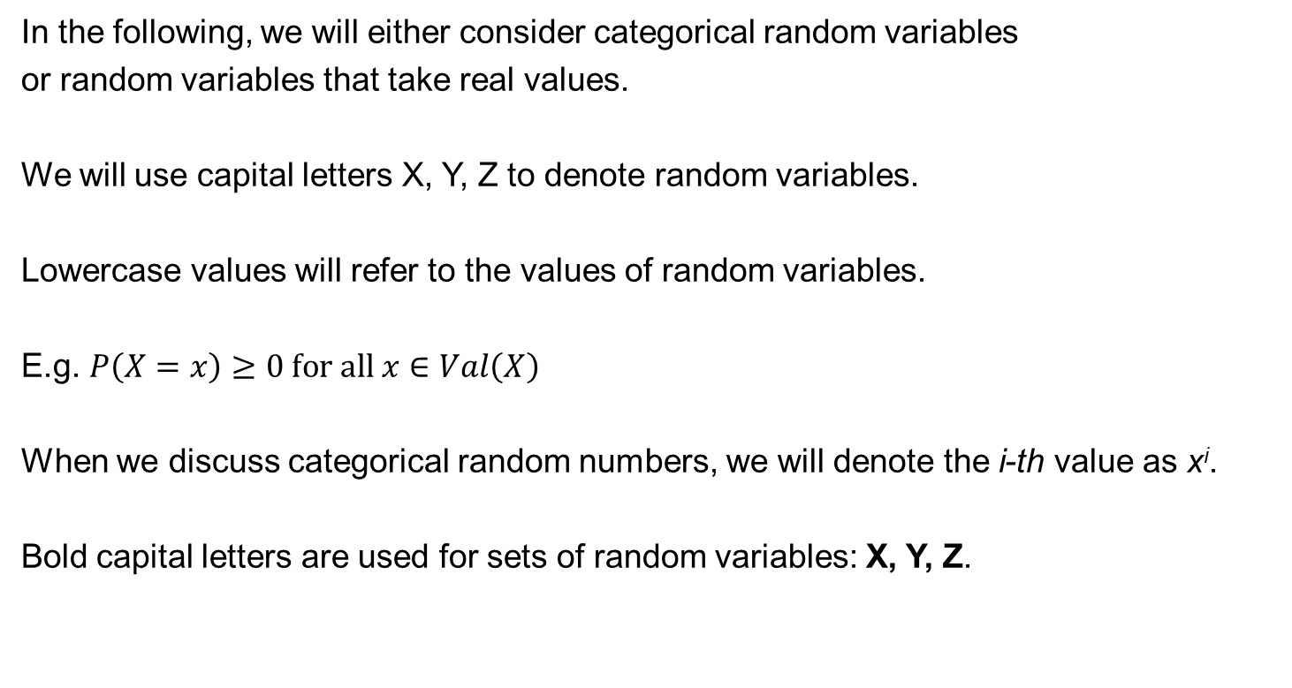
Random Variables
In the following, we will either consider categorical random variables
or random variables that take real values.
We will use capital letters X, Y, Z to denote random variables.
Lowercase values will refer to the values of random variables.
E.g. $P\left(X=x\right)≥0 \text{for} \text{all} x∈Val\left(X\right)$
When we discuss categorical random numbers, we will denote the i-th value as x^{i}.
Bold capital letters are used for sets of random variables: X, Y, Z.

Slide 46
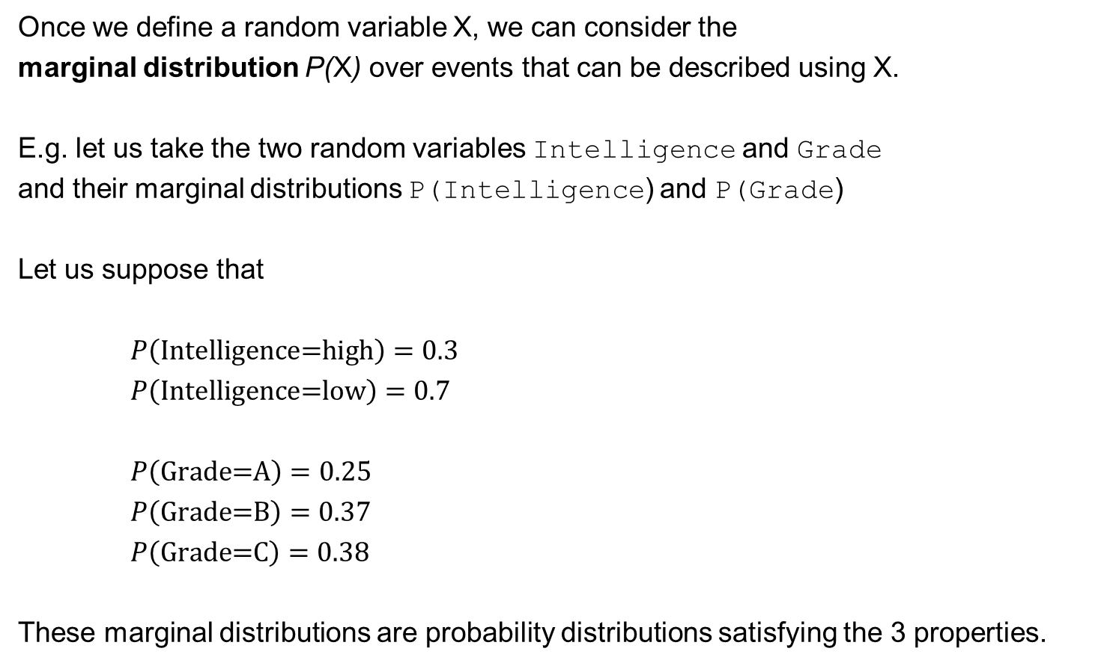
Marginal Distributions
Once we define a random variable X, we can consider the
marginal distribution P(X) over events that can be described using X.
E.g. let us take the two random variables Intelligence and Grade
and their marginal distributions P(Intelligence) and P(Grade)
Let us suppose that
$P\left(\text{Intelligence}\text{=}\text{high}\right)=0.3$
$P\left(\text{Intelligence}\text{=}\text{low}\right)=0.7$
$P\left(\text{Grade}\text{=}\text{A}\right)=0.25$
$P\left(\text{Grade}\text{=}\text{B}\right)=0.37$
$P\left(\text{Grade}\text{=}\text{C}\right)=0.38$
These marginal distributions are probability distributions satisfying the 3 properties.

Slide 47
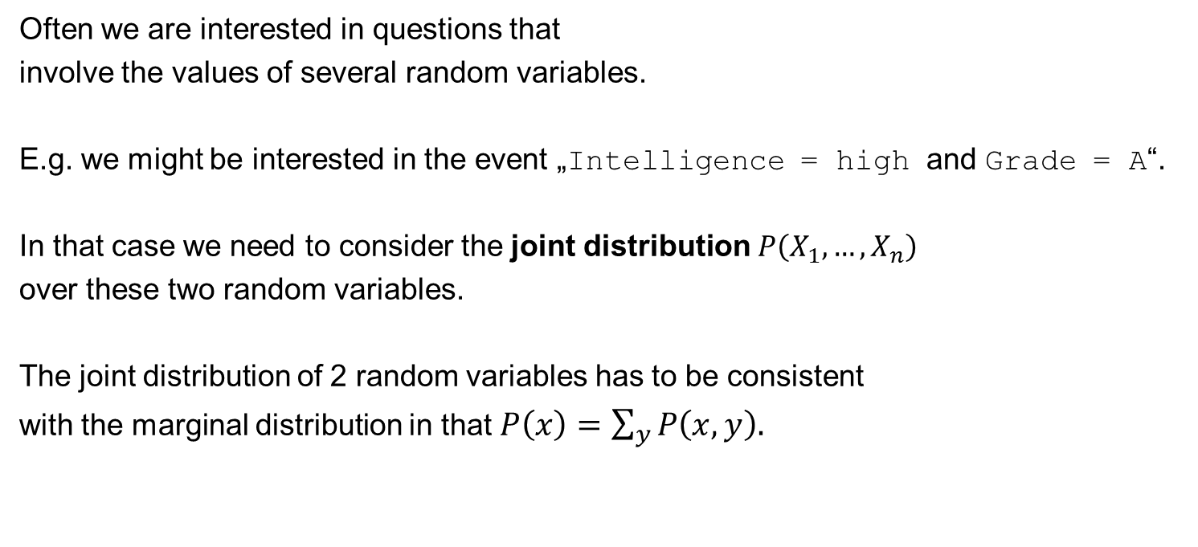
Joint Distributions
Often we are interested in questions that
involve the values of several random variables.
E.g. we might be interested in the event „Intelligence = high and Grade = A“.
In that case we need to consider the joint distribution $P\left(X_{1},…,X_{n}\right)$
over these two random variables.
The joint distribution of 2 random variables has to be consistent
with the marginal distribution in that $P\left(x\right)=\sum_{y}{P\left(x,y\right).}$
 |  | Intelligence
 |  | low | high
 | A | 0.07 | 0.18 | 0.25
Grade | B | 0.28 | 0.09 | 0.37
 | C | 0.35 | 0.03 | 0.38
 |  | 0.7 | 0.3 | 1

Slide 48
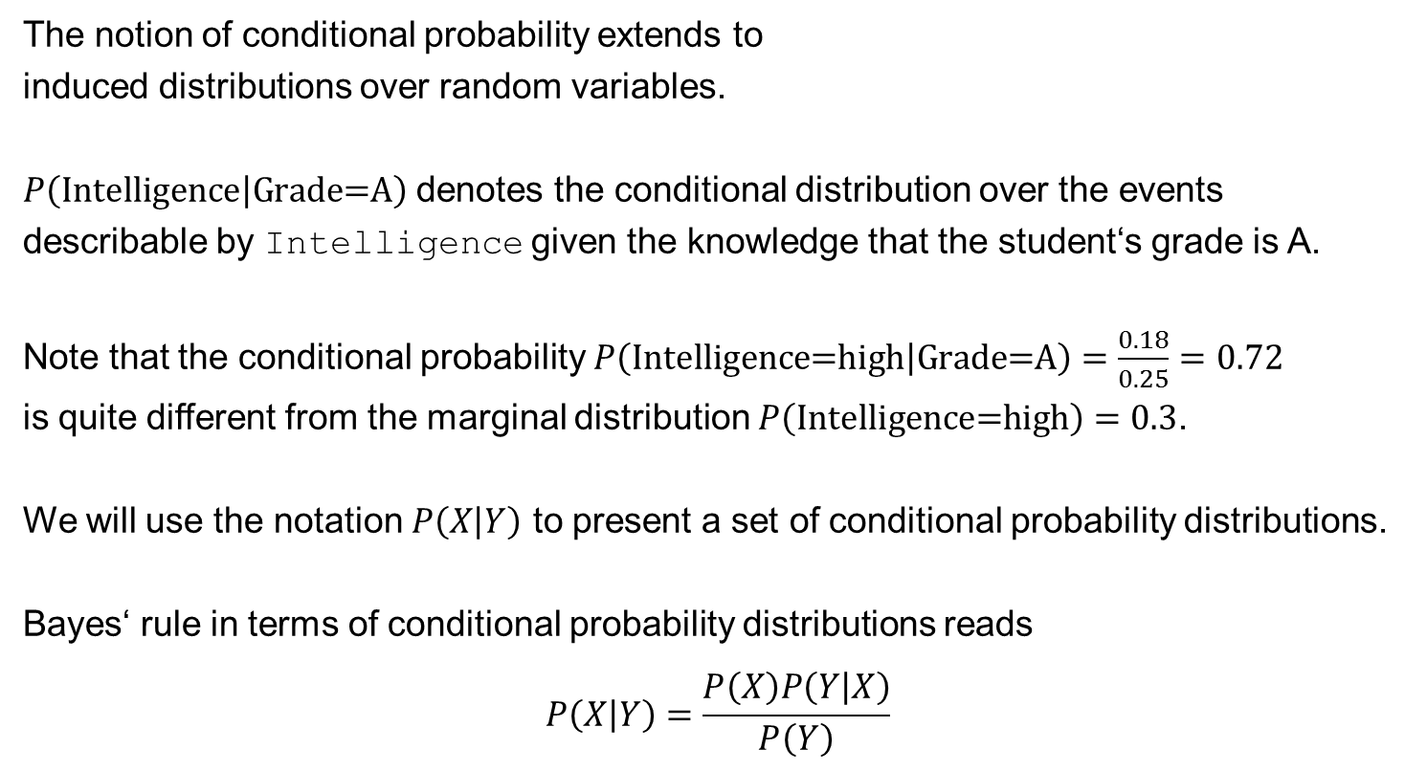
Conditional Probability
The notion of conditional probability extends to
induced distributions over random variables.
$P\left(\text{Intelligence}\left|\text{Grade}\text{=}\text{A}\right.\right)$ denotes the conditional distribution over the events describable by Intelligence given the knowledge that the student‘s grade is A.
Note that the conditional probability $P\left(\text{Intelligence}\text{=}\text{high}\left|\text{Grade}\text{=}\text{A}\right.\right)=\frac{0.18}{0.25}=0.72$
is quite different from the marginal distribution $P\left(\text{Intelligence}\text{=}\text{high}\right)=0.3$.
We will use the notation $P\left(X\left|Y\right.\right)$ to present a set of conditional probability distributions.
Bayes‘ rule in terms of conditional probability distributions reads
$$P\left(X\left|Y\right.\right)=\frac{P\left(X\right)P\left(Y\left|X\right.\right)}{P\left(Y\right)}$$

Slide 49
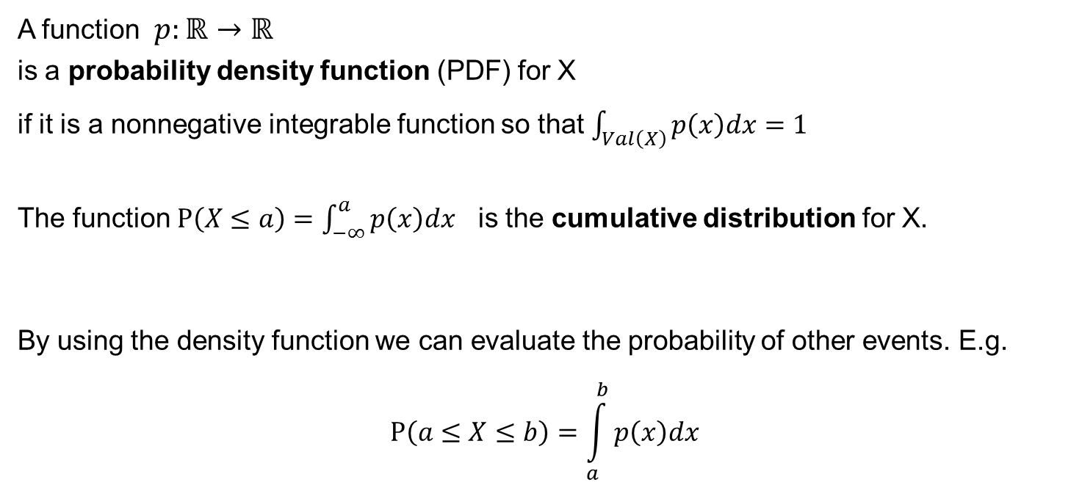
Probability Density Functions
A function $p:ℝ→ℝ$
is a probability density function (PDF) for X
if it is a nonnegative integrable function so that $\int_{Val\left(X\right)}{p\left(x\right)dx=1}$
The function $P\left(X≤a\right)=\int_{−∞}^{a}{p\left(x\right)dx}$ is the cumulative distribution for X.
By using the density function we can evaluate the probability of other events. E.g.
$$P\left(a≤X≤b\right)=\int_{a}^{b}{p\left(x\right)dx}$$

Slide 50
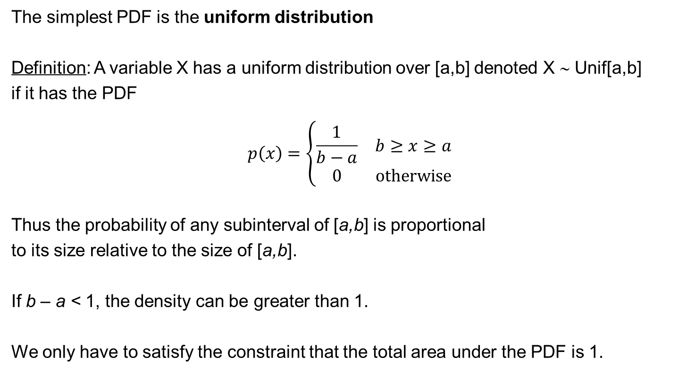
Uniform distribution
The simplest PDF is the uniform distribution
Definition: A variable X has a uniform distribution over [a,b] denoted X ∼ Unif[a,b]
if it has the PDF
$$p\left(x\right)=\left\{\begin{matrix}\frac{1}{b−a} & b≥x≥a \\ 0 & \text{otherwise}\end{matrix}\right.$$
Thus the probability of any subinterval of [a,b] is proportional
to its size relative to the size of [a,b].
If b – a < 1, the density can be greater than 1.
We only have to satisfy the constraint that the total area under the PDF is 1.

Slide 51
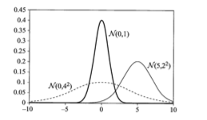

Gaussian distribution
A random variable X has a Gaussian distribution with mean μ and variance σ² ,
denoted X ∼ N(μ;σ²) if it has the PDF
$$p\left(x\right)=\frac{1}{\sqrt{2π}σ}e^{−\frac{{\left(x−μ\right)}^{2}}{2σ^{2}}}$$
A standard Gaussian has mean 0 and variance 1.
Fig. 2.2.

Slide 52
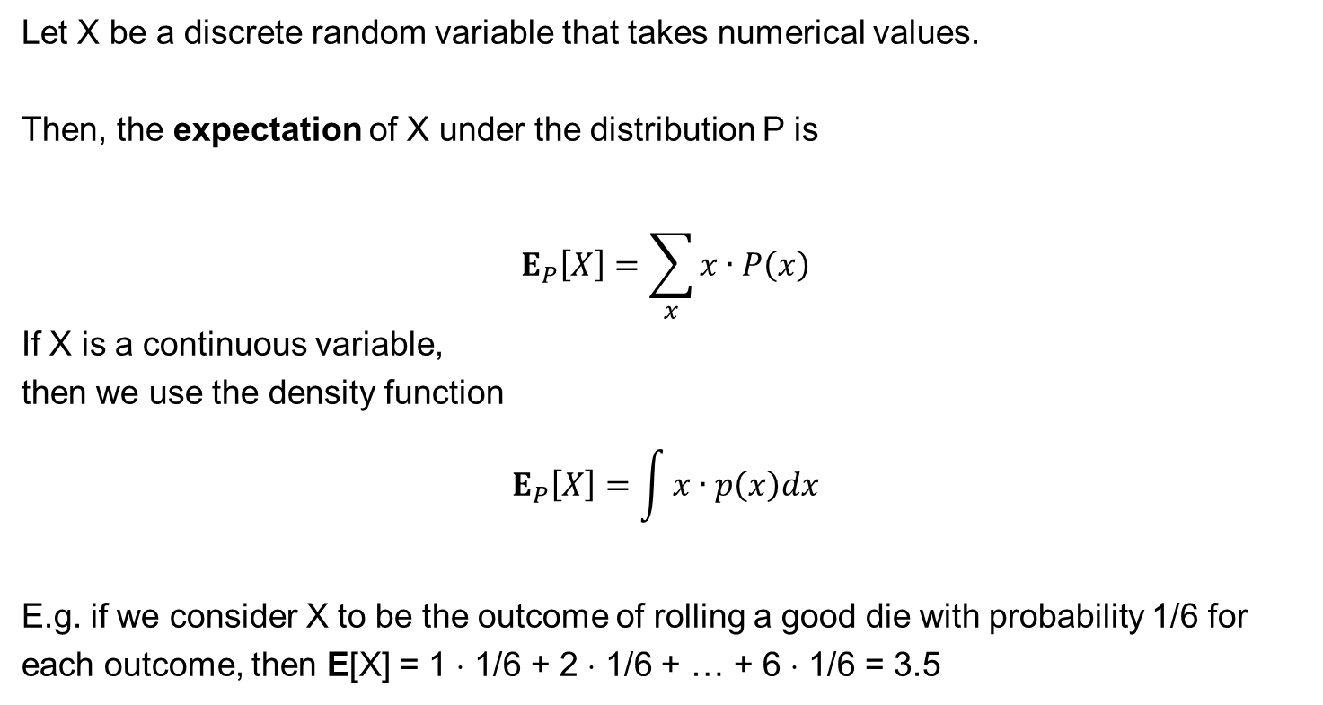
Expectation
Let X be a discrete random variable that takes numerical values.
Then, the expectation of X under the distribution P is
$$E_{P}\left[X\right]=\sum_{x}{x∙P\left(x\right)}$$
If X is a continuous variable,
then we use the density function
$$E_{P}\left[X\right]=\int{x∙p\left(x\right)dx}$$
E.g. if we consider X to be the outcome of rolling a good die with probability 1/6 for each outcome, then E[X] = 1 ⋅ 1/6 + 2 ⋅ 1/6 + … + 6 ⋅ 1/6 = 3.5

Slide 53
Properties of the expectation of a random variable
E[a ⋅ X + b] = a E[X ] + b
Let X and Y be two random variables
E[X + Y] = E[X] + E[Y]
Here, it does not matter whether X and Y are independent or not.
What can be say about the expectation value of a product of two random variables?
In the general case, we can say very little.
Consider 2 variables X and Y that each take on the values +1 and -1 with
probabilities 0.5.
If X and Y are independent, then E[X ⋅ Y] = 0.
If they always take on the same value (they are correlated), then E[X ⋅ Y] = 1.

Slide 54
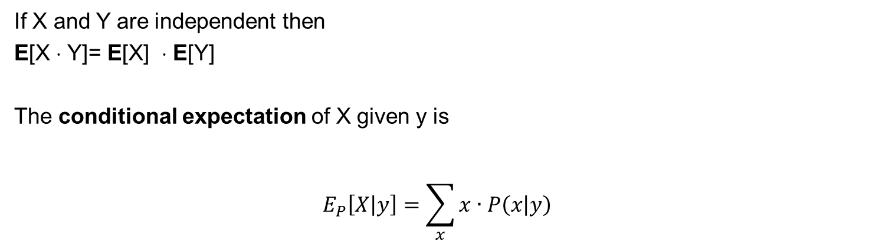
Properties of the expectation of a random variable
If X and Y are independent then
E[X ⋅ Y]= E[X] ⋅ E[Y]
The conditional expectation of X given y is
$$E_{P}\left[X\left|y\right.\right]=\sum_{x}{x∙P\left(x\left|y\right.\right)}$$

Slide 55
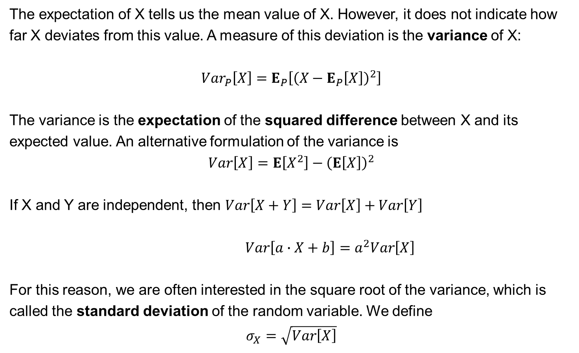
Variance
The expectation of X tells us the mean value of X. However, it does not indicate how far X deviates from this value. A measure of this deviation is the variance of X:
$${Var}_{P}\left[X\right]=E_{P}\left[{\left(X−E_{P}\left[X\right]\right)}^{2}\right]$$
The variance is the expectation of the squared difference between X and its expected value. An alternative formulation of the variance is
$$Var\left[X\right]=E\left[X^{2}\right]−{\left(E\left[X\right]\right)}^{2}$$
If X and Y are independent, then $Var\left[X+Y\right]=Var\left[X\right]+Var\left[Y\right]$
$Var\left[a∙X+b\right]=a^{2}Var\left[X\right]$
For this reason, we are often interested in the square root of the variance, which is called the standard deviation of the random variable. We define
$$σ_{X}=\sqrt{Var\left[X\right]}$$

Slide 56
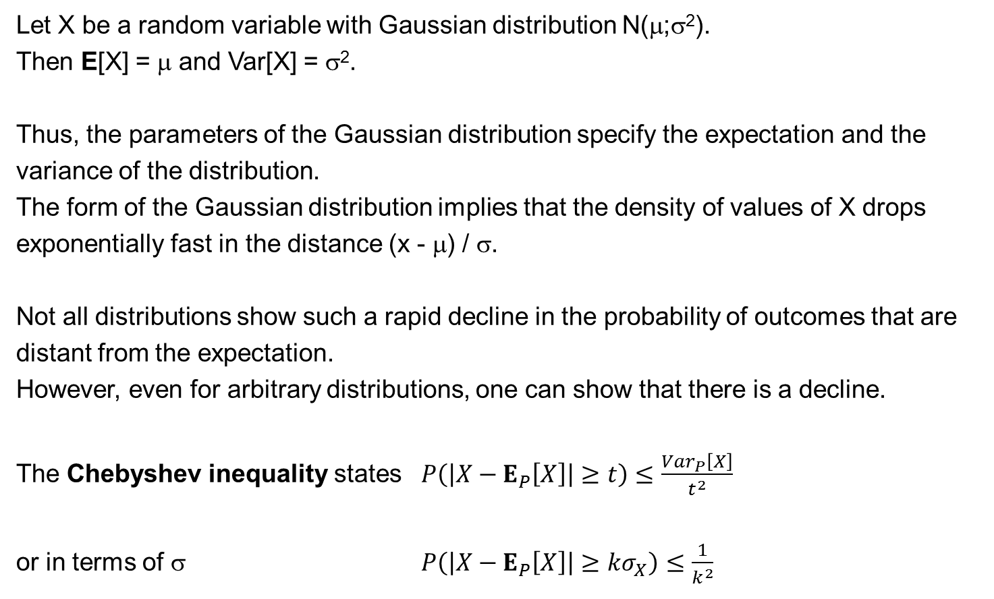
Variance
Let X be a random variable with Gaussian distribution N(μ;σ²).
Then E[X] = μ and Var[X] = σ².
Thus, the parameters of the Gaussian distribution specify the expectation and the variance of the distribution.
The form of the Gaussian distribution implies that the density of values of X drops exponentially fast in the distance (x - μ) / σ.
Not all distributions show such a rapid decline in the probability of outcomes that are distant from the expectation.
However, even for arbitrary distributions, one can show that there is a decline.
The Chebyshev inequality states $P\left(\left|X−E_{P}\left[X\right]\right|≥t\right)≤\frac{{Var}_{P}\left[X\right]}{t^{2}}$
or in terms of σ $P\left(\left|X−E_{P}\left[X\right]\right|≥kσ_{X}\right)≤\frac{1}{k^{2}}$

Slide 57
Variance
Let X be a random variable with Gaussian distribution N(μ;σ²).
Then E[X] = μ and Var[X] = σ².
Thus, the parameters of the Gaussian distribution specify the expectation and the variance of the distribution.
The form of the Gaussian distribution implies that the density of values of X drops exponentially fast in the distance (x - μ) / σ.
Nice online resources on statistics:
https://www.khanacademy.org/math/statistics-probability
http://tutorials.istudy.psu.edu/basicstatistics/
https://stattrek.com/statistics/problems.aspx

