Slide 1
V1 Processing of Biological Data
Leistungspunkte/Credit points: 5 (V2/Ü1)
This course is taught in English language.
The material (from books and original literature) are provided online at the course website:
https://www-cbi.cs.uni-saarland.de/teaching/ws-2021-22/stl-bioinformatics-processing-of-biological-data/
Topics to be covered:
This course will discuss the handling of different sorts of biological data,
often on the example of recent publications.
Data curation
Processing
Imputation
Data analysis
Machine learning
….
Raw data
Notes:
Welcome to the lecture „Processing of Biological Data“ in winter semester 2021/22.
At the bottom, I visualized the typical flow of a bioinformatics project from raw data over several preprocessing steps listed in the middle box to the data analysis/machine learning block on the right.
Obviously, the last block is expected to reveal the biological or biomedical insight that may be contained in the provided raw data.
Often, answering a biological question relies on selecting 2 suitable groups of samples and comparing them.
So the left and right blocks are obviously most interesting.
However, as I will point out in this lecture, the middle block is equally important in reality as the other two.

Slide 2
Tutorial
We will handout 5 bi-weekly assignments.
Groups of up to two students can hand in a solved assignment.
Send your solutions by e-mail to the responsible tutors
until the time+date indicated on the assignment sheet (no extensions!).
Tutors will be: Andreas Denger (sheets 1 and 4), Markus Hollander (2), Nicolas Künzel (3), Trang Do (5)
The bi-weekly tutorial on Tuesday 12.45 am – 2.15 pm (time is negotiable) will discuss the assignment solutions.
On demand, the tutors may also give some advice on how to solve the new assignments.
Notes:
Assignments will be connected to the content of the lecture and will deal with typical tasks of a bioinformatician who is processing biological data.
Some assignments will contain programming tasks, others can be solved either with available software or even by hand.

Slide 3
Schein conditions
The successful participation in the lecture course („Schein“)
will be certified upon fulfilling
Schein condition 1 : ≥ 50% of the aggregated points for the assignments
Schein condition 2 : pass final written exam at end of semester (February 2022).
The grade on your „Schein“ will equal that of your final exam.
Everybody can take part in the written re-exam at the beginning of SS22,
those who failed or missed the final exam and those who want to improve their grades. The better grade from both exams counts.
International students who are unable to come to Saarbrücken can take an oral online exam instead.
Notes:
In case the Corona regulations make it impossible to offer a written exam, the final exams would alternatively be conducted as individual oral exams of around 20 minute duration.
As it is very time-consuming for the lecturer to conduct oral exams, we would then NOT offer the chance for a re-exam to those who have passed the first exam.

Slide 4
Planned lecture - overview
  V1: bacterial data on gene inventory (S. aureus): clustering / PCA
  V2: bacterial data/DNA methylation: prediction of missing values (BEclear)
  V3: differential gene expression, detection of outliers
  V4: MS proteomic data, imputation, normalization, protein arrays
  V5: peak detection, breathomics
  V6: shape detection, processing of kidney tumor MRI scans
  V7: genomic sequences, SNPs
  V8: functional GO annotations
  V9: curve fitting, data smoothing (AKSmooth …)
  V10: protein X-ray structures: titration states, hydration sites, multiple side chain and ligand conformations, superposition … protein-protein complexes: crystal contacts, interfaces, …
  V11: analysis of MD simulation trajectories: correlation of snapshots, remove CMS motion
  V12: multi-variate analysis
  V13: integrative analysis of multidimensional data sets
Notes:
This is the planned lecture content.

Slide 5
Data preprocessing
Data preprocessing is one of the most critical steps in data mining.
Data preprocessing methods are divided into 4 categories:
Data cleaning
Data integration
Data transformation
Data reduction
Data Mining: Know It All by Ian H. Witten et al. Publisher: Morgan Kaufmann (2008)
Notes:
Although this may not be very obvious to you right now, preprocessing is a very crucial step of data processing.
If we do not remove problematic data points from the data set at the beginning and if we do not apply proper normalization in the next step, then all downstream processing becomes highly problematic and possibly misleading.
Listed here are 4 categories of data preprocessing methods.
In this lecture, we will discuss examples from all 4 listed categories.

Slide 6
Data preprocessing
◦ Data cleaning: fill in missing values, smooth noisy data, identify or remove outliers, and resolve inconsistencies.
◦ Data integration: using multiple databases, data cubes, or files.
◦ Data transformation: normalization and aggregation.
◦ Data reduction: reducing the volume but producing the same or similar analytical results.
◦ Data discretization: part of data reduction, replacing numerical attributes with nominal ones.
Data Mining: Know It All by Ian H. Witten et al. Publisher: Morgan Kaufmann (2008)
Notes:
Listed here are some typical tasks for all 4 categories of data preprocessing methods.
Note that I took these examples from the text book of Ian Witten listed at the bottom.
In fact, these tasks are typical to any data mining field.
So after you have taken this lecture, you will be ready for data mining☺
Biological data is particular noisy. Clinical data on patient characteristics is often incomplete.
Thus, the first step (data cleaning) is particularly important in bioinformatics.
The other steps deal with the data available after the cleaning step.

Slide 7


Whole Genome Sequence Typing and
Microarray Profiling of Methicillin-Resistant
Staphylococcus aureus isolates
Classification of MSSA / MRSA S. aureus strains in Saarland (PLoS ONE 2012)
DFG Germany-Africa project (J. Clin. Microbiol. 2016; Sci. Reports 2017)
Co-workers
(1) Ruslan Akulenko, Ulla Ruffing, Mathias Herrmann, Lutz von Müller,
(2) StaphNet Consortium led by Mathias Herrmann, funded by DFG
Notes:
Often in this lecture, we will discuss examples from our past and current research projects.
This is how I came into contact with the various tasks of data preprocessing.
You will often read very little about the data preprocessing steps in the methods section of publications.
But be assured, most if not all bioinformatics projects involve significant amount of data preprocessing.
In the example of today‘s first lecture, we will look at genomic data from a project related to bacterial resistance.
Together with Prof. Mathias Herrmann and Prof. Lutz von Müller from the medical department of Saarland University in Homburg, we became partners with a pilot study on S. aureus samples that was published in PLoS ONE.
(Note that the latin names of organisms such as Staphylococcus aureus should be written in italic font.)
The results from this pilot study then helped us to acquire funding for a large scale multi-center study involving a number of research groups from Germany and Africa.

Slide 8

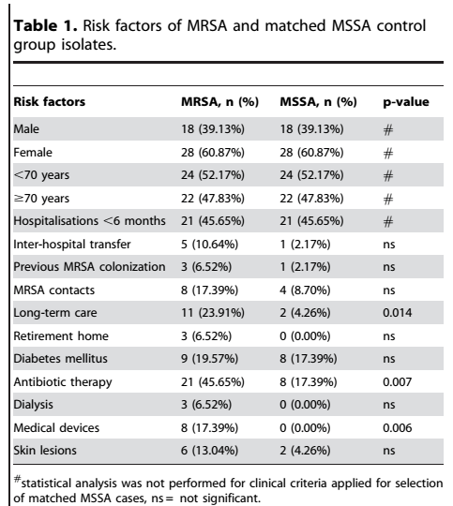

Pilot study: classification of resistant
Staphylococcus aureus strains
Aim: classify MRSA / MSSA
according to gene repertoire
Notes:
During 1 month of 2011, all patients who were admitted to the university hospital of Saarland university during this month
were screened for the presence of methicillin sensitive or methicillin resistant S. aureus strains.
As shown in table 1, we selected 46 MRSA isolates and 46 MSSA colonized patients from all patients.
The two groups were matched for gender, age and diverse types of predisposition and exposition.
The aim of the study was to identify the clonal lineage distribution of MSSA and MRSA isolates and to detect differences in the accessory gene equipment of MRSA and MSSA isolates.

Slide 9
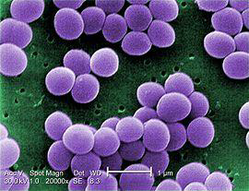
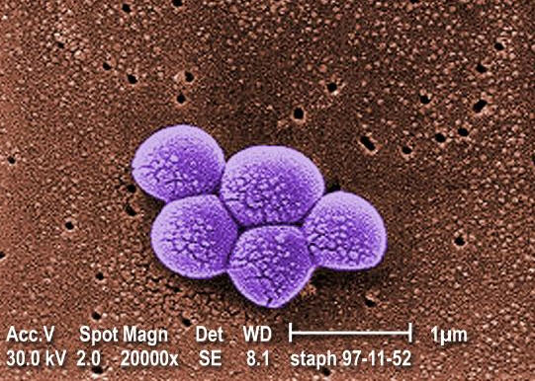
Methycillin sensitive/resistant Staphylococcus aureus
(MSSA/MRSA)
MSSA
MRSA
anaerobic Gram-positive coccal bacterium,
frequently part of the normal skin flora,
60% of population are carriers
any strain of S. aureus with resistance to beta-lactam antibiotics:
penicillins;
cephalosporins;
Need to classify MRSA strains to detect infections, prevent transmission
Notes:
MSSA S.aureus strains are „good strains“. They are sensitive to the antibiotic named methycillin. More than half of the human population carry MSSA strains in their nose.
MRSA S.aureus strains are „evil strains“ that are multi-resistant to beta-lactam antibiotics, see https://en.wikipedia.org/wiki/%CE%92-lactam_antibiotic
It is very important to detect MRSA early on to avoid treating patients with useless therapies and to disrupt transmission chains.
https://www.cdc.gov/mrsa/lab/index.html
MRSA is resistant to all β-lactams because of the presence of mecA, a gene that produces a penicillin binding protein (PBP2a) with low affinity for β-lactam antibiotics.

Slide 10
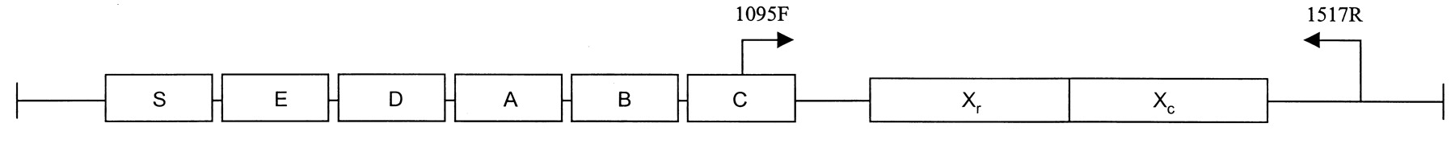

routine: Characterize MRSA by Spa-typing
Protein A gene map. Boxes indicate segments of the gene coding for the signal sequence (S), the immunoglobulin G-binding regions (A–D), a region homologous to A–D (E), and the COOH terminus (X), which includes the polymorphic X_{r} region consisting of a variable number of 24-bp repeats and the cell wall attachment sequence (X_{c}).
Shopsin et al. J. Clin. Microbiol. 37, 3556 (1999)
DNA preparation of polymorphic X-region of staphylococcus protein A from S. aureus (Spa)
amplify by PCR
sequencing assignment using Ridom StaphType software
Spa-types: | Repeats: | Total strains: | Strain records: | Strain countries:
17897 | 762 | 398228 | 165914 | 135
Notes:
In 2012, the typical detection of MRSA relied on so-called Spa-typing.
Spa stands for a protein termed protein A from S. aureus. It contains a highly variable polymorphic X_{r} region.
Sequencing of this region was demonstrated to be a rapid and accurate method to discriminate S. aureus outbreak isolates from those deemed epidemiologically unrelated.
The Spa sequences can be submitted to a webserver that classifies the submitted strain.

Slide 11
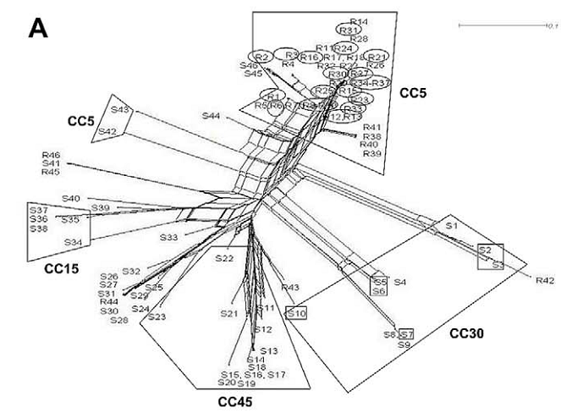
Results from Spa-typing: splits graph
For MSSA, spa-typing allowed for good discrimination of patient isolates.
However, the majority of MRSA isolates clustered into clonal complex CC5/t003.
This hampers sub-classification by spa-typing
Unrouted tree generated with
www.splitstree.org
MSSA strains labeled S__
MRSA strains labeled R__
Notes:
Shown here is something like a phylogeny of the 92 samples from this pilot study based on their Spa-sequences.
The labels of MSSA samples start with the letter S, those of MRSA samples with the letter R.
It turns out that MSSA samples can be well separated into different clusters, so-called clonal complexes.
The terminology „clonal complex“ will be explained on one of the following slides.
However, most MRSA samples fall into one big cluster that belongs to clonal complex 5 (abbreviated as CC5).
We concluded that Spa-typing alone was not able to properly resolve the MRSA samples.
Therefore, we looked for an alternative method that would provide information about many more genes.

Slide 12
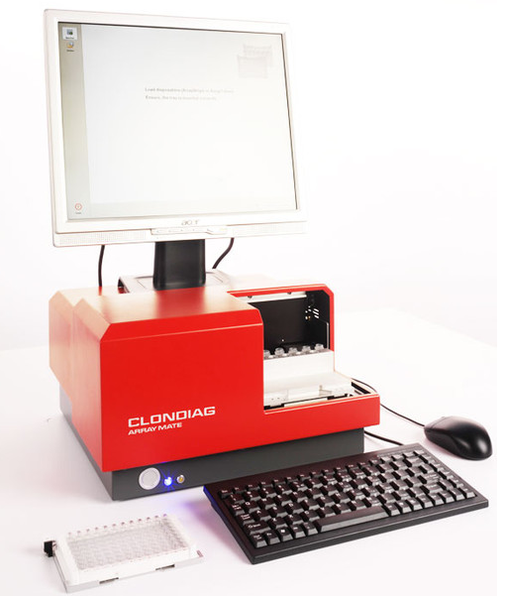

DNA microarray (IdentiBAC – Alere)
Microarray contains 334 DNA probes for genes/regions that are clinically relevant and/or relevant for clonal typing
alere-technologies.com
Notes:
The bacterial DNA that was isolated from the patients is loaded on a manufactured DNA microarray.
Each of its wells contains many copies of a particular DNA probe for one out of 334 regions from the S. aureus genome.
Some of these genomic regions belong to known virulence or resistance genes.
Other regions are relevant to determine to which clonal complex the bacterial strain belongs to.
In the picture on the right, black circles indicate positive hybridization meaning that this genomic region was detected in the sample.

Slide 13
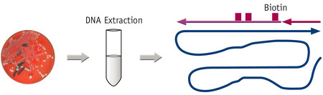
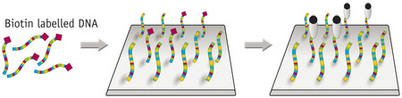
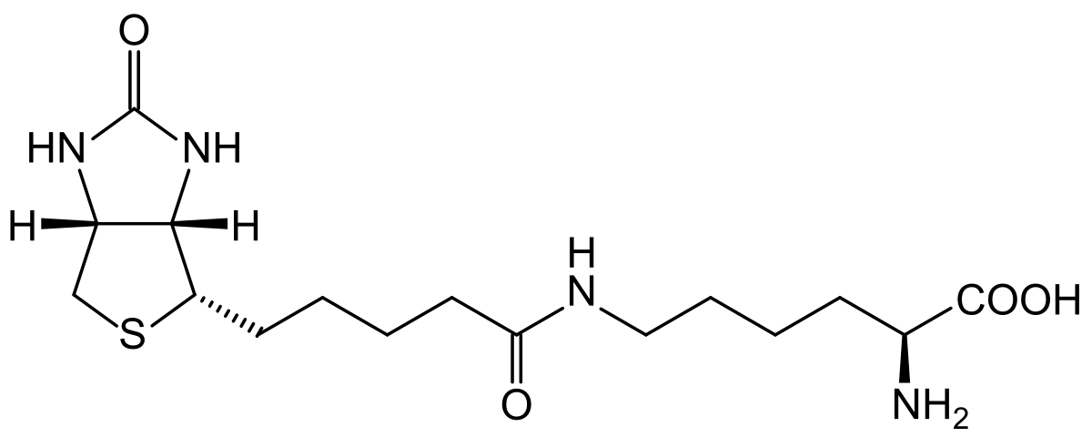
DNA microarray principle
The extracted RNA free genomic DNA from the bacterial overnight culture is internally biotin labelled through a set of antisense primers.
biotin
The resulting single stranded and biotin labelled amplicons are hybridized to a set of discriminative probes that are covalently bound onto the microarrays.
The biotin labelled DNA bound to the probes on the array is subsequently stained.
alere-technologies.com, www.wikipedia.de
Notes:
In the top row, this slide illustrates some of the technical steps involved in the preparation of bacterial DNA.
The presence of any of the 334 genetic probes in the bacterial sample is detected using antisense primers and subsequent PCR amplification.
The PCR products are termed amplicons. They are then labeled with biotin, a small molecule that is also known as vitamin B7.
The second row shows how the biotin-labeled DNA stretches are applied to the microarray.
Then, the bound PCR products are detected using a horse-radish peroxidase – streptavidin conjugate. Streptavidin binds tightly to biotin.
Then, a substrate (seramun green) is applied to the probe that is converted by the enzyme peroxidase into a dark-colored precipitate.
The colored spots are then read out automatically by the image reader.

Slide 14
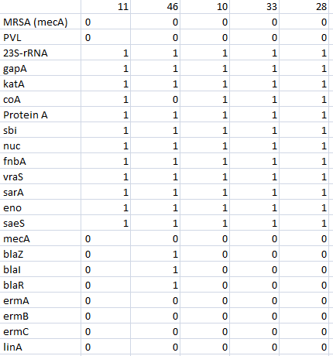
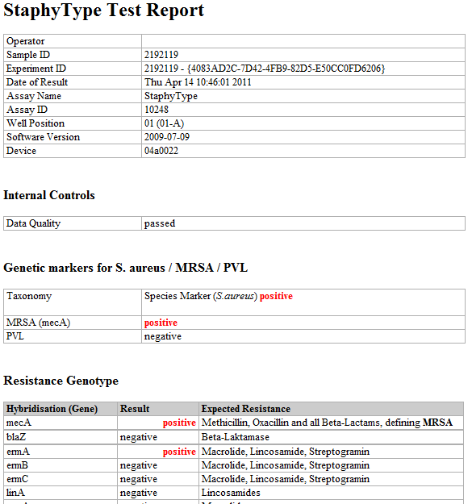

Process microarray data (334 probes)
Simple idea: Compute Euclidian distance between samples
Other distances are possible, also weighted distances, where some probes get higher weights.
Notes:
The left picture shows the header of the output that we obtained as a PDF file from the image reader.
A biologist would then sit down, look at each file and type the information contained in it into an Excel sheet. This is error-prone and labour-intensive.
Instead, Ruslan wrote a small piece of code to extract the presence and absence of the 334 probes in each sample from the PDF files.
In the right plot, 0 and 1 entries denote absence and presence of about 20 genetic probes in 5 samples labeled from 11 to 28.
For example, the gene mecA encodes penicillin-binding protein 2A, which makes S.aureus resistant against penicillin-like antibiotics.
The task was now to express the degree of similarity between samples in a numerical way.
For this, we computed the Euclidian distance between any two columns of this matrix. In principle, one could also introduce weights for each row entry (gene) in the formula because the presence/absence of certain genes may be of different importance. But this information was not available to us. Hence, all weights were equal to 1.

Slide 15
Further distance measures
An edit distance is a way of quantifying how dissimilar two strings (e.g., words) are to one another by counting the minimum number of operations required to transform one string into the other.
Edit distance variant 1: The Levenshtein distance allows deletions, insertions and substitutions.
Edit distance variant 2: The Hamming distance allows only substitutions. Hence, it only applies to strings of the same length and counts the number of positions at which the corresponding symbols are different.
Example: The Hamming distance between: "karolin" and "kathrin" is 3.
1011101 and 1001001 is 2.
The Mahalanobis distance is a measure of the distance between a point P and a distribution D (P. C. Mahalanobis, 1936).
It is a multi-dimensional generalization of the idea of measuring how many standard deviations away P is from the mean of D.
https://en.wikipedia.org/wiki/Category:Similarity_and_distance_measures
Notes:
There exist many further distance measures that are used in diverse fields of data mining.
The Wikipedia page cited at the bottom of the slide contains links to 26 distance measures including e.g. cosine similarity, Jaccard index or overlap coefficient.
On this slide, we explain the simple Hamming distance that belongs to the class of edit distances and also mention the Mahalanobis distance.

Slide 16
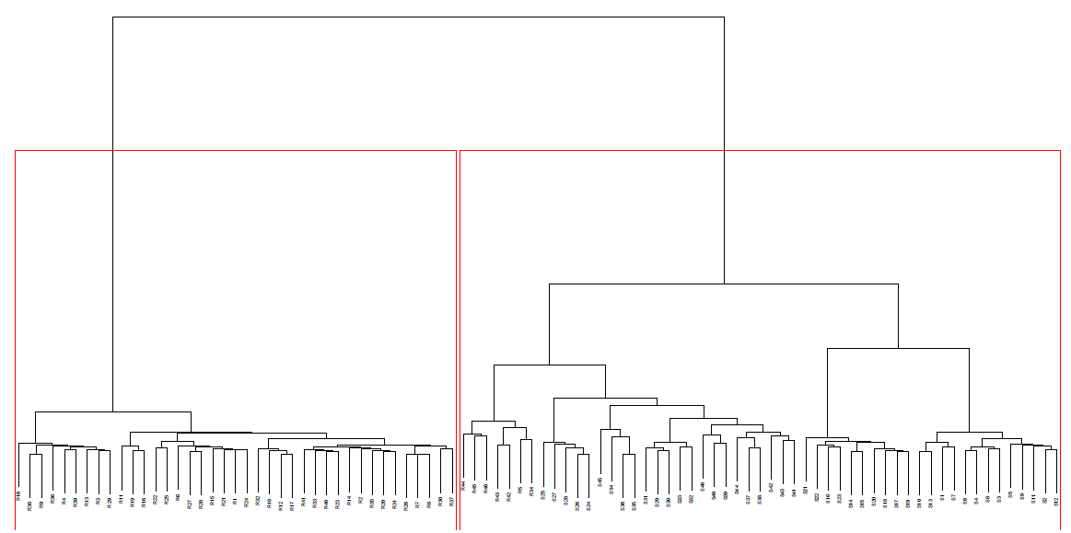
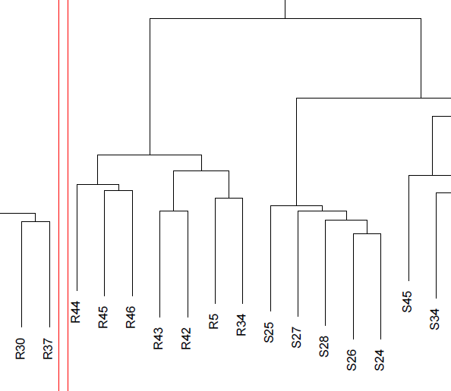
Hierarchical agglomerative clustering based on MA data
MRSA
MSSA
Hierarchical clustering:
(1) Calculate pairwise distance matrix for all samples to be clustered based on their Euclidian distances.
(2) Search distance matrix for two most similar samples or clusters (initially each cluster consists of a single sample).
If several pairs have the same separation distance, a predetermined rule is used to decide between alternatives.
(3) The two selected clusters are merged to produce a new cluster that now contains at least two objects.
(4) The distances are calculated between this new cluster and all other clusters.
(5) Repeat steps 2–4 until all objects are in one cluster.
Clustering based on Euclidian distance yields almost perfect separation between MSSA/MRSA
except the encircled resistant samples
Notes:
Based on their pairwise Euclidian distances, the bacterial samples were now hierarchically clustered. This method is a type of agglomerative clustering and is explained on the left side.
This yielded an almost perfect separation of MRSA and MSSA samples, except for 7 resistant samples (enclosed by a green circle) that are clustered together with MSSA samples.

Slide 17
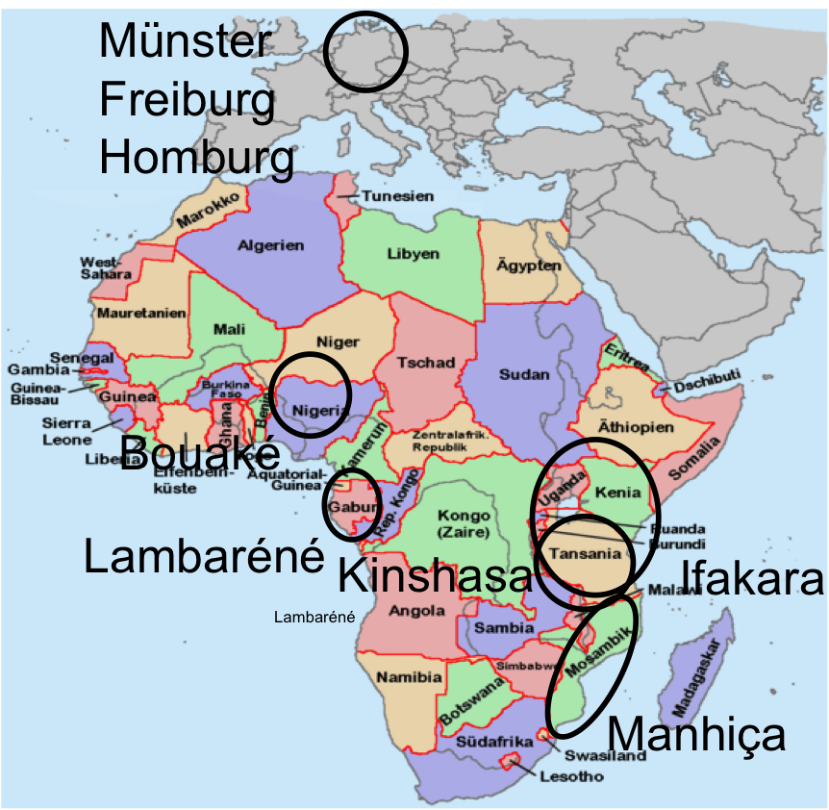
S. aureus in Germany vs. Africa: StaphNet
6 study sites each collected 100 isolates of healthy volunteers and 100 of blood culture or clinical infection sites
→ 1200 isolates
Aim
microbiological and molecular characterization of African S. aureus isolates
by DNA microarray analysis including clonal complex analysis
supplemented by Whole Genome Sequencing
Notes:
In a follow-up project of the first pilot study, we became partners of the international StaphNet consortium that was led by Prof. Mathias Herrmann from the medical department of Saarland University.
The consortium included partners from three African countries, Mozambique, Tanzania and Gabun and from three German cities, Münster, Freiburg and Homburg.
Each site collected isolates from the nose of healthy individuals and isolates from the blood of infected patients.
The objective of this study was to compare the molecular-epidemiologic profiles of S. aureus isolates from Sub-Saharan Africa and Germany.

Slide 18
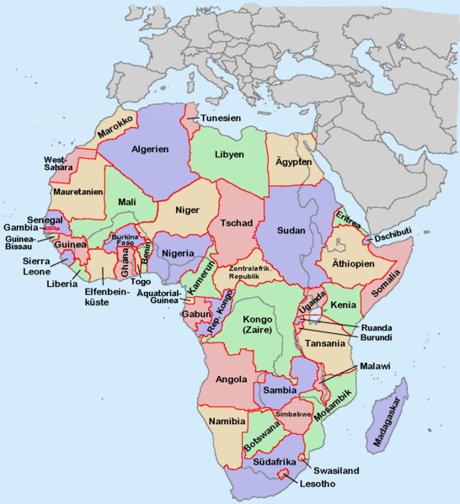
What does the microarray measure?
Naively, one can interpret the microarray result as
1 : gene is present in the strain
0 : gene is not present in the strain
However, false negative non-detections of particular targets may occur due to non-binding of the sample amplicon to the microarray’s probe or
primer oligonucleotide due to polymorphisms in the respective target gene.
On the other hand, false positive results may occur between highly similar probe and amplicon sequences, e. g. between agrI and agrIV.
Is this clear to you?
→ check MA results by whole genome sequencing
Strauss et al. J Clin Microbiol (2016)
Münster
Freiburg
Homburg
Münster
Freiburg
Homburg
Bouaké
Bouaké
Bouaké
Lambaréné
Kinshasa
Lambaréné
Kinshasa
Ifakara
Kinshasa
Ifakara
Lambaréné
Lambaréné
Manhiça
Manhiça
Notes:
The samples were again processed in the same way as in the pilot study by the DNA microarray.
Ideally, one could interpret the output of the image reader as presence and absence of genes in a bacterial genome.
However, you should realize that the microarray actually relies on a PCR protocol and on the hybridization of amplicons to the probe sequences on the chip.
If a particular resistance gene of this sample contains several SNP mutations with respect to the reference genome of S. aureus, the PCR product reflecting this gene may show poor hybridization to the probe.
One would then conclude that the gene is absent, although it is in fact present, but simply contains one or more mutations.
This would be an example of a false negative testing result.
On the other hand, one can also imagine false positive results that may occur, for example, by cross-hybridization.
An amplicon sequence representing a different gene may by accident also hybridize to a similar probe that actually stands for another gene.

Slide 19
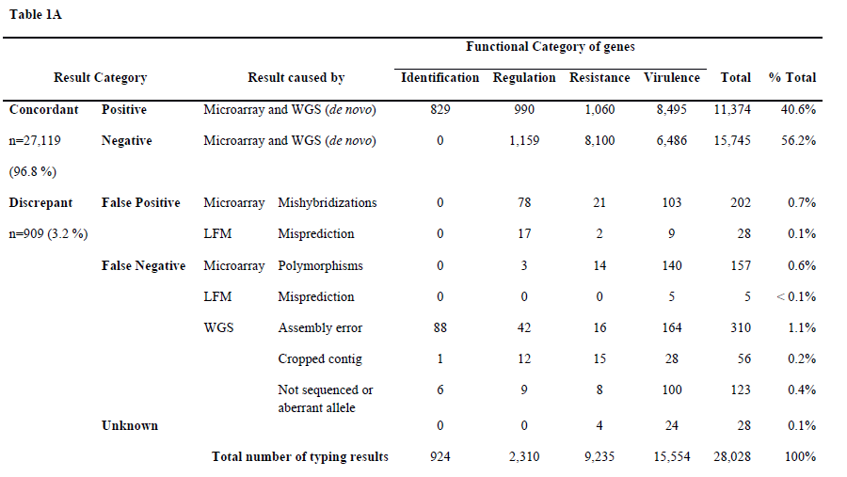
MA assignment to CCs confirmed by whole-genome sequencing
154 S. aureus isolates (182 target genes) from Germany-vs-Africa study
→ 97% agreement of MA and WGS
Strauss et al. J Clin Microbiol (2016)
Notes:
As a control, our partners from Münster therefore sequenced 154 bacterial isolates also by next generation sequencing
which can be assumed to provide more extensive and also more accurate information.
The point of the comparison was to validate the results of the DNA microarray experiments.
The comparison was restricted to 182 unique genes that are present on the microarray.
As shown here, the results of NGS and microarray are highly consistent or concordant.
In 40.6% of the cases, NGS and microarray jointly detected a gene, in 56.2% of the cases both methods agreed that it is absent.
This makes 96.8% agreement.
Both methods show an error rate of 1-2% due to various reasons that are listed here.
This comparison validates that the developers of the microarray did a very good job when they designed the hybridization sequences for the probe genes.

Slide 20
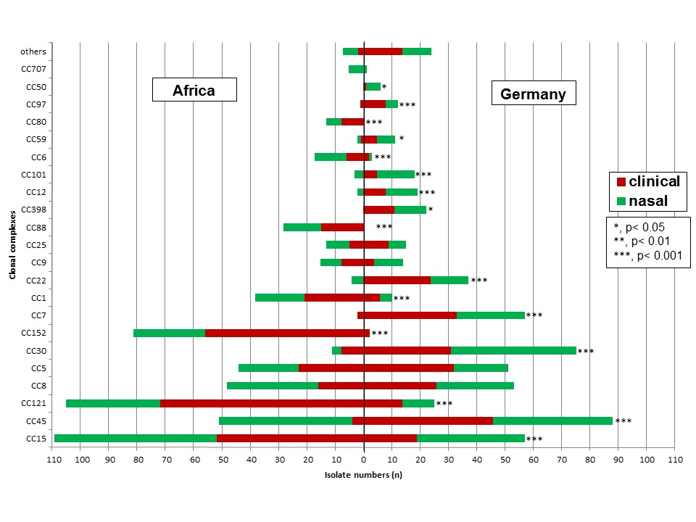
Distribution of clonal complexes
Some clonal complexes (CC) are more prevalent in Africa,
others predominant in Germany.
Ruffing et al. Sci. Rep. 7, 154 (2017)
Notes:
This is an overview of the samples collected in this project.
The y-axis displays different clonal complexes of Staphylococcus aureus. They are named CC followed by a number.
For S. aureus, a clonal complex contains a group of sequence types that share at least five of seven identical alleles with at least one other sequence type in the group.
Shown on the x-axis are the number of bacterial isolates of a particular clonal complex found either in Africa or in Germany.
The data is colored according to the origin, nasal isolates are colored green, clinical isolates red.
No members of CC80 and CC88 were found in Germany. No members of CC50 and CC398 in Africa.
All other CCs with at least six isolates were found both in Africa as well as in Germany.
For about half of the detected CCs, significant geographic distribution differences were found.
The statistical imbalance is marked by asterisks.

Slide 21
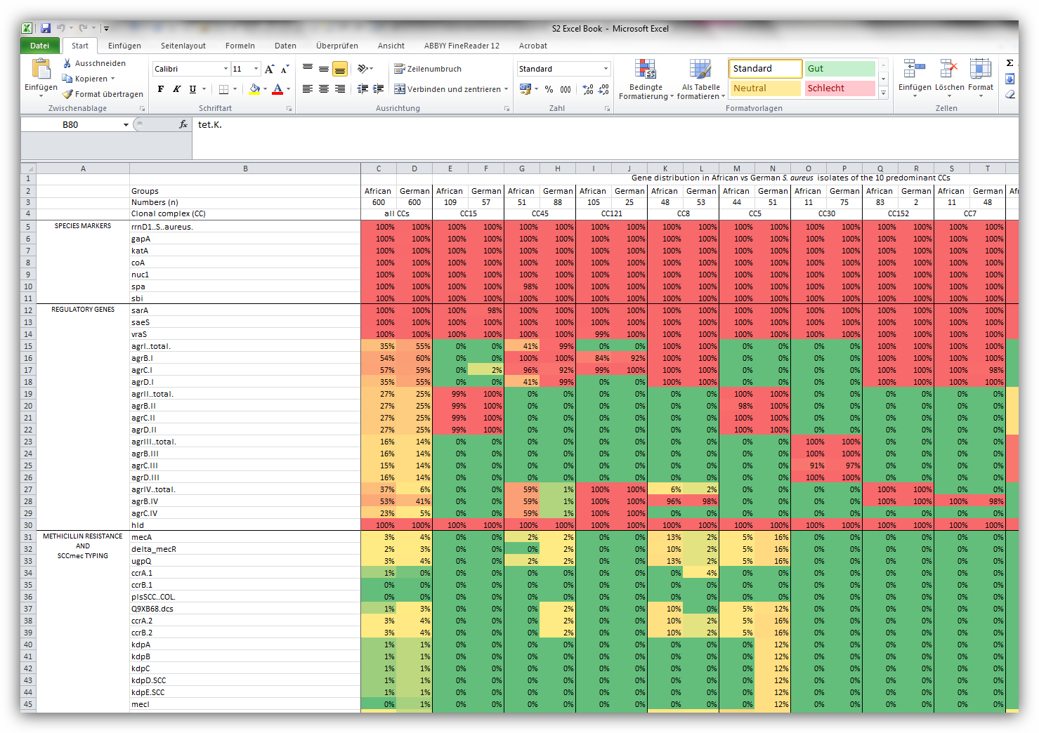
Activitity of individual probes for CCs
Notes:
Shown is here the frequency of finding the probe genes of the DNA microarray in a group of bacterial isolates.
The third column contains all isolates, columns to the right contain particular clonal complexes.
The top group of genes are characteristic marker genes of S.aureus that are detected in all isolates.
The bottom group are methicillin resistance genes. Very few isolates contain them.
The largest differences are observed in the middle group of regulatory genes of the agr family.
The accessory gene regulator (agr) locus of Staphylococcus aureus encodes a two-component signal transduction system that affects the expression of surface proteins and secreted proteins and also influences the expression of many virulence genes.

Slide 22
Antibiotic resistance
The majority of resistance genes were equally distributed among isolates from Africa and Germany. Striking differences in phenotypic resistance could be observed for tetracycline and trimethoprim-sulfamethoxazole with a larger proportion of resistant isolates in the African population, and clindamycin, with resistance more prevalent among German isolates
Ruffing et al. Sci. Rep. 7, 154 (2017)
Notes:
As shown on the previous slide, the majority of resistance genes were equally distributed among isolates from Africa and Germany.
These findings correspond well to the phenotypic resistance profile against certain antibiotics which are shown on this slide.
The most striking differences are marked by red boxes.
Usually when you have a bacterial infection (e.g. of the urinary tract), you go to the doctor and will receive a prescription for a broad-band antibiotics. Will it be effective against the bacteria? This depends on the chances for resistance. It would be safer to do a bacterial colony and determine the specifics of the bacterium. But this takes time and costs money.

Slide 23
Phylogenetic tree based on WGS data of 154 strains
neighbor-joining tree based on the allelic profiles of 1861 S. aureus core genome features.
-> the majority of clusters are based on the geographical region.
Clusters of isolates from infection or colonization were not detected
Notes:
Shown is a phylogeny of 154 strains based on data from whole genome sequencing (WGS).
Reference genomes of S. aureus at NCBI contain around 2800 genes.
A so-called core genome contains 1861 genes that are detected in practically all S. aureus isolates.
The phylogeny was constructed from the sequence variations found between these 1861 genes.
Most clusters detected in this way contain samples either from Africa or from Germany.

Slide 24
Clustering of all 1200 isolates based on MA is not handy
Can’t see too much
Notes:
Here, we tried to cluster all 1200 isolates based on the DNA microarray data and using the Euclidian distances as done before.
One can merely see some red, green or blue clusters, but actually the image is very messy.
The question is whether and how one can present this data in a somehow condensed fashion that would better reveal the differences between samples.

Slide 25
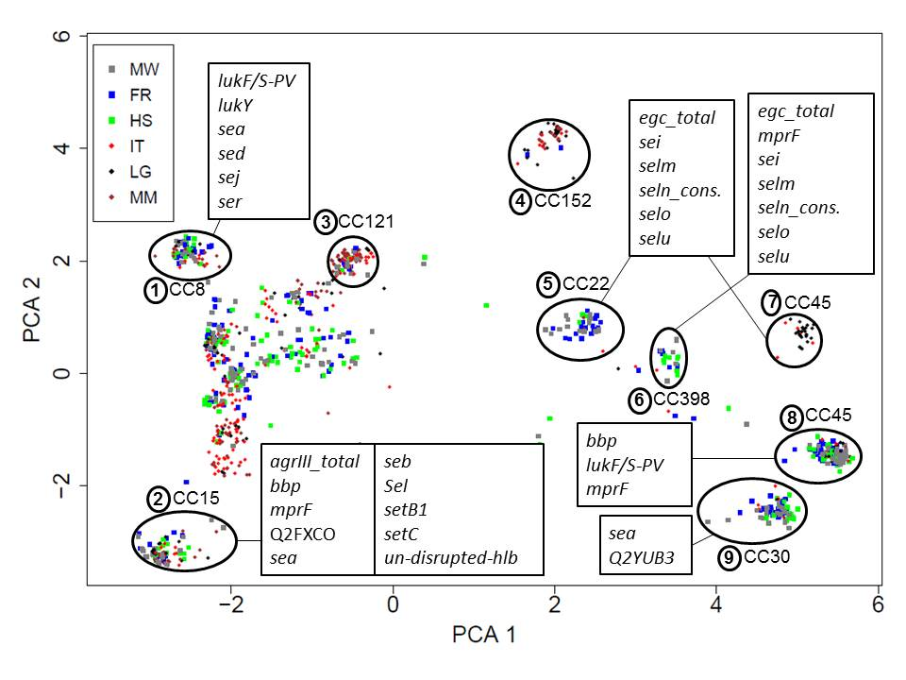
Principle component analysis of 1200 strains
Input data: binary matrix of MA data; dimension 1200 x 334 probes
PCA identifies local gene clusters that are characteristic
for particular clonal complexes
Color code:
6 different sites
Marked in boxes:
Characteristic genes present in this cluster.
Notes:
Shown here are the results of visualizing the same data – the gene inventory of 1200 bacterial samples – by a so-called principal component analysis.
The x-axis represents the projection of each sample along the first principal component vector termed PC1.
The y-axis those along PC2.
The color coding respresents the geographical origin of the probes.
Red or warm colors are used for African samples, green/blue or cold colors for German samples.
Many samples from the same clonal complexes cluster together because they share the same genes (and therefore have similar projections). This is captured by the microarray data.
Listed in text boxes are genes that are enriched in the samples in a circle with respect to the background of all other probes.
So altogether, this PCA analysis looks quite successful.

Slide 26
PCA- intro
PCA is the most popular multivariate statistical technique.
It is used by almost all scientific disciplines.
It is likely also the oldest multivariate technique.
Its origin can be traced back to Pearson, Cauchy, Jordan, Cayley etc
This part of the lecture is based on the article
“Principal component analysis” by Herve Abdi & Lynne J. Williams in
WIREs Computational Statistics, 2, 433-459 (2010)
Notes:
We will now discuss in detail how PCA works.

Slide 27
PCA- intro
PCA analyzes a data table X representing observations described by
several dependent variables, which are, in general, inter-correlated.
Q: What is the difference of dependent and independent variables?
The goal of PCA is to extract the important information from the
data table and express this information as a set of new orthogonal
variables called principal components
that capture the directions of largest variance in the data.
We will consider a data table X of I observations and J variables.
The elements are x_{ij}.
The matrix X has rank L where L ≤ min [I,J]
Notes:
The two main variables in an experiment are the independent and dependent variable.
An independent variable is the variable that is changed or controlled in a scientific experiment to test the effects on the dependent variable.
A dependent variable is the variable being tested and measured in a scientific experiment.
In our case, the dependent variable is the binary output of the DNA microarray experiment.
The independent variable could be the count of clonal complexes CC1, CC2, CC3 …. or the country of origin or the age of the individuals or whether they have diabetes or are co-infected by HIV.
The question would then be whether the presence/absence of genes that is detected by the microarray is a function of such independent variables.

Slide 28
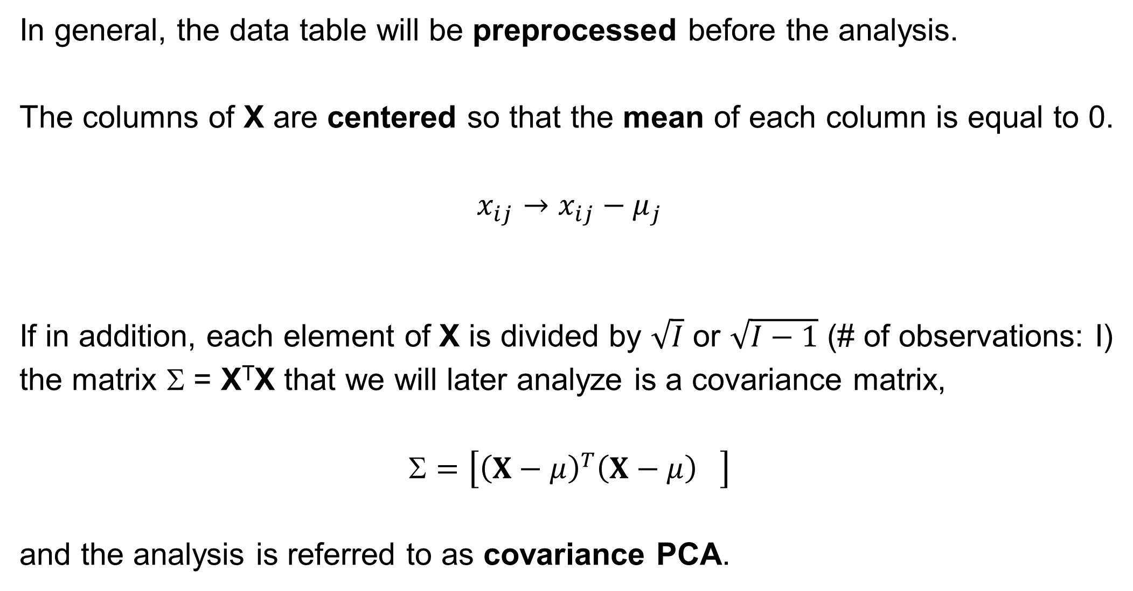
PCA- preprocessing data entries
In general, the data table will be preprocessed before the analysis.
The columns of X are centered so that the mean of each column is equal to 0.
$$x_{ij}→x_{ij}−μ_{j}$$
If in addition, each element of X is divided by $\sqrt{I}$ or $\sqrt{I−1}$ (# of observations: I)
the matrix Σ = X^{T}X that we will later analyze is a covariance matrix,
$$=\left[{{\left(X−μ\right)}^{T}\left(X−μ\right)}^{}\right]$$
and the analysis is referred to as covariance PCA.
Notes:
If you don‘t center the data, the result would differ and its interpretation becomes more difficult.

Slide 29
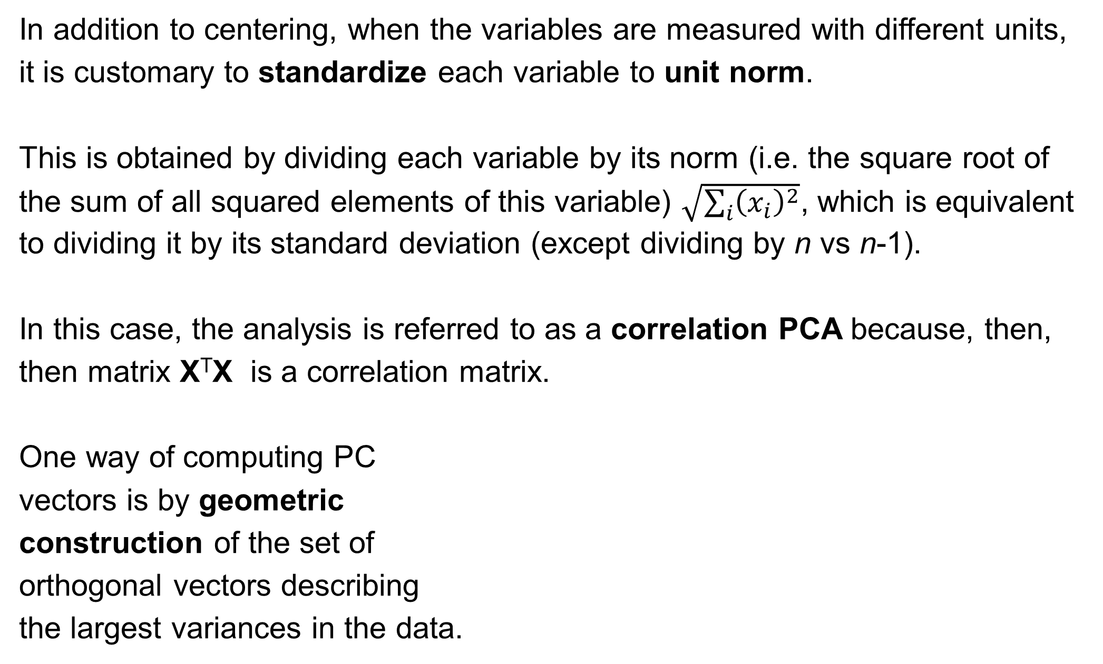
PCA- preprocessing data entries
In addition to centering, when the variables are measured with different units,
it is customary to standardize each variable to unit norm.
This is obtained by dividing each variable by its norm (i.e. the square root of the sum of all squared elements of this variable) $\sqrt{\sum_{i}{{\left(x_{i}\right)}^{2}}}$, which is equivalent to dividing it by its standard deviation (except dividing by n vs n-1).
In this case, the analysis is referred to as a correlation PCA because, then, then matrix X^{T}X is a correlation matrix.
One way of computing PC
vectors is by geometric
construction of the set of
orthogonal vectors describing
the largest variances in the data.
http://www.stefan-evert.de/PUB/Handout_LA_Trento_3.pdf
Notes:
Standardizing or normalizing the data is important if one uses variables with different units
or variables which measure incomparable „things“.
Remember that the PCA algorithm tries to find PC vectors that capture the largest variance in the data.
Let us assume we measure the size of different cars in three dimensions: length, width and height.
If we used units of metre for length and width and units of centimetre for the height, the coordinates for the height would be a factor of 100 larger than the coordinates of length and width.
PC1 would definitely be oriented along the height axis because the PCA algorithm thinks that this is the axis where cars differ most.

Slide 30
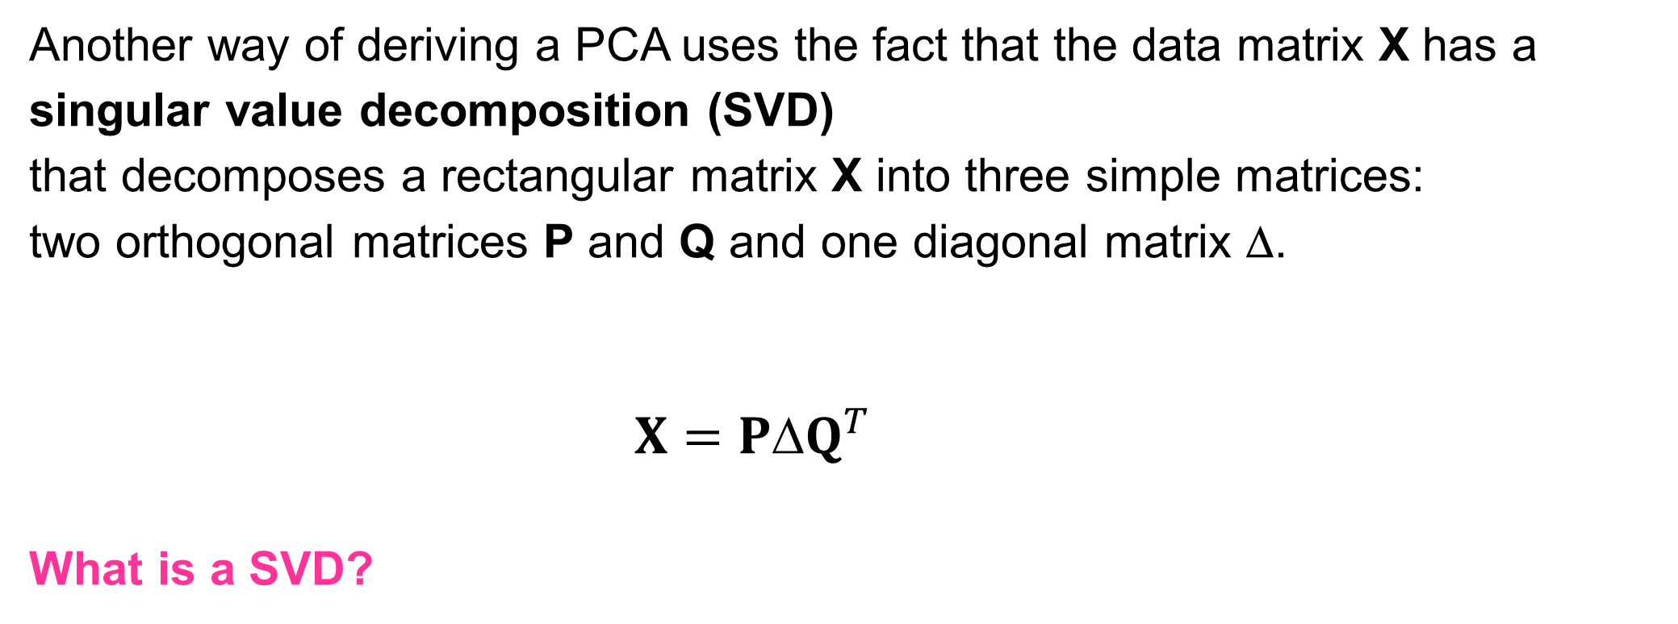
PCA- preprocessing data entries
Another way of deriving a PCA uses the fact that the data matrix X has a singular value decomposition (SVD)
that decomposes a rectangular matrix X into three simple matrices:
two orthogonal matrices P and Q and one diagonal matrix Δ.
$X=P{Q}^{T}$
What is a SVD?
Notes:
We will now review some basics from linear algebra that take us to the singular value decomposition.

Slide 31
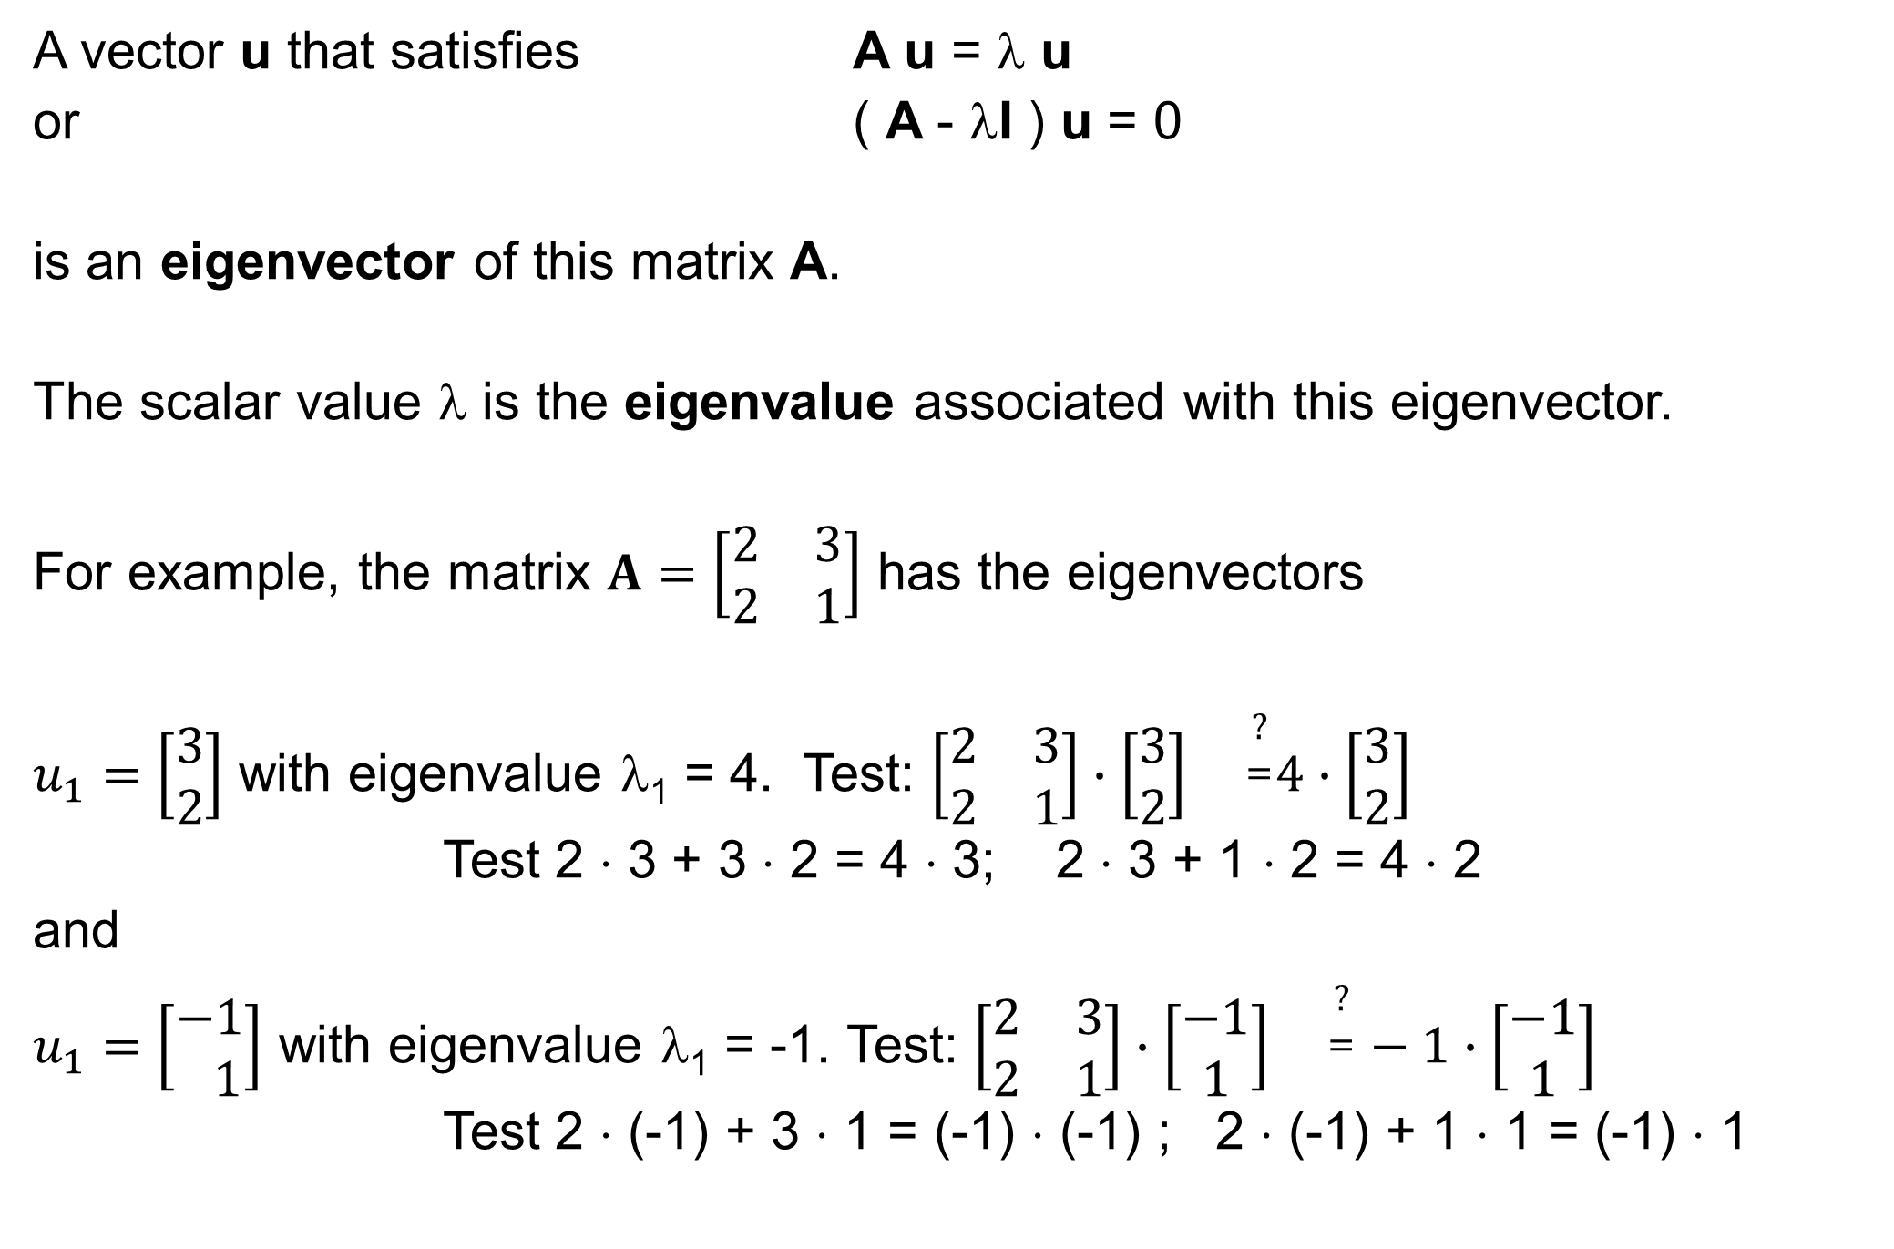
Insert: review of eigenvalues
A vector u that satisfies A u = λ u
or ( A - λI ) u = 0
is an eigenvector of this matrix A.
The scalar value λ is the eigenvalue associated with this eigenvector.
For example, the matrix $A=\left[\begin{matrix}2 & 3 \\ 2 & 1\end{matrix}\right]$ has the eigenvectors
$u_{1}=\left[\begin{matrix}3 \\ 2\end{matrix}\right]$ with eigenvalue λ₁ = 4. Test: $\left[\begin{matrix}2 & 3 \\ 2 & 1\end{matrix}\right]∙\left[\begin{matrix}3 \\ 2\end{matrix}\right]{}^{\begin{matrix}? \\ =\end{matrix}}4∙\left[\begin{matrix}3 \\ 2\end{matrix}\right]$
Test 2 ⋅ 3 + 3 ⋅ 2 = 4 ⋅ 3; 2 ⋅ 3 + 1 ⋅ 2 = 4 ⋅ 2
and
$u_{1}=\left[\begin{matrix}−1 \\ 1\end{matrix}\right]$ with eigenvalue λ₁ = -1. Test: $\left[\begin{matrix}2 & 3 \\ 2 & 1\end{matrix}\right]∙\left[\begin{matrix}−1 \\ 1\end{matrix}\right]{}^{\begin{matrix}? \\ =\end{matrix}}−1∙\left[\begin{matrix}−1 \\ 1\end{matrix}\right]$
Test 2 ⋅ (-1) + 3 ⋅ 1 = (-1) ⋅ (-1) ; 2 ⋅ (-1) + 1 ⋅ 1 = (-1) ⋅ 1
Notes:
You probably know these things very well. No need to add any explanations here.

Slide 32
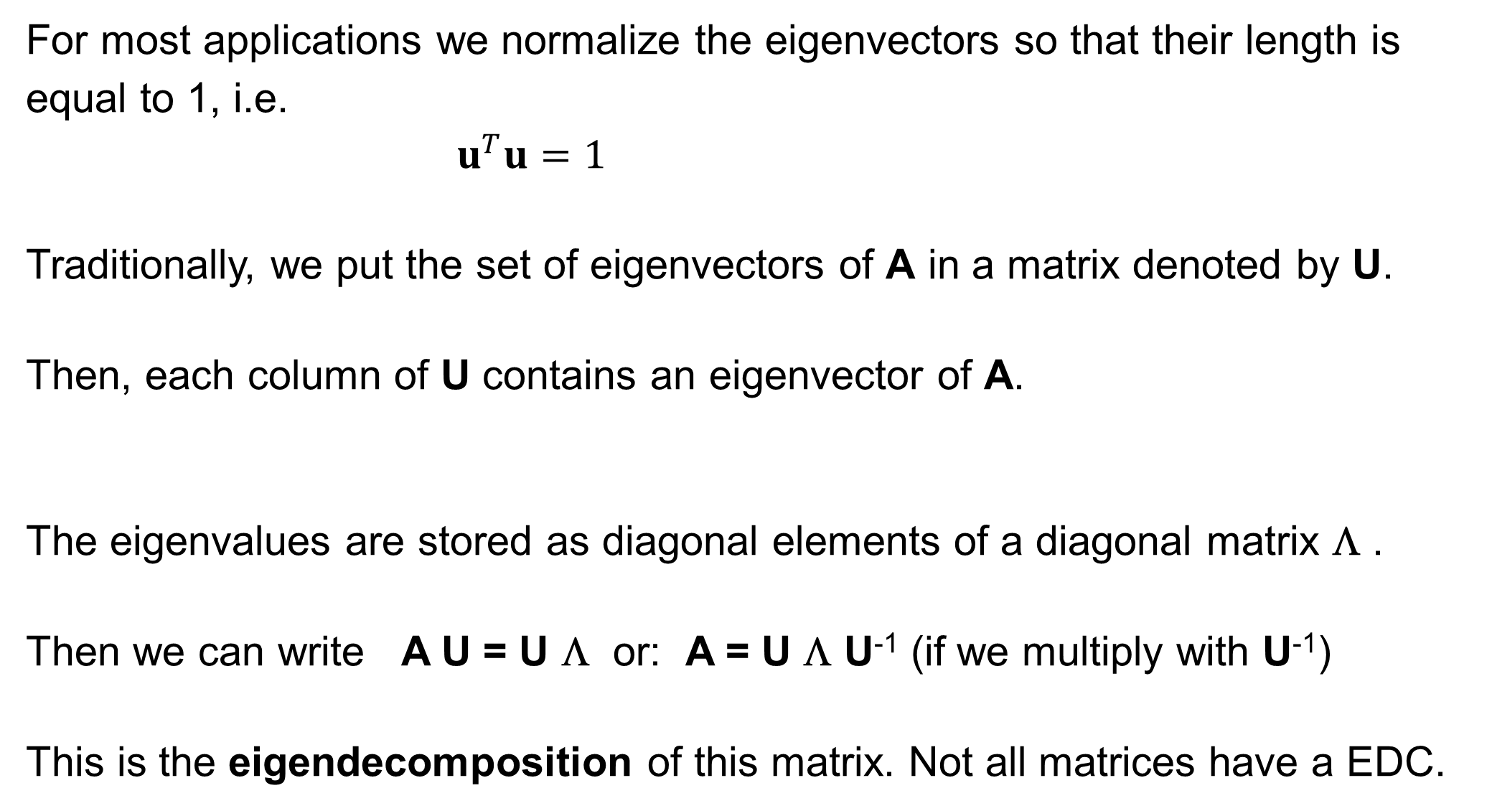
Insert: review of eigenvalues
For most applications we normalize the eigenvectors so that their length is equal to 1, i.e.
$u^{T}u=1$
Traditionally, we put the set of eigenvectors of A in a matrix denoted by U.
Then, each column of U contains an eigenvector of A.
The eigenvalues are stored as diagonal elements of a diagonal matrix Λ .
Then we can write A U = U Λ or: A = U Λ U⁻¹ (if we multiply with U⁻¹)
This is the eigendecomposition of this matrix. Not all matrices have a EDC.
Notes:
Only diagonalizable matrices can be factorized as an eigendecomposition.
We will leave the details to the mathematicians.

Slide 33
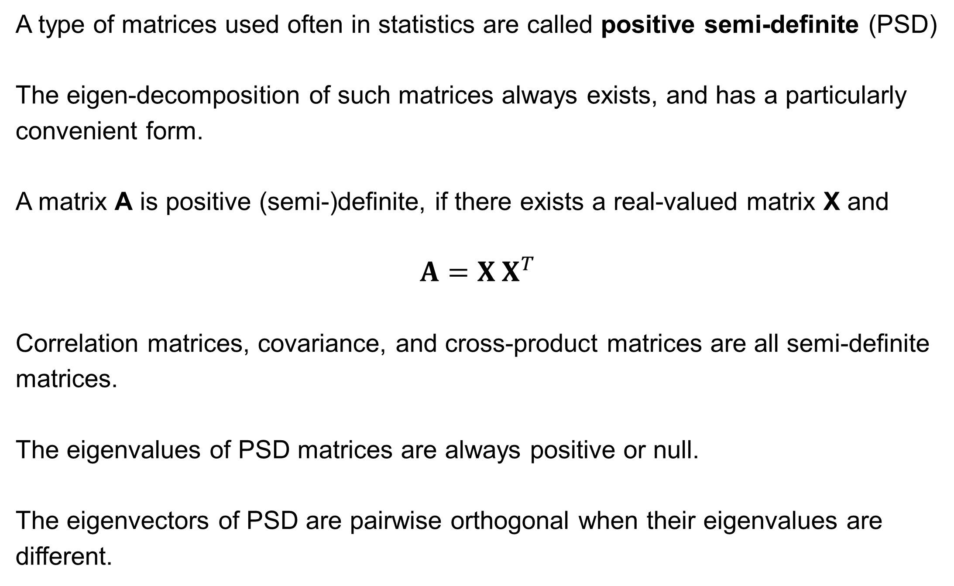
Insert: positive (semi-) definite matrices
A type of matrices used often in statistics are called positive semi-definite (PSD)
The eigen-decomposition of such matrices always exists, and has a particularly convenient form.
A matrix A is positive (semi-)definite, if there exists a real-valued matrix X and
$$A=X X^{T}$$
Correlation matrices, covariance, and cross-product matrices are all semi-definite matrices.
The eigenvalues of PSD matrices are always positive or null.
The eigenvectors of PSD are pairwise orthogonal when their eigenvalues are different.
Notes:
Also here, we will skip the mathematical details.

Slide 34
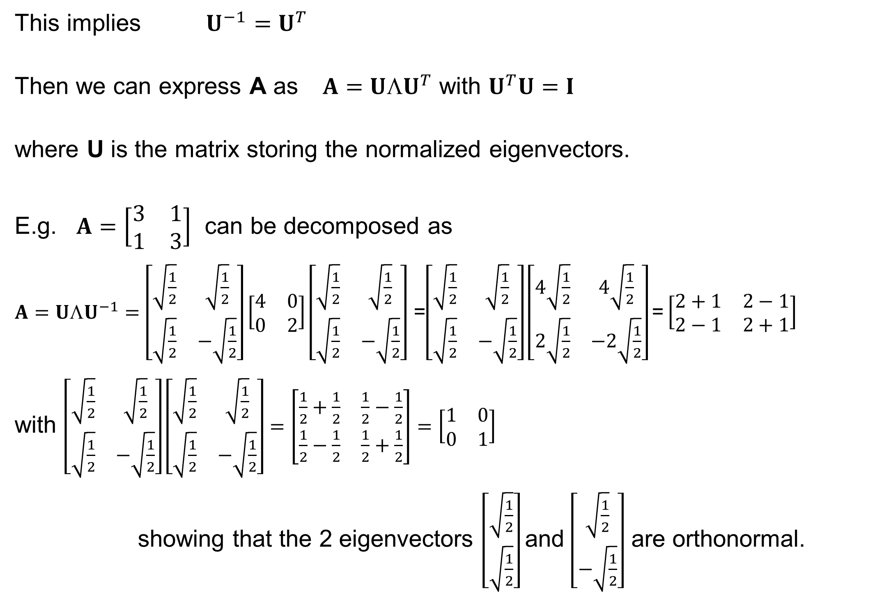
Insert: positive (semi-) definite matrices
This implies $U^{−1}=U^{T}$
Then we can express A as $A=U{☹U}^{T}$ with $U^{T}U=I$
where U is the matrix storing the normalized eigenvectors.
E.g. $A=\left[\begin{matrix}3 & 1 \\ 1 & 3\end{matrix}\right]$ can be decomposed as
$A=U{ΛU}^{−1}=\left[\begin{matrix}\sqrt{\frac{1}{2}} & \sqrt{\frac{1}{2}} \\ \sqrt{\frac{1}{2}} & −\sqrt{\frac{1}{2}}\end{matrix}\right]\left[\begin{matrix}4 & 0 \\ 0 & 2\end{matrix}\right]\left[\begin{matrix}\sqrt{\frac{1}{2}} & \sqrt{\frac{1}{2}} \\ \sqrt{\frac{1}{2}} & −\sqrt{\frac{1}{2}}\end{matrix}\right]$ =$\left[\begin{matrix}\sqrt{\frac{1}{2}} & \sqrt{\frac{1}{2}} \\ \sqrt{\frac{1}{2}} & −\sqrt{\frac{1}{2}}\end{matrix}\right]\left[\begin{matrix}4\sqrt{\frac{1}{2}} & 4\sqrt{\frac{1}{2}} \\ 2\sqrt{\frac{1}{2}} & −2\sqrt{\frac{1}{2}}\end{matrix}\right]\text{=}\left[\begin{matrix}2+1 & 2−1 \\ 2−1 & 2+1\end{matrix}\right]$
with $\left[\begin{matrix}\sqrt{\frac{1}{2}} & \sqrt{\frac{1}{2}} \\ \sqrt{\frac{1}{2}} & −\sqrt{\frac{1}{2}}\end{matrix}\right]\left[\begin{matrix}\sqrt{\frac{1}{2}} & \sqrt{\frac{1}{2}} \\ \sqrt{\frac{1}{2}} & −\sqrt{\frac{1}{2}}\end{matrix}\right]=\left[\begin{matrix}\frac{1}{2}+\frac{1}{2} & \frac{1}{2}−\frac{1}{2} \\ \frac{1}{2}−\frac{1}{2} & \frac{1}{2}+\frac{1}{2}\end{matrix}\right]=\left[\begin{matrix}1 & 0 \\ 0 & 1\end{matrix}\right]$
showing that the 2 eigenvectors $\left[\begin{matrix}\sqrt{\frac{1}{2}} \\ \sqrt{\frac{1}{2}}\end{matrix}\right]$and $\left[\begin{matrix}\sqrt{\frac{1}{2}} \\ −\sqrt{\frac{1}{2}}\end{matrix}\right]$ are orthonormal.
Notes:
This is a brief review of some linear algebra.

Slide 35
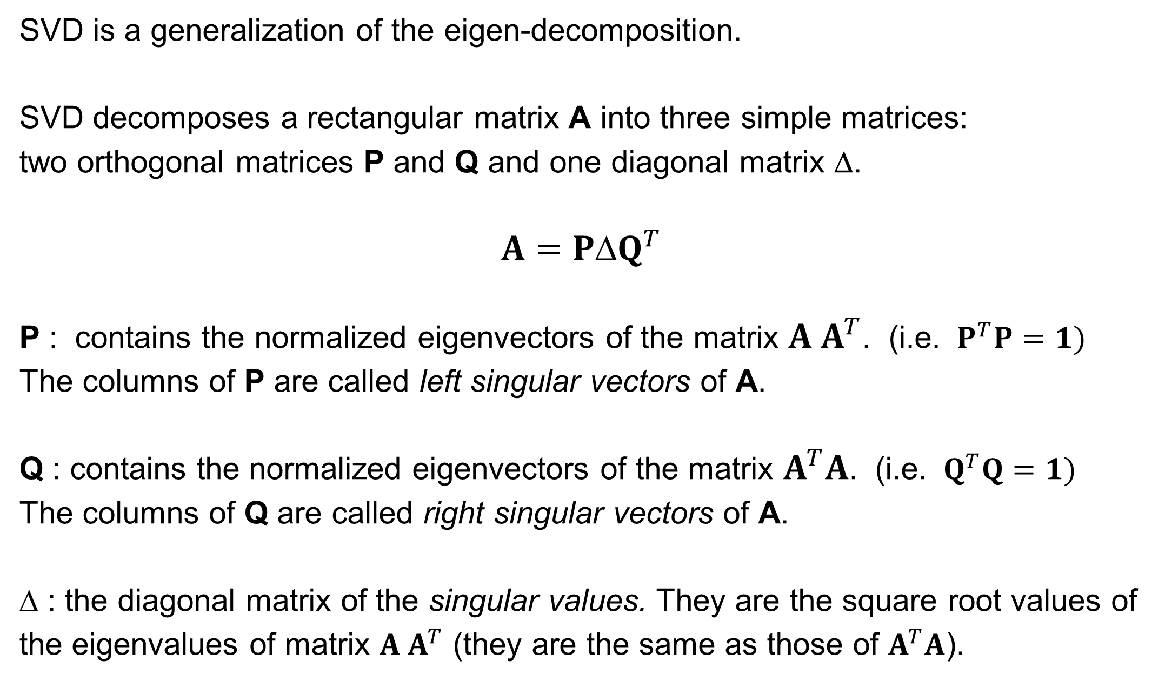
Singular Value Decomposition (SVD)
SVD is a generalization of the eigen-decomposition.
SVD decomposes a rectangular matrix A into three simple matrices:
two orthogonal matrices P and Q and one diagonal matrix Δ.
$$A=P{Q}^{T}$$
P : contains the normalized eigenvectors of the matrix $A A^{T}$. (i.e. $P^{T}P=1)$
The columns of P are called left singular vectors of A.
Q : contains the normalized eigenvectors of the matrix $A^{T}A$. (i.e. $Q^{T}Q=1)$
The columns of Q are called right singular vectors of A.
$$ : the diagonal matrix of the singular values. They are the square root values of the eigenvalues of matrix $A A^{T}$ (they are the same as those of $A^{T}A$).
Notes:
The rows of an orthogonal matrix are an orthonormal basis.
That is, each row has length one, and are mutually perpendicular.

Slide 36
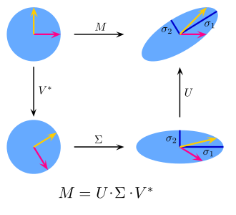
Interpretation of SVD
In the special, yet common, case when M is an m × m real square matrix with positive determinant, U, V∗, and Σ are real m × m matrices as well. Σ can be regarded as a scaling matrix, and U, V∗ can be viewed as rotation matrices.
www.wikipedia.org
Notes:
This is an intuitive illustration how the combined action of matrix M on the top-left data points can be decomposed as sequential application of the rotation matrix V*, a compression by the diagonal matrix sigma which scales the two coordinate axes, and of the second rotation matrix U.

Slide 37
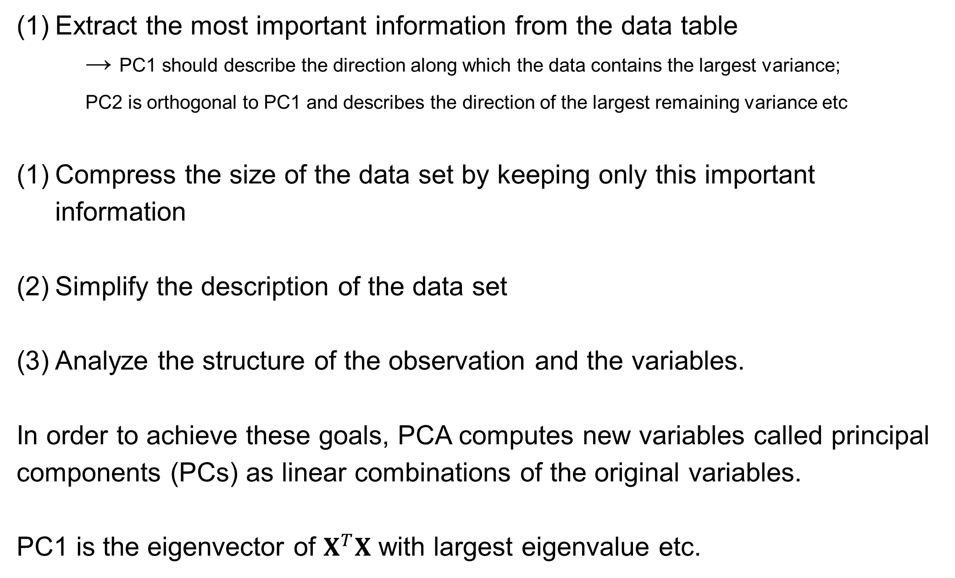
Goals of PCA
Extract the most important information from the data table
→ PC1 should describe the direction along which the data contains the largest variance;
PC2 is orthogonal to PC1 and describes the direction of the largest remaining variance etc
Compress the size of the data set by keeping only this important information
Simplify the description of the data set
Analyze the structure of the observation and the variables.
In order to achieve these goals, PCA computes new variables called principal components (PCs) as linear combinations of the original variables.
PC1 is the eigenvector of $X^{T}X$ with largest eigenvalue etc.
Notes:
These are again the goals of PCA.

Slide 38
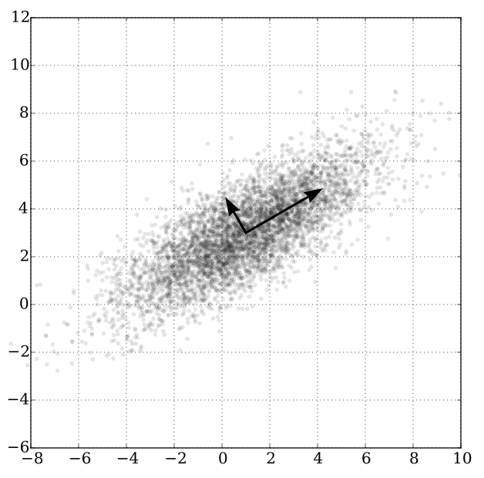
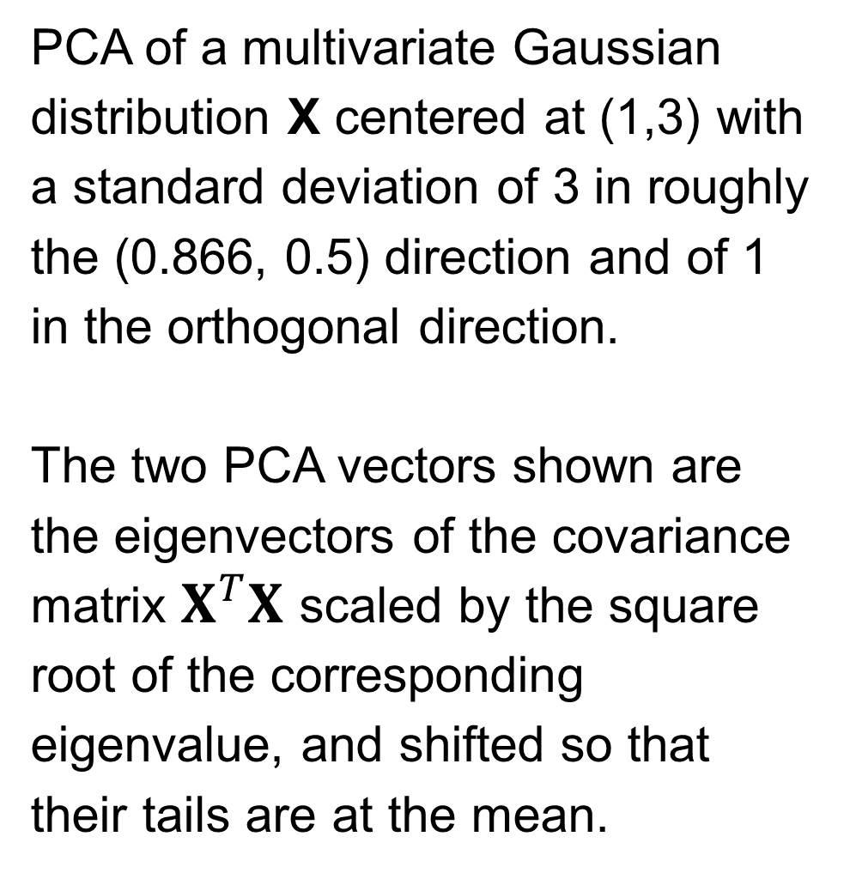
PCA example
PCA of a multivariate Gaussian distribution X centered at (1,3) with a standard deviation of 3 in roughly the (0.866, 0.5) direction and of 1 in the orthogonal direction.
The two PCA vectors shown are the eigenvectors of the covariance matrix $X^{T}X$ scaled by the square root of the corresponding eigenvalue, and shifted so that their tails are at the mean.
Note that shown here is the data along the original coordinates.
In a PCA plot, the data is projected onto two PCs, usually PC1 and PC2.
www.wikipedia.org
Notes:
The PCA of this data set was likely performed on centered data.
The two PC vectors were then shifted back to the mean of the original data and rotated with respect to the original variables according to their loadings.

Slide 39
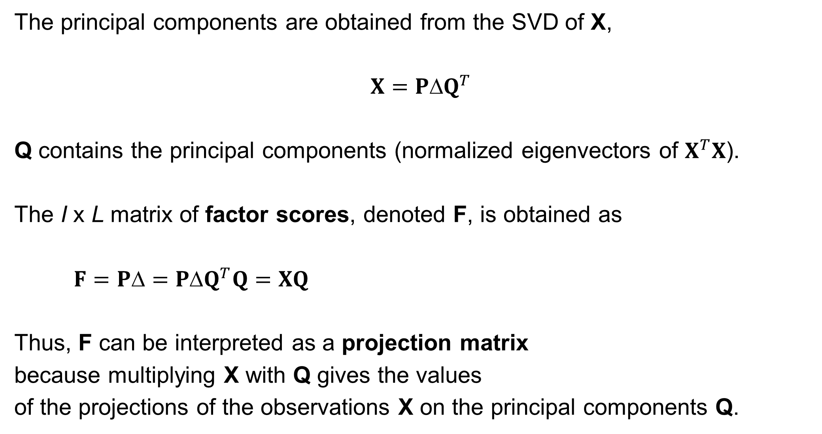
Deriving the components
The principal components are obtained from the SVD of X,
$X=P{Q}^{T}$
Q contains the principal components (normalized eigenvectors of $X^{T}X$).
The I x L matrix of factor scores, denoted F, is obtained as
$F=P{=PQ}^{T}Q=XQ$
Thus, F can be interpreted as a projection matrix
because multiplying X with Q gives the values
of the projections of the observations X on the principal components Q.
Notes:
The results of a PCA are usually discussed in terms of component scores (or factor scores) and loadings.
The factor scores are the projections of the original data points onto the principal component vectors.
The so-called loadings describe the relationship between the PCs and the original variables.

Slide 40
PCA of MA hybridization data (again)
PCA identifies local clusters that are characteristic
for particular clonal complexes
Projection (factor score) of data points on PC1
Notes:
This is the same plot that was shown earlier.
Shown are projections (factor scores) of the original data points onto the two first PC vectors.

Slide 41
Summary
What we have covered today:
Detection of DNA probes by DNA microarray
Euclidian distance of 1/0 signals as distance measure
Clustering of MA data
PCA analysis of MA data
Next lecture:
- Reconstruct missing (ambiguous) data values with BEclear
Notes:
Today‘s lecture was a typical mix of looking into a real-life task from a past research project
and an introduction of some helpful mathematical techniques that we used in this project.
Often your experimental collaborators will completely depend on you.
They will tell you „You are the bioinformatician. You know what needs to be done.“
In some cases, you may actually know what to do.
In the other cases, you need to refresh your math or to pick up new skills.
In such a collaboration, the data analysis part is your job!
Luckily you are usually not the first one to solve such a problem.
So you should read a lot and talk to other people how they have solved the same problem before.

