Slide 1
V4 – differential gene expression analysis - outliers
V2: data imputation
V3: batch effects
What is measured by microarrays?
Microarray normalization
Differential gene expression (DE) analysis based on microarray data
Detection of outliers
RNAseq data
DE analysis based on RNAseq data
Notes:
In today‘s lecture, we will discuss the detection of differentially expressed genes between samples from two groups.
The 2 groups may correspond to healthy and disease conditions or to two sequential stages in cellular differentiation.
Traditionally, gene expression was measured by DNA microarrays.
Since 2015 or so, this has been replaced more and more by next generation sequencing, namely the RNAseq technology.
But there still exists a lot of useful expression data in public repositories that was measured by microarrays.
So, bioinformaticians will keep analyzing this data in the coming years.

Slide 2
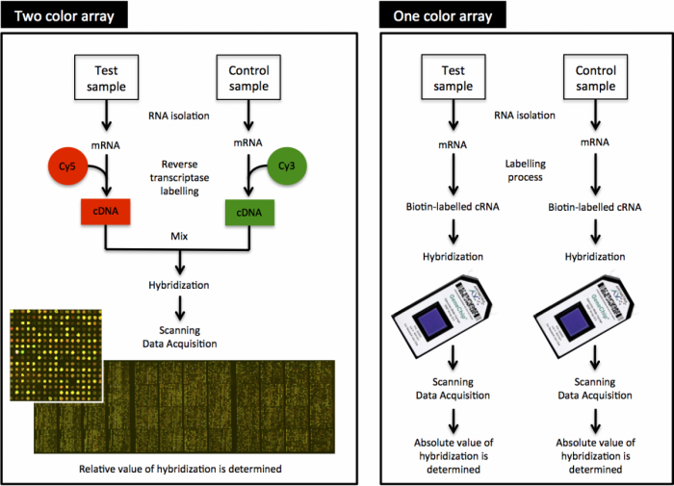
What is measured by microarrays?
Microarrays are a collection of DNA probes that are bound in defined positions to a solid surface, such as a glass slide.
The probes are generally oligonucleotides that are ‘ink-jet printed’ onto slides (Agilent) or synthesised in situ (Affymetrix).
Labelled single-stranded DNA or antisense RNA fragments from a sample are hybridised to the DNA microarray.
The amount of hybridisation detected for a specific probe is proportional to the number of nucleic acid fragments in the sample.
http://www.ebi.ac.uk/training/online/course/
functional-genomics-ii-common-technologies-and-data-analysis-methods/microarrays
Notes:
We will start with some basics about the microarray technology.
Essentially, microarrays detect the hybridization (binding) of single-stranded DNA stretches of the probe to single-stranded DNA probes that were chemically fixed in the wells of the microarray chip.
Each well contains many copies of the same DNA fragment.
The fragments have a typical length of 40-60 nt. If they were much shorter, then multiple DNA stretches could bind to them -> loss of specificity.
If they were much longer, this would increase the costs for production, and carry the danger that the DNA fragment finds a way to hybridize with itself -> loss of accessibility.
So if we want to apply DNA microarrays to measure the abundance of mRNAs in the sample, we first need to reverse-transcribe the mRNAs into cDNA.
Also, we need a detectable readout. For this, we label the cDNA stretches with a fluorescent dye molecule.

Slide 3
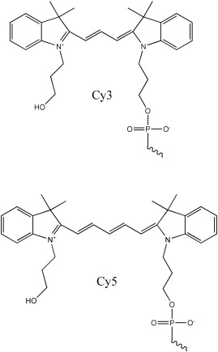
2-color microarrays
In 2-colour microarrays, 2 biological samples are labelled with different fluorescent dyes, usually Cyanine 3 (Cy3) and Cyanine 5 (Cy5).
Equal amounts of labelled cDNA are then simultaneously hybridised to the same microarray chip.
Then, the fluorescence measurements are made separately for each dye and represent the abundance of each gene in the test sample (Cy5) relative to the control sample (Cy3).
http://www.ebi.ac.uk/training/online/course/
functional-genomics-ii-common-technologies-and-data-analysis-methods/microarrays
www.sciencedirect.com
Notes:
If we use 2 different fluorescent dye molecules that emit at different light colors (e.g. green and red light), then we can detect to which sample the majority of cDNA/mRNA belonged to.
Remember: we are not measuring the original mRNA abundance. A cell often only contains 1 – 10 copies of individual mRNA molecules. Detecting this on a chip is practically impossible. This can only be done by mass spectrometry.
Also, we measure the amount of labeled cDNA that was obtained after several chemical processing steps. Each of them has its own efficiency.

Slide 4
MicroArray Quality Control (MAQC) project (2006)
MAQC project: community-wide effort that was initiated and led by FDA scientists involving 137 participants from 51 organizations.
In this project, gene expression levels were measured
- from 2 high-quality, distinct RNA samples (Universal Human Reference RNA (UHRR) from Stratagene and a Human Brain Reference RNA (HBRR) from Ambion)
- in 4 titration pools (Sample A, 100% UHRR; Sample B, 100% HBRR; Sample C, 75% UHRR:25% HBRR; and Sample D, 25% UHRR:75% HBRR.)
- on 7 microarray platforms (Applied Biosystems (ABI); Affymetrix (AFX); Agilent Technologies (AGL for two-color and AG1 for one-color); GE Healthcare (GEH); Illumina (ILM) and Eppendorf (EPP))
- and 3 alternative expression methodologies (TaqMan Gene Expression Assays; StaRT-PCR from Gene Express (GEX) and QuantiGene assays from Panomics (QGN)).
Each microarray platform was deployed at 3 independent test sites and 5 replicates were assayed at each site.
Aim of this study: find out how reproducable MA experiments are.
Nature Biotechnology 24, 1151–1161(2006)
Notes:
Here, we review the findings of a large-scale comparison that tested the reproducability of MA experiments.
This is the link to the paper on the MACS study: https://www.nature.com/articles/nbt1239

Slide 5
MicroArray Quality Control (MAQC) project
The coefficient of variation (CV)
relates standard deviation to mean.
Shown here is CV of the signal (not log transformed) between the intrasite replicates (n ≤ 5) for genes that were detected in at least 3 replicates of the same sample type within a test site.
Most of the one-color microarray platforms and test sites demonstrated similar replicate CV median values of 5–15%.
Nature Biotechnology 24, 1151–1161(2006)
Notes:
ABI – NCI are the 7 different microarray platforms tested. The segments labeled A to D are the 4 titration pools. The right system termed NCI shows higher variability.
The boxplots illustrate the coefficient of variation (y-axis left), the zig-zag lines at the top indicate the number of detected genes (y-axis right).
For each segment, there are 3 data distributions representing 3 different test sites.
The authors concluded in the abstract of their paper that there exists “intraplatform consistency across test sites”.

Slide 6
MicroArray Quality Control (MAQC) project
Concordance of genes identified as differentially expressed for pairs of test sites, labeled as X and Y.
light-colored square: high percent overlap between the gene lists at both test sites.
dark-colored square: low percent overlap
For all but the NCI test sites, the gene list overlap is at least 60% for each test site comparison (both directions) with many site pairings achieving 80% or more between platforms and 90% within platforms.
Nature Biotechnology 24, 1151–1161(2006)
Notes:
The authors concluded in the abstract of their paper that there exists “a high level of interplatform concordance in terms of genes identified as differentially expressed.”
We will explain in a bit how differentially expressed genes are determined by different algorithms.
There is a follow study termed MACS-II: https://www.nature.com/articles/nbt.1665 that compared linear models for tumor outcome based on MA expression data

Slide 7
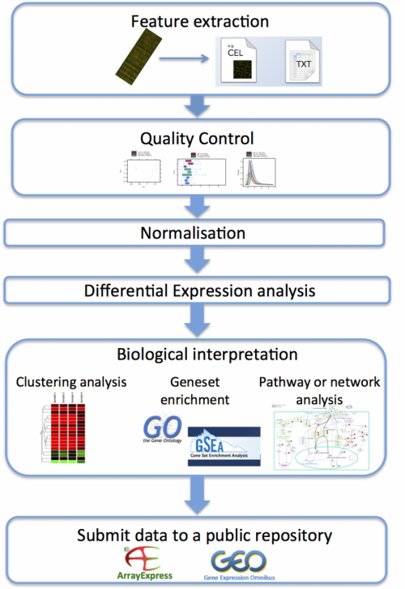
Analysis of microarray data: workflow
Microarrays can be used in many types of experiments including
- genotyping,
- epigenetics,
- translation profiling and
- gene expression profiling.
Gene expression profiling is by far the most common use of microarray technology.
Both one and two colour microarrays can be used for this type of experiment.
http://www.ebi.ac.uk/training/online/course/
functional-genomics-ii-common-technologies-and-data-analysis-methods/microarrays
Notes:
Here, we present an overview of the various steps of microarray data analysis.
The individual steps listed on the flow chart will be explained on subsequent slides.

Slide 8
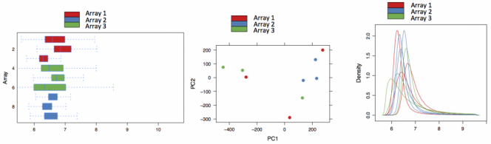
Quality control (QC) is done on the raw data
QC of microarray data begins with the visual inspection of the scanned microarray images to make sure that there are no obvious splotches, scratches or blank areas.
Data analysis software packages produce different sorts of diagnostic plots, e.g. of background signal, average intensity values and percentage of genes above background to help identify problematic arrays, reporters or samples.
  expression expression
  Box plot PCA Density plot
http://www.ebi.ac.uk/training/online/course/
functional-genomics-ii-common-technologies-and-data-analysis-methods/microarrays
Notes:
Box plot, PCA and density plot are different ways to visualize the distribution of data points in the individual samples, see also lecture #2 slide 21.
In the case shown here, no apparent outlier is visible.

Slide 9
Normalisation
Normalisation is used to control for technical variation between assays, while preserving the biological variation.
There are many ways to normalise the data. The methods used depend on:
- the type of array;
- the design of the experiment;
- assumptions made about the data;
- and the package being used to analyse the data.
For the Expression Atlas at EBI, Affymetrix microarray data is normalised using the 'Robust Multi-Array Average' (RMA) method within the 'oligo' package (which is based on quantile normalization).
Agilent microarray data is normalised using the 'limma' package:
'quantile normalisation' for one-colour microarray data;
'Loess normalisation' for two colour microarray data.
http://www.ebi.ac.uk/training/online/course/
functional-genomics-ii-common-technologies-and-data-analysis-methods/microarrays
Notes:
Normalization is crucial for analysis of microarray data, see also lecture #2 (quantile normalization of proteomics data).
The manufacturers of the microarray chips typically recommend particular normalization strategies that may (or may not?) be best suited for the data produced with their devices.
Usually, it is easiest to follow these instructions. This also avoids most of the trouble with reviewers of your manuscripts.

Slide 10
Differential expression analysis: Fold change
The simplest method to identify DE genes is to evaluate the log ratio between two conditions (or the average of ratios when there are replicates)
and consider all genes that differ by more than an arbitrary cut-off value to be differentially expressed.
E.g. the cut-off value chosen could be chosen as a two-fold difference.
Then, all genes are taken to be differentially expressed if the expression under one condition is over two-fold greater or less than that under the other condition.
This test, sometimes called 'fold' change, is not a statistical test.
→ there is no associated value that can indicate the level of confidence in the designation of genes as differentially expressed or not differentially expressed.
Cui & Churchill, Genome Biol. 2003; 4(4): 210.
Notes:
It is not possible to give a universal threshold above which fold changes should be considered „significant“.
One aspect is statistical significance. This cannot be answered by analyzing fold changes.
Another aspect is biological relevance. For some genes, a small fold change may already be very relevant to the cell. For other genes, only larger fold changes may induce a phenotypic change.

Slide 11
Standard error of the mean
The standard deviation σ gives the „standard“ deviation of all measurements.
Often we are more interested in the standard deviation of the average.
This is denoted by the standard error of the mean (SEM):
Whenever we use a random sample as estimate for a population, there is a good chance that our estimate will contain an error.
SEM provides an estimate for this error.
Typically, we actually need to compute SEM for the difference of the means of two random samples → 2-sample t-test.
Notes:
The standard deviation measures the typical deviation of single data points from the average.
But how about the standard deviation of the average itself?
This is measured by the standard error of the mean.
It is obtained by dividing the standard deviation by the square root of the number of data points.

Slide 12
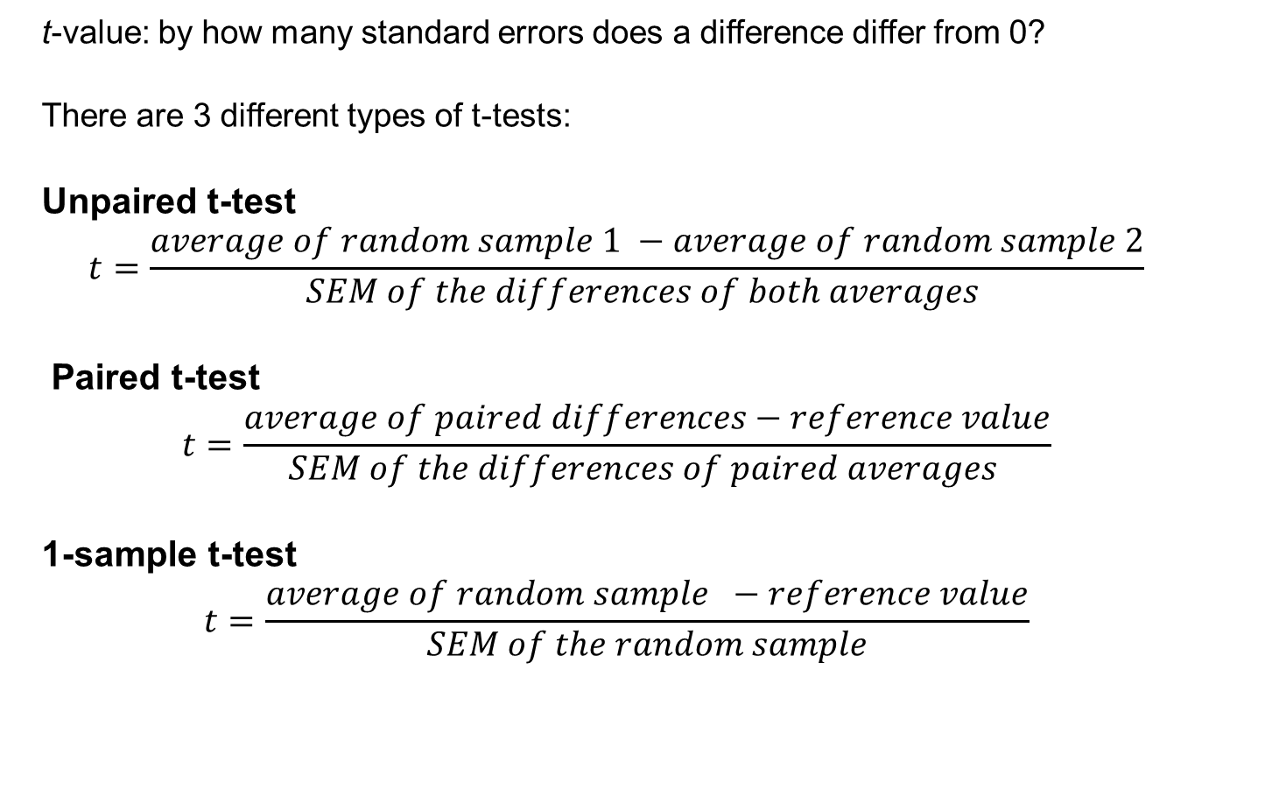
t-tests
t-value: by how many standard errors does a difference differ from 0?
There are 3 different types of t-tests:
Unpaired t-test
$$t=\frac{average of random sample 1 −average of random sample 2}{SEM of the differences of both averages }$$
Paired t-test
$$t=\frac{average of paired differences−reference value}{SEM of the differences of paired averages }$$
1-sample t-test
$$t=\frac{average of random sample −reference value}{SEM of the random sample}$$
Notes:
The student t-test compares the magnitude of the effect (e.g. what is the different of the averages of 2 sample groups) to the standard error of the mean.

Slide 13
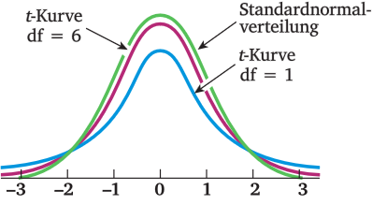
t distribution
The form of the t-distribution is very similar to a standard normal distribution – at least for large random samples.
For small random samples, the t-distribution is flatter than a normal distribution.
Therefore, the t-distribution needs another parameter that adjusts its variance (and thus its shape).
This parameter is called the degrees-of-freedom; abbreviated as df.
https://matheguru.com/stochastik/t-test.html
Notes:
To measure the statistical significance of the obtained t-values (effect over sd), the so-called t-distribution is used.
It is tabulated.

Slide 14
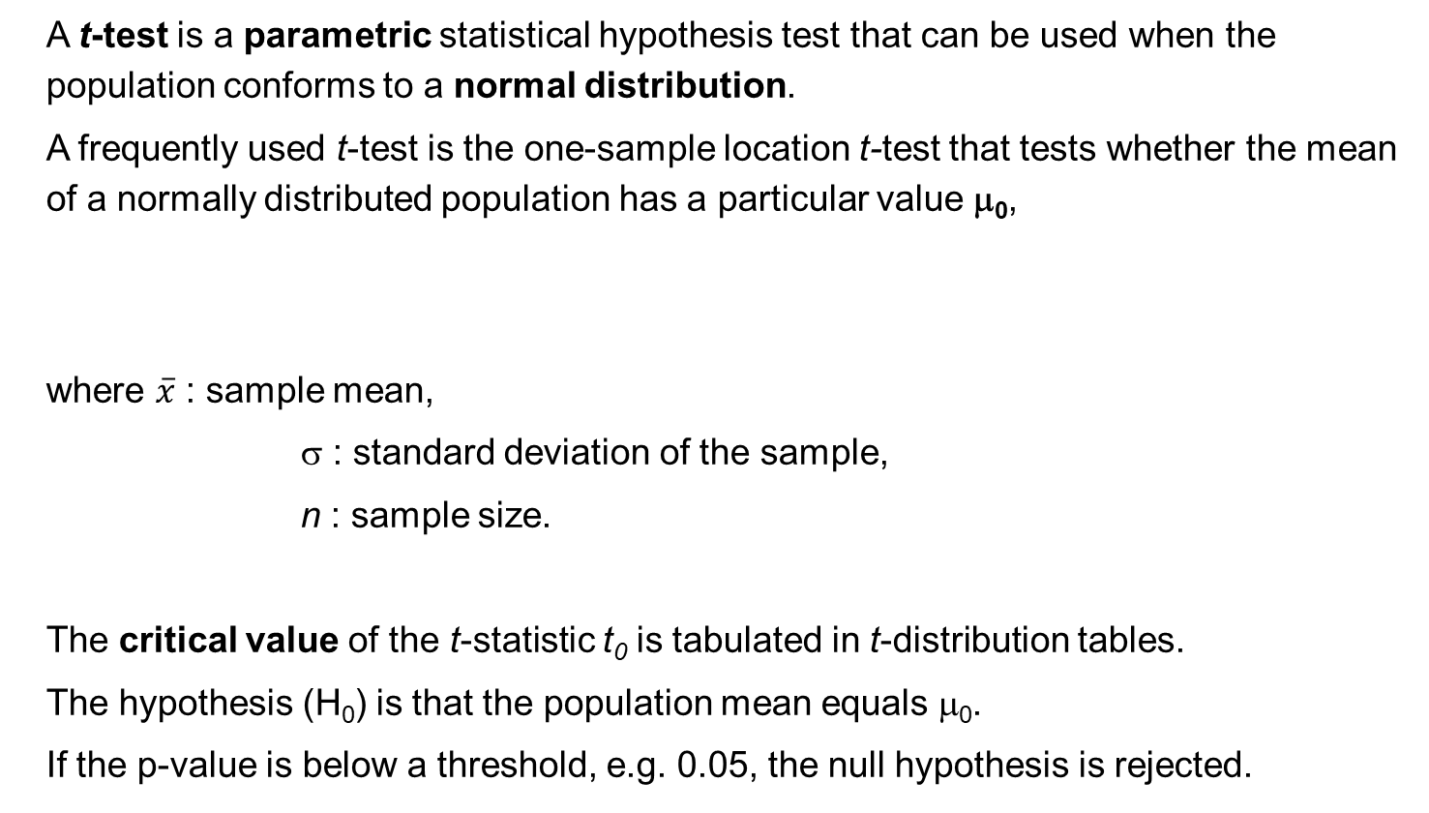
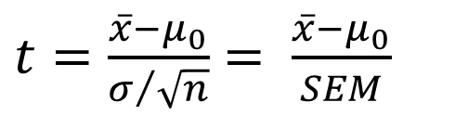
1-sample t-test
A t-test is a parametric statistical hypothesis test that can be used when the population conforms to a normal distribution.
A frequently used t-test is the one-sample location t-test that tests whether the mean of a normally distributed population has a particular value μ₀,
where $\overline{x}$ : sample mean,
σ : standard deviation of the sample,
n : sample size.
The critical value of the t-statistic t₀ is tabulated in t-distribution tables.
The hypothesis (H₀) is that the population mean equals μ₀.
If the p-value is below a threshold, e.g. 0.05, the null hypothesis is rejected.
$t=\frac{\overline{x}−μ_{0}}{σ/{\sqrt{n}}}$ $= \frac{\overline{x}−μ_{0}}{SEM}$
Notes:
The 1-sample t-test compares the mean value of a normally distributed population to a particular value.

Slide 15
2-sample t-test
The 2-sample t-tests measures
Assumptions: both random samples have close to normal distribution and they have the same standard deviation.
$$t=\frac{average of random sample 1 −average of random sample 2}{SEM of the difference of both averages }$$
Correction
of SEM
Degrees of
freedom
If 2 random variables X and Y are independent, the variance of their sum
is the sum of the individual variances
V(X+Y)=V(X)+V(Y)
estimated
variance of X₁
estimated
variance of X₂
https://matheguru.com/stochastik/t-test.html
Notes:
The 2-sample t-test compares the averages of two distributions.

Slide 16
Limma Package: Volcano plot
The 'volcano plot' is an easy-to-interpret graph that summarizes both fold-change and t-test criteria.
It is a scatter-plot of the negative log₁₀-transformed p-values from the gene-specific t test against the log₂ fold change.
Genes with statistically significant differential expression according to the gene-specific t test will lie above a horizontal threshold line.
Genes with large fold-change values will lie outside a pair of vertical threshold lines. The significant genes identified by the S, B, and regularized t tests will tend to be located in the upper left or upper right parts of the plot.
Rapaport et al. (2013) Genome Biol. 14: R95
Cui & Churchill, Genome Biol. 2003; 4(4): 210
Notes:
The name of this plot reflects that the data usually has the shape of an inverted volcano.
Each data point is typically the difference in gene expression of one gene between samples from 2 groups, e.g. healthy vs. disease.
Each gene is characterized by its fold-change of expression (x-axis) and by the statistical significance (y-axis) that will depend on the number of samples.

Slide 17
Detection of Outlier Samples/Genes
Outlier : an observation that deviates “too much” from other observations.
Detecting outliers might be important either because the outlier observations are of interest themselves or because they might contaminate the downstream statistical analysis.
One common reason for outliers is mislabeling, where accidently a sample of one class might be falsely assigned to another one.
An outlier might also be a gene with abnormal expression values in one or more samples from the same class. In the case of cancer, this may reflect that this patient or his/her disease is a special case.
Notes:
Now we come to the detection of outlier points.
In gene expression data, an outlier can be a problematic gene or a problematic sample.
As will be later demonstrated, it is crucially important to identify and remove problematic outlier genes/samples before the further processing of the data set.
Link to the paper: https://www.longdom.org/open-access/robust-detection-of-outlier-samples-and-genes-in-expression-datasets-jpb-1000387.pdf

Slide 18
Grubbs test
Grubbs’ test can be used to test the presence of one outlier and can be used with data that is normally distributed (except for the outlier) and has at least 7 elements (preferably more).
One tests the null hypothesis that the data has no outliers vs. the alternative hypothesis that there is one outlier.
If you suspect that the maximum (minimum) value in the data set may be an outlier you can use the test statistic
The critical value for the test is
where t_{crit} is the critical value of the t distribution T(n−2) and the significance level is α/n. Thus the null hypothesis is rejected if G > G_{crit}.
http://www.real-statistics.com/students-t-distribution/identifying-outliers-using-t-distribution/grubbs-test/
Notes:
Grubbs’ test can be used to test the presence of one outlier and can be used with data that is normally distributed (except for the outlier) and has at least 7 elements (preferably more).

Slide 19
GESD
GESD was developed to detect ≥1 outliers in a dataset assuming that the body of its data points comes from a normal distribution.
First, GESD calculates the deviation between every point x_{i} and the mean μ,
normalized by the standard deviation.
At each iteration, it then removes the point with the maximum deviation.
This process is repeated until all outliers that fulfill the condition are identified where λ is the critical value calculated for all points using the percentage points of the t distribution.
Notes:
The Generalized Extreme Studentized Deviate (ESD) Test (Rosner 1983) is a generalization of Grubbs’ Test and handles more than one outlier. It is widely used.
In GESD, you essentially run k separate Grubbs’ tests to detect one or more outliers in a univariate data set that follows an approximately normal distribution.
See e.g. https://www.itl.nist.gov/div898/handbook/eda/section3/eda35h3.htm
or https://www.astm.org/standardization-news/images/nd15/nd15_datapoints.pdf
for more infos.

Slide 20
GESD
GESD and its predecessor ESD will always mark at least one data point as outlier even when there are in fact no outliers present.
Therefore, using GESD to detect outliers in microarray data must be accompanied with a threshold of outlier allowance where a certain amount of outliers are detected before marking a gene as an outlier.
The GESD method is said to perform best for datasets with more than 25 points.
Additionally, the algorithm requires the suspected amount of outliers as an input.
Notes:
No comments.

Slide 21
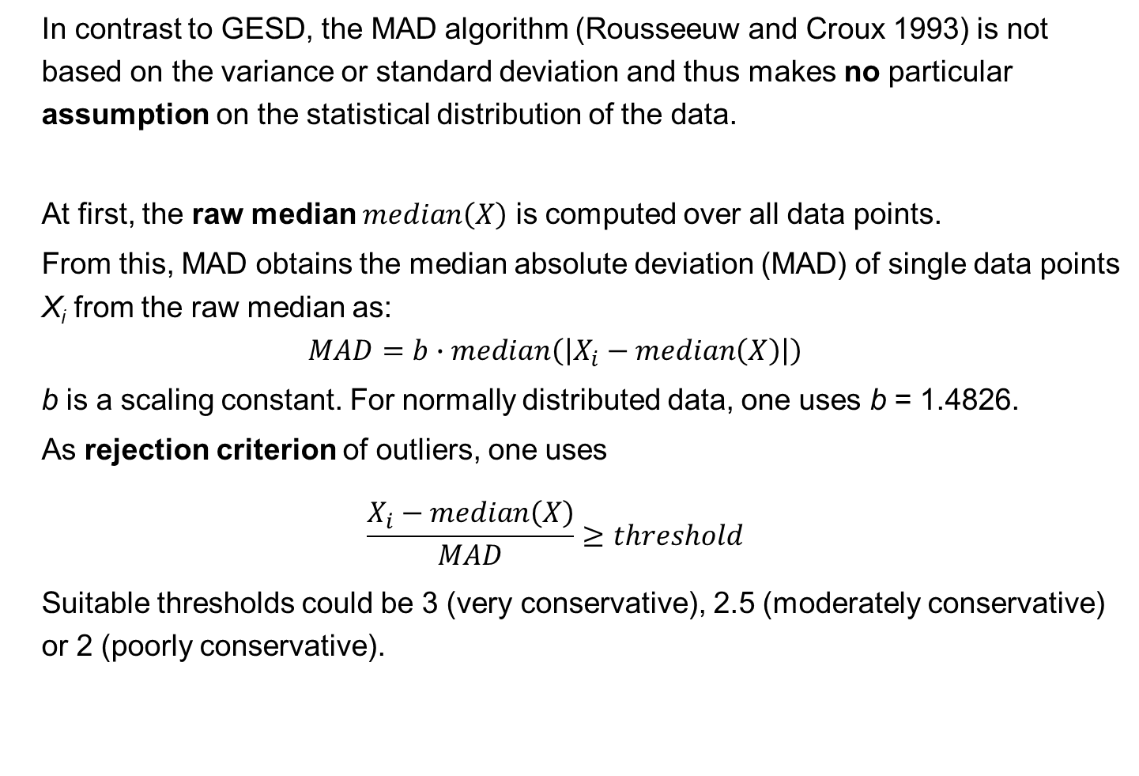
8.4 Detect outliers with MAD
In contrast to GESD, the MAD algorithm (Rousseeuw and Croux 1993) is not based on the variance or standard deviation and thus makes no particular assumption on the statistical distribution of the data.
At first, the raw median $median\left(X\right)$ is computed over all data points.
From this, MAD obtains the median absolute deviation (MAD) of single data points X_{i} from the raw median as:
$$MAD=b∙median\left(\left|X_{i}−median\left(X\right)\right|\right)$$
b is a scaling constant. For normally distributed data, one uses b = 1.4826.
As rejection criterion of outliers, one uses
$$\frac{X_{i}−median\left(X\right)}{MAD}≥threshold$$
Suitable thresholds could be 3 (very conservative), 2.5 (moderately conservative) or 2 (poorly conservative).
Notes:
The median absolute deviation (MAD) is a measure of statistical dispersion (or variability) of the data in a population.
https://eurekastatistics.com/using-the-median-absolute-deviation-to-find-outliers/ states:
One of the most common ways of finding outliers in one-dimensional data is to mark as a potential outlier any point that is more than two standard deviations, say, from the mean.
But the presence of outliers is likely to have a strong effect on the mean and the standard deviation, making this technique unreliable.
As the standard deviation is based on squared distances, extreme points are much more influential than those close to the mean.
Thus it is preferential to use a measure of distance that's robust against outliers. A good candidate for this job is the median absolute deviation from median, commonly shortened to the median absolute deviation (MAD).

Slide 22
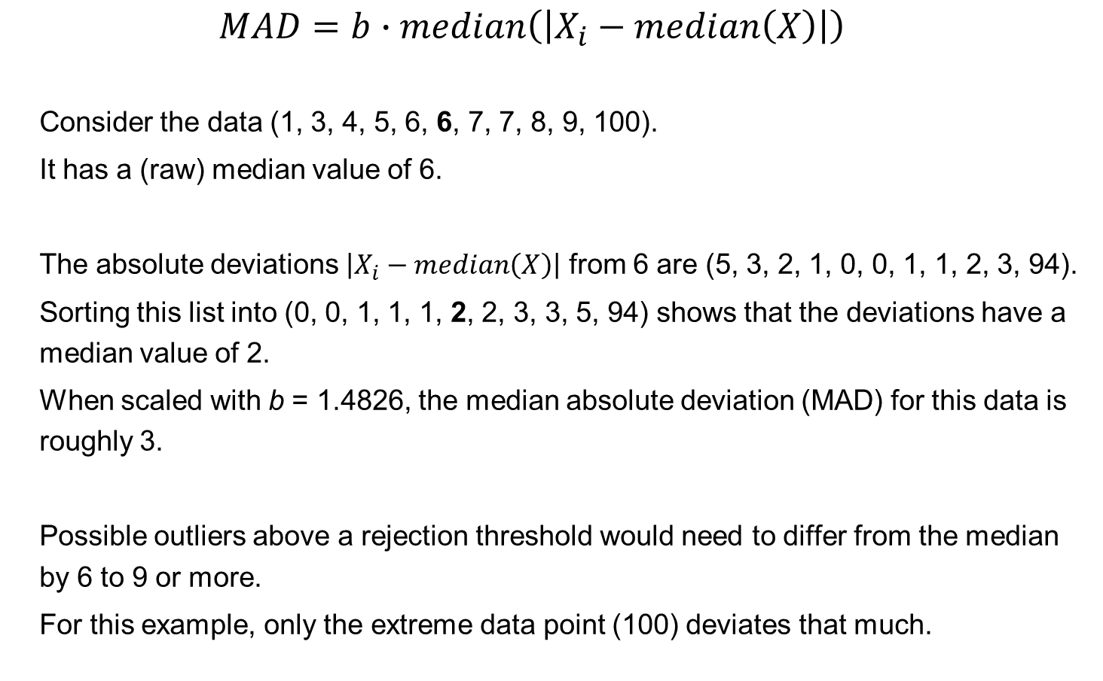
8.4 Detect outliers with MAD
$$MAD=b∙median\left(\left|X_{i}−median\left(X\right)\right|\right)$$
Consider the data (1, 3, 4, 5, 6, 6, 7, 7, 8, 9, 100).
It has a (raw) median value of 6.
The absolute deviations $\left|X_{i}−median\left(X\right)\right|$ from 6 are (5, 3, 2, 1, 0, 0, 1, 1, 2, 3, 94).
Sorting this list into (0, 0, 1, 1, 1, 2, 2, 3, 3, 5, 94) shows that the deviations have a median value of 2.
When scaled with b = 1.4826, the median absolute deviation (MAD) for this data is roughly 3.
Possible outliers above a rejection threshold would need to differ from the median by 6 to 9 or more.
For this example, only the extreme data point (100) deviates that much.
Notes:
No comments.

Slide 23
Effect of 2 outliers on auto-correlation of a gene
Effect of 2 introduced outlier points on co-expression analysis of a gene with itself
(4 datasets from TCGA for COAD; GBM; HCC, OV tumor).
X-axis : magnitude of perturbations applied as multiples of standard deviations (SD).
For the smallest sample (COAD), two 2SD outliers, reduce the auto- correlation to 0.75.
Barghash et al., J Proteomics Bioinform 2016, 9:2
Notes:
This slide shows you examples on real data sets for tumor patients from the TCGA data portal.
They are labeled COAD (for colon adenocarcinoma), GBM (glioblastoma), HCC (hepatocellular carcinoma), OV (ovarian cancer).
Measured is the auto-correlation of the expression of single genes. Without data outliers, the value should be 1.
Shown on the x-axis is the magnitude of the outlier points in multiples of standard deviation.

Slide 24
Simulated expression data sets
Different gray levels represent different classes.
Outlier cases are in black.
SDS1/2 (left) has two known outliers (black) and 3 known switched samples.
SDS3/4 (right) contain 50 outliers each.
SDS1-3 follow Gaussian distributions while SDS4 follows a Poisson distribution.
Barghash et al., J Proteomics Bioinform 2016, 9:2
Notes:
Here, we did a test with synthetic data that was generated by randomly drawing data points from a Gaussian distribution (SDS1-3) or from a Poisson distribution (SDS4).
Into these data sets, we introduced outlier data points of a certain magnitude at known positions.

Slide 25
Clustering dendogram
Clustering dendrogram of dataset of simulated expression.
Average Hierarchical Clustering based on Euclidean distances (AHC-ED) clustered SDS1 into 3 main classes grouping the outlier samples (50 and 100) in a separate class.
All switched samples – marked by asterisks - were correctly clustered into their original classes.
Barghash et al., J Proteomics Bioinform 2016, 9:2
Notes:
Shown here is the clustering result.
The outliers were introduced at positions 50 and 100. This was perfectly detected by clustering.

Slide 26

Silhouette: validates clustering
Large s(i) means good clustering
Silhouette validation of the AHC-ED clustering of SDS1.
The average distance of 0.36 indicates that AHC-ED succeeded in clustering SDS1.
Silhouette coefficient:
a(i) : average dissimilarity of i with all other data within the same cluster
b(i) : lowest average dissimilarity of i to any other cluster, of which i is not a member
Barghash et al., J Proteomics Bioinform 2016, 9:2
Notes:
This slide shows clustering of the same data as the slide before.
Shown on the x-axis is the silhouette coefficient that measures how well this data point fits into its current cluster.
A high value indicates that the object is well matched to its own cluster and poorly matched to neighboring clusters.

Slide 27
# of detected synthetic outlier data points (out of 50)
Top: In normally distributed data, GESD identified largest number (46/50) of synthetic outliers.
Bottom: If the two distributions have larger overlap (1 SD → 2 SD →3 SD), detecting outliers becomes considerably harder.
Barghash et al., J Proteomics Bioinform 2016, 9:2
Notes:
We compared the three algorithms GESD, MAD, and Boxplot in terms of their ability to identify simulated outliers in 100 generated datasets in the form of SDS3.
Each outlier gene was modeled to have 5 known outlier values out of 50 points.
The GESD algorithm was able to detect at least four out of five outlier values in 46 out of 50 outlier genes on average.
In contrast, MAD and Boxplot on average detected four out of five outlier points in only 33 and 34 genes, respectively, and some outlier points of the other outlier genes.
On average, 31 outlier genes were commonly detected by all algorithms.

Slide 28
MA quality control
These authors compared four strategies of data analysis :
- Strategy 1 No outlier removal
- Strategy 2 Outlier removal guided by arrayQualityMetrics (outliers of boxplot)
- Strategy 3 Removing random arrays (same number of arrays as in strategy 2)
- Strategy 4 Array weights using the function arrayWeights from the limma Bioconductor package
Kauffman, Huber (2010) Genomics 95, 138
Notes:
Wolfgang Huber from EBI is the developer of several important software packages for detecting differential expression, e.g. DESeq and DESeq2.
He is also on the advisory board of the Bioconductor initiative.
Here, they analyzed whether removing outliers improves the detection of differentially expressed genes.
Link for this paper: https://www.sciencedirect.com/science/article/pii/S0888754310000042
The developers of the arrayWeights method argued in https://bmcbioinformatics.biomedcentral.com/articles/10.1186/1471-2105-7-261
„that "bad" arrays are usually not entirely bad. Very often the lesser quality arrays do contain good information about gene expression but which is embedded in a greater degree of noise than for "good" arrays. “
In their method, an array with exp γ _{j} = 2 is twice as variable as a typical array and will be given half weight in an analysis.

Slide 29
Number of DE genes
Data -> rma -> DE genes with moderated t-test in limma, FDR correction
Number of differentially expressed genes identified:
on the whole dataset (white bars),
after removing outliers identified by arrayQualityMetrics (black bars) and
using weights obtained by arrayWeights from limma (grey bars).
→ Many more DE genes identified after removing outlier genes.
E-MEXP-170 has additional confounding effect of experiment date! This explains high # of DE genes.
Kauffman, Huber (2010) Genomics 95, 138
Notes:
Here, the authors analyzed 7 experimental data sets.
If all data points are used (white bars), only few genes are detected as differentially expressed.
If they remove outliers identified by boxplots (black bars), the largest number of DE genes is detected.
E-MEXP-170 with over 4000 DE genes likely suffers from a confounding effect of treatment or experiment date.

Slide 30
Effect of Outlier removal on DE genes
In (c), (d), (e) good overlap of outlier removal and weight method.
Venn diagrams representing the number of DE genes identified by each method:
all arrays, after removing outlier arrays, using array weights.
(a) E-GEOD-3419,
(b) E-GEOD-7258,
(c) E-GEOD-10211,
(d) E-MEXP-774,
(e) E-MEXP-170.
Kauffman, Huber (2010) Genomics 95, 138
Notes:
The previous slide only showed that the number of DE genes increases when outliers are removed.
Does one also find the same genes?
With the exception of experiment E-GEOD-3419 (top left), the outlier removal strategy identifies almost all genes detected using the weighting method

Slide 31
Effect of removing random genes on DE genes
Boxplots representing the number of DE genes in each experiment when removing arbitrary subsets of size K, the number of outlier arrays identified from the N samples.
When N over K < 1000, all possible subsets were considered, otherwise 1000 subsets were sampled randomly.
If the same number of random genes is removed, fewer DE genes are detected.
Kauffman, Huber (2010) Genomics 95, 138
Notes:
Compared with using all arrays, removal of random arrays leads to a loss of power and hence fewer genes are detected. In contrast, outlier removal and array weighting increased the numbers of differentially expressed genes.

Slide 32
KEGG pathway enrichment analysis
Does removal of outliers result
in better biological sensitivity?
gene set enrichment analysis :
5 most enriched KEGG pathways among DE genes for experiments E-GEOD-3419 and E-GEOD-7258, with and without outlier removal.
→ The pathways are related to the biology studied in the experiments.
→ Their enrichment is more significant after outlier removal.
Kauffman, Huber (2010) Genomics 95, 138
Notes:
Listed are the biological pathways that are enriched in DE genes.
From the biological design of the experiment, these findings are to be expected.
However, one finds them only to be significant after removing the problematic sample outliers.

Slide 33
Results from other outlier detection methods
Comparison of different outlier detection methods:
method implemented in arrayQualityMetrics (based on boxplots),
generalized extreme studentized deviate (GESD),
method of Hampel (it is based on the median absolute deviation (MAD)).
The results of different methods overlap mostly -> robustness
Kauffman, Huber (2010) Genomics 95, 138
Notes:
GESD and MAD identified very similar problematic samples.

Slide 34
DE analysis from RNAseq data
Compared to microarrays, RNA-seq has the following advantages for DE analysis:
- RNA-seq has a higher sensitivity for genes expressed either at low or very high level and higher dynamic range of expression levels over which transcripts can be detected (> 8000-fold range).
It also has lower technical variation and higher levels of reproducibility.
- RNA-seq is not limited by prior knowledge of the genome of the organism.
- RNA-seq detects transcriptional features, such as novel transcribed regions, alternative splicing and allele-specific expression at single base resolution.
While Microarrays are subject to cross-hybridisation bias,
RNA-seq may have a guanine-cytosine content bias and
can suffer from mapping ambiguity for paralogous sequences.
Rapaport et al. (2013) Genome Biol. 14: R95
Cui & Churchill, Genome Biol. 2003; 4(4): 210
Notes:
As mentioned before, the RNAseq technique has replaced microarrays since several years.
Importantly, RNAseq provides much more information about individual samples, because it also detects sequence mutations, isoforms etc.
It can be applied to novel organisms without reference genome and without availability of a standardized chip.

Slide 35
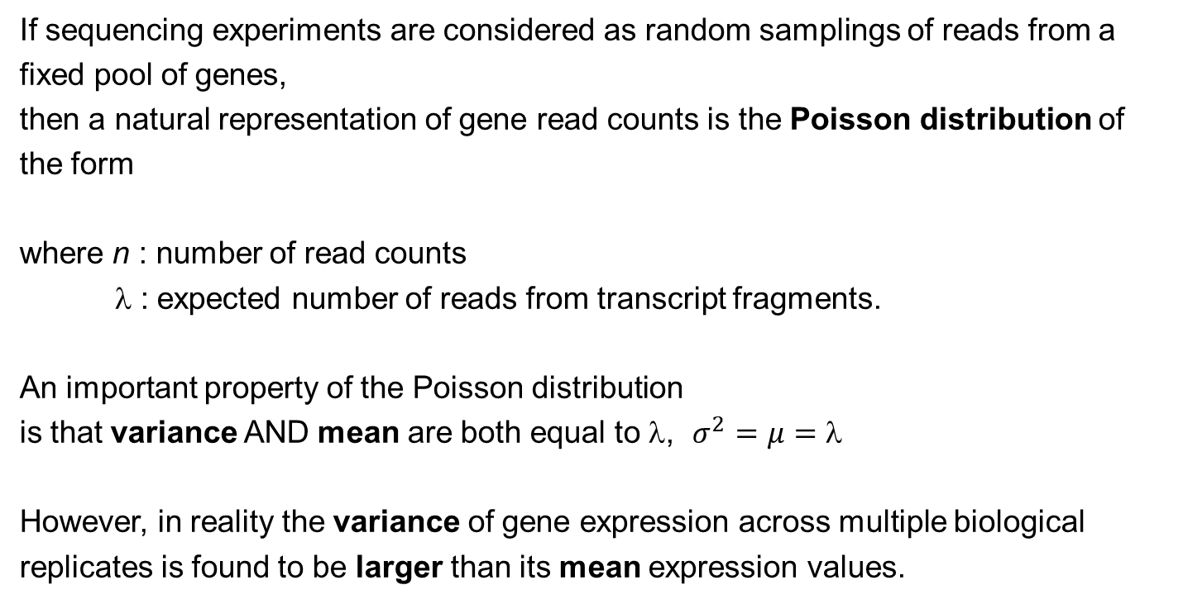
DE detection based on RNAseq data
If sequencing experiments are considered as random samplings of reads from a fixed pool of genes,
then a natural representation of gene read counts is the Poisson distribution of the form
where n : number of read counts
λ : expected number of reads from transcript fragments.
An important property of the Poisson distribution
is that variance AND mean are both equal to λ, $σ^{2}=μ=$
However, in reality the variance of gene expression across multiple biological replicates is found to be larger than its mean expression values.
Rapaport et al. (2013) Genome Biol. 14: R95
Notes:
Unfortunately, the methodology for detecting DE genes from RNAseq data is not as mature yet as for microarray data.
One clear point is that assuming a Poisson distribution for the observed read counts is too unflexible in that both variance and mean must be equal to $$.
This is not observed in reality.

Slide 36
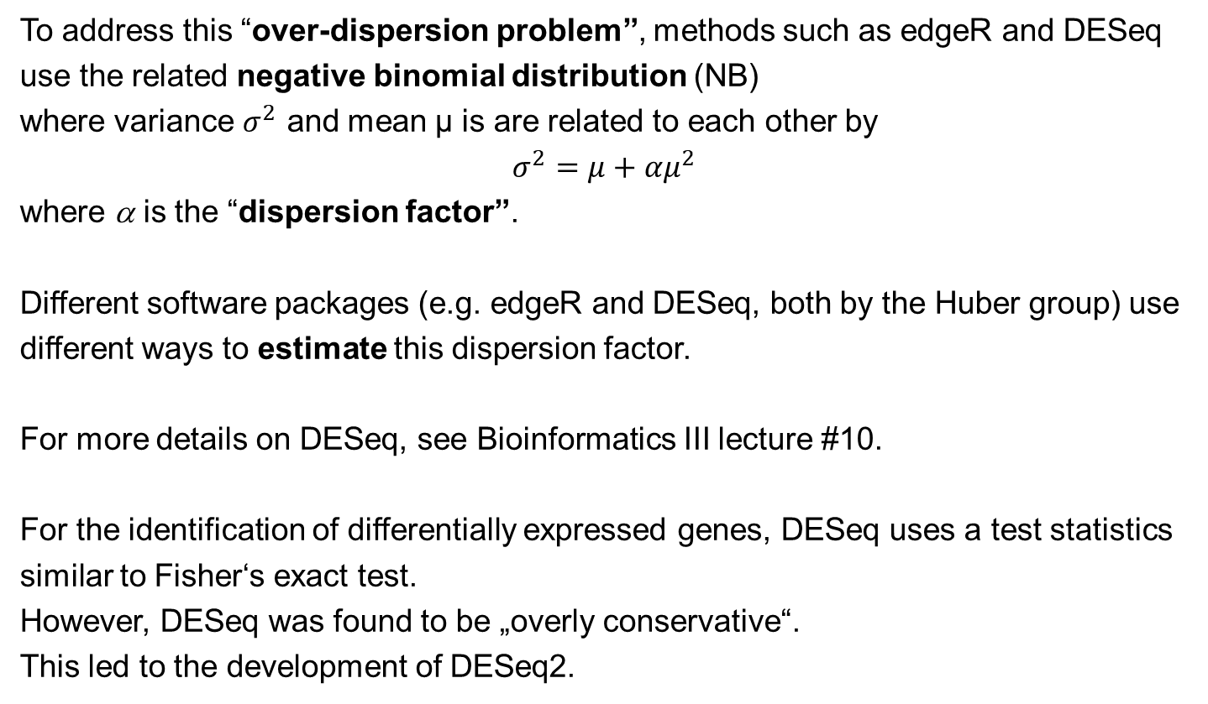
DE detection in RNAseq data
To address this “over-dispersion problem”, methods such as edgeR and DESeq use the related negative binomial distribution (NB)
where variance $σ^{2}$ and mean μ is are related to each other by
$$σ^{2}=μ+αμ^{2}$$
where α is the “dispersion factor”.
Different software packages (e.g. edgeR and DESeq, both by the Huber group) use different ways to estimate this dispersion factor.
For more details on DESeq, see Bioinformatics III lecture #10.
For the identification of differentially expressed genes, DESeq uses a test statistics similar to Fisher‘s exact test.
However, DESeq was found to be „overly conservative“.
This led to the development of DESeq2.
Notes:
The variance of data points is also termed „dispersion“.
Thus, if the variance is greater than the mean, one speaks of „over-dispersion“.
One way of modelling their dependence is by a polynomial with linear and quadratic term. The „dispersion factor“ alpha describes the magnitude of the quadratic term.

Slide 37
Reference data: gold standard
Samples from group A : Strategene Universal Human Reference RNA (UHRR):
total RNA from ten human cell lines.
Samples from group B: Ambion’s Human Brain Reference RNA (HBRR).
ERCC spike-in control : mixture of 92 synthetic polyadenylated oligonucleotides, 250 to 2,000 nucleotides long, which resemble human transcripts.
The two ERCC mixtures in groups A and B contain different (known!) concentrations of 4 subgroups of the synthetic spike-ins.
Then the log expression change is predefined and can be used to benchmark DE performance.
Rapaport et al. (2013) Genome Biol. 14: R95
Notes:
How should one decide which differential expression analysis method is the best one?
This can only be done based on a gold-standard dataset when the correct answer is known.
But it is usually not known what genes are differentially expressed. This is what we expect from the method.
One suitable strategy is to add synthetic data points with known concentrations.
Here, the authors added quantities of 92 synthetically generated oligonucleotides (250 – 2000 nt long) to the probes.
This strategy is termed „spike-in“.
These 92 oligonucleotides are then used as gold-standard set.
Link to this paper: https://genomebiology.biomedcentral.com/articles/10.1186/gb-2013-14-9-r95

Slide 38
Performance for DE detection
ERCC control oligonucleotides were divided into four groups with different mixing ratios between samples A and B (1:1, 4:1, 1:2 and 2:3).
In this ROC analysis the 1:1 mix are the set of undifferentiated controls (true negatives) and all others are differentiated (true positives).
AUC = area under the curve.
All methods performed reasonably well in detecting the truly differentiated spike-in sequences with an average area under the curve (AUC) of 0.78
Rapaport et al. (2013) Genome Biol. 14: R95
Notes:
This test on spike-in probes was successful, but an AUC of 0.78 is far from perfect.
Maybe this is due to the medium size of the data set and the definition of the two classes (undifferentiated 1:1 and differentiated which contains all other mixing ratios).

Slide 39
Performance for DE detection
Differential expression analysis using qRT-PCR validated gene set
of about 1000 genes from the MACQ project (slides 4-6).
ROC analysis was performed using a qRT-PCR log₂ expression change threshold of 0.5.
If the change is >0.5, the gene is DE, otherwise not.
The results are quite comparable.
DESeq and edgeR have slightly higher detection accuracy.
Rapaport et al. (2013) Genome Biol. 14: R95
Notes:
Here, the authors used a larger set of 1000 genes from the MACQ benchmark and the expression values determined by rtPCR.
Differential expression was determined based on the log2-transformed data.
Now, all AUC values are quite good (between 0.86 and 0.89) and similar to eachother.

Slide 40
Performance for DE detection
If one measures AUC at increasing cutoff values of qRT-PCR expression changes, this should define sets of DE genes at increasing stringency.
Now, there is a significant performance advantage for negative binomial and Poisson-based approaches with consistent AUC values close to 0.9 or higher.
On the other hand, Cuffdiff and limma methods display decreasing AUC values indicating reduced discrimination power at higher expression change log values.
Rapaport et al. (2013) Genome Biol. 14: R95
Notes:
This test shows that one should not compare methods only at one fixed threshold.
Probably such methods are preferable that show a consistently high performance over a range of parameters.

Slide 41
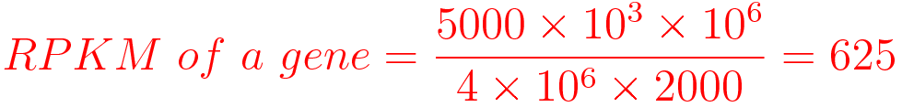
Current situation: detecting DE genes from RNAseq data
Normalization of RNA-seq read counts is an essential procedure that corrects for non-biological variation of samples due to library preparation, sequencing read
depth, gene length, mapping bias and other technical issues.
There are many normalization methods to correct for technical variations and biases:
Some methods correct for read depth and transcript length:
RPKM (Reads Per Kilobase per Million mapped reads) – used by package DEGSeq
Here, 10³ normalizes for gene length and 10⁶ for sequencing depth factor.
E.g. you have sequenced one library with 5 M reads. Among them, total 4 M matched to the genome sequence and 5000 reads matched to a given gene with a length of 2000 bp.
Li et al. BMC Genomics (2020) 21:75
https://www.biostars.org/p/273537/
Notes:
Link für Li-Paper: https://bmcgenomics.biomedcentral.com/articles/10.1186/s12864-020-6502-7
RPKM is one of the most-often used normalization methods.

Slide 42
Current situation: detecting DE genes from RNAseq data
FPKM (Fragments Per Kilobase per Million mapped fragments) – CuffDiff
FPKM is analogous to RPKM and used especially in paired-end RNA-seq experiments.
Other methods use global scaling quantile normalization: TC (per-sample total counts),
UQ (per-sample 75% upper quartile Q3), Med (per-sample Median Q2), or
Q (full quantile) implemented in Aroma.light.
DESeq/DESeq2 and edgeR use an imputed size factor to correct for read depth bias.
RUV normalizes by the expression of control genes to remove unwanted technical variation across samples.
Sailfish is an alignment-free abundance estimation using k-mers to index and count RNA-seq reads.
Li et al. presented a method called UQ-pgQ2 (per-gene Q2 normalization following per-sample upper-quartile global scaling at 75 percentile) for correcting library depths and scaling the reads of each gene into the similar levels across conditions.
Notes:
FPKM is analogous to RPKM.
But there exist many other normalization methods.

Slide 43
Comparison of different methods
Other earlier studies were left out.
Li et al. BMC Genomics (2020) 21:75
Notes:
There exists already a number of benchmark studies, but no consistent trends are apparent yet.
DESeq2 is often among the best-performing methods, but not always.
Li et al. found for the benchmark MAQC dataset that their own method performed best.
I guess the jury is still out what method will make it in the long run.

Slide 44
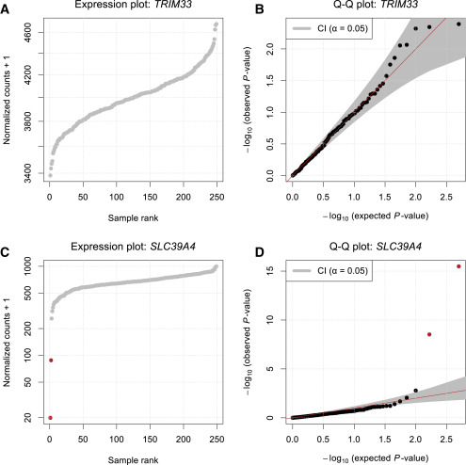
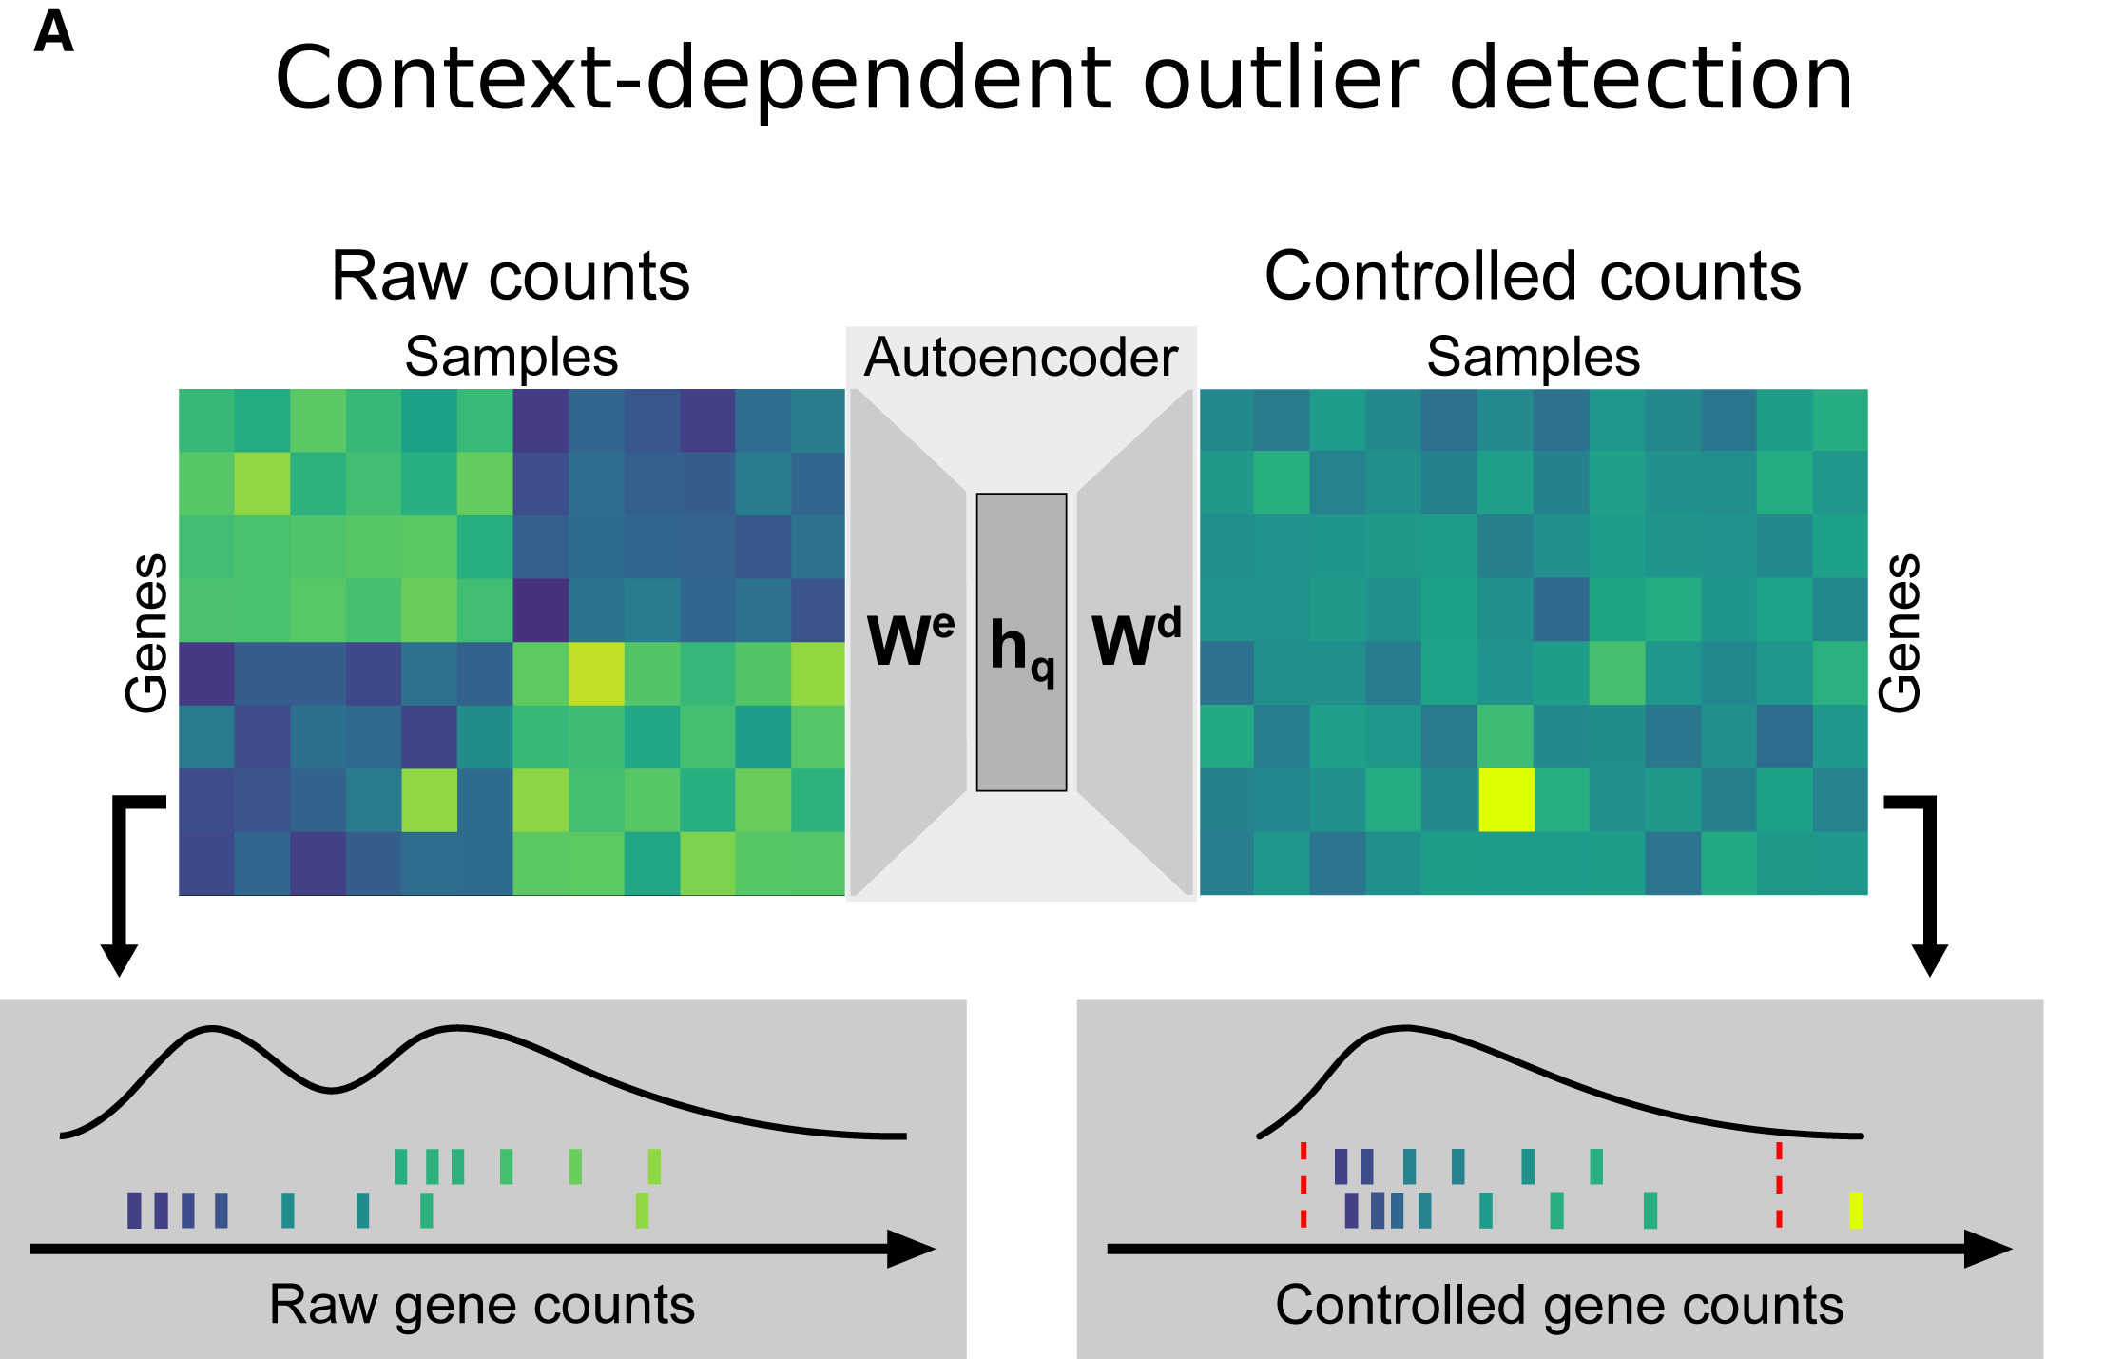
Outlier detection for RNA-seq data: Outrider
Outlier detection is equally important when processing RNA-seq data.
Based on synthetic data, an autoencoder is entrained to detect outlier data points.
Normalized RNA-seq read counts plotted against their rank (A and C) and quantile-quantile plots of observed p values against expected p values with 95% confidence bands (B and D); outliers are shown in red (FDR < 0.05). Shown are data for TRIM33 with no detected expression outlier (A and B) and data for SLC39A4 with two expression outliers (C and D).
Brechtmann … Gagneur,
Am J Hum Genet. (2018) 103, 907-917.
Notes:
This paper by the group of Julien Gagneur presents a Deep Learning (autoencoder) method termed Outrider to identify outliers in RNAseq data.
The left figure illustrates schematically how the autoencoder transforms raw counts into so-called controlled counts.
Now, the yellow-colored field clearly represents an outlier that was not detectable in the raw counts.
The right figure presents two ways of representing expression data.
The upper example belongs to gene TRIM33, the lower example to the gene SLC39A4 (a membrane transporter).
For SLC39A4, two clear outliers are visible both in the sample rank plot as well as in the Q-Q plot for the p-values.

Slide 45
Convolution of bulk sequencing data
Genotype-tissue expression (GTEx) project:
over 10,000 bulk RNA-seq samples representing 53 different tissues from 30 organs obtained from 635 genotyped individuals.
The aim is to link the influence of genetic variants on gene expression levels through quantitative trait loci analysis (eQTL).
Problem: data set does not account for cellular heterogeneity (i.e., different cell types within a tissue and the relative proportions of each cell type across samples of the same tissue)
Possible solution: deconvolute data into separate cell types.
Donovan et al. (2020) Nature Commun. 11:955
Notes:
Link to this paper: https://www.nature.com/articles/s41467-020-14561-0
Large-scale projects such as GTEx have produced very valuable and costly datasets. However, many of these methods used bulk sequencing, not single-cell sequencing.
Can one decompose / deconvolute these data sets into the contributions of individual cell types?

Slide 46
Convolution of bulk sequencing data
In a proof-of-concept analysis, the cellular estimates of 2 GTEx tissues (liver and skin) were deconvoluted using both mouse and human signature genes obtained from scRNA-seq.
We then performed cellular deconvolution of the 28 GTEx tissues from 14 organs using CIBERSORT and characterized both the heterogeneity in cellular composition between tissues and the heterogeneity in relative distributions of cell populations between RNA-seq samples from a given tissue.
Finally, we used the cell type composition estimates as interaction terms for eQTL analyses to determine if we could detect cell-type-associated genetic associations.
Donovan et al. (2020) Nature Commun. 11:955
Notes:
The idea is to steer the convolution by providing a certain amount of single-cell sequencing data either from human or from mouse.

Slide 47
CIBERSORT
Deconvolution of gene expression profiles (GEP) can be represented by M = f × B, provided that B contains more marker genes than cell types (i.e., the system is overdetermined).
M : mRNA mixture
B : GEP signature matrix
f : vector consisting of the unknown fractions of each cell type in the mixture
Previous groups have applied linear least squares regression (LLSR) and more recently, non-negative least squares regression (NNLS) and quadratic programming (QP) to solve for f.
Cibersort uses ν-support vector regression (details are not important here).
Newman et al. Nature Methods 12, 453–457 (2015)
Notes:
Deconvolution was done using the CIBERSORT software that uses nu-support vector regression to split up samples into groups.
The details of nu-support vector regression are not relevant at this point.
CIBERSOFT software: https://www.nature.com/articles/nmeth.3337

Slide 48
Convolution of bulk sequencing data
Bar plots showing the fraction of cell types estimated in the 175 GTEx liver RNA-seq samples deconvoluted using
c gene expression profiles from high-resolution human liver scRNA-seq, or
d from low-resolution mouse liver scRNA-seq, or
e GTEx estimates generated by collapsing high-resolution human cell types within each of the seven distinct cell classes.
Hepatocyte estimates from mouse liver were positively and highly correlated with the human high-resolution hepatocyte 0 population estimate (r = 0.71, p-value = 5.4 × 10⁻²⁸).
Donovan et al. (2020) Nature Commun. 11:955
Notes:
The upper plot shows the convolution of human bulk liver sequencing data into 15 different cell types present in human livers.
The middle plot shows a deconvolution of the same bulk data into 5 broad types of mouse liver cells.
The bottom plot shows a deconvolution of the same data when the data of the top plot is collapsed into seven broad types.
Interpretation: scRNA-seq generated from human and mouse liver captured similar cell types.
Technical differences, including the number of cells analyzed and tissue sampling methodology, affect the cell type resolution.

Slide 49
Summary
Removing outlier data sets from the input data is essential for the downstream analysis (unless these outliers are of particular interest -> personalized medicine).
Analysis tools: box-plots, PCA, density plots, clustering
Some outlier methods (GESD) are based on variants of the t-test.
MAD and boxplots are other simple methods.
Normalization of RNA-seq data: many different strategies exist.
Single-cell data based deconvolution of bulk sequencing data can help in increasing the insight that can be obtained from existing bulk data.

Slide 50
Additional slides (not used)

Slide 51
CIBERSORT uses nu–support vector regression (ν-SVR).
ν-SVR is an instance of support vector machine (SVM), a class of optimization methods for binary classification problems, in which a hyperplane is discovered that maximally separates both classes.
The support vectors are a subset of the input data that determine hyperplane boundaries. Unlike standard SVM, SVR discovers a hyperplane that fits as many data points as possible (given its objective function) within a constant distance, ɛ, thus performing a regression.
All data points within ɛ (termed the ‘ɛ-tube’) are ignored, whereas all data points lying outside of the ɛ-tube are evaluated according to a linear ɛ-insensitive loss function. These outlier data points, referred to as ‘support vectors’, define the boundaries of the ɛ-tube and are sufficient to completely specify the linear regression function.
In this way, support vectors can provide a sparse solution to the regression in which overfitting is minimized (a type of feature selection). Notably, support vectors represent genes selected from the signature matrix in this work.
Newman et al. Nature Methods 12, 453–457 (2015)
Notes:
CIBERSOFT software: https://www.nature.com/articles/nmeth.3337

Slide 52
CIBERSORT
A simple 2D dataset analyzed with linear ν-SVR, with results shown for two values of ν (note that both panels show the same data points).
As linear SVR identifies a hyperplane (which, in this 2D example, is a line) that fits as many data points as possible (given its objective function) within a constant distance, ɛ (open circles).
Data points lying outside of this ‘ɛ-tube’ are termed ‘support vectors’ (red circles), and are penalized according to their distance from the ɛ-tube by linear slack variables (ξ_{i}).
Importantly, the support vectors alone are sufficient to completely specify the linear function, and provide a sparse solution to the regression that reduces the chance of overfitting. In ν-SVR, the ν parameter determines both the lower bound of support vectors and upper bound of training errors. As such, higher values of ν result in a smaller ɛ-tube and a greater number of support vectors (right panel). For CIBERSORT, the support vectors represent genes selected from the signature matrix for analysis of a given mixture sample, and the orientation of the regression hyperplane determines the estimated cell type proportions in the mixture.
Newman et al. Nature Methods 12, 453–457 (2015)
Notes:
CIBERSOFT software: https://www.nature.com/articles/nmeth.3337

Slide 53
CIBERSORT
CIBERSORT requires an input matrix of reference gene expression signatures, collectively used to estimate the relative proportions of each cell type of interest. To deconvolve the mixture, we employ a novel application of linear support vector regression (SVR), a machine learning approach highly robust with respect to noise. Unlike previous methods, SVR performs a feature selection, in which genes from the signature matrix are adaptively selected to deconvolve a given mixture. An empirically defined global P value for the deconvolution is then determined.
Newman et al. Nature Methods 12, 453–457 (2015)
Notes:
CIBERSOFT software: https://www.nature.com/articles/nmeth.3337

Slide 54
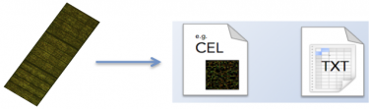
Extraction of features
Feature extraction is the process of converting the scanned image of the microarray into quantifiable values and annotating it with the gene IDs, sample names and other useful information
Common microarray raw data file types.
Manufacturer | Typical raw data format | How to open / Analysis software examples
Affymetrix | .CEL (binary) | R packages (affy, limma, oligo…)
Agilent | feature extraction file (tab-delimited text file per hybridisation) | Spreadsheet software (Excel, OpenOffice, etc.)
GenePix (scanner) | .gpr (tab-delimited text file per hybridisation) | Spreadsheet software (Excel, OpenOffice, etc.)
Illumina | .idat (binary) | R packages (e.g. illuminaio)
 | txt (tab-delimited text matrix for all samples) | Spreadsheet software (Excel, OpenOffice, etc.)
Nimblegen | NimbleScan, .pair (tab-delimited text matrix for all samples) | Spreadsheet software (Excel, OpenOffice, etc.)
This process is often performed using the software provided by the microarray manufacturer.
http://www.ebi.ac.uk/training/online/course/
functional-genomics-ii-common-technologies-and-data-analysis-methods/microarrays
Notes:
The .CEL files produced from Affymetrix chips and the .idat from Illumina chips are most common.

