Slide 1
Special-topic lecture bioinformatics: Mathematics of Biological Networks
Leistungspunkte/Credit points: 5 (V2/Ü1)
This course is taught in English language.
The material (from books and original literature) are provided online at the course website:
http://gepard.bioinformatik.uni-saarland.de/teaching/ss-2014/stl-bioinformatics-mathcellnet-ss14
Topics to be covered:
This course will enter into details of selected topics on the topology of
biological networks.

Slide 2
Tutorial
We will handout 6 bi-weekly assignments.
Groups of up to two students can hand in a solved assignment.
Send your solutions by e-mail to the responsible tutors :
Maryam Nazarieh (#1 - #3) and Thorsten Will (#4 - #6)
until the time+date indicated on the assignment sheet.
The weekly tutorial on Tuesday 12.45 am – 1.30 pm (same room) will discuss
the assignment solutions.
On demand, the tutors may also give some advice for solving the new assignments.

Slide 3
Schein / certification conditions
The successful participation in the lecture course („Schein“)
will be certified upon fulfilling
Schein condition 1 (> 50% of the points for the assignments)
and upon passing the final written exam at the end of the semester
The grade on your „Schein“ equals that of your final exam.
Everybody who took the final exam (and passed it or did not pass it)
and those who have missed the final exam
can take the re-exam at the beginning of WS14/15.
The better grade counts! But there will no second re-exam.

Slide 4
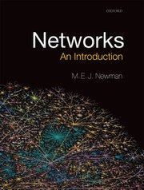
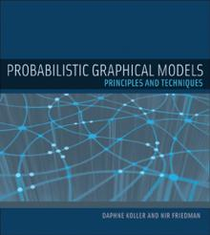
Lecture material
Lectures 1-6 follow this book by Mark Newman / Oxford Univ Press
Chapter 7: measures and metrics
Chapter 11: matrix algorithms and graph partitioning
Chapter 17: epidemics on networks
Chapter 7-10/12 follow this book by Daphne Koller & Nir Friedman /MIT Press
Chapter X:
Chapter Y:
Chapter Z:
You can find both books in the CS library.
Lectures 11/13-15 introduce modern methods
to reconstruct gene-regulatory networks

Slide 5
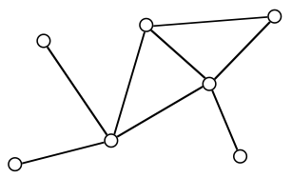
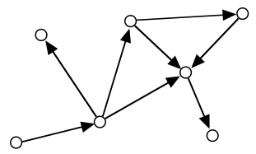
Some Graph Basics
Network <=> Graph
Formal definition:
A graph G is an ordered pair (V, E) of a set V of vertices and a set E of edges.
G = (V, E)
undirected graph
directed graph
If E = V⁽²⁾ => fully connected graph

Slide 6
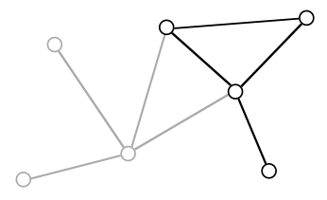
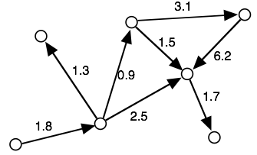
Graph Basics II
Subgraph:
Weighted graph:
G' = (V', E') is a subset of G = (V, E)
Weights assigned to the edges

Slide 7
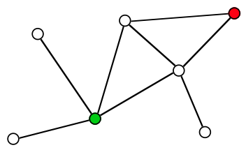
Walk the Graph
Path = sequence of connected vertices
start vertex => internal vertices => end vertex
Two paths are independent (internally vertex-disjoint),
if they have no internal vertices in common.
Vertices u and v are connected, if there exists a path from u to v.
otherwise they are disconnected
Trail = path, in which all edges are distinct
Length of a path = number of vertices || sum of the edge weights
There is an infinite number of paths connecting the green to the red vertex.
The shortest paths have length = 2.
Four trails go from the green to the red vertex.
Two of them are independent.

Slide 8
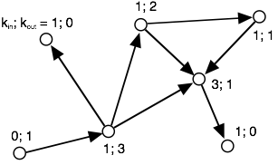
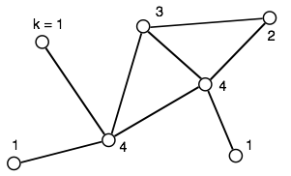
Local Connectivity: Degree
Degree k of a vertex = number of edges at this vertex
Directed graph => distinguish kin and kout
Degree distribution P(k) = fraction of nodes with k connections
k | 0 | 1 | 2 | 3
P(kin) | 1/7 | 5/7 | 0 | 1/7
P(kout) | 2/7 | 3/7 | 1/7 | 1/7
k | 0 | 1 | 2 | 3 | 4
P(k) | 0 | 3/7 | 1/7 | 1/7 | 2/7

Slide 9
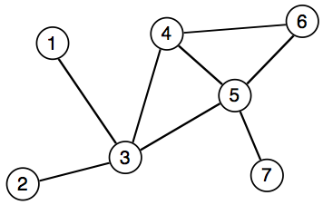
Graph Representation: e.g. by adjacency matrix
Adjacency matrix is a N x N matrix
with entries Muv
Muv = weight when edge between u and v exists,
0 otherwise
→ symmetric for undirected graphs
 | 1 | 2 | 3 | 4 | 5 | 6 | 7
1 | – | 0 | 1 | 0 | 0 | 0 | 0
2 | 0 | – | 1 | 0 | 0 | 0 | 0
3 | 1 | 1 | – | 1 | 1 | 0 | 0
4 | 0 | 0 | 1 | – | 1 | 1 | 0
5 | 0 | 0 | 1 | 1 | – | 1 | 1
6 | 0 | 0 | 0 | 1 | 1 | – | 0
7 | 0 | 0 | 0 | 0 | 1 | 0 | –
+ fast O(1) lookup of edges
– large memory requirements
– adding or removing nodes is expensive
Note: very convenient in programming languages that support sparse multi-dimensional arrays
=> Perl

Slide 10
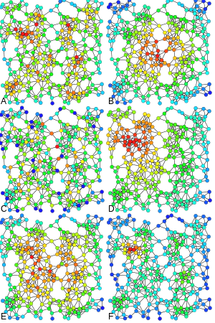
Measures and Metrics
“ Which are the most important or central vertices in a network? “
Examples of
Degree
centrality,
C) Betweenness centrality,
E) Katz centrality,
B) Closeness centrality,
D) Eigenvector centrality,
F) Alpha centrality of the same graph.
www.wikipedia.org

Slide 11
Degree centrality
Perhaps the simplest centrality measure in a network is the
degree centrality that is simply equal to the degree of each vertex.
E.g. in a social network, individuals that have many connections
to others might have
more influence,
more access to information,
or more prestige than those individuals who have fewer connections.
A natural extension of the simple degree centrality is eigenvector centrality.

Slide 12
Towards Eigenvector Centrality
Let us start by defining the centrality of vertex x_{i} as the sum of the centralities
of all its neighbors:
$${x_{i}}^{′}=\sum_{j}{A_{ij}x_{j}}$$
where A_{ij} is an element of the adjacency matrix.
(This equation system must be solved recursively until convergence.)
We can also write this expression in matrix notation as
x’ = A x where x is the vector with elements x_{i} .
Repeating this process to make better estimates gives after t steps
the following vector of centralities:
x(t) = A^{t} x(0)

Slide 13
Eigenvector Centrality
Now let us write x(0) as a linear combination of the eigenvectors v_{i} of the
(quadratic) adjacency matrix¹
$\text{x}\left(0\right)= \sum_{i}{c_{i}{\text{v}}_{i}}$ with suitable constants c_{i}
Then $\text{x}\left(t\right)=A^{t}\sum_{i}{c_{i}{\text{v}}_{i}}$ = $\sum_{i}{c_{i}{ {k_{i}}^{t} \text{v}}_{i}}={k_{1}}^{t}\sum_{i}{c_{i}{\left[\frac{k_{i}}{k_{1}}\right]}^{t}{\text{v}}_{i}}$
where the k_{i} are the eigenvalues of A and k₁ is the largest of them.
(remember A x = λ x from linear algebra for each eigenvector x)
Since k_{i} / k₁ < 1 for all i ≠ j , all terms in the sum decay exponentially as t
becomes large.
In the limit t → ∞, we get x(t) = c₁ k₁^{t} v₁
¹ Remember from linear algebra that a quadratic matrix with full rank can be diagonalized.

Slide 14
Eigenvector Centrality
This limiting vector of the eigenvector centralities is simply proportional
to the leading eigenvector of the adjacency matrix.
Equivalently, we could say that the centrality x satisfies
A x = k₁ x
This is the eigenvector centrality first proposed by Bonacich (1987).
The centrality x_{i} of vertex i is proportional to the sum of the centralities of
its neighbors:
$x_{i}={k_{1}}^{−1}\sum_{j}{A_{ij}x_{j}}$
This has the nice property that the centrality can be large either because a vertex
has many neighbors or because it has important neighbors (or both).

Slide 15
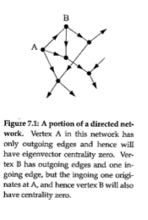
Problems of the Eigenvector Centrality
The eigenvector centrality works best for undirected networks.
For directed networks, certain complications can arise.
In the figure on the right,
vertex A will have eigenvector
centrality zero.
Hence, vertex B will also have
centrality zero.

Slide 16
Katz Centrality
One solution to the issues of the Eigenvector Centrality is the following:
We simply give each vertex a small amount of centrality “for free”,
regardless of its position in the network or the centrality of its neighbors.
→ we define $x_{i}=α\sum_{j}{A_{ij}x_{j}+β}$ where α and β are positive constants.
In matrix terms, this can be written as x = αAx + β 1
where 1 is the vector (1,1,1,…) ^{T} . By rearranging for x we find
I x - α A x = β 1 (where we used I x = x)
(I - α A) x = β 1
(I - α A )⁻¹ (I - α A) x = (I - α A )⁻¹ β 1
x = β (I - α A )⁻¹ 1
When setting β =1, we get the Katz centrality (1953) x = (I - α A )⁻¹ 1

Slide 17
Computing the Katz Centrality
The Katz centrality differs from the ordinary eigenvector centrality by having
a free parameter α, which governs the balance between the eigenvector term and the constant term.
However, inverting a matrix on a computer has a complexity of O(n³) for a graph with n vertices.
This becomes prohibitively expensive for networks with more than 1000 nodes or so.
It is more efficient to make an initial guess of x and then repeat
x' = αAx + β 1
many times. This will converge to a value close to the correct centrality.
A good test for convergence is to make two different initial guesses and run this until the resulting centrality vectors agree within some small threshold.

Slide 18
Towards PageRank
The Katz centrality also has one feature that can be undesirable.
If a vertex with high Katz centrality has edges pointing to many other vertices,
then all those vertices also get high centrality.
E.g. if a Wikipedia page points to my webpage, my webpage will get a centrality comparable to Wikipedia!
But Wikipedia of course also points to many other websites, so that its contribution to my webpage “should” be relatively small because my page is only one of millions of others.
-> we will define a variation of the Katz centrality in which the centrality I derive from my network neighbors is proportional to their centrality divided by their out-degree.

Slide 19
PageRank
This centrality is defined by
$x_{i}=α\sum_{j}{A_{ij}\frac{x_{j}}{{k_{j}}^{out}}+β}$
At first, this seems problematic if the network contains vertices with zero outdegree.
However, this can easily be fixed by setting k_{j}^{out} = 1 for all such vertices.
In matrix terms, this equation becomes
x = α A D⁻¹ x + β 1
where 1 is the vector (1,1,1,…)^{T} and D the diagonal matrix with D_{ij} = max(k_{j}^{out} , 1)

Slide 20
PageRank
By rearranging we find that
x = β (I - α A D⁻¹ )⁻¹ 1
Because β plays the same unimportant role as before, we will set β = 1.
Then we get x = (I - α A D⁻¹ )⁻¹ 1 = D (D - α A )⁻¹ 1
This centrality measure is commonly known as PageRank,
using the term used by Google.
PageRank is one of the ingredients used by Google to determine the ranking of the answers to your queries.
α is a free parameter and should be chosen less than 1. (Google uses 0.85).

Slide 21
Hubs and Authorities
So far we have considered measures that assign high centrality to a vertex if those vertices that point to it have high centrality too.
However, in some networks it is appropriate also to accord a vertex high centrality if it points to others with high centrality.
E.g. a review article pointing at many important papers in one research field may be a useful source of information.
Authorities are nodes that contain useful information on a topic of interest.
Hubs are nodes that tell us where the best authorities can be found.
An authority may also be a hub, and vice versa.

Slide 22
Hubs and Authorities
Kleinberg developed this into a centrality algorithm called
Hyperlink-induced topic search (HITS).
The HITS algorithm gives each vertex i in a network an authority centrality x_{i} and a hub centrality y_{i} .
A vertex with high authority centrality is pointed to by many hubs, i.e. by many other vertices with high hub centrality.
A vertex with high hub centrality points to many vertices with high authority centrality.
Thus, an important scientific paper (in the authority sense) would be one that is cited in many important reviews (in the hub sense).
An important review is one that cites many important papers.

Slide 23
Authority and Hub Centralities
Kleinberg defined the authority centrality of a vertex to be proportional to the sum of the hub centralities of the vertices that point to it
$x_{i}=α\sum_{j}{A_{ij}y_{j}}$ where α is a constant.
Similarly the hub centrality of a vertex is proportional to the sum of the authority centralities of the vertices it points to:
$y_{i}=β\sum_{j}{A_{ji}x_{j}}$ with another constant β
Note that the indices of the matrix element A_{ji} are swapped around in this second equation.
These equations can be written as x = α A y and y = β A^{t} x
Or, combining the two, A A^{t} x = λ x , A^{t} A y = λ y

Slide 24
Closeness centrality
An entirely different measure of centrality is provided by the closeness centrality.
Suppose d_{ij} is the length of a geodesic path (i.e. the shortest path) from a vertex i to another vertex j.
Here, length means the number of edges along the path.
Then, the mean geodesic distance from i, averaged over all vertices j in the network is
$l_{i}=\frac{1}{n}\sum_{j}{d_{ij}}$
The mean distance l_{i} is not a centrality measure in the same sense as the other centrality measures.
It gives low values for more central vertices and high values for less central ones.

Slide 25
Closeness centrality
The inverse of l_{i} is called the closeness centrality C_{i}
$C_{i}=\frac{1}{l_{i}}=\frac{n}{\sum_{j}{d_{ij}}}$
It has become popular in recent years to rank film actors according to their closeness centrality in the network of who has appeared in films with who else.
Using data from www.imdb.com the largest component of the network includes more than 98 % of about half a million actors.

Slide 26
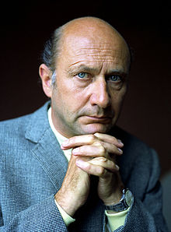
Closeness centrality
The highest closeness centrality of any actor is
0.4143 for Christopher Lee.
The second highest centrality has
Donald Pleasence (0.4138).
The lowest value has the Iranian actress Leia Zanganeh (0.1154).
→ the closeness centrality values are crammed in a very small interval [0,0.4143]
Other centrality measures including degree centrality and eigenvector centrality typically don‘t suffer from this problem. They have a wider dynamic range.
Pictures from wikipedia

Slide 27
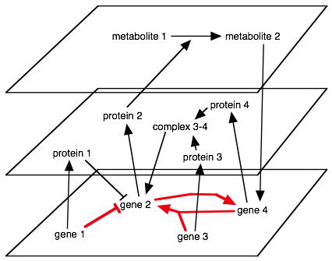
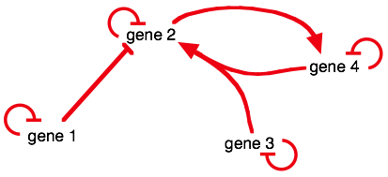
Gene-regulatory networks (GRNs)
Biological regulation
via proteins and metabolites
<=>
Projected gene-regulatory network
<=>
Remember:
genes do not interact directly

Slide 28
Centrality of Genes in Gene Regulatory Networks
Authors analyzed centralities within the gene regulatory
network (GRN) of Escherichia coli. Falk Schreiber
The GRN network was constructed based on the transcriptional regulatory interactions of genes in RegulonDB, Version 5.5 (Salgado et al. (2006)).
Genes are represented by vertices and transcriptional regulatory interactions between genes are modelled as edges, a common approach to model GRNs.
The interactions between genes represent transcriptional control of transcription
factors on the transcription of regulated genes.
The resulting network consisted of 1250 vertices and 2515 edges.

Slide 29
Subgraph motifs in biological networks
Several motifs (overrepresented subgraphs) have been identified in all kinds of biological networks.
The best studied motif is the feed-forward loop (FFL) motif. Its functional properties have been analyzed in detail theoretically and experimentally especially in gene regulatory networks (Shen-Orr et al. (2002).
Different motifs occurring in a human cellular signalling network were analysed by Awan et al. (2007).
They discovered that genes which are related to cancer are enriched in the target vertices of several motifs and that cell mobility genes are enriched in the source vertices of motifs.

Slide 30
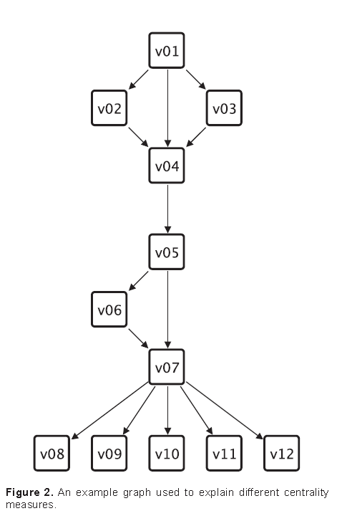
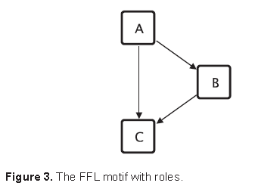
Motif-based centrality
Given: a graph G, a motif M and
the corresponding motif match set MS_{G}.
Define the motif-based centrality C_{mb} that assigns
to every vertex v the number of matches
the vertex v occurs in.
E.g. the vertex v01 in the graph shown in Fig. 2
occurs in 2 matches of the FFL motif shown
in Fig. 3. Therefore C_{mb}(v01) = 2.

Slide 31
Motif-based centralities
Two extensions of this motif-based centrality exist:
- motif-based centrality with roles and
- motif-based centrality with classes.
Vertices of motifs may represent different functions.
E.g. in the gene regulatory network context 3 different functions of the vertices of the feed forward loop (FFL) motif can be identified:
the vertex at the top is the master regulator, this vertex regulates the other two vertices;
(2) the vertex on the right side is the intermediate regulator, it is regulated by the master regulator and itself regulates together with the master regulator the vertex at the bottom

Slide 32
Motif-based centralities
(3) the vertex at the bottom of the drawing is regulated by both other vertices and is therefore called the regulated vertex.
Such different functions of vertices within motifs are called roles and 3 roles can be assigned to the vertices of the FFL motif.
The motif-based centrality with roles C_{mbr} restricts the number of counted matches to those matches where the vertex occurs in the match with the role under consideration.

Slide 33
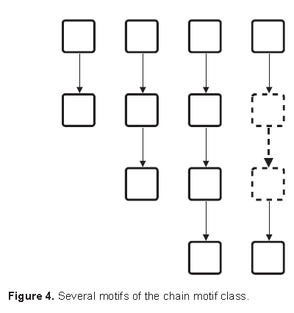
Chain of motifs
Using the previously introduced concepts we can extend the motif-based centrality method further.
By assigning the same role to similar vertices of a group of similar motifs we can establish a centrality based on a class (or group) of motifs.
Consider, for example, a group of chains
(see Fig. 4), where all vertices at the start
of such chains have a similar characteristic
(no incoming edges) and all vertices at the
end have another similar characteristic
(no outgoing edges).

Slide 34
Motif classes
For gene regulatory networks several motif classes are known.
For example, the regulatory chain motif class, as in the example above, consists of a set of chains of 3 or more regulators in which one regulator regulates another regulator, which in turn regulates a third one and so forth.
In the motif class single input motif (SIM) a set of vertices is exclusively regulated by a single vertex.
The motif-based centrality with classes C_{mbc} therefore is the sum of motif-based centralities with roles C_{mbr} for the same role in similar or related motifs.

Slide 35
Radiality and integration centralities
These two centrality measures are related to the closeness centrality.
Given the distance matrix D = (dist(i,j)) between all vertices,
one can define the reverse distance matrix
RD_{ij} = diameter(G) + 1 – D_{ij} where diameter(G) is the highest distance value of the graph.
On the basis of this, the radiality is defined as
$C_{rad}\left(i\right)=\frac{\sum_{i≠j}{{RD}_{ij}}}{n−1}$
and integration is defined as $C_{int}\left(j\right)=\frac{\sum_{i≠j}{{RD}_{ij}}}{n−1}$
A vertex with high radiality value can easily reach other vertices.
A vertex with a high integration value is easily reachable from other vertices.
Both measures are shortest-pathway based measures.

Slide 36
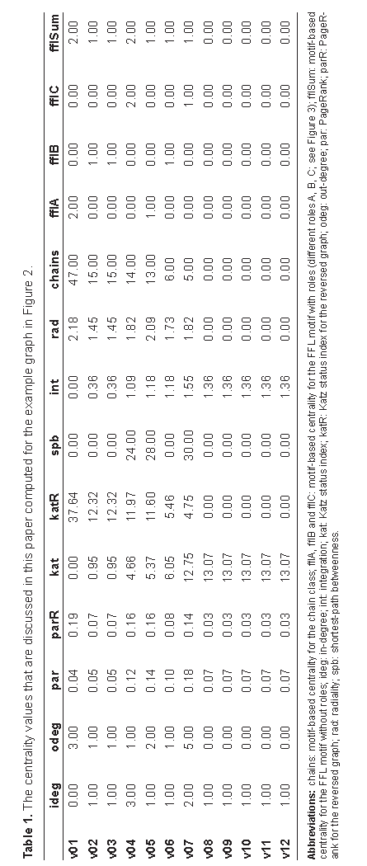
Comparison of centrality measures
chains: motif-based centrality for the chain class
fflA, fflB, fflC: motif-based centralities for the FFL motif with roles
ideg: in-degree kat: Katz status index, katR: reversed g.
odeg: out-degree spb: shortest-path betweenness
par: PageRank int: integration
parR: PageRank for the reversed graph rad: radiality

Slide 37
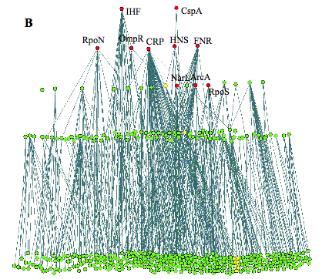
Background: Hierarchical GRN of E.coli
Largest WCC: 325 operons
(3/4 of the complete network)
WCC = weakly connected component (ignore directions of regulation)
Lowest level: operons that code for TFs with only auto-regulation, or no TFs
Next layer: delete nodes of lower layer, identify TFs that do not regulate other operons in this layer (only lower layers)
Continue …
Network with all regulatory edges pointing downwards
→
→ a few global regulators (•) control all the details
Ma et al., BMC Bioinformatics 5 (2004) 199

Slide 38
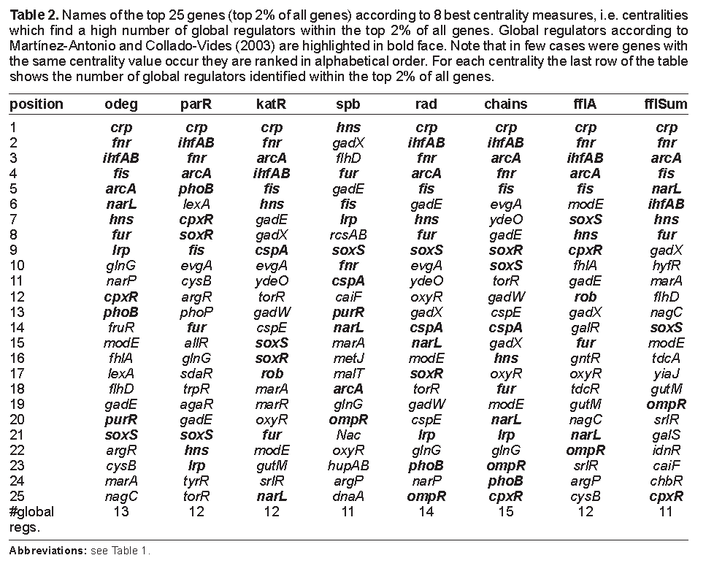
Most central genes in E. coli GRN

Slide 39
Correlation between results for different centralities
Some centralities correlate with values above 0.9 to other centralities (out-degree, PageRank, Katz status index, radiality, motif-based centrality with chain classes (chains)).
These high coefficients can be easily explained:
1101 out of 1250 vertices have an out-degree of zero. All these vertices are assigned the same centrality of nearly zero for Katz, PageRank, and the value zero for the radiality and chains.

Slide 40
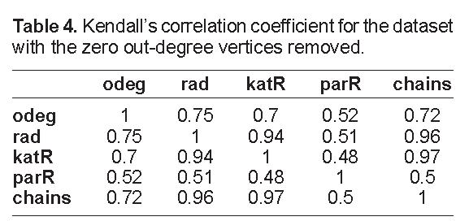
Centralities of vertices with non-zero outdegree
Table 4 shows the pairwise correlation coefficients for the centrality values of the vertices which have a non-zero out-degree.
These coefficients show a different
picture: all 5 centralities rank the remaining
149 genes differently.
Only the centrality radiality and Katz status
index achieve a considerable high
correlation to each other and to chains.
In conclusion, the centralities applied to the GRN rank the genes quite differently.
The motif-based centrality with chain classes is able to rank the highest number (15) of interesting genes (18 global regulators identified by Martínez-Antonio and Collado-Vides (2003)) within the top 2% of all genes.

Slide 41
Summary
The analysis of network topology is of interest in many different disciplines,
e.g. social networks.
There exist different sorts of networks for biological cells:
Protein-protein interaction networks, gene-regulatory networks, metabolic networks, …
For the gene regulatory network of E. coli motif-based centrality outperforms other methods in terms of identifying the key regulatory genes.

