Slide 1
V6 Time-dependent properties of Epidemic Networks
Review (V5): An SI outbreak starting with a single randomly chosen vertex eventually spreads to all members of the component containing that vertex.
Let us assume that vertex i belongs to the giant component.
With probability s_{i} , vertex i is susceptible.
To become infected an individual must catch the disease from a
neighboring individual j that is already infected.
The probability for j being infected is
$x_{j}=1−s_{j}$
The transmission of the disease during the time interval t and t + dt
occurs with probability $βdt$.

Slide 2
Review: Time-dependent properties of Epidemic Networks
Multiplying these probabilities and then summing over all neighbors of i ,
yields the total probability of i becoming infected :
$$βs_{i}\sum_{j}{A_{ij}x_{j}}$$
where A_{ij} is an element of the adjacency matrix.
Thus, the s_{i} obey a set of n non-linear differential equations
$\frac{ds_{i}}{dt}=−βs_{i}\sum_{j}{A_{ij}x_{j}}$=- $βs_{i}\sum_{j}{A_{ij}\left(1−s_{j}\right)}$
From $s_{i}+x_{i}=1$ we get the complementary equation for x_{i}.
$\frac{dx_{i}}{dt}=βs_{i}\sum_{j}{A_{ij}x_{j}}$=$β\left(1−x_{i}\right)\sum_{j}{A_{ij}x_{j}}$
We will assume again that the disease starts either with a single vertex
or a small randomly selected number c of vertices.
Thus x_{i} = c/n → 0, s_{i} = 1 - c/n → 1 in the limit for large n.

Slide 3
Review: Time-dependent properties of Epidemic Networks
The equation $\frac{ds_{i}}{dt}=−βs_{i}\sum_{j}{A_{ij}x_{j}}$=- $βs_{i}\sum_{j}{A_{ij}\left(1−s_{j}\right)}$ is not solvable
in closed form for general A_{ij}.
By considering suitable limits, we can calculate some features of its behavior.
Let us e.g. consider the behavior of the system at early times.
For large n and the given initial conditions, x_{i} will be small in this regime.
By ignoring terms of quadratic order, we can approximate
$\frac{dx_{i}}{dt}=βs_{i}\sum_{j}{A_{ij}x_{j}≈}$ $β\sum_{j}{A_{ij}x_{j}}$
or in matrix form
$\frac{\text{d}\text{x}}{\text{dt}}=β\text{Ax}$ where x is the vector with elements x_{i} .

Slide 4
Review: Time-dependent properties of Epidemic Networks
Write x as a linear combination of the eigenvectors of the adjacency matrix
$$x\left(t\right)=\sum_{r=1}^{n}{a_{r}\left(t\right){\text{v}}_{r}}$$
where v_{r} is the eigenvector with eigenvalue σ_{r} . Then
$$\frac{d\text{x}}{dt}=\sum_{r=1}^{n}{\frac{da_{r}}{dt}{\text{v}}_{r}=β\text{A}}\sum_{r=1}^{n}{a_{r}\left(t\right){\text{v}}_{r}=β\sum_{r=1}^{n}{σ_{r}a_{r}\left(t\right){\text{v}}_{r}}}$$
By comparing terms in v_{r} we get $\frac{da_{r}}{dt}=βσ_{r}a_{r}$
This has the solution $a_{r}\left(t\right)=a_{r}\left(0\right)e^{βσ_{r}t}$
Substituting this expression back gives $x\left(t\right)=\sum_{r=1}^{n}{a_{r}\left(0\right)e^{βσ_{r}t}{\text{v}}_{r}}$
The fastest growing term in this expression is the term corresponding
to the largest eigenvalue σ₁ .

Slide 5
Review: Time-dependent properties of Epidemic Networks
Assuming this term dominates over the others we will get
$$\text{x}\left(t\right)\sim e^{βσ_{1}t}{\text{v}}_{1}$$
So we expect the number of infected individuals to grow exponentially, just as in the fully mixed version of the SI model, but now with an exponential constant that depends not only on β but also on the leading eigenvalue of the adjacency matrix.
The probability of infection in this early period varies from vertex to vertex
roughly as the corresponding element of the leading eigenvector v₁ .

Slide 6
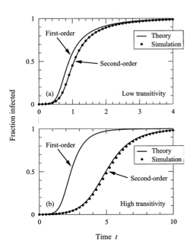
Propagation of SI model on network
For long times, the network version of the SI model predicts that the probability
of infection of a vertex in the giant component tends to 1.
This is qualitatively similar to the fully mixed version of the SI model.
What happens if we integrate $\frac{dx_{i}}{dt}=β\left(1−x_{i}\right)\sum_{j}{A_{ij}x_{j}}$ numerically?
The curve „first-order“ shows the results
of a numerical integration.
The points labelled„simulation“ are average
values from many simulations of simulated
epidemics with the same spreading β.
→ the agreement is ok but not perfect.

Slide 7
Propagation of SI model on network
The reason for this discrepancy is that the probabilities of the two nodes i and j in $\frac{ds_{i}}{dt}=−βs_{i}\sum_{j}{A_{ij}x_{j}}$are not independent.
In general, the quantities s_{i} and x_{j} between neighboring vertices are correlated.
We can incorporate this into our calculations, at least approximately,
by using a so-called pair approximation.

Slide 8
Pair approximations
Let us denote by $\left\langle s_{i}\right\rangle$the average probability that vertex i is susceptible.
Similarly, $\left\langle x_{i}\right\rangle$is the average probability that i is infected and $\left\langle s_{i}x_{j}\right\rangle$is the average probability that i is susceptible AND j is infected at the same time.
This yields now a truly exact version of our previous eq. $\frac{ds_{i}}{dt}=−β\sum_{j}{A_{ij}{\left\langle s_{i}x_{j}\right\rangle }_{.}}$(1)
The previously used equation $\frac{ds_{i}}{dt}=−βs_{i}\sum_{j}{A_{ij}x_{j}}$
is an approximation to this true equation where we assumed that $\left\langle s_{i}x_{j}\right\rangle ≅\left\langle s_{i}\right\rangle \left\langle x_{j}\right\rangle$
The trouble with the new eq. is that we cannot solve it directly because
it contains the unkown quantity $\left\langle s_{i}x_{j}\right\rangle$.

Slide 9
Pair approximations
-> we need an expression for $\left\langle s_{i}x_{j}\right\rangle$.
To reach the state where i is susceptible and j is infected, j must have been infected by another neighboring vertex k.
The probability for such a previous configuration where i and j are susceptible
and k is infected is $\left\langle s_{i}{s_{j}x}_{k}\right\rangle$.
When starting with this configuration, j will become infected via k with rate β.
Summing over all neighbors k except for i, the total rate at which j becomes infected is
$β\sum_{k≠i}{A_{jk}\left\langle s_{i}s_{j}x_{k}\right\rangle }$

Slide 10
Pair approximations
However, $\left\langle s_{i}x_{j}\right\rangle$can also decrease when i becomes infected.
This can happen in 2 ways.
Either i can be infected by its infected neighbor j what happens wih rate $β\left\langle s_{i}x_{j}\right\rangle ,$or
i can be infected by another neighbor l ≠ j so that i is infected with rate $β\left\langle {x_{l}s}_{i}x_{j}\right\rangle .$
Summing the latter expression over all neighbors l other than j gives a total rate of
$$β\sum_{l≠j}{A_{il}\left\langle x_{l}s_{i}x_{j}\right\rangle }.$$

Slide 11
Pair approximations
Putting all these terms together, we get
$\frac{d\left\langle s_{i}x_{j}\right\rangle }{dt}=β\sum_{k≠i}{A_{jk}\left\langle s_{i}s_{j}x_{k}\right\rangle } \text{−}β\sum_{l≠j}{A_{il}\left\langle x_{l}s_{i}x_{j}\right\rangle }$ - $β\left\langle s_{i}x_{j}\right\rangle$
In theory this equation now allows us to calculate $\left\langle s_{i}x_{j}\right\rangle$.
In practice, it involves yet more terms that we don‘t know on the right-hand side,
the three-variable averages $\left\langle s_{i}s_{j}x_{l}\right\rangle$ and $\left\langle x_{l}s_{i}x_{j}\right\rangle$.
Such a succession of equations will never end – in the jargon of mathematics,
it doesn‘t close.

Slide 12
Moment closure
However, we can make progress by approximating the 3-variable averages by appropriate combinations of 1-variable and 2-variable averages.
This will allow us to close the equations and get a set that we can solve.
This process is called moment closure.
The moment closure method at the level of 2-variable averages that we discuss here is also called pair approximation method.
Starting with $\frac{d\left\langle s_{i}x_{j}\right\rangle }{dt}=β\sum_{k≠i}{A_{jk}\left\langle s_{i}s_{j}x_{k}\right\rangle }\text{ −}β\sum_{l≠j}{A_{il}\left\langle x_{l}s_{i}x_{j}\right\rangle }$ - $β\left\langle s_{i}x_{j}\right\rangle$
our goal is to approximate the 3-variable averages with lower-order ones.

Slide 13
Moment closure
We will make use of Bayes theorem for probabilities:
$$\left\langle s_{i}s_{j}x_{k}\right\rangle =P\left(i,j∈S,k∈I\right)=P\left(i,j∈S\right)P\left(k∈I\left|i,j∈S\right.\right)$$
where $P\left(i∈S\right)$ means the probability that vertex i is in the set S of susceptible vertices.
We know that i and j are neighbors in the network and that j and k are neighbors.
We will assume that the disease state of k does not depend on the disease state of i.
If the only path in the network from i to k is through j, this is a good approximation.
If there is another path, this remains an approximation.

Slide 14
Moment closure
Assuming the state of k to be indepdendent of the state of i, we have
$$P\left(k∈I\left|i,j∈S\right.\right)=P\left(k∈I\left|j∈S\right.\right)=\frac{P\left(j∈S,k∈I\right)}{P\left(j∈S\right)}=\frac{\left\langle s_{j}x_{k}\right\rangle }{\left\langle s_{j}\right\rangle }$$
After putting this into our previous equation we get
$$\left\langle s_{i}s_{j}x_{k}\right\rangle =P\left(i,j∈S,k∈I\right)=P\left(i,j∈S\right)P\left(k∈I\left|i,j∈S\right.\right)$$
$$=\left\langle s_{i}s_{j}\right\rangle \frac{\left\langle s_{j}x_{k}\right\rangle }{\left\langle s_{j}\right\rangle }$$
In a similar way, we can derive an expression for the other 3-variable average
$$\left\langle x_{l}s_{i}x_{j}\right\rangle =\left\langle x_{l}s_{i}\right\rangle \frac{\left\langle s_{i}x_{j}\right\rangle }{\left\langle s_{i}\right\rangle }$$

Slide 15
Moment closure
We can now substitute both expressions into our previous equation and get the pair approximation equation
$$\frac{d\left\langle s_{i}x_{j}\right\rangle }{dt}=β\frac{\left\langle s_{i}s_{j}\right\rangle }{\left\langle s_{j}\right\rangle }\sum_{k≠i}{A_{jk}\left\langle s_{j}x_{k}\right\rangle −β\frac{\left\langle s_{i}x_{j}\right\rangle }{\left\langle s_{i}\right\rangle }}\sum_{l≠j}{A_{il}\left\langle s_{i}x_{l}\right\rangle −β\left\langle s_{i}x_{j}\right\rangle }$$
This equation now contains only averages over 2 variables at a time.
It contains also a new average $\left\langle s_{i}s_{j}\right\rangle$ that we have not encountered before.
This can be rewritten as $\left\langle s_{i}s_{j}\right\rangle =\left\langle s_{i}\left(1−x_{j}\right)\right\rangle =\left\langle s_{i}\right\rangle −\left\langle s_{i}x_{j}\right\rangle$ . With this, our eq. becomes
$\frac{d\left\langle s_{i}x_{j}\right\rangle }{dt}=β\frac{\left\langle s_{i}\right\rangle −\left\langle s_{i}x_{j}\right\rangle }{\left\langle s_{j}\right\rangle }\sum_{k≠i}{A_{jk}\left\langle s_{j}x_{k}\right\rangle −β\frac{\left\langle s_{i}x_{j}\right\rangle }{\left\langle s_{i}\right\rangle }}\sum_{l≠j}{A_{il}\left\langle s_{i}x_{l}\right\rangle −β\left\langle s_{i}x_{j}\right\rangle }$ (2)
We will simplify this eq. further.

Slide 16
Moment closure
Let us define p_{ij} to be the conditional probability that j is infected given that i is not:
$$p_{ij}=P\left(j∈I\left|i∈S\right.\right)=\frac{P\left(i∈S,j∈I\right)}{P\left(i∈S\right)}=\frac{\left\langle s_{i}x_{j}\right\rangle }{\left\langle s_{i}\right\rangle }$$
Then the time evolution of p_{ij} is given by
$$\frac{dp_{ij}}{dt}=\frac{d}{dt}\left(\frac{\left\langle s_{i}x_{j}\right\rangle }{\left\langle s_{i}\right\rangle }\right)=\frac{1}{\left\langle s_{i}\right\rangle }\frac{d\left\langle s_{i}x_{j}\right\rangle }{dt}−\frac{\left\langle s_{i}x_{j}\right\rangle }{{\left\langle s_{i}\right\rangle }^{2}}\frac{d\left\langle s_{i}\right\rangle }{dt}$$
$$=β\left(1−\frac{\left\langle s_{i}x_{j}\right\rangle }{\left\langle s_{i}\right\rangle }\right)\sum_{k≠i}{A_{jk}\frac{\left\langle s_{j}x_{k}\right\rangle }{\left\langle s_{j}\right\rangle }−β\frac{\left\langle s_{i}x_{j}\right\rangle }{\left\langle s_{i}\right\rangle }\sum_{l≠j}{A_{il}\frac{\left\langle s_{i}x_{l}\right\rangle }{\left\langle s_{i}\right\rangle }−β\frac{\left\langle s_{i}x_{j}\right\rangle }{\left\langle s_{i}\right\rangle }+β\frac{\left\langle s_{i}x_{j}\right\rangle }{\left\langle s_{i}\right\rangle }\sum_{l}{A_{il}\frac{\left\langle s_{i}x_{l}\right\rangle }{\left\langle s_{i}\right\rangle }}}}=β\left(1−p_{ij}\right)\sum_{k≠i}{A_{jk}}p_{jk}−βp_{ij}\sum_{l≠j}{A_{il}p_{il}}−βp_{ij}+βp_{ij}\sum_{l}{A_{il}p_{il}}$$
The terms in the 2 sums over l now cancel out except for l = j, leaving
$$\frac{dp_{ij}}{dt}=β\left(1−p_{ij}\right)\left[−p_{ij}+\sum_{k≠i}{A_{jk}p_{jk}}\right]$$
where have also used A_{ij} = 1
Use (1) and (2)

Slide 17
Moment closure
Rewriting $\frac{ds_{i}}{dt}=−β\sum_{j}{A_{ij}{\left\langle s_{i}x_{j}\right\rangle }_{}}$in terms of p_{ij} gives
$$\frac{d\left\langle s_{i}\right\rangle }{dt}=−β\left\langle s_{i}\right\rangle \sum_{j}{A_{ij}p_{ij}}$$
which has the solution
$$\left\langle s_{i}\left(t\right)\right\rangle =\left\langle s_{i}\left(0\right)\right\rangle exp\left(−β\sum_{j}{A_{ij}\int_{0}^{t}{p_{ij}\left(t^{′}\right)dt^{′}}}\right)$$
Numerical integration of these
2 equations for $\frac{dp_{ij}}{dt}$ and $\left\langle s_{i}\left(t\right)\right\rangle$
gives the „second order“ curve,
which agrees very nicely with
the simulated epidemics.
17

Slide 18
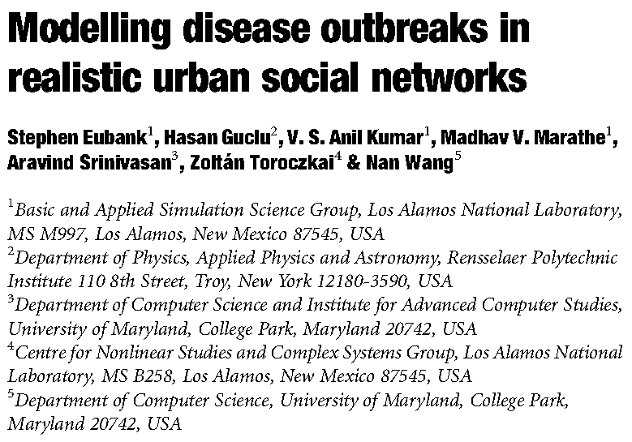
Recent extensions in modelling disease spreading
It is estimated that by 2030 more than
60% of the world‘s population live in
cities.
Urban areas form a perfect fabric for
fast, uncontrolled disease propagation.
-> Need to model inter-person contacts
in more detail than by differential
equations.
Nature 429, 180 (2004)
Authors used the Transportation Analysis and Simulation System (TRANSIMS) developed at Los Alamos Natl. Laboratories.
18

Slide 19
TRANSIMS
TRANSIMS creates a synthetic population with a demographic distribution (age, income) consistent with joint distributions in census data.
The program uses an agent-based paradigm to simulate the movement of all individuals during e.g. one day.
By this it estimates positions and activities of all travelers using a transportation infrastructure on a second-by-second basis.
Nature 429, 180 (2004)
19

Slide 20
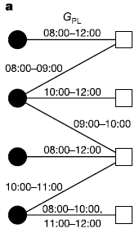
Model social contact network as bipartite graph
a, A bipartite graph G_{PL} with two types of vertices representing four people (P) and four locations (L).
If person p visited location l, there is an edge in this graph between p and l.
Vertices are labelled with appropriate demographic or geographic information, edges with arrival and departure times.
For the city Portland / US, G_{PL} has about 1.6 million vertices with a giant component of 1.5 million people and 180.000 locations.
Nature 429, 180 (2004)
20

Slide 21
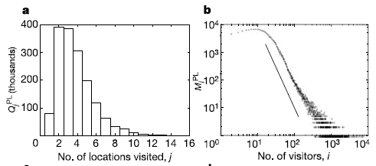
Degree distributions for estimated Portland social network.
a, The number of people Q^{PL}_{j} who visited j different locations in the bipartite people–locations graph G_{PL}.
On average people visited 4 locations / day.
This distribution decays exponentially (nobody visited more than 15 locations in 1 day).
b, The number of locations M^{PL}_{i} in G_{PL} that are visited by exactly i different people.
This plot follows a power-law tail. The slope of the straight-line graph is -2.8.
Nature 429, 180 (2004)
21

Slide 22
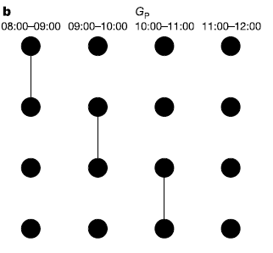
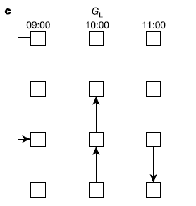
Disease transmission
Many infectious diseases get transmitted between people in the same location.
Diseases spread mainly due to people‘s movement.
-> investigate two projections of G_{PL} obtained by drawing an edge between all pairs of vertices that have a distance of 2 from each other on the bipartite graph.
This yields two disconnected graphs G_{P} and G_{L.}
Nature 429, 180 (2004)
22

Slide 23
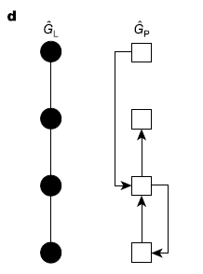
Static projections of graph G_{PL}
In G_{P} the edges are labelled with the sets of time intervals during which the people were co-located.
For simplicity, we will discard these time labels and look at the static projections shown below
d, People (such as 24-year-old male) are represented by filled circles, and locations (such as 34 Elm Street) by open squares.
This projection yields a worst-case scenario for the spreading of a disease because the static graph is much more connected than G_{P}.
Consider also the idea of an “effective contact” by removing all edges for which the duration of contact was shorter than 1 hour.
Nature 429, 180 (2004)
23

Slide 24
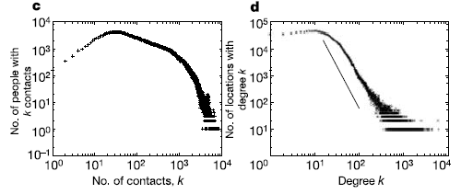
Degree distributions of static graph
d, The in and out degree distributions of the locations network G_{L}.
This network resembles a scale-free network with a power-law distribution. The slope of the straight-line graph is -2.8.
c, The number of people who have k neighbors in the static people–contact graph _{P} on log–log scale.
This network resembles a small-world network.
The scale-free nature of the localization network reflects the capacity distribution of locations.
Shopping malls take up large numbers of people who normally live in small homes.
Nature 429, 180 (2004)
24

Slide 25
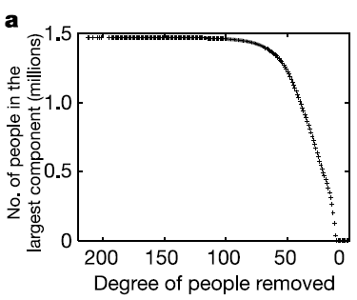
Effects of removing high-degree vertices
Can one e.g. prevent disease propagation in this social network by vaccinating (or putting into quarantine) a small number of high-degree vertices?
-> investigate the size of the giant component after removing from the bipartite graph G_{PL} all vertices with degree higher than k.
-> even when all vertices of degree 11 and higher are removed, a unique giant component persists.
Thus, any effective vaccination strategy must be mass vaccination.
Nature 429, 180 (2004)
25

Slide 26
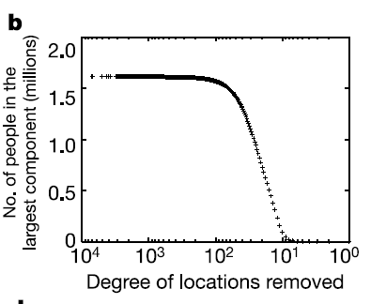
Effect of removing most visited locations
In b we remove all locations with degree k or higher from G_{PL} and monitor the size of the largest connected component in the static people–contact graph induced by the remaining bipartite graph
-> Even closing the most-visited locations – or vaccinating everyone who visits them – does not shatter the induced people-contact graph until large fractions of the population have been effected.
Q: Can epidemics be stopped at all without resorting to mass vaccination?
Nature 429, 180 (2004)
26

Slide 27
Early detection
An alternative strategy could involve early detection of infected individuals and efficient targeting.
Consider an idealized situation in which sensors at a location can detect whether any person is infected.
The feasibility of early detection depends on the number of sensors required.
This problem is equivalent to finding the minimum dominating set.
Nature 429, 180 (2004)
27

Slide 28
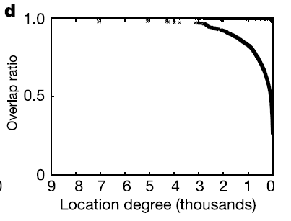
Overlap ratio
We wish to find a subset L‘ of locations so that all (or most) people visit some location in L‘.
The overlap ratio ω(J) of a set of locations J ⊂ L is $\frac{n\left(J\right)}{\sum_{l∈J}{deg\left(l\right)}}$
where n(J) is the total number of people visiting any location in J
and deg(l) is the number of different people visiting location l ∈ J.
The smaller the overlap ration, the larger is the number of different locations in J visited by a single person.
d. Overlap ratio by degree. The lower curve shows the
cumulative overlap ratio by degree, which is the overlap ratio
for locations having degree k or less. The upper curve shows
the overlap ratio for locations having degree = k.
-> Not many people visit more than one high-
degree location per day. Early detection could
be accomplished by placing sensors there.
Nature 429, 180 (2004)
28

Slide 29
Recent extensions in modelling disease spreading
Use IATA database : 3880 airports , 18.810 weighted edges, where weight w_{jl} denotes passenger flow between airports j and l.
Consider also populations N_{j} of the metropolitan areas served by each airport.
Focus on 3100 largest airports and 17182 edges accounting for 99% of the world-wide air traffic.
PNAS 103, 2015 (2006)
29

Slide 30
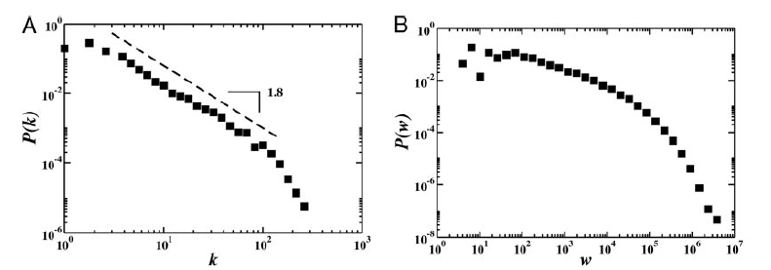
Properties of the world-wide airport network
(B) The distribution of the weights (fluxes) is skewed and heavy-tailed.
(A) The degree distribution P(k) that an airport j has k_{j} connections to other airports follows a power-law behavior on almost two decades with exponent 1.8 ± 0.2.
PNAS 103, 2015 (2006)
30

Slide 31
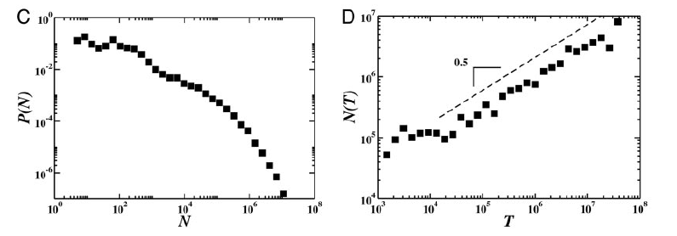
Properties of the world-wide airport network
(C) The distribution of populations N_{j} is heavy-tailed distributed.
(D) The city population varies with the traffic of the corresponding airport as N ≈ T ^{α} with α ≅ 0.5.
PNAS 103, 2015 (2006)
31

Slide 32
Model disease propagration by SIR model for each airport
Use compartment model with 3100 compartments.
In each city (airport), individuals can exist in one of 3 discrete states:
susceptible (S), infected (I), permanently recovered (R)
Model dynamics by numerical integration of a set of 3 × 3100 stochastic differential equations.
PNAS 103, 2015 (2006)
32

Slide 33
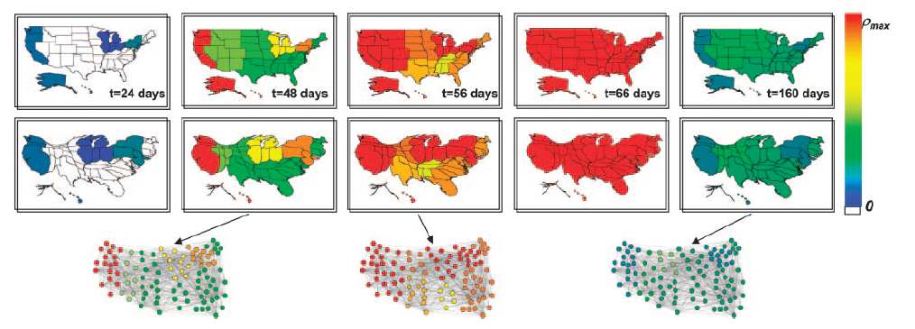
Recent extensions in modelling disease spreading
Geographical representation of the disease evolution in the United States for an epidemics starting in Hong Kong based on a SIR dynamics within each city. The color code corresponds to the prevalence in each region, from 0 to the maximum value reached (ρ_{max}).
Top row: the original United States maps,
Bottom row: obtained by rescaling each region according to its population.
Shown below are 3 representations of the airport network restricted to the 100 airports in the United States with highest traffic; the color is assigned in accordance to the color code adopted for the maps.
PNAS 103, 2015 (2006)
33

Slide 34
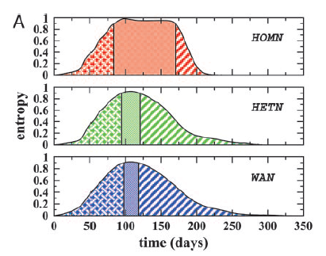
Heterogeneity of epidemic pattern
heterogeneity of epidemic pattern in actual network (WAN) is compared with 2 network models (HOMN and HETN).
HOMN: homogenous Erdos-Renyi random graph
HETN: topology of real network
For HOMN and HETN, all fluxes and populations are set to average value.
Shown is entropy $H\left(t\right)=\sum_{j}{ρ_{j}\left(t\right)logρ_{j}\left(t\right)}$ .
H(t) = 1 means that epidemics is homogenously distributed over all nodes.
H(t) = 0 means that only 1 city is affected
Each profile is split into 3 different phases. The central phase corresponds to
H > 0.9; i.e., to a homogeneous geographical spread of the disease.
This phase is much longer for the HOMN than for the real airport network WAN.
The behavior observed in HETN is close to the real case meaning that the connectivity pattern plays a leading role in the epidemic behavior.
PNAS 103, 2015 (2006)
34

Slide 35
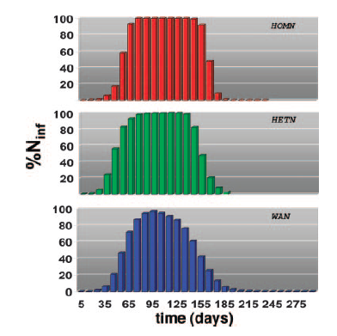
What cities are affected?
Percentage of infected cities as a function of time for an epidemics starting in Hong Kong based on a SIR dynamics within each city.
The HOMN case displays a large interval in which all cities are infected.
The HETN and the real case show a smoother profile with long tails, signature of a long lasting geographical heterogeneity of the epidemic diffusion.
PNAS 103, 2015 (2006)
35

Slide 36
Quality of disease forecasts?
Measure similarity of 2 outbreak scenarios.
Overlap = 1 means that the very same cities have the very same number of infectious individuals in both realizations.
Overlap = 0 means that the two realizations do not have any common infected cities at time t.
PNAS 103, 2015 (2006)
36

Slide 37
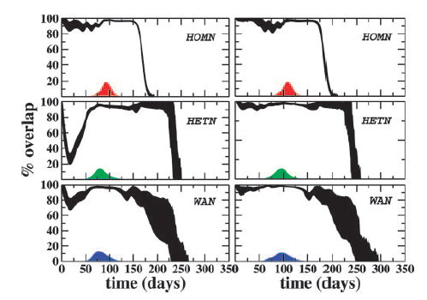
Overlap as a function of time
(Right): Outbreaks from poorly connected cities lead in all models to well reproducable behavior because only few connections are available.
(Left): Outbreaks from hubs lead to well reproducable behavior in the HOMN model.
The HETN and WAN models lead to considerable variation of the results here because the epidemics can take one of several possible channels.
(Left): initially infected city is an airport hub
(Right): initially infected city is a poorly connected city.
PNAS 103, 2015 (2006)
37

Slide 38
Conclusions
air-transportation-network properties seems responsible for the global pattern of emerging diseases.
Large-scale mathematical models that take fully into account the complexity of the transportation matrix can be used to obtain detailed forecast of emergent disease outbreaks.
To make the forecast more realistic, it is necessary to introduce more details in the disease dynamics. In particular, seasonal effects and geographical heterogeneity in the basic transmission rate (due to different hygienic conditions and health care systems in different countries) should be addressed.
Also need to connect air transportation network with other transportation systems such as railways and highways for forecasting on longer time scales.
PNAS 103, 2015 (2006)
38

